Slide 1
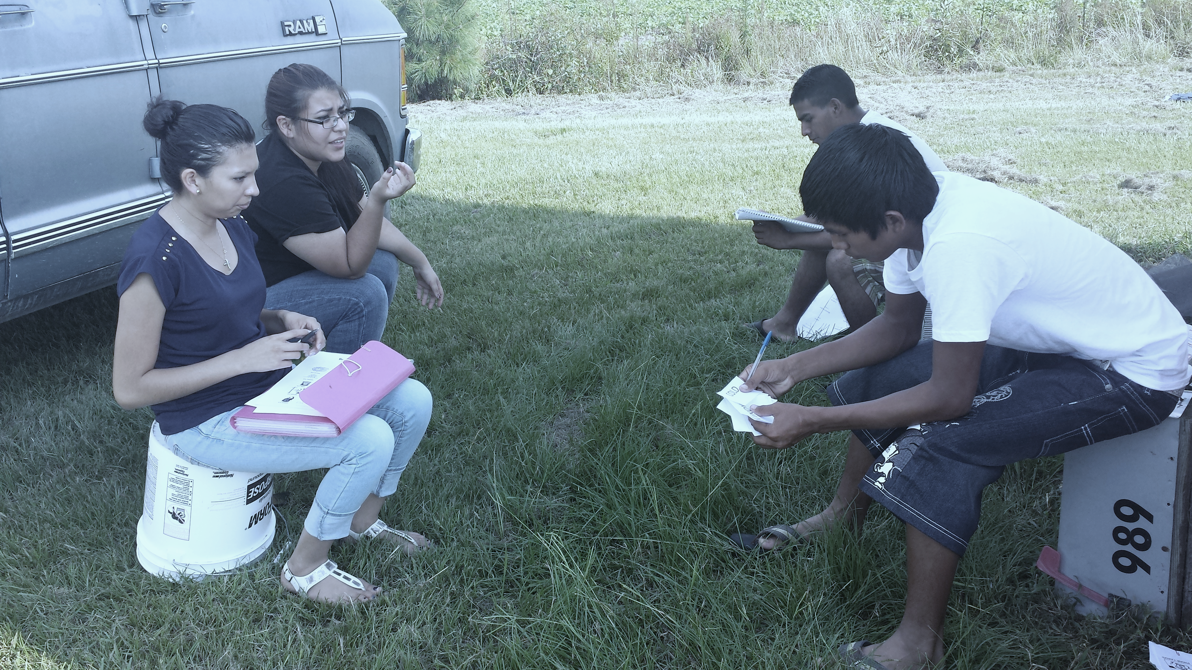
2020 Regional ID&R Training
February 11th , 2020: Western Regions
February 12th, 2020: North Central & Northeast
February 13th, 2020: Southeast & Sandhills
North Carolina Migrant Education Program- NCDPI

Slide 2
Welcome!
WIFI Network: NCPS-NDW
Password: Ncps!s4m3
If you have not completed the self-assessment (sent yesterday afternoon), please complete it while you wait

Slide 3
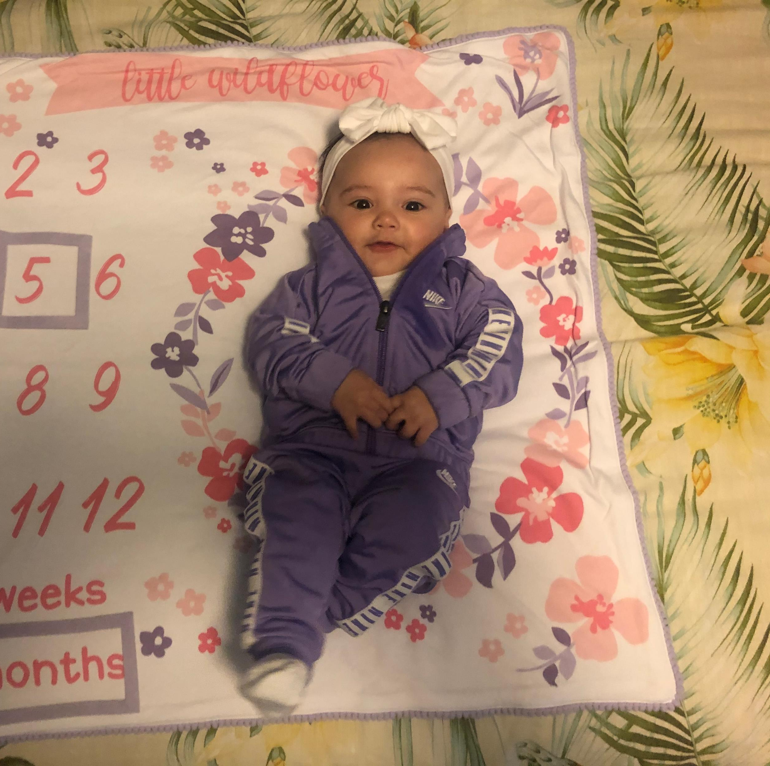


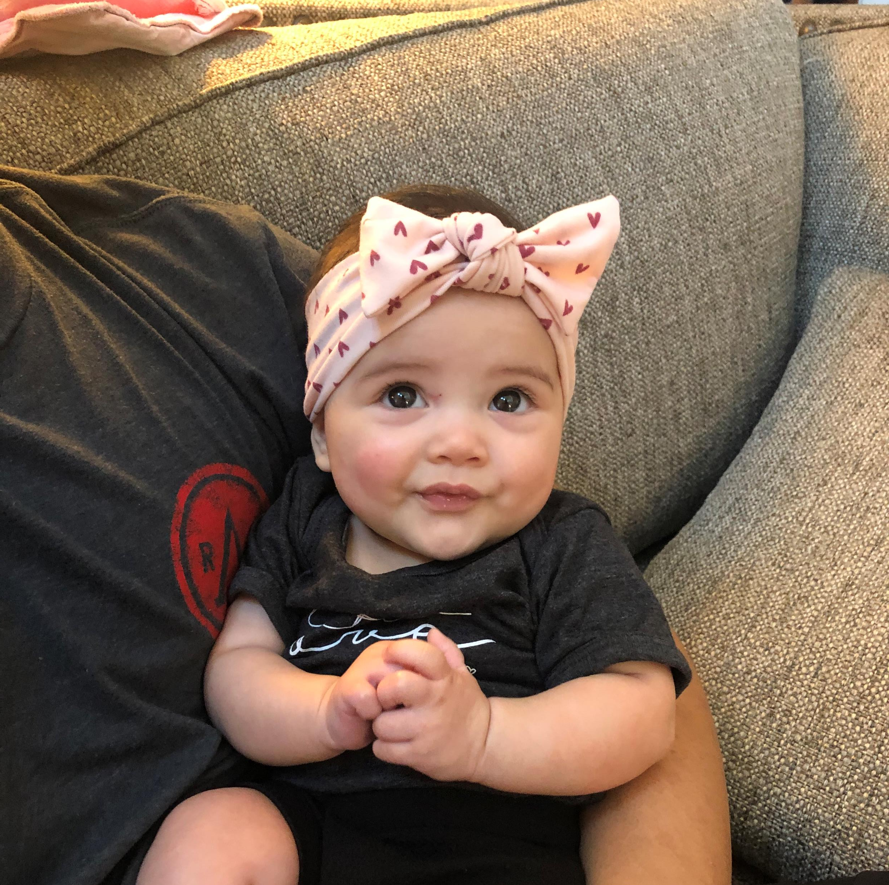

Slide 4
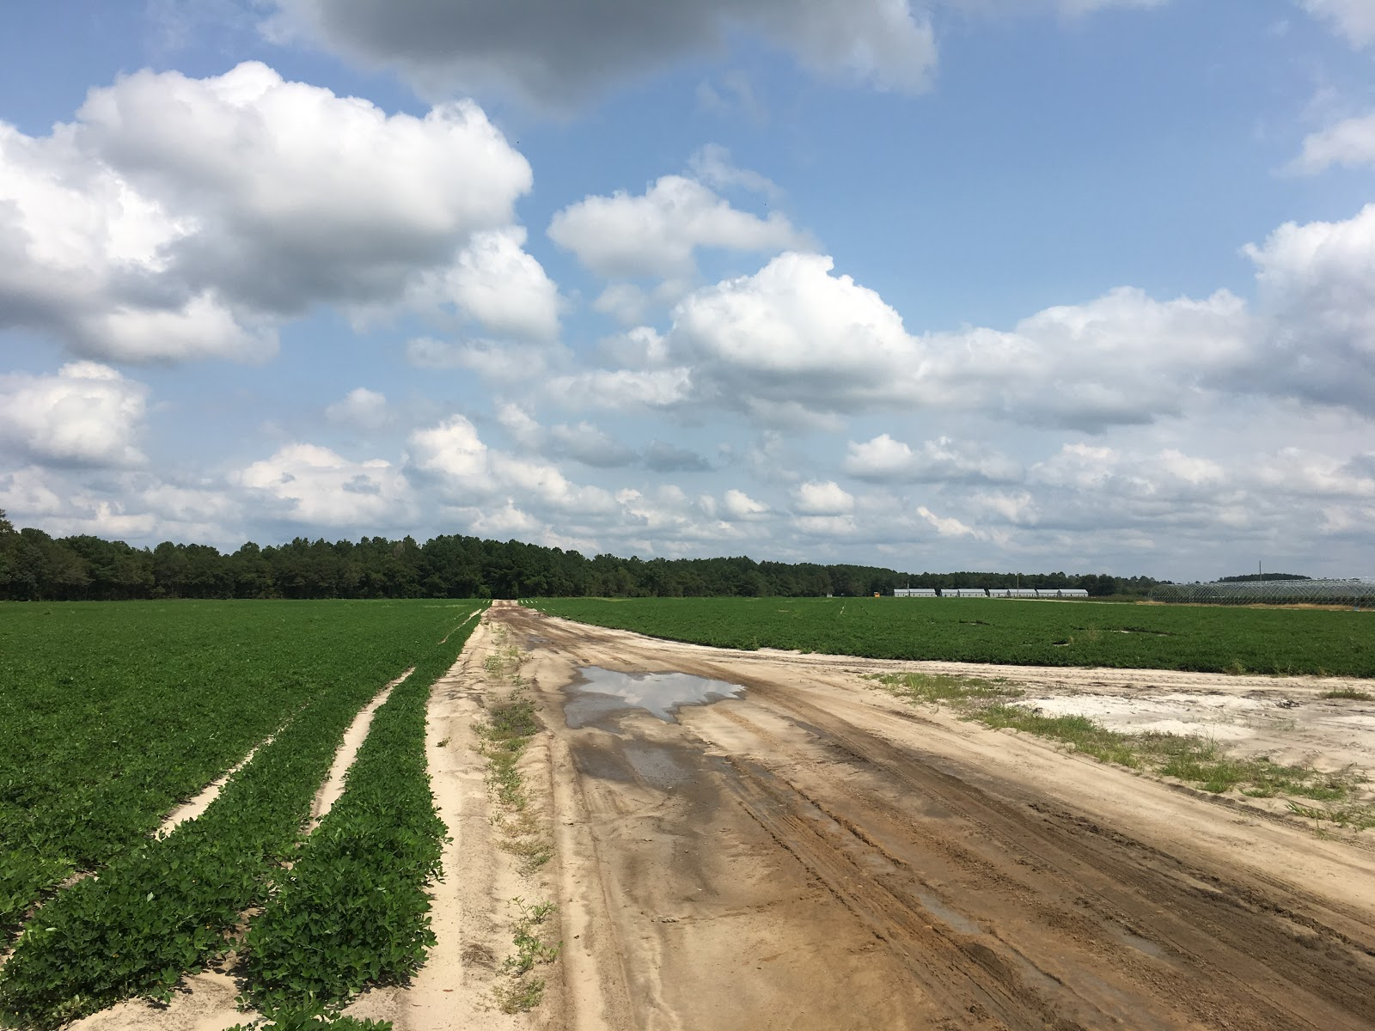
Introductions, Logistics, & Goals
Staff will accurately apply the ESSA guidelines to a variety of advanced scenarios
Staff will identify areas for improvement and better understand how to complete and utilize the ID&R Plan
Staff will collaborate with others in order to evaluate best practices and new ideas on locating migrant students, gaining families’ trust, and speaking to different audiences about the MEP
Staff will learn new techniques to identify and recruit Out-of-School Youth(OSY)
Staff will apply use of MSIX to enhance their ID&R efforts

Slide 5
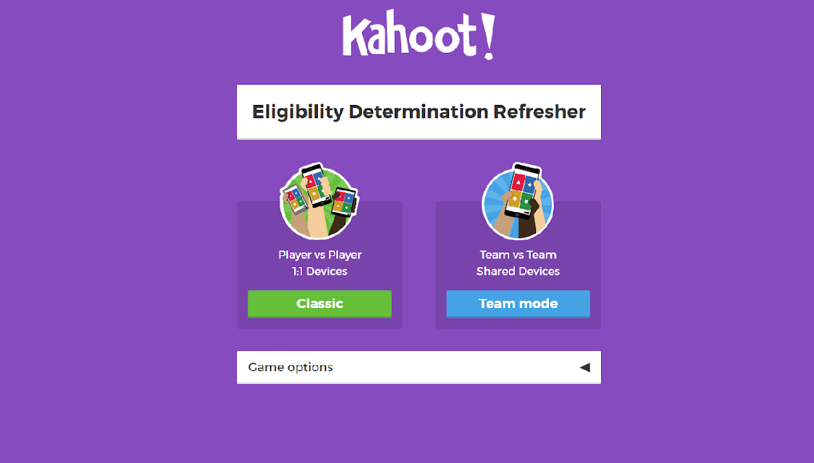
Quick Review & Eligibility Determination Stations
Goal: Staff will accurately apply ESSA eligibility guidelines to advanced scenarios
  Review Game through Kahoot!
  Model Scenario with COE Reminders
  Eligibility Determination Stations in small groups

Slide 6
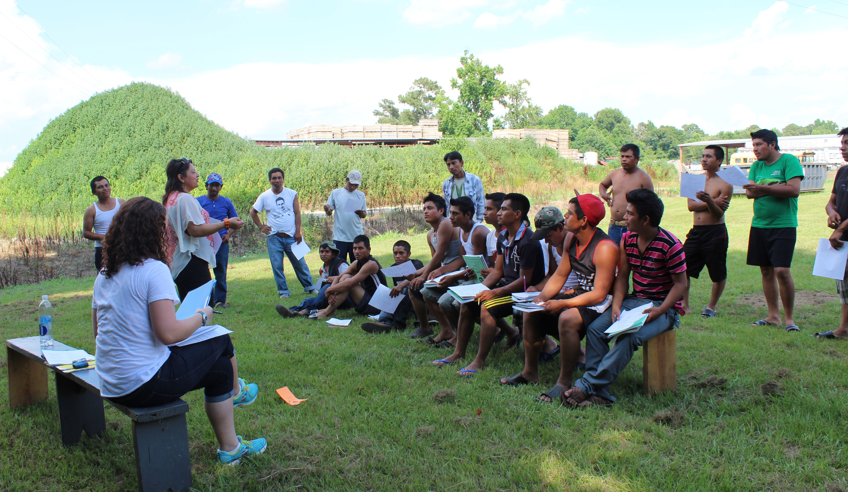
Determining Eligibility is as easy as 1…2…3!
Is there a Migratory Child (MC)?
Is there a Migratory Qualifying Worker (MQW)?
Did the child and the worker make a qualifying move (QM)?

Slide 7

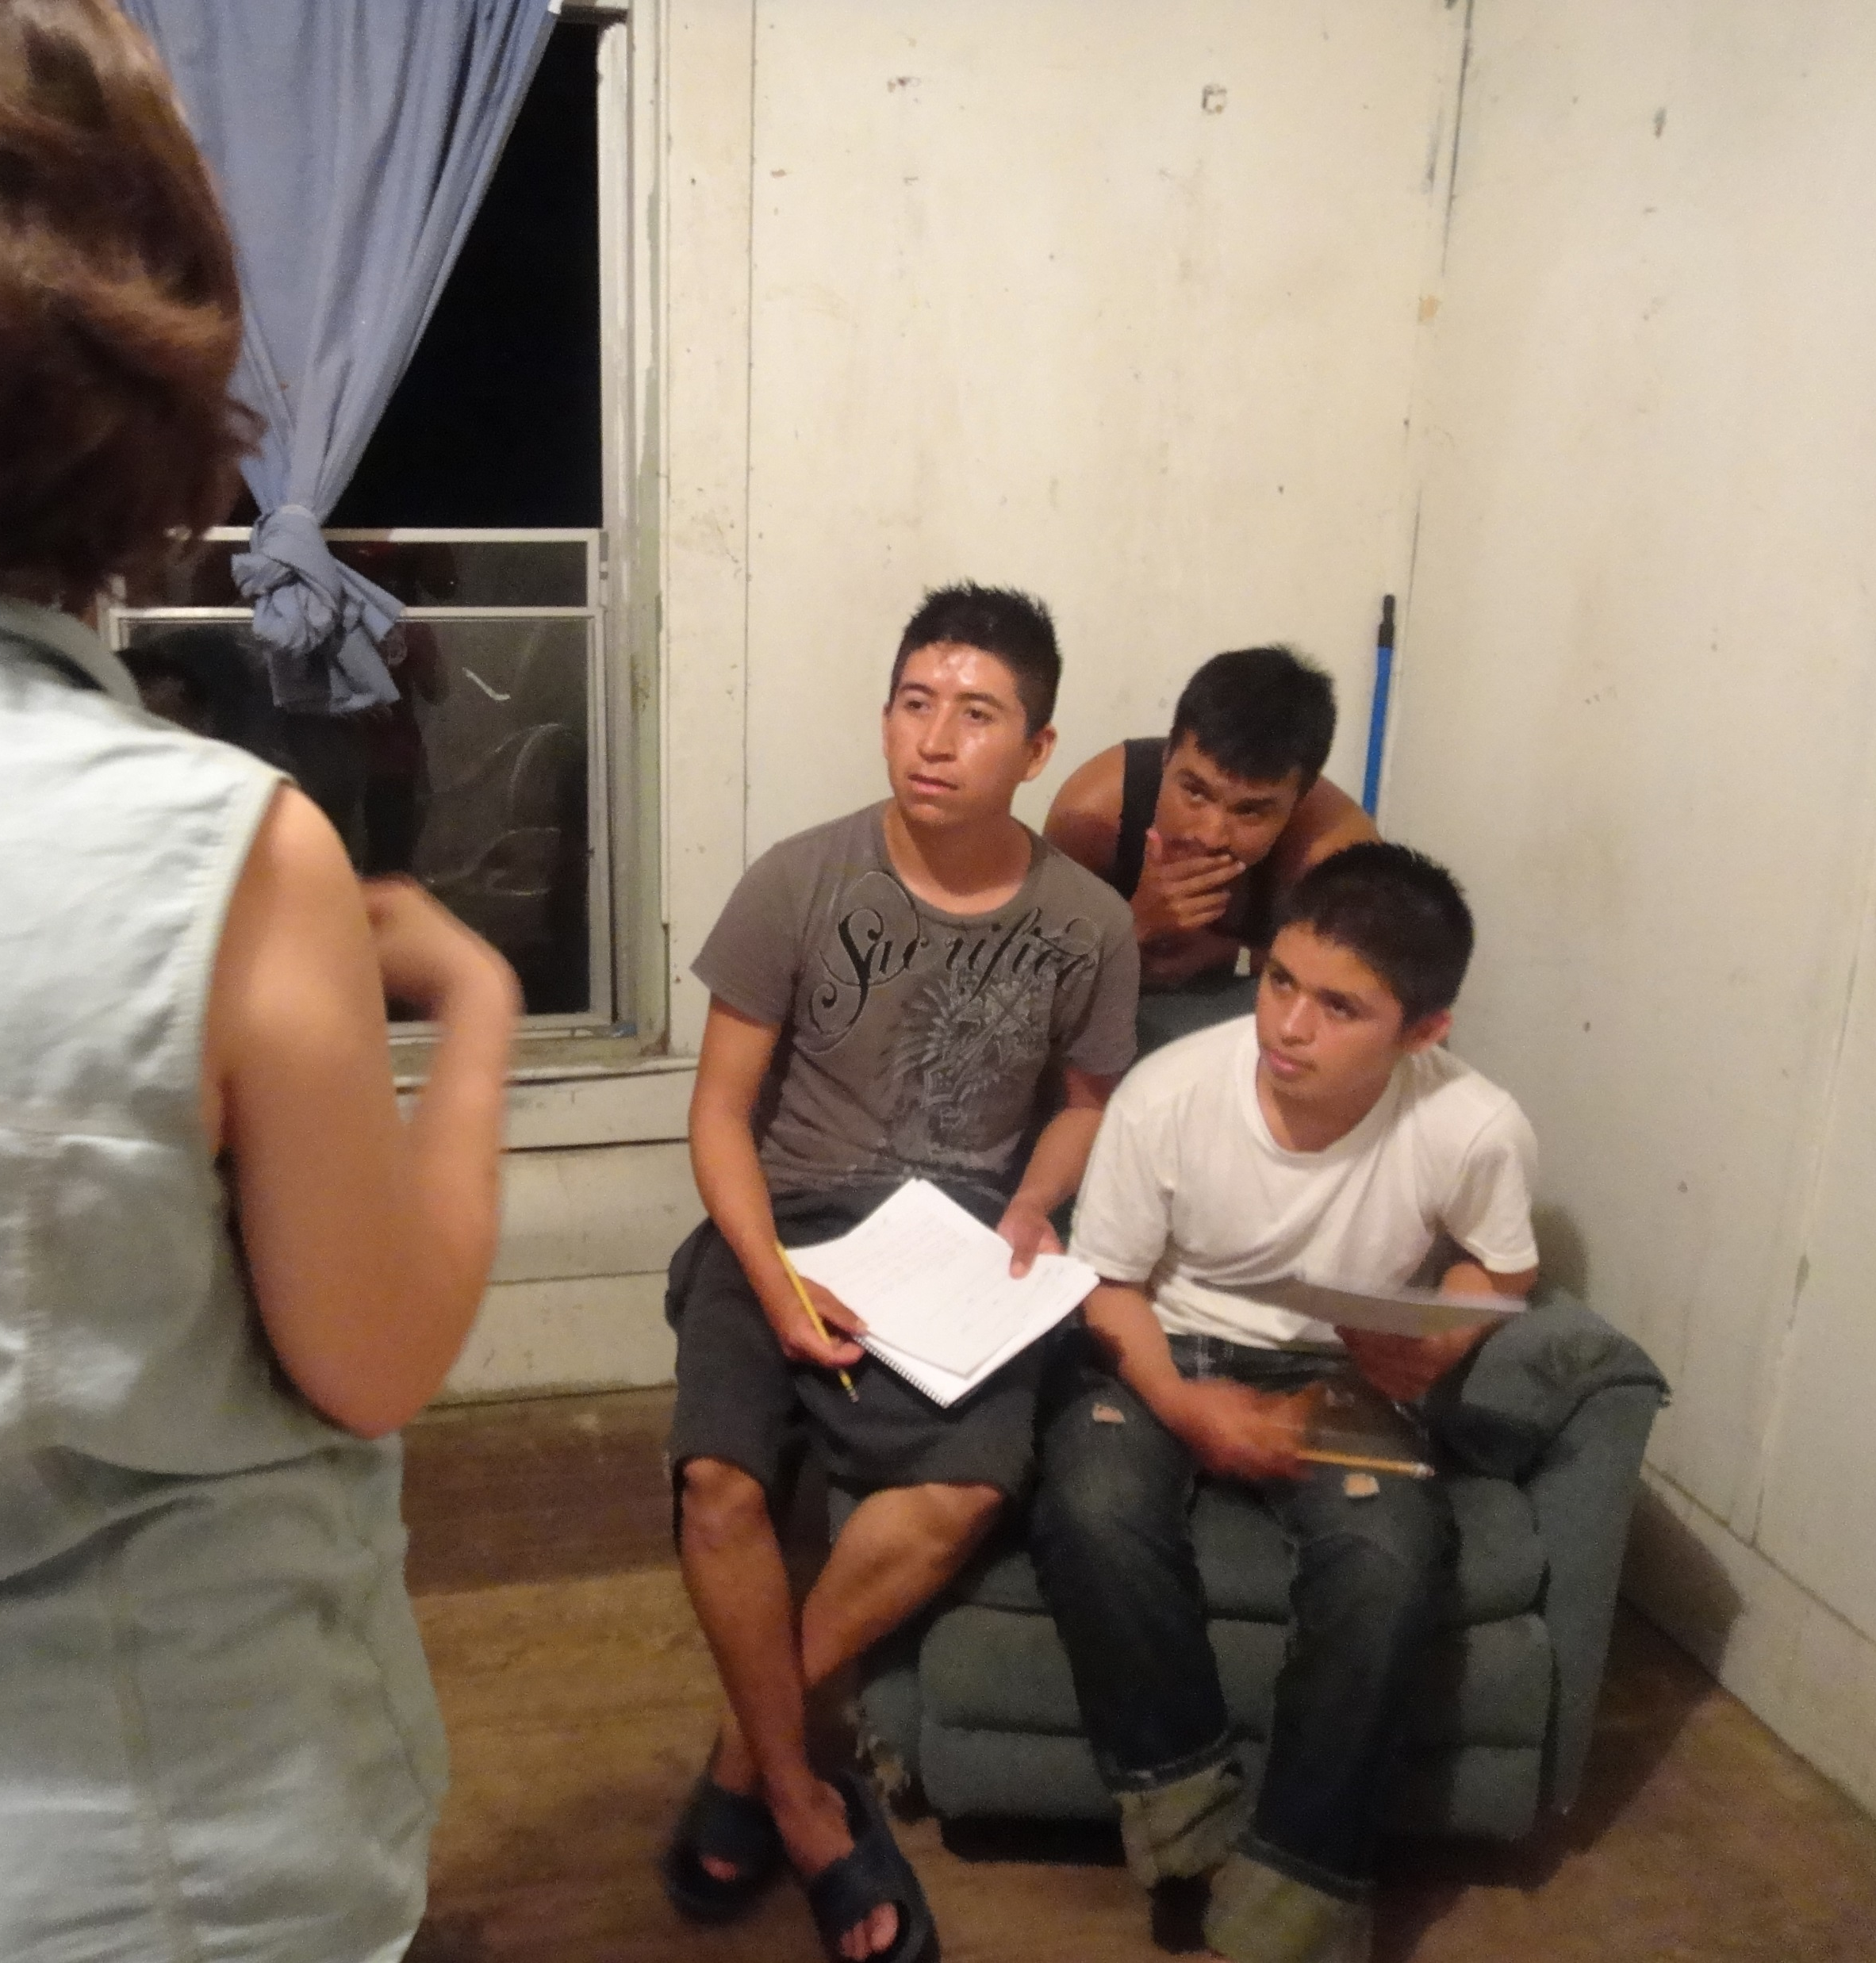
ID&R Quality Assurance Reminders
COE must be reviewed by someone in the LEA who has received training from the SEA
Once a COE is submitted with a reviewer’s signature, they are certifying that all information is complete and correct
If there are questions while the COE is being reviewed, contact the SEA

Slide 8
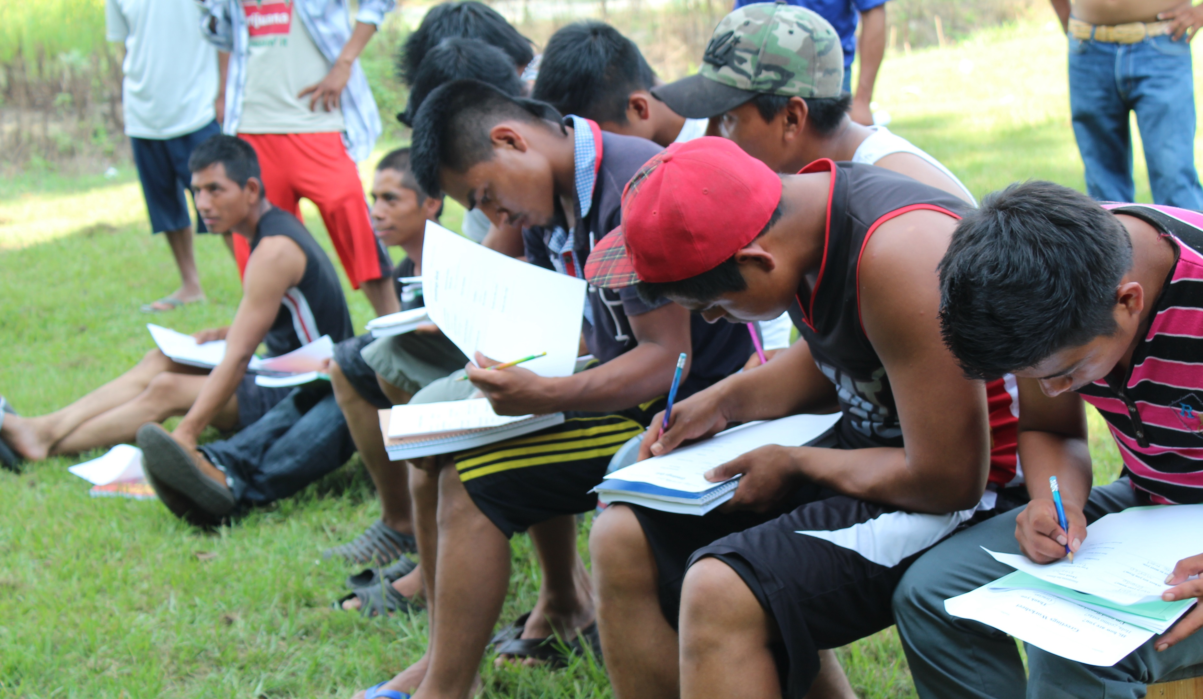
As the Reviewer…
Use the review form
Be picky!
  Dashes in blanks
  Two-digit dates
  All required data elements completed

Slide 9
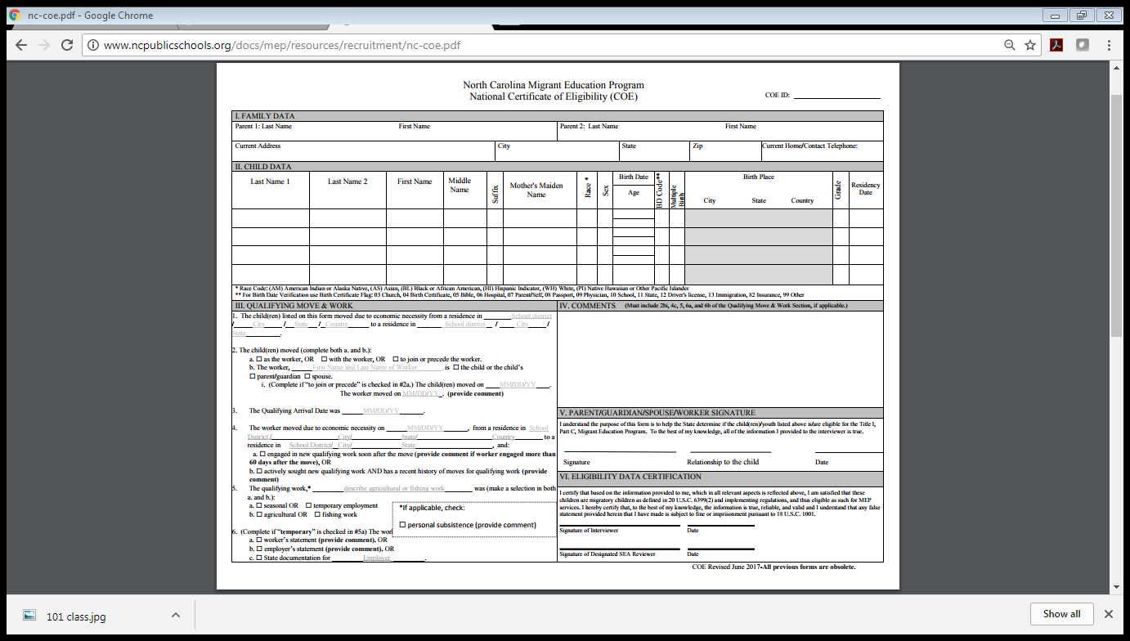
Required Data Elements

Slide 10
III. Qualifying Moves and Work Section – CHEAT SHEET!
1.
The child(ren) listed on this form moved due to economic necessity from a residence in
/ State / Country to a residence in School district / City /
School district / City
This should include information on the last QM the children made either as, with, or to join the MQW
State
.
2.
The child(ren) moved (complete both a. and b.):
Make sure that you check a box in both “a” and “b.” “i” should only be completed in the case of a “to join” move. Put dashes if the child moved as or with the worker
a. ◻ as the worker, OR ◻ with the worker, OR ◻ to join or precede the worker. b.
The worker,
First Name and Last Name of Worker , is ◻ the child or the child’s ◻ parent/guardian ◻ spouse.
i.(Complete if “to join or precede” is checked in #2a.) The child(ren) moved on MM/DD/YY . The worker moved on MM/DD/YY (provide comment)
This is the date that both the MC and the MQW completed the move listed in III.1
3.
The Qualifying Arrival Date was MM/DD/YY
.
This should include information on the most recent move that the individual made to establish him/herself as an MQW. This move does not have to be the same as the move listed in III.1
4.
The worker moved due to economic necessity on MM/DD/YY
, from a residence in School District/
City/ State/ Country to a residence in School District/ City/ State, and:
◻ engaged in new qualifying work soon after the move (provide comment if worker engaged more than 60 days after the move), OR
◻ actively sought new qualifying work after the move AND has a recent history of moves for qualifying work (provide comment)
5.
The qualifying work,* describe agricultural or fishing work was (make a selection in both a. and b.):
◻ seasonal OR ◻ temporary employment
◻ agricultural OR ◻ fishing work
*If applicable, check:
personal subsistence (provide comment)
6.
(Complete if “temporary” is checked in #5a) The work was determined to be temporary employment based on:
a. ◻ worker’s statement (provide comment), OR
b.
c.
employer’s statement (provide comment), OR
State documentation for
Employer .

Slide 11
Model Scenario
Paul, age 13, lived with his parents in Asheville. Unable to find work in Asheville (Buncombe Co.), Paul’s father moved on his own to Marion (McDowell Co.) on August 8th, 2017. Within one week of moving, he begins work harvesting tomatoes. At the end of the season, Paul’s father returned to Asheville on October 20th, 2017. Shortly thereafter, Paul’s mother was able to find work in a restaurant in Charlotte (Mecklenburg Co). So Paul and his parents moved from Asheville to Charlotte on November 1st, 2017.
The recruiter identifies Paul and his family in Charlotte on 12/1/18.

Slide 12

Qualifying Moves and Work Section
Model Scenario
Is there a QM?
c Due to economic necessity; AND
c From one residence to another; AND
c From one district to another; AND
Occurred in the past 36 months
Is there a MQW?
c Made a QM in the past 36 months?
Engaged in new temporary or seasonal employment in agriculture soon after the move
c Did not engage in new temporary or season employment in agriculture
c actively sought such new employment; AND
c has a recent history of moves for temporary or seasonal agricultural employment
Is there a MC?
c The child is younger than 22
c The child is eligible for a free, public education under State law
c The child made a QM in the past 36 months
c as a Migratory Qualifying Worker
c with a Migratory Qualifying Worker
c to join/precede a parent/guardian or spouse who is a Migratory Qualifying Worker
1.
The child(ren) listed on this form moved due to economic necessity from a residence in
/ State / Country to a residence in School district / City /
School district / City
3 QMs for dad; 1 QM for child (11/1/17)
State
.
2.
The child(ren) moved (complete both a. and b.):
a. ◻ as the worker, OR ◻ with the worker, OR ◻ to join or precede the worker. b.
Father; established as MQW on 8/8/17
The worker,
First Name and Last Name of Worker , is ◻ the child or the child’s ◻ parent/guardian ◻ spouse.
i.(Complete if “to join or precede” is checked in #2a.) The child(ren) moved on MM/DD/YY . The worker moved on MM/DD/YY (provide comment)
3.
The Qualifying Arrival Date was MM/DD/YY
.
4.
The worker moved due to economic necessity on MM/DD/YY
, from a residence in School District/
City/ State/ Country to a residence in School District/ City/ State, and:
◻ engaged in new qualifying work soon after the move (provide comment if worker engaged more than 60 days after the move), OR
◻ actively sought new qualifying work after the move AND has a recent history of moves for qualifying work (provide comment)
5.
The qualifying work,* describe agricultural or fishing work was (make a selection in both a. and b.):
◻ seasonal OR ◻ temporary employment
◻ agricultural OR ◻ fishing work
Paul becomes MC on 11/1/17 when he moves with MQW
*If applicable, check:
personal subsistence (provide comment)
6.
(Complete if “temporary” is checked in #5a) The work was determined to be temporary employment based on:
a. ◻ worker’s statement (provide comment), OR
b.
c.
employer’s statement (provide comment), OR
State documentation for
Employer .

Slide 13
Qualifying Moves and Work Section
Model Scenario
Is there a QM?
c Due to economic necessity; AND
c From one residence to another; AND
c From one district to another; AND
Occurred in the past 36 months
Is there a MQW?
c Made a QM in the past 36 months?
Engaged in new temporary or seasonal employment in agriculture soon after the move
c Did not engage in new temporary or season employment in agriculture
c actively sought such new employment; AND
c has a recent history of moves for temporary or seasonal agricultural employment
Is there a MC?
c The child is younger than 22
c The child is eligible for a free, public education under State law
c The child made a QM in the past 36 months
c as a Migratory Qualifying Worker
c with a Migratory Qualifying Worker
c to join/precede a parent/guardian or spouse who is a Migratory Qualifying Worker
1.
The child(ren) listed on this form moved due to economic necessity from a residence in
/ NC / USA to a residence in Mecklenburg Co/ Charlotte /
Bucombe Co /Asheville
3 QMs for dad; 1 QM for child (11/1/17)
NC
.
2.
The child(ren) moved (complete both a. and b.):
a. ◻ as the worker, OR ⌧ with the worker, OR ◻ to join or precede the worker. b.
Father; established as MQW on 8/8/17
The worker,
Paul’s Father , is ◻ the child or the child’s ⌧ parent/guardian ◻ spouse.
i.(Complete if “to join or precede” is checked in #2a.) The child(ren) moved on ----------. The worker moved on ----------(provide comment)
3.
The Qualifying Arrival Date was 11/01/17
.
4.
The worker moved due to economic necessity on 08/08/17
, from a residence in Buncombe Co
Asheville/ NC/ USA to a residence in Mcdowell Co/ Marion/ NC, and:
⌧ engaged in new qualifying work soon after the move (provide comment if worker engaged more than 60 days after the move), OR
◻ actively sought new qualifying work after the move AND has a recent history of moves for qualifying work (provide comment)
5.
The qualifying work,* harvesting tomatoes was (make a selection in both a. and b.):
⌧ seasonal OR ◻ temporary employment
⌧ agricultural OR ◻ fishing work
Paul becomes MC on 11/1/17 when he moves with MQW
*If applicable, check:
personal subsistence (provide comment)
6.
(Complete if “temporary” is checked in #5a) The work was determined to be temporary employment based on:
a. ◻ worker’s statement (provide comment), OR
b.
c.
employer’s statement (provide comment), OR
State documentation for
Employer .

Slide 14

Eligibility Determination Stations
Break into groups on the agenda
You will have 7 minutes per scenario

Slide 15
Scenario 1
On April 28th, 2019 Odelia, Bruce and their 4 school age children moved across a school district line from Asheville, NC (Buncombe Co) to Dobson, NC (Surry) where Odelia engaged soon after the move tying grape vines for the season. During the interview Odelia tells the recruiter that she plans to work in the vineyard until mid-October so the kids could start the school year at the local charter school that they have attended for the past three years. They will then go to Pennsylvania to work the apple season. While discussing the children’s school needs, Odelia tells you she is sad that her children will miss school at the charter school while they are in Pennsylvania working. She tells you that she has moved many times from apartment to apartment in search of work but has always been able to keep her children at the same charter school with their friends until this year.
The recruiter conducts the interview today.
If the children qualify, complete Section III of the COE for this scenario.

Slide 16
Scenario 2
On July 2, 2018, Mario and San Juana Alvarado and their daughter Cynthia, 7 years old, moved from Mission, Texas to Shallotte, NC (Brunswick Co) to pick tomatoes. When they arrived, the farmer was only able to hire Mario. San Juana, was able to get a job at a local gas station as a cashier. On August 19, 2018, San Juana and Cynthia moved to the next migrant camp they will be living at which is located in Salem, MI. Mario, will be joining the family in a few weeks. While at the camp, the local recruiter visits the family but does not know if Cynthia qualifies for the MEP since Mario is still living in Bloomingdale.
The recruiter conducts the interview on August 20, 2018.
If the children qualify, complete Section III of the COE for this scenario.

Slide 17
Scenario 3
John, Karen and her 2 young children (Jane and Janet) have lived in Scranton, PA since May 1, 2016. Both parents have been working seasonally at Ed’s Apple Farm since their move. John’s 2 young children from a previous marriage (Mike and Max) came to join John and Karen on March 10, 2018 since the children’s mother could not care for them due to health issues. On May 15, 2018, after losing her job, Karen and her 2 children move to Elizabethtown, North Carolina for Karen to pick blueberries for the season. Due to custody issues, John’s children cannot leave the state so John stays behind in Scranton with his children, Mike and Max. Karen returns to Scranton with her two children on September 10, 2018 after the blueberry season ends.
The recruiter conducts the interview today.
If the children qualify, complete Section III of the COE for this scenario.

Slide 18
Scenario 4
On January 7, 2017, Jose Reyna and his 2 young daughters moved from Bellevue, FL to Rochester, NY to work at Ginger’s Dairy Farm. A NY recruiter found the family and did a COE 1 month later, as the worker stated he would only work 9 months. After 13 months working at the dairy, Jose and family moved to Easton, PA to work at Mills Dairy. Again, a PA recruiter did a COE as the worker stated he would be there for 6 months. After 14 months working at the dairy, Jose and family moved to Gratiot, Michigan on April 9, 2019. He has found work at Bills Dairy, and during interview, did not know how long he would work this time, but the owner hopes Jose will stay permanently.
The recruiter conducts the interview today.
If the children qualify, complete Section III of the COE for this scenario.

Slide 19
Scenario 5
On April 14, 2019, Cirilo and Anabel Hernandez, and their twin daughters Vanessa and Ava (8 years old) moved from Matehuala, SLP, Mexico to Warsaw, NC (Duplin Co) after hearing there was work at a hog farm vaccinating pigs. Cirilo has never worked on a hog farm, but decided to try it. When the family arrives in Warsaw, the hog farm tells Cirilo he is hired, but he cannot move into the migrant housing. The farmer allows the family to stay at the migrant camp for two weeks while Cirilo looks for a different living arrangement. The farmer also tells Cirilo that he only has work for nine months. On April 28, 2019, Cirilo finds an affordable apartment in the neighboring town of Albertson, across the Lenoir County line, where the local recruiter begins to interview Cirilo to see if his children qualify for the MEP.
The recruiter conducts the interview today.
If the children qualify, complete Section III of the COE for this scenario.

Slide 20

Creating and Implementing a Successful ID&R Plan
Making your plan work for you!

Slide 21
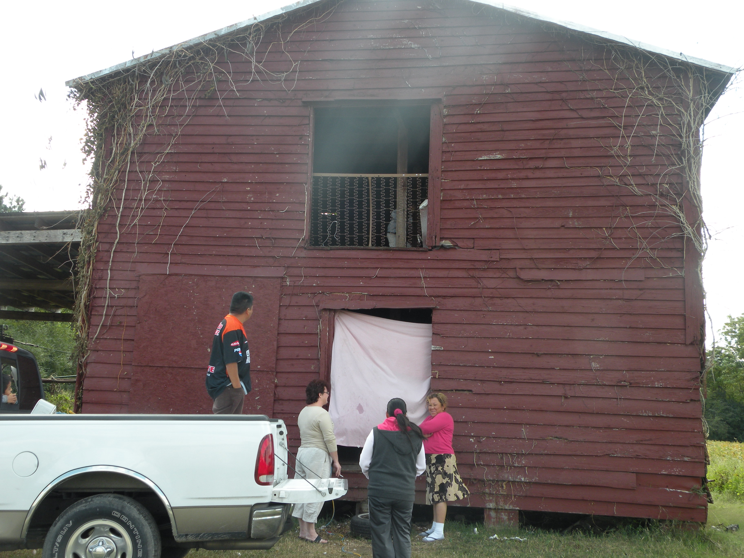
Goals and Quick Review
Staff will identify areas for improvement and better understand how to complete and utilize the ID&R Plan
Staff will collaborate with others in order to evaluate best practices and new ideas on locating migrant students, gaining families’ trust, and speaking to different audiences about the MEP

Slide 22
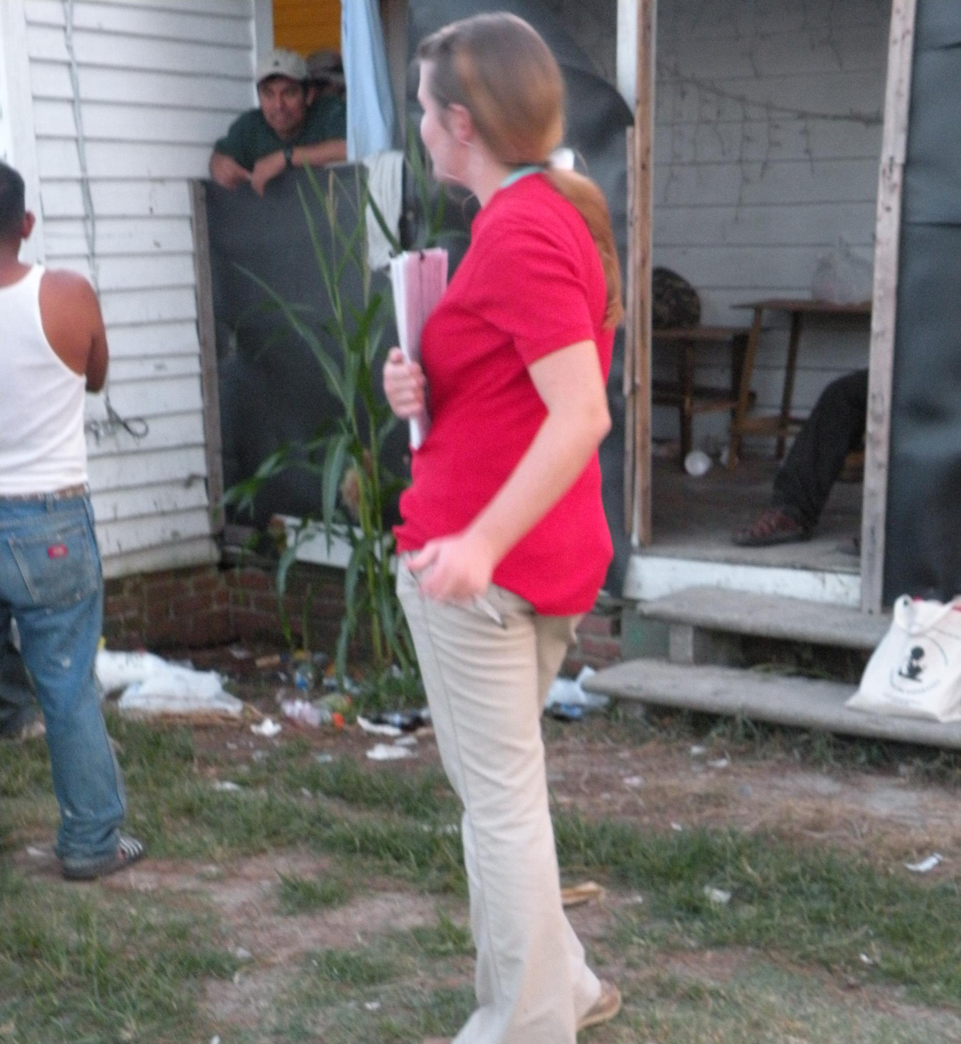
What is a local ID&R Plan?
“If you don’t know where you’re going, you’ll end up someplace else.” – Yogi Berra
The ID&R plan helps the recruiter, supervisor, and other recruitment staff organize and prioritize recruitment activities and evaluate ID&R efforts
A district with clear objectives and a plan is more likely to be successful
Districts will be required to upload ID&R plans & calendars in CCIP next year

Slide 23
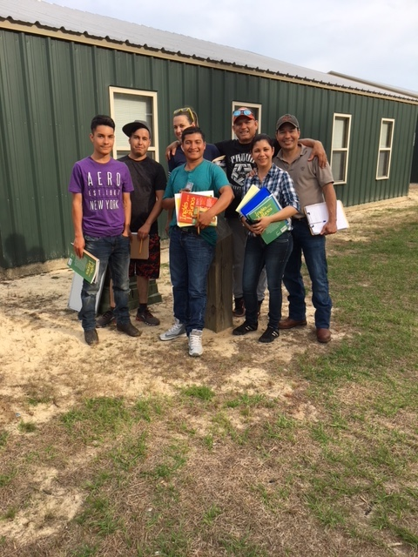
Key Components of an ID&R Plan
District Mapping
Training for Recruitment Staff
Deploying Recruitment Staff
  Recruitment Calendar
  Strategies for active ID&R throughout the year
Quality Control
Evaluating Recruitment Efforts

Slide 24
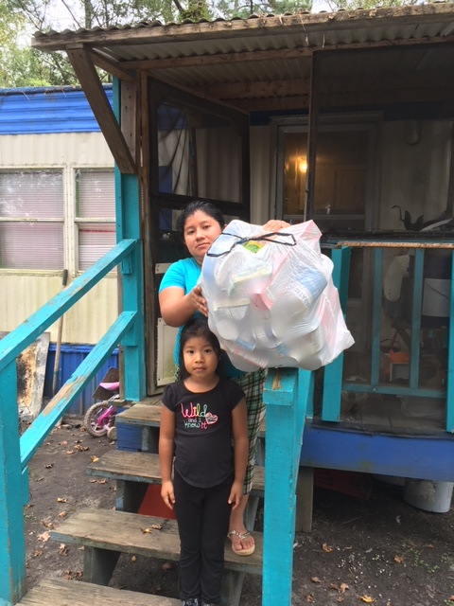
ID&R Plan Format
Objectives (related to key components)
Staff Responsible (Personnel)
Activities
Timeline
Method of Evaluation

Slide 25
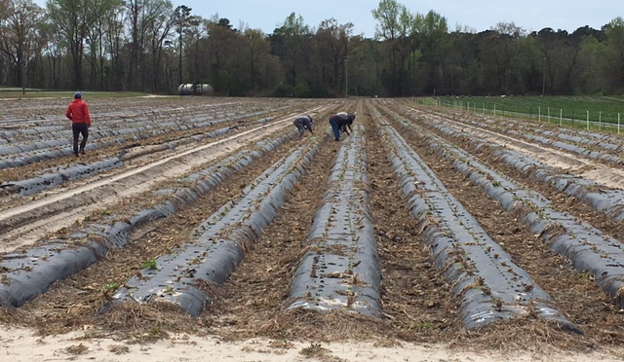
ID&R Plan is a “Living Document”
Always active
Revisiting the Plan
Updating the Plan
Strategizing
Surveying your District
Planning ahead

Slide 26
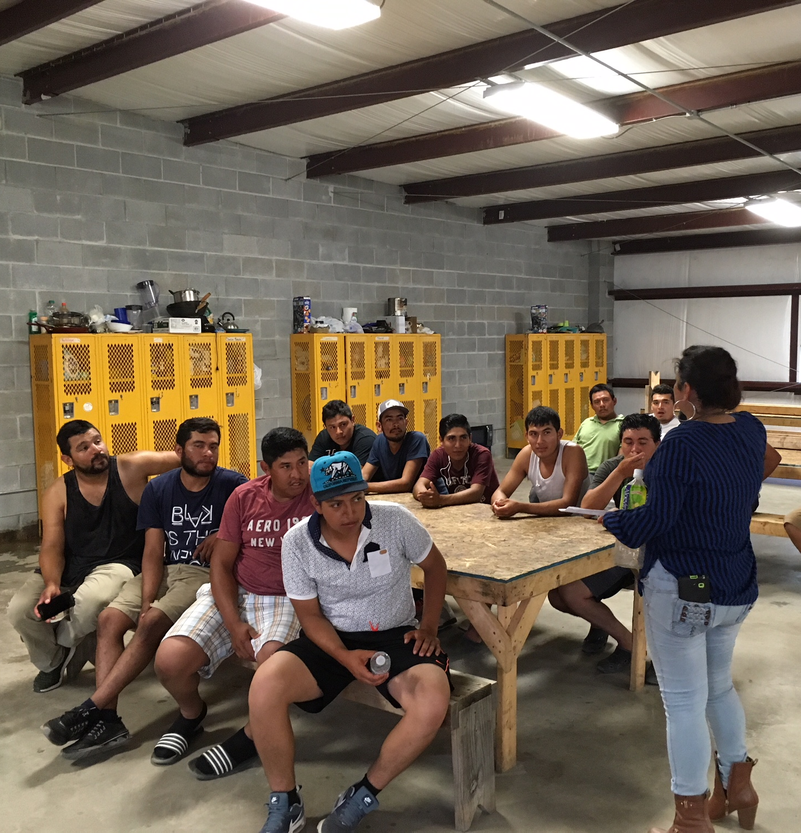
Translating the ID&R Plan to Individual Plans
Recruiters should use the LEA ID&R Plan to create individual action plan
  Create a Google Calendar with action step deadlines for specific activities that pertain to you
  Create an activities/outcomes sheet that aligns with your specific tasks as outlined in the ID&R Plan
  Keep a recruitment log and use it to fill in your outcomes

Slide 27
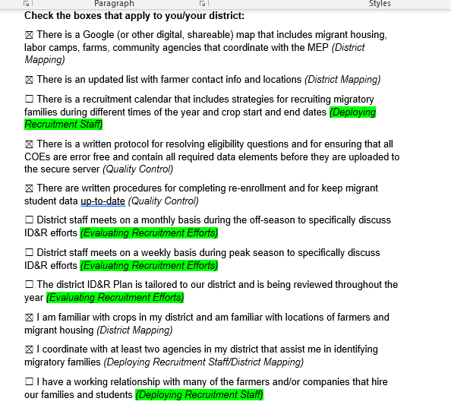
Using the ID&R Self-Assessment
What key components need improvement?
What does this show me that I may need to focus on in my district?

Slide 28
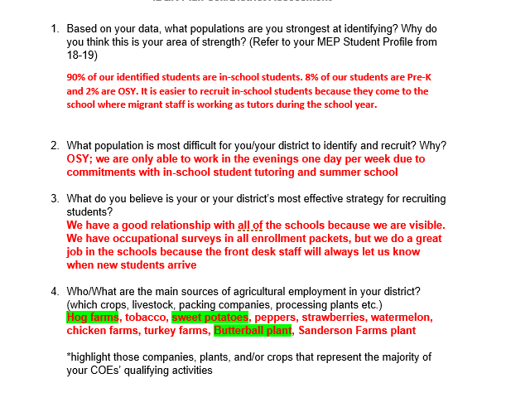
Based on this self-assessment…
What population(s) does the district need to focus their efforts on?
What should they continue doing?
Which employers should they be focusing on?

Slide 29
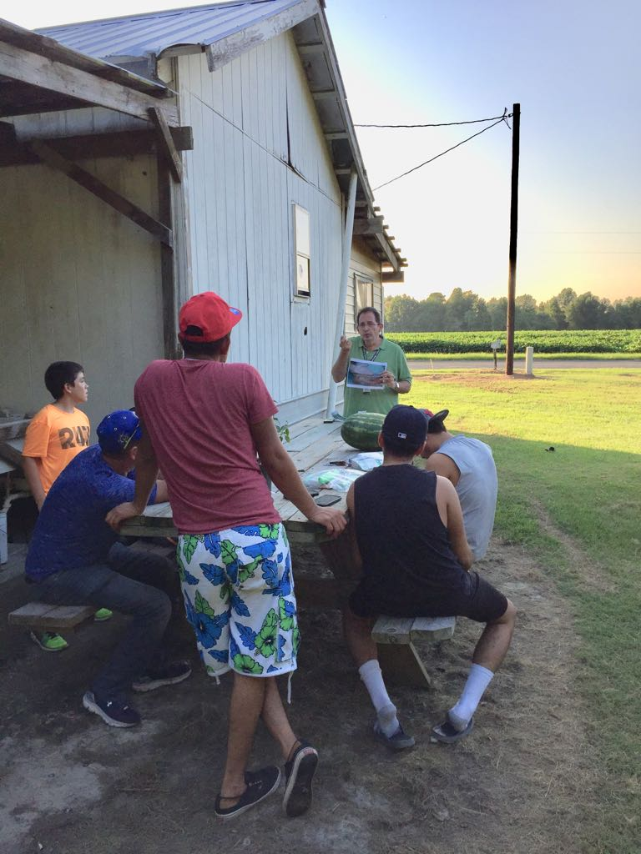
Where else should I look for data?
Annual Statistical Bulletin: https://www.nass.usda.gov/Statistics_by_State/North_Carolina/Publications/Annual_Statistical_Bulletin/index.php
Ag Census: https://www.nass.usda.gov/Publications/AgCensus/2017/Full_Report/Census_by_State/North_Carolina/index.php

Slide 30
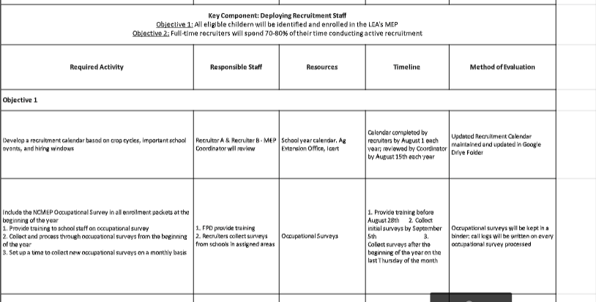
Do their activities align with their needs?

Slide 31
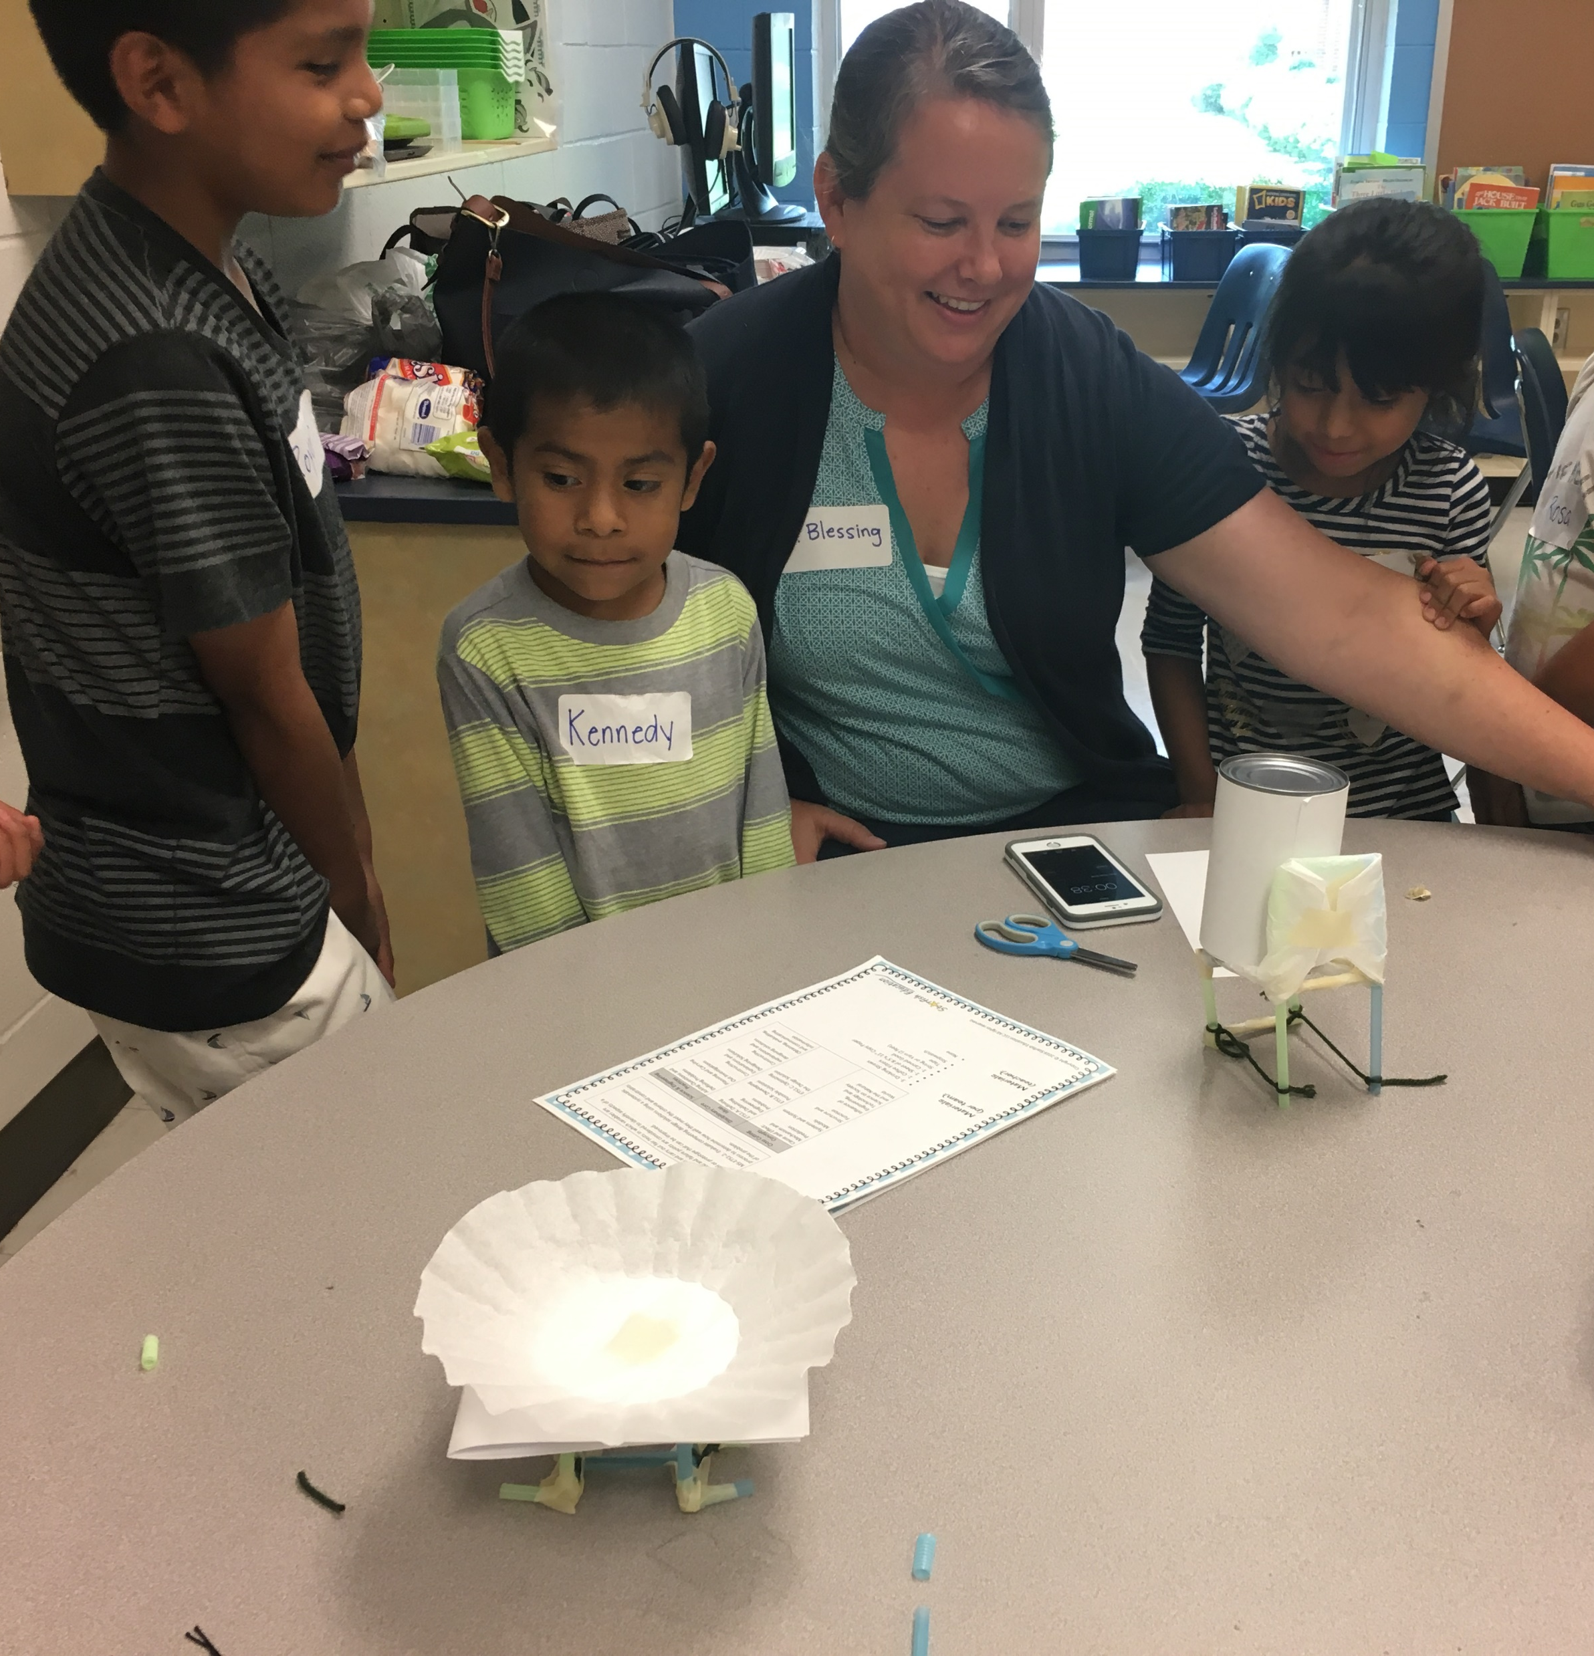
Discuss!
What are your district’s areas for growth?
What recruitment strategy is most effective in your district?
What employers do you need to work with? Which employers are you already successfully working with? How did you establish those relationships?
What information surprised you from the USDA ag data? Are there other crops/areas you should focus on?
What advice can you give to your colleagues based on their responses?

Slide 32

Next Steps…
Look at your ID&R Plan either individually or with your district
Determine where you need to make changes based on your self evaluation and discussion with colleagues
Begin making those changes now!

Slide 33

Recruiting Out-of-School Youth
Hunter Ogletree and Israel Olivares Mejia

Slide 34
MSIX AS A RECRUITMENT TOOL

Slide 35


Ways I use MSIX
Think
Pair
Share

Slide 36
PowerSchool & MSIX:
Great Allies
Log into your PowerSchool account (if you don’t have a PS, partner with someone who does)
Open MSIX in another browser (msix.ed.gov)

Slide 37
Let’s Check for New Enrollments
In PS:
  Type the following command on the start page: entrydate>11/01/2019;entrydate<02/07/2020 – hit Enter
  Click “Quick Export” at the bottom right
  You will see a window with space to input fields for your list

Slide 38
Let’s Check for New Enrollments - CON
In the window type the following commands:
  Last_name * S_NC_STUDENTDEMO.PREVIOUS_STATE
  First_name * StudentCoreFields.father_employer
  Student_number * StudentCoreFields.mother_employer
  Grade_level
  Ethnicity
  Street
  City
  Home_phone

Slide 39
Now, Let’s Go to MSIX
Check students from PS list and who may qualify in MSIX
Find them!
Review students found in PS and analyze his/her information

Slide 40
MSIX Reports
The Move to
Missed Enrollment

Slide 41
Few MSIX Reminders
Login to MSIX at least once a month
Use Reports – Use Reports
Connect PowerSchool to MSIX
Password Resets = Ms. Nancy Holloway

Slide 42
Evaluation & Closing
Please complete the evaluation sent to you in your e-mail prior to leaving
Make sure that you have signed in
Rachel Wright Junio
Eastern MEP Administrator
Rachel.wrightjunio@dpi.nc.gov
Heriberto Corral, Ed.D.
Western MEP Administrator
Heriberto.corral@dpi.nc.gov

