Slide 1
Ready to Learn
Fostering Academic Success Through Social Emotional Instruction
Nicole Moyer, EdS, NCSP
Pine Springs Preparatory Academy

Slide 2
What is Social Emotional Learning?

Slide 3
“Social and emotional learning (SEL) teaches children to recognize and understand their emotions, feel empathy, make decisions, and build and maintain relationships.”
Summary:
“Promoting Positive Youth Development Through School-Based Social and Emotional Learning Interventions: A Meta-Analysis of Follow-Up Effects”

Slide 4


Slide 5
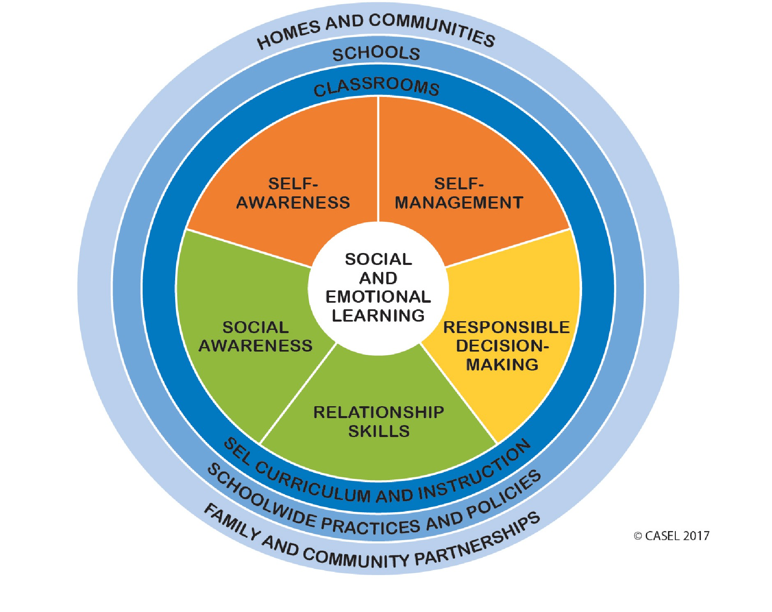

Slide 6
Benefits
Social Competence
Students in SEL programs improve by 9-10 percentage points in positive attitude, addressing conduct problems, and reducing emotional distress
Students in SEL programs demonstrate better social skills than 76% of comparison-group students
Average gain of 23 percentage points in Social Emotional skills compared to control group
Including long-term effects…(6 months to 18 years post-intervention)
Increased prosocial behaviors and attitudes
Decreased likelihood of clinical mental health disorder
Decreased arrests/involvement in juvenile justice system
Lower rates of STIs and pregnancies
Sources: Civic Enterprises & Peter D. Hart Research Associates (2013); CASEL Summary

Slide 7
Benefits
Academic Achievement
Evidence that SEL participants have 11-percentile-point gain in achievement
After an average of 3.5 years, follow-up assessments indicate an average of 13-percentile-points higher academic performance for SEL vs. non-SEL students
Increase graduation rate
SEL participants saw a 6% increase in high school graduation and 11% increase in college graduation rates
Sources: Durlak, Weissberg, Dymnicki, Taylor, & Schellinger (2011); CASEL Summary

Slide 8
Teachers in schools that report successful SEL
programs are ½ as likely to report negative school climate
95% believe SEL
skills are TEACHABLE
CASEL Teacher Survey
44% report SEL
is
implemented schoolwide
77% of teachers believe
SEL
will improve
academic performance
93% believe SEL
is very or fairly IMPORTANT
for student experience
Source: Civic Enterprises & Peter D. Hart Research Associates (2013)

Slide 9
Assess
Next Steps
Set as a priority
Incorporate throughout programming
AND
Implement explicit SEL instruction for ALL
Needs assessment
Resource assessment

Slide 10
Universal Instruction
ALL students must be taught
PSPA Method: Morning Meeting
Every morning class gathers and interacts through the implementation of 4 purposeful elements

Slide 11
Morning Meeting
Greeting
Students and teacher greeted by name
Sharing
Students share important information about their lives
Group Activity
Brief activity that promotes cohesion
Morning Message
Students read/use a short message written by their teacher

Slide 12
Student Quotes
"What I really liked about the first week of school was morning meeting. It was really fun. I can't wait to come back on Tuesday to learn!"
"I liked morning meeting and playing the games. I had a lot of fun"
"I loved the first week because morning meeting helped me show how I was feeling nervous."
"My favorite part about the morning was the meeting. I loved poison dart frog. I liked morning meeting more than recess!"

Slide 13
Questions to ask about our universal instruction...
How do we know it is working?
What about the other 20%?

Slide 14
Measure
Universal Social and Emotional Screenings
Screen all students for additional need
Use measures as progress data
Analyze data to improve system

Slide 15
Measure
Screening System
The BASC™-3 Behavioral and Emotional Screening System (BESS)
Student Risk Screening Scale (free)
Strengths and Difficulties Questionnaire
Resources: http://www.ci3t.org/screening
Analyze screening data to determine specific student needs

Slide 16
Interventions
Interventions through a tiered system
Check In/Check Out
Behavior Contract
Peer Tutoring
Social Decision Making/Social Problem Solving
Zones of Regulation

Slide 17
Resources and Ideas
Mental Health First Aid courses
SEL Impact/Resources: https://casel.org/
District Resource Center: https://drc.casel.org/
Screenings: http://www.ci3t.org/screening
Interventions: http://www.pbisworld.com/

Slide 18
What are the biggest roadblocks to implementation?

Slide 19
References
CASEL Summary: “Promoting Positive Youth Development Through School-Based Social and Emotional Learning Interventions: a Meta-Analysis of Follow-Up Effects”
Jones, D. E., Greenberg, M., & Crowley, M. (2015). Early Social-Emotional Functioning and Public Health: The Relationship Between Kindergarten Social Competence and Future Wellness. American Journal of Public Health, 105(11). Retrieved from https://ajph.aphapublications.org/doi/10.2105/AJPH.2015.302630.
Durlak, J. A., Weissberg, R. P., Dymnicki, A. B., Taylor, R. D., Schellinger, K. B. (2011). The Impact of Enhancing Students’ Social and Emotional Learning: A Meta-Analysis of School-Based Universal Interventions. Child Development, 82(1), 405-432.
Civic Enterprises & Peter D. Hart Research Associates (2013). The Missing Piece: A National Teacher Survey on How Social and Emotional Learning Can Empower Children and Transform Schools. Retrieved from https://casel.org/wp-content/uploads/2016/01/the-missing-piece.pdf.

