Slide 1
NCDPI’s School Connectivity and E-Rate Services for Charter Schools and LEAs
Michael.Ramsey@dpi.nc.gov

Slide 2
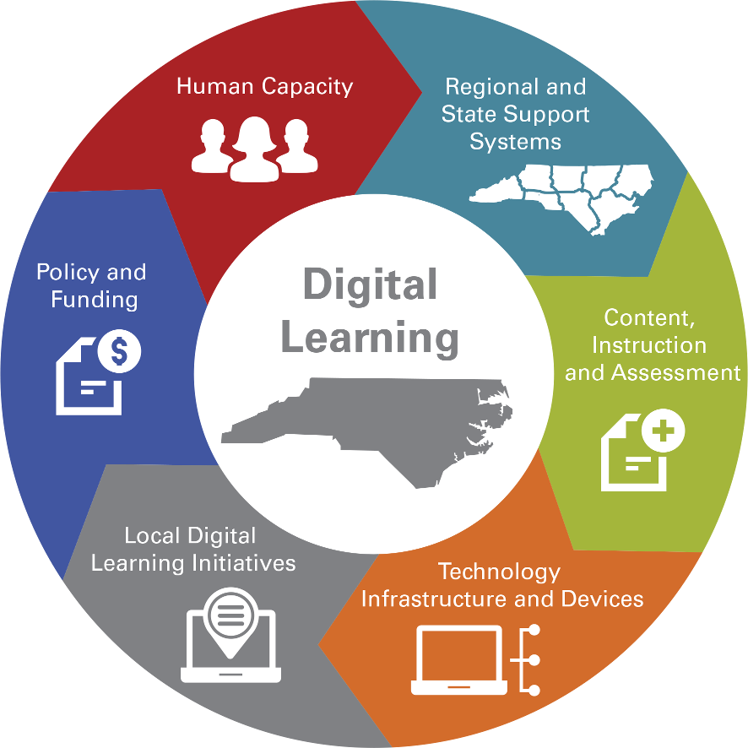
DTL
Digital Teaching and Learning
Legislation
Plan
Infrastructure
E-rate
Notes:
Roxie will discuss DTL plan and how it interfaces with Infrastructure (SCI)

Slide 3
Problem
Your district or charter school needs:
Internet, Content Filtering, Firewall
Network Connection to another campus
Wireless Access Points in every classroom
Network switches in the closets
Network Wiring
Someone to tell us what we need; advice without a sales pitch
Someone to install and configure all of it

Slide 4
Problem #2
We have no money for IT infrastructure like this

Slide 5
Solution #1 – Federal Funds
Federal E-rate Program
- Provides up to 90% of funding for Internet and WAN (Category 1).
- Provides up to 90% of funding for internal network connections such as wireless access points, network switches, cabling, installation, and maintenance (Category 2) up to $156 per student over five years

Slide 6
Solution #1 – Federal Funds
$156 per student for Category 2
@ 200 students = $31,200
@ 2,000 students = $312,000
Discount rate based on Urban/Rural and NSLP or other similar numbers.
Statewide average discount rate is 70%
Your cost, at 70% discount:
@200 students = $963
@ 2,000 students = $9,630
[You’re thinking, “But we don’t have those funds locally!”]

Slide 7
Discount Matrix

Slide 8
Solution #2 – SCI
NCDPI School Connectivity & E-rate Services can:
Pay Internet, Firewall, Content Filtering, WAN
Pay the local portion for Category 2 so there is zero local cost
SCI has contracts in place for most Category 2 goods and services, making it easy file
SCI has contracts to perform IT Need Assessments, IT Security Assessments, and general consulting

Slide 9
Solution #2 - SCI
NCDPI School Connectivity & E-rate Services
Provides Internet access through the North Carolina Research and Education Network (NCREN), including Firewall and Content Filter
Pays the local portion of WAN costs
Provides full-service training and assistance for local filing of E-rate for WAN and Category 2

Slide 10
History
NCDPI School Connectivity & E-rate Services
Established in 2007, has provided over $130M directly to LEAs and Charters to enable quality network infrastructure to the classroom
NC is the first state to have, on average, one wireless access point per classroom
In 2018, will enable $30M in statewide Category 2 purchases

Slide 11
SCI Objectives
Expand the number of schools with broadband Internet access
Further develop communication networks for rural and underperforming schools
Aid in professional development
Develop a scalable model to maintain and enhance network services to all schools in North Carolina.
Notes:
Roxie discusses how E-Rate makes it possible for SCI to leverage state and local funding

Slide 12
Last Year
 | Total Cost | E-rate Share | State Share
Category 1 School Fiber Connections (WAN) | $34.5M | $26.8M | $7.7M
Category 1 Consortium Internet | $15.3M | $11.9M | $3.4M
Category 2 Classroom Connections (Wi-Fi) | $28.8M | $17.9M | $10.9M
E-rate Eligible Totals | $78.6M | $56.6M | $22.0M
Identity and Access Management | $1.5M | Not eligible | $1.5M
Client Network Engineering | $1.8M | Not eligible | $1.8M
Program Administration – NCDPI, FFL, FI | $0.9M | Not eligible | $0.9M
Firewall Services | $1.8M | Not eligible | $1.8M
Content Filtering Services | $3.5M | Not eligible | $3.5M
Non E-rate Eligible Totals | $9.5M | Not eligible | $9.5M
Grand Totals | $88.1M | $56.6M | $31.5M

Slide 13
Details
Internet Access provided through NCREN
Fiber-based, unrestricted Internet access
Used by all 115 LEAs and the majority of charters
Bandwidth increased at 60% utilization
New charters start at 50Mbps, full-duplex
No monthly costs; NCDPI SCI files all E-rate
zScaler content filtering and Cisco firewall included, can be self-managed or managed

Slide 14
NCREN

Slide 15
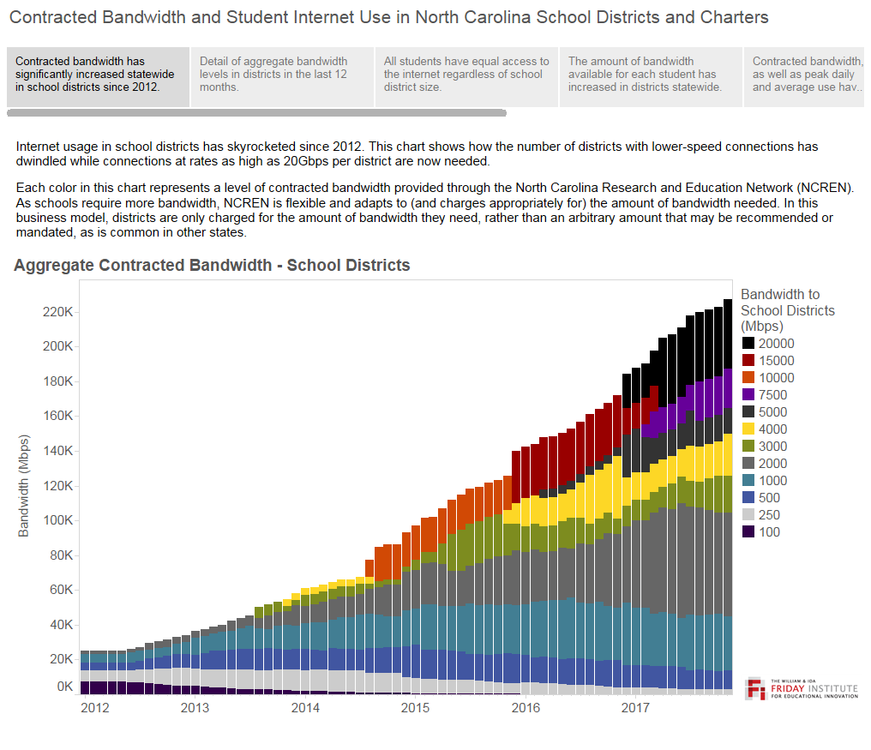

Slide 16
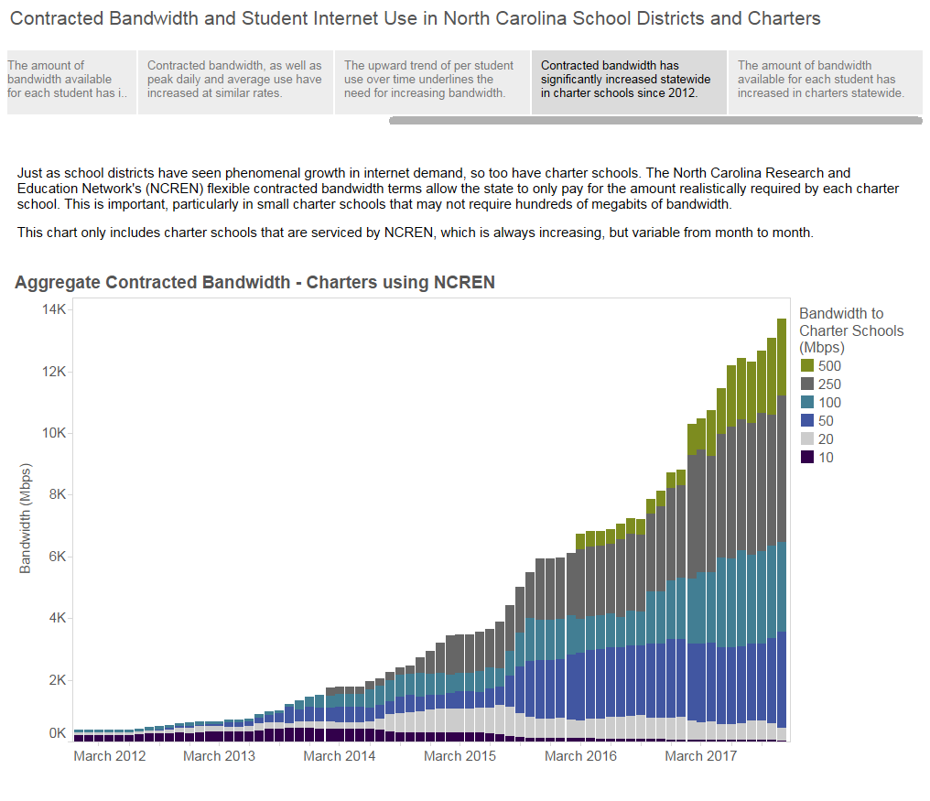

Slide 17
Client Network Engineering
IT Needs Assessments, Security Assessments, and IT Planning Assistance
Provided by MCNC CNE team
Confidential between LEA/Charter and MCNC
NCDPI does not monitor results

Slide 18
E-rate Assistance
E-rate training held several times a year across the state
Regionally dedicated E-rate experts available for phone, email, Google Hangouts, GoToMeeting screen sharing, and on-site visits to help you through the entire filing process

Slide 19
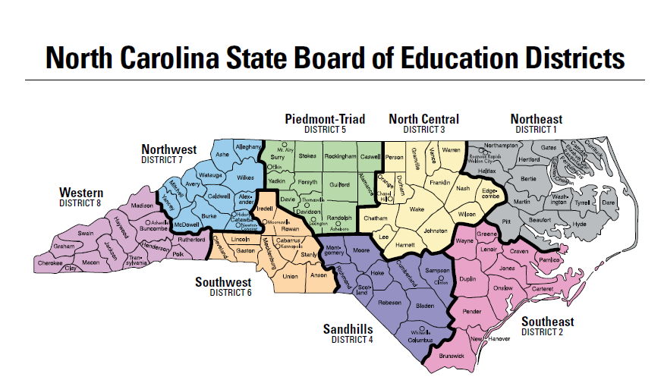
E-rate Support
Jeannene
Roxie
Rebecca

Slide 20
SCI & E-rate Team
Northeast and North Central
Jeannene.Hurley@dpi.nc.gov
Southeast, Sandhills, Piedmont Triad
Rebecca.Martin@dpi.nc.gov
Southwest, Northwest, Western
Roxie.Miller@dpi.nc.gov
Program Manager
Michael.Ramsey@dpi.nc.gov

Slide 22
LINKS
NCDPI School Connectivity & E-rate Services: https://erate.fi.ncsu.edu
Federal E-rate Program: https://www.usac.org/sl
NCREN: https://www.mcnc.org/our-community/k12/services
Eligible Services List for 2018:
https://www.fcc.gov/document/wcb-releases-eligible-services-list-e-rate-funding-year-2018

Slide 23
Questions?

