Slide 1

NC New Teacher Support Program
+ NC Charter Schools
= Beginning Teacher Success
Leveraging University Partnerships to Promote Teacher Development
State Leadership Conference
Raleigh, NC
October 18th, 2018
Notes:
PC

Slide 2

Presenters
Jonathan Bryant Chief Administrator
Lincoln Charter School
Tiffany Moceri Lincoln Charter Schools
Dr. Misty Hathcock Regional Director UNCC
Dr. Kim Ramadan Lead Instructional Coach UNCC
Jackie Hoskins Lead Instructional Coach UNCG
Christina Bush Lead Instructional Coach UNC-CH
Dr. Patrick Conetta Director NC NTSP
Notes:
PC

Slide 3
The NC NTSP Mission
The NC NTSP seeks to improve student achievement by improving beginning teacher effectiveness & teacher retention with three core services.
Institutes | Regional PD | Instructional Coaching
Instructional boot camps Early Fall | Designed to meet district needs | Intensive, individualized Designed to meet teacher, school, and district needs
Notes:
PC

Slide 4
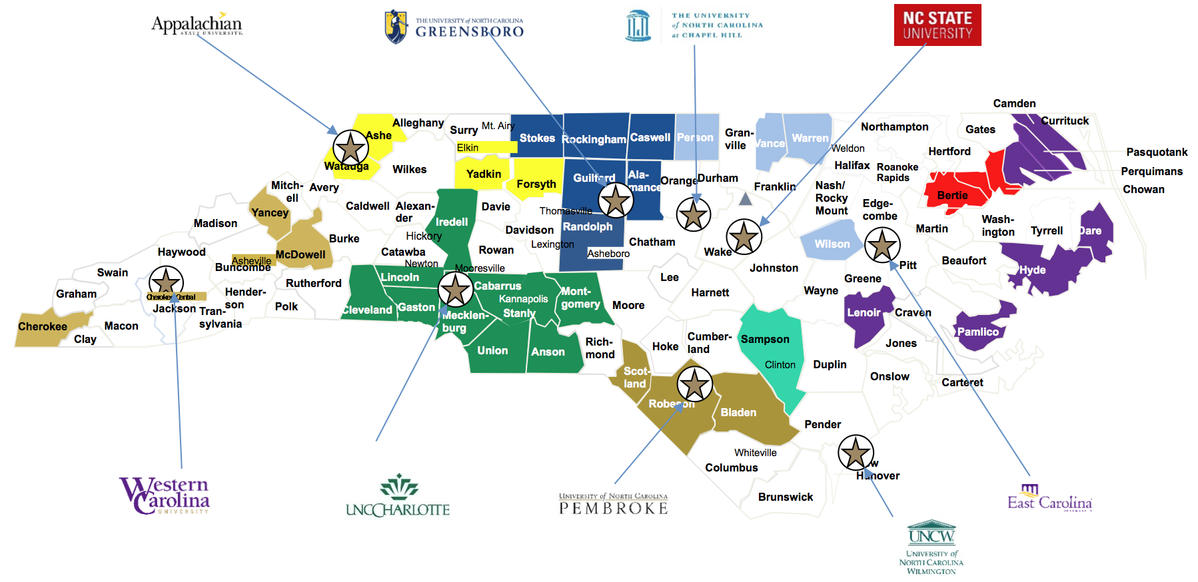
University-Based Partnership Delivery Model
Notes:
MH
53 school district3 (9 Charters)
230 schools
About 1,300 teachers

Slide 5
2017-18 Statewide Service Data
32,805 Total Coaching Interactions
1.4 million minutes of Instructional Feedback
31.8 Coaching Interactions per teacher
Over 1,300 Minutes of Instructional Support per teacher
Notes:
MH

Slide 6
What We’ve Accomplished
Teachers served by the NC NTSP are significantly more likely to return to teach in their school, LEA and state than a matched sample of teachers not supported by NC NTSP.
Teachers served by the NC NTSP in their second and third year performed significantly higher in all five areas of their NCEES evaluation than teachers not supported by NC NTSP.
Lateral entry teachers served by the NC NTSP performed significantly higher in four of five areas of their NCEES evaluation than teachers not supported by NC NTSP.
Teachers served by the NC NTSP in their second and third year significantly outperformed teachers not supported by NC NTSP in student achievement at elementary, middle, and high school levels (EVAAS).
Middle grades lateral entry teachers served by the NC NTSP significantly outperformed teachers not supported by NC NTSP in student achievement (EVAAS).
80.3% of teachers served by the NC NTSP felt their Instructional Coach helped them with the confidence, knowledge, and skills in teaching, compared to district/school support (66.8%).
Notes:
PC
& Transition

Slide 7

Lincoln Charter School
The mission of Lincoln Charter School is to facilitate the development of college ready individuals through emphasis on rigorous academics and our community expectations: honesty, respect, empathy, responsibility, service and preparedness.
Admin Team Structure
Beginning Teacher Program/Teacher Support/NAIP
Notes:
TM & JB
How was the partnership leveraged to support instruction and achieve the Lincoln Charter’s vision?
Considerations, recommendations, unanticipated outcomes…

Slide 8
Lincoln Charter School
Lincoln Charter + NC NTSP
Initial year (2017) - caseload - 2 teachers
Year two (2017-2018) - caseload - 7 teachers
Year three (2018-2019) - caseload - 12 teachers
Lessons Learned
Notes:
TM & JB

Slide 9
NC NTSP Instructional Coach Perspective
Charter Goals/Vision
Relationship with Administration
Relationship with Facilitators/CRTs
Professional Development (presenting and attending)
Coaching
Notes:
MH & KR
Worked with Bradford Prep and Union Prep
Know charter goals - “Bradford way”
Relationship w admin – check in – Bradford – check in led to PD because of need based on survey data
Relationship with fac. CRT – co-present PD at Union Prep, check in co-coach
PD – Bradford Prep attend Singapore Math training Union Prep induction days – present based on need (aggressive monitoring and entry routine)
- Individual coaching – following teachers multiple years – data shows successful work

Slide 10
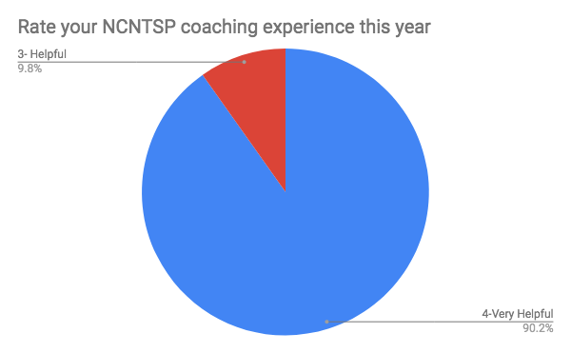
UNC Charlotte Regional Data
Notes:
KR
Teacher feedback

Slide 11
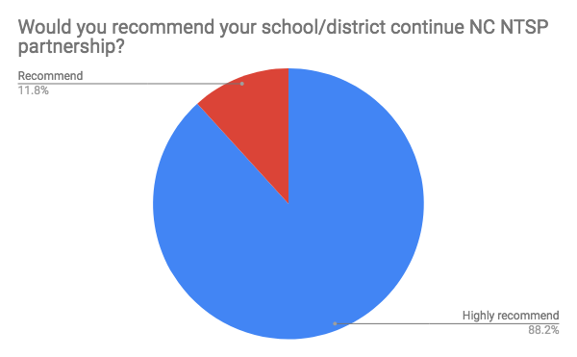
UNC Charlotte Regional Data
Notes:
Teacher feedback
51 Participants

Slide 12
Teacher Feedback
How has your NC NTSP coaching experience differed from your coaching experience at the school/district level?
- Highly personalized and real-time
- More frequent and more helpful
- The coaches really are able to come consistently to observe and give me hands-on feedback about my class and lessons.
Notes:
CB – feel free to add perspectives from Haliwa-Saponi Tribal School

Slide 13
Teacher Feedback
What was most valuable about your coaching experience this year?
- My coach was so understanding and always helped me to reach my goal in the classroom.
- Time spent reflecting on different teaching methods and new ideas to optimize student learning.
- The expertise of the coach was extremely valuable. She was able to see exactly what I needed to fix and always had multiple strategies for me to implement no matter what the issue was. She really knew her stuff.
Notes:
CB -feel free to add perspectives from Haliwa-Saponi Tribal School

Slide 14
Teacher Feedback
If you were to participate in NC NTSP again, what support would you like from your coach?
- The same support I received!
- The same as this year. Being able to observe and co-teach was extremely beneficial
Honestly I can’t think of anything. She was amazing and always exceeded my expectations
Notes:
JC feel free to add perspectives from Guilford Prep

Slide 15
Teacher Feedback
Additional Comments:
All teachers need this program! I wish it was mandatory for all NC new teachers!
I am forever grateful to have had the support this year.
My coach came to me my first year teaching. She provided me with clear, practical, structures, and easy to follow support.... By the end of the year I requested to my principal that “I need my coach again next year” and so she followed me from the very beginning until the end of my second year. I now call her my “Fairy Godmother” because she had truly helped shape me into the teacher I am becoming. I support the NC NTSP 100%.
Notes:
JC - feel free to add perspectives from Guilford Prep

Slide 16

NC New Teacher Support Program
Questions?
Notes:
PC

Slide 17
How to Partner with Us
Contact Us
NC New Teacher Support Program
College of Education
East Carolina University
Greenville, NC 27858
conettap18@ecu.edu
http://ncntsp.northcarolina.edu
Notes:
PC

