Slide 1

Unlock the Power of Home Base
bit.ly/oct18charter

Slide 2
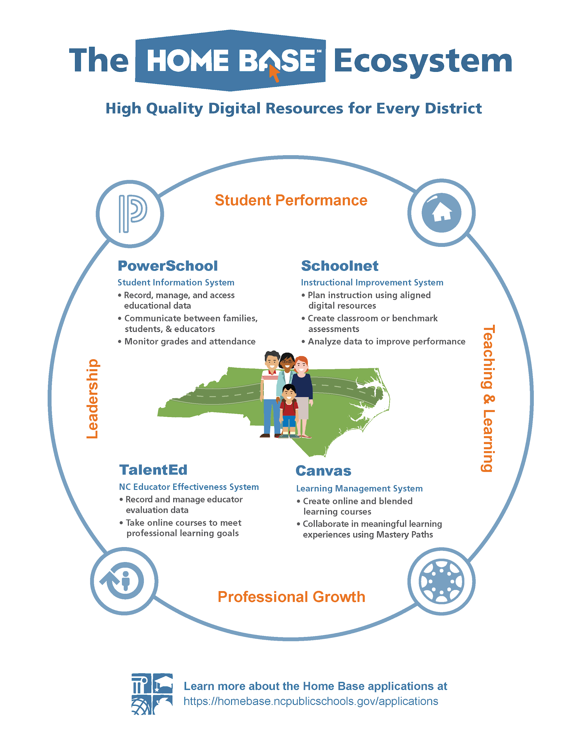
Topics for Today:
What is Home Base?
Truenorthlogic/NCEES
PowerSchool
  PowerTeacher Pro
Schoolnet
Canvas
How to Opt-In
Questions?

Slide 3
Truenorthlogic/NCEES:
North Carolina Educator Effectiveness System
ENGAGE: TNL/NCEES provides a platform where all the pieces of a professional development plan can connect with one another including evaluations, observations and improvement plans.
LEARN: Professional Development in TNL/NCEES helps Charters and LEAs manage professional development for staff through DPI PD or Local PD.
SUPPORT: TNL/NCEES centralizes this information in one place to support teacher, support staff and administrators’ professional growth.
MEASURE: Charters and LEAs utilize TNL/NCEES to measure competencies through both professional development and staff evaluation.
In order to access Truenorthlogic, you must opt-in to Home Base and pay the $1 per ADM fee to gain access to TNL and Schoolnet.

Slide 4
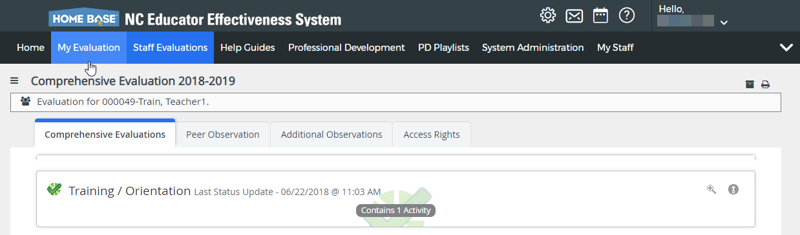

Truenorthlogic/NCEES:
ENGAGE TNL/NCEES provides a platform where all the pieces of a professional development plan can connect with one another including evaluations, observations and improvement plans. (Click here for Charter TNL/NCEES INFORMATION)
ROLES:
NCEES
District Admin
Admin
Principal
AP
Instructional
Support
Peer
Observers
Instructional
Teachers
Mentors

Slide 5
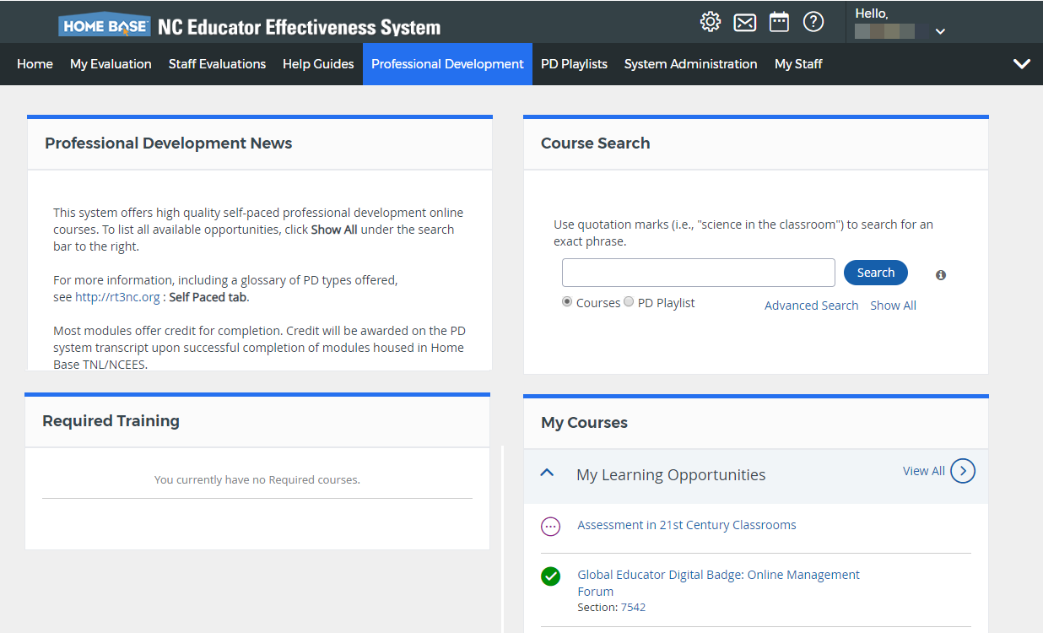

Truenorthlogic/NCEES:
LEARN Professional Development in TNL/NCEES helps Charters and LEAs manage professional development for staff through
DPI PD or Local PD.
Online PD/PD Playlists
Local PD Office
Self-Paced/Instructor Led
Record Attendance and Completion for credit
Click here for a listing of Educator Effectiveness PD Courses:
https://rt3nc.org/

Slide 6
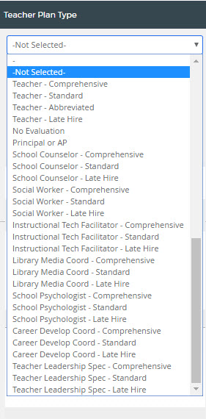
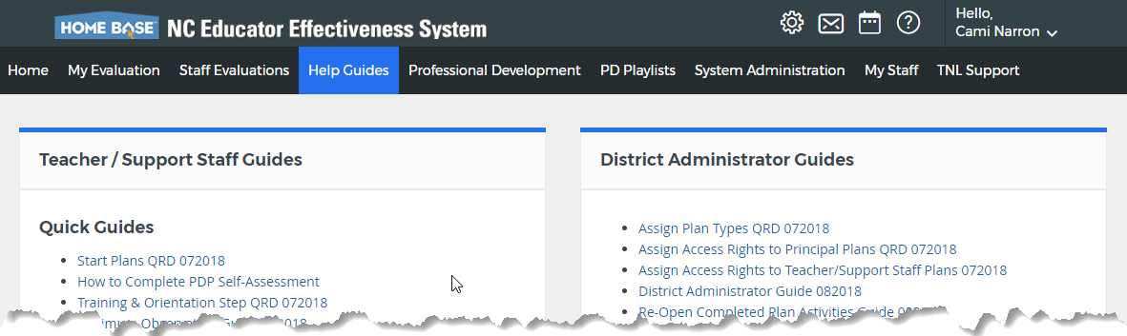
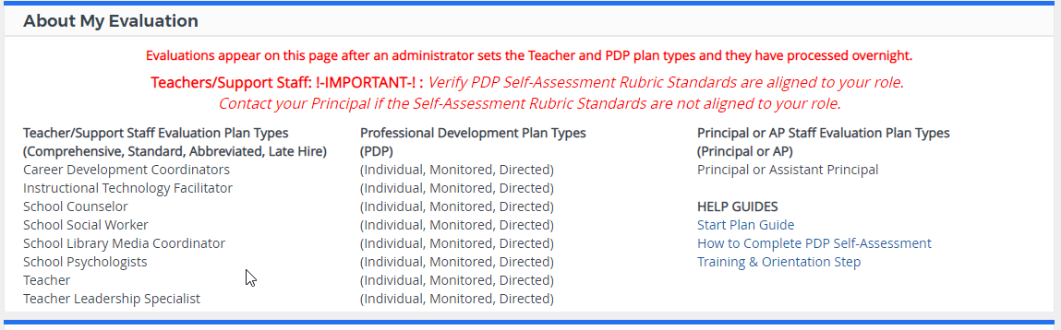

Truenorthlogic/NCEES:
SUPPORT TNL/NCEES centralizes this information in one place to support teacher, support staff and
administrators’ professional growth.
Click here for TNL/NCEES District Administrator Guide 2018

Slide 7
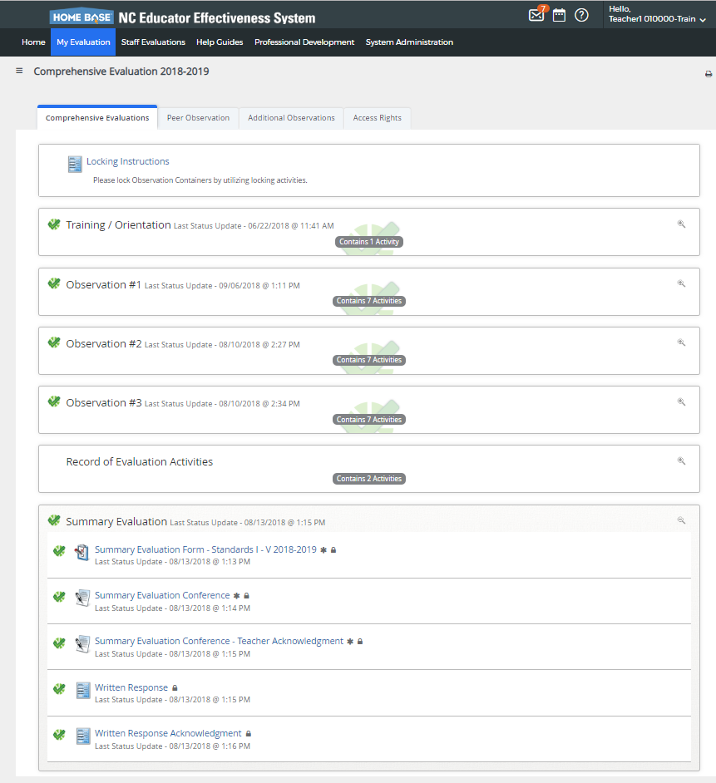

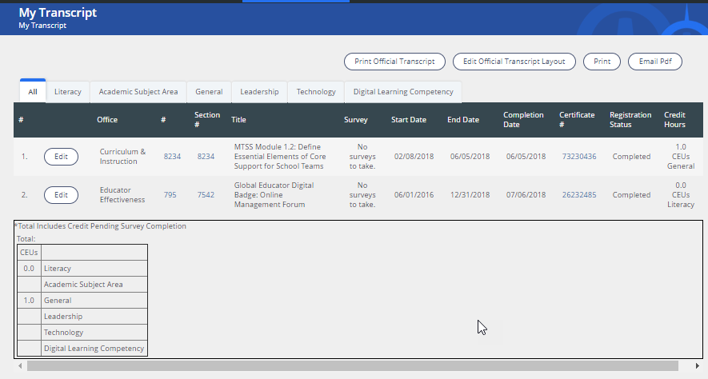
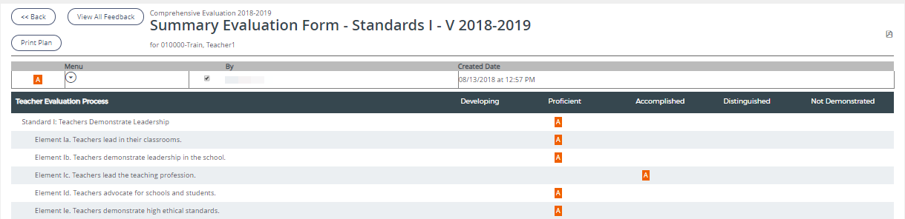
Truenorthlogic/NCEES:
MEASURE Charters and LEAs utilize TNL/NCEES to measure competencies through professional development and staff evaluation.
Quick Reports
Ad-Hoc Reports
Developing
Proficient
Accomplished
Distinguished

Slide 8
PowerSchool:
Beginning in the 2018-19 school year, all NC public and charter schools use PowerTeacher Pro

Slide 9

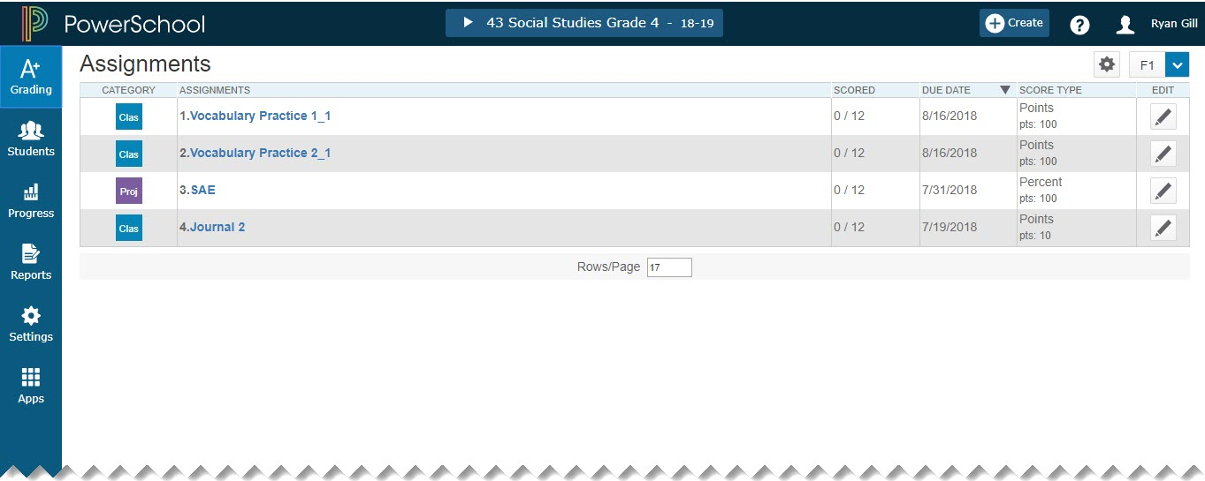
PowerTeacher Pro:
Teachers navigate to the HTML-based gradebook directly through the teacher portal of PowerSchool.
User friendly interface
Adapts to any computer or tablet, including Mac, Windows, iOS, Android, Chromebooks
Anytime, anywhere access
Flexible data views
Advanced features for both standards-based and traditional grading
District level configuration

Slide 10
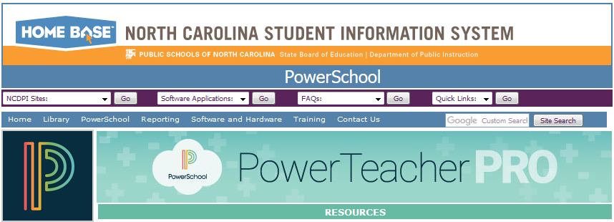
North Carolina Student Information Site (NC SIS)
www.nc-sis.org
PowerTeacher Pro Resources Link: www.nc-sis.org/ptp.html
Presentations Videos Documentation

Slide 11

Schoolnet:
Instructional Improvement System
Access to over 60,000 instructional resources aligned to K-12 NC Standards.
Access to over 100,000 assessment items aligned to K-12 NC Standards.
Robust assessment creation and delivery- including PowerSchool gradebook integration and accommodations support for students taking online assessments.
Ability to co-author assessments with educators from around the state.
Rich data and analytics available immediately after an assessment is completed online, reports available at the classroom and school level.
In order to access Schoolnet, you must opt-in to Home Base and pay the $1 per ADM fee to gain access to Schoolnet and TNL.

Slide 12

Schoolnet:

Slide 13

Canvas:
Learning Management System
Students, teachers, and courses populated from PowerSchool
Ability to create additional courses for professional development, clubs, parent communication, ect.
Parent and Student apps for on-the-go learning.
Mastery Paths allow teachers to create personalized learning for each student- great for multiple grades/subjects within a course.
Access to Canvas and NC Commons- course materials and entire courses available to be imported into your instance at no charge.
Canvas is available as part of a convenience contract with state of NC, separate contract and fee of $3.74 per user per year required for access.

Slide 14

Canvas:

Slide 15

How Do I Opt-In?
Home Base Website
Charter School Principal or Operator must use the Opt-In tool on the website.
Want to check if your school has opted-in?

Slide 16


Collaboration Opportunities
real time product demonstrations/updates
user networking and problem solving
planning by us for us….
Meetups
Digging Deep….
Training Plan
Product Playtime
What’s going well?
Challenges?
Image Credit: https://pixabay.com/en/group-team-feedback-confirming-2822423/

Slide 17
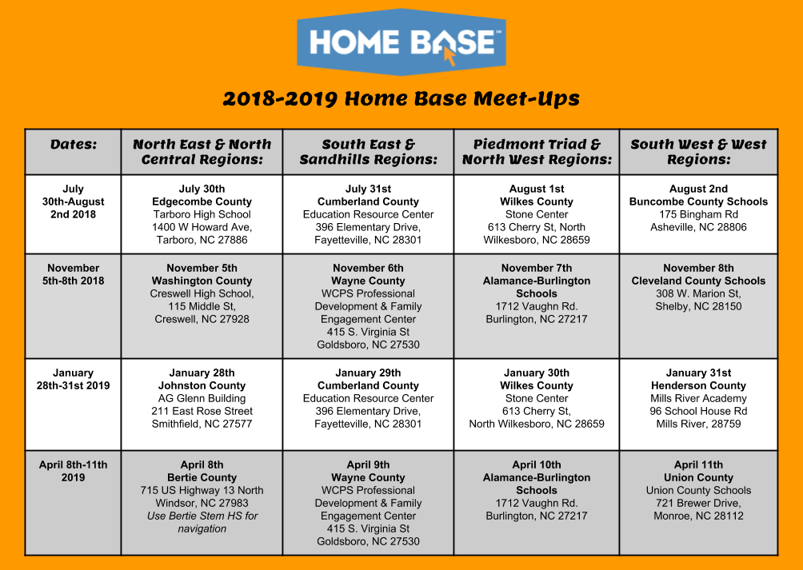

Slide 18

Cami Narron - Truenorthlogic/NCEES
cami.narron@dpi.nc.gov
Justin Connor - PowerSchool
justin.connor@dpi.nc.gov
Pamela Batchelor - Schoolnet & Canvas
pamela.batchelor@dpi.nc.gov
Tiffany Kinney - Home Base Trainer
tiffany.kinney@dpi.nc.gov
Questions???

