Slide 1


Charter School Leadership Institute
SDI within an MTSS
Oct. 18, 2018
karmen.mills@dpi.nc.gov
https://tinyurl.com/SDIinMTSS

Slide 2

MTSS
definition
our words
NC MTSS is a multi-tiered framework which promotes school improvement through engaging, research-based academic and behavioral practices. NC MTSS employs a systems approach using data-driven problem-solving to maximize growth for all.
School Improvement
Notes:
General Introduction - Name and role

Slide 3

We believe
all students are general education students first.
Notes:
NC MTSS Core Beliefs

Slide 4

We believe
every child has the right to a strong, core level of support.
Notes:
NC MTSS Core Beliefs

Slide 5

We believe
special education shouldn’t be the only way a struggling student gets the help that he/she needs.
Notes:
NC MTSS Core Beliefs

Slide 6

“Instruction provided at the right level of difficulty is distinct from simply providing easier content.”
“Equity for students served in special education is about equity of results or outcomes, not providing identical (or equal) content or instruction.” - KNOW THE DIFFERENCE!

Slide 7
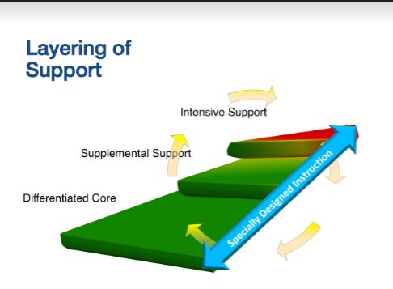
ALL Students are
General Education Students
Notes:
Resource SDI within an MTSS
Page 2 (Focus on the How)
Teachers often use a variety of instructional approaches in order to meet the needs of all learners. However SDI takes this a step farther and requires the instruction be provided to the student as speci­fied in his/her Individualized Education Program (IEP). Differentiated instruction, personalized learning, explicit instruction and other “high yield” instructional strategies are available to all students, whether or not they are eligible for special education services, and should be used by all teachers in order to scaffold instruction and meet the needs of the different learners in their classrooms, across all ability levels.
Specially designed instruction goes beyond differentiated instruction to address the unique needs that exist because of a student’s disability and should be implemented in addition to, not in place of, differentiated instruction.

Slide 8

Specially Designed Instruction within an MTSS begins with the knowledge that:
Students with disabilities are always general education students
Special education is a service and not a place
All students have access to the full system of support
An effective integrated system results in accelerated learning of academics and functional skills for students who are behind
Specially designed instruction is inseparably linked to school improvement

Slide 9

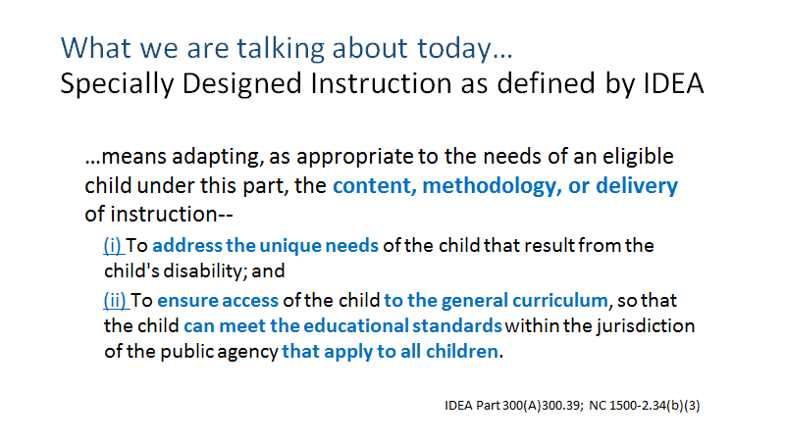
Notes:
Teachers often use a variety of instructional approaches in order to meet the needs of all learners. However SDI takes this a step farther and requires the instruction be provided to the student as speci­fied in his/her Individualized Education Program (IEP). Differentiated instruction, personalized learning, explicit instruction and other “high yield” instructional strategies are available to all students, whether or not they are eligible for special education services, and should be used by all teachers in order to scaffold instruction and meet the needs of the different learners in their classrooms, across all ability levels.
Specially designed instruction goes beyond differentiated instruction to address the unique needs that exist because of a student’s disability and should be implemented in addition to, not in place of, differentiated instruction.
Providing a student access to the general education curriculum goes beyond exposure to grade level content standards. It is the responsibility of the instructor to ensure that each student has the supports needed to make the content “accessible” to him/her. Creating equitable access for students with disabilities involves ensuring active meaningful participation for each student. Students with disabilities work toward the same standards as their grade level peers. They do this through:
Adequate instructional supports across the school day
Appropriate accommodations and modifications

Slide 10
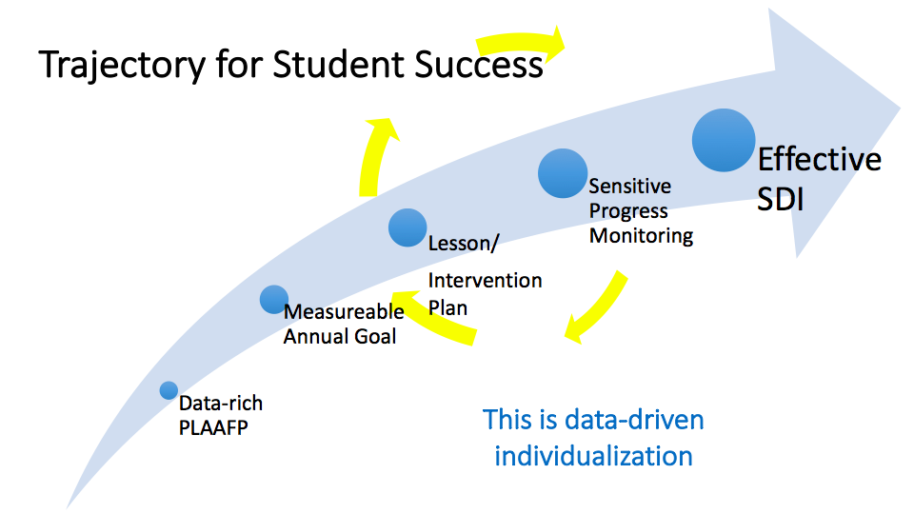
Notes:
Similar to how the foundation for a full and individual evaluation is a thorough review of existing data, the foundation of a quality IEP is a collection and synthesis of all the data. This foundation will sufficiently establish the Present Levels of Academic and Functional Performance (PLAAFP) from which the IEP goals are derived. The IEP describes the student’s present levels of academic and functional performance, the goals and objectives based on standards that apply to all children and the specially designed instruction that the student requires to progress close achievement gaps. The specially designed instruction is what will be implemented in addition to the full system of support that all students have access to.
While the specially designed instruction is not explicitly described in the IEP; it is the education team that designs and delivers the specially designed instruction based on the goals identified in the IEP and the specialists’ knowledge of the unique needs of the student that results from the disability. Frequent progress monitoring of both IEP goals and progress on grade level standards is critical to ensure that adjustments to instruction can be made immediately. A critical feature of Specially Designed Instruction is academic time on task. Academic time on task is the amount of time students are successfully engaged in learning on academic tasks at the appropriate level of difficulty with a high level of success. While this is a critical element for ALL students, for students who have been the most resistant to instruction and intervention, their should be a sense of urgency and relentless in the delivery of SDI

Slide 11
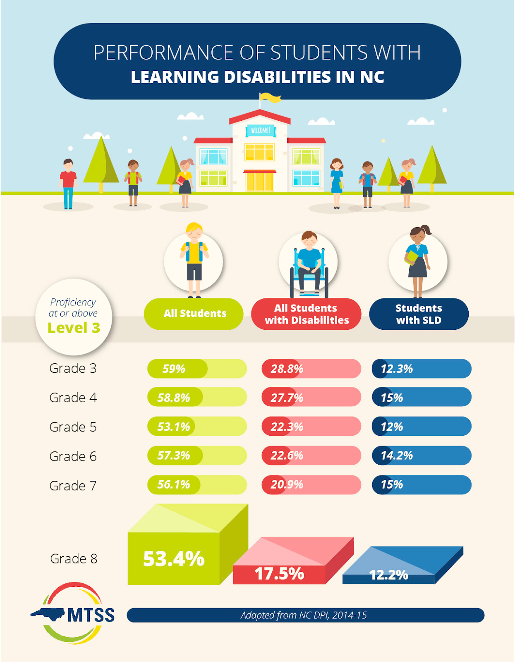
Why?
NC SLD Facts
Notes:
how are your students performing? Do you know?

Slide 12


  We have until July 2020 before we have to start implementing an instructional model for SLD eligibility.
    TRUE
    FALSE
Notes:
The policy became effective February 5, 2016. Full implementation by July 1, 2020.
We DO need to be installing the infrastructure to support the policy through the MTSS School improvement framework and
by assessing our current practices.

Slide 13
Within the SLD Policy Addendum that will be fully implemented by July 1, 2020, which of the following is required as an essential component when using an instructional model of evaluation?
1. Multiple tiers of instruction matched to student need
2. A system of high quality core instruction and scientifically research-based intervention
3. A comprehensive balanced assessment system
4. A systematic problem solving process and data-based decision making
5. All of the above

Slide 14

Where are we currently?
“You can have a multi-tiered system of support in place without an RtI-based SLD identification system...”
BUT….
...You cannot have an RtI-based identification system for SLD without a multi-tiered system of support in place.
Shapiro, 2015

Slide 15

TAKE AWAY
ALL LEAs, including charters, should be installing the systems and structures for full implementation NOW.
Notes:
LEAs should be actively building readiness for full implementation by ensuring the systems and practices are in place to fully implement by July 1, 2020.
EC representation MUST be included on the district and school level MTSS implementation teams

Slide 16

EVALUATION - NOT JUST ABOUT ELIGIBILITY
“The full intent of special education is to devise a program of instruction that will accelerate the student’s progress beyond that which was realized during the provision of multi-tier supports.”
The RTI Approach to Evaluating Learning Disabilities
Kovaleski, VanDerHeyden & Shapiro
Notes:
For students who are not eligible, we stlll must have a system in place that is going to support their progress and enable them to meet GL standards

Slide 17

Turn and Talk
Does your school culture reflect this?
Is data used to identify the difference or “gap” between expected and current student outcomes for all students, including students with disabilities?
How does your school respond to identified gaps to ensure students with disabilities make accelerated progress?

Slide 18

TAKE AWAY
We begin by making sure EVERY student is receiving and benefiting from appropriate instruction.
Notes:
Loeser 23-30
11:30

Slide 19
SLD ELIGIBILITY CRITERIA
NC SLD Policy Addendum - July 1, 2020
Convergence of Data from Multiple Sources
START HERE
CRITERION 1
CRITERION 2
CRITERION 3
CRITERION 4
Rule out as determinant factors:
Lack of appropriate instruction in reading and/or math delivered by qualified personnel
Limited English proficiency
Rule out as primary factors:
Vision, hearing, motor disability
Intellectual disability
Emotional disturbance
Cultural factors
Environmental or economic influences
Loss of instructional time
Inadequate achievement:
Does not meet age or grade level standards
When provided learning experiences and instruction appropriate for the child’s age or grade
Insufficient progress:
Demonstrates a lack of response to instruction/ intervention OR
Responds at a rate insufficient to reduce risk over time
CRITERION 5
Adverse effect and requires special education
Notes:
Policy at a glance
Lack of appropriate instruction
This requirement, which applies to all evaluations including those that do not use RTI directs evaluation teams to document that the referred student has been provided with instruction and interventions that are sufficient to allow for adequate progress. If the team cannot document that student’s difficulties are not a result of a lack of instruction, the student may not be identified as eligible for special education. For example, for a student demonstrating reading difficulties, there should be evidence that he or she was provided with instruction that adequately addresses the “big ideas in reading” (i.e., phonemic awareness, alphabetic principle, fluency, vocabulary, and comprehension).
Similarly, the evaluation team must document that repeated assessments, such as universal screening and progress monitoring, were conducted on a regular basis with the referred student, and that the results of these assessments were shared meaningfully with parents.
This requirement includes a number of important features of the infrastructure associated with MTSS.
Exclusionary factors
Loss of instructional time- ensure that disciplinary removals, poor attendance, tardies or high mobility rates are not the primary reason for the inadequate achievement
Inadequate achievement
NOTE: when provided learning experiences and instruction appropriate for the child’s age or grade- includes the interventions- does the gap continue?
To document the student’s discrepancy or gap between current and grade or age level standards, the evaluation team gathers data from statewide testing, universal screening, progress monitoring, and assessments that drill down into student skills.
All of these assessments should have been completed during the course of instruction and intervention,
If the evaluation team believes that this information is sufficient to address this criterion, no further assessments would be needed. If not, the team can conduct further academic assessments.
What evidence indicated a significant achievement gap even after the implementation of targeted and/or intensive intervention?
Preponderance of data across data sources should indicate inadequate achievement in one of the 8 areas of LD
THIS GAP DOES NOT CONSIDER THE STUDENT’S intellectual development
Insufficient progress
The assessment of the student’s progress in response to intervention is the heart of the RTI process. During the comprehensive evaluation, the evaluation team analyzes all the progress monitoring data, including the trajectory of the student's progress as compared to that of typical students.
The team might address questions such as: What evidence showed that the achievement gap between the student and grade-level peers was closing? In order to benefit from the general education program, did the student need ongoing supports and services that could not be maintained through general education alone?
Whereas each of these criterion must be established, these criterion do not operate in isolation and are all integrally linked. Diagnostic processes and measures may be used to support establishment of any of these criteria.

Slide 20

“The key to identification is being able to identify kids who are not making progress in a well-functioning educational system.”
Dr. Jack Fletcher
Notes:
In an RtI-based approach to a comprehensive evaluation, a multi-tiered system of support is critical. North Carolina has intentionally paired an RtI-based approach to evaluation and identification of students with SLD with a multi-tiered system of support (MTSS).
Essential Components
INSTRUCTIONAL SYSTEM:
A system of high quality core instruction and scientific research-based intervention
Multiple tiers of instruction that vary in intensity, matched to student need
ASSESSMENT SYSTEM
A systematic process of problem solving/ data based decision making
A comprehensive, balanced assessment system

Slide 21

CONSIDER AND DISCUSS
How would your school describe an effective intervention system?
How effective is your system of intervention in reducing risk for students?
Is the intervention system effective in identifying students where there is a suspicion of a disability?

Slide 22
RESOURCES
MTSS livebinder bit.ly/livebinderSLD
  Information and resources
SLD webpage bit.ly/SLDpolicy
  White paper
  Fact Sheets
  Webinars

