Slide 1
Aligning School Culture and School Mission
David Ennis, Director of Operations
dennis@raleighcharterhs.org
Lisa Huddleston, Principal
lhuddleston@raleighcharterhs.org

Slide 2

What is school culture?
Framework that makes everything else work …
Assumptions
Beliefs
Expectations
Norms
Rituals
Source: http://hugohd.com/editor/?

Slide 3

How do we use our mission?
Lens through which we view everything …
Defining our mission and sticking to it is the heart of creating positive culture.
Students can learn and will learn because of what we do together.
Source: http://eagleblufflighthouse.doorcountyhistoricalsociety.org/fresnel-lens-light-across-the-water/

Slide 4
How do you (or how will you) use your school mission to focus your school culture?

Slide 5
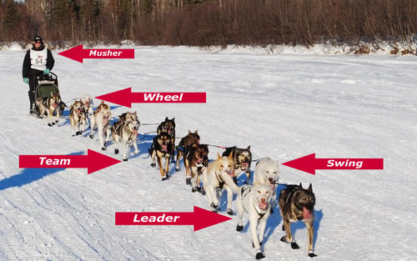
How do we ensure that all stakeholders are moving in the right direction?
Lead dogs set pace and direction, but actual hard work of pulling the sled falls to dogs farther back in the team …
Teachers
Support staff
Students
Parents
Board
Alumni
Community members
Source: https://www.sleddoginfo.com/resources/

Slide 6
How do we share our mission and plans with all stakeholders?
Communicate very deliberately about why we do what we do …
Focus on growth for everyone in the community
Have a plan for communicating with each unique group

Slide 7
What are some effective techniques that you use (or will use) to share your mission and plans with your school community?

Slide 8
What do we do when things don’t go according to plan?
Conflict is inevitable …
Assume positive intent
Separate facts from stories
Patiently align it all with our mission
Focus on progress and growth
Be kind in standing firm when necessary

Slide 9
Questions?

