Slide 1

Read to Achieve:
Understanding the Legislation
North Carolina Department of Public Instruction
K-3 Literacy Division
Notes:
Good Morning! Thank you for joining me this morning. I am Rebecca Belcastro the K-3 Literacy Consultant for the Piedmont Triad Region and I currently support Charter Schools. Today we are going to explore Read to Achieve as part of the Excellent Public Schools Act. Charters have the choice to participate in many of the components while some are required. I will share with you the legislation and options for charter schools. I am new in this roll and still maneuvering the Read to Achieve Charter law. There may be some questions I do not have answers too, but I will be sure to record those questions and follow up with you at a later time. You are all muted, please type an of your questions in the questions tab. I will stop at the end to answer questions

Slide 2
720
Notes:
720 – For a student entering Kindergarten in North Carolina, that is a pretty important number. This number represents the days of literacy instruction that a kindergarten student has until the end of third grade. When you think about all of that time in number of days, it doesn’t seem like much. Factor in teacher absences, student sickness, early dismissals, etc. and precious instructional time is lost. So remember, 720. How can we make the most of those 720 days for our youngest learners in North Carolina?

Slide 3

Read to Achieve
Notes:
This is a class of Read to Achieve kids. These children are a heterogeneous mix of students that are working on literacy skills. They are reading and comprehending at all levels. Many times, we hear that a teacher has 8 Read to Achieve kids or Susie is a Read to Achieve kid. In reality, don’t we want ALL students to Read to Achieve? We want all students reading, writing, and comprehending complex texts so they can be career and college ready by the end of 12th grade. All students should be called Read to Achieve kids.

Slide 4
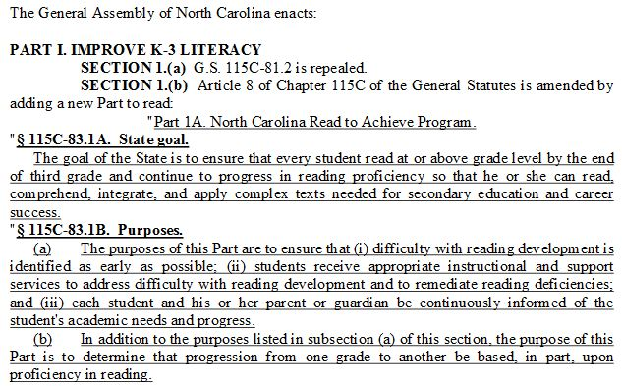
Notes:
The state goal is to ensure that every student read at or above grade level by the end of third grade and continue to progress in reading proficiency so that he or she can read, comprehend, integrate, and apply complex texts needed for secondary education and career success. As you can see, the goal of the state encompasses all grade levels, K-12.
Let’s look at the purpose of Read to Achieve. The General Assembly created this law, so that students with difficulty in reading development are identified as early as possible and these students receive appropriate instruction and support services to address their weaknesses. Parents play a huge part in student achievement and part of the legislation is that parents are continuously informed of their child’s needs and progress.

Slide 5
The 7 Components
Comprehensive Reading Plan
Kindergarten Entry Assessment
Facilitating Early Grade Reading Proficiency
Elimination of Social Promotion
Successful Reading Development for Retained Students
Notification Requirements to Parents and Guardians
Accountability Measures
Notes:
There are 7 components in the Read to Achieve legislation that was passed by the General Assembly in 2012. The K-3 Literacy Division is responsible for the implementation of 6 of the 7 components. Those 6 components, which we will go over in detail this afternoon, were implemented beginning with the 2013-14 school year. There was much work to be done quickly for the children of North Carolina.
The one component that the K-3 Literacy Division is not responsible for is the Kindergarten Entry Assessment. This component has been developed by the Office of Early Learning.

Slide 6

North Carolina
Comprehensive Reading Plan
NC Comprehensive Reading Plan
Notes:
The first component, The North Carolina Comprehensive Reading Plan, is a blueprint that articulates the state’s literacy goals for grades K-12 and was approved by the NC State Board of Education in 2013. The reading plan was developed based on a comprehensive needs assessment from all tiers of stakeholders including superintendents, central office administrators, teachers, parents, representatives of institutes of higher education, and community members in all of the state board regions. Stakeholders were asked to address this essential question, “From your perspective, what could NCDPI do to improve reading proficiency across the state in standards, leadership, professional development, assessment, instruction, and partnerships and communication?” This information was gathered, prioritized, categorized, drafted and shared with stakeholders for input. Adjustments and corrections were made based on feedback and sent back once again for additional input and clarifications to the plan. The plan shares actions that the NCDPI has implemented and continues to work towards to promote reading proficiency across the state. As a result of the newly aligned literacy vision between all stakeholders, suggested actions were developed for each of the six key component areas for the LEA, school administrator, and the classroom teachers.
The reading plan has various appendices that focus on best practice in literacy instruction and student-centered, literacy-learning environments during whole group lessons, small group instruction, differentiated literacy stations, and other areas of literacy instruction. Appendices include questions for principals to ask teachers about literacy instruction as well as suggestions for a framework for the 90 minute block.

Slide 7
Reading Plan Strategies
Comprehension
Vocabulary
Fluency and Accuracy
Phonics
Phonemic Awareness
Notes:
As part of the Read to Achieve legislation, a list of research-based strategies has been developed to provide teachers a resource for instruction. The legislation requires the citing of research for each strategy. These strategies include, but are not limited to, the work of Marzano, the National Institute of Child Health and Human Development, Rasinski, Fisher, Frey, and Clay. The list includes strategies for each of the Basic Early Literacy Skills (phonological/phonemic awareness, alphabetic principle/phonics, fluency, vocabulary, and comprehension) as identified by the National Reading Panel in 2000. Additionally a list of strategies has also been developed for middle and high school teachers that include integration of reading comprehension in the content areas, as well as strategies for teaching vocabulary and fluency. These strategies continue to be shared with administrators and teachers through face-to-face professional development, webinars, data analysis sessions, the Read to Achieve LiveBinder and the NCDPI K-3 Literacy Division’s website. The strategies are a valuable resource when reflecting on progress monitoring and benchmarking data during professional learning communities facilitated by NCDPI literacy consultants, as well as when reviewing data to determine student strengths, weaknesses, and for planning next steps in instruction.
The Comprehensive Reading Plan, appendices, and the research-based Literacy strategies encompass all grade levels from kindergarten through high school, supporting all teachers of language arts and all students in the state, no matter the advantages or disadvantages students may have.

Slide 8
Read to Achieve:
Kindergarten Entry Assessment (KEA)
Office of Early Learning

Slide 9
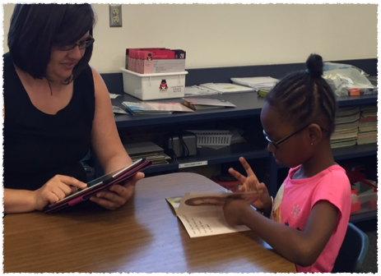
Facilitating Early Grade
Reading Proficiency
Notes:
This component of the legislation provides teachers with a formative, diagnostic reading assessment to monitor reading development and inform instruction. The assessment provides information about a student’s strengths and weaknesses in their reading development. The current assessment system, mCLASS:Reading 3D provides instructional strategies and activities to help meet the needs of students.

Slide 10
Reading 3D Update
Default Benchmark Window Dates
  September 4 – 24 *October 8
  January 3 – 25
  May 6 – 24
Determining the Benchmark Dates
  BOY: between days 1-25 of the school year
  MOY: between days 80-105 of the school year
  EOY: between days 150-180 of the school year
Notes:
These are the default dates for the 2018-2019 school year. The default dates are set so that there is a baseline at the beginning of the year and effective instruction may take place prior to each subsequent benchmark window. Due to technical issues and the weather this year’s BOY has been extended until October 8th. Some of you will need an extension passed this date. If you have not already emailed me about this, you can email me with the end date you need for your window and the reason for additional extension.
At other times of the year, there may need to be a change in dates due to weather or other circumstances with your district calendar. The process for requesting a benchmark window change is to email your me your request. Please include in the request the day you would like the window to open and the day you would like the assessment window to close. Extensions are handled the same way. Include the date that you would like your assessment window to close. We will respond with an email to let you know if this change has been accepted. We know that weather related issues will cause lots of requests for extensions.

Slide 11
Reading 3D Updates
Early Literacy Diagnostic
  Atlas Book Sets
    New TRC Benchmark Books
    3 books per level till upper levels, A – Z
    Allocated 1:20 per ADM
    Secure Assessment Materials
Notes:
This year, we are using a different book set for Text, Reading, and Comprehension or the TRC portion of the assessment. The new book set supports the complexity of texts and cross-curricular texts that students will need to be able to read and comprehend in Grades K-5. It offers a balance of literary and informational texts, the use of academic vocabulary through informational text and the integration of language process and disciplinary content through a wide range of genres.
The book set is considered secure testing material and should be kept in a secure location within the school or teacher’s classroom.

Slide 12
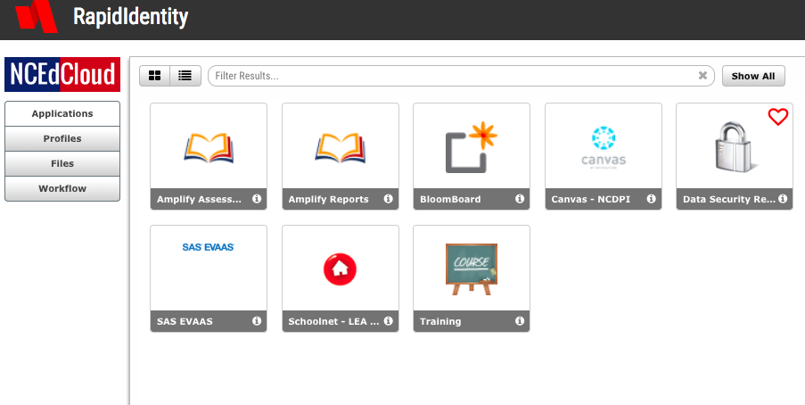
DO NOT USE www.mclasshome.com
Notes:
To access mCLASS:Reading 3D, enter through NC EdCloud using your UID number. Click on the Amplify Assessment tab to select students to assess. Click Amplify Reports to see all student results, access literacy supports, and the Home Connect letter. Never use www.mclasshome.com. Many schools had old created shortcuts to mclasshome.com, please make sure these have been deleted.

Slide 13
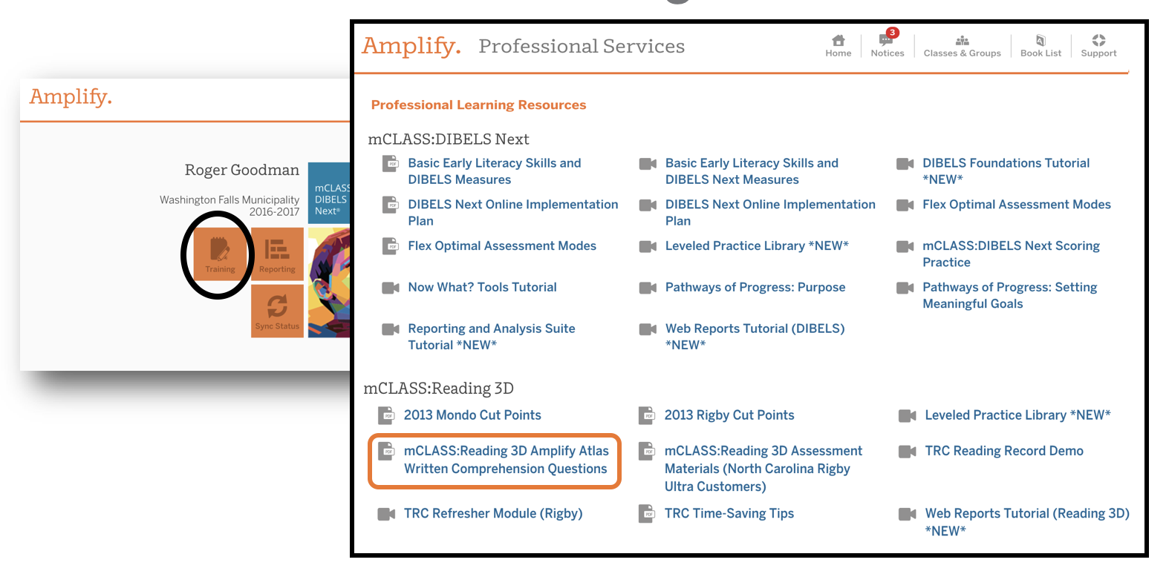
mClass:Reading 3D
Online Resources
Notes:
You can find more information, research, and trainings about DIBELS and Atlas as well as the Written Comprehension questions in the Support button or the Training Tab. This is located in the mClass Reporting page in NC EdCloud. Remember to access these resources using Single Sign On at NC EdCloud.

Slide 14
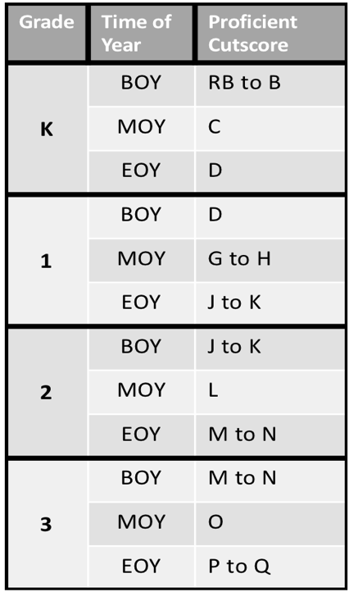
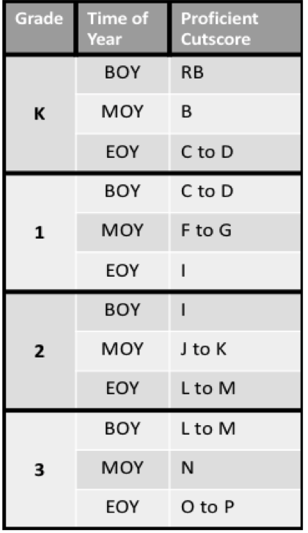
Cutpoints
Rigby Ultra
Atlas
Notes:
As you can see, the cutpoints for some grade levels have changed.
Considerations of text complexity are especially important for book sets used for screening assessment, such as the Atlas book set. Screening tools must be technically sound, meaning they produce reliable and valid results, and must provide data that are useful for instructional decision-making (Glover & Albers, 2007).
A key feature of any leveled book set is the complexity of the included books. Books must be of appropriate, increasing complexity to obtain accurate information about a student’s current instructional reading level. The Common Core State Standards for ELA called attention to a multidimensional approach for evaluating text complexity: qualitative features, quantitative features, and the interaction of reader and task. While the CCSS for ELA discusses these approaches to evaluating the appropriateness of texts, Amplify used this three-part model to guide the development of the Atlas book set.

Slide 15
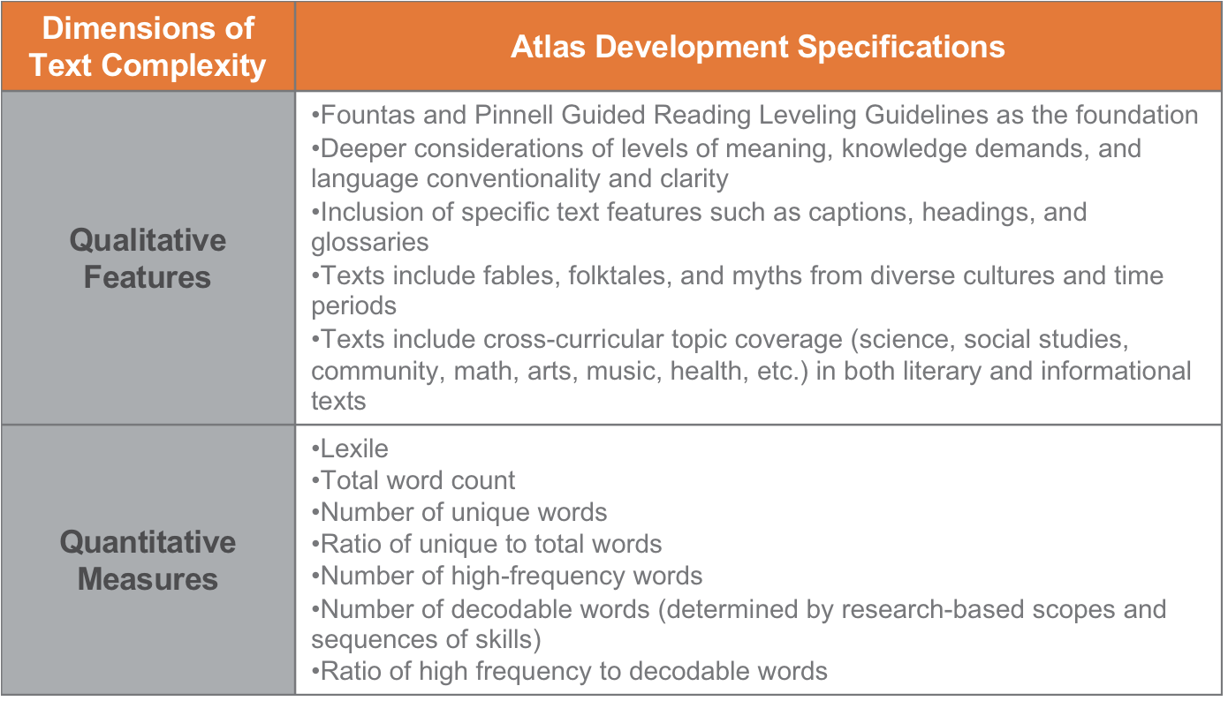
Notes:
The dimensions of text complexity for the Atlas Book Set have many Qualitative Features and Quantitative Measures. The White Paper that includes the specifics of the Atlas Book Set Development can be found on the Amplify website.

Slide 16
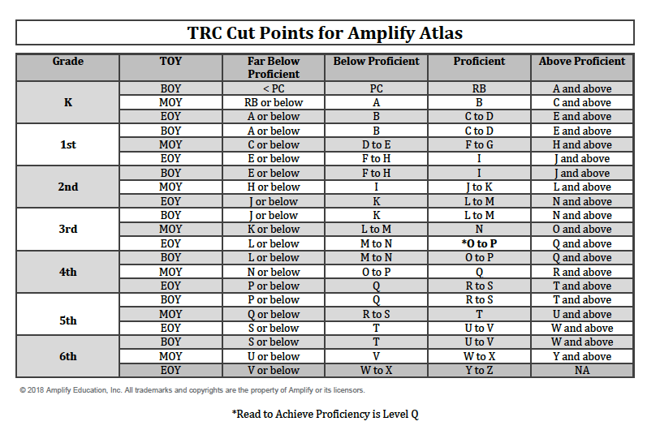
Notes:
Here are the Text and Performance Levels for Amplify Atlas by Grade and Time of Year. Notice the asterisk at EOY of Grade 3. In North Carolina, to meet the rigor of the EOG there is a requirement of a Lexile level of 725. In order to meet these requirements students in North Carolina must read a Level Q or above to meet these requirements.

Slide 17
Written Comprehension
Optional
Prompts are online in the Training and Support tab
District may decide to utilize for instruction
Does not count in reading level
Scored same as in the past (see Reading 3D FAQs)
Notes:
Written Comprehension becomes optional this year. Charters may choose to administer the written comprehension tasks to determine next steps for instruction. Prompts for each of the books are located on the training and support tab online under mClass:Reading 3D reports page on NC EdCloud. If a charter decides to use the written comprehension tasks and the teacher inputs the score into the program, it does not factor into the student’s reported reading level. Written comprehension is scored the same as in the past by taking the lower of the two scores. As before, written comprehension is used to determine next steps for instruction.

Slide 18
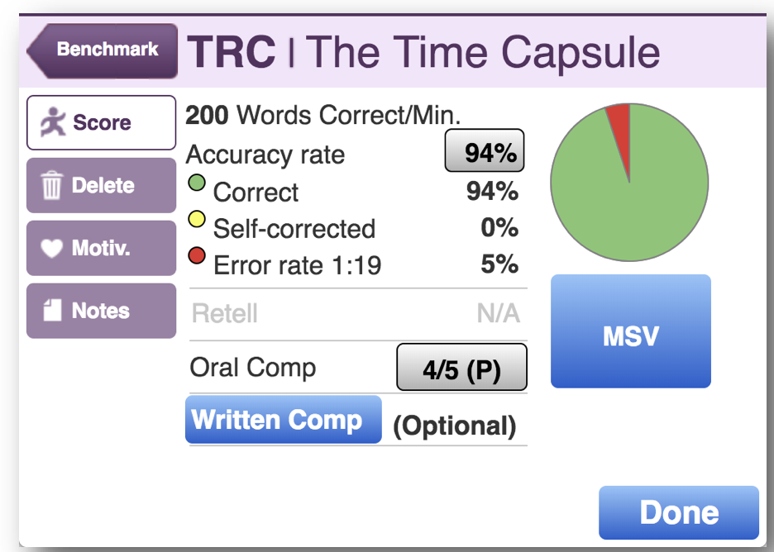
TRC Assessment Screen
Notes:
This is the Atlas TRC Assessment Screen. It shows the Written Comprehension as optional. As you can see, the screen is the same with the exception of the written comprehension score. MSV is still available as this is an important part of providing information for instruction when completed.

Slide 19
Observational Assessment for TRC
Student sits beside teacher, while the teacher listens to the student read aloud and record reading behaviors and errors.
Student completes reading the rest of the book alone, then returns to the teacher to respond to 5 oral comprehension questions
Student may use the text to respond to the 5 oral comprehension questions
Notes:
Let’s look at the definition of observational assessment for TRC.
The Student sits beside the teacher, while the teacher listens to the student read aloud and record reading behaviors and errors.
The Student reads the rest of the book silently and then returns to the teacher to respond to 5 oral comprehension questions.
The Student may use the text to respond to the oral comprehension questions.

Slide 20
Flex TRC Online Assessment
Student sits at the computer and reads silently with headphones
Student answers 8 comprehension questions
Student may use the text to answer comprehension questions
Teacher selects level to start, no choice over which book the student reads
Notes:
The definition of Flex TRC Online Assessment is when
The Student sits at the computer and reads silently with headphones.
The Student then answers 8 comprehension questions. The student will read the questions silently and respond to the multiple choice questions.
The Student may use the text to answer oral comprehension questions.
The teacher will use the online management system to select online assessment and the level of book the student needs to begin reading. The computer will select the text for the student at the level set by the teacher. If the teacher does not set a starting TRC level for the student it will default to that time of year’s text level
Also, consider the student. If a student is a struggling reader it is recommended the assessment be done observationally.

Slide 21
Flex DIBELS Online Assessment
Students are at computer to complete DIBELS using headphones
Available beginning at 2nd grade MOY
Notes:
Flex DIBELS Online Assessment provides students the opportunity to complete the DIBELS assessments online beginning at 2nd grade MOY. The student uses headphones to complete the assessment. Again, the teacher would go into the online management system to select the online assessment for the desired students.

Slide 22
Online Assessment Considerations
How will your Charter determine who should be assessed online versus observational?
What does the student history tell you about their grasp of foundational reading skills and comprehension?
Does the student have proficient computer skills?
Will all students have access to headphones?
Notes:
Some things to consider when thinking about online assessments:
Will your Charter have a school-wide policy or district guidance with teacher choice or will teachers make the decision based on their instruction and observational progress monitoring? Can the student focus attention on the computer screen during assessment period?
Best practice suggests students who do not demonstrate embedded foundational reading skills in and outside of text for DIBELS and/or TRC should be assessed observationally. Additional guidance can be found in the implementation documents on the Amplify website and on the Read to Achieve LiveBinder.
If a student does have proficient skills, it is strongly suggested an adult monitor the student or group of students taking the assessment to troubleshoot any technical or user errors. However the teacher cannot provide support with the assessment.
Another consideration is to make sure that all students will have access to headphones?

Slide 23
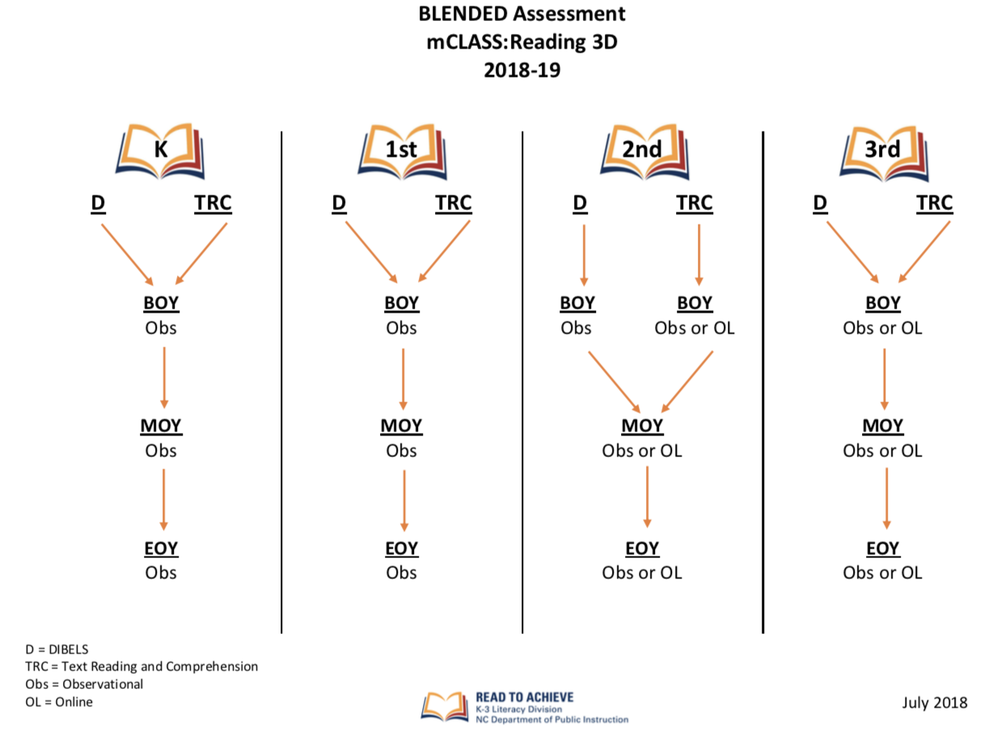
Notes:
This chart shows the assessment options now available for mClass:Reading 3D. We will take a look at each grade level in detail in the following slides.

Slide 24
Kindergarten and First Grade
Observational administration
  BOY, MOY, EOY
DIBELS and TRC is not offered as an online administration for grades K and 1 due to assessment tasks and observation of early reading behaviors
An alternate assessor is required for EOY administration
This remains unchanged for K and 1st teachers
Notes:
Grade level administration requirements are as follows. Kindergarten and First Grade require observational administration of the assessment at each benchmark window. DIBELS and TRC are not offered online by Amplify due to assessment tasks and observation of early reading behaviors. Word recognition is still completed using the iPad and does not require any other materials. An alternate assessor is required for EOY administration only.

Slide 25
Second Grade
BOY
  DIBELS – Observational
  TRC – Observational OR Online
MOY
  DIBELS – Observational OR Online
  TRC – Observational OR Online
EOY
  DIBELS – Observational OR Online
  TRC – Observational OR Online
An alternate assessor is required for EOY observational administration
Notes:
In second grade, at the BOY assessment period, DIBELS is offered as an observational assessment only. TRC can be administered observationally or online at BOY. At MOY and EOY, students may be assessed online or observationally. Best practice for students that are deficient in foundational skills at benchmark periods would be to administer the assessment observationally so that the teacher can listen to the student read and record reading behaviors and errors. Please follow district guidelines as to whether a student is benchmarked observationally or online. An alternate assessor is required for EOY observational administration only.

Slide 26
Third Grade
BOY, MOY, EOY
  DIBELS – Observational OR Online
  TRC – Observational OR Online
If using the observational administration at MOY or EOY, an alternate assessor must be used
Notes:
Students in Grade 3, may be assessed observationally or online at all three benchmark periods for both DIBELS and TRC. Students at MOY and EOY should be assessed by an alternate assessor if using the observational administration option as a pathway for proficiency.

Slide 27
EVAAS
TRC will be used to measure growth for teachers in K-2
Written comprehension (if mandated by the district) is no longer considered in the student’s reading and comprehension level
2nd grade only
  If BOY is completed online, then EOY shall be completed online as well
  Same applies to observational as well for BOY and EOY
Notes:
TRC will continue to be used to measure growth for teachers in grades K-2. The rigor of the texts as well as the oral comprehension questions will continue to provide guidance for the teacher’s instructional practice in the classroom.
If a district requires that teachers complete the written comprehension part of the TRC assessment, the written score is no longer considered in the student’s reading and comprehension level, so it will not be a part of the teacher’s growth score. As in the past, the written comprehension prompts should be used to guide instruction for the teacher, based on the student’s level of comprehension.
TRC can be administered online beginning at BOY 2nd grade. An important thing to remember is that if a 2nd grade student is assessed at BOY online, the student shall be assessed online at the EOY benchmark window. If the teacher administers the TRC assessment observationally at BOY, then it must be completed observationally for EOY using an alternate assessor. The observational assessment is measuring accurate and fluent reading, comprehension, vocabulary, and language skills. The online assessment is measuring silent reading fluency and the comprehension threshold set in the online system.
DIBELS is NOT a part of the teacher’s EVAAS growth score.

Slide 28
Rigby Ultra Benchmark Kits
Use for monitoring student progress (Add Book)
Put together for small group reading instruction book sets (be aware of different leveling system with Atlas)
Placed in classroom libraries for independent reading
Used in literacy stations
Notes:
You can use the Rigby Ultra books for progress monitoring although you will need to use the Add Book feature. There are also many other options for using the old benchmark book sets. You can use them for small group reading instruction or they can be used in classroom libraries. Please remember that Amplify uses a different leveling system from Rigby Ultra. Take this into consideration when using the books to guide instruction.

Slide 29
iPads
Used for K – 3 teachers to administer assessments
Uses for older iPads
  Literacy stations
  1:1 initiatives
  Research tools
Notes:
Charters that use Reading 3D were delivered iPads to use for Reading 3D assessments. The allotments were based on a ratio of 1 to 20 students. This ratio was based on the year end Average Daily Membership of the 2017-18 school year. If you have been using Reading 3D in previous school years, there are many uses for the older iPads that you have. These can be used for literacy stations or as research tools for students.

Slide 30

Lizzie
Notes:
Let’s meet Lizzie. She is a third grade student in a charter school in North Carolina. Lizzie has had appropriate literacy instruction that includes the Basic Early Literacy Skills: Phonemic Awareness, Phonics, Fluency and Accuracy, Vocabulary, and Comprehension. Lizzie is working below grade level standards. Her small group instruction and intensive intervention time include instruction in phonics, fluency and accuracy as well as comprehension. At the end of the year, Lizzie did not show proficiency. What happens next for Lizzie?

Slide 31
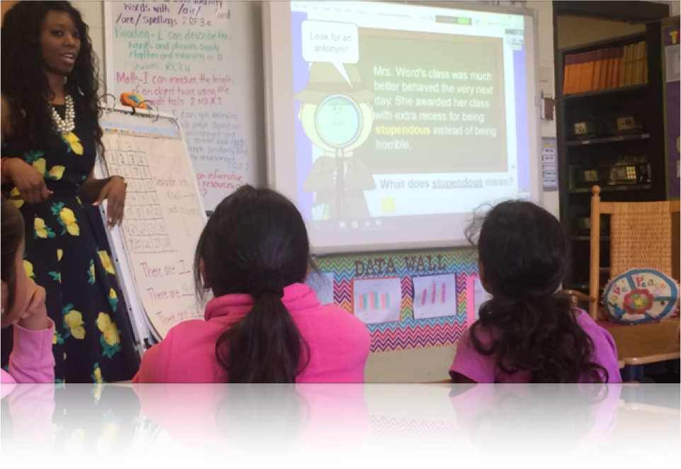
Student Reading Portfolio
Alternative Assessment
Multiple Retention/Interventions
Children with Disabilities
Good Cause Exemptions
English Learners
Notes:
In the Read to Achieve legislation, students may be exempt from mandatory retention in third grade if they qualify for a good cause exemption. Students that qualify for a good cause exemption are still eligible to participate in reading camps and should receive instructional supports, services, and reading interventions appropriate for their age and reading level.
Let’s talk about each Good Cause Exemption.
Students with less than two school years of instruction in an ELL program qualify for the Limited English Proficient good cause. Services for these students would include EL services and intensive support. Visuals are helpful for English Learners and should be included in all parts of the literacy block. For the 18/19 school year, EL students identified on or after July 1, 2017 for ESL instruction qualify for a Good Cause Exemption.
Students that with disabilities whose Individual Education Plan indicates the use of the NCEXTEND 1 or have at least a two school year delay in education performance or receive intensive reading interventions for at least two school years. Further information about this good cause exemption is available on the Read to Achieve LiveBinder or you can speak with your district’s Exceptional Children’s director. It is important to remember that a child DOES NOT qualify for a Good Cause Exemption just because they are identified as an EC student. Another important point is that a child must have the IEP in place before the end of third grade with one of the qualifiers (two years of intensive reading interventions or a two year delay in educational performance) to even be considered for a Good Cause Exemption.
Alternative assessments is another good cause exemption. It gives the LEAs the flexibility to give their local alternatives at each benchmark period and before the 10 day period at the end of the year. If the student has not passed an alternative assessment before the EOGs and they do not pass the EOG, then the DPI RtA Alternative test can be given after the administration of the EOG in the last 10 days because of the standardized method of administering this test. EOG retests can also be given during this 10 day window. Alternative assessments must be approved by the State Board of Education. Examples of alternative assessments are mClass:Reading 3D Level P, provided by the state, CASE 21, MAP, and other assessments that are approved for use. The list of the approved assessments can be found on the RtA LiveBinder.
Students may also qualify for a good cause exemption by completing a reading portfolio. The State Board of Education provides a student reading portfolio where students must pass each standard by reading passages and answering 5 comprehension questions related to the standard. Use of the portfolio is optional for districts. We will talk more about this good cause exemption a little later.
Students that have received reading intervention and have previously been retained more than once in kindergarten, first, second, or third grades may receive a good cause exemption.
Remember, even if a student has a good cause exemption, rigorous instruction and interventions should be in place for these students. This part of the Read to Achieve legislation ensures that all students are served and are continuously working toward proficiency. Even though Lizzie does not qualify for a good cause exemption, there are many ways that Lizzie can show proficiency of third grade standards.

Slide 32
Ways to Show Proficiency
BOG (Beginning of Grade test)
EOG (End of Grade test)
EOG retest
RtA Alternative Test
Reading 3D at Level Q (with oral comprehension task)
Alternative Assessment- Reported to SBE
Completed Portfolio
Notes:
In the third grade, Lizzie has the opportunity to show proficiency in many ways. If she makes a Level 3, 4, or 5 on the Beginning of Grade test given in early September, the EOG at the end of the year, the EOG retest, or the Read to Achieve Alternative test, then Lizzie has shown proficiency and moves on to a regular 4th grade classroom. It is a district decision along with parent input as to whether a student retakes the EOG retest and Read to Achieve Alternative test but students should be given the opportunity. One or both of those assessments can be given within the last 10 days of schools. Consider the best interests of the student when making decisions around end of year testing.
The NCDPI also provides all districts with mClass:Reading 3D, which includes an alternative assessment. A student that reaches a Level P and is able to show their thinking by answering correctly 5 oral comprehension questions and 2 written comprehension questions are considered proficient in meeting third grade proficiency.
Many districts use various alternative assessments that must be approved by the State Board of Education. Many of these assessments are purchased by the district and must go through a linking study before being approved. This list is updated after each linking study is completed and is shared by email with each LEAs testing coordinator and Read to Achieve central office contacts.
Lizzie can also show proficiency through a reading portfolio. Let’s talk a little more about the portfolio.

Slide 33
Portfolios
Developed throughout the year
Scoring the passages
Completed in school during instructional time
Securing testing materials
Notes:
The portfolio passages are COMPLETED throughout the year. After Lizzie’s teacher has provided instruction on the standard, she can select passages for Lizzie that will best meet her needs and interests. Instructional passages are included in the Portfolio Box. There are five instructional passages for each of the 12 standards assessed. These instructional passages may be used for all students, even those that are not working on a reading portfolio for proficiency. Instructional passages are clearly marked. They may not be used by a student to show proficiency. If your district or school decides not to use the portfolio for children to show proficiency, teachers may not use the regular passages for instruction. They may only use passages marked as instructional. Sometimes students move to another district and the district may be using the passages for students to show proficiency. The passages can be administered during regular classroom instruction. A teacher may give the passages to her reading group or she may give it to students as a literacy station activity. The passages are not meant to be given as a test, in a testing situation, nor should instruction stop. We recommend that only two passages be given per week and this is only after instruction has taken place.
In order for a student to show proficiency using the portfolio passages, a student must demonstrate mastery of each standard. To do this, the student is required to complete a minimum of three passages per standard with a combined score of 70% mastery. So if Lizzie reads and answers questions on 3 portfolio passages from the same standard and she scores 11 out of 15, Lizzie has demonstrated mastery of that particular standard. Since there are 21 passages for each standard, Lizzie has multiple opportunities to show proficiency within a standard.
There are some passages that can show mastery of two standards. So if Lizzie reads one of these particular passages and passes it by making 70% or higher, she has completed one of the passages required for proficiency in two of the standards.
All portfolio passages are secure testing materials. They should not be used outside of the classroom setting or sent home for parents to sign or view. Parents may ONLY view the passages during a parent conference. The passages should be kept in a secure location out of reach of students and school personnel that should not have access to them. Some districts require that a testing code of ethics is signed to ensure that teachers understand the securing of these passages.
Many times, we hear about children that are anxious about the passages. The passages are not a test. The passages are simply a way for the student to show proficiency over time, one standard at a time. The Read to Achieve portfolio passages are optional. They are not required.
We also hear, “Well she is a RtA kid, because she is doing the passages.” or we hear “RtA passages.” Remember, we want all of our students to read to achieve and be successful, not just students that are reading and comprehending below grade level.

Slide 34
Portfolio Purpose
To give struggling readers the opportunity to show proficiency in reading standards
OVER TIME
Notes:
The purpose of the portfolio is to provide the opportunity for struggling readers to show proficiency over time. Teachers provide instruction on the focus standard and the student works on passages designed to show proficiency of that particular standard.
Let’s take a look at the legislation about portfolios

Slide 35
Reading Interventions
Charter Students
90 minutes of uninterrupted instruction
Evidence-based reading instruction
Accelerated reading classes
Transition classes
Summer reading camps
Notes:
The Charter law reads: Students in the third grade shall be retained if the student fails to demonstrate reading proficiency by reading at or above the third grade level as demonstrated by the results of the State-approved standardized test of reading comprehension administered to third grade students. The charter school shall provide reading interventions to retained students to remediate reading deficiency, which may include 90 minutes of daily, uninterrupted, evidence-based reading instruction, accelerated reading classes, transition classes containing third and fourth grade students, and summer reading camps. We will go talk about what the accelerated and transition classes are all about in just a few slides.

Slide 36

Reading Camps - Charter Option
Encouraged, not required
Provide opportunity to demonstrate reading proficiency
Complete portfolios in reading camp
Include 1st and 2nd graders to work on deficits in skills
Notes:
Lizzie is invited to reading camp if applicable to your charter school. Reading camps and placement in the coming year are a part of the component, Successful Reading Development for Retained Students process. Although It is her parents’ decision as to whether or not she attends, Lizzie’s parent send her to reading camp. At reading camp, Lizzie will get instruction tailored to meet her needs based on the data from the formative, diagnostic reading assessment. If the charter opted to use the portfolio passages, that she has worked on throughout the year, the portfolio passages will follow her to reading camp, so she can continue to work on proficiency using the passages. Since the passages are secure passages, she can only work on the passages in the camp. Reading camp is an opportunity for Lizzie to work in a smaller group of students OVER at least 3 weeks with a total of 72 hours of reading instruction as required by the Read to Achieve legislation. It should be noted, that even though a student has a good cause exemption, they should still be invited to attend reading camp.

Slide 37
The End of Reading Camp
Portfolio Passages
Alternative Assessment
Read to Achieve test
Notes:
It is the end of reading camp and Lizzie still has not shown proficiency. She has worked on her portfolio passages and was not successful in completing the portfolio. She was able to read to her teachers and demonstrate understanding at a Level P, but could not reach a Level q. She also took the Read to Achieve test and did not show proficiency. What about Lizzie’s placement for the upcoming school year? What is the best placement for Lizzie? What will best meet her needs?

Slide 38
Retained Student Placement Charter Option
Retained in 3rd Accelerated Reading Class – third grade standards and curriculum, third grade EOG
Placed in 3/4 Transition Class with Retained Reading label – fourth grade standards and curriculum, fourth grade EOG
Placed in 4th Grade Accelerated Reading Class with Retained Reading label – fourth grade standards and curriculum, fourth grade EOG
Notes:
At the end of summer, the principal and teachers familiar with the students should decide on the placement of students for the following year and discuss this with the superintendent. At the end of third grade, the director of the charter has the right to grade and classify students. There are 3 choices for placement for those students not proficient in reading at the end of reading camp. Lizzie could be placed in one of three classes.
She could be retained in 3rd grade and placed in an accelerated reading class – these children are being taught third grade standards and curriculum and are pulled out for 90 minutes of uninterrupted intensive reading instruction by a reading specialist.
Another possible placement for Lizzie is the 3/4 Transition Class, these students are being taught 4th grade standards and curriculum and have a 90 minute uninterrupted ELA block within the class taught by a teacher who has demonstrated student outcomes in reading proficiency. Lizzie would have a retained reading label and would receive whole group instruction on grade level standard, but would also work with other students with similar needs on standards that Lizzie is working on below grade level. A transitional third and fourth class is designed to produce learning gains sufficient to meet fourth grade performance while continuing to remediate areas of reading deficiency.
A 4th grade Accelerated reading class is also an option for Lizzie. Students are taught 4th grade standards and curriculum. It is a pull out model where students receive 90 minutes of uninterrupted intensive reading instruction outside of the classroom. This requires a lot of collaboration and coordination between the regular classroom teacher and the reading teacher. This class is designed so that students can show two year growth during the course of one year of instruction.
Also, a principal can decide to retain a child not based solely on the reading law or reading performance. Principals and teachers familiar with the student can make a decision to retain a child for reasons other than reading. These children would not necessarily have to be in an accelerated reading class unless they are non-proficient in reading from the year before.
No matter the placement for Lizzie, based on the legislation, she should be provided with a selected teacher based on demonstrated outcomes in reading proficiency.
The decision for placement should not just be based on one score or reading camp attendance. It should be a comprehensive look at the student from their previous year in third grade – formative, diagnostic results, benchmarks, summative assessments, report card grades, classroom work, classroom observations and reading camp performance (if applicable)
Reading camp attendance or taking any alternative test does NOT determine retention. Placement must be decided by principal and teachers most familiar with each child and signed off by the superintendent.

Slide 39
So what happened to Lizzie?
3/4 Transition Class
Instructional supports and services
Portfolio
RtA Test in October
Alternative Assessment/s
4th grade EOG
Notes:
At the end of reading camp, Lizzie is placed in a ¾ Transition Class. She receives instructional supports and services. This includes 90 minutes of uninterrupted literacy instruction. Uninterrupted means that the teacher cannot stop instruction to go to lunch, or music. She can’t send students to the media center. The instructional time must be held sacred based on the Read to Achieve legislation. This is required by law for all retained reading label students. For some children, this instruction includes teachers working with children on foundational skills typically taught in the primary grades. The portfolio that she was working on in her third grade year and in reading camp follows her to the ¾ transition class. She can continue to work on any passages she has not completed. Lizzie has many opportunities to show proficiency. She could pass the Read to Achieve test given near the end of October, complete the portfolio she could pass using the state board of education’s approved alternative assessment that her district uses at each benchmark period, or she could be given the mClass:Reading 3D Level P. If Lizzie shows proficiency, the retained reading label is removed. Lizzie still continues to receive instructional support and services. If Lizzie does not achieve proficiency prior to the administration of the 4th grade EOG, she will take the EOG with the other 4th grade students in her class. Remember, Lizzie has been taught the 4th grade standards in whole group during the required 90 minutes of uninterrupted literacy instruction.
Lizzie’s last chance at proficiency is to pass the 4th grade end of grade test

Slide 40
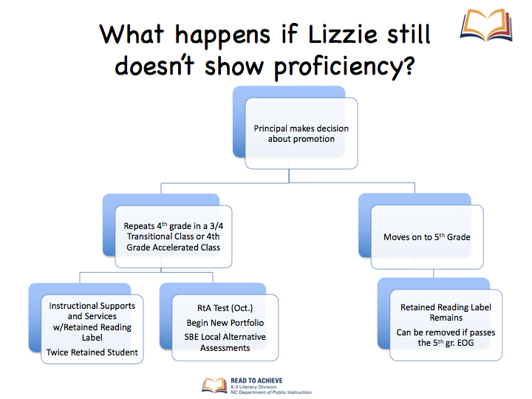

Slide 41
Notification to Parents- Required
Notification of not reading at grade level and possible retention or exemption for good cause
Notice of retention and reason the student is not eligible for a good cause exemption
  Description of proposed reading interventions
Notes:
The charter school shall provide notice to parents and guardians when a student is not reading at grade level. The notice shall state that if the student's reading deficiency is not remediated by the end of third grade, the student shall be retained unless he or she is exempt from mandatory retention for good cause. Notice shall also be provided to parents and guardians of any student who is to be retained under this subsection of the reason the student is not eligible for a good cause exemption, as well as a description of proposed reading interventions that will be provided to the student to remediate identified areas of reading deficiency.

Slide 42
Reporting Requirements
The number and percentage of third grade students demonstrating and not demonstrating reading proficiency on the State-approved standardized test of reading comprehension administered to third grade students.
The number and percentage of third grade students not demonstrating reading proficiency and who do not return to the charter school for the following school year.
Notes:
The charter school shall annually publish on the charter school's Web site and report in writing to the State Board of Education by September 1 of each year the following information on the prior school year:
a. The number and percentage of third grade students demonstrating and not demonstrating reading proficiency on the State-approved standardized test of reading comprehension administered to third grade students.
b. The number and percentage of third grade students not demonstrating reading proficiency and who do not return to the charter school for the following school year.

Slide 43
Reporting Requirements
The number and percentage of third grade students who take and pass the an alternative assessment of reading comprehension and the name of each alternative assessment used for this purpose with the number of students who passed it.
The number and percentage of third grade students retained for not demonstrating reading proficiency.
The number and percentage of third grade students exempt from mandatory third grade retention by category of exemption as listed in subdivision (2) of this subsection.
Notes:
c. The number and percentage of third grade students who take and pass the an alternative assessment of reading comprehension and the name of each alternative assessment used for this purpose with the number of students who passed it.
d. The number and percentage of third grade students retained for not demonstrating reading proficiency.
e. The number and percentage of third grade students exempt from mandatory third grade retention by category of exemption as listed in subdivision (2) of this subsection."

Slide 44
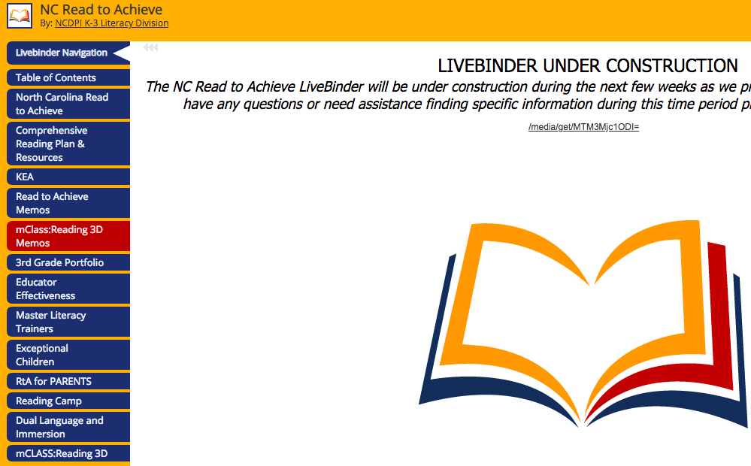
Read to Achieve- LiveBinder
http://www.livebinders.com/play/play/850102
Notes:
Please visit the Read to Achieve LiveBinder for Read to Achieve information and resources.

Slide 45
Professional Development
MOOC-Ed @ The Friday Institute
  Teaching Foundational Reading Skills
  https://place.fi.ncsu.edu/
Running Records: Activate and Inform Your Reading Instruction (10 Hours)
  NCEDCloud
  True North Logic (TNL)
Notes:
We know professional development is one of the ways for us to grow as educators. NCState offers a free MOOC-Ed course called Teaching Foundational Reading Skills. Also, the K-3 Literacy division has developed a 10 hour self-paced course titles Running Records: Activate and Inform Your Reading Instruction. Teachers can go into their NCEdcloud and select True North Logic (TNL). They can search Running Records: Activate and Inform Your Reading Instruction.

Slide 46

Notes:
Thank you for your questions. We will respond with a recorded webinar in the near future including further supporting documents. For any additional questions, please send those to your regional consultant to be included in the webinar.

