Slide 1
Intro to CDW December 8, 2015 Terra Dominguez Data, Research & Federal Policy cedars-info@dpi.nc.gov Kelley Blas Exceptional Children Division Kelley.blas@dpi.nc.gov
CEDARS Data Warehouse (CDW)

Slide 2
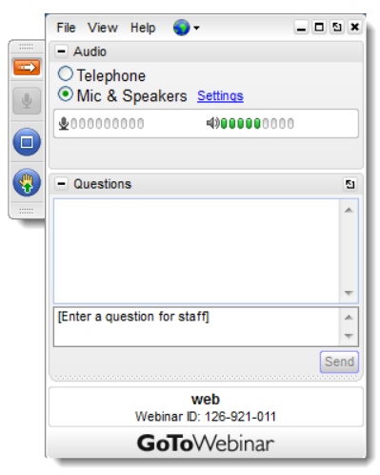
House Keeping
Default audio is Mic & Speakers. To join over the phone, click Telephone.
Use the Hand icon to indicate you have audio.
Use the Question/Chat panel at any time to ask questions or make comments.
Please preface the question with the subject. Example: “Security – how do I...”
Notes:
Good morning and thank you for joining us today.
This is Terra Dominguez with Data Research and Federal Policy at NC DPI.
Today we’ll be talking about the CEDARS Data Warehouse (CDW).
I’m going to put you back on Mute now as we wait for others to arrive. We’ll give them just a few more minutes to log in and then we’ll get started.
Again, thank you for joining us today for a review of the CDW.
By a show of hands, using your Grab Tab in the top right corner, please indicate you can hear me.
Before we get started, I’d like to go over a few items so you know how to participate in today’s event.
We've taken a screen shot of an example of the Attendee interface. You should see something that looks like this on your own computer desktop in the upper-right corner. You’re listening in using your computer's speaker system by default. If you would prefer to join over the phone, just select “Telephone” in the Audio pane and the dial-in information will be displayed.
You will have the opportunity to submit text questions to today’s presenter by typing your questions into the Questions pane of the control panel. You may send in your questions at any time during the presentation; we will collect these and address them during the Q&A session at the end of today’s presentation.

Slide 3
Agenda
What is the CDW?
Security Requirements
Registering for Access
Self-Assessment Demo
Resources

Slide 4
Poll – What is Your Focus Today?
Notes:
I’d like to know who in the audience already has access to the system?
This overview will be helpful to you in that I will demonstrate how to use some of the resources the team has created but today we are talking about the types of data the business/program areas submit, the types of user roles, and how to register for the system. The

Slide 5
What is CEDARS?
Common Education Data And Reporting System
An “Umbrella Term” for three systems:
UID Staff
UID Student
CEDARS Data Warehouse (CDW)
Today’s presentation is on the CDW

Slide 6
The CDW IS
Historical data for trending and analysis
Multiple NCDPI authoritative sources
Federal, state & local level reporting
Accessible to State, LEA & School level staff
Secure - authenticate using NCID
Notes:
CEDARS stands for ‘Common Education Data Analysis and Reporting System’.
CEDARS is the name for the project initiative. You will notice out in the field that like many of the other projects and systems in the state, the project name becomes what we call the system. The CEDARS Data Warehouse is more commonly called the ‘CDW’.
The project began in the 2007-2008 school year. The ultimate goal of the team was to provide the state a product where a user could look at all sorts of education based data in one location over spans of years.
We capture data in a multitude of systems through out the state.
For example, we use multiple student information management systems for various student needs.
NC WISE houses the majority of our student population. A close second in student population is the CECAS system which allows us to track EC information. We track information for LEP students in another area. Migrant uses another SIS system. The list goes on. Some of our students are even tracked in more that one system. An EC student may exist in NC WISE and CECAS. An EC student may exist in NC WISE, CECASE and LEP.
The biggest challenge are those students whose data crosses multiple systems. Each system; being a database creates a ‘Key’; and ID for the student. Each system relies on that ID for the student to be able to track and report.
So if the student’s data is being tracked in NC WISE, CECAS and LEP, how do we know that in each system we are looking at the same student?
We can rely on Name, Birthdate – we’re talking about the entire state. We can’t rely on SSN; we may or may not be provided that information from the parent.
The team had to create a ‘master ID’ for the students. Something that tied all the systems together.
One that was unique to the student and would not be used for any other. So the first part of the project was to create the UID.
We had the same issue for staff information and so a UID was created for them.
The CDW was created to house historical data for trending and analysis and is comprised of multiple data sources. This could mean a particular system/application or, more importantly, from a particular program or business area. The data loaded into the CDW are from the authoritative source, meaning we are getting it from the application you are creating the data from.
An example might be a student’s home language. While we see this information in the NC WISE system, we know that if a student is part of an ESL program, that information is actually imported into NC WISE from the application where they track their student population.
The CDW is used for reporting purposes. Here at the state level we provide the Federal Government their information from the CDW. Local Agency and even schools can use the system for reporting as well.
The CDW is accessible to State, LEA and School employees via NCID. There is no need to try to remember another User Name and Password.

Slide 7
The CDW IS
Not replacing any operational systems (PowerSchool, CECAS, Licensure)
Not real time, transactional data
Not open to the public
Notes:
The CDW is not real-time, it’s not transactional and it is not replacing any of NC DPI’s student information systems, meaning it does not replace CECAS, NC WISE or another system. The CDW is a supplement to our other systems.
A note about IIS and the Pearson initiatives:
Both efforts are still on schedule.
The transition to the Pearson product, PowerSchool will occur at the beginning of the 2013-2014 school year. IIS will be in place at the beginning of the 2014-2015 school year.
PowerSchool will provide data to the CDW and the CDW will provide historical data to the IIS. Today’s presentation is only in regards to the CDW but you can see who the CDW integrates with those to major initiatives. Additionally, the CDW is will become another spoke in the P-20 Hub. Any detailed questions about IIS and Pearson should be asked to those respective project teams.
The CDW is not open to the public, the CDW is presently only accessible to only education staff members within the state that have an NCID.

Slide 8
Data Loads by School Year
Then
Complete
SY 2009-2010
SY 2010-2011
SY 2011-2012
SY 2012-2013
In progress (not visible on Dashboards)
SY 2013-2014
SY 2014-2015
SY 2015-2016
Now
Notes:
Last year this system was in it’s infancy. NC DPI came out to the LEAs and showed the CDW LEA Trainers the CDW interface. At that time we only had two years of data to work with; school years 2008-2009 and 2009-2010. Due to the error/matching rate of student and staff UIDs in school year 2008-2009 we used it for training purposes and then we would removed it from the system.
This year have almost three years of complete data and we are working on the fourth year.
I do want to mention something about school year 2010-2011:
- we plan to upgrade the CDW very soon to v14. During the course of the year while working with the business/program areas there were requests to add even more data elements. The CEDARS team plans to accommodate these requests, however we will not be able to do so until we upgrade.
Files that are pending the 2010-2011 school year are Choice, PLA (persistently low achieving), Immigrant (high level indicators), and also coming soon: McRel data.
We are currently in the process of loading year end files for school year 2011-2012.
And our school year 2012-2013 is in progress and on target.

Slide 9
What data is in the CDW?
LEA and School
LEA and School examples include: Demographics, General Ledger, Charter or Magnet Status, AYP Indicator, Dropout Percentages
Student and Staff
Student examples include: Demographics, Enrollment, Attendance, Course and Grades, Assessments and Program Participation
Staff examples include: Demographics, Hire Date, National Board Certification, Highest Degree Earned
Data System (examples):
EDDIE
PowerSchool
CECAS
UID Staff
Licensure
Notes:
This slide has a lot of information, but it gives you a good idea of the business/program areas that feed data to the CDW.
This is slide is a mix of the business area responsible for the data or the actual application that the data is exported from.
A good example is NC WISE. We know we’ll get demographics from NC WISE, but actual business area at NC DPI is called student accounting. We’ll receive course and marks data from the NC WISE system, but we know that the business area at NC DPI is called curriculum. EDDIE is the system that someone at your LEA or school records your demographic data for your school/LEA, but the business area that handles that at NC DPI is finance.
This slide is not a complete representation of all sources and systems, but it’s very close.

Slide 10
Student & Staff - Sensitive Data
Collected at the Detail level, meaning records specific to the individual student and staff member are collected
PII – ‘Personally Identifiable Information’ and must be protected
No detail level data is used for Federal Reporting
FERPA guidelines are enforced and dictate how any detail level data is to be used

Slide 11
Poll – Do You Have Access?

Slide 12
Who Determines Who Has Access?
LEAs and Charters should create a process for granting access to the CDW to ensure personnel have the appropriate visibility into the system.
All LEAs/Charters must have a Security Officer to manage access to the CDW.

Slide 13
What Does ‘Security Officer’ Mean?
The term ‘Security Officer’ is used for the staff member(s) who is responsible for managing user roles that provide access to their district/charter’s longitudinal data.

Slide 14
Security Officer Responsibilities
Approve district and school level reporting users
Confirm regularly that active user accounts are valid
Contact the state should the Security Officer leave the position
Inform staff who will not be approved for access

Slide 15
Who Do I Contact for Access?
State Security Officer
The State Security Officer approves LEA/Charter Security Officers only
LEA/Charter Security Officer
LEA and School Level Reporting Users must be granted access by the LEA/Charter Security Officer
LEA/Charter Reporting Users
LEA/Charter Reporting Users should contact their Security Officer with questions about access

Slide 16
Who Could Benefit From Having Access?
Administrators
Tech Directors
Data Analysts
Report Writers
Coordinators (all programs, including PowerSchool)
Data Managers
The list goes on and on…

Slide 17
What Type of Access Can I Request?
LEA
LEA Detail Answers Super Powers – complete visibility
LEA Users Detail “One Click” dashboard reports with drill down to sensitive data
Aggregate (LEA/Charter) Extremely limited “One Click” dashboards, not recommended
Security Officer Super Powers to registration system only
School
School Users Detail “One Click” dashboard reports with drill down to sensitive data
Aggregate (School) Extremely limited “One Click” dashboards, not recommended

Slide 18
Detail Vs. Aggregate
User roles with the word Detail allow individuals access to data that is Personally Identifiable Information (PII)
Every user role that is approved has access to Aggregate Dashboards by default
Aggregate Dashboards are totals only and do not display any PII

Slide 19
You still with me?

Slide 20
Registering for Access
Each individual must apply for access manually, using the CEDARS registration system
Authentication is based on NCID for any ‘CEDARS’ related application
Reporting Users only need one role to the system
Security Officers must apply for a second role in the registration system to access the CDW
The NC Public Schools website offers a contact list of the LEA’s Security Officers and is updated monthly

Slide 21
More About Registration
Each system under the CEDARS umbrella has it’s own registration system
They all look the same
Each system has a specific registration process that is outlined on the NC DPI website: http://www.ncpublicschools.org/cedars/

Slide 22
Password Pitfall
In order to access the CDW reporting system, your NCID cannot contain the following characters:
Ampersand (&)
Exclamation Point (!)

Slide 23
CDW Registration Link: https://schools.nc.gov/reporting
Demo

Slide 24
Logging into the CDW Registration System
Don’t let the graphic fool you – it’s a warning
Log in using your NCID user name and password

Slide 25
Registering for the Security Officer Role
Fill in the form in consecutive order by field, left to right, from top to bottom

Slide 26
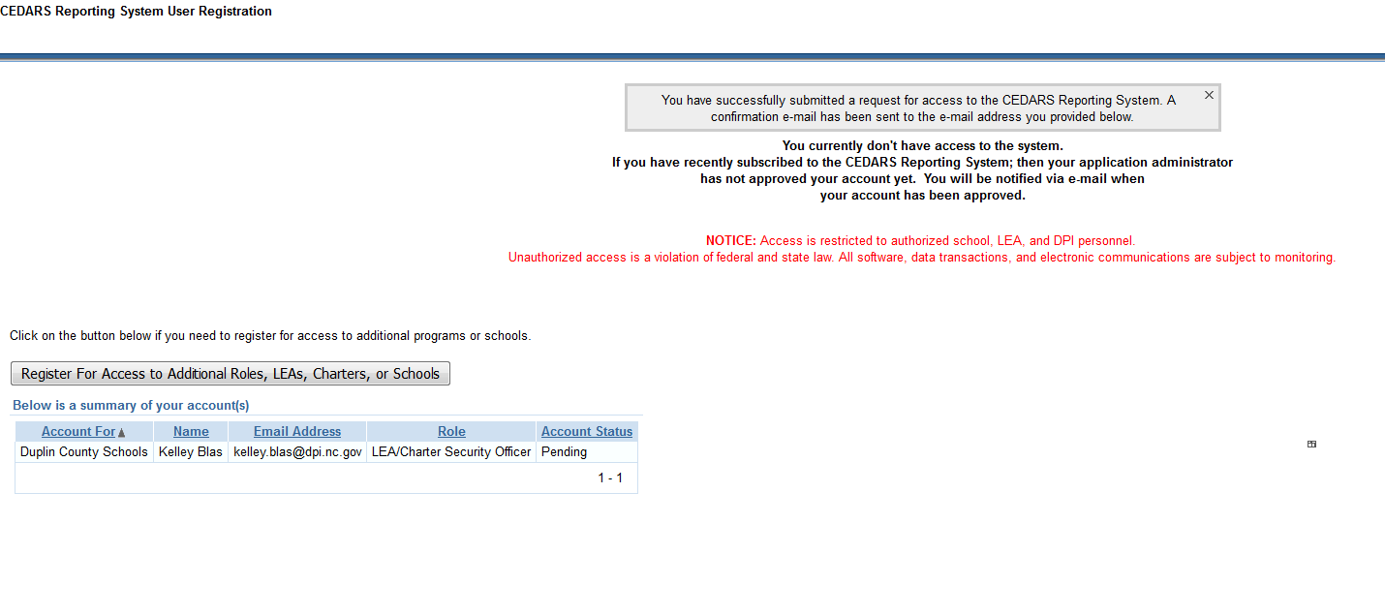
Registration Completion
An email will be sent to the Security Officer

Slide 27
Text to Security Officer
Dear CEDARS Reporting System Administrator,
A new subscription request for the CEDARS Reporting System has been submitted. The details are below:
Subscriber Level: LEA/Charter Security Officer Access Code: 310 Subscriber Name: Kelley Blas Date Submitted: 12/04/2015 11:33AM Subscriber E-mail Address: kelley.blas@dpi.nc.gov Subscriber Phone Number: (919) 555-1212 Note Subscriber Left for You: Please create any notes you would like the Security Office to see.
To approve or deny the subscription request, log in to the subscription system [https://schools.nc.gov/reporting] and go to the Manage Permissions tab.
Regards,
CEDARS Team

Slide 28
Security Officers Manage Records in the CDW Registration System
Welcome Approver!
Must register for a second role to access reporting system
Two tabs

Slide 29
The Manage Permissions Tab
Pending, Active, Disabled and Denied links
Functions field, Actions button
Staff registration requests
Click the icon to drill into the record

Slide 30
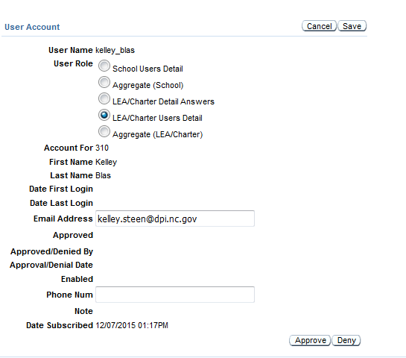
Approving a Request
Update role if needed, Save
Approve or Deny
If Denied, contact staff out of curtesy

Slide 31
Text to User: Confirmation
Dear Kelley Blas,
Your security administrator has approved your subscription to the CEDARS Reporting System. Please allow 24 hours before you attempt to access the system to allow time for the registration application to post the security updates to the CEDARS Reporting System.
You can access the CEDARS Reporting System at the following URL: [https://cedars.ncpublicschools.gov/analytics/]
https://cedars.ncpublicschools.gov/analytics/
Regards,
CEDARS Team

Slide 32
About the LEA Self-Assessment
For a full overview of the LEA Self-Assessment, and other data sources visit:
http://ncimplementationscience.ncdpi.wikispaces.net/LEA+Self-Assessment

Slide 33
LEA Self-Assessment and CDW
Potential data source
“One Click” dashboard report with ability to drill to student detail
Proficiency by Disability
Attendance by Disability
More reports coming soon!

Slide 34
CDW Reporting system Link: https://cedars.ncpublicschools.gov/analytics/saw.dll?bieehome
Demo

Slide 35
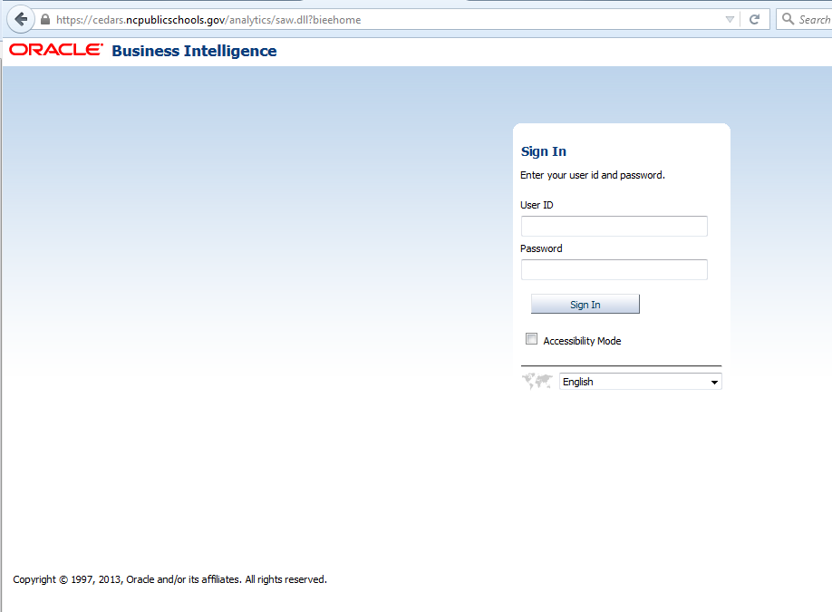
Logging into the CDW
Log in using your NCID user name and password

Slide 36
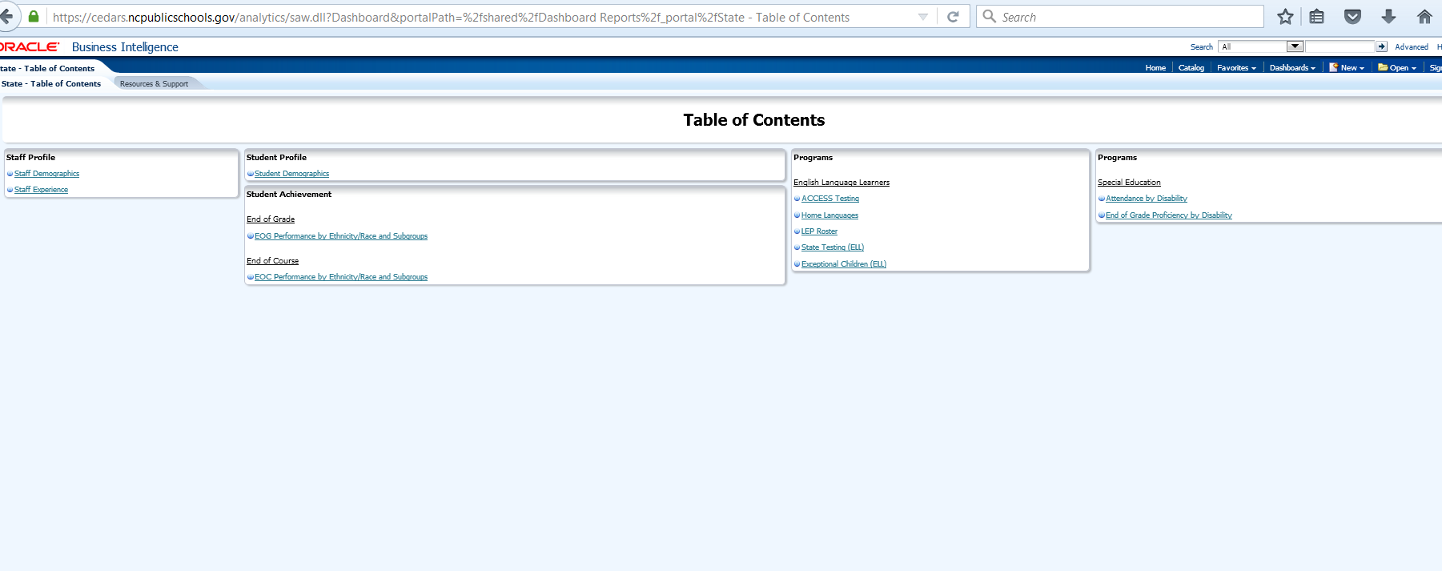
Navigating to EC Dashboards

Slide 37
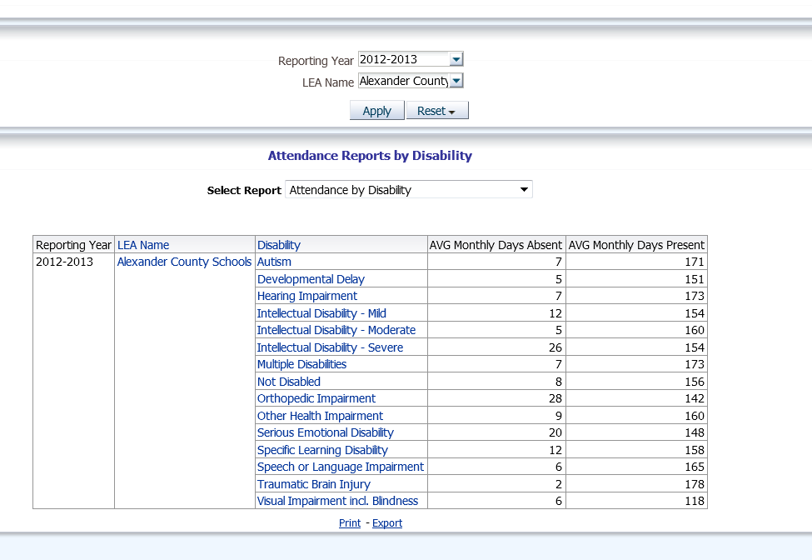
Attendance Reports by Disability

Slide 38
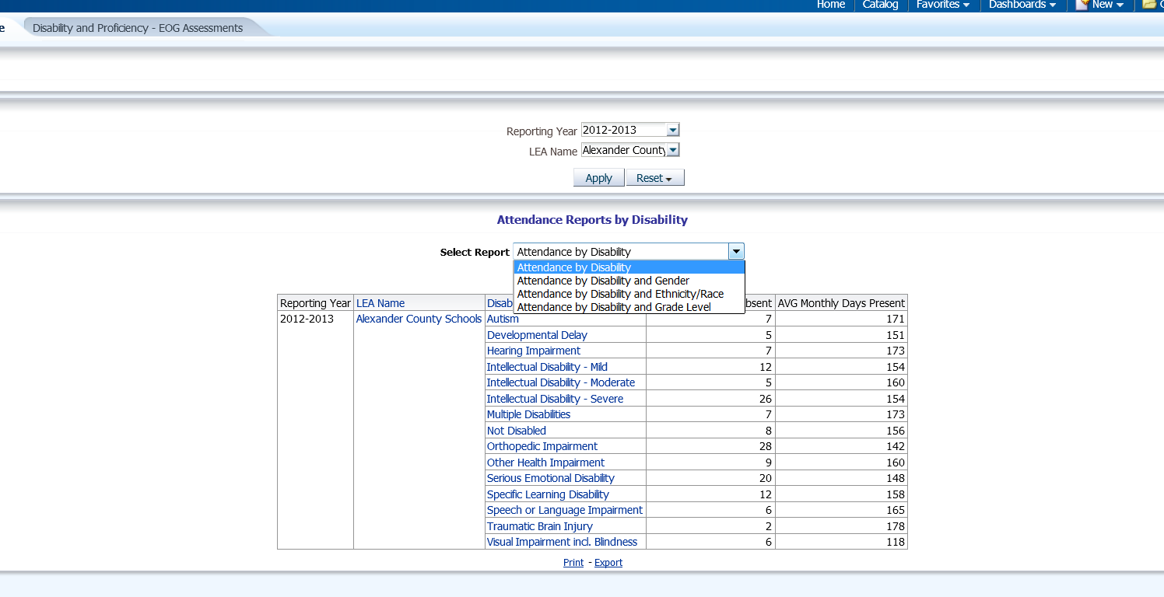
How do I Change my View?

Slide 39
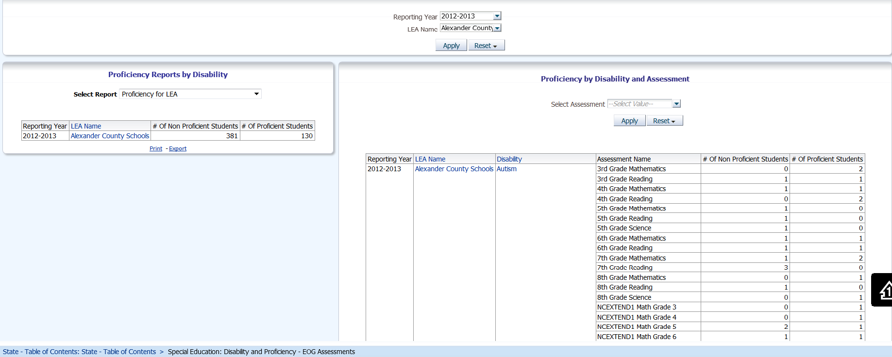
Proficiency by Disability

Slide 40
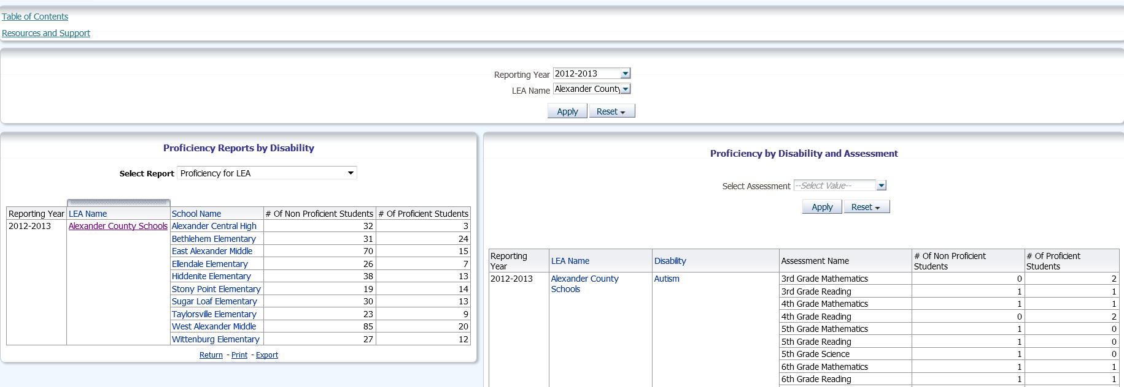
How do I Drill Deeper into my Data?

Slide 41
Resources
CEDARS Website
Cedars-info@dpi.nc.gov
Exceptional Children Wiki

Slide 42
So….did you get all that?

Slide 43
CEDARS Data Warehouse Quick Sheet
Longitudinal Data Store
Does not replace existing operational systems
Used for Federal, state and local reporting
From state authoritative system’s data
LEA & School
Staff & Finance
Student & Programs
Individual level data submitted as often as monthly*
Aggregate and Detail Data
Data accessible based on user security levels
SEA created dashboards
Trending
Data Validation
Report Writer
Access available to SEA, LEA and School Level Staff
Secure, authenticate with NCID
Must register and be approved based on SEA, LEA & School
http://www.ncpublicschools.org/cedars/reporting/registration/
Resources
http://www.ncpublicschools.org/cedars/reporting/documentation/
Data Submission Schedule
Security Officer and LEA Trainer Contact Lists
Quick Reference Documents

Slide 44
Terra Dominguez
Division of Data Research & Federal Policy
919.807.3272
cedars-info@dpi.nc.gov
Thank you!

