Slide 1
Overview to the CEDARS Data Warehouse (CDW)
October 2020

Slide 2
Topics
What is the CDW?
Security Requirements
Registering for Access
Dashboard Demo
Resources
Notes:
Thank you for tuning in to learn more about the CEDARS Data Warehouse, (CDW). Here’s what you can expect to find in this presentation: We’ll cover points like, “What is the CEDARS Data Warehouse?” We’ll discuss the necessary Security Requirements. Registering for Access is another topic to be examined. We will complete a Dashboard Demonstration for you so you will be familiar with them. And we will give you additional resources, so you know where to find answers to your questions.

Slide 3
The CDW is:
Historical data for trending and analysis
Multiple NCDPI authoritative sources
Federal, state & local level reporting
Accessible to State, LEA & School level staff
Secure - authenticate using NCID
Notes:
The project began in the 2007-2008 school year. The ultimate goal of the team was to provide the state with a product where a user could look at all sorts of education-based data in one location over a span of years. We capture data in a multitude of systems through out the state. For example, we use multiple student information management systems for various student needs.
PowerSchool houses the majority of our student population. A close second in housing student population is the CECAS system, which allows us to track Exceptional Children (EC) information. Some of our students are even tracked in more than one system. For example, an EC student may exist in PowerSchool and CECAS. The biggest challenges are those students whose data crosses multiple systems. Each system, being a database, creates a ‘key’ and ‘ID’ for the student. Each system relies on that ID for the student to be able to track and report. So if the student’s data is being tracked in PowerSchool, CECAS and LEP, (or Limited English Proficient) how do we know that in each system we are looking at the same student?
Can we rely on Name and Birthdate? – we’re talking about the entire state! We can’t rely on SSN; we may or may not be provided with that information from the parent. The team had to create a ‘master ID’ for the students. Something that tied all the systems together. One that was unique to the student and would not be used for any other. So the first part of the project was to create the UID. We had the same issue for staff information and so a UID was created for them. The CDW was created to house historical data for trending and analysis and is comprised of multiple data sources; this could mean data is housed in a particular system/application or, more importantly, governed by a particular program or business area. The data loaded into the CDW are from the authoritative source, meaning we are getting it from the application you are creating the data from.
The CDW is used for reporting purposes. Here at the state level we provide the Federal Government with their information from the CDW. Local Agency and even schools can use the system for historical reporting as well.
The CDW is accessible to State, LEA and School employees via NCID. There is no need to try to remember another User Name and Password.

Slide 4
The CDW is Not:
Replacing any operational systems (PowerSchool, CECAS, Licensure)
Real time, transactional data
Open to the public
Notes:
The CDW is not real-time, it’s not transactional and it is not replacing any of NC DPI’s student information systems, meaning it does not replace CECAS, PowerSchool or another system. The CDW is a supplement to our other systems. The CDW is not open to the public, the CDW is presently only accessible to only education staff members within the state that have an NCID.

Slide 5
What Systems Feed the CDW?
EDDIE
PowerSchool:
ECATS (Exceptional Children)
Accountability
UID Staff
Licensure
Homeless
Immigrant
LEP
Migrant
LEA and School Directory
Disability, LRE setting, exit reason
Assessments, EOG, and EOC
Staff Demographics
Licensing and Certifications
Notes:
Now we’ll discuss what systems feed CEDARS. The Educational Directory and Demographical Information Exchange (or Eddie) is one such system. In it you will find information such as the LEA and School Directories. PowerSchool is another system that feeds CEDARS. You could expect to find program data such as: Homeless, Immigrant, LEP, and Migrant data in this system. CECAS, the Exceptional Children system, feeds CEDARS as well. In CECAS you will see Disability, LRE setting, and Exit reasons. Accountability is another system feeding CEDARS. Assessments, End Of Grade and End Of Course (EOG, EOC respectively) data are contained within this system. UID Staff comprises another system that feeds CEDARS. You will find staff demographics here. Licensure is yet another system that feeds CEDARS. In licensure, you’ll find licensing and certifications data.

Slide 6
What data is in the CDW?
Examples include, but are not limited to the following:
LEA : Dropout Rate, Graduation Rate, General Ledger, Assessment participation (performance ‘met/not met’)
School: Demographics and characteristics (Charter / ALP / Magnet Status)
Student: Demographics, Enrollment, Attendance, Course and Grades, Assessments and Program Participation, Discipline Data
Staff: Demographics, Hire Date, National Board Certification, Highest Degree Earned
6
Notes:
his slide gives you a good idea of what data you can expect to find in the CEDARS Data Warehouse (CDW). LEA examples include: Dropout Rate, Graduation Rate, General Ledger, Assessment participation (performance met and not met). School examples include: Demographics and characteristics (Charter, ALP, Magnet Status). Student examples include data like: Demographics, Enrollment, Attendance, Course and Grades, Assessments and Program Participation, and Discipline Data. While staff examples include data such as: Demographics, Hire Date, National Board Certification, and Highest Degree Earned.

Slide 7
Student & Staff - Sensitive Data
Collected at the Detail level, meaning records specific to the individual student and staff member are collected
PII – ‘Personally Identifiable Information’ and must be protected
No detail level data is used for Federal Reporting
FERPA guidelines are enforced and dictate how any detail level data is to be used
Notes:
Now let’s talk about some sensitive data you will find in the CDW: student and staff. It’s important to remember that when we say data is collected at the DETAIL level, what we mean is that records specific to the individual student or staff member are collected. PII or Personally Identifiable Information must be protected. No detail level data is used for any Federal Reporting. Federal Reporting is submitted at the aggregate level only. We take FERPA very seriously and remind you that the FERPA guidelines are enforced and dictate how any detail level data is to be used.

Slide 8
Who Could Benefit From Having Access?
Administrators
Tech Directors
Data Analysts / Report Writers
Coordinators (all programs, including PowerSchool)
Data Managers
The list goes on and on…
Notes:
First let’s talk about who might benefit from gaining access. Administrators would obviously find value in being granted access in order to locate records for students and staff. Tech Directors could use access to great advantage. Data analysts and report writers are definitely aided by the access to this data. Coordinators, Data Managers, etc,…

Slide 9
What Type of Access Can I Request?
LEA
LEA Detail Answers “Super Powers” – complete visibility
LEA Users Detail “One Click” dashboard reports with drill down to sensitive data
Security Officer “Super Powers” to registration system only
School
School Users Detail “One Click” dashboard reports with drill down to sensitive data
Notes:
Maybe you[‘re unsure what type of access you can request? There are a number of options for you to choose from depending on if you’re gaining access at the LEA level or the school level. For LEAs, the first type of access you can request is the LEA Detail Answers. We refer to this level as having SUPER POWERS as you’ll have complete visibility if you choose this type of access. The next type of access would be LEA Users Detail. With this type of access you have “one click” dashboard reports with the ability to drill down to sensitive data. The next type is for the Security Officer. You’ll have SUPERPOWERS here too, but only to the registration system. For Schools, you can select: school users detail. Where you can drill down to sensitive data from your one click dashboards or aggregate at the school level.
All users receive access to aggregate level pre-created dashboards.

Slide 10
Who Determines Who Has Access?
All LEAs/Charters must have a Security Officer to manage access to the CDW.
If no Security Officer is assigned, no registration requests will be granted.
LEAs and Charters should create a process for granting access to the CDW to ensure personnel have the appropriate visibility into the system.
Notes:
{1} Now we’re getting into the Security Officer role, or who determines access? LEAS and Charters should create a process for granting access to the CDW to ensure personnel have the appropriate visibility into the system. You don’t want to limit those who need access to detail level to have access only to aggregate level data. By the same token, a staff member may only require dashboard access to satisfy an initiative surrounding a certain business area. All LEAs and Charters must have a Security Officer to manager access to the CDW. This management includes systematic, periodic updates to the system when someone leaves a position and should no longer have access, and when someone new comes in and needs to be granted access. Staying on top of these security needs is really important.

Slide 11
Who Do I Contact for Access?
LEA/Charter Users
LEA/Charter Security Officer
The LEA/Charter Security Officer approves LEA and School Level Users, contacts State Security Officer with Security Officer staff changes
LEA/Charter Users should contact their LEA/Charter Security Officer with questions about access
State Security Officer
The State Security Officer approves LEA/Charter Security Officers
Notes:
Now, who should you contact for access? LEA and Charter users should contact their LEA/Charter Security Officer with questions about access. The LEA/Charter Security Officer approves LEA and School Level Users, and contacts the State Security Officer with Security Officer staff changes. The State Security Officer in turn approves LEA/Charter Security Officers.

Slide 12
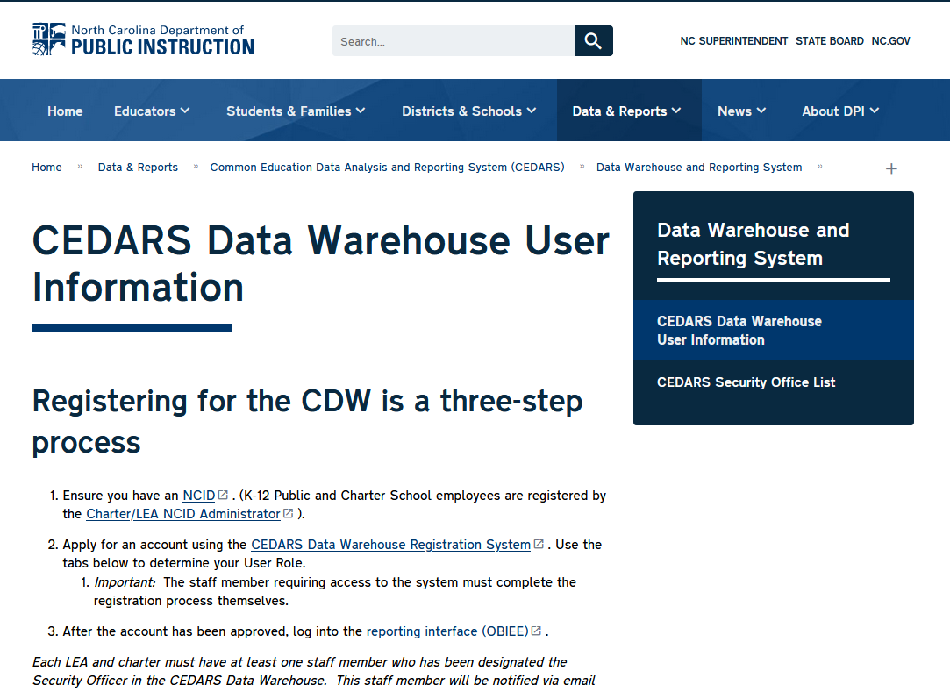
How Do I Register for Access?
Individuals must apply for access manually, using the CEDARS registration system
Register for CEDARS from the NC DPI website
Notes:
{2} Now we get to the heart of the matter. How do you register for access? Each individual MUST apply for access manually, using the CEDARS registration system. Go to the following link: http://www.ncpublicschools.org/cedars/reporting/registration. Once there, click the STEP 2 link. Log in using your NCID username and password. You don’t have to memorize yet another username and password!

Slide 13
Logging into the CDW Registration System
Don’t let the graphic fool you – it’s a warning
Log in using your NCID username and password
Notes:
{1} Now when you get the CDW Registration system don’t let the stop sign graphic fool you into thinking you shouldn’t be here. It’s a warning to those trying to enter the site without the proper NCID credentials. That’s all. Log in using your NCID user name and password.

Slide 14
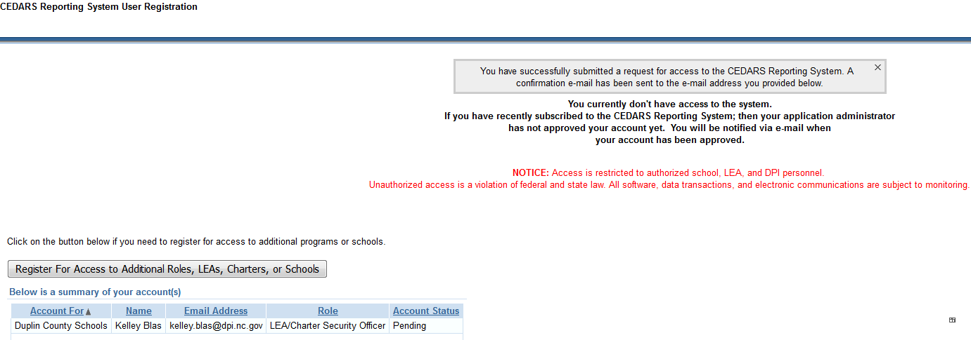
Registration Completion
An email will be sent to the Security Officer
Notes:
{2} Once you’ve completed your registration, an email will be generated and sent directly to the security officer. Your registration isn’t complete until your security officer approves you. Then, after approval, you’ll receive an email when your account has been approved. Notice also that you can click on the button below to register for access to additional roles (security officers only), LEAs, Charters, or Schools.

Slide 15
Tips for Registering for Access
Security Officers must apply for a second role in the registration system to access the CDW
CDW Users only need one role to access the system
The NC Public Schools website offers a contact list of the LEA’s Security Officers and is updated monthly
Authentication is based on NCID for any ‘CEDARS’ related application
Notes:
Here are some tips for registering for access:
Security officers must apply for a second role in the registration system to access the CDW.
CDW users only need one role to access the system.
The NC Public Schools website offers a contact list of the LEA’s Security Officers and this list is updated on a monthly basis.
Authentication is based on NCID for any CEDARS related application.

Slide 16
Potential Password Pitfalls
In order to access the CDW reporting system, your NCID cannot contain the following characters:
Ampersand (&)
Exclamation Point (!)
Notes:
There are some potential password pitfalls you might run into when you try to access the CDW. IN order to access the system, your NCID cannot contain the following characters: The ampersand or “AND” sign. And the exclamation point symbol. Both of these characters have created problems for people trying to gain access in the past, so we wanted to let you know about them in case you find yourself in a similar position. NCID accepts the characters BUT CEDARS does not, so you might need to change your NCID password if this applies to you.

Slide 17
Do Browsers Make A Difference?
Yes, they do!!
Use Mozilla Firefox for the best results!
Notes:
{1} So, anything else to keep in mind while I’m trying to gain access to the CDW? What about browsers for instance? Do they matter? Yes, they do! Use Mozilla Firefox for the best results. Some users have noticed that Chrome and Internet Explorer drop things off. We want to help you avoid that problem, so always use Mozilla just to be on the safe side.

Slide 18
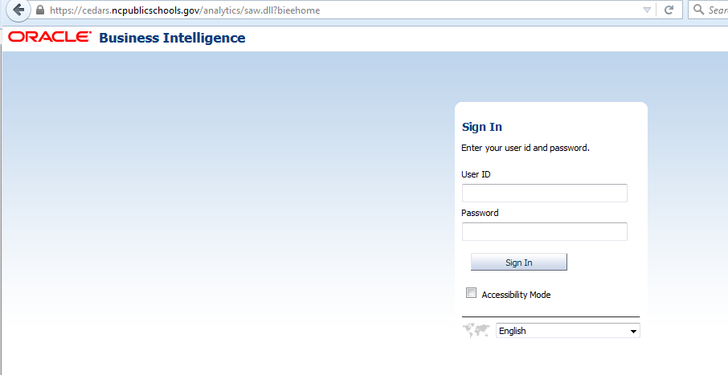
Logging into the CDW
Log in using your NCID username and password
Notes:
{2} This is the login for the CEDARS Data Warehouse. You’ll need your user id and password. Then push sign-in.

Slide 19
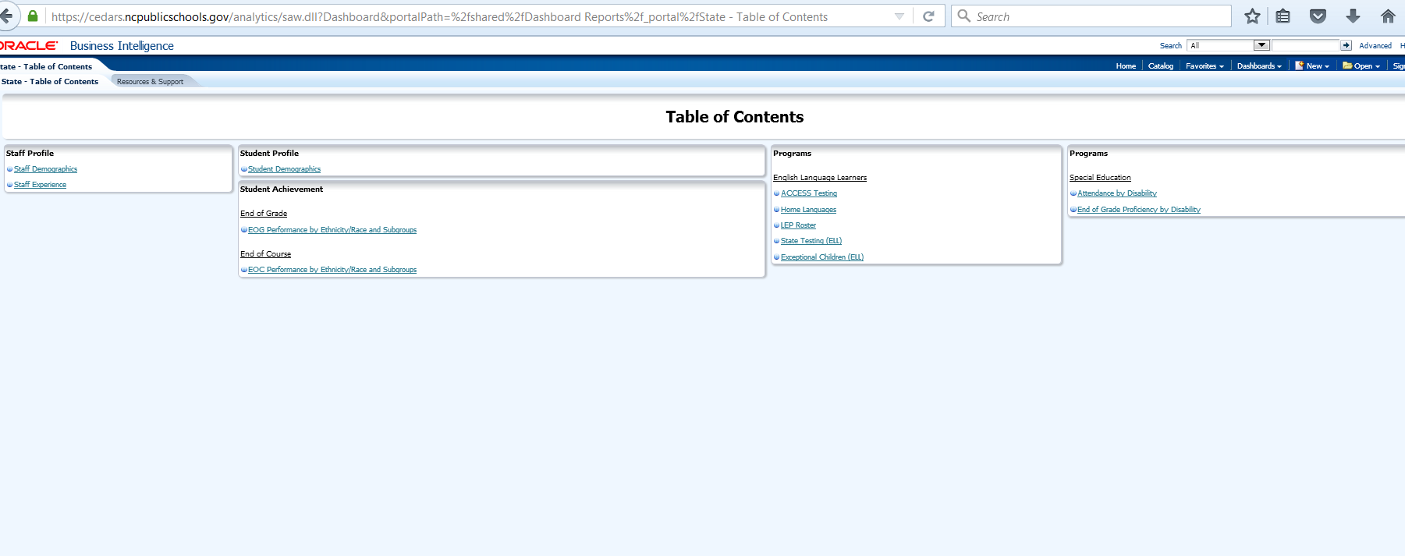
Navigating Dashboards
Please note: this slide and the subsequent 4 slides will reflect actual dashboards which show the functionality of a single program area.
Notes:
This slide and the subsequent 4 slides will reflect actual dashboards which show the functionality of a single program area. In this case: Special Education.

Slide 20
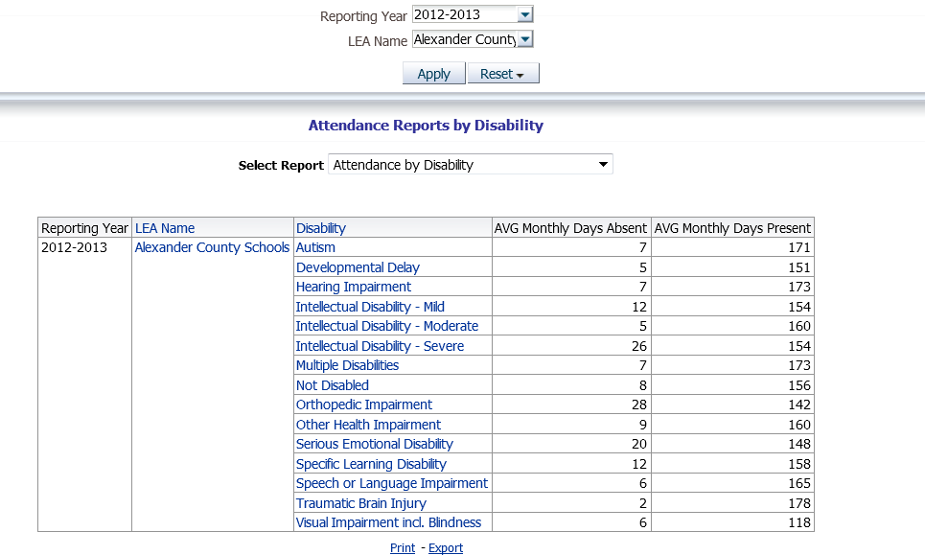
Attendance Reports by Disability
Notes:
{3} This next slide shows the attendance reports by disability. In this case we’re showing the 2012-2013 school year for our reporting year. LEA name is for the Alexander County Schools. And then you can see the attendance. The days absent and the days present for each disability are shown.

Slide 21
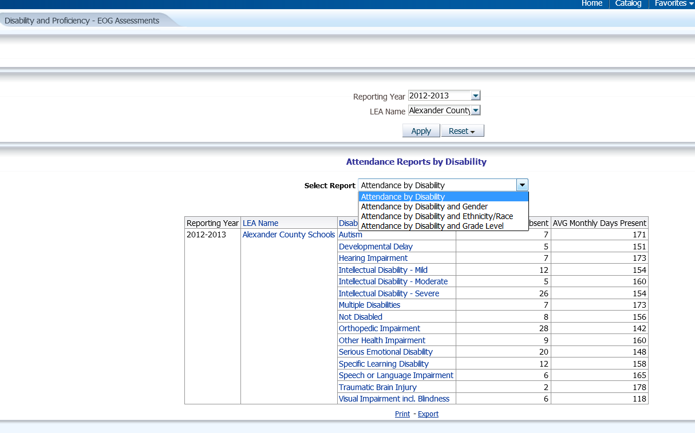
How do I Change my View?
Notes:
{1} Perhaps you want to change your view? Click on the scroll down for the select report and choose from the options there. In this case, you can choose the following views: attendance by disability, attendance by disability and gender, attendance by disability and ethnicity, or attendance by disability and grade level. Once you select one of the options, it will allow you to see these views.

Slide 22
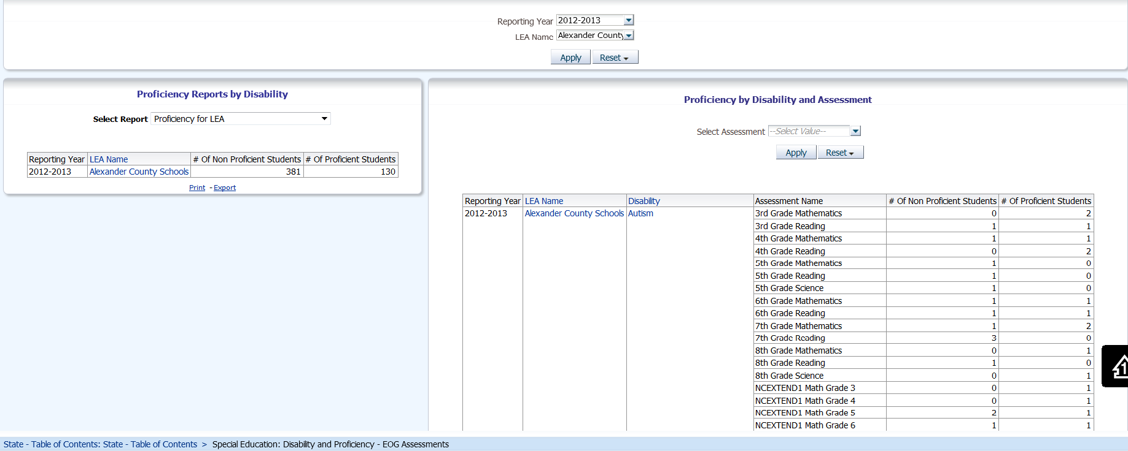
Proficiency by Disability
Notes:
In this next slide we see the proficiency by disability. You’ll notice the breakdown by grade and course listings. Then you’ll see the number of non-proficient students and the number of proficient students. These are End of Grade assessments.

Slide 23
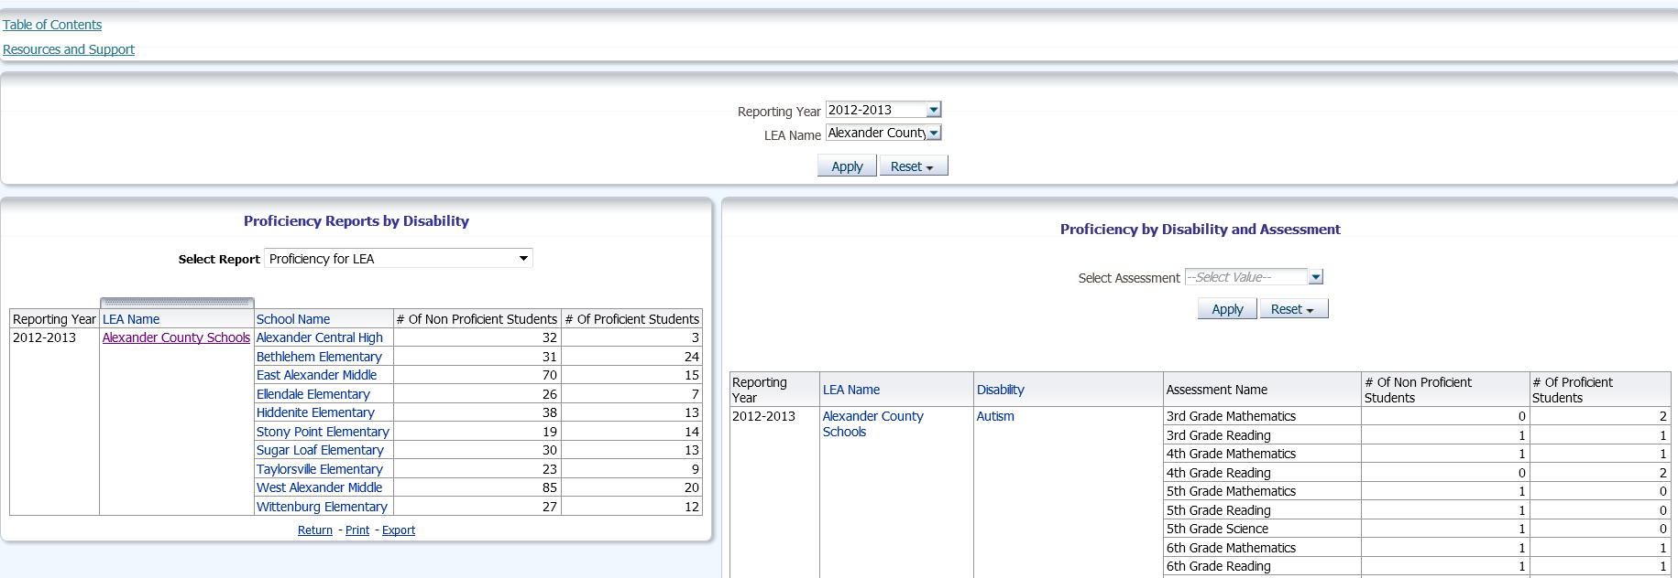
How do I Drill Deeper into my Data?
Notes:
{1} Perhaps you’re interested in drilling down deeper into your data? How do you do that? If you’ll notice on this slide the proficiency reports by disability has been further drilled down by Proficiency for LEA, you have their breakdown by the different schools within Alexander County. You also have the breakdown by course grades and a specific disability. In this case, Autism.

Slide 24
Resources
Registering for the CEDARS Data Warehouse
Security Officer Administration Guide
Viewing Pre-created Dashboards
Creating Reports
CEDARS Data Dictionary
Overview to the CEDARS Data Warehouse (ppt)
Understanding Subject Areas (ppt)
CEDARS is located under “Data and Reports” on the NC DPI website

