Slide 1


Multi-Tiered System of Support
Joining Cohort 5

Slide 2
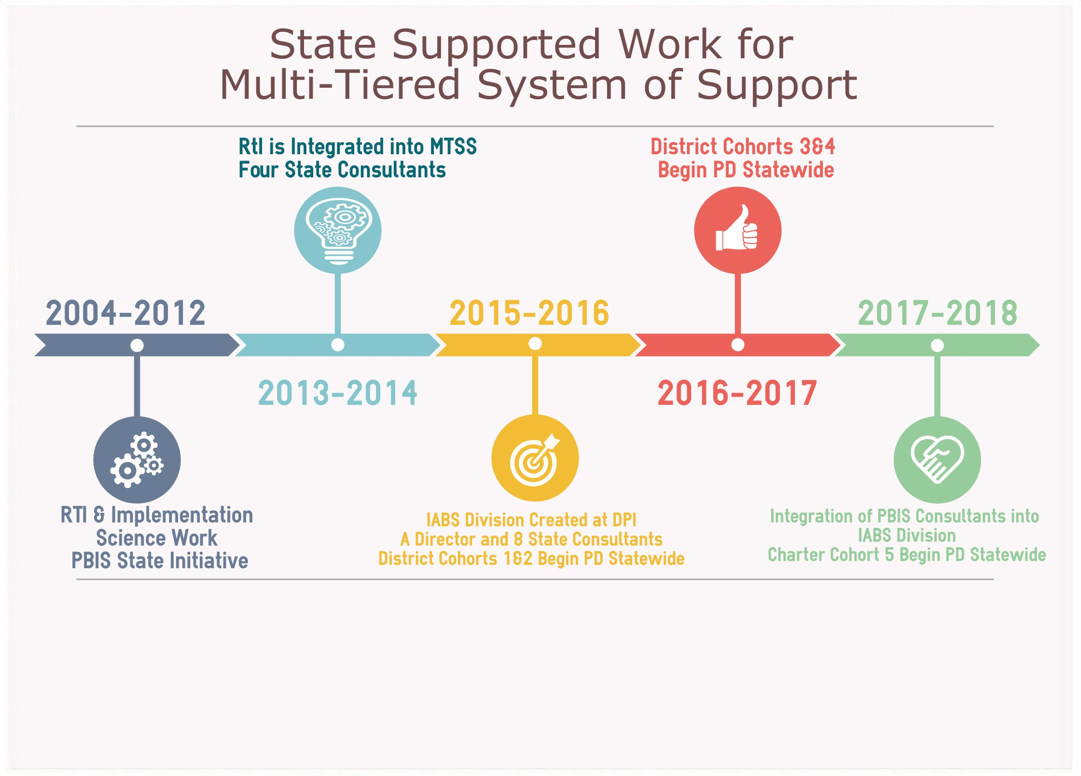
Notes:
We want to give you a chance to look at these milestones and make connections.
Consider, Implementation Science, Responsiveness to Intervention/ Response to Instuction, and PBIS and how your work has evolved along with the state support.
Districts engage in the work. (Skim over the big ideas with the beginning and the end) state support started with regional training that consisted of about 8 days for teams to attend sessions. DPI was contracting with leaders in the field as well as collaborating with other NC DPI Divisions to assist with these sessions.
Through the use of research and evaluation that has led us to refine the supports and integration of state support programs. The work continues to evolve and grow.
Through these integrated efforts the state has become more effective and efficient at serving school districts and charters.
2013-2014- four work areas- common language and understanding was the focus.
The work is organized around cohorts which was initially based on readiness and was grounded in partnership agreements….
NC MTSS is a multi-tiered framework that promotes school improvement through engaging, research-based academic and behavioral practices. NC MTSS employs a systems approach using data-driven problem solving to maximize growth for all.
Move from process for some students to framework for all students
All students are part of MTSS, it is about analyzing how all students are responding to instruction
Vision: Every NC Pre K-12 public education system implements and sustains all components of a Multi-Tiered System of Support to ensure college and career readiness for all students.
Mission: NCDPI will prepare and support LEAs to implement a Multi-Tiered System of Support for total school improvement by providing professional development, coaching and technical assistance, research and evaluation, and communication and visibility that results in college and career readiness for all students.

Slide 3
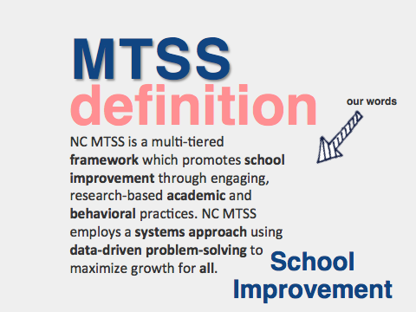

Slide 4

When establishing common understanding of MTSS, the following is often stated:
This school improvement framework
centers around the 2 Big E’s:
EFFECTIVE for students
EFFICIENT for the adults
In this framework, we think about what we are doing, examine the results and respond rapidly
We must work to ensure that this is true in both theory and practice.
Notes:
Speaker Notes:
If you’ve participated in MTSS overviews or initial professional development designed to establish common understanding, you’ve undoubtedly heard these two statements:
This school improvement framework centers around the 2 Big E’s: EFFECTIVE for students EFFICIENT for the adults
In this framework, we think about what we are doing, examine the results and respond rapidly.
Take a moment to reflect: Is this true? Is this how MTSS is currently perceived in your LEA?
We must work to ensure that this is true in both theory and practice.

Slide 5

MTSS Should Make the Difficult Job of
Teaching Easier AND Increase Student Achievement
cc: Hindrik S - https://www.flickr.com/photos/63991153@N00
Notes:
This statement should be in the forefront of everything we do. If this isn’t true - we need to closely examine our current plans for building this infrastructure.

Slide 6
Critical Components of NC MTSS:
Leadership
Building the Capacity/Infrastructure for Implementation
Communication/Collaboration
Data-Based Problem-Solving
3 Tiered Instruction/Intervention
Data-Evaluation
Connections
Notes:
Presentation section: Introduction by making connections to current implementation efforts
Speaker Notes:
Let’s begin by checking in to our work of building a multi-tiered system of support. Here we see the six critical components that support an MTSS. When we consider these components, we understand that these are the foundational elements to total school improvement. As we become familiar with ECATS,, you will see that ECATS can and will support and compliment this school improvement framework
Also, Explain that these are the components which SAM measured. If we are doing these things well we will be improving our current systems, processes and procedures. Maybe ask audience to reflect which areas they are thinking about in Summer planning? A share out?

Slide 7

Our goal is to have
teachers
FEWER
do
things
BETTER

Slide 8
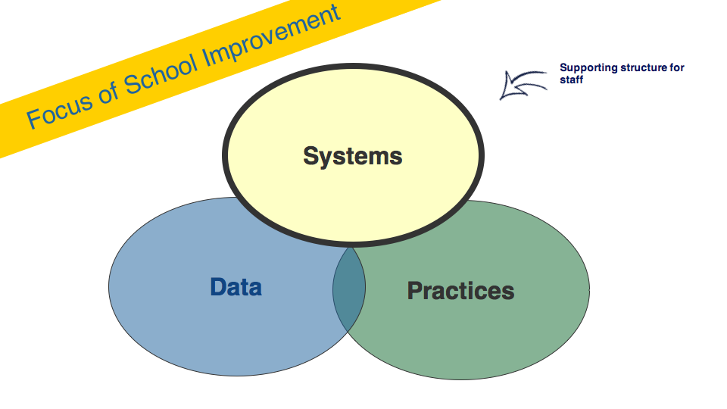

Slide 9
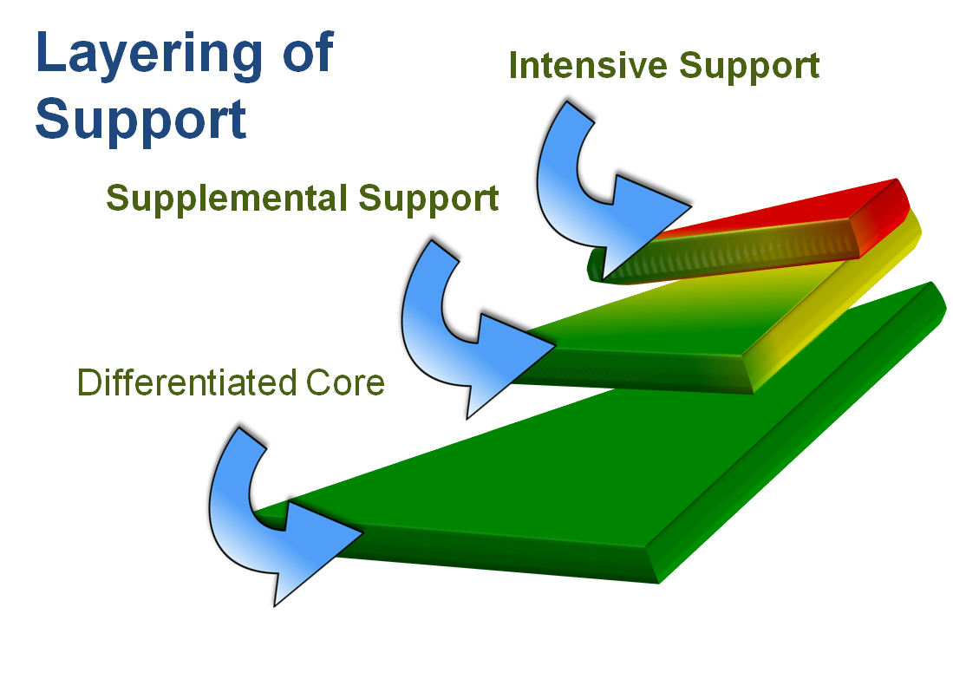
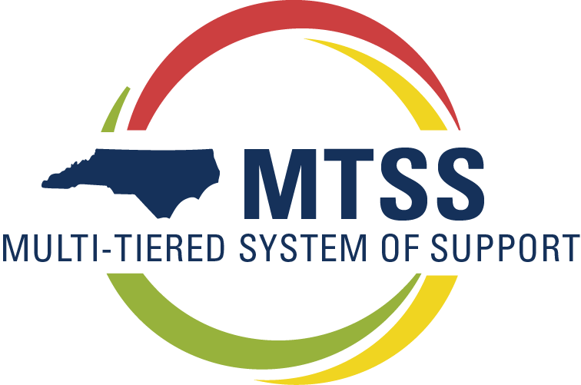
Notes:
you may have seen a triangle previously.
one significant change that has been made
is a layered visual that better displays the big ideas that core is the only and best prevention.
That supplemental and intensive supports are in addition to…

Slide 10
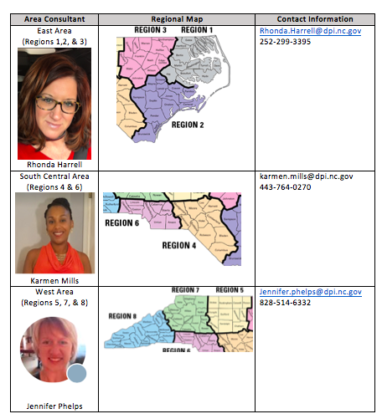
Joining Cohort 5
Partnership Agreement
Online Modules
Face to Face Support
Virtual Coaching Sessions

Slide 11


