Slide 1
New Charter Schools:
Planning Year Session 4
Every Student Succeeds Act (ESSA)
Paul Davis
Analysis and Reporting, Accountability Services
North Carolina Department of Public Instruction
December 12, 2018

Slide 2
Before We Get Started — Definitions
Elementary School (elementary/middle)
Means a nonprofit institutional day or residential school, including public elementary charter school, that provides elementary education, as determined under state law
Secondary School (middle/high—non-graduating)
Means a nonprofit institutional day or residential school, including public charter school, that provides secondary education, as determined under state law, except that the term does not include any education beyond grade 12
High School
A school that has one of the following indicators: Biology, Math Course Rigor or ACT/ACT WorkKeys

Slide 3
Before We Get Started — Requirements
Meaningful Differentiation
Under the Every Student Succeeds Act (ESSA) and state law, all schools must be included in the accountability system and be differentiated in some way
School Performance Grades (A–F) is the model of meaningful differentiation
Identification of Schools Needing Academic Support
Must be identified for both federal and state purposes
Comprehensive Support and Improvement (CSI) — ESS
Targeted Support and Improvement (TSI) — ESSA
Low Performing Schools (D/F) — State
95% Assessment Participation Rate
Schools are required to ensure that they meet the 95% participation requirements
Consequences for not meeting participation may impact School Performance Grades

Slide 4
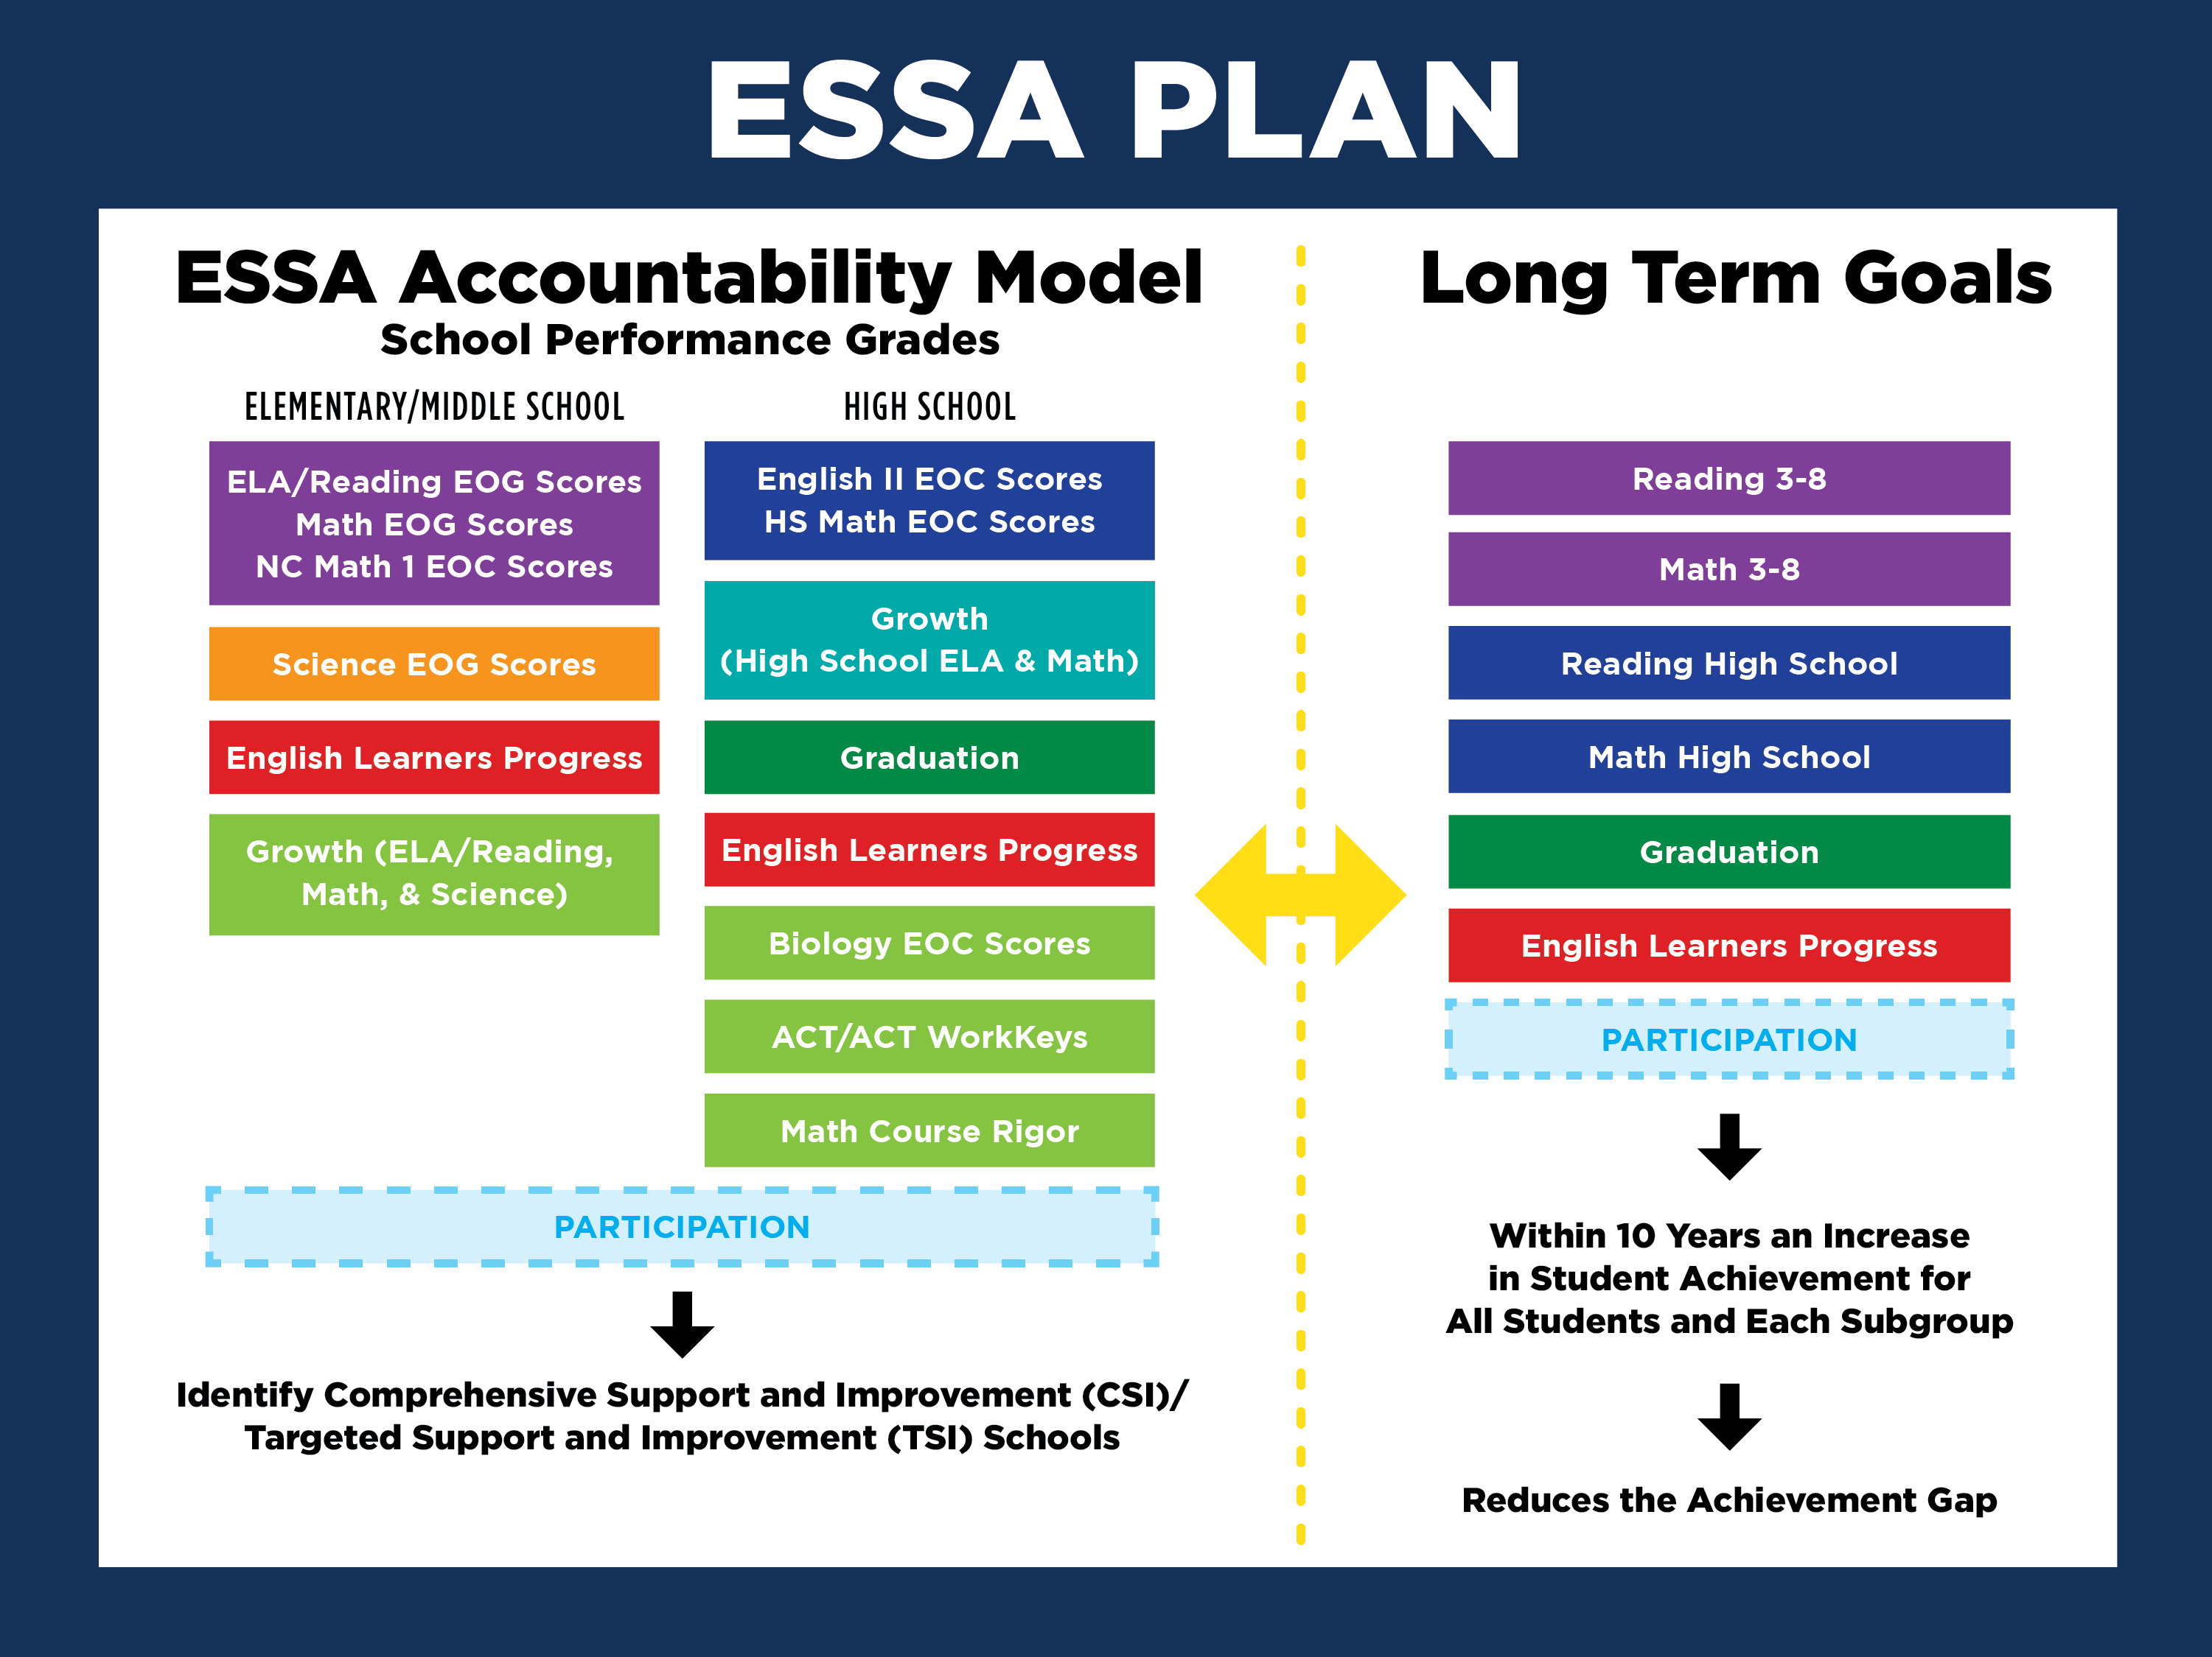
ESSA Accountability Model
Long Term Goals
School Performance Grades
ELEMENTARY/MIDDLE SCHOOL HIGH SCHOOL
ELA/Reading EOG Scores
E s
Reading 3-8
Math 3-8
Reading High School
Math EOG Scores
s
NC Math 1 EOC Scores
-
- - ----
Science- EOG S1,;ores
 | Growt |  |  | h
Scho |  | l | ELA & Math
(High
o
)
English Learners Progress
Graduation
Math High School
Growth (ELA/Reading,
English Learners Progress
lol_c:;,gy _f;O S_co r4!_S
I
Graduation
Math, & Science)
English Learners Progress
ACT WorkKeys
Math Course Rigor
Within 10 Years an Increase
in Student Achievement for All Students and Each Subgroup
Identify Comprehensive Support and Improvement (CSI)/ Targeted Support and Improvement (TSI) Schools
Reduces the Achievement Gap

Slide 5
School Performance Grades
Includes a separate grade for ELA/reading and mathematics for elementary and middle schools
Includes grades for reported subgroups
  Major ethnic groups, Students with Disabilities, English Learners, and Economically Disadvantaged
15-point scale for the 2018–19 school year (e.g. A = 85–100)

Slide 6
Long-term Goals
All schools should have long-term goals
  Baseline data for goals will be based on first year of results for the school
Minimum N-size is 30 data points in a subgroup
95% participation requirements apply to long-term goals

Slide 7
Measures of Long-term Goals
State Level Targets
Long Term Goals | Baseline Performance (All Students) | 10-year Goal (All Students)
Grades 3–8 Reading | 45.8 | 65.8
Grades 3–8 Mathematics | 47.0 | 74.1
High School Reading | 51.0 | 71.3
High School Mathematics | 43.5 | 73.3
4-year Cohort Graduation Rate | 85.9 | 95.0
English Learner Progress | 17.9 | 50.0

Slide 8

State Level Math Grades 3–8 | 2015–16 Baseline Performance (Percent Proficient) | Percent Increase Per year | 2017–18 (Percent Prof) | 2018–19 (Percent Prof) | 2019–20 (Percent Prof) | 2020–21 (Percent Prof) | 2021–22 (Percent Prof) | 2022–23 (Percent Prof) | 2023–24 (Percent Prof) | 2024–25 (Percent Prof) | 2025–26 (Percent Prof) | 2026–27 10-Year Goal (Percent Prof) | 10-Year Percent Improvement
 |  |  | Yearly Measures of Interim Progress
All Students | 47.0 | 2.709 | 49.7 | 52.4 | 55.1 | 57.8 | 60.5 | 63.3 | 66.0 | 68.7 | 71.4 | 74.1 | 27.1
Subgroups
American Indian | 31.6 | 3.216 | 34.8 | 38.0 | 41.2 | 44.5 | 47.7 | 50.9 | 54.1 | 57.3 | 60.5 | 63.8 | 32.2
Asian | 76.1 | 1.763 | 77.9 | 79.6 | 81.4 | 83.2 | 84.9 | 86.7 | 88.4 | 90.2 | 92.0 | 93.7 | 17.6
Black | 27.1 | 3.363 | 30.5 | 33.8 | 37.2 | 40.6 | 43.9 | 47.3 | 50.6 | 54.0 | 57.4 | 60.7 | 33.6
Hispanic | 38.1 | 3.004 | 41.1 | 44.1 | 47.1 | 50.1 | 53.1 | 56.1 | 59.1 | 62.1 | 65.1 | 68.1 | 30.0
Two or More Races | 45.1 | 2.775 | 47.9 | 50.6 | 53.4 | 56.2 | 59.0 | 61.7 | 64.5 | 67.3 | 70.1 | 72.9 | 27.8
White | 58.9 | 2.325 | 61.2 | 63.6 | 65.9 | 68.2 | 70.5 | 72.9 | 75.2 | 77.5 | 79.8 | 82.2 | 23.3
Economically Disadvantaged Students | 32.1 | 3.200 | 35.3 | 38.5 | 41.7 | 44.9 | 48.1 | 51.3 | 54.5 | 57.7 | 60.9 | 64.1 | 32.0
English Learners | 21.4 | 3.549 | 24.9 | 28.5 | 32.0 | 35.6 | 39.1 | 42.7 | 46.2 | 49.8 | 53.3 | 56.9 | 35.5
Students with Disabilities | 14.1 | 3.788 | 17.9 | 21.7 | 25.5 | 29.3 | 33.0 | 36.8 | 40.6 | 44.4 | 48.2 | 52.0 | 37.9

Slide 9
Questions
Thank you

