Slide 1
Special Project Grant Funds A Presentation for Charter School Leaders
Prepared and presented by
Lori Peterson, Special Projects Consultant

Slide 2

There are 6 Special Project Grant Funds
Special State Reserve
Risk Pool
Group/Foster Home
Developmental Day Center
Community Residential
Out-of-District

Slide 3
Each of the grants listed support students in varying circumstances. Each grant has specific parameters described in the application and manual (purpose, due dates, required supporting documentation, etc.).
Special State Reserve- for newly enrolled students with high needs.
Risk Pool- for students with high needs enrolled in the LEA in the previous year. Rubric score and minimum cost threshold part of eligibility criteria.
Group/Foster Home- for students new to the LEA who are residing in a licensed group or foster home.
Developmental Day Center- for students receiving educational services in a licensed DDC as per IEP Team decision.
Community Residential- for students receiving educational services in a licensed CRC. LME/MCO places – IEP Team decides on provision of educational services).
Out-of-District- when LEA IEP Team decides and makes arrangements for student to receive educational services outside of LEA.

Slide 4

How are Special Project Grant Funds the same as other funding sources?
How are they different?

Slide 5
Funds are only for children with disabilities.
Behavior support funds are also for non-disabled children.
Special Project Grant funds are child specific, whereas, the others have a broader reach or are intended to support the LEA’s personnel capacity for instructional delivery.
Special Project Grant funds provided for a specific child cannot be applied toward another child’s expenses without amending the application and receiving approval.
Accessing funds involves an application process.
Funds require an expenditure reporting process and varying types of monitoring.

Slide 6
These grant funds are not intended to replace existing federal, state or local exceptional children funds.
Note: The LEA’s per child amount of state and federal child count funds are subtracted from Risk Pool Program, PRC 114, allotments.
Purpose is to assist with providing financial support to
LEAs as they meet the needs of children with disabilities
who have extraordinary, high cost needs.
Special Project Grant Funds cannot be combined with
each other or PRC 029.

Slide 7
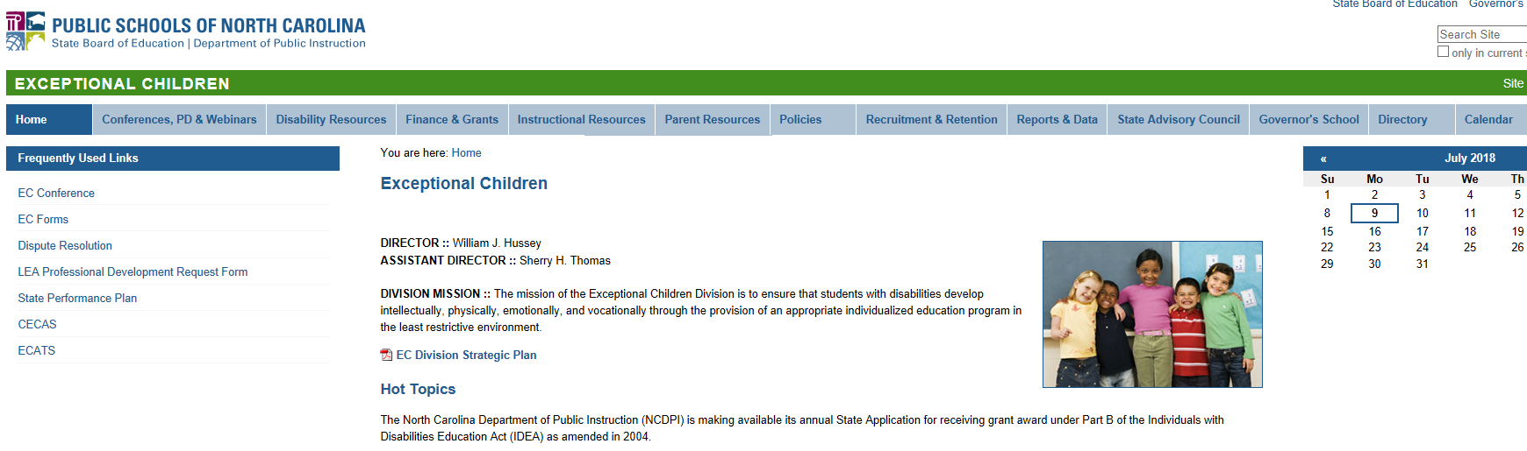
Funds are accessed via an application process.
Available at:
DPI’s EC website under Finance & Grants
http://ec.ncpublicschools.gov/finance-grants/applications

Slide 8
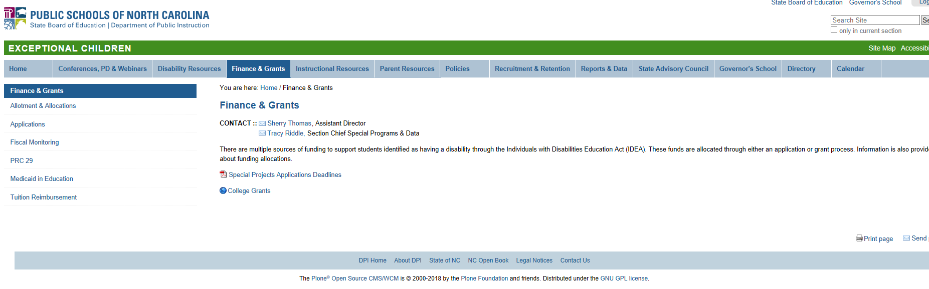
Select “Applications” from the menu.

Slide 9
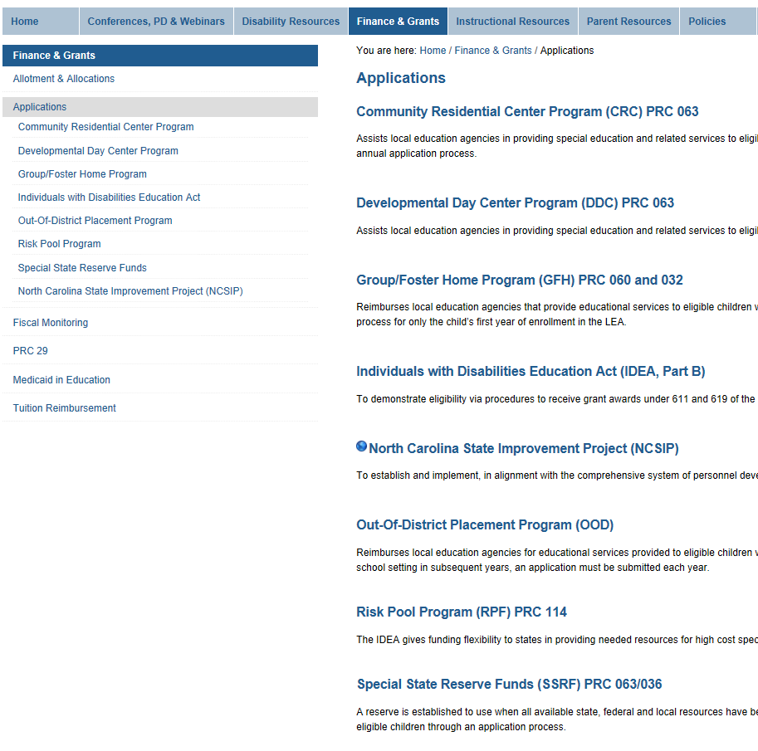
Next, a listing of the individual applications appears.
A brief description for each funding area is also provided.
Click on the funding area name to view, download and save documents or forms to complete.

Slide 10
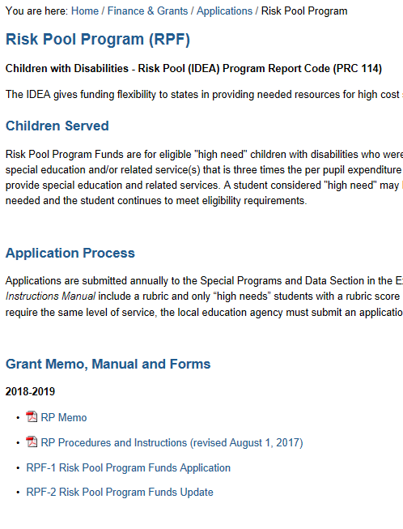
Applications, Procedures, and Instructions
An overview is provided, and a list of documents.
Click on the document to view, download, save or complete.

Slide 11

Applications are submitted by the EC Director or
Coordinator after the child has attended the first day
of school.
Notification of approval/denial is sent postal mail to the EC Director/Coordinator.
* Memo is to be shared with Finance Officer.
* Attach memo(s) to LEA’s copy of the
application that was submitted.

Slide 12

Available until all funds have been allocated.
Once grant funds are no longer available, LEAs are to use their other Federal, State and/or Local funds to meet the needs of the child(ren).
Grant funds are not guaranteed.
Funding levels may vary from year to year.
LEAs should develop financial plans for providing services to children with disabilities in the event grant funds are not available.

Slide 13

Allocated when state and federal funds are in place.
State funds – dependent upon state level budget and typically allocated in the early fall of the school year.
Federal funds – fiscal calendar means funds are allocated later in the year, typically December.
What to do about expenditures that have incurred
since the child’s first day of school?
Approved expenditures noted on the memos mailed to the EC Director or Coordinator may be recoded.

Slide 14

Conduct regular reviews of expenditures, balances and child’s status.
Ensure invoices align with contractual arrangements.
Ensure invoices reflect correct billing.
Is child still enrolled? Does he/she still require the same level of service?
Is spending on track with quarterly budget/estimates?
Are there excess funds that need to be applied to another child or reverted?
Are adjustments/amendments needed to be made with the grant application?
Will a BAAS budget amendment need to be submitted?

Slide 15

Lori Peterson, Special Projects Consultant
Special Programs and Data Section
lori.peterson@dpi.nc.gov
919-807-3932

