Slide 1
K-12 Standards, Curriculum & Instruction
Ms. Christie Lynch Ebert, Interim Director
Christie.lynchebert@dpi.nc.gov
919-807-3817

Slide 2

Stay Connected
http://www.ncpublicschools.org/curriculum/
Gov Delivery - Sign-up to receive updates in areas of interest via open listservs
C and I Leaders Listserv (contact Amy.Betsill@dpi.nc.gov and request to be added)
#NCSCOS – standards-related training on social media

Slide 3
Division Overview
Section Overview/Slides | NCDPI Contact | Resource Links
ELA | Dr. Julie Joslin | ELA Wiki ELA Livebinder
Global Education | Helga Fasciano | http://www.ncpublicschools.org/globaled/ Global Education Wiki
Healthy Schools Healthful Living Middle School Athletics Reproductive Health/Safety Ed | Dr. Ellen Essick | Healthful Living Wiki
K-12 Program Areas Arts Education English Language Development (ESL/Title III) School Counseling World Languages | Christie Lynch Ebert | Arts Ed Wiki English Language Development Wiki School Counseling Wiki World Languages Wiki
Math Science | Beverly Vance | Math Wikispace Science Wikispace
Social Studies | Fay Gore | Social Studies Wikispace

Slide 4
New Standards: ELA and MA
 | English Language Arts | Mathematics
Primary Contact | Julie Joslin, Section Chief julie.joslin@dpi.nc.gov | Beverly Vance, Section Chief beverly.vance@dpi.nc.gov
Revised Standards Adopted by SBE | K-12 (April 2017) | K-8 (June 2017)
Extended Content Standards Adopted | June 2017 | September 2017
Required Implementation | K-12 (2018-19) | K-8 (2018-19)
New Assessments | K-12 (2019-20) | K-8 (2018-19)
Materials Adoption | TBD | K-8 (2018-19)
Notes:
This chart provides an at-a-glance overview of where we are right now with the newest approved standards for K-12 ELA and K-8 Mathematics.
Both sets of standards were revised in spring/summer 2017 (April and June, respectively)
Extended content standards were approved in June and September for ELA and MA, respectively
Both areas have required implementation at the school level in the 2018-19 school year
Both have new assessments that will be implemented in either the 2018-19 or 2019-20 school year
Materials adoption schedule will take place for K-8 Math in 2018 and other content areas are under discussion and being finalized
Note: Math standards K-12 were adopted as follows:
K-8 (June 2017)
Math 1, 2, 3 (June, 2016)
Math 4 (in development 2017-19)

Slide 5
Focus Areas for Efficient, Effective, Sustainable Implementation
Communication and Visibility
Professional Development
Technical Assistance and Coaching
Research and Evaluation
Notes:
Implementation is defined as a specified set of activities designed to put into practice an activity or program of known dimensions.
The new standards have been approved and LEAs are preparing for initial implementation of these standards with students in the schools in the 2018-19 school year. These 4 focus areas for implementation: Communication and Visibility, Professional Development, Coaching and Technical Assistance, and Research and Evaluation, ensure that the new standards are implemented successfully from the state, to the LEAs, to the schools, and to ultimately impact student success.

Slide 6
Communication
and Visibility
Notes:
ELA Trailer - https://drive.google.com/file/d/1Q5i2hOh-Vz-tjWpsLz_MhrfekE-uIQmD/view
The next series of slides will progress through each focus area, beginning with communication and visibility to provide an update on the aligned efforts during this period of installation for the new standards.
Communication is embedded throughout exploration, installation, initial implementation, and full implementation of the standards. We shared with you some of the state and local efforts around communication and visibility at the February 2018 board meeting. These efforts continue, and we have a few new examples to share with you today.
State
NCDPI staff are collaborating on an overarching communication plan that reaches all of the appropriate audiences at the appropriate times, with relevant information to ensure clear and consistent communication to support standards implementation.
We are building an easily accessible standards page on the front page of http://www.ncpublicschools.org, where any stakeholder can quickly access the standards and relevant support materials for each content area.
Sample strategies to help with communication and visibility include listserv messages to various audiences; internal communications across divisions and areas; social media; webinars; wikispaces; and face to face meetings, conferences, etc.
Local
The state level communications and visibility support provides the infrastructure for LEAs and charters to develop local implementation plans. For example, District teams have a communication planning tool and process modeled through the Curriculum Leaders Collaborative. DPI provides ELA and MA virtual resources and training for local implementation and facilitates planning time for LEA teams to work on their local communication and implementation plans.

Slide 7
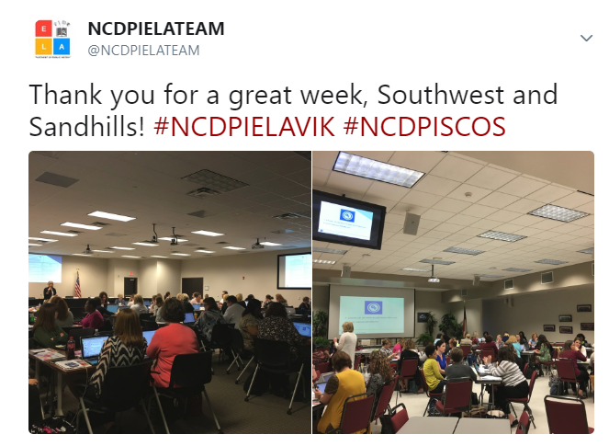
Communication & Visibility #NCSCOS
Notes:
New, since we last presented to you in February is a Twitter hashtag, which has been used in standards trainings for ELA and Mathematics this past winter and spring. Here you can see participants in the Southwest and Sandhills regions participating in ELA VIK training.

Slide 8
Professional
Development
Notes:
The following slides include information on how NCDPI is providing professional development to support stakeholders during installation of the new standards.

Slide 9
Professional Development
 | English Language Arts | Mathematics
Face to Face Professional Development Winter and Spring 2018 | Virtual Implementation Kit Regional Trainings Northeast (District 1) - 02/13/18 - Edenton Southeast (District 2) - 02/15/18 - Kinston North Central (District 3) - 03/01/18 - Raleigh Sandhills (District 4) - 02/22/18 - Fayetteville Piedmont-Triad (District 5) - 03/08/18 - Summerfield Southwest (District 6) - 02/21/18 - Salisbury Northwest (District 7) - 02/28/18 - Morganton Western (District 8) - 03/27/18 - Asheville Charter Schools - 03/23/18 - Raleigh | K-8 Mathematics Revised Standards Regional Meetings Northeast (District 1) - 02/20/18 - Plymouth Southeast (District 2) - 02/22/18 - Kinston North Central (District 3) - 03/07/18 - Henderson Sandhills (District 4) - 03/05/18 - Hamlet Piedmont-Triad (District 5) - 03/02/18 - Winston-Salem Southwest (District 6) - 02/26/18 - Charlotte Northwest (District 7) - 03/21/18 - Wilkesboro Western (District 8) - 03/22/18 - Asheville Charter Schools - 03/16/18 - Raleigh
Notes:
Professional development plans took place across all 8 districts and for charters for both English Language Arts and Mathematics during the winter and spring of 2018.
ELA Virtual Implementation Kit:
Explore the new resources and learn how to use them
Join NCDPI ELA consultants for professional development on the new resources developed by NC educators for supporting the implementation of the 2017 standards.
Who: LEAs are encouraged to bring a team of up to 5. We suggest creating a team that includes elementary, middle and high ELA leaders, coaches, and district leads.
What: Along with introducing the new resources, we will explore how to use them as a part of your ELA implementation plan.
When and where: Choose the area and date that works best for you. Click on the corresponding link to register.
Notes: All sessions are 9:00-3:00 p.m. Please bring a laptop.
K-8 Mathematics Revised Standards Regional Meetings
This session, designed for District Level Curriculum Leaders or designees, will focus on supports and information for the implementation of the Revised North Carolina K-8 Mathematics Standards to be taught and assessed beginning in the 2018-19 academic school year. The session will include an overview of the substantive changes to the standards, a sampling of the resources that will be available to support implementation, and a tentative timeline of the resource roll-out.
The session will also serve as an introduction to the follow-up workshop in late spring/early summer that will be designed specifically for teacher leaders that will be heavily involved in implementation within their districts. Therefore, it is highly encouraged that districts thoughtfully choose two individuals that can contribute to the planning and roll-out in their districts.

Slide 10
Professional Development
 | English Language Arts | Mathematics
Professional Development Summer 2018 (Virtual and F2F) | Virtual Implementation Kit (VIK) Canvas Course Trio 3 Virtual Learning Opportunities: topics based on LEA survey data | The North Carolina Collaborative for Mathematics Learning (NC2ML) Expanding the Canvas Course, K-12 (18-19 SY) K-8 Mathematics Revised Standards 2-Day Regional Meetings June 18-19 at Lake Norman High School Mooresville, NC June 21-22 at Appalachian State University Boone, NC July 9-10 at Tarboro High School Tarboro, NC July 12-13 at Southern Lee High School Sanford, NC June 17-18 – Longleaf School School of the Arts, Raleigh June 18-19 - Raleigh Charter HS
Notes:
Virtual Implementation Kit (VIK) NCDPI formed a team of educators, (Digital Supports Writers) who created digital resources to support stakeholders in the implementation of the new ELA Standard Course of Study. These resources are part of the virtual implementation kit released in January 2018.
* An additional 100 standard-focused lessons will be uploaded to the VIK in June and August. These lessons that target the expectations of the standards and do not name a specific text to allow for teacher adaptation.
Canvas Course Trio - Quite a few stakeholders are taking these self-paced, self-guided courses to learn about the new standards.
Virtual Learning Opportunities - Using the Clarifications and ‘In the Classroom’ Ideas in the Understanding the Standards Document plus two other self-guided learning opportunities, based on stakeholder feedback
Upcoming Resources:
* In September, a Canvas course will be offered. This course will be on standard-focused, text-centered instruction and will be guided by members of the ELA team.
Math Collaborative for Mathematics Learning - is a research-practice partnership that includes the University of North Carolina at Greensboro, the North Carolina Department of Public Instruction, universities, and school districts across the state of North Carolina where teachers, district and state leaders, mathematicians, and researchers work together to support mathematics education in North Carolina.
(Expanding K-12 for 18-19 school year)
K-8 Mathematics will be provide 2-day regional training on the revised standards for districts and charters. The training will build on the spring training, adding teacher leaders with district leaders for the purpose of redelivery in the LEAs/charters.

Slide 11
Technical Assistance & Coaching
Notes:
Technical assistance and coaching focuses on enabling support structures that can build upon the skills introduced within professional development. It ensures ongoing support in implementing behavior changes and provides skills to move individuals charged with leading implementation to greater proficiency.
Technical assistance is being provided in a variety of ways, including
Digital or Print Support Documents/Publications
Link to Standards
Support Documents
Wikispaces and Repositories
Print Materials

Slide 12
Technical Assistance & Coaching
 | English Language Arts | Mathematics
Digital or Print Support Documents/Publications Link to Standards Support Documents Wikispace Print Copies | VIK tools and resources ELA SCOOP (“Choose Your Own Summer Adventure”) May 23, 2018 ELA Leaders Webinar Podcasts Series “Up to Standards” (Fall 2018) | Online and print tools and resources K-8 Canvas Repository (Fall 2018) New K-8 Instructional Frameworks Math Leaders Focus Session (Summer Institute)
Notes:
This chart illustrates some of the digital or print resources that have been and will continue to be used to assist school systems with developing local implementation plans for the new standards.
Upcoming Resources:
*The VIK continues to serve as a resource for PD and technical assistance.
The ELA Resources LiveBinder has been updated to align with the 2017 SCOS. This LiveBinder is housed under a new link. The current resources LiveBinder for the 2010 standards is archived under a tab within this new LiveBinder.
* The SCOOP, the ELA quarterly newsletter was shared via listserve on June 1. It included a section that provides optional paths educators can take to determine which VIK resources to use when they begin their summer planning. Another section offers some guidance to help teachers align old lessons to the new SCOS.
* Another new resource ELA: The Basics, will be released in July. This is for beginning and lateral entry teachers. It focuses on the basics of ELA instruction and is meant to be used with the resources in the VIK.
* The Parent Guides—both English and Spanish versions-- will be available for purchase in July from publications.
* In the Fall, the ELA team will begin their podcast series Up to Standards.
NC2ML includes materials to support the standards as well as research-based materials that can specifically be used for coaching to impact instruction.
A new, K-8 Canvas Repository will be available in Fall 2018, and will be accessible from the NC2ML site. The Canvas Site includes standards, support documents, and opportunities to discuss math for NC educators, K-8.
New K-8 Instructional Frameworks, created as part of the MSP projects, are available on NC2ML.
A Math Leaders Focus Session will take place during the summer regional PD. The focus session will provide information and support on ESSA and the new accountability model.

Slide 13
Technical Assistance & Coaching
ELA Leaders Webinar May 23, 2018
6 School Systems shared local implementation plans with ~130 participants | Alamance Burlington Charlotte-Mecklenburg Cumberland Nash-Rocky Mount Robeson Wilkes | *Other local implementation plans are being compiled and linked in collaborative space
Notes:
Here is an example from a recent webinar hosted by the ELA section at NCDPI with a focus on local implementation plans. There were approximately 130 participants, and 6 individual systems (listed here) shared their local implementation plans with participants.

Slide 14
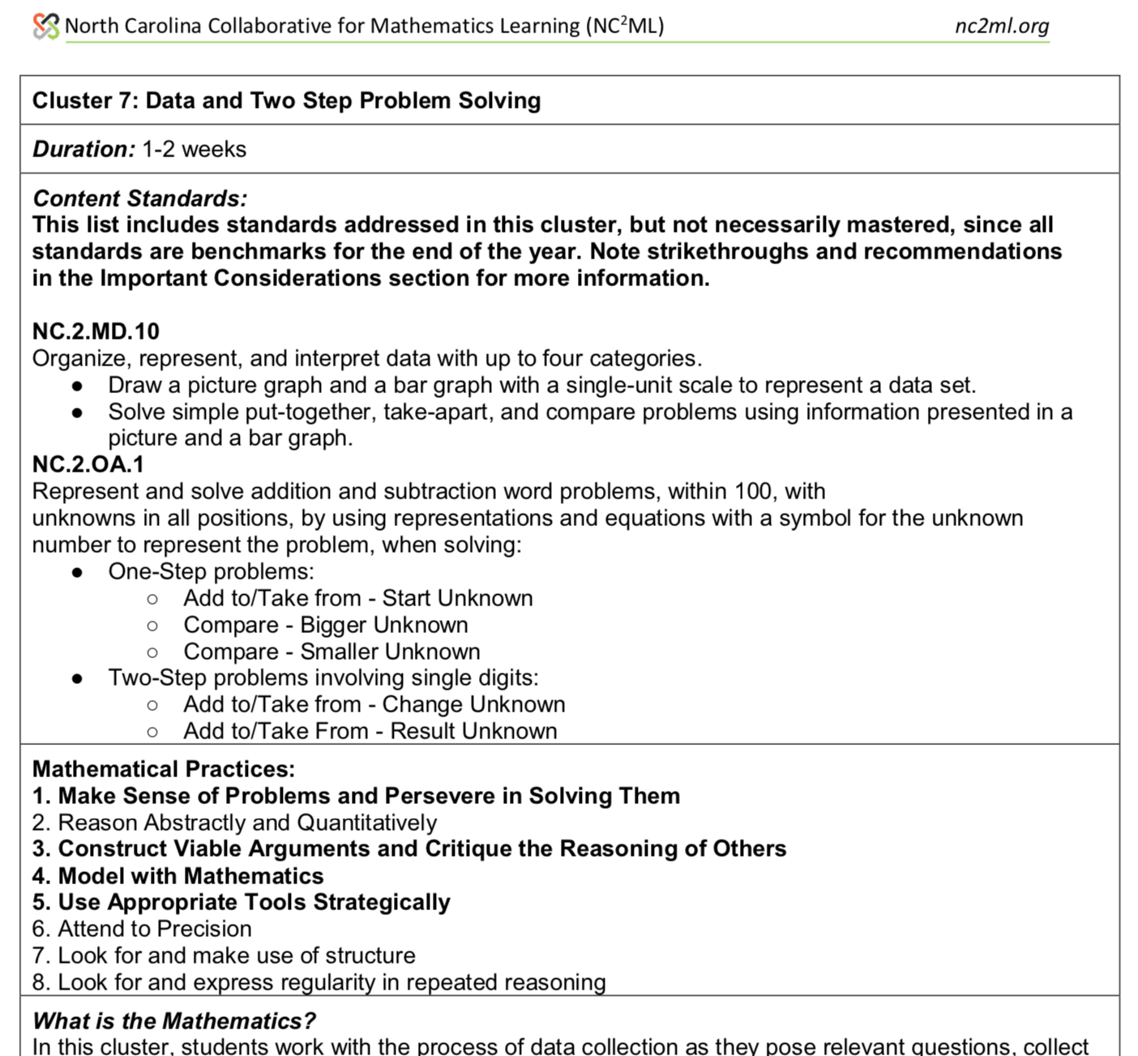
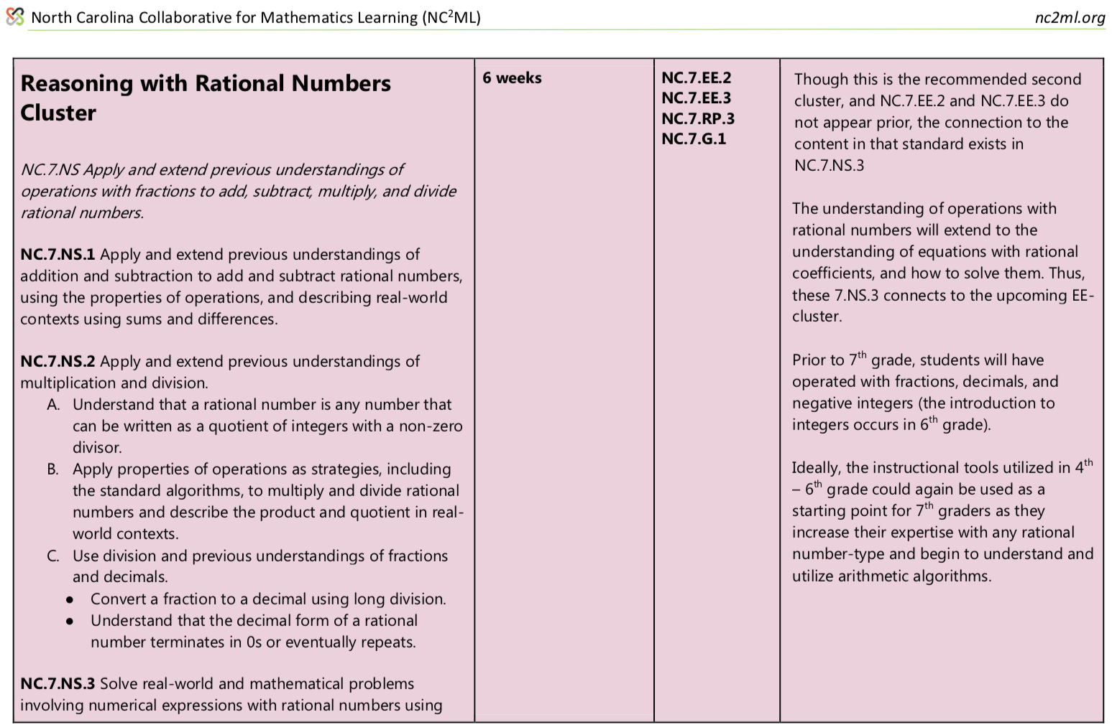
Math Example: Technical Assistance & Coaching
Notes:
The new K-8 instructional frameworks provide an approach to pacing clusters of standards based on research and learning progression of content for each grade level.

Slide 15
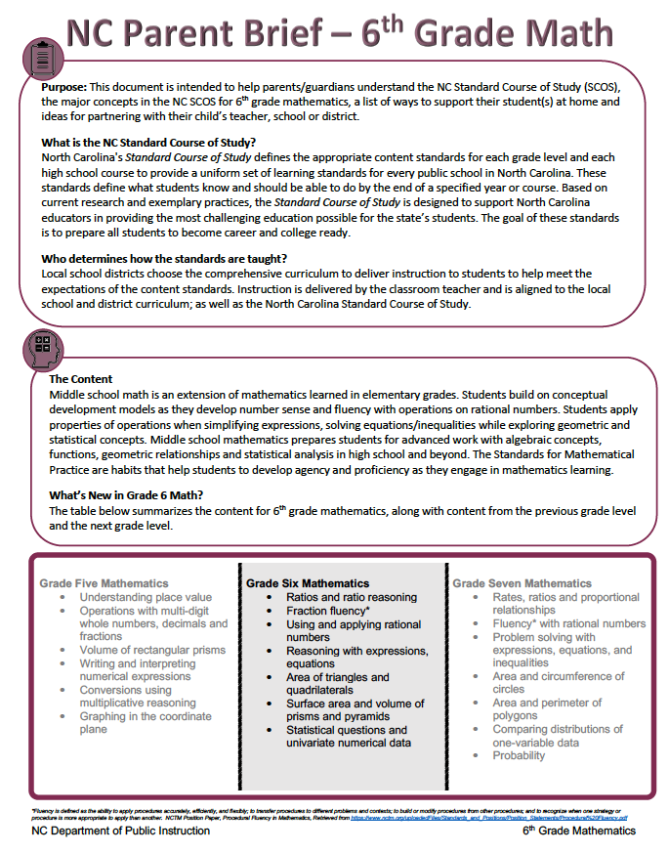
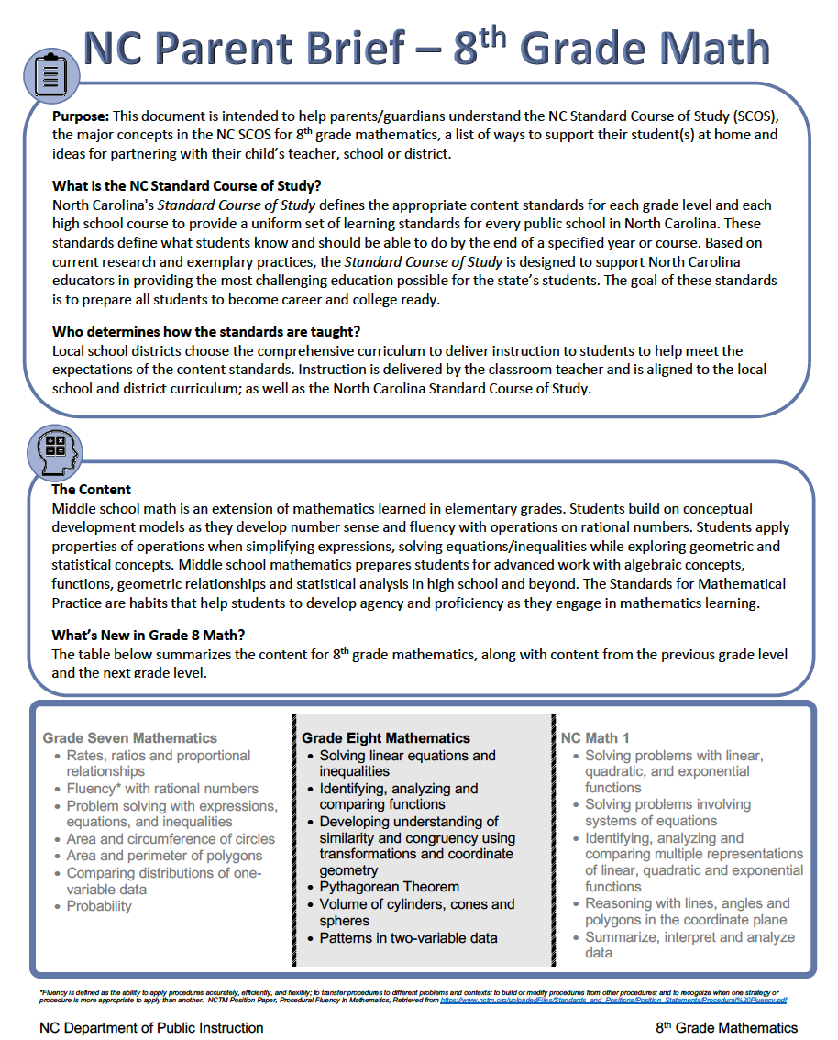
Math Example: Technical Assistance & Coaching
Notes:
This slide gives you an example of technical assistance for parents in mathematics for grades 6 and 8. The parent guides will be provided with the instructional resources to help parents at each grade level.

Slide 16
Research and
Evaluation
Notes:
The last focus area is research and evaluation.

Slide 17
Research and Evaluation
 | English Language Arts | Mathematics
Continuous evaluation and study of standards implementation | Focus groups and surveys to inform materials Evaluation of training and support documents Evaluation and reporting on the implementation of the standards Surveys for virtual learning topics Compiling local implementation plans New with SCOS-012 - Annual Report
Notes:
This table illustrates some of the ways that Research and Evaluation are used throughout the standards review, revision, and implementation process. During this stage in the process (installation), we have used focus groups to inform materials development and refinement; we are implementing feedback loops through instructional materials and websites; and we are incorporating evaluation as a component for all training and support documents.
Collecting information from internal and external stakeholders and inviting them to inform materials, resources, and PD needs; For example, Dr. Sulock, a retired veteran teacher of 45 years continues to work with our teachers and students and collects feedback on the implementation of the standards, which she shares with NCDPI in an ongoing basis,

Slide 18

Standards Survey for ELA and MATH
Thank you for attending a North Carolina Department of Public Instruction Training for English Language Arts or Mathematics. Please take a few moments to respond to the questions below. Your responses will inform future training and support and will help us to know how the information you learned today will impact your implementation of the NC Standard Course of Study in your school/system. Don't forget to tweet about your learnings to help share with other NC educators using #NCDPISCOS
Notes:
One example of how we are using research and evaluation with standards implementation is the development of a consistent survey, which was used with participants in the winter and spring ELA and MA PD sessions. The responses are being used to inform future training and support and to help us know how the information learned will impact local standards implementation.

Slide 19
Standards Survey for ELA and MATH
642 Responses - February 2018 - Present
All Regional Districts including Charters, VPS, Residential Schools
Audience: K-12 Central Office Coordinators, Lead Teachers, DPI Staff, Others (Curriculum Resource Teachers, Instructional Coaches, Principals, Specialists)
Majority SATISFIED with the Quality of Training (97%) and the Quality of Materials/Resources shared during the training (98.15%)
99.5% of participants indicated that the information from the training will impact standards implementation in their schools or districts
Notes:
Here you see a summary of survey responses to date:
642 Responses - February 2018 - Present
All Regional Districts including Charters, VPS, Residential Schools
Audience: K-12 Central Office Coordinators, Lead Teachers, DPI Staff, Others (Curriculum Resource Teachers, Instructional Coaches, Principals, Specialists)
Majority SATISFIED with the Quality of Training (97%) and the Quality of Materials/Resources shared during the training (98.15%)
99.5% of participants indicated that the information from the training will impact standards implementation in their schools or districts

Slide 20
How Training will be used in Local Standards Implementation
Face to face professional development with teachers | 29.11% | 559
Local materials development (print or virtual) | 22.29% | 428
Stakeholder communications (parents, local school board, teachers, etc.) | 18.54% | 356
Professional Learning Community (PLC) discussions | 28.49% | 547
Other | 1.56% | 30
Total | 100% | 1920
Notes:
This slide depicts ways that charters and school systems are using the training to inform local standards implementation. Other responses included working with leadership to determine next steps, developing canvas-based training, summer PD, and other decisions for using the rich materials that were shared.

Slide 21
Comments from Stakeholders
I've been in NC for 22 years now and this is the most comprehensive and systematic roll out of new curricula that I have seen. Thank you for your work to make this meaningful for all stakeholders. It will make my job as an ELA specialist much more efficient and manageable, allowing me to spend more time on the actual implementation and professional development.
The ELA department have knocked it out of the park. I have rarely attended a more useful PD session that had usable products at the end. Thank you.

Slide 22
Comments from Stakeholders
Thank you for providing this training - it provided a much better understanding of the benchmarks and where the different types of math fit in by grade level and the progression that is needed to be made.
I have been given a wealth of information concerning the new mathematical standards. This has been so refreshing and is in such a format that it is very teacher-friendly and just makes "sense". Thank you so much.

Slide 23
Mathematics Surveys & Public Input
Mathematics Education Survey (K-Math 3)
Who?
Teachers, school-based coaches, curriculum facilitators, principals, assistant principals, district level personnel
What?
Mathematics Teaching and Learning
Research
Professional Learning
Perceptions on Existing Resources
Please take this short 10-15 min survey to help inform future resources available for teachers: 2018 North Carolina Mathematics Education Survey
Notes:
This is an example of a survey done last year, as part of our ongoing efforts to improve mathematics education in NC by supporting teachers in implementing mathematics standards. The survey elicited responses from teachers; school-based coaches, curriculum facilitators, principals, and assistant principals; and district level personnel.
The survey was developed by NC DPI Mathematics Section and The North Carolina Collaborative for Mathematics Learning (NC²ML), a partnership of mathematics educators and researchers from DPI, institutions of higher education, districts, schools, and teachers across our state to support and research the process of implementing mathematics standards.

Slide 24
Standards - Next Steps
Continue to foster cross-sector collaboration around standards implementation
Apply consistent processes to the entire NC SCOS, as we implement SCOS-012 (approved by SBE March 2018)
Notes:
We have provided an update on the implementation of the installation of the K-12 ELA and K-8 Mathematics Standards during the 2017-18 school year in alignment with Implementation Science.
As we move forward toward initial implementation of the standards in the 2018-19 school year, we will continue our internal and external collaborative efforts toward supporting this implementation. All the resources and our future work are designed to help districts in their planning.
Additionally, we will be applying the lessons learned from ELA and MA implementation to new standards as they are developed as part of our State Implementation Plan for each content area. An internal PM team is focusing its work on internal procedures for the review, revision, and implementation of the NCSCOS in alignment with the policy passed by this board in March 2018.

Slide 25

Global Education
State Board of Education Vision
Every public school student, through access to needed resources and rigor, will graduate ready for post-secondary education and work, prepared to be a globally engaged and productive citizen.
http://www.ncpublicschools.org/globaled/
Notes:
Since 2004, the SBE vision statement has included a reference to students being globally ready and LEAs have adopted global education or global readiness as part of their vision and strategic plan.
In 2011 the SBE Chairman appointed a Task Force on Global Education with a focus on bringing to the full Board recommendations that would foster global competence in our public school graduates. The Task Force engaged in strategic listen and learn meetings over a period of 18 months. They heard from public school districts, principals, state agencies, university global or international centers, colleges of education representing public and private universities, state business leaders, national experts on global practices, economics, assessments and international experts.
The final report from the Task Force adopted by the full Board in January 2013, recommends 5 Commitments under which 10 action items will provide the support and sustainability of efforts to meet the goal of graduating students prepared to be globally engaged.

Slide 26
NC Global Education
The State Board of Education in 2014 and 2015 took action to provide statewide infrastructure that supports and guides educators in a common vision for global education North Carolina Public Schools. It designated recognition for educators, schools and districts that show significant focus and dedication.
Global Educator Digital Badge
Global - Ready Schools Designation
Global - Ready District Designation
Global Languages Endorsement
NC Dual Language/Immersion Programs
Notes:
Note to Tiffany: If you click on the word “Global Educator Digital Badge” it will take you to the flyer which provides more information on the actual process. The policy link will take you to the policy.
The State Board of Education took action on TCP-H-001 in October 2014 which outlines the criteria for teachers evaluated on the NC Professional Teaching Standards. These standards already contain the global awareness elements and earning this digital badge provides an opportunity for focused professional development that aligns to those global awareness goals and application of developed skills in the classroom as evidenced by the Capstone Project which consists of a unit(s) on their Standard Course of Study with global elements embedded. Note: this is not an endorsement on the educator’s licensure. Once the digital badge is earned, it will be noted on the educator’s profile in Home Base. The educator can note this badge through social media, attach it to resume’s or conference proposals as the badge will include meta data on what the badge is and when it was earned. The resulting Capstone Project becomes a global education resource within Home Base.
SBE approved at the October 2015 meeting the expansion of educators to earn the badge that are not evaluated on the teacher standards. This includes for example, media coordinators, technology facilitators, school counselors, principals, central office staff and superintendents.

Slide 27

Contact and Resources
Helga Fasciano
Special Assistant for Global Education
helga.fasciano@dpi.nc.gov
http://www.ncpublicschools.org/globaled/
http://gled.ncdpi.wikispaces.net/
http://ncdliprograms.ncdpi.wikispaces.net/
Notes:
Should you have any additional questions regarding the SBE’s Global Education initiative, please contact Helga Fasciano, Special Assistant for Global Education at the email indicated and/or visit the DPI Global Education web page.

Slide 28

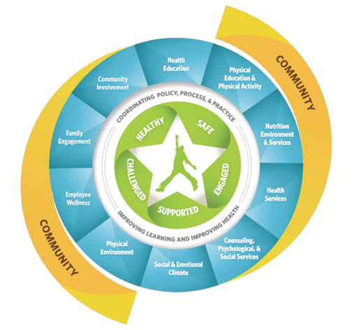
The Whole School, Whole Community, Whole Child (WSCC) model expands on the eight elements of CDC’s coordinated school health (CSH) approach and is combined with the whole child framework.
NC Healthy Schools frames its work in the context of this model
Notes:
The work of the Healthy Schools Section is guided by the Whole School, Whole Community, Whole Child Model. An expansion of the former Coordinated School Health Model, this model recognized the need to all systems to work together for student success.

Slide 29

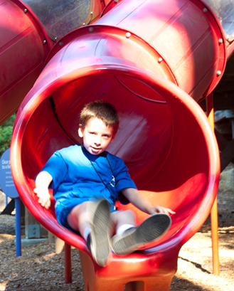
Healthy Schools: Healthy Active Children Policy
30 minutes of Physical Activity Daily
Physical Activity may not be used as punishment
Recess may not be withheld as a form of punishment
Notes:
The Healthy Active Children policy was updated in June 2014.

Slide 30
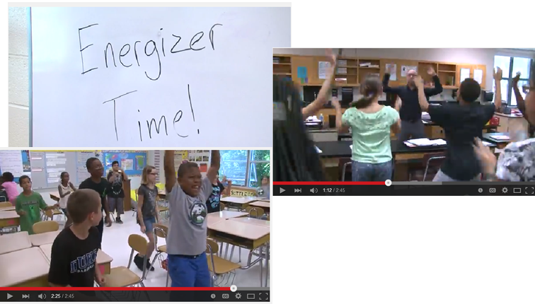
Energizers
•https://www.youtube.com/watch?v=iFUZ_KbLfEE&feature=youtu.be
Notes:
The North Carolina Energizers, which integrate physical activity into other curriculum areas, have been updated and are available to help schools meet their 30 minutes of physical activity. Click the link in the slide above to see our new video describing the importance incorporating physical activity into the classroom.

Slide 31
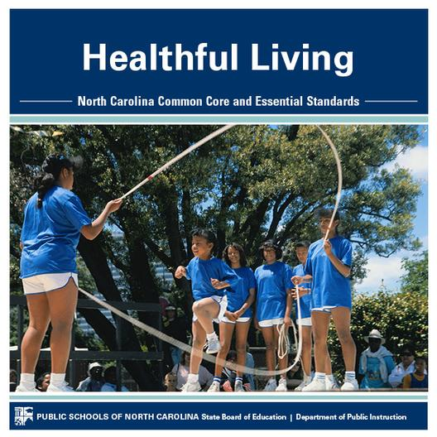
Healthy Schools: Healthful Living Education
Energizer Updates
Gfeller-Waller Concussion resources
Monthly Updates
CPR Instructional resources
http://hlnces.ncdpi.wikispaces.net/Healthful+Living+Home
Notes:
The Healthful Living consultant oversees the implementation of the Essential Standards for K-12 Health and K-12 Physical Education.
The newest resource for Healthful Living is the addition of Elementary Lesson Plans. The lesson plans are free and incorporate ELA and/or Mathematics in to each of the K-5 Health Education Essentaion Standard Objectives

Slide 32

Healthy Schools: Middle School Athletics
Rule Development
Oversight
Rule Interpretation
http://hlnces.ncdpi.wikispaces.net/Healthful+Living+Home
Notes:
The Healthful Living Consultant also oversees middle school athletics He sits ex-officio on the board of the North Carolina High School Athletic Association (NCHSAA) to ensure that policies and guidance are consistent from middle to high school.

Slide 33

Healthy Schools: HIV/STD Prevention
CDC Funding addressing 4 Approaches
Exemplary Sexual Health Education
Access to Sexual Health Services
Safe and Supportive Environments for Students and Staff
Policy
Notes:
NC Healthy Schools receives funding from the Centers for Disease Control (CDC) to work specifically on HIV/STD prevention in the 15 LEAs with the highest rates of HIV. In order to create a comprehensive approach to prevention, each LEA works in 4 specific areas. (ESHE, SHS, SSE and Policy)

Slide 34
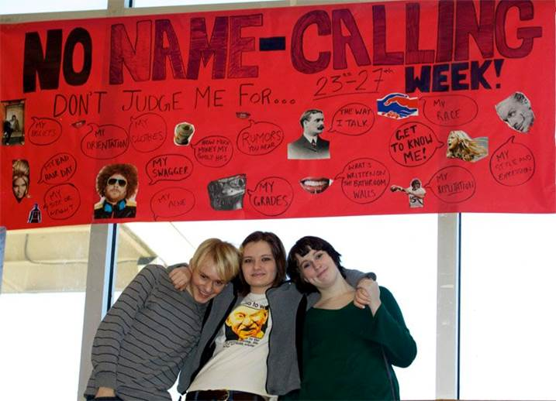
Healthy Schools: Youth at Disproportionate Risk
PD for Teachers and Administrators:
How to be an Ally to LGBTQ Youth
https://www.youtube.com/watch?v=FYGZdfJQ4_g
Working with Transgender Youth
Notes:
The CDC also requires that schools work to create safe and supportive environments for all student including Youth and Disproportionate Risk for HIV Infection. Healthy Schools provides PD for Teachers and Administrators

Slide 35

Healthy Schools: Title V Abstinence Education
Health Education
Parent/Community
Involvement
Health Services
Behavioral Health
/Mental Health Services
Notes:
NC Healthy Schools also receives funding from the Administration of Children and Families (ACF) to work in 19 LEAs with high rates of teen pregnancy in four specific areas. LEAs receive funding for puberty education, parent involvement, provision of health services and behavioral/mental health services.

Slide 36

Healthy Schools: Data Collection
Youth Risk Behavior Survey
Measures student self-reported health behaviors on 6 Serious Health Risks for youth.
Provides valuable data for health education programing.
Profiles
Measures school level policies and programs for student health
Notes:
Finally the work of Healthy schools is informed by data collected from two sources. YRBS data is collected on odd number years from randomly selected schools and students. Profiles data is collected on even number years from randomly selected principals and lead health education teacher.

Slide 37
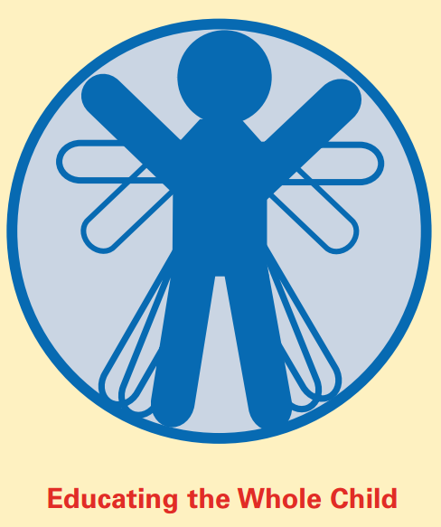
K-12 Program Areas
K-12programareas@dpi.nc.gov
The K-12 Program Areas support a balanced, comprehensive, and globally competitive education for every child.
Linda Crouch Christie Lynch Ebert
Program Assistant V Section Chief
Arts Education
Jeremy Tucker (Music, Theatre)
Slater M. Mapp (Dance, Visual Arts)
ESL/Title III
Marshall Foster (Regions 5, 6,7,8)
Vicky Kriegsman (Data Specialist)
Xatli Stox (Regions 2, 4, and Charters)
Ivanna Anderson (Regions 1,3, and Consortia)
School Counseling
Cynthia Floyd
World Languages
Ann Marie Gunter
Notes:
The K-12 Program Areas include Arts Education (Dance, Music, Theatre Arts, and Visual Arts), ESL/Title III, School Counseling, and World Languages. The K-12 Program Areas support a balanced, comprehensive and globally competitive education for every child.
Please note the section email address: k-12programareas@dpi.nc.gov or contact the individual(s) for a particular area by clicking on their names to be hotlinked to their respective email addresses. You may also contact Linda Crouch, Program Assistant, who can assist with connecting you with the appropriate person or information.

Slide 38
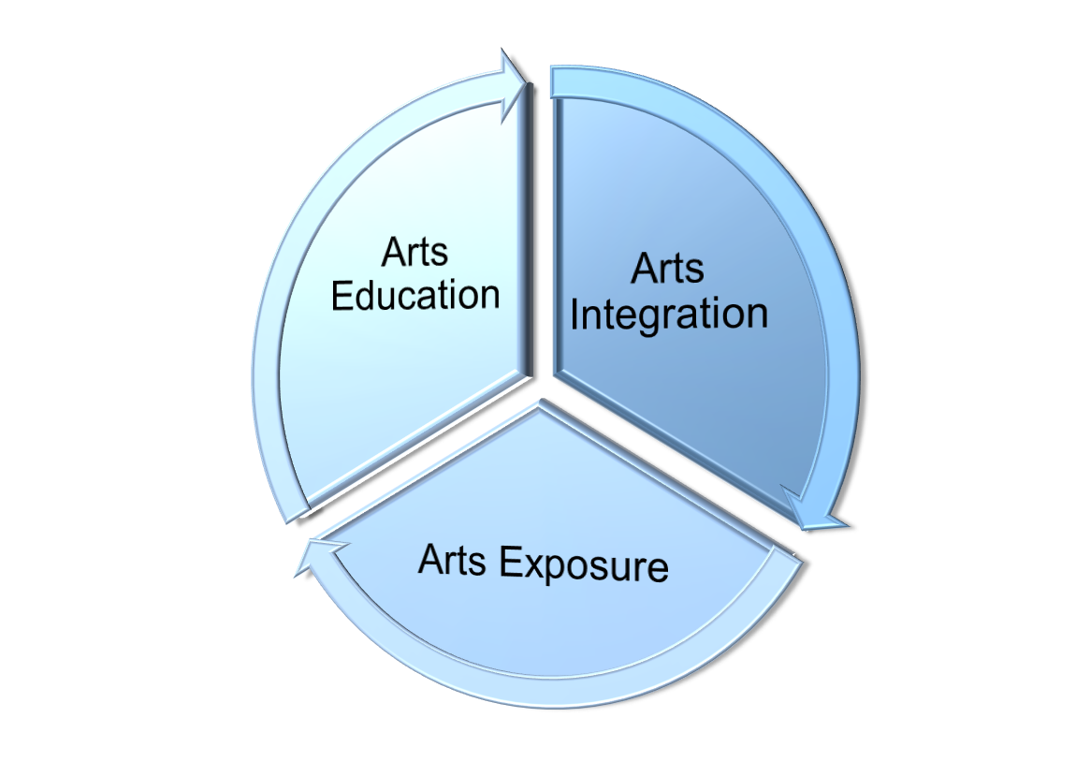
K-12 Program Areas
Arts Education
Comprehensive Arts Education
In today’s globally competitive world, innovative thinking and creativity are essential for all school children. High quality, standards-based instruction in the arts develops these skills and effectively engages, retains, and prepares future-ready students for graduation and success in an entrepreneurial economy. Dance, music, theatre arts, and visual arts, taught by licensed arts educators and integrated throughout the curriculum, are critical to North Carolina’s 21st century education.
Notes:
ABOUT ARTS EDUCATION
Arts Education is a collective term for the four separate and distinct disciplines of dance, music, theatre arts, and visual arts, each with its own body of content and skills. Arts Education should be viewed as a full partner in the academic community and fundamental to the total school curriculum. Public School Law 115C-81 specifies arts education as part of each child's education and the federal Elementary and Secondary Education Act (ESEA) identifies the Arts as core, academic subjects. The arts are one of the best ways to teach 21st century skills such as creativity and innovation; critical thinking and problem solving; communication and collaboration; flexibility and adaptability; initiative and self-direction; social and cross-cultural skills; and leadership and responsibility.
NC has a statewide definition and vision for Comprehensive Arts Education.
These three, inter-dependent components (arts education, arts integration, and arts exposure) define a comprehensive arts education. (All 3 are important and critical, are owned by many parties, and focus on the student at the center)
This is the Vision for Arts Education, as developed by the 2010 S66 Comprehensive Arts Education Task Force members.
“In today’s globally competitive world, innovative thinking and creativity are essential for all school children. High quality, standards-based instruction in the arts develops these skills and effectively engages, retains, and prepares future-ready students for graduation and success in an entrepreneurial economy. Dance, music, theatre arts, and visual arts, taught by licensed arts educators and integrated throughout the curriculum, are critical to North Carolina’s 21st century education.”
The Task Force had extensive discussion regarding why the arts were critical to preparing globally competitive, future-ready students who will be successful in school and in life. They also discussed how arts education should occur (taught by licensed arts educators AND integrated throughout the curriculum) in NC schools. This is the vision that shapes continued cross-sector collaboration with the NC Department of Public Instruction, NC Department of Cultural Resources, and partners throughout the state who are working to ensure that all NC students have access to arts education as part of a balanced, comprehensive, and competitive education.

Slide 39

Arts Education Support
Arts Education Think Tank
Arts Education Coordinators
Arts Education Leadership Coalition
ArtsR4Life Conference and Ongoing PD
Webinars and Virtual Meetings
Support Materials and Resources
Please visit the ArtsR4Life web page on this wiki for additional information!
K-12 Program Areas
Notes:
NCDPI professional development is framed under the theme, ArtsR4Life, for the 2015-16 school year.
ArtsR4Life kicks off with NC Arts Education Think Tank, Coordinators, Arts Education Leadership Coalition, and the first ever ArtsR4Life conference in September 2015.
The year continues with webinars, presentations at professional conferences, and other support materials to assist stakeholders with implementing the NC Arts Education Essential Standards.
Please visit the ArtsR4Life web page on this wiki for additional information!

Slide 40

K-12 Program Areas
Stay Connected: Arts Education
Follow us on Twitter:
@ARTSEDNC
Like Us on Facebook at “N.C. K-12 Arts Education”
Arts Ed Wikispace
http://ances.ncdpi.wikispaces.net
Join the ArtsEd Listserv to stay informed:
https://public.govdelivery.com/accounts/NCSBE/subscriber/new
Notes:
Please stay connected with NCDPI Arts Education via any of the following options (Twitter @ARTSEDNC; Facebook: N.C. K-12 Arts Education; Arts Ed Wikispace (http://ances.ncdpi.wikispaces.net); ArtsEd Listserv (join-artsed@dpi.state.nc.us)

Slide 41
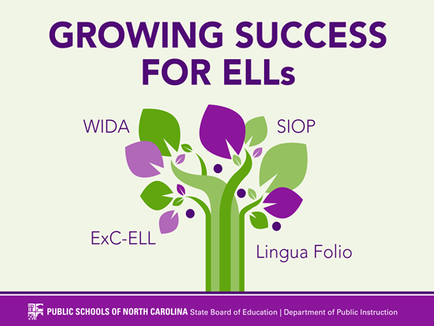
ESL/Title III: Highlights
K-12 Program Areas
Annual ELL Support Conference: Growing Success for ELs August 7-9, 2018 and other Professional Development
Annual EL Coordinators meetings
Charter School Support
http://eldnces.ncdpi.wikispaces.net/NC+Charter+Schools
Title III Information
Notes:
You may access a variety of materials and resources by clicking on the relevant links associated with each item. Some recent or upcoming highlights include:
Annual ELL Support Conference: Growing Success for ELLs August 3-5th, 2015
Summer Conference Materials
Annual LEP Coordinator meeting September 28-29th, 2015
LEP Coordinator Meeting Materials 2014
Title III Application Review Process ends October 31, 2015
Title III Information

Slide 42

School Counseling
K-12 Program Areas
Provides leadership, professional development and technical assistance to build and sustain capacity of LEAs and charters in the implementation of
the NC Professional School Counselor Standards and Evaluation,
the NC K-12 Guidance Essential Standards, and
G.S. 115C-316.1 Duties of School Counselors
in order to implement data-driven comprehensive school counseling programs that effectively address the varied needs of all learners.
Notes:
NCDPI School Counseling provides leadership, professional development and technical assistance to build and sustain capacity of LEAs and charters in the implementation of
the NC Professional School Counselor Standards and Evaluation,
the NC K-12 Guidance Essential Standards, and
G.S. 115C-316.1 Duties of School Counselors
in order to implement data-driven comprehensive school counseling programs that effectively address the varied needs of all learners.

Slide 43

School Counseling Resources
K-12 Program Areas
NCDPI School Counseling Wikispace http://schoolcounseling.ncdpi.wikispaces.net/
NCDPI School Counseling Web Pages http://www.ncpublicschools.org/studentsupport/counseling/
NCDPI School Counseling Evaluation Resources http://ncees.ncdpi.wikispaces.net/Support+Staff
NCDPI School Counseling on Facebook https://www.facebook.com/ncdpi.schoolcounseling
Cynthia Floyd at cynthia.floyd@dpi.nc.gov
Notes:
Please access any of these resources to stay connected with NC School Counseling:
NCDPI School Counseling Wikispace http://schoolcounseling.ncdpi.wikispaces.net/
NCDPI School Counseling Web Pages http://www.ncpublicschools.org/studentsupport/counseling/
NCDPI School Counseling Evaluation Resources http://ncees.ncdpi.wikispaces.net/Support+Staff
NCDPI School Counseling on Facebook https://www.facebook.com/ncdpi.schoolcounseling
Cynthia Floyd at cynthia.floyd@dpi.nc.gov

Slide 44

World Languages Resources
K-12 Program Areas
World Languages Wiki
http://wlnces.ncdpi.wikispaces.net
Featuring . . .
3 Administrator Guides or “Look For” documents for principals under the NCSCS World Language Essential Standards and Instructional Tools tab: http://wlnces.ncdpi.wikispaces.net/NCSCS+%26+Instructional+Tools
World Language Listservs
District & Charter Coordinators
K-12 Language Teachers
College & University Instructors
Dual Language/Immersion Educators
LinguaFolio Information & Updates
Spanish for Native Speakers/Heritage Language Teachers
Sign up for the listservs at https://public.govdelivery.com/accounts/NCSBE/subscriber/new

Slide 45

Science
Need help planning your
Science Summer Institute?
The science team is prepared to assist!
Please contact:
Beverly Vance
beverly.vance@dpi.nc.gov
919-807-3936

Slide 46

Social Studies
Section Members
Fay Gore Section Chief | fay.gore@dpi.nc.gov 919.807.3954
Bernadette Cole Program Assistant | bernadette.cole@dpi.nc.gov 919.807.3847
Tom Daugherty K-12 Consultant | thomas.daugherty@dpi.nc.gov 919.807-3862
Justyn Knox K-12 Consultant | justyn.knox@dpi.nc.gov 919.807.3835
Michelle McLaughlin K-12 Consultant | michelle.mclaughlin@dpi.nc.gov 919.807.3924
Phylisha Sanders K-12 Consultant | phylisha.sander@dpi.nc.gov 919.807.3832

Slide 47

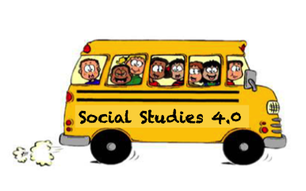
Social Studies
K-12 Support Tools
Programmatic Supports
Components of An Effective Social Studies Program
Practice Profile for Concept-Based Curriculum and Instruction Framework
The Founding Principles Support Document - Coming Soon
The K-12 Social Studies Guidebook - Coming Soon
Instructional Supports
Look-for’s Document for Discussion, Observation and/or Feedback
Strand maps used to promote disciplinary literacy, have vertical conversations, and build a learning trajectory
Note: Contact any member of our team for more information.

Slide 48


Social Studies
Character Development
Social Studies & Healthy Schools Collaboration
NCDPI Student Leadership Institute
Character Matters
Notes:
The Social studies team has partnered with the Healthy Schools section on two initiatives focused on character development. (1) Student Leadership Institute, a residential, summer institute for students in grades 4th through 11th grades. This is an application-based program focused on building character and leadership capacity in youth through teamwork and service learning. Visit the Character Matters site for more information. Character Matters is a statewide initiative that shares the message that character really does matter in the home, school, work and play. Districts, schools, and community can share their stories of character, leadership, and service by visiting the website and contacting us. This is a partnership with Capitol Broadcasting (Fox50/WRAL).

Slide 49

Social Studies
Student Opportunities
United States Senate Youth Program
An educational opportunity open to high school juniors and seniors interested in pursuing careers in public service. Two student leaders from each state, the District of Columbia and the Department of Defense Education Activity will spend a week in Washington experiencing their national government in action. All transportation, hotel and meal expenses will be provided by The Hearst Foundations. In addition, each delegate will also be awarded a $5,000 College Scholarship for undergraduate studies, with encouragement to pursue coursework in history and political science.
Learn more: http://senateyouthnc.webs.com
Contact: Michelle.McLaughlin@dpi.nc.gov
Notes:
More about Senate Youth Program: Student delegates will hear major policy addresses by Senators, cabinet members, officials from the Departments of State and Defense and directors of other federal agencies, as well as participate in a meeting with a Justice of the U.S. Supreme Court.

Slide 50

Staying Connected to Social Studies
Subscribe to our GovDelivery Listserv
Listen to Archived Webinars
Like us on Facebook
Follow us on Twitter
Get reminders of upcoming events by registering with Remind.com either via email or cell phone.
50

Slide 51
Division Overview
Section Overview/Slides | NCDPI Contact | Resource Links
ELA | Dr. Julie Joslin | ELA Wiki ELA Livebinder
Global Education | Helga Fasciano | http://www.ncpublicschools.org/globaled/ Global Education Wiki
Healthy Schools Healthful Living Middle School Athletics Reproductive Health/Safety Ed | Dr. Ellen Essick | Healthful Living Wiki
K-12 Program Areas Arts Education English Language Development (ESL/Title III) School Counseling World Languages | Christie Lynch Ebert | Arts Ed Wiki English Language Development Wiki School Counseling Wiki World Languages Wiki
Math Science | Beverly Vance | Math Wikispace Science Wikispace
Social Studies | Fay Gore | Social Studies Wikispace

