Slide 1
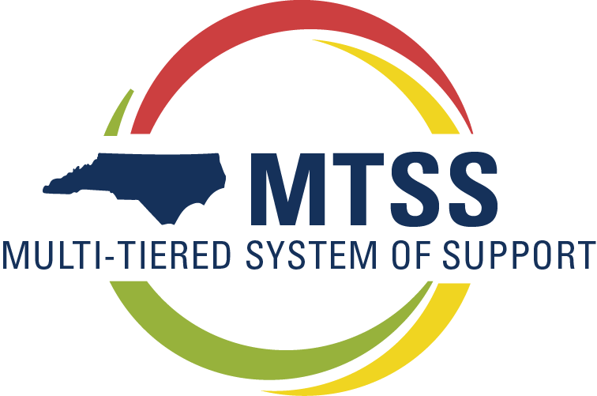
Notes:
“Welcome to the first of 6 workshop for district and school teams who are seeking to install and improve an MTSS.”
Introduce workshop goals-
Ensure common language
Focus on the leadership component of mtss
Develop effective teams
Support the implementation by creating and communicating a vision
Providing resources
Sharing tools
Facilitating opportunities for planning and networking
Introduce team presenting
Acknowledge expertise and experience in the room
Motivation to be in attendance
House keeping:
Start and stop time, breaks, lunch,
Restroom
Cell phones
How to handle questions
How to get groups attention

Slide 2

Introduction
to MTSS
Our support
Why MTSS?
Notes:
A brief description of what we’ll be covering during the meeting
3 topics on the slide

Slide 3
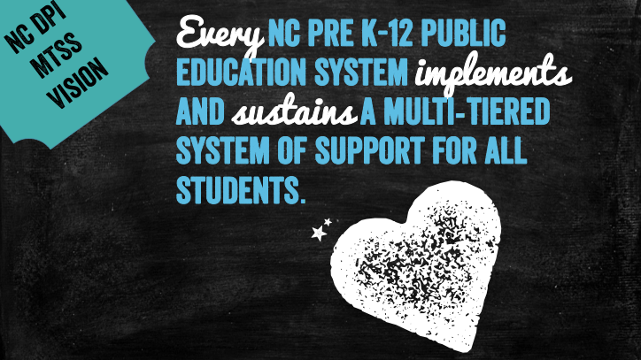

Slide 4
Structure your school in LAYERS OF INSTRUCTIONAL SUPPORT
Intensive
Support
Supplemental
Support
Differentiated
Core
Notes:
This graphic is the best depiction of the model we currently have. Many education models have this idea of a triangle or pyramid. They all start with the idea of what is the foundation of the work and what support is given to all, some and few students. This graphic though is intentionally turned to show the layering of instructional support that MTSS asks we implement. We start with this bottom triangle of differentiated core instruction for all students. What is it that all students receive for academics and behavior? This is the foundational layer and should produce good outcomes for the majority of students. We spend a lot of time here within our full training. What we realized was that when the focus is on the interventions provided for students that require more than core instruction without first figuring out if what we have in place for all students is effective at our sites, our educators spend a lot of time spinning their wheels trying to intervene without great success. No amount of intervention for individual students is going to get the outcomes that impoving core instruction will get us. So we start there with how is what we are providing to all students working? That is our foundation and it should be really strong. It should meet the needs, without any additional intervention, of aobut 80% of students. This allows supplemental and intensive instruciotn/support to do the job of closing gaps for that 20% that require it. You can see that those intervention layers of supplemental and intensive are layered on top of core instruction. So that students that require more than core are actually getting just that- more than core. But in addition it is all connected to core instruciton. Supplemental is in place to supplement core and there fore should be connected to core. It is there to supplement not supplant core instruction. Then intensive is that most intensive instruction in the building for academics and behavior. This is not necessarily students with disabilities but just based on need which may include students with disabilities but may also be students without disabilities who require that most intensive support in addition to supplemental and core.

Slide 5

MTSS
definition
our words
NC MTSS is a multi-tiered framework which promotes school improvement through engaging, research-based academic and behavioral practices. NC MTSS employs a systems approach using data-driven problem-solving to maximize growth for all.
School Improvement
Notes:
Let’s begin with a very quick introduction that will provide some context for where we’re coming from:
This is who we are – this is the framework we are working with your district leadership to build.
Framework (continue to reinforce that this is not a process)
School Improvement (each building problem solves the unique needs of their school – we begin by taking a look in the mirror through the examination of group data and focusing primarily on the core)
Academic and behavioral (problem-solving teams look at academic and behavior data at the same time - – point out that this is one of the features that distinguishes MTSS from RtI)
Systems approach (this is a total school improvement model that takes a systems approach to change)
Data-driven problem solving (MTSS takes a team approach to problem solving using a research-based model. These are weighty issues we’re dealing with, let’s take the pressure off of the individual. This approach allows us to move from “admiring the problem” to “solving the problem”)
ALL (not just for struggling learners)

Slide 6
In this framework,
we think about
what we are doing,
examine the
results we’re
getting and we
respond rapidly.
You guys said it best.

Slide 7

MTSS Leadership team
Implementation
MTSS School Coach
refine the system
communicate
evaluate effectiveness

Slide 8

The NCDPI MTSS support plan

Slide 9
How will NC DPI Help us?
Configuration of Professional Development
Online Modules Through NCEES
Independent Reading and Viewing for School MTSS Team Members
Self-paced online courses
Suggested agendas for monthly MTSS Team Meetings

Slide 10
Configuration of Professional Development
MTSS Coordinators/Coaches
Professional Learning Network Opportunities
Integrated agenda during existing regional charter school meetings
Virtual Ed Camps

Slide 11
Each
online module includes:
Recommended
pacing guides for completion
content
to establish deeper understanding
Design notes
on how to implement critical components
Module
Topics

Slide 12
Embedded time for the MTSS Leadership Team to come together, debrief on online learning and begin implementation planning
Module
Topics

Slide 13
Module 1 Series
Module
Topics
3
courses
Examining Differentiated Core Support
1.1
Establish Readiness
1.2
Essential Elements of Core Support
1.3
Analyze Core Support

Slide 14
Module 2 Series
Module
Topics
4
courses
Building an Intervention System
2.1
Establish readiness for building an intervention system
2.2
Build a literacy component to an intervention system
2.3
Build a math component to an intervention system
2.4
Build a behavior/social-emotional/ attendance
component to an intervention system

Slide 15
Module 3 Series
Module
Topics
4
courses
Evaluation and Identification of Specific Learning Disabilities
3.1
Readiness: System Requirements of Beliefs, Knowledge, Tools, and Skills
3.2
Defining a System of Evaluation and Eligibility
3.3
Common Understanding of Specially Designed Instruction
3.4
Assessing Readiness and Planning for Implementation

Slide 16
Companion Guides for each of the 11 Modules
Virtual Deep Digs into Module Content
Virtual MTSS Coaching Conversations

Slide 17

Questions
Notes:
(Cami)
Before we close out today’s webinar are there any additional questions we can answer?

Slide 18
NC MTSS Wiki
http://mtss.ncdpi.wikispaces.net/
Facebook: facebook.com/ncmtss
Twitter: @ncmtss
Regional MTSS Consultants
Northeast: Anne Nixon
Anne.nixon@dpi.nc.gov
Southeast: Angie Cloninger
Angie.cloninger@dpi.nc.gov
North Central: Amy Miller
Amy.miller@dpi.nc.gov
Angel Batts
Angel.batts@dpi.nc.gov
Sandhills: Correy Watkins
Correy.watkins@dpi.nc.gov
Southwest: Karmen Mills
Karmen.mills@dpi.nc.gov
Piedmont-Triad: Susan Laney
Susan.laney@dpi.nc.gov
West: Lynn Bailey
Lynn.bailey@dpi.nc.gov
Northwest: Beth Boggs
Beth.boggs@dpi.nc.gov

Slide 19

Notes:
Wrap up=
Leaders have the responsibility to coordinate resources. Use our team’s restructuring as an example. Blended funding, moving supports, repurposing positions---making the resources we have the most effective and efficient. Core should get the most resources.

Slide 20
Questions
Notes:
(Cami)
Before we close out today’s webinar are there any additional questions we can answer?

Slide 21


