Slide 1
Charter School Finance
June 2018
Alexis Schauss, Director of School Business

Slide 2
Who is School Business
28 employees who are responsible for the policy and data of student, personnel and financial of entities receiving public school state and federal funds.

Slide 3
What does School Business Do
Public school budget development
Allocation of funds
Collection of data
Analysis of data
Projections
Monitor the compliance of laws and policy
Report

Slide 4
Todays Topics
Reminders
Checklist
Now until December

Slide 5
Components of State Funding
State Base
Based on base allocation per student
Children with Disabilities (CWD or EC)
Based on dollars per headcount. Child must be on the April 1 headcount to be eligible
Limited English Proficiency (LEP)
If the charter school has eligible LEP headcount. At least 20 students or 2.5% of ADM.

Slide 6
State Base Allocation
New Charter Schools are funded based on the base allocation per ADM of the LEA where the student previously attended.
Kindergarten Students – base allocation per ADM of the LEA where the student would have attended.
Other – Private Schools, Home Schools, etc.- base allocation per ADM where the new charter is located.

Slide 7
How is the State Base Allocation Calculated?
Webinar on the FBS webpage – Dissecting Charter School Funding
http://www.ncpublicschools.org/fbs/charterschools/

Slide 9
CSADM System
This is the system in which the charter school provide the projection on the number of students and from which LEAs the students are coming from.
Inaccuracy of this data impacts the LEAs allocations.

Slide 10
Allotment System
This is the system provides all the details of the funding provided to the charter school

Slide 11
Initial Allotment- 1st year CS
ADM based on projection and breakdown provided by the charter school
$ per ADM based the funding of the LEA

Slide 12
Initial Allotment- Revision 1
The charter school is provided access to 34% of the annual allotment based on the projection provided by the charter

Slide 13
Supplemental State Funds
Children with Disabilities (CWD EC)
Based on dollars per headcount. Child must be on the April 1 headcount to be eligible.
Ie. If the school enrolls an student who was not in a public school last year, they are not on the April headcount.
Limited English Proficiency (LEP)
If the charter school has eligible LEP headcount. At least 20 students or 2.5% of ADM. An October 1 Headcount is needed for LEP students

Slide 14
Other State Funds not in the Base Allocation
Fines and Forfeitures
Connectivity Funds
Read to Achieve Funds (charters with grades K-3 only)
Performance Bonus for teachers and principals

Slide 15
Other State Funds
Other allocations allotted in subsequent revisions
Charters receive email notification when funds are allotted

Slide 16
Powerschool
This is the system provides all the details of the student accounting. Most important to funding is the Principals Monthly Report (PMR) which reports:
Attendance
Membership
Enrollment
Withdrawals
It is submitted every 20 instructional days. (some months may be more)

Slide 17
Month 1 PMR
Month 1 and 2 must have 20 instructional days
Annual funding is determined based on Month 1 Average Daily Membership (ADM).
ADM should not be confused with attendance.
School Attendance and Student Accounting Manual: http://www.ncpublicschools.org/fbs/accounting/manuals/

Slide 18
2nd Installment
Annual allotment is recalculated based on Month 1 ADM
68% of the new annual allotment is provided as an authority to draw.
If the charter school provided an over projection AND has drawn down the funds, the overdraft will be netted against the 2nd installment.

Slide 19
2nd Installment

Slide 20
EC Headcount Transfer
The charter has 60 days to request a transfer of funds for children with disabilities who were on a LEAs April 1 headcount but now in membership at your charter school.
Only children in membership in the first 60 days are eligible for transfer funding.
https://ec.ncpublicschools.gov/finance-grants/allotment-allocations/head-count-transfer

Slide 21
Special State Reserve
Charters may apply for additional funding for high needs students through the Exceptional Children Division.
Funds are student specific

Slide 22
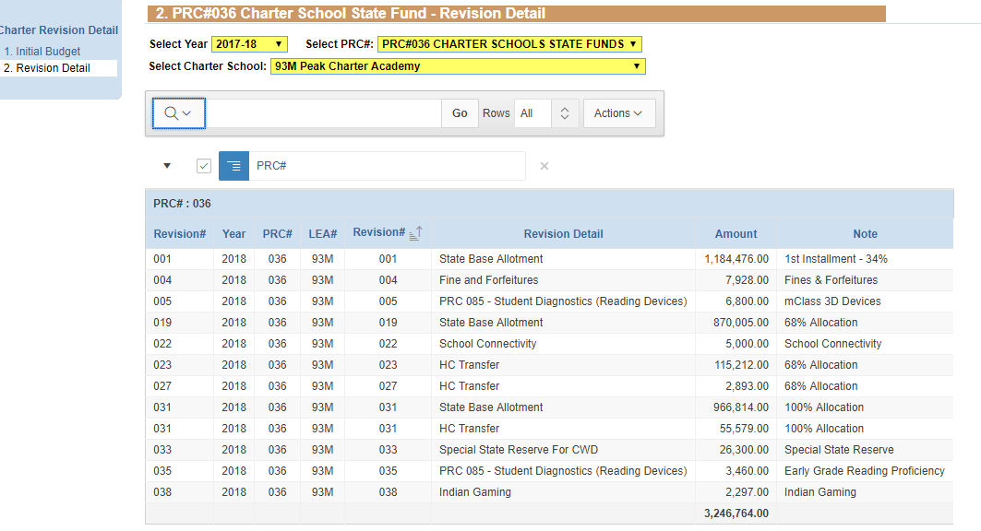
Summary of Annual Allotment- Example only
Final installment allotted before the end of February

Slide 23
State Competitive Grants
Charters may be eligible for other State grants for which they must apply.
Examples: school safety grants, transportation
Read the newsletters for announcements

Slide 24
State Competitive Grants
Charters may be eligible for other State grants for which they must apply.
Examples: school safety grants, transportation
Read the newsletters for announcements

Slide 25
Unused State Funds in PRC 036 Revert to the State on June 30

Slide 26
Federal Grants
Most common are Title I (PRC050) and IDEA VI-B (PRC060)
Allotted as grant award documents are received from Washington
Budget approval required before allotments are distributed
Refer to the NC Allotment Policy Manual at for a list of federal PRC’s, eligibility for funds, allotment formulas, and any special provisions.
Unused funds revert at the end of the grant period.

Slide 27
Local Funds
GS 115C 105(c
The LEA in which the student resides shall transfer to the charter school and amount equal to the per pupil local current expense fund.
Plus a per pupil share of the penal fines and forfeitures and supplemental school tax, if any.

Slide 28
Local Funds
115C-218.105(d)
LEA must transfer within 30 days of the receipt of the monies in to the local current expense fund.
(Best Information can be obtained from the County Finance Officer for $ per student funding.)

Slide 29
The LEA shall Provide…
The total amount of monies the local school administrative unit has in each of the funds - State Public School Fund, local current expense and capital outlay.
The student membership numbers used to calculate the per pupil share of the local current expense fund.
How the per pupil share of the local current expense fund was calculated.
Any additional records requested by a charter school from the LEA in order for the charter school to audit and verify the calculation and transfer of the per pupil share of the local current expense fund.

Slide 30
Local Funds Do Not Revert

Slide 31
Critical Items When Building Your Budget
Average Daily Membership
Be realistic
Know the breakeven number of students
2. State Base Allotment 2017-18
- Varies by LEA ($4,923 to $10,603)
- average $5,340
http://www.ncpublicschools.org/fbs/allotments/state/

Slide 32
Critical Items When Building Your Budget
Local funds vary significantly ($20 to $4,142)
Federal funds are supplemental and are not intended to be base funding

Slide 33
Reporting

Slide 34
Financial and Student Reporting
GS 115C-218.30
Schools shall comply with the Uniform Education Reporting System (UERS)
Subject to Audits
Monthly Financial
Student Accounting
Ad hoc data collection

Slide 35
UERS
Required
Accountability and Transparency
Basis for
NC General Assembly
Federal Reporting
State Reporting
Media and the public

Slide 36
Chart of Accounts
Shows how the allotments were expended.
This is the only financial communication between the Charters and DPI.
DPI uses this data to communicate to the State Legislature, the State Budget Office, media and the Federal Government.

Slide 37
Chart of Accounts
Uniform Accounting System for all LEAs and Charters
Information Gathering
Consistency amongst LEAs and Charters
Comparability between years
Decision making tool
www.ncpublicschools.org/fbs/finance/reporting

Slide 38
Chart of Accounts
Data in the chart is used for:
Reports on Teachers
Teacher certification requirement (50% rule – brick and mortar)
Reporting to the General Assembly, Federal Government, media and general public on past and future education initiatives
Building the budget
Research and Statistics

Slide 39
Financial Reports
Access these reports via WS_FTP PRO Software
ALTARPO1 - Budget Allotment Revision
ALTINRP1 - Planning Allotments
JHA 305 - Local Account Balance Reconciliation
JHA 705 - Budget Balance Reconciliation
JHA714 - Cash Balance Report
Monitor - Monthly Monitoring Report

Slide 40
Certificate of Occupancy
The following Forms are not Processed without a certificate of Occupancy

Slide 41
Cash Management
Establish a ACH bank account with the State Treasurer’s Office. Allow 2 weeks
ACH Bank Account Authorization Form
Voided Check or Original Deposit Slip (Cannot accept temporary checks)
Establish access to the Cash Management System (CMS) – Complete Security Forms
CICS Application Maintenance Form
RACF02 Site Security Officer Form
RACF03 RACF User ID Maintenance Form
Complete Bill Action Code Form – ITS Access

Slide 42
Cash Management
Know the cash calendar and funds requirement date (FRD)
Do not order more cash than needed to cover the current expenditures
It is against federal law to hold cash for more than 3 days. (GS147-86.11)
Guidelines and forms
www.ncpublicschools.org/fbs/finance/cash/

Slide 43
Take Aways
Data reporting is NOT optional (must be in our required format – on time)
Financial Datafile – UERS Transfer Schedule
PMR – PowerSchool
SAR – PowerSchool
Board of Directors is responsible for data submitted
Decisions made based on submitted data
No access to funds until approximately 2 weeks after C/O is submitted
DPI Provides Cash Management Training (Required for all new schools)

Slide 44
School Business Contacts
School Reporting Section Chief
Gwendolyn Tucker (919) 807-3708
Financial Related Questions
Roxane Bernard (919) 807- 3725
Student Accounting
LaShon Creech (919) 807-3720

