Slide 1
Beginning Teacher Support Program (BTSP) Charter Institute June 12, 2018
Notes:
Introduction: DeAnna

Slide 2
Supporting Beginning Teachers
BTSP Plans
Plan Approval Process
BTSP Peer Reviews
BTSP Monitoring
Other Support Provided
Notes:
DeAnna’s

Slide 3
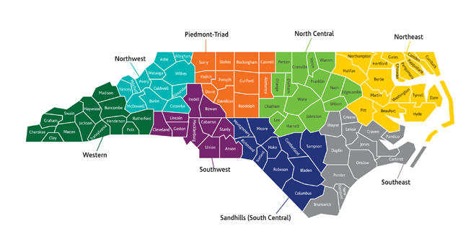
Regional Education Facilitators
http://regedfac.ncdpi.wikispaces.net/
Notes:
DeAnna’s- Already have it pulled up, no reference until time to use it.

Slide 4
Beginning Teacher Support Program Plans
Notes:
Karol’s

Slide 5
State Board Policy
Category: Licensure
Policy ID Number: TCED-016*
Policy Date: 5/03/18
*new title
https://stateboard.ncpublicschools.gov/policy-manual/teacher-education/beginning-teacher-support-program
Notes:
Karol’s

Slide 6
4.120 Beginning Teacher Support Program Plans
BTSP Plan must be approved by local board of education
“Charter schools and non-public institutions that have a state approved plan to administer the licensure renewal program shall submit a BTSP Plan to the SBE for approval.”
Notes:
Karol’s

Slide 7
4.120 Beginning Teacher Support Program Plans
1. A documented process for identifying and verifying all beginning teachers (BTs)
must include beginning teachers who meet requirements for NCDPI’s assignment of initial licensure
identifying which teachers will/will not be included in the program (based on appropriate experience and position held),
assignment in the area of licensure,
plan for documentation of required licensure tests requirement and the process for license conversion (coursework, exams passed, three years of teaching), and the
process for collecting BT data for the State of the Teaching Profession in NC Report.
Notes:
Karol’s

Slide 8
4.120 Beginning Teacher Support Program Plans
2. Plan for implementing a sound BT Induction process
Plans must include three year induction process (120 workdays each year) that includes a formal orientation, required working conditions, the process for mentor selection, training, and assignment, the process for development and monitoring of the BTs’ professional development plan, and required or prescribed professional development. This is a 3 year induction process overview
a. Orientation
b. Working Conditions-mentor assigned early, and in close proximity; limited preparations; limited non-instructional duties; limited number of exceptional or difficult students; and no extracurricular assignments unless requested in writing by the beginning teacher.
c. Mentor Selection, Training, and Assignment
d. Professional Development Plans
e. Professional Development
.
Notes:
Karol’s

Slide 9
4.120 Beginning Teacher Support Program Plans
3. A formal process for conducting observations and summative evaluations on all BTs
Provide details on the process that ensures each beginning teacher receives the required observations and evaluation as outlined in SBE policy (Teacher Performance Appraisal process), General Statute and HB 1030.
4. Plan for participation in BTSP Monitoring
Describe the plans for compliance with the BTSP Monitoring process (completed on a five-year revolving cycle) and technical assistance provided based on monitoring results to address areas of concern (if necessary).
Notes:
Karol’s

Slide 10
4.120 Beginning Teacher Support Program Plans
5. Plan for participation in the BTSP Peer Review Process
process in place for completing the annual Peer Review Self-Assessment and annual Peer Review process.
ILCC Meetings
6. Statement on how BTs’ personnel files (files that include the teacher’s PDP and performance evaluation report(s)) are filed and secured.
7. Plan for a timely transfer of BT files to subsequent employing LEAs, Charter Schools, or non-public institutions within the state
Notes:
Karol

Slide 11
Beginning Teacher Support Program Plan Approval Process
Notes:
Karol

Slide 12
BTSP Plan Approval Process
Create BTSP Plan at school level
Follow local board process for approval of BTSP Plan
Submit BTSP Plan to Regional Education Facilitator (REF)
REF will send notification to charter school
Approval Letter
Revisions needed
Notes:
Karol

Slide 13
BTSP Plan Approval Process
REF will notify Licensure Division of plan approval
REF will notify Office of Charter Schools of plan approval
Plan must remain on file at charter school AND with NCDPI (through REF)
If changes are made at the school level OR State Board of Education Policy changes, BTSP Plan will need to reflect changes and approval process must be completed again
Notes:
Karol

Slide 14
Beginning Teacher Support Program Peer Review Process
Notes:
DeAnna:
REFs facilitate and support the BTSP Peer Review Process.

Slide 15

Peer Review Process
https://stateboard.ncpublicschools.gov/policy-manual/teacher-education/beginning-teacher-support-program
Notes:
If teachers are converting from an initial license to a continuing license a school must participate in the annual Peer Review Process. If you look in policy- which is now TCED-016- Section 5- you will notice that the expectation is for you to complete a Peer Review. DFP click on the policy, then open the PDF file.
15

Slide 16
Peer Review Process
Goals
Increase teacher effectiveness, thus student achievement
Help build capacity for “critical friend” collaboration
Encourage reflection for BT support and retention
Strengthen our profession through regional collaboration
Notes:
DeAnna- read over and spotlight the green...
16

Slide 17
Peer Review Process
Aligns with what is expected from teachers
21st century skills, collaboration
Improves BT Support
Increases guidance and benefits for BTs by holding districts and charters accountable
Improves retention
Increases Student Achievement
Recognizes uniqueness of each charter school
Increased awareness and development through collaboration in professional learning communities
BENEFITS
Notes:
Dee- Provide opportunity to read silently- No elaboration...go to next slide

Slide 18
BTSP Self-Assessment
Peer Review Process
Growth Process
Critical review of current BTSP program
Rating Scale (aligned with NCEES)
Five Program Standards
Sample Evidences Document
Notes:
DeAnna’s- Take time for Q&A here...if needed

Slide 19
Self Assessment
Standard 3: Mentoring for Instructional Excellence
a. Quality Time. Effective mentor-beginning teacher interactions and relationships are at the core of a successful mentoring and induction program. Program, district and site leadership collaborate to ensure that sufficient time is provided for mentors to meet with their beginning teachers to engage in the improvement of teaching and learning and induction-related activities both during and outside of school time.
Developing | Proficient | Accomplished | Distinguished | Not Demonstrated (Comment Required)
Mentors work with beginning teachers occasionally | . . . and Mentors work with beginning teachers during and outside of the school day, based upon schedule and mentor flexibility | . . . and Mentors and beginning teachers have sufficient time to engage in induction-related activities | . . . and Mentors are provided protected time to engage with beginning teachers and support their professional growth Beginning teachers are released to work with mentors, and other support providers as appropriate
b. Instructional Focus. The North Carolina Professional Teaching Standards are the comprehensive guide used by all teachers, mentors, and beginning teachers to advance practice and student learning. Mentors are regularly present in the classrooms of beginning teachers to observe and to strategically collect data on management, instruction, and student learning. Mentors and beginning teachers collaboratively analyze observation data, develop next steps and together monitor results in an ongoing process designed to continuously improve teaching and learning.
Developing | Proficient | Accomplished | Distinguished | Not Demonstrated (Comment Required)
Mentors focus on logistical and operational issues, such as school practices and culture, administrative and classroom procedures and norms | . . . and Based on classroom observations, mentors work with beginning teachers on issues of classroom management, lesson planning, delivery of instruction and student learning aligned with curriculum standards | . . . and Mentors work with beginning teachers across the full-range of teaching practices as defined by North Carolina Professional Teaching Standards and identified by the North Carolina Teacher Evaluation Process | . . . and Mentors work with beginning teachers on a strategic focus as determined by the North Carolina Teacher Evaluation Process and other assessments of classroom practice and student learning.
c. Issues of Diversity*. Mentors support their beginning teachers to appreciate the wide-range of assets that all students bring to the classroom through their diversity. Mentors guide beginning teachers in the development of positive, inclusive and respectful environments that support learning for a diverse student population. Mentors and beginning teachers design and implement a broad range of specific strategies designed to meet the diverse needs of their students and promote high levels of learning.
Mentors are aware of equity issues as they arise in beginning teachers’ practice | . . . and Mentors support beginning teachers’ development to meet the needs of all students and create a respectful environment for a diverse population of students | . . . and Mentors guide the beginning teachers’ appreciation for diversity and responsive approaches to instruction during analysis of student work, planning of differentiated instruction and other opportunities as they arise | . . . and Mentors proactively engage beginning teachers around issues of diversity Mentors guide beginning teachers in the ongoing development of responsive curriculum and practices.
Notes:
DeAnna-Based on the new Peer Review Process, you only have to complete the standard of focus on the self assessment

Slide 20
Peer Review Process
Growth Process documented by REFs using the five program standards
2016-17 Standard 1
2017-18 Standards 2 & 3
2018-19 Standards 4 & 5
Notes:
DeAnna Because you are new this year, and we started the process this past year, you will need to complete standards 1, 2, and 3.

Slide 21
Peer Review Process
In 2019-20- Reflection for Growth
Review of current BTSP program by “critical friend” every fifth year
Within regions
Additional collaboration if needed
Rating Scale (aligned with NCEES)
Sample Evidences Document
Notes:
DeAnna- A critical friend is a charter that you have connected with during the entire process or one that is available during the final meeting that can provide feedback and rate your growth based on documentation that you provide during that meeting.

Slide 22
Peer Review Process
Standard 5: Formative Assessment of Candidates and Programs
a. Formative Assessment. The system-wide use of the North Carolina Professional Teaching Standards and the North Carolina Teacher Evaluation Process provides standards-based aligned descriptions of practice and expectations for beginning teacher development. Mentors utilize the language and expectations of these foundations in the use of formative assessment tools for ongoing collaborative data collection, analysis, reflection and implementation of next steps to improve beginning teacher practice and student learning.
Developing | Proficient | Accomplished | Distinguished | Not Demonstrated (Comment Required)
Mentors utilize the North Carolina Professional Teaching Standards with beginning teachers | . . . and Mentors apply the language and expectations in the North Carolina Professional Teaching Standards and the North Carolina Teacher Evaluation Process in supporting their beginning teachers’ practice Mentors support their beginning teachers in developing a Professional Development Plan to support professional growth | . . . and Mentors use a wide range of formative assessment tools in their ongoing work with beginning teachers Mentors use formative assessment information to guide mentoring practice in alignment with the North Carolina Professional Teaching Standards and the North Carolina Teacher Evaluation Process | . . . and Mentors integrate formative assessment into their interactions with beginning teachers and innovate upon the tools and their use Mentors help beginning teachers draw connections between the use of formative assessment to inform and improve classroom practice and student learning
b. Program Evaluation. The North Carolina Mentoring and Induction Program Standards form the basis on which individual mentoring and induction programs are assessed. District mentor program leaders and stakeholders partner to design a reliable infrastructure to support the collection, analysis and use of standards-based data to promote continuous high quality program improvement. All stakeholders work together to mediate challenges to program improvement and to advance positive impacts and successes of mentoring and induction programs.
Beginning teachers and mentors give feedback on the induction program | . . . and Program leaders collect and use data on beginning teacher practice and program implementation over time for use in program improvement Data collection should include, but not be limited to, retention, Teacher Working Conditions Survey and student learning | . . . and Program leaders engage with others to collect and analyze a range of data on program implementation to guide program improvement Results and next steps are shared within and outside of the program | . . . and Program leaders ensure that all stakeholders are aware of program successes, impacts, and challenges Data are used to guide ongoing program implementation and continuous improvement
Notes:
DeAnna-Reference the REF Wiki-Karol will pull up

Slide 23
Beginning Teacher Support Program Monitoring
Notes:
Karol

Slide 24
State Board Policy TCED-016
Section 4
Every fifth year NCDPI will formally review Beginning Teacher Support Programs to review evidence and verify that program proficiency is demonstrated on all Beginning Teacher Support Program Standards. The monitoring team should report any standards and key elements where programs are not deemed at least proficient to NCDPI. Programs that are rated developing on the standards continuum should be put on an improvement plan and reviewed more frequently to ensure that all beginning teachers are supported.
http://regedfac.ncdpi.wikispaces.net/
Notes:
Karol talk- Refer to the REF wiki again. As a new charter school, you will not be monitored until year 3.

Slide 25
IHE/LEA/CHARTER Collaborative (ILCC) Meetings
Notes:
DeAnna

Slide 26

2019 BT Summits
Over 800 BT’s registered across the state for 2018
Notes:
DeAnna’s- Please look for that information coming in early 2018. We ask for feedback from all participants. We encourage charter proposal submission.

Slide 27
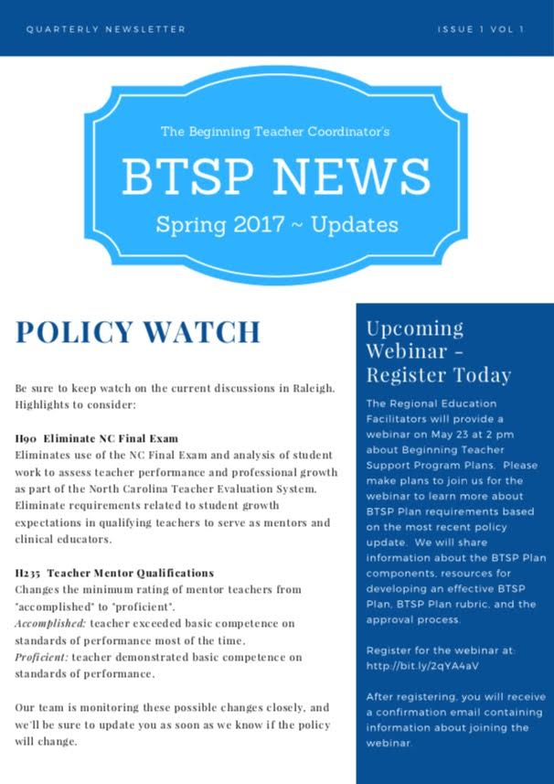
BT Coordinator Corner
Notes:
DeAnna- We shared this in the spring and got great feedback. Stay tuned, because it may be a permanent fixture of support.

Slide 28

BT Newsletters
Notes:
DeAnna’s: Each TOY (including Charter TOY)...This is shared with BT Coordinator’s, LEA/Charter leaders to blast out to their BTs. We also share with IHE’s and anyone else that has a hand in grooming our BTs. Newsletter provides tips and encouraging information here to support for our BTs.

Slide 29
Other Assistance Provided
Mentor Training
NCEES and EVAAS Trainings
Coaching
NCTWCS
Online Modules rt3nc.org
NC Teacher of the Year
Leadership Development
Notes:
Karol’s

Slide 30
Questions, Comments, Concerns
Any further explanation needed?
Any questions?
Presenters:
DeAnna Foust-Platt: Piedmont-Triad REF
Dr. Karol McNeil-Horton: Southwest REF
http://regedfac.ncdpi.wikispaces.net/
Notes:
Karol will close out! We will give them time to explore...we will pace with time for the participants.

