Slide 1
last updated: May 2019
Critical Incident Response for
School Faculty and Staff
2014

Slide 2
OBJECTIVES
Define the term active shooter.
Name some characteristics to look for in students that are congruent to the typical school shooter.
Define Critical and Tactical Thinking.
Name the steps can be taken to identify, mitigate and prevent an active shooter event.
Introduce and discuss the three new response actions teachers may utilize in a critical incident.
Introduce and discuss the new Lockdown Procedures for the classroom.
Introduce the new standard card notification system and why the changes were made to the system.
Be aware of Reunification issues

Slide 3
Introduction and Purpose
Training for school faculty & staff re: what to do in active shooter situation
1999 training film contains actions/policies no longer accepted/outdated
2014 training curriculum better describes before/during/after actions needed during active shooter situation and other critical incidents
Updated training provides more options to faculty/staff/students to mitigate active shooter situations

Slide 4
Who does this impact?
This establishes a uniform response by schools all across the state.
Has ZERO impact on HOW law enforcement or first responders respond to critical incidents at the schools. Only changes what they may SEE once they are on-scene.

Slide 5
Active Shooter
Law Enforcement officials use the term “active shooter” to describe a situation where a person(s) participates in a random or systematic shooting spree in a confined or populated area.
No pattern in selecting victims
Can occur in schools, museums, daycares, rec facilities, malls, sporting events
Active shooter situations are rare
1 in 2.5 million chance of being victim of school shooting
Evolve quickly, end quickly (3-12 minutes)

Slide 6
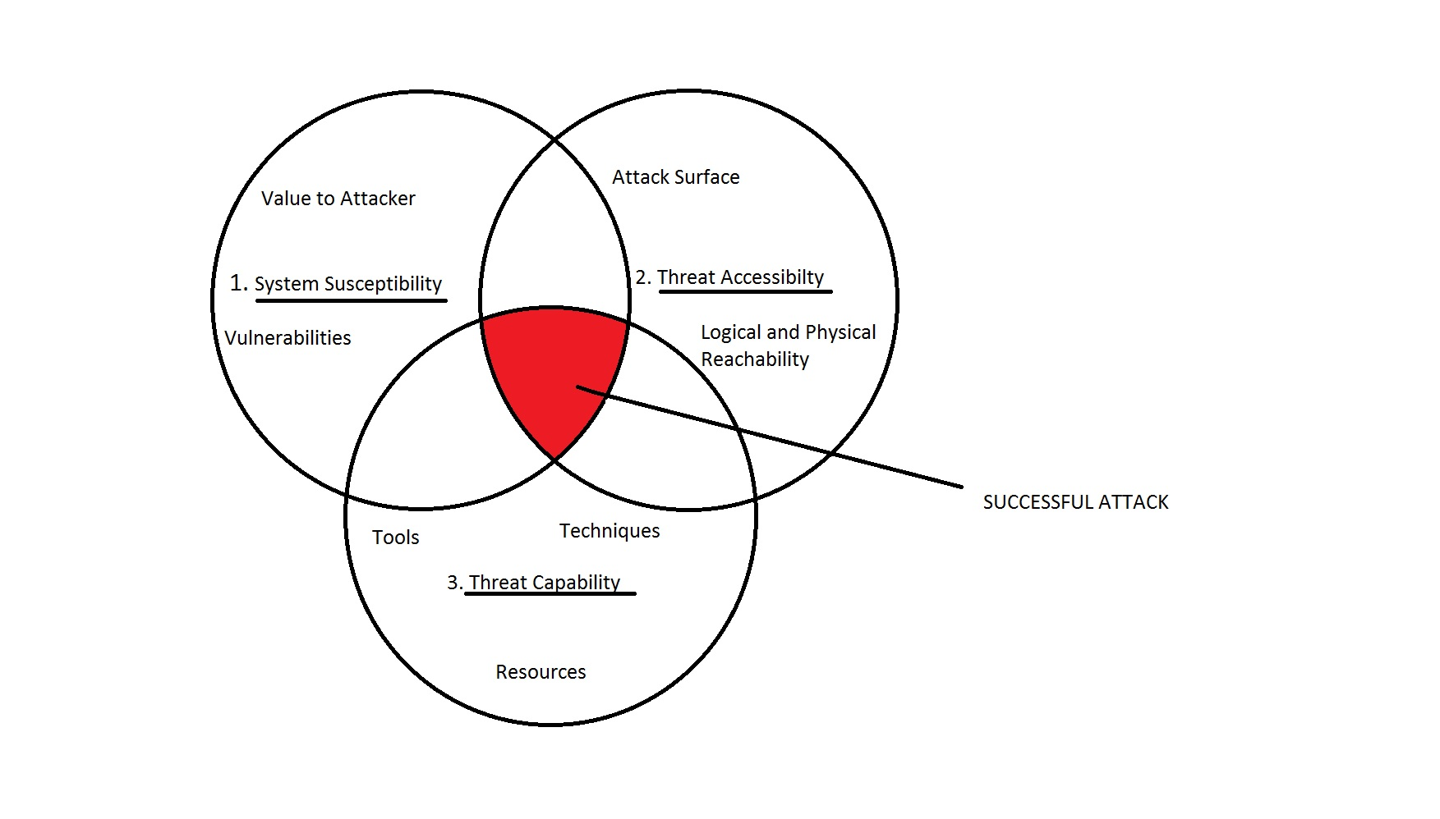

Slide 7
Possible Indications of Future
Violent Tendencies in Students
Verbal or written communication suggesting idea or intent to attack (80% of school shooters tell at least one person)
Does student possess capacity to follow through with threat? (Never take anyone for granted)
Student has experienced acute rejection/catastrophic loss
Student has experienced chronic rejection by friends, teams, social groups

Slide 8
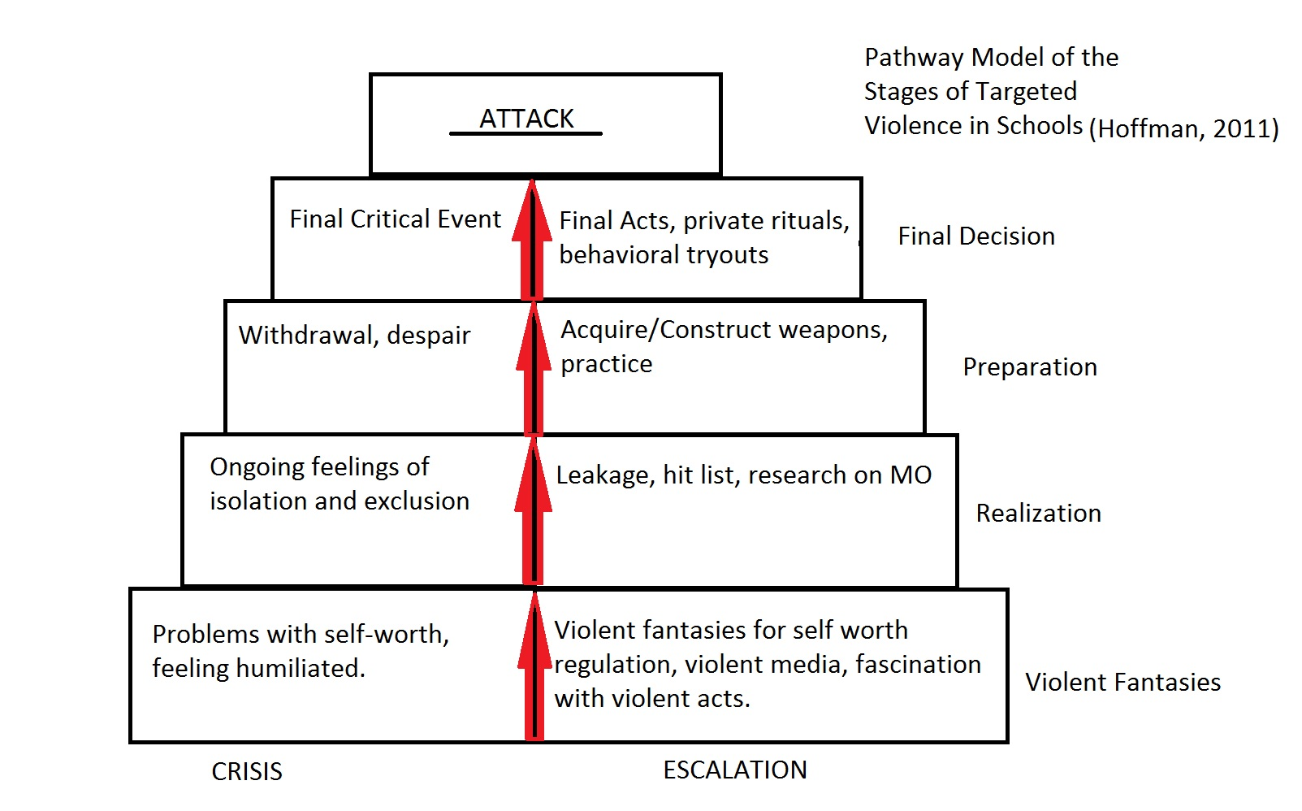

Slide 9
Steps to Identify, Prevent or Mitigate Active Shooter Event
Know your students.
Know your surroundings. “What if…?”
  Have great Situational Awareness
Encourage anti-bullying behavior; urge intervention when needed.
Treat ALL threats of violence against the school as valid until proven not to be.
Pre-plan & practice your school’s emergency response plan.

Slide 10
NEW WAY OF THINKING FOR STAFF
School Faculty and Staff HAVE to start thinking:
CRITICALLY
TACTICALLY

Slide 11
CRITICAL THINKING:
Objective analysis and evaluation of an issue in order to form judgement.

Slide 12
TACTICAL THINKING:
Short term planning to tackle a situation to put oneself in a more favorable situation.

Slide 13
Three Response Actions/Review of
Lockdown Actions & Changes
Lock or otherwise secure your door.
Turn out lights.
Turn off televisions/other sources of noise.
Move students out of view & away from doors/windows.
Keep students quiet.
If injured people are present or immediate medical care is needed USE THE RED CARD ONLY. SLIDE IT UNDER THE DOOR AND PUT IT IN THE WINDOW. NO OTHER COLORED CARDS SHOULD BE USED.

Slide 14
Changes to the COLOR CARD
SYSTEM
Plan was becoming too complex. Schools were overthinking it.
By putting a green card out at onset of event, teachers were FLAGGING their room as occupied.
Status may change in the room (ex.: medical emergency occurs following display of green card). Now you have two cards indicating two opposite things outside the door.

Slide 15
Card Changes cont’d:
Schools within the same county often had different card systems.
The event will be a Multi-Agency Response. (The card system used in this county should be the same system used in another county. Establishes STATEWIDE CONSISTENCY FOR SCHOOLS.)
Substitute Teacher Issues
Law Enforcement is only concerned with the red card anyway.

Slide 16
Changes to the Lockdown
Procedure
Do not worry about closing the window blinds/shades.
Law Enforcement has never liked this action taken by schools
Eliminates sight into the room by law enforcement snipers
Limits vision out of the class at your surroundings
If a hostage situation occurs, suspects are more apt to pull shades down to limit LE sight into the room. Will be quicker for LE to pick out room with possible trouble inside.

Slide 17
New Options for Response
The new response types we will now discuss SHOULD NOT REPLACE common sense and/or experience.

Slide 18
RUN
Students and staff should not typically deviate from Lockdown mode unless instructed by law enforcement or other first responders.

Slide 19
RUN
In extreme cases WITH NO OTHER OPTIONS and you face an imminent threat, the situation may dictate that you run.
If you are outside on a practice field or
parking lot.
Instruct students clearly if you have them
with you.
Move them to a predetermined meeting
location.

Slide 20
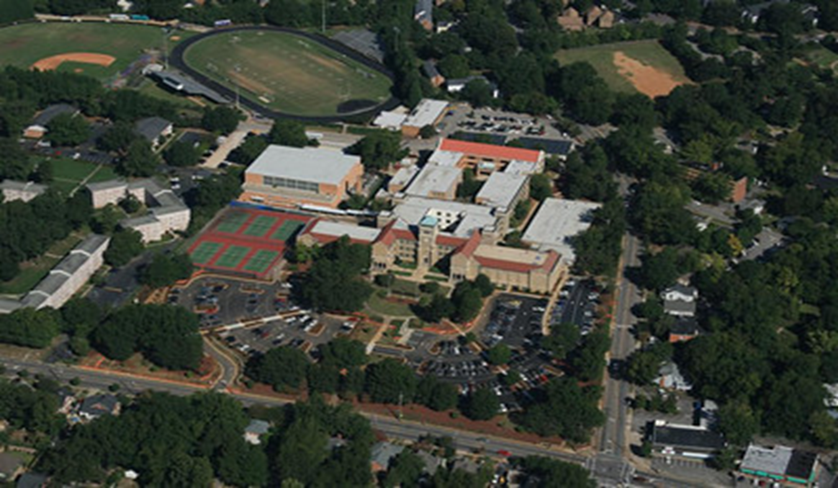
Exterior Meeting Points

Slide 21
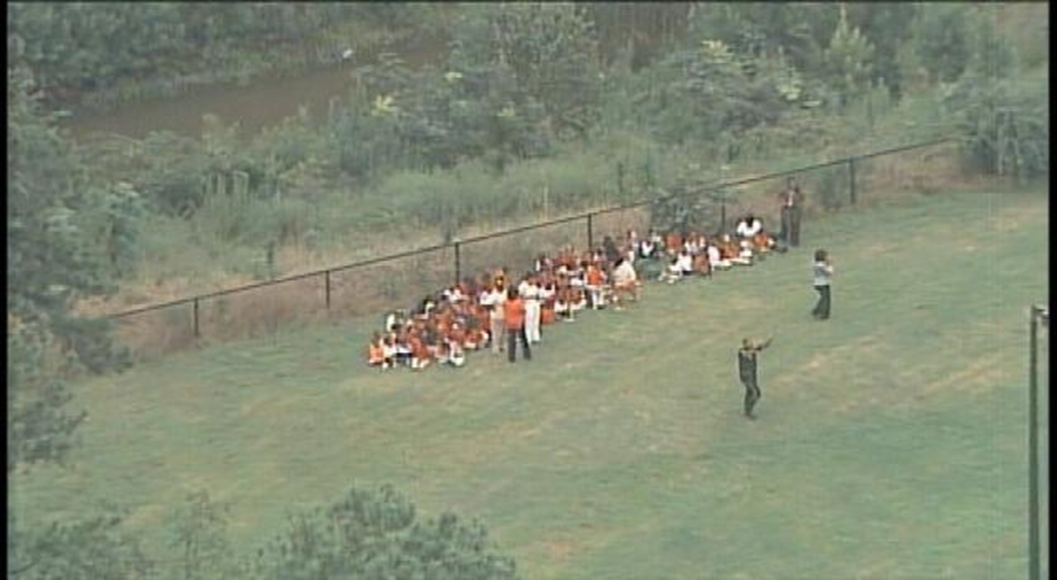

Slide 22
HIDE
Use if you cannot reach a secure classroom OR unable to secure your door.
If you are on a field trip or outside the school.

Slide 23
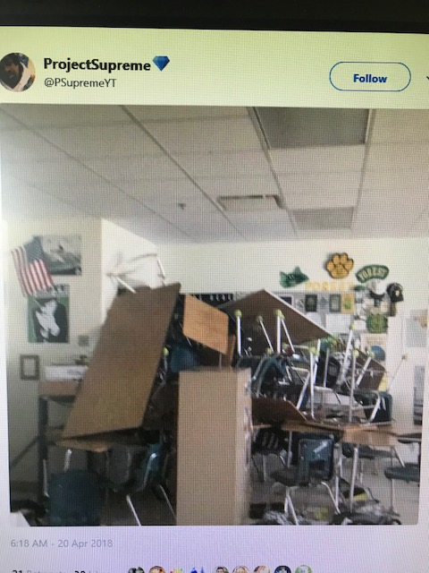
Barricade the Door if you can

Slide 24
There is no Fire Code in a
Crime Scene.

Slide 25
FIGHT
Use this response only as a LAST RESORT and ONLY if your life or the lives around you are in imminent danger.
Use chairs, heavy objects or improvise a weapon to attack the shooter.
If you use this option, stick with your decision and fight to survive.

Slide 26
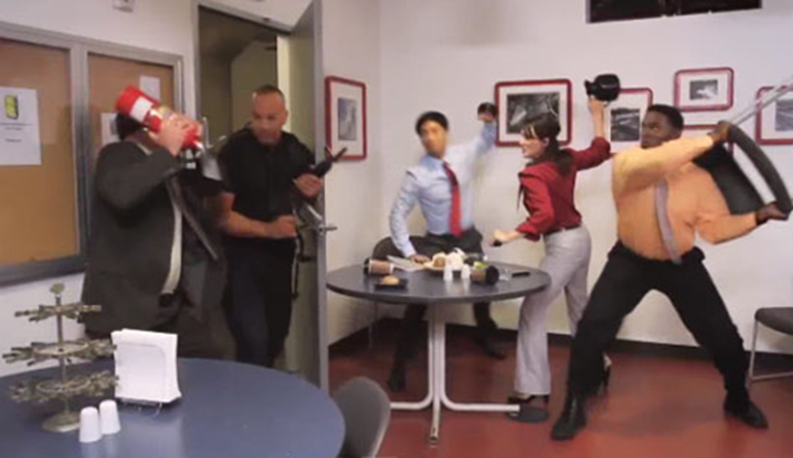

Slide 27
Before, During & After the
Emergency
BEFORE
Encourage students/staff to participate in bullying prevention.
Know your school’s climate.
Be aware of changes in students; report any of concern.
Report suspicious behavior to police or your school resource officer.
PARTICIPATE IN TRAINING. YOU WILL PLAY LIKE YOU PRACTICE!

Slide 28
Before, During & After the
Emergency
DURING
Use correct Lockdown procedures.
If you choose another response, make sure you are EFFECTIVE.
REASSESS after every action. Every action will cause a reaction.

Slide 29
Before, During & After the
Emergency
AFTER
Ensure your plans consider mass transportation for students/staff to a sister school.
Include a parent reunification plan.
Facilitate physical and psychological recovery for students/staff.

Slide 30
Mike.anderson@dpi.nc.gov
919-807-3354
Training Manager

Slide 31
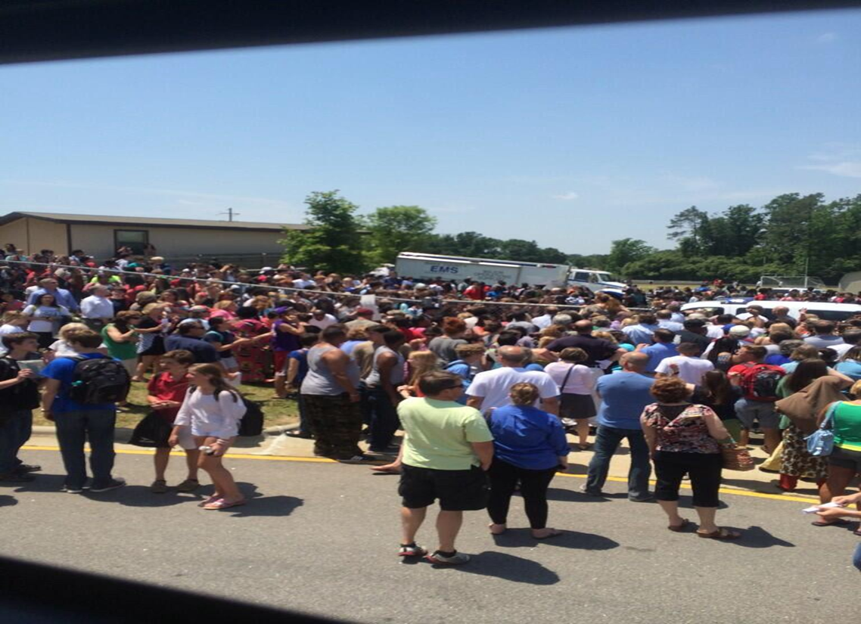
REUNIFICATION PLANS ARE A MUST
ENTRY/EXIT

Slide 32
Reunification: Things to Consider
SITE SELECTION
    More than 1 site needed
    Is cover available?
    Out of perimeter?
    How long can we stay here?

Slide 33
TRANSPORTATION
    How are we going to do it?
    What resources do we have available?
    Ask WHY you are evacuating the campus?
          More times than not it will be a LE decision

Slide 34
LOGISTICS
    Food and Water
    Medical Needs
    Restrooms

Slide 35
SEPARATE BY :
    CLASS
    GRADE
    Depends on size of student body which practice is easiest.

Slide 36
HOW TO NOTIFY PARENTS
    Social Media Outlets
    Mass Text Messages
    Robo Calls

Slide 37
Always have a plan and be sure of roles BEFORE you move the first student off campus.

Slide 38
Objectives
Define the term active shooter.
Name some characteristics to look for in students that are congruent to the typical school shooter.
Name the steps can be taken to identify, mitigate and prevent an active shooter event.
Introduce and discuss the three new response actions teachers may utilize in a critical incident.
Introduce and discuss the new Lockdown Procedures for the classroom.
Introduce the new standard card notification system and why the changes were made to the system.
Be aware of Reunification Issues

