Slide 1
Exceptional Children Division Special Programs and Data Section
EC Special Project Funding,
IDEA EC Grant Application and
Fiscal Accountability
Presented by Keashia Walker,
IDEA Consultant
Keashia.Walker@dpi.nc.gov
984-236-2602

Slide 2
Exceptional Children State and Special Project Funding
State Aid (PRC 032/036):
Intended to assist the Local Education Agency (LEA) with services for children with disabilities.
https://www.dpi.nc.gov/districts-schools/district-operations/financial-and-business-services

Slide 3
Behavior Support Funds PRC 029
The North Carolina General Assembly has allocated funds to provide resources to help school systems appropriately serve students with severe and complex behavioral-emotional needs.
Traditional or Comprehensive Needs Grant
The application process is now in the NC CCIP System
https://ccip.schools.nc.gov
For more information regarding these funds, contact:
Regions 1-4, Lisa Taylor,
919-394-3605 or lisa.taylor@dpi.nc.gov
Regions 5-8, Felicia Goodgion,
828-702-5572 or felicia.goodgion@dpi.nc.gov

Slide 4
Developmental Day Funds PRC 063
For children placed in an approved Developmental Day Center approved by NCDHHS/DCDEE.
Accessed via an application
Funds are child specific; cannot be used for other children.
Funds are used to contract with community based DDCs and to support LEA based DDC’s

Slide 5
Group/Foster Home Funds PRC 032/036 and PRC 060
Funds are available to LEAs for students with disabilities placed in group or foster homes or similar facility for residential services that were not counted on the LEAs December 1 or April 1 child count.
The LEA where the group home is located is responsible for the special education and related services for the students that reside in the group home.
Accessed via an application.
Funds may be used for other children after the child generating the funds have been served.
Application required within 60-days

Slide 6
Special State Reserve Funds PRC 063/036
For newly enrolled children with disabilities who have high cost needs.
Special circumstances may permit a submission for a change in condition.
Intended to assist Local Education Agency(LEA) with emergency, unforeseen situations that are accompanied by an unexpected fiscal burden.
Accessed via an application.
Funds are child specific; cannot be used for other children.
Application required within 60-days
Example:
A child with disabilities moves from another district and enrolls in school after budgets are set and funds are committed. The child has needs that are atypical and very expensive to provide.

Slide 7
Community Residential Center PRC 063
For children placed in an approved Community Residential Center placed through the Local Management Entity or Managed Care Organization.
Accessed via an application.
Funds are child specific; cannot be used for other children
Application required within 60-days
Applicable to Traditional LEAs Only

Slide 8
Exceptional Children Federal IDEA
and Special Project Funding

Slide 9
Federal IDEA Grant Funds PRC 060
Funds are for all children with disabilities, ages 3 through 21, who meet specific eligibility requirements under Public Law 108.446
IDEA Section 611(3 through 21) funds are allocated through PRC 60
IDEA Section 619 (3 through 5) funds are allocated to LEAs through PRC 49
Local education agencies (LEAs) must submit an IDEA Grant Application annually and receive approval prior to access funds
Grant Deadline July 10th
New Charter IDEA Grant Deadline TBD

Slide 10
Federal IDEA Grant Funds
Proportionate Share Funds PRC 060
IDEA requires LEAs to provide special education services to students with disabilities who are parentally-placed in non-public schools which are located in the LEA
Proportionate Share is a set-aside in PRC 060 and must be used for the equitable services
Equitable services may be provided to SWD enrolled by their parents in private schools
Private Schools include religious, and home schools that meet the definition of elementary and secondary school
Applicable to Traditional LEAs Only

Slide 11
Federal IDEA Grant Funds
Coordinated Early Intervening Services PRC 070
Mandatory Use
IDEA regulations mandate 15% of IDEA 611 and 619 funds are set-aside for any LEA with significant disproportionality (SD)
Plan submitted within the IDEA Grant Application
Permissive Use
LEAs without significant disproportionality may use up to 15% of their IDEA 611 and 619 funds for CEIS
Request submitted within the IDEA Grant Application

Slide 12
Out of District PRC 060
Excess cost of placement support
Up to 50% of Educational Costs reimbursed
Requires submission of fiscal documentation
Accessed via an application
Funds are child specific.
Must be IEP Team recommended out of district placement
Annual application required within 30-days

Slide 13
Risk Pool Program Funds PRC 114
For children with disabilities who have high cost, extraordinary needs.
Funds are often requested for medically fragile children and children in need of additional staff (Ex. 1:1 assistance for activities of daily living skills)
Accessed via an application
Funds are child specific
A specific child may be funded for up to five years (not necessarily consecutive years)
Services must be documented in the child’s IEP

Slide 14
Federal Targeted Assistance Funds PRC 118
Initiatives supported with Targeted Assistance funds
PBIS
Content Literacy
Personnel
Related Services
Autism Support Team
The funds that are provided to Charter Schools are intended to assist in the challenges faced when recruiting and retaining Related Service personnel (Occupational Therapists, Physical Therapists, Speech-Language Pathologists, and School Psychologists)

Slide 15
Federal Targeted Assistance Funds PRC 119
Supported with Targeted Assistance funds for Preschool initiatives:
Assessment Teams
Early Literacy Sites
Outdoor learning Environments
Center on the Social Emotional Foundation for Early learning (CSEFEL) sites
Special Projects
Funds can support professional development for Preschool Coordinators.

Slide 16
NC State Improvement Plan Funds PRC 082
The North Carolina State Improvement Project (NC SIP) provides personnel development and program support services to significantly improve the performance and success of students with disabilities in North Carolina.
Previously there have been NC SIP research-based sites that focus on
reading and writing instruction
research-based mathematics instruction sites
A growing network of sites focusing on Early Literacy

Slide 17
Compliance with IDEA Fiscal Accountability
The Individuals with Disabilities Act (IDEA) requires the North Carolina Department of Public Instruction (NCDPI) to monitor local education agencies to ensure fiscal compliance with the provision of special education and related services to appropriately identified students.
The purpose of this monitoring is to confirm that federal, state, and local fiscal resources are focused on improved results for students with disabilities.

Slide 18
IDEA Fiscal Monitoring Tiers
Budget vs. Expenditures
Exceeds 10%
Tier I
Desk Reviews
Five year cycle
Tier II
Site Reviews
Risk-based criteria
Tier III

Slide 19
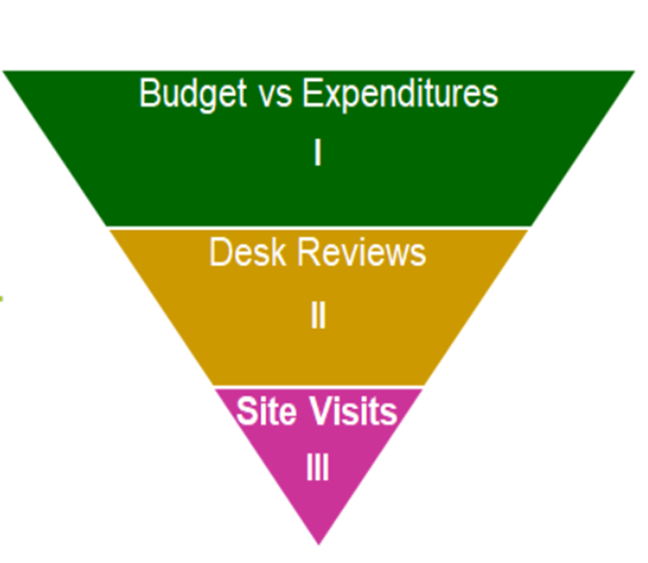
IDEA Fiscal Monitoring
Tier I
All IDEA federal program funds are reviewed biannually to ensure that LEAs are spending funds in agreement with their approved budgets,
PRC 049, 060, 070, 114 and 118.

Slide 20
IDEA Fiscal Monitoring
Tier II

Slide 21
Time and Effort
The LEA must ensure requirements are met for all personnel paid with federal IDEA funds.
Policies/Procedures
December Payroll
Semi-Annual Certifications
Single cost objective
Personnel Activity Reports
Multiple cost objectives
Supporting Documentation

Slide 22
Equipment
The LEA must maintain records for equipment purchased with federal IDEA funds and conduct a physical inventory at least every two years.
Policies/Procedures
Expenditure Reports & Paid Invoices
Physical Inventory
Disposition

Slide 23
Maintenance of Fiscal Effort (MOE)
State and Local Expenditure Reports for two preceding years.
Expenditures must match the figures on the MOE Calculation Form
Expenditures must match the figures indicated on the MOE Table 3a in the IDEA 611 Grant
Annual submission in the IDEA Part B 611 Grant MOE Expenditure Section

Slide 24
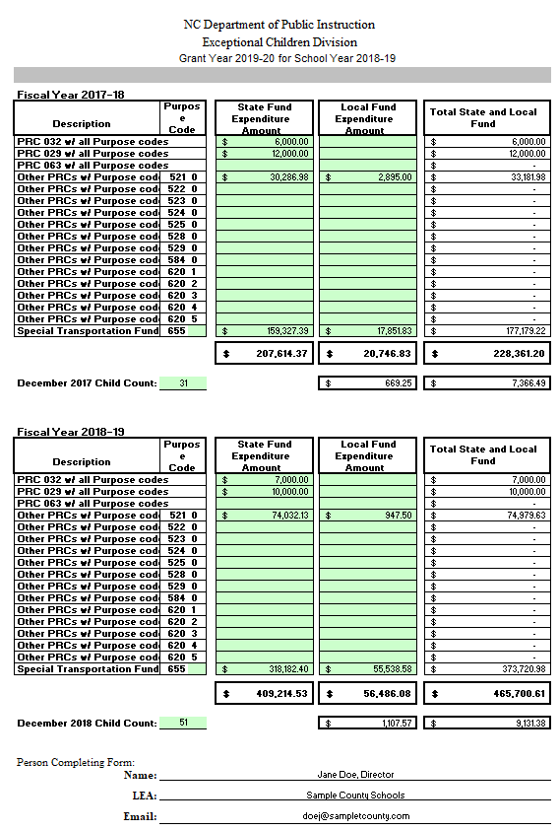
MOE Calculation Form Example:

Slide 25
Proportionate Share
Charter Schools

Slide 26
Coordinated Early Intervening Services (CEIS)
The LEA must track student participants and PRC 70 expenditures.
Provide Evidence of a Tracking Process
Provide PRC 070 Expenditure Report
Provide Time and Effort Documentation (If applicable)

Slide 27
Timely and Accurate Data
IDEA Part B 611 & 619 Grant
Submitted by specified deadline
IDEA Fiscal Monitoring
Desk Reviews
Due November 15th
On-Site Visits
Run January through April
End-of-Year Reports
Special Grants (where applicable)
Combined Expenditure Reports
Mid-Year (January/February)
June
IDEA Budgets
PRC 049 (if applicable)
PRC 070 (if applicable)
PRC 060
PRC 082
PRC 114
PRC 118
PRC 119 (if applicable)
This Photo by Unknown Author is licensed under CC BY-NC-ND

Slide 28
IDEA Fiscal Monitoring
Tier III
The Site Visit’s risk-based selection criteria was established to provide an equitable examination of an LEA’s financial reports, timely and accurate submissions and other historical operations data relative to federal funding sources for students with disabilities

Slide 29
Risk-Based Criteria
Monitoring Findings
IDEA Fiscal Desk Review
Policy, Monitoring, and Audit Program Compliance Review
Finance and Business Federal Program’s fiscal monitoring
Timely and accurate submission of data
Combined Expenditure Reports
IDEA Grant/Budget
EOY Reports
Developmental Day Center Fund (DDCF)
Special State Reserve Fund (SSRF) and
Risk Pool Fund (RPF)
SEA identified potential fiscal issues
Federal funds expiring 12/31
Budget vs. Expenditures > 10% variance
LEA EC Director/Coordinator turnover
Reported fiscal concerns

Slide 30
Contract Services
The LEA must have a written policy/procedure for contract services contract compensated through the use of IDEA funds.
Contracts and related invoices must contain sufficient information to assure that the services which have been requested have actually been received.
All paid invoices for purchased services must be supported by a valid contract between the LEA and the service provider
​Documentation should identify the funding sources used to purchase contract services.
Contracts must be signed by both the contractor and the service provider, and signatures must be dated

Slide 31
Resources
Exceptional Children Division
https://ec.ncpublicschools.gov/
IDEA Fiscal Monitoring information
https://ec.ncpublicschools.gov/finance-grants/fiscal-monitoring
EC Grants Application Management System
https://ccip.schools.nc.gov/default.aspx?ccipSessionKey=637261202195088618
Financial & Business Services
https://www.dpi.nc.gov/districts-schools/district-operations/financial-and-business-services
Federal Fiscal Oversight and Compliance
https://www.dpi.nc.gov/districts-schools/district-operations/financial-and-business-services/federal-fiscal-oversight-and-compliance#fiscal-guidance
NCDPI School Allotments Section
https://www.dpi.nc.gov/districts-schools/district-operations/financial-and-business-services/allotments-%E2%80%94-funding-public-school-units

Slide 32
Questions

Slide 33
Exceptional Children Division Special Programs and Data - Grant and Fiscal Team Contact Information
IDEA Consultant
Districts 1 and 2
Keashia Walker
Phone: 984-236-2602
Email: keashia.walker@dpi.nc.gov
SPD
Section Chief
Amanda Byrd
Phone: 984-236-2597
Email: amanda.byrd@dpi.nc.gov
IDEA Consultant
Districts 5 and 6
Elizabeth Millen
Phone: 984-236-2603
Email: elizabeth.millen@dpi.nc.gov
IDEA Consultant
Districts 3 and 4
Lori Peterson
Phone: 984-236-2596
Email: lori.peterson@dpi.nc.gov
NC Preschool 619 Consultant
Statewide
Dawn Meskil
Phone: 984-236-2642
Email: dawn.meskil@dpi.nc.gov
IDEA Consultant
Districts 7 and 8
Adam Parent
Phone: 984-236-2637
Email: adam.parent@dpi.nc.gov

