Slide 1
Tom Tomberlin Director, Educator Recruitment and Support
June 10, 2020
Teacher Evaluation and EVAAS

Slide 2
Teacher Evaluation in North Carolina

Slide 3
Student and School Growth
STUDENT GROWTH: Teachers contribute to the academic success of students.
The work of the teacher results in acceptable, measurable progress for students based on established performance expectations using appropriate data to demonstrate growth. It is the intent of the State Board of Education to provide educators a state-wide, standardized measure of student growth for the purpose of promoting professional growth for educators, guiding school improvement efforts, and informing educator evaluation processes.
Beginning with the 2016-2017 school year, Student Growth will no longer be a stand-alone standard in the NC teacher evaluation process. All processes related to the determination of student growth estimates for teachers and schools will continue.
Determining Student Growth with Statewide Method
A teacher’s rating on the student growth measure is determined by a student growth value as calculated by the statewide growth model for educator effectiveness. The measures of student learning - End-of-Course assessments, End-of-Grade assessments, Career and Technical Education Post-Assessments, NC Final Exams, K-3 Checkpoints, and Analysis of Student Work provide the student data used to calculate the growth value or performance rating.
See NCSBE policy EVAL-030 for similar language regarding School Growth
North Carolina State Board of Education Policy EVAL-006, Revised 2016-04-07

Slide 4
Measuring Teacher Effectiveness
Although student and school growth no longer has a direct impact on a teacher’s or administrator’s evaluation, the state will continue to develop a measure of teacher and administrator effectiveness that incorporates growth.
The state will continue to report to the federal and state governments the percentage of teachers and administrators in the categories of Highly Effective, Effective, and In Need of Improvement.
The NC State Board of Education will continue to use the effectiveness status of teachers to populate measures in its strategic plan.
Given that student and school growth is no longer tied to an individual’s evaluation, the state will calculate three year averages for teachers and administrators regardless of whether the employee changes districts.
Student and school growth (both single and three year measures) will continue to be used for research and analytic purposes.

Slide 5
Growth in Educator Evaluation
Educator Evaluation
(Standards 1-5 or 1-7)
Student/School Growth
Collected Artifacts
Student/Parent/Teacher Surveys
Peer Observation/Feedback

Slide 6
Understanding EVAAS Growth

Slide 7
Estimating Student Growth
Students’ Observed Scores
Students’ Predicted Scores
Difference between observed and predicted
Differences aggregated to teacher level
Student Growth Estimate
Calculate Standard Error
Divide growth estimate by standard error
Student Growth Index

Slide 8
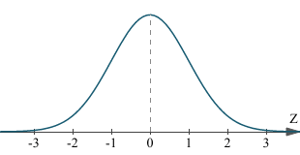
Estimating Student Growth
Does Not Meet Expected Growth
Meets Expected Growth
Exceeds Expected Growth

Slide 9
Proficiency and EVAAS
How can a school increase proficiency rates by X percentage points but not meet growth?
 | Prior Year Score | Prior Year NCE | Current Year Score | Current Year NCE | Growth
Student A | 229 | 54 | 231 | 55 | 1
Student B | 250 | 62 | 238 | 57 | -5
Student C | 255 | 64 | 236 | 56 | -8
Student D | 226 | 53 | 230 | 54 | 1
Student E | 228 | 54 | 232 | 55 | 1
Student F | 243 | 59 | 235 | 56 | -3
Student G | 225 | 52 | 230 | 54 | 2
Student H | 231 | 55 | 230 | 54 | -1
Student I | 227 | 53 | 220 | 50 | -3
Student J | 235 | 56 | 230 | 54 | -2
 | Prior Year |  | Current Year | Mean | -1.7
Proficiency = 230 | % Proficient = 50% |  | %Proficient = 90% | Std Dev | 3.2
 |  |  |  | Std Error | 0.8
 |  |  |  | Index | -2.1
Notes:
NOTE TO TOM: I removed the word “expected” from the Prior Year Score column heading. A student’s single score in the prior year is not used to generate any kind of expected score for the student in the EVAAS reporting, so I’m afraid that might be confusing for people. I changed the formatting of the columns a bit, just a thought. Also, I’m not sure about including the standard deviation here, but as with the previous slides, I’m not sure of all the points you need to make here.

Slide 10
School-Level Growth

Slide 11
Student Subgroup Growth

Slide 12
Does Evaluation Matter?

Slide 13
Does Evaluation Matter?
Notes:
Taylor, E.S, & Tyler, J.H. (2012). The effect of evaluation on teacher performance . American Economic Review, 102(7), 3628-3651. - See more at: http://cepa.stanford.edu/content/effect-evaluation-teacher-performance#sthash.cvqXEcug.dpuf

Slide 14
Does Growth Matter?
Two groups of students captured:
Younger Cohort: began Grade 5 in SY 2010-11
Older Cohort: began Grade 6 in SY 2010-11
 |  | Low¹ | High²
Younger | Math | 1935 | 1825
 | Reading | 184 | 221
Older | Math | 1560 | 1547
 | Reading | 183 | 301
¹Students in the “Low Growth” category have consecutive years of teachers in the Does Not Meet Expected Growth category
²Students in the “High Growth” category have consecutive years of teachers in the Exceeds Expected Growth category
Notes:
NOTE TO TOM: Are the Low and High values for math correct? They seem to be backwards, but it’s hard to tell since we don’t know what’s being said here.

Slide 15
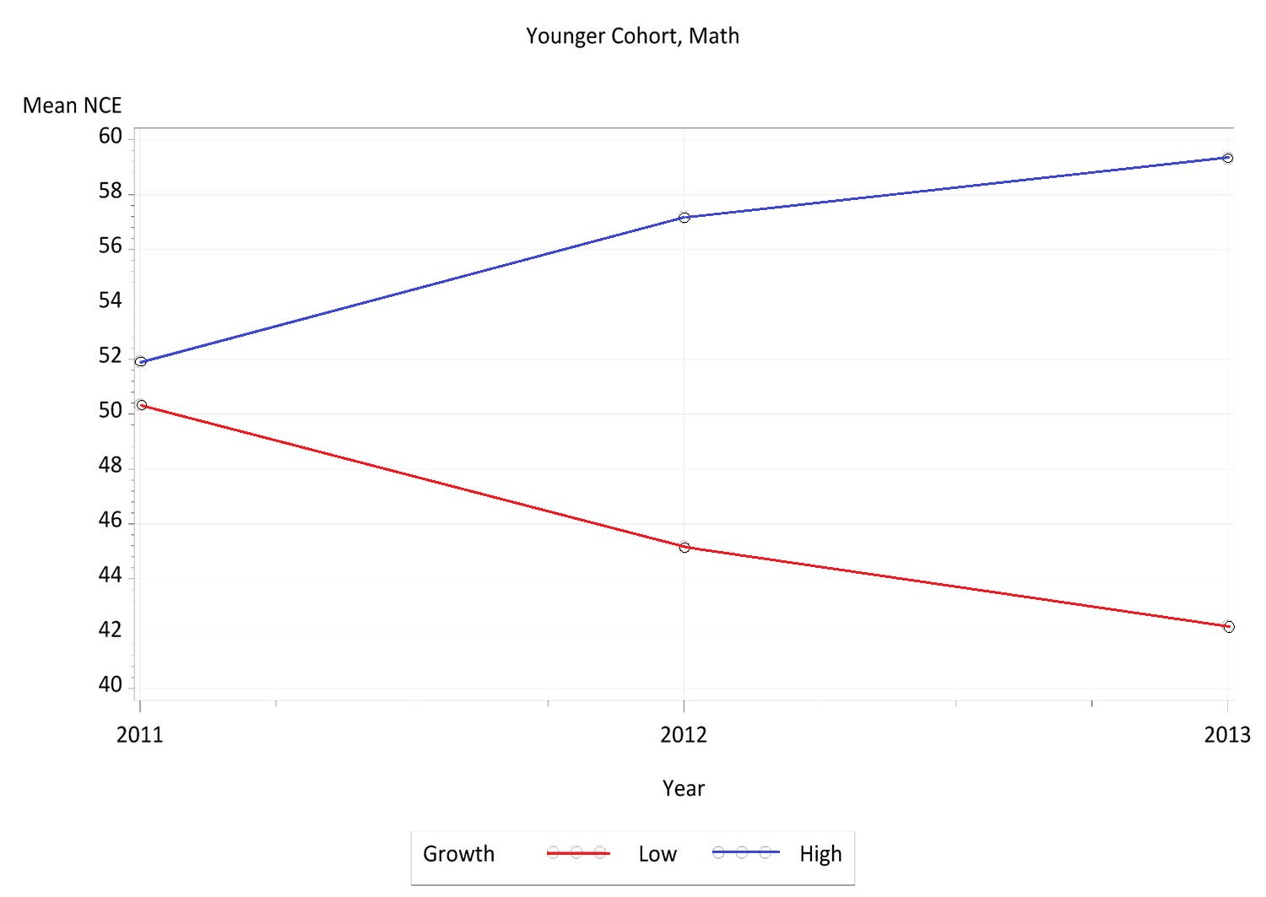

Slide 16
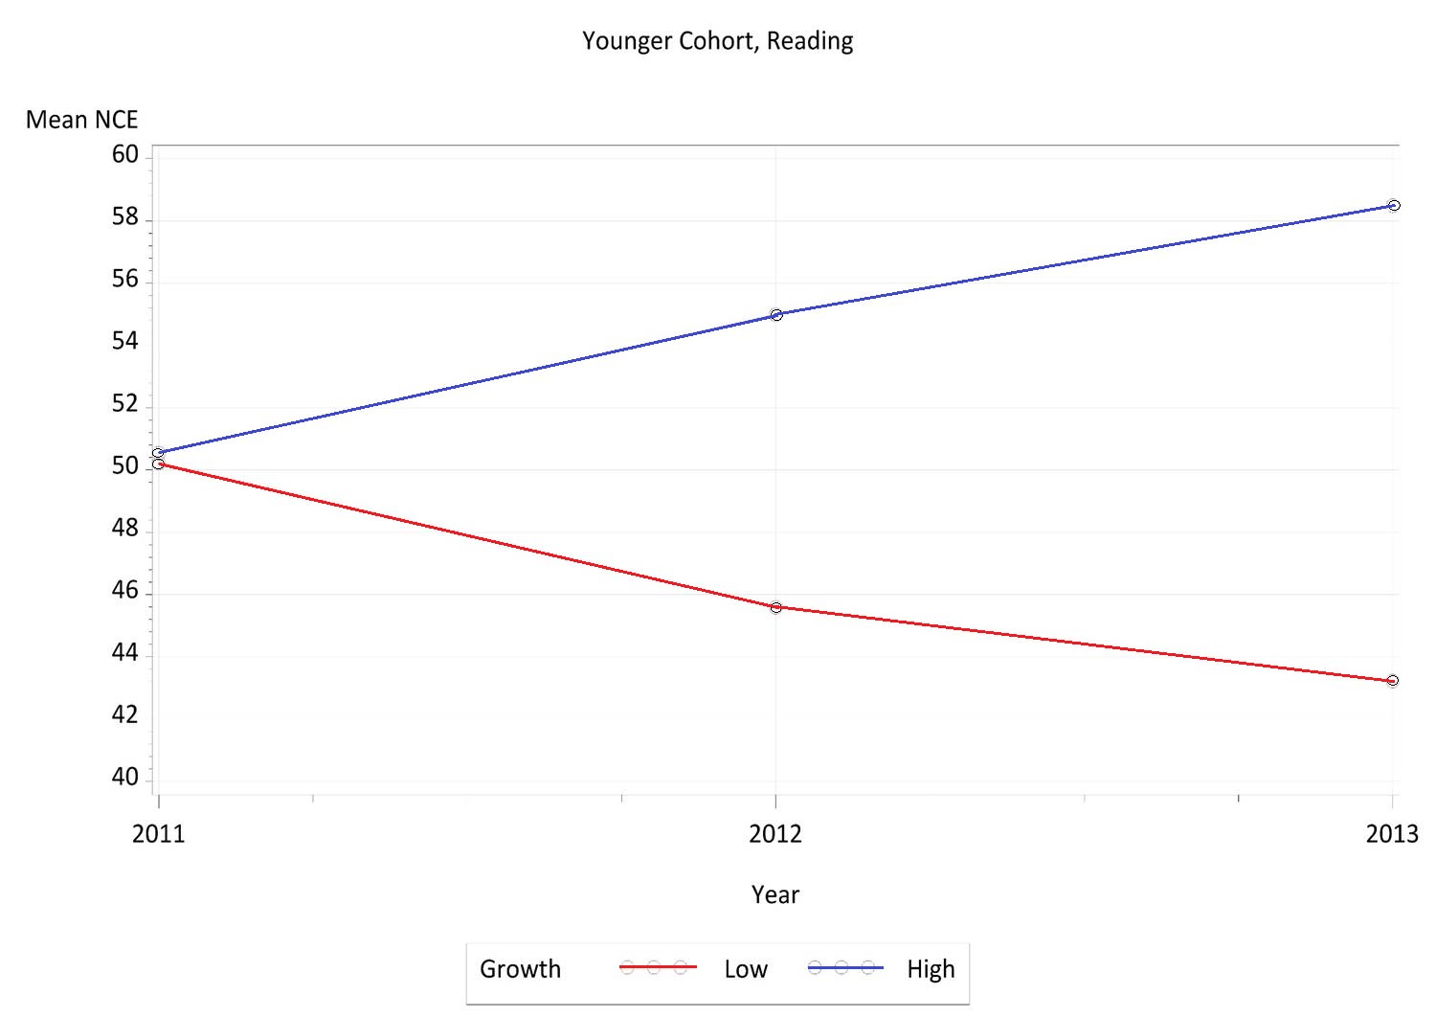

Slide 17
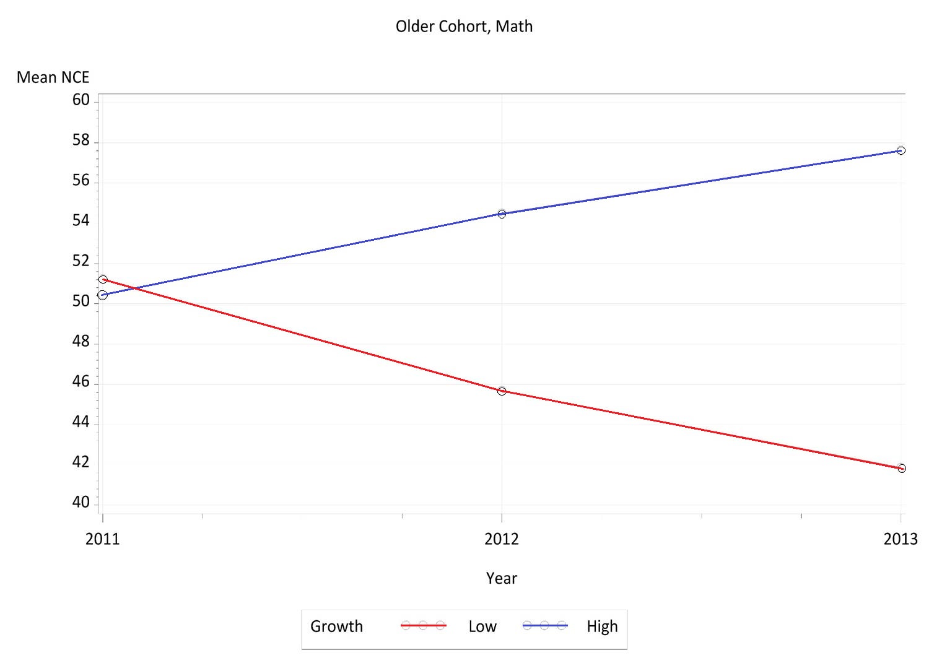

Slide 18
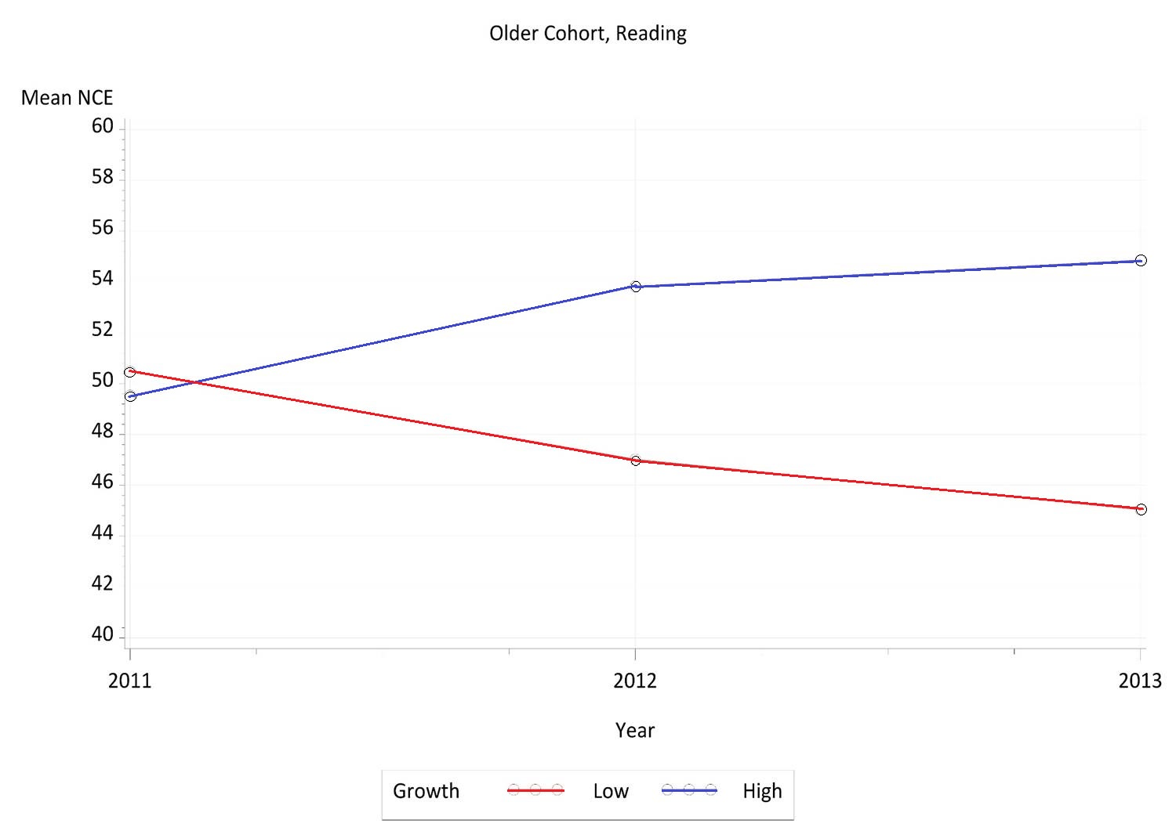

Slide 19
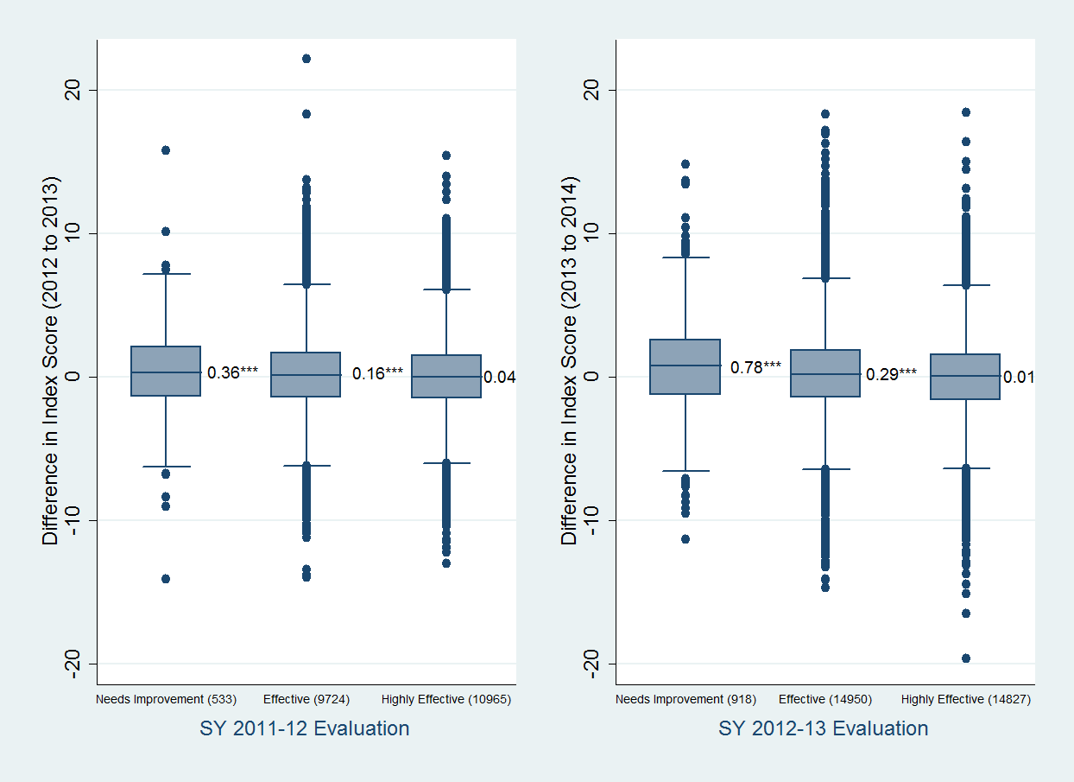
Evaluation and Change in Growth

Slide 20
Average Index Score of Teachers

Slide 21
Strengthening the Evaluation System?

Slide 22
Multiple Measures to Ensure Accuracy
Teacher Effectiveness
Principal Observation
Principal Feedback
Student Growth Data
Student Feedback
Content Expert Observation
Content Expert Feedback

Slide 23
Questions, Comments, and Feedback
Thomas R. Tomberlin
Director, District HR Support
thomas.tomberlin@dpi.nc.gov
984-236-2114

