Slide 1
Beginning Teacher Support Program (BTSP) New Charter Leaders Virtual Institute June 10, 2020

Slide 2
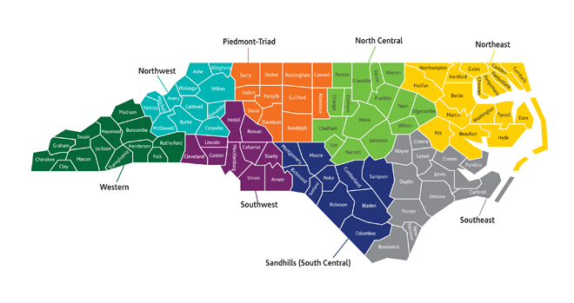
Regional Education Facilitators
http://bit.ly/NCDPIREF

Slide 3
Supporting Beginning Teachers
BTSP Plans
BTSP Peer Reviews
BTSP Monitoring
BT Support Collaborative
BT Twitter Chats
BT Newsletters
BT Summit

Slide 4
TCED-016
Beginning Teacher Support Policy Link to Policy

Slide 5
TCED-016
Beginning Teacher Support Policy
Requirements:
BTSP Plan Orientation Mentors Observations & Evaluations Professional Development BT Files
BTSP Monitoring BTSP Peer Review

Slide 6
Beginning Teacher Support Program Plans
Every public school unit must have a BTSP and a Beginning Teacher Support Program Plan (BTSP Plan) that has been approved by the local board and NCDPI and is on file for review at the public school unit or non-public school unit. The BTSP Plan must be aligned to the Beginning Teacher Support Program Standards and, when monitored, must demonstrate proficiency.

Slide 7
Beginning Teacher Support Program Plan Approval Process
Link for Template

Slide 8
BTSP Plan Approval Process
Create BTSP Plan at school level
Follow local board process for approval of BTSP Plan
Submit BTSP Plan to Regional Education Facilitator (REF)
REF will send notification to charter school
Approval Letter OR
Revisions needed

Slide 9
BTSP Plan Approval Process
REF will notify Licensure Division of plan approval
Plan must remain on file at charter school AND with NCDPI (through REF)
If changes are made at the school level OR State Board of Education Policy changes, BTSP Plan will need to be updated to reflect changes and approval process must be completed again

Slide 10
Beginning Teacher Support Program Peer Review Process
In order to assist public and non-public school units in progressing along the BTSP continuum to provide the highest quality support to beginning teachers, public and non-public school units with approved BTSP plans, which support NC licensure for their teachers, will participate in a regionally-based annual peer review. The Peer Review process includes an annual self-assessment and a peer review with a critical friend (filed annually with NCDPI).
Data from the annual peer reviews will be summarized and analyzed by NCDPI on a five-year cycle.
Notes:
.

Slide 11
Peer Review Process
Goals
Increase teacher effectiveness, thus student achievement
Help build capacity for “critical friend” collaboration
Encourage reflection for BT support and retention
Strengthen our profession through regional collaboration
Notes:
11

Slide 12
Peer Review Process
Growth Process
Begins with Self-Assessment
Critical review of current BTSP program
Annual requirement
Rating Scale (aligned with NCEES)
opportunity for continued growth
Five Program Standards
policy
Statewide documentation link

Slide 13
Beginning Teacher Support Program Monitoring
Each public and non-public school unit with an approved BTSP plan, which supports NC licensure for their teachers, will be monitored for compliance with this policy (TCED-016) by NCDPI. Monitoring is completed on a five-year revolving cycle. Technical assistance is provided as necessary to address areas of concern.

Slide 14
BTSP Monitoring Process
LEAs/Charters must be in compliance with the policy to support beginning teachers.
BT Files Reviewed
(30% of Previous Year’s BT1s, 2s, 3s)
Monitoring instrument completed on-site during the visit with ratings:
Developing, Proficient, Accomplished, Distinguished
Findings include:
Areas of Concern with resources needed to address these areas
Recommended opportunities for improvement
Commendations

Slide 15
Beginning Teacher Support Collaborative Meetings
LEAs
Charters
EPPs
REFs

Slide 16
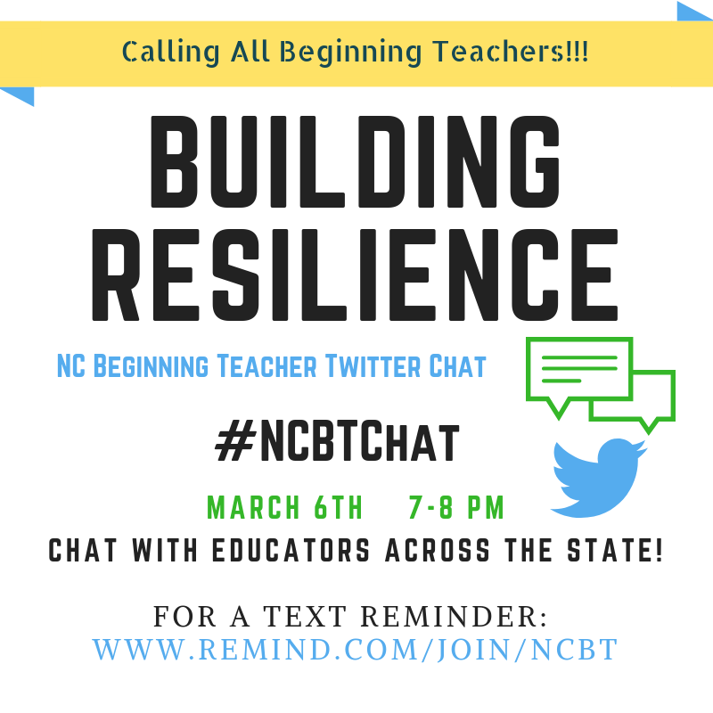
BT Twitter Chats

Slide 17
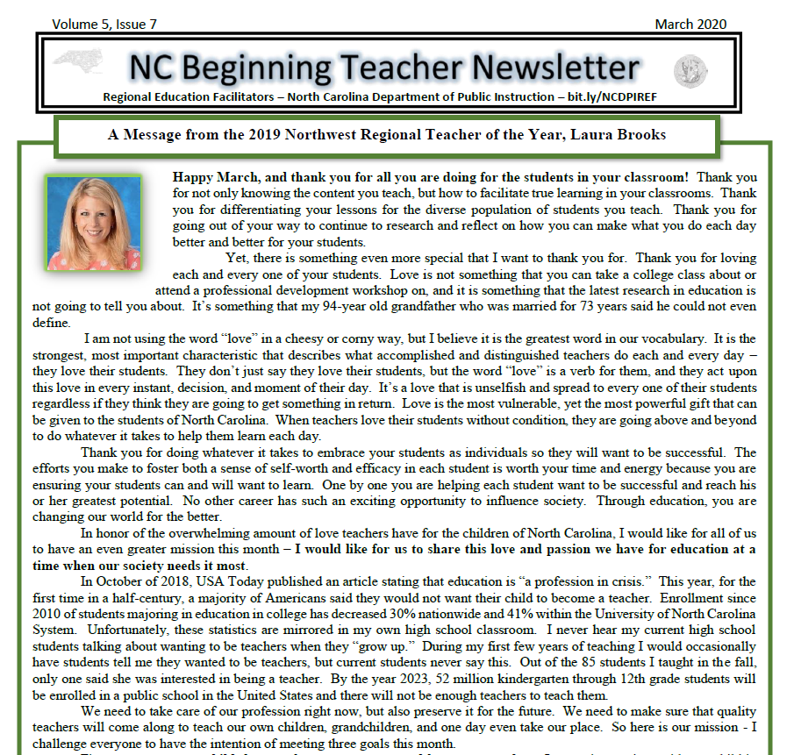
BT Newsletters

Slide 18
BT Summits
8 Regional BT Summits
Full day of professional development
BTs may self-select sessions
2021

Slide 19
Program and Support Initiatives
Mentor Training
NC Teacher Working Conditions Survey
Online Modules rt3nc.org
NC Teacher of the Year
Regional Support Team

Slide 20
Questions, Comments, Concerns
Any further explanation needed?
Any questions?
Dr. Monica Shepherd
Northwest REF
monica.shepherd@dpi.nc.gov

Slide 21
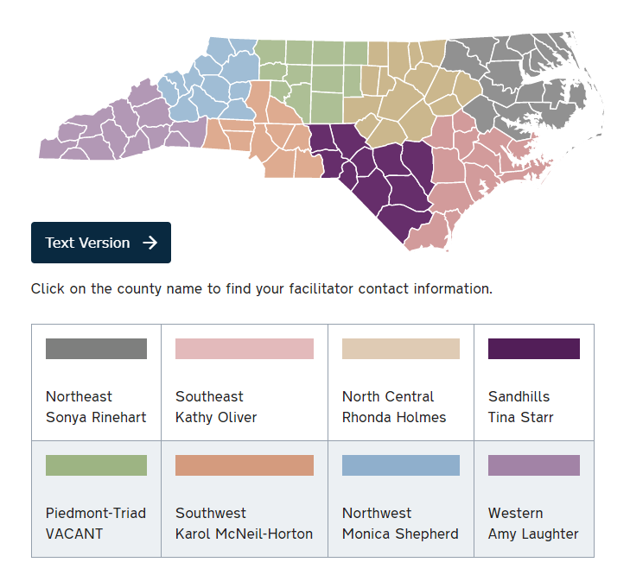
Regional Education Facilitators
http://bit.ly/NCDPIREF
Vacant
http://bit.ly/NCDPIREF
Laura Papsun

