Slide 1
New Charter School Leaders Institute
Dr. Tina Hinson
Program Administrator
James Popp
Program Administrator
NC Department of Public Instruction
Federal Program Monitoring and Support Division
6351 Mail Service Center
Raleigh, NC 27699

Slide 2
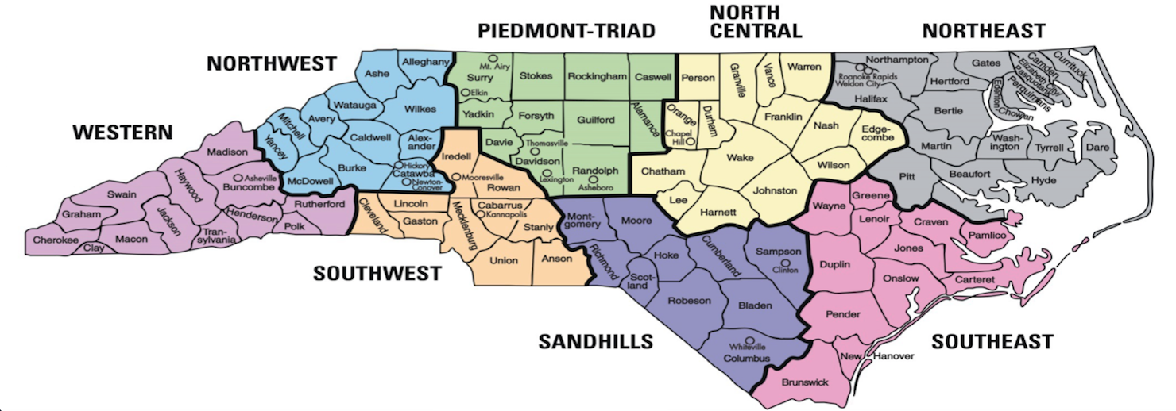
Western Charters (Piedmont-Triad, Northwest, Southwest, Western)
James J. Popp
(984) 236-2801
james.popp@dpi.nc.gov
Eastern Charters (Northeast, North Central, Sandhills, Southeast)
Dr. Tina Hinson
(984) 236-2803
tina.hinson@dpi.nc.gov

Slide 3
Federally-funded Programs
* Title I, Part A (Improving the Academic Achievement of the Disadvantaged) – PRC 050
* Title I, Part C Migrant Education Program (MEP) – PRC 051
* Title I, Part D (Neglected, Delinquent, or At-Risk Youth) – PRC 047
* Title II, Part A (Preparing, Training, and Recruiting High Quality Teachers, Principals, and
Other School Leaders) – PRC 103
* Title III, Part A Language Acquisition - PRC 104
* Title III, Part A Significant Increase – PRC 111
* Title IV, Part A Subpart 1 (Student Support and Academic Enrichment) – PRC 108
* Title IV, Part B 21st Century Community Learning Centers (21st CCLC) – PRC 110
* Title V, Part B Rural Education Achievement Program (REAP)
- Subpart 1 – Rural and Low-Income Schools (SRSA) – Dept. of Ed. Direct Grant
- Subpart 2 – Rural Low-Income Schools (RLIS) – PRC 109
* McKinney-Vento Homeless Education Program – PRC 026
* Comprehensive Support and Improvement (CSI) Funds – PRC 105
* CARES Act, Elementary and Secondary School Emergency Relief (ESSER) – PRC 163

Slide 4
What is the focus of our Division’s work?

Slide 5
Program Monitoring
Provide Grant Administration
Data Collection and Reporting
Facilitate the Necessary Technical Assistance Needed to Ensure not only Compliance, but Quality Programs for Students

Slide 6
Program Monitoring

Slide 7
Building Relationships – we’re in this together
Technical Assistance – we’re here to help
Compliance - It's the law

Slide 8
Monitoring Schedule:
Notification Letter – 30 calendar days prior to monitoring event
Documents Submitted to PA – documentation due by 5:00pm the Friday prior to monitoring event week – must be in electronic format
Monitoring Event:
Receipt of all LEA / Charter documentation for review by PA (Friday)
Document review (Tuesday & Wednesday)
Onsite school visits, interviews, and closing meeting (Thursday)
Report preparation (Friday & Monday)
Draft report submitted to Section Chief, modification of report (if required), & final supervisory approval

Slide 9
Monitoring Schedule:
Final Report: Final report is issued to the Board Chair and the Federal Program Director at the close of the monitoring event. The State Plan allows 30 business days.
Final Report Issued by Division Director, copied to PA
It is the Charter Federal Program Director’s responsibility to distribute to other applicable individuals and programs at the Charter level
Charters will have 30 business days to respond to “findings” within the formal written report

Slide 10
Monitoring Issues
School-Parent Compacts
Consultation (PFE policy, SIPs, PACs, MEP, EL Standards/Program, etc.)
NCLB Language
Supplement vs. Supplant (Title I, EL and MEP)
Agendas/Minutes/Sign-in Sheets (Documentation and Timeline)
Interviews
MOU / MOA with Head Start
Language Formatting for all Families

Slide 11
CONSOLIDATED COMPREHENSIVE IMPROVEMENT PLAN (CCIP)

Slide 12
CONSOLIDATED COMPREHENSIVE IMPROVEMENT PLAN (CCIP)
A User Access Administrator (UAA) account must be established to allow local staff to enter plan components and the funding application on North Carolina’s web-based system, the Comprehensive Continuous Improvement Plan (CCIP).
To establish a UAA account, email Anita Harris at anita.harris@dpi.nc.gov and provide the following information:
* First and Last Name
* NCID User Name (not password)
* Phone number (format nnn-nnn-nnnn)
* Extension (if any)
* Organization
* Email address

Slide 13
* Title I Plans must be developed in consultation with stakeholders. * The plan created from stakeholder consultation must be placed in the CCIP system.

Slide 14
The following outlines the sequence of steps to submit your consolidated application through CCIP:
1. Submit ESSR data in Power School (May/June – for new Charters, it may be September/October)
2. Upload required narratives in CCIP (June – for new Charters, it may be January/February):
* Comprehensive Needs Assessment
* Goals and Plan Relationships
3. Submit Title I budget to NCDPI Federal Programs Monitoring and Support. The submitted budget will populate the Budget Details page in CCIP. (June – for new Charters, it may be January/February)

Slide 15
CCIP Steps Cont.
4. Enter required information in the Funding Application in CCIP. (June – for new Charters, it may be January/February)
5. Ensure that all program areas in which an allotment was received have a complete funding application in CCIP. (June – for new Charters, it may be January/February)
6. Submit the application through the appropriate approvals: (June – for new Charters, it may be January/February)
Draft Completed
Fiscal Representative Approved
Chief Administrator Approved

Slide 16
Things to remember about BAAS/CCIP:
The “Plan” in CCIP is typically due June 30, which means the
Budget must first be in BAAS to transfer
Keep in mind Budgets / Plans are reviewed in the order
they are received…
Your budget must match your Plan
Amendments – “comments” will expedite process
Consultation must have occured prior to submission
(Tribal – if applicable)
The difference between “Planning” v. “Actual” allotments

Slide 17
3-Prong Test

Slide 18
Helpful Links
Federal Program Monitoring and Support Division:
https://www.dpi.nc.gov/districts-schools/federal-program-monitoring
Comprehensive Continuous Improvement Plan (CCIP):
https://ccip.schools.nc.gov

Slide 19
Additional Support Contacts
* NCStar (Required if CSI / TSI)
- Alessandro Montanari (984) 236-2109, alessandro.montanari@dpi.nc.gov
* MOU / MOA with Head Start
- Carla Garrett (336) 504-2037, carla.garrett@dpi.nc.gov
- Karen McKnight (984) 236-2747, karen.mcKnight@dpi.nc.gov

Slide 20
Questions or Feedback:
Please send email to james.popp@dpi.nc.gov or tina.hinson@dpi.nc.gov with a subject titled “Charter Question”
FAQ will be created and shared

