Slide 1
New Charter School Leaders Virtual Institute
June 10, 2020

Slide 2
Welcome to our Opening 2020 Charter Schools!
Dave Machado, Director of the Office of Charter Schools

Slide 3
2020 New Charter Leaders Virtual Institute
Agenda
Attendance
Housekeeping

Slide 4
Charter School Finance
June 2020
Alexis Schauss, Director of School Business
Sue Holly, Allotment Analyst
School Allotment Section

Slide 5
Who is School Business
28 employees who are responsible for the policy and data of student, personnel and financial of entities receiving public school state and federal funds.

Slide 6
What does School Business Do
Public school budget development
Allocation of funds
Collection of data
Analysis of data
Projections
Monitor the compliance of laws and policy
Report

Slide 7
Todays Topics
Reminders
Checklist
Now until December

Slide 8
Components of State Funding
State Base
Based on base allocation per student
Children with Disabilities (CWD or EC)
Based on dollars per headcount. Child must be on the April 1 headcount to be eligible
Limited English Proficiency (LEP)
If the charter school has eligible LEP headcount. At least 20 students or 2.5% of ADM. (New Charters not eligible in Year 1.)

Slide 9
State Base Allocation
New Charter Schools are funded based on the base allocation per ADM of the LEA where the student previously attended.
Kindergarten Students – base allocation per ADM of the LEA where the student would have attended.
Other – Private Schools, Home Schools, etc.- base allocation per ADM where the new charter is located.
Year 2 – Base allocations per ADM of the LEA where the Charter School is located.

Slide 10
How is the State Base Allocation Calculated?
Webinar on the FBS webpage – Dissecting Charter School Funding
https://www.dpi.nc.gov/districts-schools/district-operations/financial-and-business-services/independent-public-schools-operations

Slide 12
State Base Funding Timing
July Initial Allotment (estimate)
34% of State per student amount * projected ADM (provided by the school)
(in the event of no State budget a float will be calculated)
End of Nov
Recalculate and provide
68% of State per student amount * Actual month 1 ADM
Before the end of February
Remaining 32% provided
After 3 years of reviewed financial statements and good financial standing, the school may receive access to 100% of the allotments in 2nd installment.

Slide 13
CSADM System – Deadline June 12
This is the system in which the charter school provide the projection on the number of students and from which LEAs the students are coming from.
Projections used for budgeting and initial allotment.
Inaccuracy of this data impacts the LEAs allocations.
Contact: Angela Harrison angela.Harrison@dpi.nc.gov
https://schools.nc.gov/csadm

Slide 14
Allotment System
This system provides all the details of the State and federal funding provided to the charter school
Request access (with your NCID) at:
https://www.dpi.nc.gov/districts-schools/district-operations/financial-and-business-services/allotments-—-funding-public-school-units

Slide 15
Initial Allotment- 1st year CS
ADM based on projection and breakdown provided by the charter school
$ per ADM based the funding of the LEA

Slide 16
Initial Allotment- Revision 1
The charter school is provided access to 34% of the annual allotment based on the projection provided by the charter

Slide 17
New Charters Supplemental State Funds
Children with Disabilities (CWD EC)
Based on dollars per headcount. Child must be on the April 1 headcount to be eligible for funding.
ie. If the school enrolls an student who was not in a public school last year, they are not on the April headcount.
Limited English Proficiency (LEP) Year 2
If the charter school has eligible LEP headcount. At least 20 students or 2.5% of ADM. An October 1 Headcount is needed for LEP students

Slide 18
EC Headcount Transfer
Per legislation, the charter has 60 days to request a transfer of funds for children with disabilities who were on a LEAs April 1 headcount but now in membership at your charter school.
Only children in membership in the first 60 days are eligible for transfer funding.
New charter schools MUST go in to the transfer system and request the funds within the 60 days. This is the only way CWD counts will be considered for funding in the first year.
https://ec.ncpublicschools.gov/finance-grants/allotment-allocations/head-count-transfer

Slide 19
Special State Reserve
Charters may apply for additional funding for high needs students through the Exceptional Children Division.
Funds are restricted to specific students

Slide 20
Other State Funds not in the Base Allocation
Fines and Forfeitures
Connectivity Funds
Read to Achieve Funds (charters with grades K-3 only)

Slide 21
Other State Funds
Other allocations allotted in subsequent revisions
Charters receive email notification when funds are allotted

Slide 22
Powerschool
This system provides all the details of the student accounting. Most important to funding is the Principals Monthly Report (PMR) which reports:
Attendance
Membership
Enrollment
Withdrawals
It is submitted every school month.

Slide 23
Month 1 PMR
Month 1 and 2 must have 20 instructional days (if GS or SBE allows a different month to be used for funding, that month must also have 20 days).
Annual funding is determined based on Month 1 Average Daily Membership (ADM).
ADM should not be confused with attendance. Definitions for each can be found at:
School Attendance and Student Accounting Manual: https://files.nc.gov/dpi/documents/fbs/accounti ng/manuals/sasa.pdf
Contact: studentaccounting@dpi.nc.gov with any questions.

Slide 24
2nd Installment
Annual allotment is recalculated based on Month 1 ADM
68% of the new annual allotment is provided as an authority to draw.
If the charter school provided an over projection AND has drawn down the funds, the overdraft will be netted against the 2nd installment.

Slide 25
2nd Installment

Slide 26
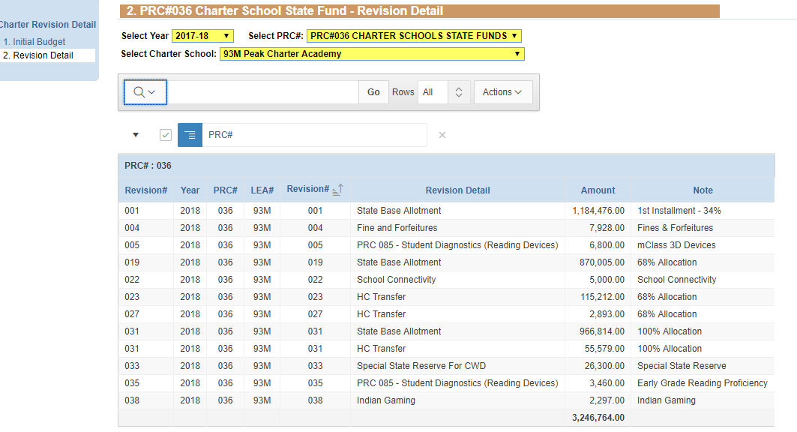
Summary of Annual Allotment- Example only
Final installment allotted before the end of February

Slide 27
State Competitive Grants
Charters may be eligible for other State grants for which they must apply.
Examples: school safety grants
Please read the newsletters (School Business Newsletter and Charter Schools Newsletter) for announcements.

Slide 28
Unused State Funds in PRC 036 Revert to the State on June 30

Slide 29
Federal Grants
Most common are Title I (PRC050) and IDEA VI-B (PRC060)
Allotted as grant award documents are received from Washington
Budget approval required before allotments are distributed
Refer to the NC Allotment Policy Manual at for a list of federal PRC’s, eligibility for funds, allotment formulas, and any special provisions.
Unused funds revert at the end of the grant period.

Slide 30
Local Funds
GS 115C 105(c
The LEA in which the student resides shall transfer to the charter school an amount equal to the per pupil local current expense fund.
Plus a per pupil share of the penal fines and forfeitures and supplemental school tax, if any.

Slide 31
Local Funds
115C-218.105(d)
LEA must transfer within 30 days of the receipt of the monies in to the local current expense fund.
(Best Information can be obtained from the County Finance Officer for $ per student funding.)

Slide 32
The LEA shall Provide…
The total amount of monies the local school administrative unit has in each of the funds - State Public School Fund, local current expense and capital outlay.
The student membership numbers used to calculate the per pupil share of the local current expense fund.
How the per pupil share of the local current expense fund was calculated.
Any additional records requested by a charter school from the LEA in order for the charter school to audit and verify the calculation and transfer of the per pupil share of the local current expense fund.

Slide 33
Local Funds Do Not Revert

Slide 34
Critical Items When Building Your Budget
Average Daily Membership
Be realistic
Know the breakeven number of students
2. State Base Allotment 2019-20
- Varies by LEA ($5,754 to $10,957)
- average $5,754
https://www.dpi.nc.gov/fbs/allotments/state/

Slide 35
Critical Items When Building Your Budget
Local funds vary significantly ($504 to $4,472)
Federal funds are supplemental and are not intended to be base funding

Slide 36
Reporting

Slide 37
Financial and Student Reporting
GS 115C-218.30
Schools shall comply with the Uniform Education Reporting System (UERS)
Subject to Audits
Monthly Financial
Student Accounting
Ad hoc data collection

Slide 38
UERS
Required
Accountability and Transparency
Basis for
NC General Assembly
Federal Reporting
State Reporting
Media and the public

Slide 39
Chart of Accounts
Shows how the allotments were expended.
This is the only financial communication between the Charters and DPI.
DPI uses this data to communicate to the State Legislature, the State Budget Office, media and the Federal Government.

Slide 40
Chart of Accounts
Uniform Accounting System for all LEAs and Charters
Information Gathering
Consistency amongst LEAs and Charters
Comparability between years
Decision making tool
https://www.dpi.nc.gov/districts-schools/district-operations/financial-and-business-services/school-district-finance-operations/chart-accounts

Slide 41
Chart of Accounts
Data in the chart is used for:
Reports on Teachers
Teacher certification requirement (50% rule – brick and mortar)
Reporting to the General Assembly, Federal Government, media and general public on past and future education initiatives
Building the budget
Research and Statistics

Slide 42
Financial Reports
Access these reports via WS_FTP PRO Software
ALTARPO1 - Budget Allotment Revision
ALTINRP1 - Planning Allotments
JHA 305 - Local Account Balance Reconciliation
JHA 705 - Budget Balance Reconciliation
JHA714 - Cash Balance Report
Monitor - Monthly Monitoring Report

Slide 43
Certificate of Occupancy
The following Forms are not Processed without a certificate of Occupancy

Slide 44
Cash Management
Establish a ACH bank account with the State Treasurer’s Office. Allow 2 weeks
ACH Bank Account Authorization Form
Voided Check or Original Deposit Slip (Cannot accept temporary checks)
Establish access to the Cash Management System (CMS) – Complete Security Forms
CICS Application Maintenance Form
RACF02 Site Security Officer Form
RACF03 RACF User ID Maintenance Form
Complete Bill Action Code Form – ITS Access

Slide 45
Cash Management
Know the cash calendar and funds requirement date (FRD)
Do not order more cash than needed to cover the current expenditures
It is against federal law to hold cash for more than 3 days. (GS147-86.11)
Guidelines and forms:
https://www.dpi.nc.gov/districts-schools/district-operations/financial-and-business-services/school-district-finance-operations/cash-management

Slide 46
Take Aways
Data reporting is NOT optional (must be in our required format – on time)
Financial Datafile – UERS Transfer Schedule
PMR – PowerSchool
SAR – PowerSchool
Board of Directors is responsible for data submitted
Decisions made based on submitted data
No access to funds until approximately 2 weeks after C/O is submitted
DPI Provides Cash Management Training (Required for all new schools)
COVID-19 Funds – PRC 163 CARESACT 2020 funds have been reserved for New Charters. HB1043 has no reserve for New Charters.

Slide 47
School Business Contacts
School Allotments Section Chief
Lydia Prude (984) 236-2462
School Reporting Section Chief
Gwendolyn Tucker (984) 236-2458
Financial Related Questions
Roxane Bernard (984) 236-2460
Student Accounting
LaShon Creech (984) 236-2461

Slide 48
The Charter School ADM (Average Daily Membership) Projection System – CSADM
Overview
June 10, 2020
Angela Harrison
Angela.Harrison@dpi.nc.gov
School Business Division
NC Department of Public Instruction

Slide 49
What is the CSADM
Online system for Charters, Regional and UNC Lab, Schools only
Comprised of three phases
Improves the accuracy of key components in the budgeting process
Only electronic submissions are acceptable received from one of the following: Executive Director(s), Head of School, or Board Chair

Slide 50
Phase 0
Material Increase in ADM or Grade Expansion
Required submission by all Charters, UNC Lab and Regional schools with current school year attendance
(November)
Phase I
ADM Projection – Initial Submission
Required submission by all Charters, UNC Lab and Regional schools with current school year attendance
(January)
Phase II
Final Verification -Initial ADM required of all:
• current Charters with 2019-2020 school attendance
•charter schools approved by the State Board of Education to open July 1, 2020
•University of North Carolina (UNC) Lab schools approve by General Assembly to open July 1, 2020.
June 1, 2020 - June 12, 2020

Slide 51
Phase 0 Material Increase in ADM or Grade
This phase gathers information for the State Board of Education concerning requests for enrollment growth and/or grade expansion of the provisions of charter’s application
General Statute guidelines used in Phase 0 concerning enrollment growth: G.S. 115C-218.7(b)
Enrollment growth of greater than twenty percent (20%) shall be considered a material revision of the charter and shall align with SESSION LAW 2020-3 SENATE BILL 704, Low-Performing Schools.
Enrollment growth of greater than twenty-five percent (25%) shall be considered a material revision of the charter for any charter school and shall align with SESSION LAW 2020-3 SENATE BILL 704, Low-Performing Schools.
The State Board may approve such additional enrollment growth of greater than twenty-five percent (25%) only if it finds all the following:
The actual enrollment of the charter school is within ten percent (10%) of its maximum
authorized enrollment.
2) The charter school has commitments for ninety percent (90%) of the requested maximum
growth.
3) The charter school is not currently identified as low-performing.

Slide 52
Phase 0 Material Increase in ADM or Grade
- continued
This phase gathers information for the State Board of Education concerning requests for enrollment growth and/or grade expansion of the provisions of charter’s application
General Statute guidelines used in Phase 0 concerning enrollment growth: G.S. 115C-218.7(b)
4) The charter school meets generally accepted standards of fiscal management.
5) The charter school is, at the time of the request for the enrollment increase,
substantially in compliance with State law, federal law, the charter school's own
bylaws, and the provisions set forth in its charter granted by the State Board.

Slide 53
Phase 0 Material Increase in ADM or Grade
- continued
This phase gathers information for the State Board of Education concerning requests for enrollment growth and/or grade expansion of the provisions of charter’s application
General Statute guidelines used in Phase 0 concerning grade expansion:
G.S. 115C-218.8. Nonmaterial revisions of charters.
It shall not be considered a material revision of a charter and shall not require prior approval of the State Board for a charter school to do any of the following:
Notify the Office of Charter Schools in making or requesting appropriate adjustments within CSADM.
Increase its enrollment during the charter school's second year of operation and annually thereafter in accordance with G.S. 115C-218.7(b).
Increase its enrollment during the charter school's second year of operation and annually thereafter in accordance with planned growth as authorized in its charter.
Expand to offer one grade higher or lower than the charter school currently offers if the charter school has (i) operated for at least three years, (ii) aligns with SESSION LAW 2020-3 SENATE BILL 704, Low-Performing Schools, and (iii) has been in financial compliance as required by the State Board.

Slide 54
Phase I. ADM Projection Initial Submission
Phase I collection is to clearly provide the maximum ADM allowable for each school and to improve the accuracy of the budget process.
The accuracy of this number is critical to ensure adequate funding is available for the upcoming year and to minimize the disruption to charter and LEA funding.

Slide 55
Phase II. Final Verification: Initial ADM
Phase II is used for the first installment of the annual allotment and will be the maximum actual ADM that the charter school may be funded on the next school year

Slide 56
DEFINITIONS OF TERMS
Power School - A web-based student information system. Power School provides the full range of features needed by administrators at the district and school level for student accounting. The system is developed by Pearson Education, Inc.
Student Accounting - The data collection regarding student enrollment, membership, attendance, and withdrawal from membership in the public schools. Power School is the official student information system by which this data is reported to the Department of Public Instruction.

Slide 57
DEFINITIONS OF TERMS
Average Daily Membership (ADM) - The sum of the number of days in membership for all students in individual Local Education Agencies (LEAs), divided by the number of school days in the term.
Allotted ADM - The higher of the first two months total projected ADM for the current year or the higher of the first two months total prior year ADM.

Slide 58
DEFINITIONS OF TERMS
Dollars per ADM - LEA's Initial Allotments divided by the allotted ADM for that LEA. Charter schools receive an amount equal to the state funded dollars per ADM for the LEA in which the school is located or (for new charters) in which the student was previously enrolled.
Initial Allotments – The allocation of state and federal funds to LEAs occurring after adjournment of the General Assembly.

Slide 59
RESOURCES
Allotments — Funding Public School Units
https://www.dpi.nc.gov/districts-schools/district-operations/financial-and-business-services/allotments-—-funding-public-school-units
Charter School Average Daily Membership Projection System (CSADM) https://schools.nc.gov/csadm
Charter school NCID administrators
www.ncid.its.state.nc.us/LEAListing.asp
Financial and Business Services, Independent Public School Operations –IPS
(charter schools, lab schools, regional schools, and the Innovative School District) https://www.dpi.nc.gov/districts-schools/district-operations/financial-and-business-services/independent-public-schools-operations
Financial and Business Services web site
www.dpi.nc.gov/districts-schools/district-operations/financial-and-business-services

Slide 60
Thank You

Slide 61
Break Time!
This Photo by Unknown Author is licensed under CC BY-ND

Slide 62
Helpful Tips for Working with Exceptional Children
Exceptional Children Division
June 10, 2020
Notes:
LM
*Need to add something on SLD Policy Implementation July 1, 2020

Slide 63
1. Records Request
Parent Disclosure
Registration Form
Parent Conferences
Request of Records from Previous School
Form with needed documents listed
Follow up on receipt of records
Review record for compliance
Statewide Search through ECATS
NC 1503-4.4(e)(1)
Notes:
63
LM
NC.4(e)(1) If a child with a disability (who has a current IEP that was in effect in a previous LEA in the State) transfers to a new LEA in the State, and enrolls in a new school, the new LEA, in consultation with the parents, must provide FAPE to the child (including services comparable to those described in the child’s IEP from previous LEA), until the new LEA either ---
Adopts the child’s IEP from the previous LESA; or
Develops, adopts, and implements a new IEP that
meets the applicable requirements in NC 1503-4.1
through NC 1503-5.1.
Parent Disclosure: some parents will notify you of an IEP and some will not
Request of Records: When your request records, explicitly ask for Special Education records. In request ask for specific forms needed. Then make sure you follow up with receipt of records. Does office staff inform EC person when new information has come in? Be persistent with previous school iEstablish a method to review folders for compliance. Ensure that you have all the reports and information needed-you have the responsibility to bring the folder into compliance, once the student enrolls in your LEA.
Search for students in ECATS to ensure that you haven’t missed a student who is in need of EC services because you don’t want to miss providing services for a student who is eligible.

Slide 64
2. Comparable Services
What are comparable services?
Goals
Accommodations
Full Continuum of Services
How to communicate them to parents?
When do they have to be in place?
How long are they provided?
NC 1503-4.4 (e & f)
Notes:
64
LM
Comparable means similar or equivalent to. Making phone calls to previous school to see what student was being provided. If previous school was using a certain program or approach with the student, find out what was beneficial to the student’s unique needs so that you can determine a “similar” or “equivalent” service to meet that student’s need. Don’t say “WE DON’T OFFER THAT AT OUR SCHOOL” Let the parents know that you will be collecting data on how whether these services/accommodations are working for the student and you will meet back to discuss progress. DO NOT CHANGE SETTING JUST BECAUSE YOU ARE NOT OFFERING IT. Remember that in your application and RTO evidences you stated that you would be prepared to provide the Full Continuum of Services. The services/setting must match the unique needs of the student not the schedule of the school.
When should services be in place? Day One of Instruction for the student or make a contingency plan of how missed services will be made up for the student.
How long are comparable services provided? Until the LEA has adopted or amended the current IEP.

Slide 65
3. Personnel Practices
EC Teacher
Provision of services
Caseload/Class Size
Training
Teacher Assistant
Role & Responsibilities
Related Services
Service Documentation
Educational vs Medical Necessity
Screenings/Support for Staff
Training
NC 1501-12.2
Notes:
65
LM
EC Teacher-Provision of Services-See Considerations for SDI in Google folder shared at the end of the presentation
Highly qualified special education teachers, including BK certified teachers, and related service providers with specialized training and competency in the area of need (e.g., license, education, and/or credentials), in collaboration with regular education teachers
General education teachers, therapy assistants and paraprofessionals, under the supervision of the special education teacher or related service provider, may assist in the provision of specially designed instruction, but may not be the primary provider of SDI
Training: make sure you provide opportunities for teachers to obtain Continuing Education Units for renewing their license; EC Division provides a lot of PD that is provided at very minimal prices; prioritize the training to support the unique needs of the students enrolled in your school
Caseload: outlined on p. 137-139 (pg 139 provides caseload number 137 outlines); other things to consider would be other assigned duties of EC teacher, how many grades their caseload covers could limit the opportunity for collaboration with general education teachers; level of services provided and complexity of student needs
Class Size: Review chart on p. 138 of Policy Book; have participants look at chart, if you add a teacher assistant how many more identified students can you have in the class
Caseload/Class Size can significantly influence the retainment of your licensed EC Teacher
Teacher Assistant-Role is to assist under the supervision of the EC teacher; Warnings of TA s being one-on-ones
Related Services- how will you receive documentation of services provided to students? How will you communicate schedule conflicts (testing, field trips, etc) to ensure services are provided without additional costs? Since most of you will be using contract services, what is the difference between educational & medical model of services? Vulnerability when you ask contracted services to do mass screenings…Make sure you problem solve through why you want the mass screening & how will you handle the results of the mass screening….Give example of what may happen with a mass speech screening for K-2 students; Instead could related service personnel (esp. Speech Pathologist & Occupational Therapist) provide staff with interventions or tips on how to help increase speech, language, or fine motor skills. Don’t forget to include related service personnel in trainings. The EC division provides Lead Meetings for Related Service Personnel. You can use PRC 118 funds to pay for them to go to these meetings. There are also Institutes for Related Service Providers at the EC Conference in November that you can ask that they attend.

Slide 66
4. Scheduling
Prioritize Special Education students
Verify services match student’s IEP
Collaboration between General Education & Special Education Teachers
Prepared to provide all special education services on day 1
Notes:
LM
If you schedule the special populations first (EC, ESL, AIG, etc) then the other students usually fill in the gaps. If you schedule all the regular students first then you will have difficulty fitting in the special populations. Verify that services provided match what is on the child’s IEP.
Be careful about providing services on certain days of the week. Example EC services for all students are only offered Monday through Thursday, so the EC teacher can complete paperwork on Fridays. Make sure services are based on what student’s need.
EC services and accommodations MUST be provided on Day 1 of school. BE READY. Administrators should have a written schedule of services provided by the EC teacher.
It is also important to provide time/opportunities for general education and special education teachers to discuss identified students. They can compare their data to determine effectiveness of instruction, problem solve areas of concern, and plan for further instruction.

Slide 67
5. Share IEP’s with Regular Education Teachers
Prior to first day of school
Maintain Confidentiality
Documentation of Classroom Accommodations
Process for Updates
Annual Reviews & IEP Addendums
NC 1503.4.4d
Notes:
67
MH
Don’t forget to share with all of the student’s teachers including the enrichment or “specials” teachers (art, PE/health, music, spanish, technology, etc)
Share goals, accommodations, and services provided
Share means to give them a copy of and make sure they understand their responsibility is
EC teacher should keep documentation of when the information was shared and have each teacher sign off that they received the information
Be careful with sharing information electronically. Make sure you maintain confidentiality. Also remind general education teachers that they must maintain confidentiality by keeping copies of IEPs in a secure place, as well as, not talking about students identification and needs in public places
This process must be done prior to the first day a student with a disability enters their classroom. This process must be repeated whenever there are changes made to the IEP throughout the year. So do you have a process for keeping the general education teachers updated?

Slide 68
6. Documentation
Use of Accommodations
Classroom
Testing
Specially Designed Instruction
Progress Monitoring of IEP Goals
Notes:
MH
Documentation can be your friend. Do you have a process or form for documenting the use of accommodations in the classroom. Accountability has provided a form for the use of testing accommodations for state tests.
How will your EC teachers document the Specially Designed Instruction that is provided? This could be documented in their Lesson Plans, Schedule, Therapy Notes, etc
How will your EC teachers progress monitor the IEP goals of their student? How will this be communicated with the parent?
By documenting these things well, it will often times head off problems with parents. Just make sure that you are responding the data that you document. Example: if data collected is obvious that student continues to struggle, make sure that you are meeting and making changes to IEP to ensure student is making progress on IEP goals and in the general curriculum

Slide 69
7. Funding & Contracts
Children with Disabilities Head Count Transfer
State Funding (PRC 036)
Federal Funding: 611 Grant (PRC 060)
Special Projects Funding
Contracts - caution, care
Notes:
69
MH
Where do I get some money?
State Funding (PRC 032) is dumped into PRC 036 which is a general fund. Make sure that what you receive from State EC funds is being used for EC students.
You will be notified when the 611 grant opens (sometime after school starts). It is typically due for new charters by the end of October. There is an upcoming training on how to complete the grant on August 22. It is a good idea to send your EC lead as well as the person who submits your budget to Finance & Business to this training.
There are other funding sources through Special Projects Funding. Lori Peterson is having an all day session on these funding sources at the Summer Institutes on July 26. You can click on that link to register to go.

Slide 70
8. Communication with Parents
Proactive
Established Chain of Command
Transparency
Documentation
Phone calls vs Emails
Notes:
MH
Be proactive when communicating with parents. Reach out to them before they call you. If a parent is constantly reaching out to you with concerns, meet with them as a team and set up a communication plan.
Go ahead and establish a “Chain of Command” for responding to problems. This is where it is important that teachers collaborate. No one needs to be blindsided. Establishing a “Chain of Command” makes for more consistent answers and prevents shopping for answers. Give example of when parents call into DPI. We try to point the parent back to the initial consultant they talked to. If that consultant feels that they want to involve other consultants they can. This allows for a consistent plan of communication to be carried through.
Be Transparent. Even if you made the mistake. Confess and make a plan to fix it. When changes occur within the school, communicate it to the parent. Our job is to keep parents informed. Most reported problem from parents is “Lack of Communication”
Document, document, document whatever communication is done(phone calls, meetings (informal or formal, planned or unplanned), emails, etc). Follow through with whatever you promised would happen so be thoughtful in what you promise.
Phone calls vs emails. A lot of miscommunication happens through email. It is better to discuss issues through a phone call or meeting rather than email. Email should only be used to communicate plan as follow up. Stay away from responding to problems through Social Media!!!!!

Slide 71
9. Recent Staff Development Topics
Every Child Accountability Tracking System (ECATS)
Program Compliance Review
Specially Designed Instruction
SLD Policy 2020
Notes:
RM
Here are just a few training opportunities that will be provided this school year through the EC division

Slide 72
10. Communication from Us
EC Division Memos
Sent to Administrator listed in EDDIE
Office of Charter Schools Newsletter
Regional Consultant(s) Emails & Monthly Updates
Notes:
RM
Here are the tools that we use to communicate with LEAs across the state.
Explain how EC Division Memos are sent out. Urge administrators to pass the information sent out through memos to the appropriate personnel at their school. It is always better to be sent the communication multiple times than to never receive it at all.
Best communication tool is the Office of Charter Schools Newsletter. It compiles everything that is going on at DPI including trainings, memos, reports, etc. Anyone can sign up to receive it. Directions on how to sign up are in the Google folder linked at the end of the presentation.
Last but not least, make sure that the EC Lead at your school has been added to the Regional Consultants email list. Simply email the appropriate Regional consultant and ask them to add you to their email list. They send out periodic reminders or heads up of things coming up.

Slide 73
Resources
Google folder:
https://drive.google.com/open?id=15Xn4B65jX7dB4b8BDtR8B5ntqIEHoPD7
Notes:
RM - Related services, month-at-a-glance, specially designed instruction

Slide 74
Charter Support Team
Michelle Hamm
Regional Consultant Northeast, Southeast, Sandhills
Michelle.Hamm@dpi.nc.gov
984-236-2565
Rob McOuat
Regional Consultant Piedmont-Triad, North Central
Robert.McOuat@dpi.nc.gov
984-236-2600
Lynn Metcalf
Regional Consultant Southwest, Northwest, Western
Lynn.Metcalf@dpi.nc.gov
984-236-2599
Ginger Cash
Consultant for Intervention
Ginger.Cash@dpi.nc.gov
984-236-2559
Teresa Cestaro
Monitoring Consultant Piedmont-Triad & Southwest
Teresa.Cestaro@dpi.nc.gov
984-236-2608
Heidi Carico
Consultant for Autism
Heidi.Carico@dpi.nc.gov
984-236-2620
74
Notes:
RM

Slide 75
Exceptional Children Division Special Programs and Data Section
EC Special Project Funding,
IDEA EC Grant Application and
Fiscal Accountability
Presented by Keashia Walker,
IDEA Consultant
Keashia.Walker@dpi.nc.gov
984-236-2602

Slide 76
Exceptional Children State and Special Project Funding
State Aid (PRC 032/036):
Intended to assist the Local Education Agency (LEA) with services for children with disabilities.
https://www.dpi.nc.gov/districts-schools/district-operations/financial-and-business-services

Slide 77
Behavior Support Funds PRC 029
The North Carolina General Assembly has allocated funds to provide resources to help school systems appropriately serve students with severe and complex behavioral-emotional needs.
Traditional or Comprehensive Needs Grant
The application process is now in the NC CCIP System
https://ccip.schools.nc.gov
For more information regarding these funds, contact:
Regions 1-4, Lisa Taylor,
919-394-3605 or lisa.taylor@dpi.nc.gov
Regions 5-8, Felicia Goodgion,
828-702-5572 or felicia.goodgion@dpi.nc.gov

Slide 78
Developmental Day Funds PRC 063
For children placed in an approved Developmental Day Center approved by NCDHHS/DCDEE.
Accessed via an application
Funds are child specific; cannot be used for other children.
Funds are used to contract with community based DDCs and to support LEA based DDC’s

Slide 79
Group/Foster Home Funds PRC 032/036 and PRC 060
Funds are available to LEAs for students with disabilities placed in group or foster homes or similar facility for residential services that were not counted on the LEAs December 1 or April 1 child count.
The LEA where the group home is located is responsible for the special education and related services for the students that reside in the group home.
Accessed via an application.
Funds may be used for other children after the child generating the funds have been served.
Application required within 60-days

Slide 80
Special State Reserve Funds PRC 063/036
For newly enrolled children with disabilities who have high cost needs.
Special circumstances may permit a submission for a change in condition.
Intended to assist Local Education Agency(LEA) with emergency, unforeseen situations that are accompanied by an unexpected fiscal burden.
Accessed via an application.
Funds are child specific; cannot be used for other children.
Application required within 60-days
Example:
A child with disabilities moves from another district and enrolls in school after budgets are set and funds are committed. The child has needs that are atypical and very expensive to provide.

Slide 81
Community Residential Center PRC 063
For children placed in an approved Community Residential Center placed through the Local Management Entity or Managed Care Organization.
Accessed via an application.
Funds are child specific; cannot be used for other children
Application required within 60-days
Applicable to Traditional LEAs Only

Slide 82
Exceptional Children Federal IDEA
and Special Project Funding

Slide 83
Federal IDEA Grant Funds PRC 060
Funds are for all children with disabilities, ages 3 through 21, who meet specific eligibility requirements under Public Law 108.446
IDEA Section 611(3 through 21) funds are allocated through PRC 60
IDEA Section 619 (3 through 5) funds are allocated to LEAs through PRC 49
Local education agencies (LEAs) must submit an IDEA Grant Application annually and receive approval prior to access funds
Grant Deadline July 10th
New Charter IDEA Grant Deadline TBD

Slide 84
Federal IDEA Grant Funds
Proportionate Share Funds PRC 060
IDEA requires LEAs to provide special education services to students with disabilities who are parentally-placed in non-public schools which are located in the LEA
Proportionate Share is a set-aside in PRC 060 and must be used for the equitable services
Equitable services may be provided to SWD enrolled by their parents in private schools
Private Schools include religious, and home schools that meet the definition of elementary and secondary school
Applicable to Traditional LEAs Only

Slide 85
Federal IDEA Grant Funds
Coordinated Early Intervening Services PRC 070
Mandatory Use
IDEA regulations mandate 15% of IDEA 611 and 619 funds are set-aside for any LEA with significant disproportionality (SD)
Plan submitted within the IDEA Grant Application
Permissive Use
LEAs without significant disproportionality may use up to 15% of their IDEA 611 and 619 funds for CEIS
Request submitted within the IDEA Grant Application

Slide 86
Out of District PRC 060
Excess cost of placement support
Up to 50% of Educational Costs reimbursed
Requires submission of fiscal documentation
Accessed via an application
Funds are child specific.
Must be IEP Team recommended out of district placement
Annual application required within 30-days

Slide 87
Risk Pool Program Funds PRC 114
For children with disabilities who have high cost, extraordinary needs.
Funds are often requested for medically fragile children and children in need of additional staff (Ex. 1:1 assistance for activities of daily living skills)
Accessed via an application
Funds are child specific
A specific child may be funded for up to five years (not necessarily consecutive years)
Services must be documented in the child’s IEP

Slide 88
Federal Targeted Assistance Funds PRC 118
Initiatives supported with Targeted Assistance funds
PBIS
Content Literacy
Personnel
Related Services
Autism Support Team
The funds that are provided to Charter Schools are intended to assist in the challenges faced when recruiting and retaining Related Service personnel (Occupational Therapists, Physical Therapists, Speech-Language Pathologists, and School Psychologists)

Slide 89
Federal Targeted Assistance Funds PRC 119
Supported with Targeted Assistance funds for Preschool initiatives:
Assessment Teams
Early Literacy Sites
Outdoor learning Environments
Center on the Social Emotional Foundation for Early learning (CSEFEL) sites
Special Projects
Funds can support professional development for Preschool Coordinators.

Slide 90
NC State Improvement Plan Funds PRC 082
The North Carolina State Improvement Project (NC SIP) provides personnel development and program support services to significantly improve the performance and success of students with disabilities in North Carolina.
Previously there have been NC SIP research-based sites that focus on
reading and writing instruction
research-based mathematics instruction sites
A growing network of sites focusing on Early Literacy

Slide 91
Fiscal Accountability
IDEA Fiscal Monitoring Tiers
Budget vs. Expenditures
Exceeds 10%
Tier I
Desk Reviews
Five year cycle
Tier II
Site Reviews
Risk-based criteria
Tier III

Slide 92
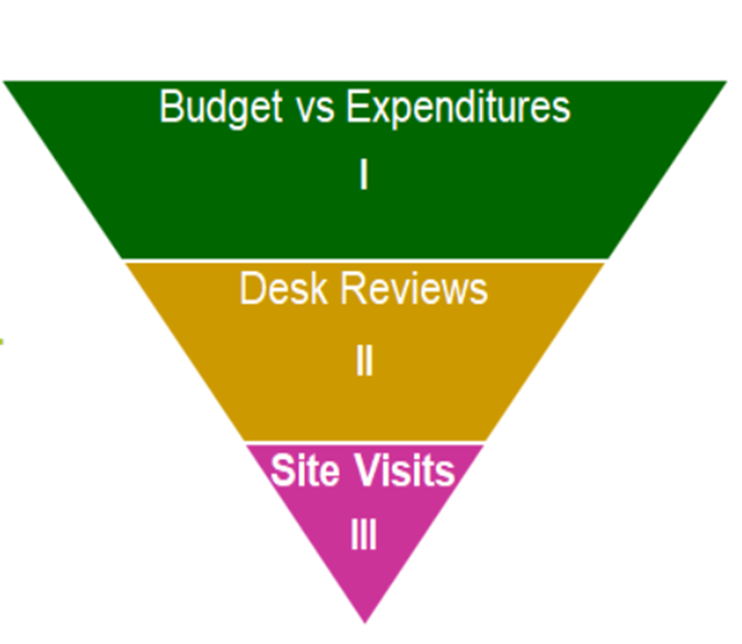
IDEA Fiscal Monitoring
Tier I
All IDEA federal program funds are reviewed biannually to ensure that LEAs are spending funds in agreement with their approved budgets,
PRC 049, 060, 070, 114 and 118.

Slide 93
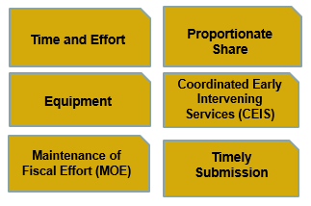
IDEA Fiscal Monitoring
Tier II

Slide 94
IDEA Fiscal Monitoring
Tier III
The Site Visit’s risk-based selection criteria was established to provide an equitable examination of an LEA’s financial reports, timely and accurate submissions and other historical operations data relative to federal funding sources for students with disabilities

Slide 95
Risk-Based Criteria
Monitoring Findings
IDEA Fiscal Desk Review
Policy, Monitoring, and Audit Program Compliance Review
Finance and Business Federal Program’s fiscal monitoring
Timely and accurate submission of data
Combined Expenditure Reports
IDEA Grant/Budget
EOY Reports
Developmental Day Center Fund (DDCF)
Special State Reserve Fund (SSRF) and
Risk Pool Fund (RPF)
SEA identified potential fiscal issues
Federal funds expiring 12/31
Budget vs. Expenditures > 10% variance
LEA EC Director/Coordinator turnover
Reported fiscal concerns

Slide 96
Resources
Exceptional Children Division
https://ec.ncpublicschools.gov/
IDEA Fiscal Monitoring information
https://ec.ncpublicschools.gov/finance-grants/fiscal-monitoring
EC Grants Application Management System
https://ccip.schools.nc.gov/default.aspx?ccipSessionKey=637261202195088618
Financial & Business Services
https://www.dpi.nc.gov/districts-schools/district-operations/financial-and-business-services
Federal Fiscal Oversight and Compliance
https://www.dpi.nc.gov/districts-schools/district-operations/financial-and-business-services/federal-fiscal-oversight-and-compliance#fiscal-guidance
NCDPI School Allotments Section
https://www.dpi.nc.gov/districts-schools/district-operations/financial-and-business-services/allotments-%E2%80%94-funding-public-school-units

Slide 97
Exceptional Children Division Special Programs and Data - Grant and Fiscal Team Contact Information
IDEA Consultant
Districts 1 and 2
Keashia Walker
Phone: 984-236-2602
Email: keashia.walker@dpi.nc.gov
SPD
Section Chief
Amanda Byrd
Phone: 984-236-2597
Email: amanda.byrd@dpi.nc.gov
IDEA Consultant
Districts 5 and 6
Elizabeth Millen
Phone: 984-236-2603
Email: elizabeth.millen@dpi.nc.gov
IDEA Consultant
Districts 3 and 4
Lori Peterson
Phone: 984-236-2596
Email: lori.peterson@dpi.nc.gov
NC Preschool 619 Consultant
Statewide
Dawn Meskil
Phone: 984-236-2642
Email: dawn.meskil@dpi.nc.gov
IDEA Consultant
Districts 7 and 8
Adam Parent
Phone: 984-236-2637
Email: adam.parent@dpi.nc.gov

Slide 98
Break Time!
This Photo by Unknown Author is licensed under CC BY-ND

Slide 99
Standards, Curriculum, and Instruction Updates
Dr. Angie Mullennix
Director of Innovation Strategy & Interim Director of SC&I
Angie.Mullennix@dpi.nc.gov
NCDPI
Notes:
The primary purpose of the K-12 Standards, Curriculum, and Instruction Division is to serve as the authoritative source for the review, revision, and support for implementation of state content standards in the North Carolina Standard Course of Study in the areas of Arts Education (Dance, Music, Theatre Arts, and Visual Arts), English Language Arts, English Language Development, Guidance, Healthful Living (Health and Physical Education), Mathematics, Science, Social Studies, and World Languages.
The Division additionally supports multiple legislative and grant-related programs, initiatives, and reporting requirements, related to the federal Every Student Succeeds Act (ESSA); Title III, Part A (English Language Acquisition); Title V (Sexual Risk Avoidance); CDC Physical Activity, Physical Education, Nutrition, and Chronic Disease Management; Specialized Instructional Support Personnel; and state legislative and policy requirements related to areas such as Character Education, English Learners, Global Education, Healthy Active Children, Middle School Athletics, and STEM.
The Division provides leadership for equity and access to support and tools for standards and program implementation, collaboration and engagement with internal and external stakeholders, (including cross-area work groups around materials adoption/alignment, assessments, district and regional support), and professional learning and support for grades K-12 in order to realize the State Board of Education vision that every public school student will graduate ready for post-secondary education and work, prepared to be a globally engaged and productive citizen through access to needed resources and rigor. The Division is organized in four primary sections, as illustrated on the left.

Slide 100
Stay Connected with SC&I
NC Public Schools Site
SC&I Google Site
Gov Delivery - Sign-up to receive updates in areas of interest via open listservs
C and I Leaders Listserv (contact Amy.Betsill@dpi.nc.gov and request to be added)
#NCSCOS – standards-related training on social media

Slide 101
Welcome and Purpose
Provide updates to Charter Leaders
Share upcoming professional learning opportunities
Answer questions and provide resources for support

Slide 102
Standards, Curriculum, and Instruction
Focus Areas
Equity and Access of Support and Tools
Collaboration and Engagement
Professional Learning and Support
Review, Revision, and Implementation of Standards

Slide 103
K-12 Standards, Curriculum, and Instruction
Mathematics, Science, & STEM
English Language Arts & Languages
SC&I
Social Studies &
Arts Education
Specialized Instructional Support & NC Healthy Schools
Notes:
In November 2018, SC&I reorganized into these 4 sections.

Slide 104
Standards
Updates
Notes:
North Carolina's Standard Course of Study defines the appropriate content standards for each grade level and each high school course to provide a uniform set of learning standards for every public school in North Carolina. These standards define what students know and should be able to do.
Based on a philosophy of teaching and learning that is consistent with current research, exemplary practices, and national standards, the Standard Course of Study is designed to support North Carolina educators in providing the most challenging education possible for the state’s students. The goal of these standards is to prepare all students to become career and college ready.
With these standards as the foundation, local school leaders make decisions about the comprehensive curriculum that they choose to deliver to students so that they can reach the content standards for every grade and subject. In addition, local schools and districts may offer electives and coursework that is above and beyond the NC Standard Course of Study's content standards. Classroom instruction is a partnership between the state, which sets content standards in the Standard Course of Study, and local educators who determine which curriculum materials they will use to deliver instruction to reach the standards.
*Note: To access the standards, visit the Public Schools of North Carolina website, which is the authoritative source for all standards approved by the NC State Board of Education.

Slide 105
SCOS-012
Approved by SBE in March 2018
NCDPI will use a uniform and formalized system built on four guiding principles to guide the standards:
A. Feedback-Based
B. Research-Informed
C. Improvement-Oriented
D. Process-Driven
Notes:
The State Board of Education policy SCOS-012 defines the Process for the Review, Revision, and Implementation of the NC Standard Course of Study (SCOS) (Approved March 2018).
The policy ensures a system for standards review, revision, and implementation that promotes transparency and stakeholder engagement and unifies and formalizes the standards development process, which is:
Feedback-Based
Research-Informed
Improvement-Oriented, and
Process-Driven.

Slide 106
4th Level Mathematics
Approved August 2019
Timeline
Support documents available July 2020
Virtual PD -July 2020
Implementation 2020-21
New Course Codes available
AFM no longer available to new students
Notes:
AFM course is only available for students who previously failed the course and must retake to fulfill graduation requirements.
(SCOS-012) and Graduation Requirements Policy (GRAD-004) - (GRAD-004) NC Math 1, 2, and 3 and a fourth mathematics course to be aligned with the student’s post high school plans
The department continues to work diligently to ensure that there are a variety of options for students that align to their plans after high school graduation, whether that be career, community college or technical school, or college.
For mathematics, the State Board high school graduation requirements, take into account options aligned to students’ post high school plans. These options have been in effect since the 2012-13 school year. The NC Mathematics Graduation Requirements Options Charts were developed according to the State Graduation Requirements to ensure that students receive mathematics coursework that aligns to their post high school plans, which includes options for students entering directly into a career following high school. Students who elect to enter directly into a career following high school, follow Option 3 on the charts, which includes a variety of courses that can be used to satisfy a 4th math credit following Math 1, 2, and 3. Courses that may be used include AP or IB options (such as AP computer science); single CTE courses (in areas such as Accounting, Carpentry, Computer Science, Drafting, Interior Design); paired CTE courses (for example, Masonry I and II or Electronics I and II); and additional mathematics courses.
The Essentials of College Math (ECM) course referenced in the educator’s email will no longer be available beginning with the 2019-2020 school year because unfortunately, the ECM course does not meet the course content required by the US Office of Civil Rights to be considered an advanced course; thus, it can no longer be offered as a 4th math option for fulfilling graduation requirements.
In an effort to ensure the usefulness of the NC Mathematics Standard Course of Study for meeting the needs of all students, NCDPI relies on feedback from various stakeholders, which includes the business community. To ensure that we are current with the requirements to meet the demands of the workforce, NCDPI’s mathematics team in Standards, Curriculum, and Instruction and the Career and Technical Education staff continuously collaborate to determine the appropriate course content for students entering different fields of work.

Slide 107
Support Documents and Virtual PD
Math Resources available July 2020 on Google Site
Math webinars and virtual PD planned for July 2020;
Science webinars and virtual PD planned for July 2020.
Notes:
Data review team considered 4th level math (what needs to be included) during review of 1-3

Slide 108
K-12 Social Studies
Received approval to begin revision process at April 2019 SBE meeting
Writing & review teams worked through the year to draft new standards
Draft 3 will be going before the board in June 2020
Professional development & support resources will be created and shared after approval
Timeline
Exploration (Anticipated approval Spring 2020)
Installation 2020-21
Implementation 2021-22

Slide 109
Economics and Personal Finance Required Course
HB 924 approved in July 2019
GRAD 004 updated in January to include
Timeline
Exploration and Installation - 2019-20
Development of course
Implementation 2020-21
Professional development legislated to be provided by the North Carolina Council for Economic Education (virtual option this summer)

Slide 110
K-12 Information and Technology
ISTE Standards for Students as SCOS for K-12 IT discussion at SBE at June 2019 meeting; anticipated approval July 2019
Timeline
Exploration (Anticipated approval July 2019)
Installation 2019-20
Implementation 2020-21

Slide 111
K-12 Computer Sciences
Will be added as a SCOS content area by the State Board of Education
Framework for Computer Sciences
SCOS development (2019-20)
See June SBE materials for additional information
Contact:
Dr. Mary Hemphill, Director of Computer Sciences at NCDPI

Slide 112
Professional Learning Opportunities

Slide 113
English Language Arts
Upcoming resources for formative assessment and scaffolding
Summer virtual PD sessions (TBD)
New resources: Choice Boards and EL Text Sets
Remote Learning Site

Slide 114
ESL/Title III
Virtual PD
The EL Support Team provided several spring virtual professional learning sessions. Visit the ESL/Title III Google site for the recordings!
Remote Learning Site

Slide 115
World Languages
Webinar series has wrapped up - visit the Google site for recorded archives
The 2020 Language Diversity Map will be released next month
Remote Learning Site
Notes:
The language diversity map is an overview of the languages other than English that are spoken in homes across the state.

Slide 116
Arts Education Leaders
Spring Coordinators Meeting (recording)
Series of virtual professional development offerings on our google site.
Fall gathering & ArtsR4Life TBD

Slide 117
Resources and Other Opportunities

Slide 118
K-12 Standards, Curriculum, and Instruction
Mathematics, Science, & STEM
English Language Arts & Languages
SC&I
Social Studies &
Arts Education
Specialized Instructional Support & NC Healthy Schools
Notes:
Visit the site to access materials and resources for all areas.

Slide 119
Remote Learning Resources
Listservs Remote Learning
Friday Institute

Slide 120
Beginning Teacher Support Program (BTSP) New Charter Leaders Virtual Institute June 10, 2020

Slide 121
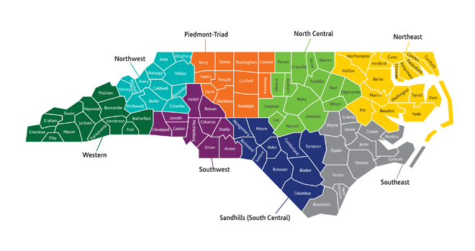
Regional Education Facilitators
http://bit.ly/NCDPIREF

Slide 122
Supporting Beginning Teachers
BTSP Plans
BTSP Peer Reviews
BTSP Monitoring
BT Support Collaborative
BT Twitter Chats
BT Newsletters
BT Summit

Slide 123
TCED-016
Beginning Teacher Support Policy Link to Policy

Slide 124
TCED-016
Beginning Teacher Support Policy
Requirements:
BTSP Plan Orientation Mentors Observations & Evaluations Professional Development BT Files
BTSP Monitoring BTSP Peer Review

Slide 125
Beginning Teacher Support Program Plans
Every public school unit must have a BTSP and a Beginning Teacher Support Program Plan (BTSP Plan) that has been approved by the local board and NCDPI and is on file for review at the public school unit or non-public school unit. The BTSP Plan must be aligned to the Beginning Teacher Support Program Standards and, when monitored, must demonstrate proficiency.

Slide 126
Beginning Teacher Support Program Plan Approval Process
Link for Template

Slide 127
BTSP Plan Approval Process
Create BTSP Plan at school level
Follow local board process for approval of BTSP Plan
Submit BTSP Plan to Regional Education Facilitator (REF)
REF will send notification to charter school
Approval Letter OR
Revisions needed

Slide 128
BTSP Plan Approval Process
REF will notify Licensure Division of plan approval
Plan must remain on file at charter school AND with NCDPI (through REF)
If changes are made at the school level OR State Board of Education Policy changes, BTSP Plan will need to be updated to reflect changes and approval process must be completed again

Slide 129
Beginning Teacher Support Program Peer Review Process
In order to assist public and non-public school units in progressing along the BTSP continuum to provide the highest quality support to beginning teachers, public and non-public school units with approved BTSP plans, which support NC licensure for their teachers, will participate in a regionally-based annual peer review. The Peer Review process includes an annual self-assessment and a peer review with a critical friend (filed annually with NCDPI).
Data from the annual peer reviews will be summarized and analyzed by NCDPI on a five-year cycle.
Notes:
.

Slide 130
Peer Review Process
Goals
Increase teacher effectiveness, thus student achievement
Help build capacity for “critical friend” collaboration
Encourage reflection for BT support and retention
Strengthen our profession through regional collaboration
Notes:
130

Slide 131
Peer Review Process
Growth Process
Begins with Self-Assessment
Critical review of current BTSP program
Annual requirement
Rating Scale (aligned with NCEES)
opportunity for continued growth
Five Program Standards
policy
Statewide documentation link

Slide 132
Beginning Teacher Support Program Monitoring
Each public and non-public school unit with an approved BTSP plan, which supports NC licensure for their teachers, will be monitored for compliance with this policy (TCED-016) by NCDPI. Monitoring is completed on a five-year revolving cycle. Technical assistance is provided as necessary to address areas of concern.

Slide 133
BTSP Monitoring Process
LEAs/Charters must be in compliance with the policy to support beginning teachers.
BT Files Reviewed
(30% of Previous Year’s BT1s, 2s, 3s)
Monitoring instrument completed on-site during the visit with ratings:
Developing, Proficient, Accomplished, Distinguished
Findings include:
Areas of Concern with resources needed to address these areas
Recommended opportunities for improvement
Commendations

Slide 134
Beginning Teacher Support Collaborative Meetings
LEAs
Charters
EPPs
REFs

Slide 135
BT Twitter Chats

Slide 136
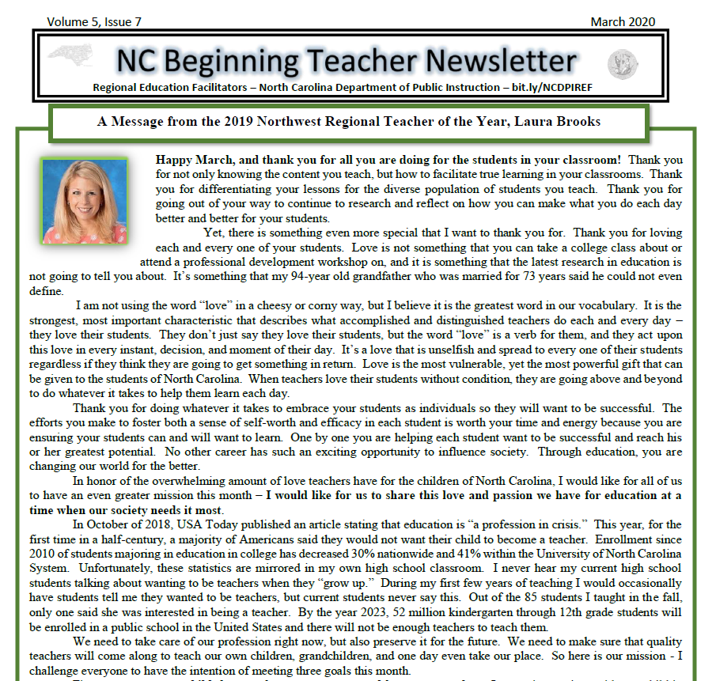
BT Newsletters

Slide 137
BT Summits
8 Regional BT Summits
Full day of professional development
BTs may self-select sessions
2021

Slide 138
Program and Support Initiatives
Mentor Training
NC Teacher Working Conditions Survey
Online Modules rt3nc.org
NC Teacher of the Year
Regional Support Team

Slide 139
Questions, Comments, Concerns
Any further explanation needed?
Any questions?
Dr. Monica Shepherd
Northwest REF
monica.shepherd@dpi.nc.gov

Slide 140
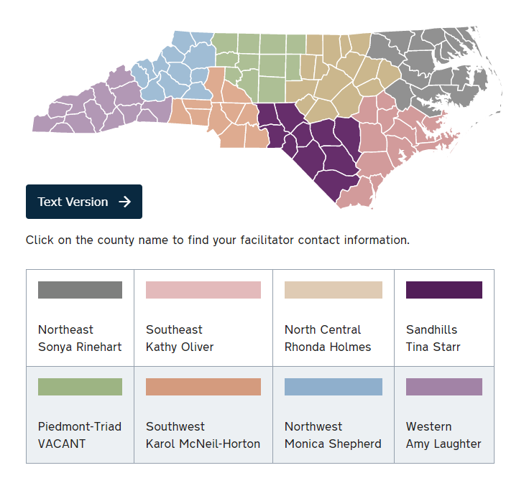
Regional Education Facilitators
http://bit.ly/NCDPIREF
Vacant
http://bit.ly/NCDPIREF
Laura Papsun

Slide 141
Enjoy Your Lunch! We will reconvene at 12:25 p.m.

Slide 142
New Charter School Leaders Institute
Dr. Tina Hinson
Program Administrator
James Popp
Program Administrator
NC Department of Public Instruction
Federal Program Monitoring and Support Division
6351 Mail Service Center
Raleigh, NC 27699

Slide 143
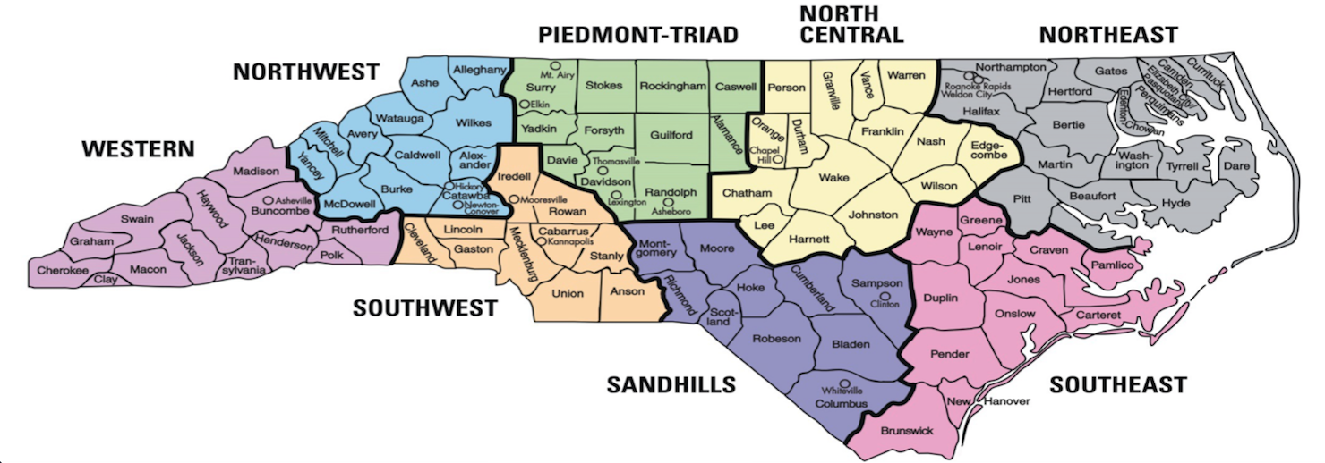
Western Charters (Piedmont-Triad, Northwest, Southwest, Western)
James J. Popp
(984) 236-2801
james.popp@dpi.nc.gov
Eastern Charters (Northeast, North Central, Sandhills, Southeast)
Dr. Tina Hinson
(984) 236-2803
tina.hinson@dpi.nc.gov

Slide 144
Federally-funded Programs
* Title I, Part A (Improving the Academic Achievement of the Disadvantaged) – PRC 050
* Title I, Part C Migrant Education Program (MEP) – PRC 051
* Title I, Part D (Neglected, Delinquent, or At-Risk Youth) – PRC 047
* Title II, Part A (Preparing, Training, and Recruiting High Quality Teachers, Principals, and
Other School Leaders) – PRC 103
* Title III, Part A Language Acquisition - PRC 104
* Title III, Part A Significant Increase – PRC 111
* Title IV, Part A Subpart 1 (Student Support and Academic Enrichment) – PRC 108
* Title IV, Part B 21st Century Community Learning Centers (21st CCLC) – PRC 110
* Title V, Part B Rural Education Achievement Program (REAP)
- Subpart 1 – Rural and Low-Income Schools (SRSA) – Dept. of Ed. Direct Grant
- Subpart 2 – Rural Low-Income Schools (RLIS) – PRC 109
* McKinney-Vento Homeless Education Program – PRC 026
* Comprehensive Support and Improvement (CSI) Funds – PRC 105
* CARES Act, Elementary and Secondary School Emergency Relief (ESSER) – PRC 163

Slide 145
What is the focus of our Division’s work?

Slide 146
Program Monitoring
Provide Grant Administration
Data Collection and Reporting
Facilitate the Necessary Technical Assistance Needed to Ensure not only Compliance, but Quality Programs for Students

Slide 147
Program Monitoring

Slide 148
Building Relationships – we’re in this together
Technical Assistance – we’re here to help
Compliance - It's the law

Slide 149
Monitoring Schedule:
Notification Letter – 30 calendar days prior to monitoring event
Documents Submitted to PA – documentation due by 5:00pm the Friday prior to monitoring event week – must be in electronic format
Monitoring Event:
Receipt of all LEA / Charter documentation for review by PA (Friday)
Document review (Tuesday & Wednesday)
Onsite school visits, interviews, and closing meeting (Thursday)
Report preparation (Friday & Monday)
Draft report submitted to Section Chief, modification of report (if required), & final supervisory approval

Slide 150
Monitoring Schedule:
Final Report: Final report is issued to the Board Chair and the Federal Program Director at the close of the monitoring event. The State Plan allows 30 business days.
Final Report Issued by Division Director, copied to PA
It is the Charter Federal Program Director’s responsibility to distribute to other applicable individuals and programs at the Charter level
Charters will have 30 business days to respond to “findings” within the formal written report

Slide 151
Monitoring Issues
School-Parent Compacts
Consultation (PFE policy, SIPs, PACs, MEP, EL Standards/Program, etc.)
NCLB Language
Supplement vs. Supplant (Title I, EL and MEP)
Agendas/Minutes/Sign-in Sheets (Documentation and Timeline)
Interviews
MOU / MOA with Head Start
Language Formatting for all Families

Slide 152
CONSOLIDATED COMPREHENSIVE IMPROVEMENT PLAN (CCIP)

Slide 153
CONSOLIDATED COMPREHENSIVE IMPROVEMENT PLAN (CCIP)
A User Access Administrator (UAA) account must be established to allow local staff to enter plan components and the funding application on North Carolina’s web-based system, the Comprehensive Continuous Improvement Plan (CCIP).
To establish a UAA account, email Anita Harris at anita.harris@dpi.nc.gov and provide the following information:
* First and Last Name
* NCID User Name (not password)
* Phone number (format nnn-nnn-nnnn)
* Extension (if any)
* Organization
* Email address

Slide 154
* Title I Plans must be developed in consultation with stakeholders. * The plan created from stakeholder consultation must be placed in the CCIP system.

Slide 155
The following outlines the sequence of steps to submit your consolidated application through CCIP:
1. Submit ESSR data in Power School (May/June – for new Charters, it may be September/October)
2. Upload required narratives in CCIP (June – for new Charters, it may be January/February):
* Comprehensive Needs Assessment
* Goals and Plan Relationships
3. Submit Title I budget to NCDPI Federal Programs Monitoring and Support. The submitted budget will populate the Budget Details page in CCIP. (June – for new Charters, it may be January/February)

Slide 156
CCIP Steps Cont.
4. Enter required information in the Funding Application in CCIP. (June – for new Charters, it may be January/February)
5. Ensure that all program areas in which an allotment was received have a complete funding application in CCIP. (June – for new Charters, it may be January/February)
6. Submit the application through the appropriate approvals: (June – for new Charters, it may be January/February)
Draft Completed
Fiscal Representative Approved
Chief Administrator Approved

Slide 157
Things to remember about BAAS/CCIP:
The “Plan” in CCIP is typically due June 30, which means the
Budget must first be in BAAS to transfer
Keep in mind Budgets / Plans are reviewed in the order
they are received…
Your budget must match your Plan
Amendments – “comments” will expedite process
Consultation must have occured prior to submission
(Tribal – if applicable)
The difference between “Planning” v. “Actual” allotments

Slide 158
3-Prong Test

Slide 159
Helpful Links
Federal Program Monitoring and Support Division:
https://www.dpi.nc.gov/districts-schools/federal-program-monitoring
Comprehensive Continuous Improvement Plan (CCIP):
https://ccip.schools.nc.gov

Slide 160
Additional Support Contacts
* NCStar (Required if CSI / TSI)
- Alessandro Montanari (984) 236-2109, alessandro.montanari@dpi.nc.gov
* MOU / MOA with Head Start
- Carla Garrett (336) 504-2037, carla.garrett@dpi.nc.gov
- Karen McKnight (984) 236-2747, karen.mcKnight@dpi.nc.gov

Slide 161
Questions or Feedback:
Please send email to james.popp@dpi.nc.gov or tina.hinson@dpi.nc.gov with a subject titled “Charter Question”
FAQ will be created and shared

Slide 162
Last Updated: May 2020
Critical Incident Response for School Faculty and Staff

Slide 163
OBJECTIVES
Define the term active shooter.
Name some characteristics to look for in students that are congruent to the typical school shooter.
Define Critical and Tactical Thinking.
Name the steps can be taken to identify, mitigate and prevent an active shooter event.
Introduce and discuss the three new response actions teachers may utilize in a critical incident.
Introduce and discuss the new Lockdown Procedures for the classroom.
Introduce the new standard card notification system and why the changes were made to the system.
Be aware of Reunification issues

Slide 164
Introduction and Purpose
Training for school faculty & staff re: what to do in active shooter situation
1999 training film contains actions/policies no longer accepted/outdated
2014 training curriculum better describes before/during/after actions needed during active shooter situation and other critical incidents
Updated training provides more options to faculty/staff/students to mitigate active shooter situations

Slide 165
Who does this impact?
This establishes a uniform response by schools all across the state.
Has ZERO impact on HOW law enforcement or first responders respond to critical incidents at the schools. Only changes what they may SEE once they are on-scene.

Slide 166
Active Shooter
Law Enforcement officials use the term “active shooter” to describe a situation where a person(s) participates in a random or systematic shooting spree in a confined or populated area.
No pattern in selecting victims
Can occur in schools, museums, daycares, rec facilities, malls, sporting events
Active shooter situations are rare
1 in 2.5 million chance of being victim of school shooting
Evolve quickly, end quickly (3-12 minutes)

Slide 168
Possible Indications of Future Violent Tendencies in Students
Verbal or written communication suggesting idea or intent to attack (80% of school shooters tell at least one person)
Does student possess capacity to follow through with threat? (Never take anyone for granted)
Student has experienced acute rejection/catastrophic loss
Student has experienced chronic rejection by friends, teams, social groups

Slide 170
Steps to Identify, Prevent or Mitigate Active Shooter Event
Know your students.
Know your surroundings. “What if…?”
Have great Situational Awareness
Encourage anti-bullying behavior; urge intervention when needed.
Treat ALL threats of violence against the school as valid until proven not to be.
Pre-plan & practice your school’s emergency response plan.

Slide 171
NEW WAY OF THINKING FOR STAFF
School Faculty and Staff HAVE to start thinking:
CRITICALLY
TACTICALLY

Slide 172
CRITICAL THINKING:
Objective analysis and evaluation of an issue in order to form judgement.

Slide 173
TACTICAL THINKING:
Short term planning to tackle a situation to put oneself in a more favorable situation.

Slide 174
Three Response Actions/Review of Lockdown Actions & Changes
Lock or otherwise secure your door.
Turn out lights.
Turn off televisions/other sources of noise.
Move students out of view & away from doors/windows.
Keep students quiet.
If injured people are present or immediate medical care is needed USE THE RED CARD ONLY. SLIDE IT UNDER THE DOOR AND PUT IT IN THE WINDOW. NO OTHER COLORED CARDS SHOULD BE USED.

Slide 175
Changes to the COLOR CARD SYSTEM
Plan was becoming too complex. Schools were overthinking it.
By putting a green card out at onset of event, teachers were FLAGGING their room as occupied.
Status may change in the room (ex.: medical emergency occurs following display of green card). Now you have two cards indicating two opposite things outside the door.

Slide 176
Card Changes cont’d:
Schools within the same county often had different card systems.
The event will be a Multi-Agency Response. (The card system used in this county should be the same system used in another county. Establishes STATEWIDE CONSISTENCY FOR SCHOOLS.)
Substitute Teacher Issues
Law Enforcement is only concerned with the red card anyway.

Slide 177
Changes to the Lockdown Procedure
Do not worry about closing the window blinds/shades.
Law Enforcement has never liked this action taken by schools
Eliminates sight into the room by law enforcement snipers
Limits vision out of the class at your surroundings
If a hostage situation occurs, suspects are more apt to pull shades down to limit LE sight into the room. Will be quicker for LE to pick out room with possible trouble inside.

Slide 178
New Options for Response
The new response types we will now discuss SHOULD NOT REPLACE common sense and/or experience.

Slide 179
RUN
Students and staff should not typically deviate from Lockdown mode unless instructed by law enforcement or other first responders.

Slide 180
RUN
In extreme cases WITH NO OTHER OPTIONS and you face an imminent threat, the situation may dictate that you run.
If you are outside on a practice field or
parking lot.
Instruct students clearly if you have them
with you.
Move them to a predetermined meeting
location.

Slide 181
Exterior Meeting Points

Slide 183
HIDE
Use if you cannot reach a secure classroom OR unable to secure your door.
If you are on a field trip or outside the school.

Slide 184
Barricade the Door if you can

Slide 185
There is no Fire Code in a
Crime Scene.

Slide 186
FIGHT
Use this response only as a LAST RESORT and ONLY if your life or the lives around you are in imminent danger.
Use chairs, heavy objects or improvise a weapon to attack the shooter.
If you use this option, stick with your decision and fight to survive.

Slide 188
Before, During & After the Emergency
BEFORE
Encourage students/staff to participate in bullying prevention.
Know your school’s climate.
Be aware of changes in students; report any of concern.
Report suspicious behavior to police or your school resource officer.
PARTICIPATE IN TRAINING. YOU WILL PLAY LIKE YOU PRACTICE!

Slide 189
Before, During & After the Emergency
DURING
Use correct Lockdown procedures.
If you choose another response, make sure you are EFFECTIVE.
REASSESS after every action. Every action will cause a reaction.

Slide 190
Before, During & After the Emergency
AFTER
Ensure your plans consider mass transportation for students/staff to a sister school.
Include a parent reunification plan.
Facilitate physical and psychological recovery for students/staff.

Slide 191
Mike.anderson@dpi.nc.gov
919-807-3354
Training Manager

Slide 192
Break Time!
This Photo by Unknown Author is licensed under CC BY-ND

Slide 193
Accessing State and Local K-12 Applications
By:
Jordan Kincaid
DPI Technology Services

Slide 194
K-12 Applications
NCID
RACF
NC EDDIE
Staff UID
Student UID
NCEdCloud IAM Service
PowerSchool
Schoolnet
Canvas
GoOpenNC
NCEES
EVAAS
ECATS
Local applications

Slide 195
K-12 Application Categories
Access
NCID
Staff UID
Student UID
NCEdCloud IAM Service
Operational
EDDIE
EVAAS
ECATS
PowerSchool
Schoolnet
Canvas
NCEES
Etc.

Slide 196
How to Access the Access Apps
OCS
EDDIE
NCID
Student UID
DPI IT
Staff UID
RACF

Slide 197
How to Access the Ops Apps
Finance/HR
Staff UID
ODS
NCEdCloud
Student UID
PowerSchool

Slide 198
How to Access the Ops Apps
EVAAS
PowerSchool
Schoolnet
NCEES
NCEdCloud
Canvas
ECATS
GoOpenNC
NC ELI
Local Apps
Istation

Slide 199
Next Steps
Get Relevant System Admin Roles
Local Admins for NCID: Create other local NCID accounts and provide account management support.
Security Officer for Student UID: Review and approve access requests to Student UID for other CD staff.
LEA/CS Administrator in the NCEdCloud: Approves other roles in system, submits integration requests, has access to staff and student accounts, performs account management activities, etc.

Slide 200
Additional Information
DPI Website:
www.ncpublicschools.org
DPI Technology Support Center:
https://ncgov.service-now.com/sp_dpi
(919) 716-1840
NCEdCloud Info Site:
https://ncedcloud.mcnc.org/
NCEdCloud Info Site Charter Info:
https://ncedcloud.mcnc.org/charter-schools

Slide 201
Tom Tomberlin Director, Educator Recruitment and Support
June 10, 2020
Teacher Evaluation and EVAAS

Slide 202
Teacher Evaluation in North Carolina

Slide 203
Student and School Growth
STUDENT GROWTH: Teachers contribute to the academic success of students.
The work of the teacher results in acceptable, measurable progress for students based on established performance expectations using appropriate data to demonstrate growth. It is the intent of the State Board of Education to provide educators a state-wide, standardized measure of student growth for the purpose of promoting professional growth for educators, guiding school improvement efforts, and informing educator evaluation processes.
Beginning with the 2016-2017 school year, Student Growth will no longer be a stand-alone standard in the NC teacher evaluation process. All processes related to the determination of student growth estimates for teachers and schools will continue.
Determining Student Growth with Statewide Method
A teacher’s rating on the student growth measure is determined by a student growth value as calculated by the statewide growth model for educator effectiveness. The measures of student learning - End-of-Course assessments, End-of-Grade assessments, Career and Technical Education Post-Assessments, NC Final Exams, K-3 Checkpoints, and Analysis of Student Work provide the student data used to calculate the growth value or performance rating.
See NCSBE policy EVAL-030 for similar language regarding School Growth
North Carolina State Board of Education Policy EVAL-006, Revised 2016-04-07

Slide 204
Measuring Teacher Effectiveness
Although student and school growth no longer has a direct impact on a teacher’s or administrator’s evaluation, the state will continue to develop a measure of teacher and administrator effectiveness that incorporates growth.
The state will continue to report to the federal and state governments the percentage of teachers and administrators in the categories of Highly Effective, Effective, and In Need of Improvement.
The NC State Board of Education will continue to use the effectiveness status of teachers to populate measures in its strategic plan.
Given that student and school growth is no longer tied to an individual’s evaluation, the state will calculate three year averages for teachers and administrators regardless of whether the employee changes districts.
Student and school growth (both single and three year measures) will continue to be used for research and analytic purposes.

Slide 205
Growth in Educator Evaluation
Educator Evaluation
(Standards 1-5 or 1-7)
Student/School Growth
Collected Artifacts
Student/Parent/Teacher Surveys
Peer Observation/Feedback

Slide 206
Understanding EVAAS Growth

Slide 207
Estimating Student Growth
Students’ Observed Scores
Students’ Predicted Scores
Difference between observed and predicted
Differences aggregated to teacher level
Student Growth Estimate
Calculate Standard Error
Divide growth estimate by standard error
Student Growth Index

Slide 208
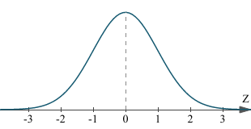
Estimating Student Growth
Does Not Meet Expected Growth
Meets Expected Growth
Exceeds Expected Growth

Slide 209
Proficiency and EVAAS
How can a school increase proficiency rates by X percentage points but not meet growth?
 | Prior Year Score | Prior Year NCE | Current Year Score | Current Year NCE | Growth
Student A | 229 | 54 | 231 | 55 | 1
Student B | 250 | 62 | 238 | 57 | -5
Student C | 255 | 64 | 236 | 56 | -8
Student D | 226 | 53 | 230 | 54 | 1
Student E | 228 | 54 | 232 | 55 | 1
Student F | 243 | 59 | 235 | 56 | -3
Student G | 225 | 52 | 230 | 54 | 2
Student H | 231 | 55 | 230 | 54 | -1
Student I | 227 | 53 | 220 | 50 | -3
Student J | 235 | 56 | 230 | 54 | -2
 | Prior Year |  | Current Year | Mean | -1.7
Proficiency = 230 | % Proficient = 50% |  | %Proficient = 90% | Std Dev | 3.2
 |  |  |  | Std Error | 0.8
 |  |  |  | Index | -2.1
Notes:
NOTE TO TOM: I removed the word “expected” from the Prior Year Score column heading. A student’s single score in the prior year is not used to generate any kind of expected score for the student in the EVAAS reporting, so I’m afraid that might be confusing for people. I changed the formatting of the columns a bit, just a thought. Also, I’m not sure about including the standard deviation here, but as with the previous slides, I’m not sure of all the points you need to make here.

Slide 210
School-Level Growth

Slide 211
Student Subgroup Growth

Slide 212
Does Evaluation Matter?

Slide 213
Does Evaluation Matter?
Notes:
Taylor, E.S, & Tyler, J.H. (2012). The effect of evaluation on teacher performance . American Economic Review, 102(7), 3628-3651. - See more at: http://cepa.stanford.edu/content/effect-evaluation-teacher-performance#sthash.cvqXEcug.dpuf

Slide 214
Does Growth Matter?
Two groups of students captured:
Younger Cohort: began Grade 5 in SY 2010-11
Older Cohort: began Grade 6 in SY 2010-11
 |  | Low¹ | High²
Younger | Math | 1935 | 1825
 | Reading | 184 | 221
Older | Math | 1560 | 1547
 | Reading | 183 | 301
¹Students in the “Low Growth” category have consecutive years of teachers in the Does Not Meet Expected Growth category
²Students in the “High Growth” category have consecutive years of teachers in the Exceeds Expected Growth category
Notes:
NOTE TO TOM: Are the Low and High values for math correct? They seem to be backwards, but it’s hard to tell since we don’t know what’s being said here.

Slide 215
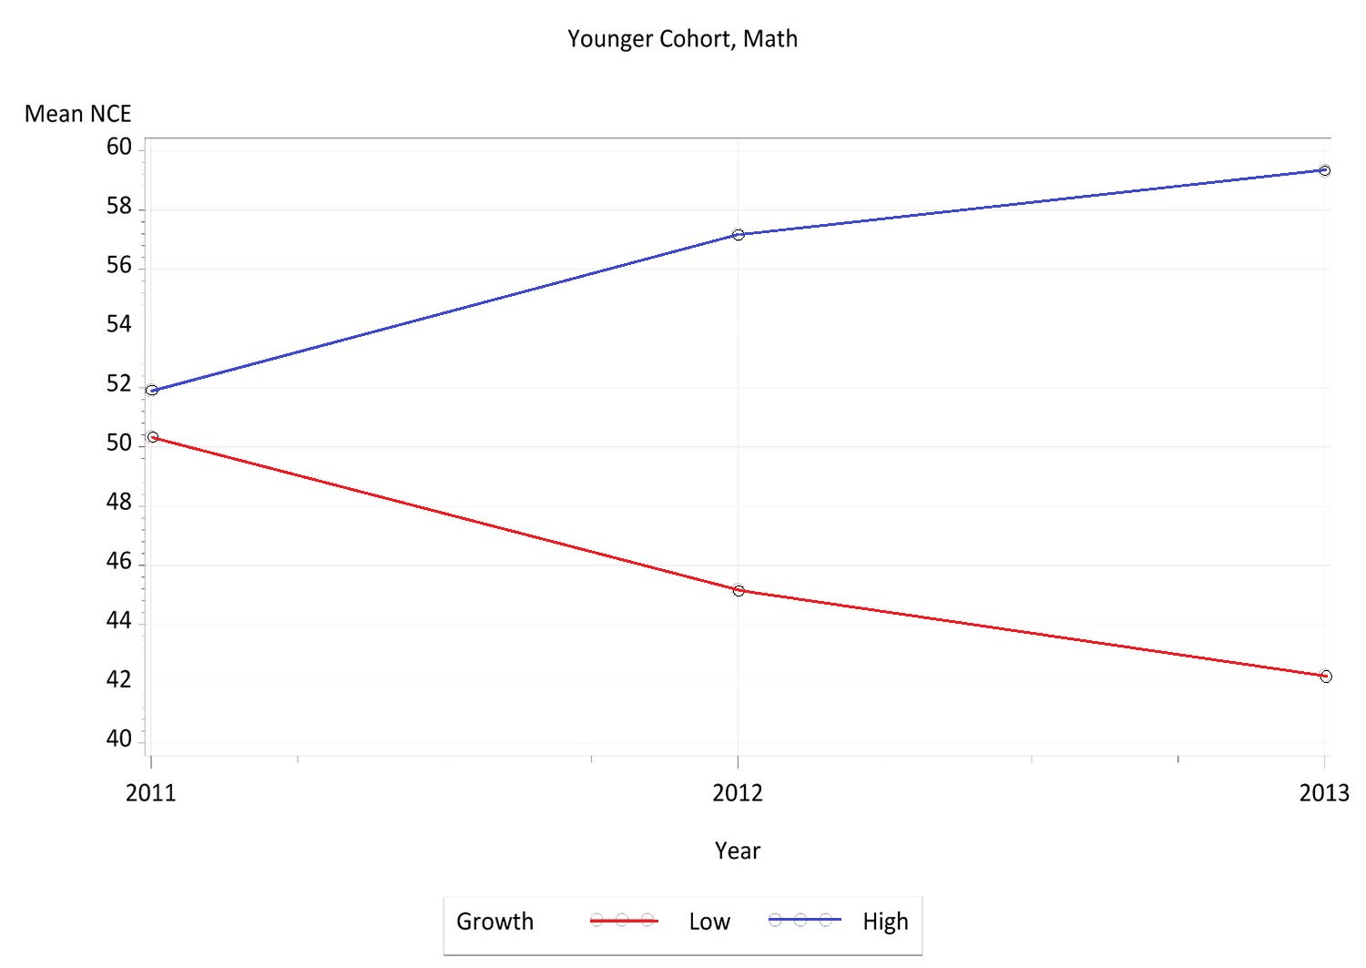

Slide 216
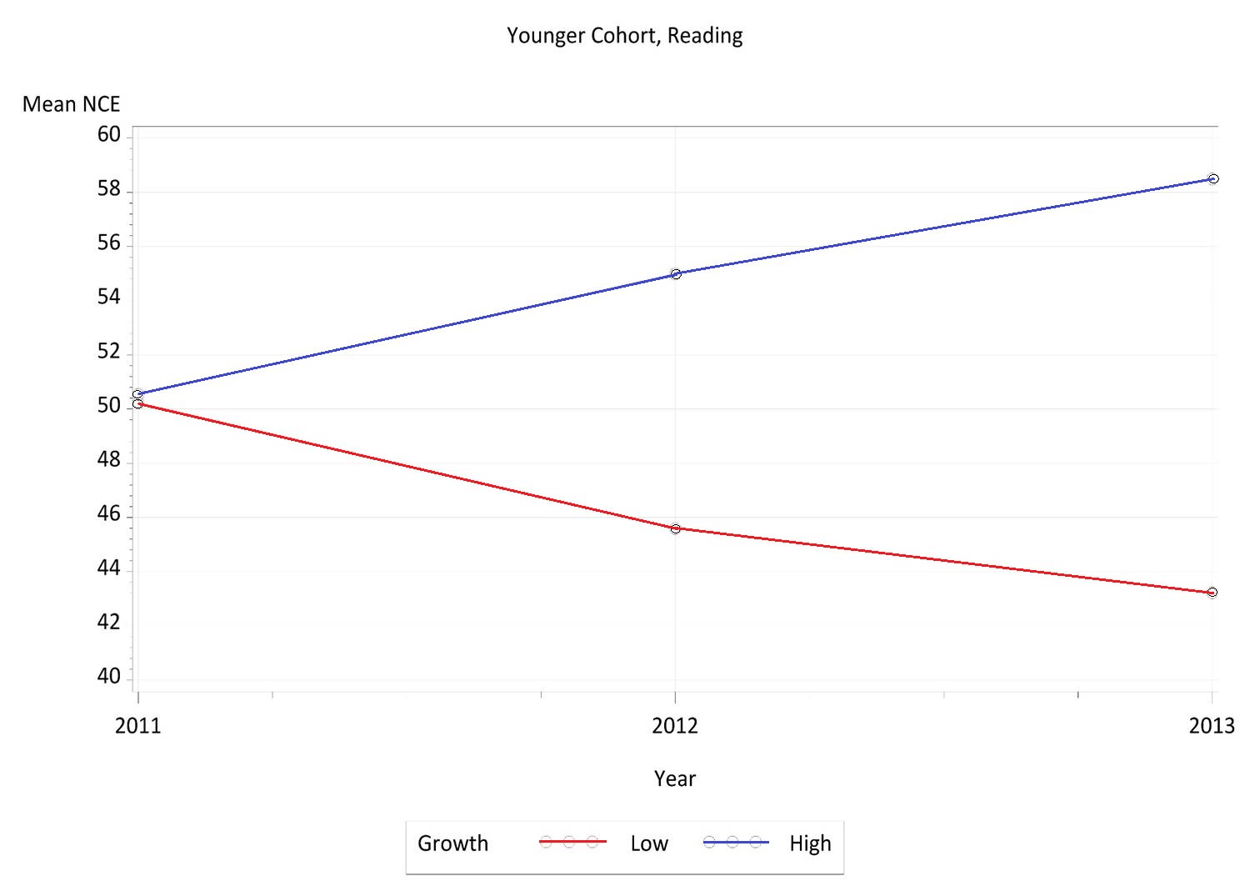

Slide 217
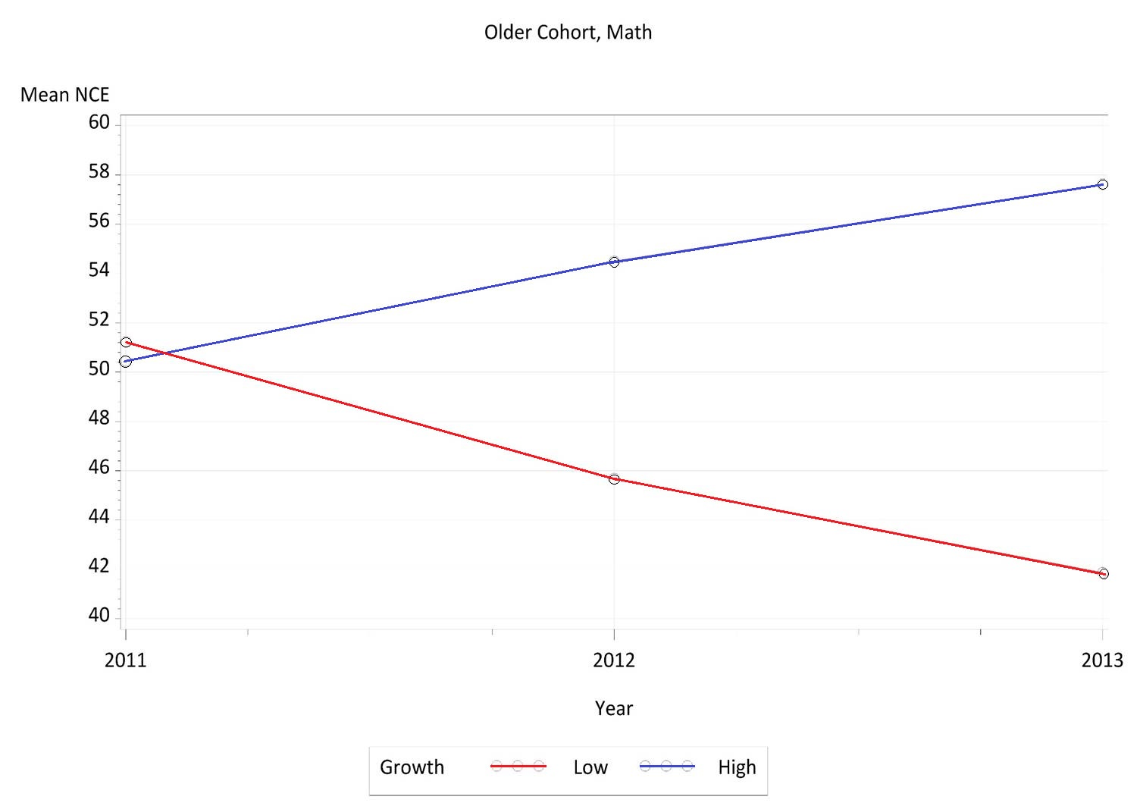

Slide 218
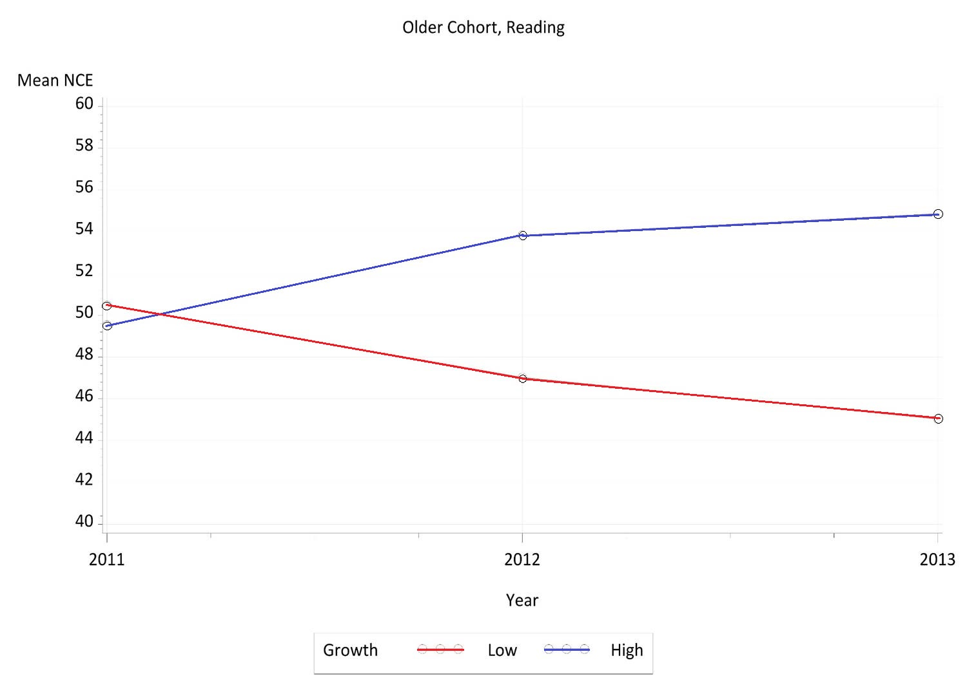

Slide 219
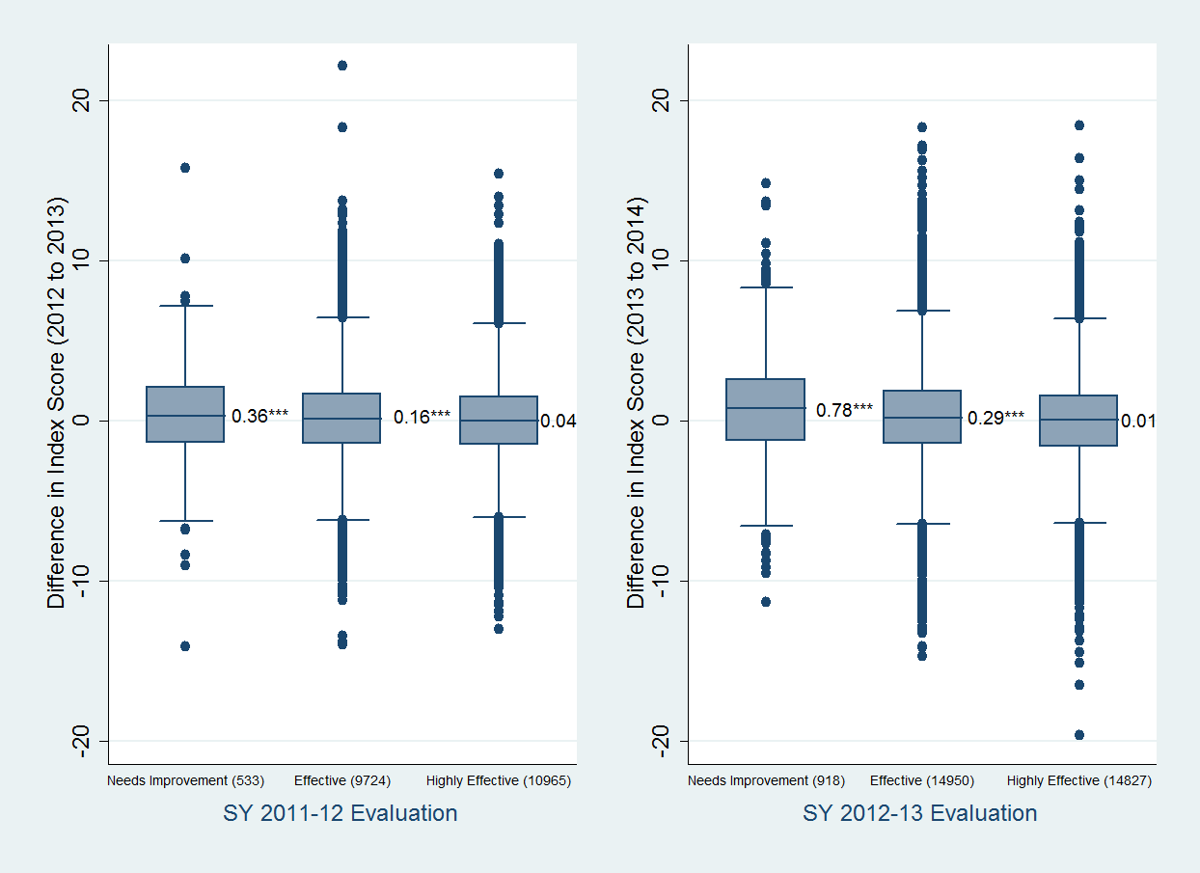
Evaluation and Change in Growth

Slide 220
Average Index Score of Teachers

Slide 221
Strengthening the Evaluation System?

Slide 222
Multiple Measures to Ensure Accuracy
Teacher Effectiveness
Principal Observation
Principal Feedback
Student Growth Data
Student Feedback
Content Expert Observation
Content Expert Feedback

Slide 223
Questions, Comments, and Feedback
Thomas R. Tomberlin
Director, District HR Support
thomas.tomberlin@dpi.nc.gov
984-236-2114

Slide 224
Break Time!
This Photo by Unknown Author is licensed under CC BY-ND

Slide 225
LESSONS LEARNED FROM A CHARTER SCHOOL BOARD ATTORNEY
New Charter School Leaders VIRTUAL Institute
June 10, 2020
Donna R. Rascoe
drascoe@cshlaw.com

Slide 226
Legal Foundation for NC Charter Schools
NC Nonprofit Corporation Act (G.S. 55A-1-01, et seq.)
The business and affairs of a NC corporation are ordinarily managed by its board of directors.
The corporation is managed by its board and operated by its officers and agents.

Slide 227
Legal Foundation for NC Charter Schools
NC Nonprofit Corporation Act
All corporate powers shall be exercised by or under the authority of, and the affairs of the corporation managed under the direction of, its board of directors, except as otherwise provided in the articles of incorporation.
G.S. 55A-8-01.

Slide 228
Legal Foundation for NC Charter Schools
NC Charter Schools Statute (G.S. 115C-218, et seq.)
General Operation
Exemptions
Accountability to State Board of Education
Admissions
Course of Study
Nonrenewal/Termination
Funding

Slide 229
Legal Foundation for NC Charter Schools
Examples - Other NC Public School Laws
Student Discipline (Article 27 of Chapter 115C)
Personnel Records (Article 21A of Chapter 115C)
Criminal Background Checks (115C-332)
Teacher Licensure (16 N.C.A.C. 6C.0312)

Slide 230
Legal Foundation for NC Charter Schools
Examples - Other State and Federal Laws
NC Open Meetings and Public Records Laws
Student Records Laws (including FERPA)
Student Discipline Laws
Special Education Laws (including IDEA)
Discrimination Laws (including ADA and Section 504)
Health and Safety Regulations

Slide 231
Being a Public Entity Matters
Charter Agreement - Paragraph 23.
The Nonprofit agrees to be subject to the Open Meetings Law (Article 33C of Chapter 143 of the General Statutes).
Notices
Public Access
Closed Sessions
Minutes

Slide 232
Being a Public Entity Matters
Charter Agreement - Paragraph 12.2.
The Nonprofit is subject to the Public Records Law (Chapter 132 of the General Statutes).

Slide 233
The Deliberative Process Matters
Fiduciary Duties of Board Members
Board members must act in good faith, with ordinary care and in the best interests of the corporation. (G.S. 55A-8-30(a)).
A director is not liable for any action taken as a director, or any failure to take any action, if he performed the duties of his office in compliance with this section. (G.S. 55A-8-30(d)).

Slide 234
It Helps to Stay in Your Lane
Board Members
School Administration/Others
Be familiar with history, mission, policies, general activities
Work cooperatively with other board members
Prepare for and attend board meetings
Develop policies
Support school administration
Represent the school as needed
Detailed knowledge of school operations
Make recommendations to board
Provide reports to the board
Propose policy needs and drafts
Implement policies and develop necessary procedures
Seek out board input and support

Slide 235
Attend to and Avoid Conflicts of Interest
The Nonprofit shall adopt and ensure compliance with a conflict of interest and anti-nepotism policy.
See 115C-218.15(b) and Charter Agreement ¶ 4.3.
No compensation for board members (really, none.)
Review policy regularly and as specific situations of concern arise.

Slide 236
“School of Choice”
- Parents get to choose so long as the student is qualified for admission to a public school in North Carolina and there is a seat.
- Once the parent makes the choice, the student may enroll and may remain at the school for subsequent enrollment periods.

Slide 237
“School of Choice”
Be careful:
Suggesting that the choice should be revisited.
Putting conditions on continued enrollment.

Slide 238
Serving Students with Disabilities
No discrimination during admission process.
Once enrolled, determine prior services and address services to be provided in the charter school.
Offer FAPE.
Follow all required evaluation, IEP development and IEP implementation procedures.
Avoid declarations about what the charter school “does not provide.”

Slide 239
Contracts
Review contracts carefully.
Consider a policy or procedure for handling, including when board approval is required .
Be careful with boilerplate forms or standard vendor proposals.
Don’t forget no indebtedness.

Slide 240
Using a Board Attorney
Identify a clear point of contact. (Board Chair, Committee Chair, EC Director, other)
Be prepared for consultations.
Locate and provide relevant documents.
Consider preparing a chronology.
Ask any and all questions (don’t be shy).

Slide 241
Using a Board Attorney
Consider when a specific matter might represent a claim covered by your insurance.
Attorney-client privilege.

Slide 243
Panel Discussion: If We Had Known Then

Slide 244
Next Steps
Certificate of Occupancy, SBE meeting in July and monthly progress reports due
No funds released until COs in place
Update your Liability Insurance and send to OCS
CSADM Phase II Final Verification June 1st through 12th
Charter Agreement begins July 1st
Enrollment Report #4 is due June 30th and includes your facility update
EDDIE
EC Coordinators contact EC division
Designate a Testing Coordinator/EL Coordinator and provide contact info to RAC
Attend July 14/15 PS training and set up PS
New Charter Schools Task List for Opening in 2020

