Slide 1
Charter Development Solutions
Due Diligence Report
Submitted to the NC Charter School Advisory Board

Slide 2
Agenda
Introduction to Charter Management Organization
Obligations of CDS
Obligations of the Board of Revolution Academy Bunker Hill
Fee Structure
Term Clause
Termination by CDS
Termination by Revolution Academy Bunker Hill
Termination by Either Party
Organizational Structure
Advisor to CDS
Academic Performance of Related Schools
Financial Performance

Slide 3
Introduction to Charter Management Organization (CMO)
This report was compiled from
  Information received in the Revolution Academy Bunker Hill Application and Appendices
  NCDPI Accountability Division
  NC Secretary of State Website
  Triad City Beat
  Guilford County Schools
  Greensboro News and Record

Slide 4
Introduction to Charter Management Organization (CMO)
Charter Development Solutions (“CDS”) is a charter management organization, whose principal office is located in Summerfield, NC.
The website for CDS is www.cds4schools.org
Charter applicant Revolution Academy Bunker Hill in Guilford County plans to contract services with CDS.
According to the proposal, Revolution Academy Bunker Hill will serve 309 students in grades K-6 in year 1, and grow to serve 727 students in grades K-8 at capacity.

Slide 5
Introduction to Charter Management Organization (CMO)
The organization was officially recognized as a non-profit corporation by the NC Secretary of State on June 18, 2019.
Randy Shaver is listed in the application as the contact person for CDS, and is listed on the CDS website as the Director of School Development.
Dr. Shaver was formerly a School Support Officer for High School Options Area 12 and area superintendent in Guilford County Schools, as well as the interim Chief Operations Officer.
Karla Hall is the Director of School Operations. She was a founding board member for Cornerstone Charter Academy and the board president for 5 years.
Scot Conklin is the CDS Board Chairman. He is also the Director of Operations of Carpigiani Corporation of America, and served on the Cornerstone Charter Board of Directors for 3 years.

Slide 6
Introduction to Charter Management Organization (CMO)
The Registered Agent and Executive Director of CDS is Mary Catherine Sauer.
Ms. Sauer is also the Registered Agent for Revolution Academy, which the NC State Board of Education approved to open in June 2019. The school is slated to open in the fall of 2020.
Ms. Sauer founded Cornerstone Charter and Piedmont Classical High School.
Question: Is Revolution Academy intending to partner with Charter Development Solutions as well?

Slide 7
CDS Responsibilities
Revolution Academy Bunker Hill’s charter application states:
“The CMO will use their expertise, resources, and experience to manage the school and ensure the school’s success…the CDS will manage the day to day operations of the school including teacher support and evaluation…”
“The management agreement outlines the CMO obligations which include meeting measurable SMART goals that are in this application…CDS will be required to keep the RABH board of directors apprised of the progress towards those goals.”

Slide 8
Management Services Agreement
Note: The Executed CMO Contract (Appendix A4.1) has been signed by Mary Catherine Sauer and Alex Valencsin, board chair for Revolution Academy Bunker Hill.

Slide 9
Obligations of CDS
Responsibility. CDS shall be responsible and accountable to the School for the operation and performance of the School as set forth in this Agreement.
Educational Program. CDS agrees to implement the Educational Program set forth in the Charter. Not less than annually, or as reasonably requested by the School, CDS shall provide the School with a report detailing progress made on each of the educational goals set forth in the Educational Program.
Question: What will happen as a result of the progress report provided by CDS? What happens if the educational goals are not being met?

Slide 10
Obligations of CDS
C. Services
  The day-to-day management of the School;
  The development and supervision of all components of the school design, including staffing, scheduling, curriculum/instruction, assessment, data analysis, technology, compensation and incentives, transportation, and facilities;
  The recruitment and enrollment of students by various means, in accordance with the Board approved marketing plan set forth in the Annual Budget

Slide 11
Obligations of CDS
  The employment of personnel working at the school and management of all personnel functions, as set forth herein;
  Student behavior management and discipline;
  All aspects of food service, in compliance with the Charter and as set forth in the Annual Budget
  The implementation and administration of the Educational Program, including selections of instructional materials, equipment, technology, and supplies;

Slide 12
Obligations of CDS
  The implementation and administration of extra-curricular and co-curricular activities and programs approved by the School;
  The performance of evaluations, assessments, and continuous improvements of and to the Educational Program, including reports of same to the School upon its request;
  The management, selection, and application of technology services required to facilitate the operation of the School;
  The management of certain personnel functions, as set forth in Article VII of this agreement;

Slide 13
Obligations of CDS
  The management of the business administration of the School;
  The Accounting operations of the School, including general ledger management and financial reporting;
  The identification, application, and administration of grants to or for the School, including in any audits related thereto;
  The preparation and submission of the Annual Budget;
  The performance of any other functions necessary or expedient for the administration of the School.

Slide 14
Obligations of CDS
Location of Services. Other than instruction, and unless prohibited by the Charter or applicable law, CDS may provide the Services, including but not limited to purchasing, professional development, and administrative services off-site.
Subcontracts. CDS reserves the right to subcontract any and all aspects of the Services. Notwithstanding the foregoing, CDS will not subcontract the management, oversight, or operation of the teaching and instructional program without the express approval of the Board.
Question: If CDS has the ability to subcontract out all services, what is the benefit to the school of contracting with the management company?

Slide 15
Obligations of CDS
Purchases. Purchases made by CDS on behalf of the School with the School’s funds, such as non-proprietary instructional materials, books and supplies, and equipment, will be the property of the school. CDS shall own, and the School shall not have any claim to, any items of personal property leased or purchased by CDS with its own funds.
Rules and Procedures. From time to time, CDS shall recommend reasonable rules, regulations, procedures, and policies to the School regarding the management, operation, and administration of the School. Once adopted by the School, CDS shall be authorized and directed to enforce such rules, regulations, procedures, and policies.

Slide 16
Obligations of CDS
Student Performance and Evaluation. CDS shall implement student performance evaluations that permit evaluation of the academic progress of each student. CDS shall utilize assessment strategies required by the Charter and applicable law. The School and CDS shall cooperate in good faith to identify and periodically adjust academic goals and methods to assess academic performance. CDS shall provide the School with timely reports regarding student performance.
Question: What is the role of student performance evaluations in the overall progression of students? What will happen as a result of what is found in the performance evaluations? What happens if students are not meeting the performance standards?

Slide 17
Obligations of CDS
Unusual Events. CDS shall timely notify the School of any anticipated or known material: (i) health or safety issues, including all mandatory reporting by applicable law; (ii) labor, employee, or funding issues; or (iii) other issues that may reasonably and adversely impact the School’s ability to comply with the Charter, applicable law, or this Agreement.
School Records. The School Records are the property of the School.
CDS Performance Goals. During the term of this Agreement, CDS shall use its commercially reasonable best efforts to:
  Timely submit all reports required by this Agreement to the School;
  Strictly adhere to the approved Annual Budget
  Meet or exceed the school-wide goals contained in the Charter, or subsequently revised or amended by the mutual consent and approval of both parties.

Slide 18
Obligations of CDS
Facility. CDS shall use reasonable efforts to secure an appropriate facility for the School’s use.
Start-Up Funds. CDS shall use reasonable efforts to secure start-up funds for the School through grants, loans, and/or donations.
Legal Compliance. CDS will implement and enforce rules, regulations, and procedures applicable to the School that are consistent with adopted School policy, if any, and the Educational Program in accordance with the Charter and applicable law, including without limitation, rules, regulations, and policies regarding non-discrimination, discipline, special education, confidentiality, and access to records.

Slide 19
Obligations of the RABH Board
Board Policies. The Board shall be responsible for the fiscal and academic policies of the School.
Assistance to CDS. The Board shall cooperate with CDS, and to the extent consistent with applicable law, timely furnish all CDS documents and information necessary for CDS to properly perform its responsibilities under this Agreement.
Unusual Events. The Board shall timely notify CDS of any anticipated or known material: (i) health or safety issues, including all mandatory reporting by applicable law; (ii) labor, employee, or funding issues; or (iii) other issues that may reasonably and adversely impact the School’s ability to comply with the Charter, applicable law, or this Agreement.

Slide 20
Obligations of the RABH Board
Retained Authority. To the extent required by law, the Board shall retain the authority to make reasonable regulations relative to anything necessary for the proper establishment, maintenance, management, and operation of the School.
Office Space. The Board shall provide CDS and its employees with suitable office space at the School’s facility at no cost to CDS, provided that the requested space is available and can be provided without materially prejudicing the School’s programs.
Governance. Board members shall actively participate in board development and governance training, comply with the Board’s adopted Code of Conduct, and make reasonable efforts to govern the School using generally accepted best practices for charter school governance.

Slide 21
Obligations of the Board
Question: This contract requires the board to turn all operation of the school over to the management company. What controls or oversight does the Board have in place to ensure the management company is carrying out their responsibilities with fidelity?

Slide 22
Fee Structure
Article VI, Section C states,
CDS shall receive, as reasonable compensation for its services, a Management Fee equal to: (i) 10% of the School’s annual Revenues; and (ii) 50% of the School’s Annual Surplus in excess of $50,000. Should the School have an Annual Surplus of less than $50,000, CDS will reduce its Management Fee to ensure an Annual Surplus of at least $50,000. Notwithstanding the foregoing, CDS will not be required to reduce its Management Fee below the actual costs and expenses for services provided to the School, including but not limited to the Services set forth in Article IV, under this Agreement.

Slide 23
Fee Structure
10% of the Annual Revenues will be reflected in the Annual Budget as the Management Fee and will be payable in monthly installments based on Revenues received the previous month.
After the end of the Fiscal Year, the Annual Surplus will be calculated and the remainder of the Management Fee will be payable on the following September 1.
Question: In the event that the school does not meet its enrollment projections, will CDS reduce its management fee? Or will their fee come “off the top”? If the Annual Surplus is not calculated until the end of the fiscal year, when will CDS have an opportunity to revise its Management Fee (that has presumably been collected monthly over the prior calendar year?

Slide 24
Fee Structure
Question: Does CDS receive 50% of any surplus over $50K (if surplus is $60K, CDS will receive 50% of $10K)? Or if the surplus is greater than $50K, does CDS receive 50% of the entire surplus (if surplus is $60K, CDS will receive $30K)?
Question: The budget does not appear to include a dedicated board spending account line item. What resources are available to the board, in the event that they need access to resources to carry out their duties?
Question: Is RABH contractually obligated to pay the full fee amount, even if CDS subcontracts out all services?

Slide 25
Availability of Funds
Section IV, subsection D Availability of Funds states:
CDS shall only be required to perform its responsibilities under this Agreement to the extent that there are sufficient Revenues to make payments in accordance with the terms of the Annual Budget.
Question: If the school is unable to pay 10% of its Revenues to the management company (due to low enrollment, for example), is CDS able to terminate the contract? What structures are in place to assist the school with daily operations in the event that this happens?
Question: Does CDS have the capacity to support the school financially, in the event that projected revenue assumptions are not met?

Slide 26
Term Clause
Service agreement states that the Agreement “shall commence on the Effective Date and, unless terminated as set forth herein, shall continue until the termination or expiration of the Charter, inclusive of any Charter reauthorizations or renewal periods thereof. Any such termination shall only be effective at the end of the then-current Academic Year.
Question: Does the stipulation that termination becomes effective at the conclusion of the current year provide the Board maximum flexibility to make adjustments and operate the school effectively, should the decide to terminate their contract with CDS at the mid-year point?

Slide 27
Termination
CDS may terminate this Agreement if the Board fails to remedy a material breach of this agreement within thirty (30) days after receiving a notice from CDS of such a breach. For the purposes of the Article, a material breach includes, but is not limited to: (i) CDS’s failure to timely receive any compensation or reimbursement required by this Agreement; (ii) a suspension, revocation, or non-renewal of the Charter; (iv) failure of Board members to substantially comply with the Board-approved Code of Conduct; (iv) a decision by the Board not to adopt CDS’s recommendations as to a specific policy, rule, or regulation, that inhibits, in CDS’s opinion, CDS’s ability to implement the school design and Educational Program as set forth in the Charter.
Question: Is there room for the Board to disagree with CDS on the adoption of a particular policy? Will CDS automatically terminate the contract if the board refuses to adopt a particular policy suggested by CDS?

Slide 28
Termination
The School may terminate this Agreement if CDS fails to remedy a materials breach of this Agreement within (30) days after receiving a notice from the School of such a breach. For the purposes of this Article, a material breach includes, but is not limited to: (i) failure to account for its expenditures or pay the School’s operating costs (provided funds are available to do so) in accordance with the Annual Budget, (ii) failure to follow policies duly adopted by the Board which are not in violation of this agreement, the Charter, or applicable law, (iii) insufficient progress in attaining student achievement objectives and school-wide goals adopted by the Board and mutually agreeable to the Parties; (iv) any action or inaction by CDS that places the Charter in jeopardy of suspension, termination, revocation, or non-renewal.
Question: Who will determine what is deemed “insufficient progress” in attaining student objectives and school-wide goals?

Slide 29
Termination
Either party may terminate this agreement, with or without cause, by providing the other party with at least ninety (90) days written notice.

Slide 30
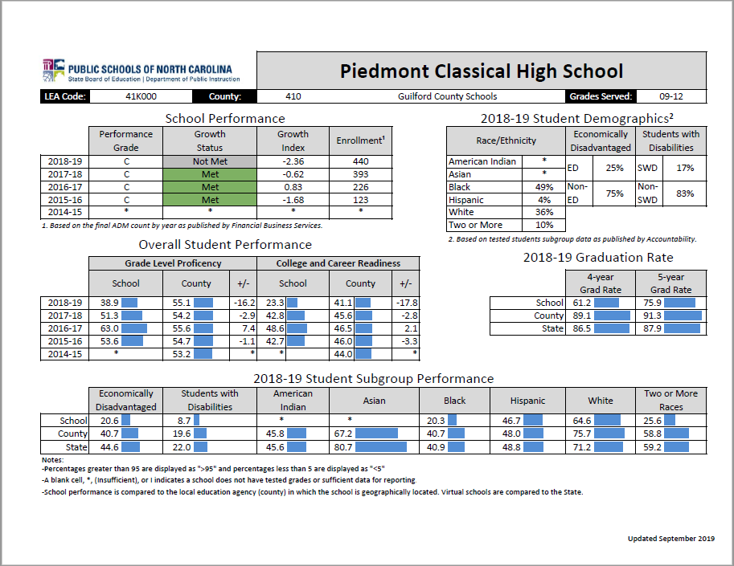
Academic Performance:
Piedmont Classical HS

Slide 31
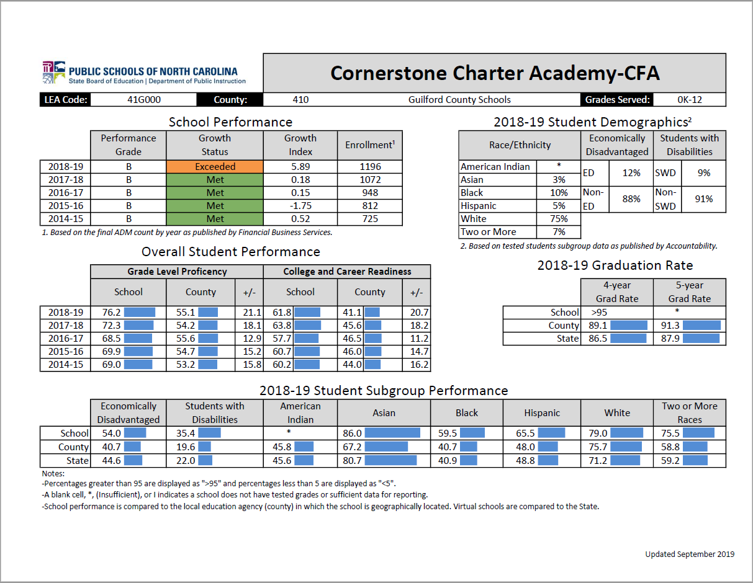
Academic Performance:
Cornerstone Charter: CFA

Slide 32
CDS Financial Performance
Appendix A4.3: EMO/CMO Financial History is used to determine the financial history and health of the EMO/CMO over the last three years.
Because CDS is a new entity, they were unable to provide financial statements or year end fund balances.
Question: What is the current state of CDS’s finances? Does CDS have the capacity/resources to support the opening of RABH, particularly in the event that RABH does not meet projected enrollment?

Slide 33
Potential Areas for Further Clarification
Additional Schools Planning to Partner with CDS
Obligations of RABH Board
Obligations of CDS
Fee Structure and Availability of Funds to Board
Term Clause
Contract Termination
Financial Health/Capacity of the CMO

