Slide 1
Building Better Lives...
One step at a time

Slide 2
HOW WE CAN HELP YOU
Since 1965, we have helped individuals access educational services that lead to better jobs, better lives, and better communities. Headquartered in Raleigh, North Carolina, Telamon Corporation is a nonprofit organization that offers services in 11 states.

Slide 3
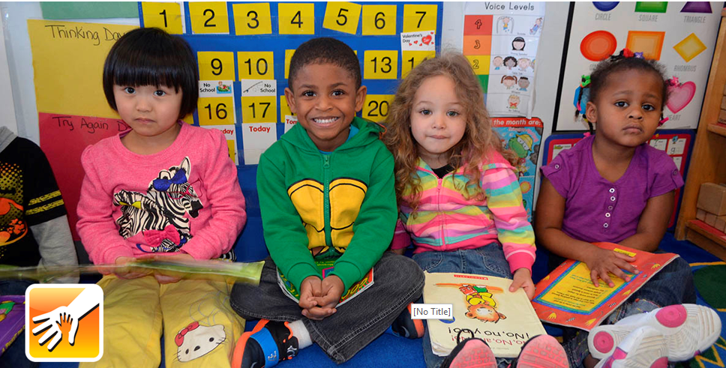
WE BELIEVE IN TRANSFORMING LIVES
BETTER EDUCATION leads to better jobs…
Early Childhood & Family Support offers families exemplary childcare services that ensure children start school ready to learn and succeed.
BETTER JOBS lead to better lives…
Workforce & Career Services creates hope and prepares people of all ages for more competitive jobs. Our customers want to identify more promising career paths that fit their skills and interests.

Slide 4
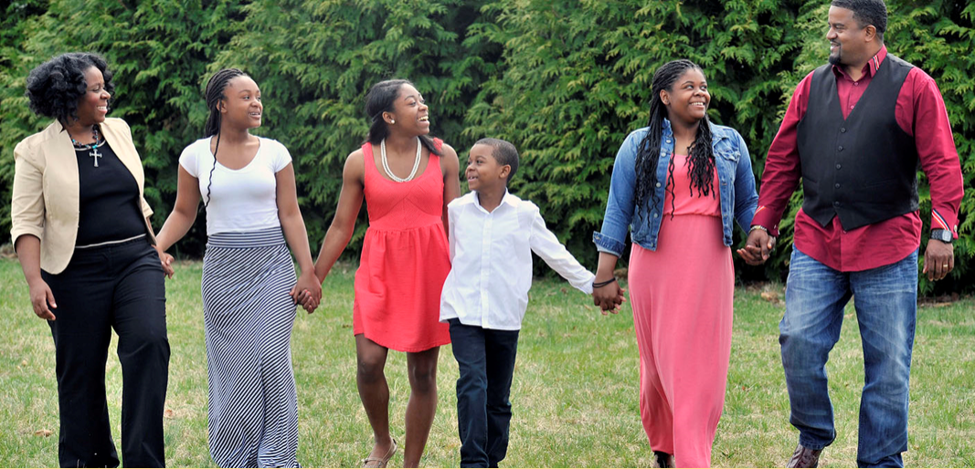
WE BELIEVE IN TRANSFORMING LIVES
BETTER LIVE & HOMES creates better communities…
With financial stability, families can achieve their dream of stable housing — and even homeownership. Housing & Financial Empowerment services ensure that families receive support so they can reach these important goals.
BETTER COMMUNITIES supply better education, and the cycle of improvement from individuals to communities continues.

Slide 5
WHO WE ARE…
WORKFORCE & CAREER SERVICES
We link youth and adults to educational opportunities that lead to better jobs and careers. Workforce and career services range from information about local job listings to financially supported occupational training.
Job Referrals Job Placement Assistance Career Counseling Supportive Services | Education & Skill Level Assessments Assistance with Obtaining Occupational Certificates and Educational Credentials
Services are tailored to meet the abilities and needs of individual customers, and supported by professionals in the workforce development field.

Slide 6
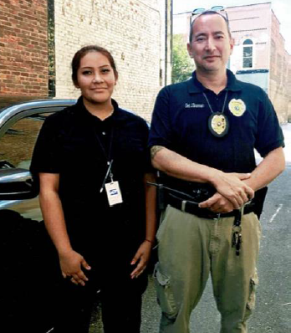
WHAT WE DO… From the Fields to a Dream.
Giovanna Rojas, “Gigi,” is an NFJP Youth Participant with the Telamon TRC-Dunn office and is a dependent of a farmworker family. She is on track to graduate from Sampson Community College May 2019 with an Associates Degree in Criminal Justice in less than 18 months. She will then begin Basic Law Enforcement Training in Fall 2019. Through Telamon’s Work Experience activity, Gigi gained skills as an Administrative Intern and Translator for the Department. She worked alongside Detective Brennan and assisted with traffic stops, ride-alongs, and became a huge asset to the department, not just for her bilingual ability, but for the way she genuinely cared about community relations/policing.

Slide 7
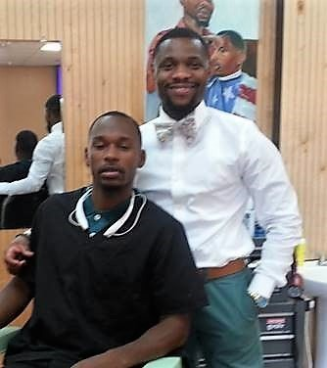
WHAT WE DO… From the Fields to a Dream.
George completed the barber program, obtained his license and fulfilled his dream of becoming a barber. Today, George is working at a profitable barbershop in Elizabeth, NC. He also creates barbering how-to videos which he posts on YouTube. George’s success as a barber has enabled him to purchase a car and a home, and he is now married. George is happy to be earning a living in the career he always dreamed of and he is very grateful for all the support and assistance he received from Telamon-TRC's National Farmworkers Jobs Program.

Slide 8
WHAT THIS MEANS FOR YOU…
Business Partners:
a trained workforce based on your needs
incentives for hiring program participants
Workforce Partners:
bilingual staff that can assist you with connecting to a broader client base
Community Partners:
bilingual staff that can assist you with connecting to a broader client base
additional resources to improve the community by empowering the individuals

Slide 9
A Moment of
Thank you all for attending and for your support as we strive to make an impact in the farmworker community!!!
Contact Us
www.telamon.org
NC01@telamon.org
https://www.facebook.com/Telamon.Corporation/

Slide 10
Questions?

