Slide 2
Time | Room 114 | Room 115 | Room 116
8:30 – 9:10 am | Registration
9:10 – 10:00 am | Opening Session
10:05 – 11:00 am | Don’t Reinvent the Wheel: Best Practices in Recruiting and Serving OSY | Exemplary Summer Programs | Migrant Education and Early Learning
11:05 – 12:00 pm | ID&R: Families, Where Art Thou? | Productive PAC meetings | Telamon & MEP: A Productive Partnership
12:00 – 1:25 pm | LUNCH ON YOUR OWN
1:25 – 2:20 | HCPS – Boys & Girls Club Partnership | MEP EL Data: Where to Find it and How to Use It | OSY & The High School Equivalency Diploma
2:25 – 3:00 | Students Panelists
3:05 – 3:30 | Closing Comments & Survey

Slide 3
Presentation | Brief Description
Don’t Reinvent the Wheel: Best Practices in Recruiting and Serving OSY Presenter: Rachel Wright Junio, Eastern NCMEP Administrator, GOSOSY Grant Coordinator, NCDPI | Over the past five years, there has been a significant increase in the number of Out-of-School Youth (OSY) who qualify for the Migrant Education Program (MEP). However, many districts still face challenges in both recruiting and serving these students. During this interactive presentation, participants will learn and share best practices for recruiting OSY and will be provided with an overview of resources to serve OSY. By the end of the presentation, participants will feel more confident recruiting OSY and will better understand how to align OSY students’ needs with available services.
Exemplary Summer Programs Presenters: Hoke, Lenoir, & Pender Counties | MEP programs from Hoke, Lenoir, & Pender will share their successes with their MEP Summer Programs. This session will provide strategies on how to run a successful summer program in your own district.
Migrant Education & Early Learning Presenter: Carla Garrett, Title I Pre-School Consultant NCDPI | What can teachers, coordinators, and administrators do to best support migrant preschool children and their families? This session will discuss the importance of the early years, preschool programs in NC, and transition to kindergarten. The discussion will include an intentional focus on best practices as well as opportunities and strategies.
ID&R: Families, where are thou? Presenters: Maria Alcala, NCDPI Regional Recruiter Ivan Padron Bueno, NCDPI Regional Recruiter | Migrant families are becoming harder to find. This session will share strategies used by two Regional Recruiters in their efforts to find migratory families across North Carolina. Participants will learn strategies that they can apply to their own recruitment efforts.
Productive Parent Advisory Council (PAC) Meetings Presenter: Litzamarie de Jesus, Lead Recruiter, Sampson County Schools (SCS) | Running a successful PAC is an integral part of MEP success. In this session, LEA’s will learn how SCS has developed strategies to implement successful PAC meetings. Participants will work on adapting these strategies to fit their own needs and will also learn about how to assist and empower migratory parents to feel included in the educational planning of their child.

Slide 4
Presentation | Brief Description
Henderson County Public Schools (HCPS) - Boys & Girls Club Partnership Presenters: Hunter Ogletree, MEP Coordinator, Henderson County Public Schools | The purpose of this workshop is to address the needs of migrant students and families as they transition to a new environment by developing unique and impactful collaborations with local community organizations. Participants will learn about collaboration between the Boys and Girls Club and Migrant Education Program in Henderson County, NC. Positive results include improvement in reading levels at the end of the program, promoting self-confidence, and registering students for school in timely manner.
Data on your MEP English Learners (ELs) - Where to find it and how to use it! Presenter: Marshall Foster, ESL/Title III Consultant | In this presentation, you will learn where data on ELs can be found within the PowerSchool environment, how to access these data, and how to utilize it when contemplating service delivery options, including instructional strategies for your MEPs who are EL.
OSY and the High School Equivalency Diploma: HEP & CAMP Presenter: Maria Lafuente Fister, Director HEP (High School Equivalency Program) | During this presentation, participants will understand how NC MEP and Wake Tech HEP can overcome barriers OSY face in order to purse their High School Equivalency Diploma (HSED) and to explore best practices for a successful HEP-MEP partnership. Session attendees will also learn about “HEP Online” which allows qualified HEP students from any part of the state to participate in online HSE preparation classes.
Telamon & MEPs: A Productive Partnership Presenters: Monica Almodovar, Workfoce Development Specialist Marisela Hernandez, Workfoce Development Specialist | This session will provide an understanding of how Telamon Corporation and local MEPs in the state can offer services to our mutual population and how, through a partnership, we can collaborate to better help our Migrant families and students. Since 1965, Telamon has helped individuals access educational services that lead to better jobs, better lives, and better communities. Headquartered in Raleigh, Telamon Corporation is a nonprofit organization that offers services in 11 states.

Slide 5
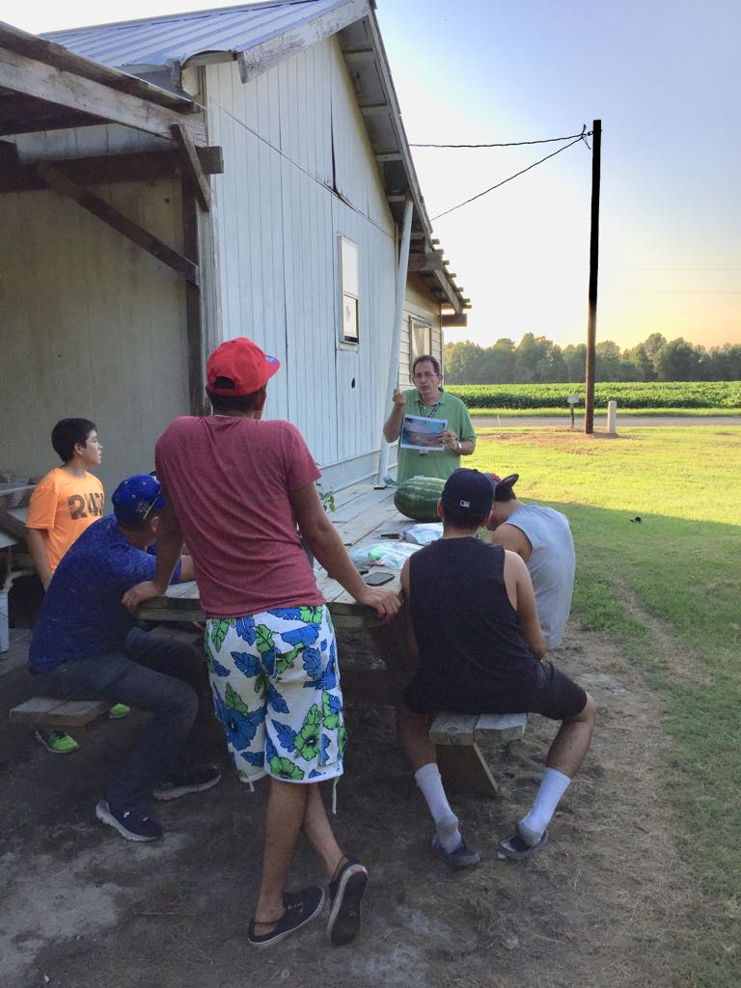
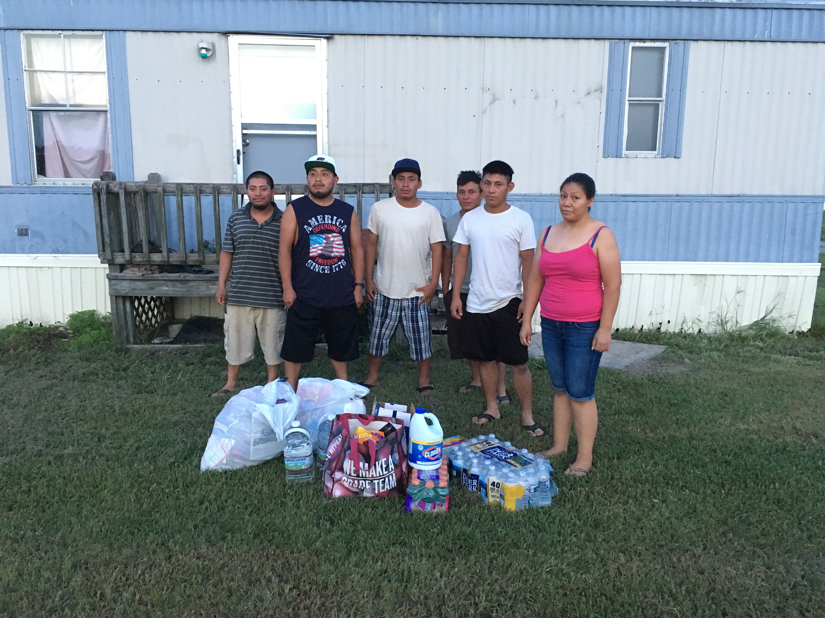
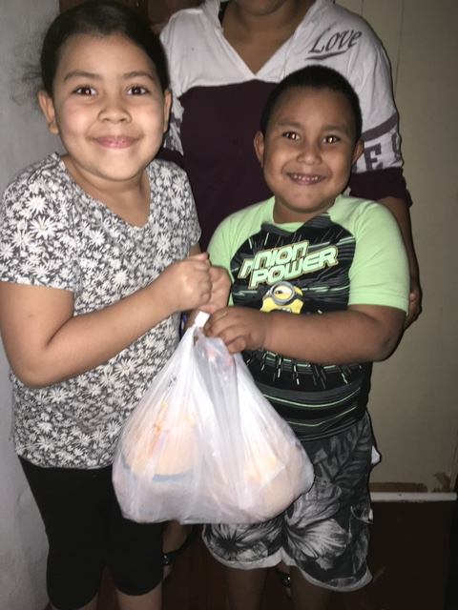
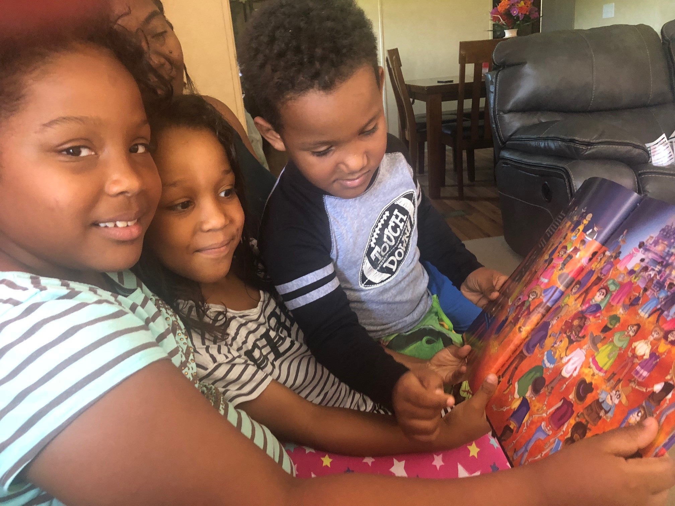
Special Thanks to…
A special thanks to ALL the experts for taking the time to come and present today, to the students for sharing their experiences, to Guilford County Schools Laughlin Development Center for allowing us to use their facility, and to all the participants for coming to our first NC MEP Summit.

