Slide 1
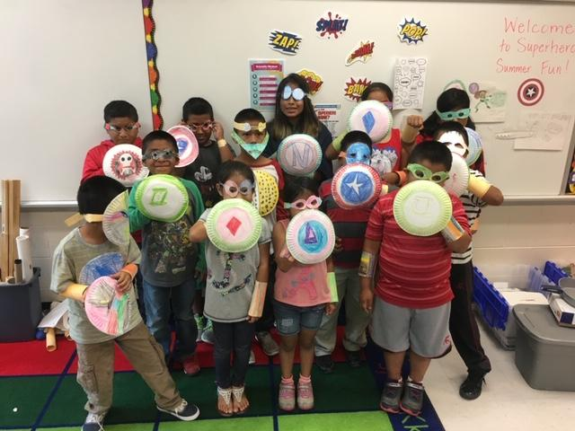
Pender County Schools - Migrant Summer Program
April 30, 2019

Slide 2
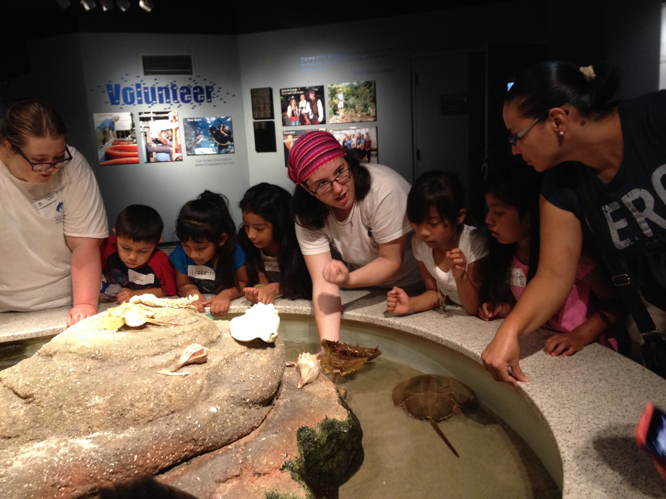
General Details
2014 - Ecosystems
Grades K-5
K-2 class
3-5 class
One centralized location
School day can range from 7:30 am - 2:45 pm
This depends if we partnering with other programs
The students receive breakfast, lunch, and snack at no cost to them
Runs from June 14-30 (this depends on the last teacher workday and last business day of June)

Slide 3
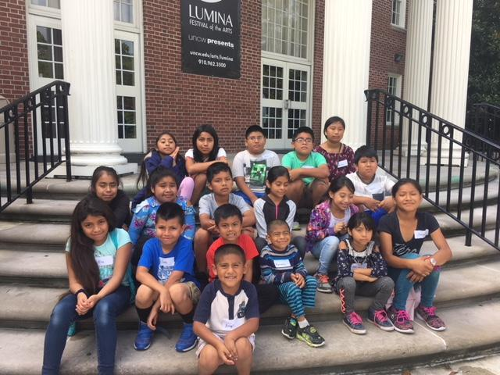
Planning
Begin to look at the budget in February to plan for staff and supplies.
Involved in planning:
MEP Director, Coordinator of Migrant Services, Teachers and TA once hired for the summer program
Have a planning session to pick a theme and work on lessons in May or June before the program begins.

Slide 4
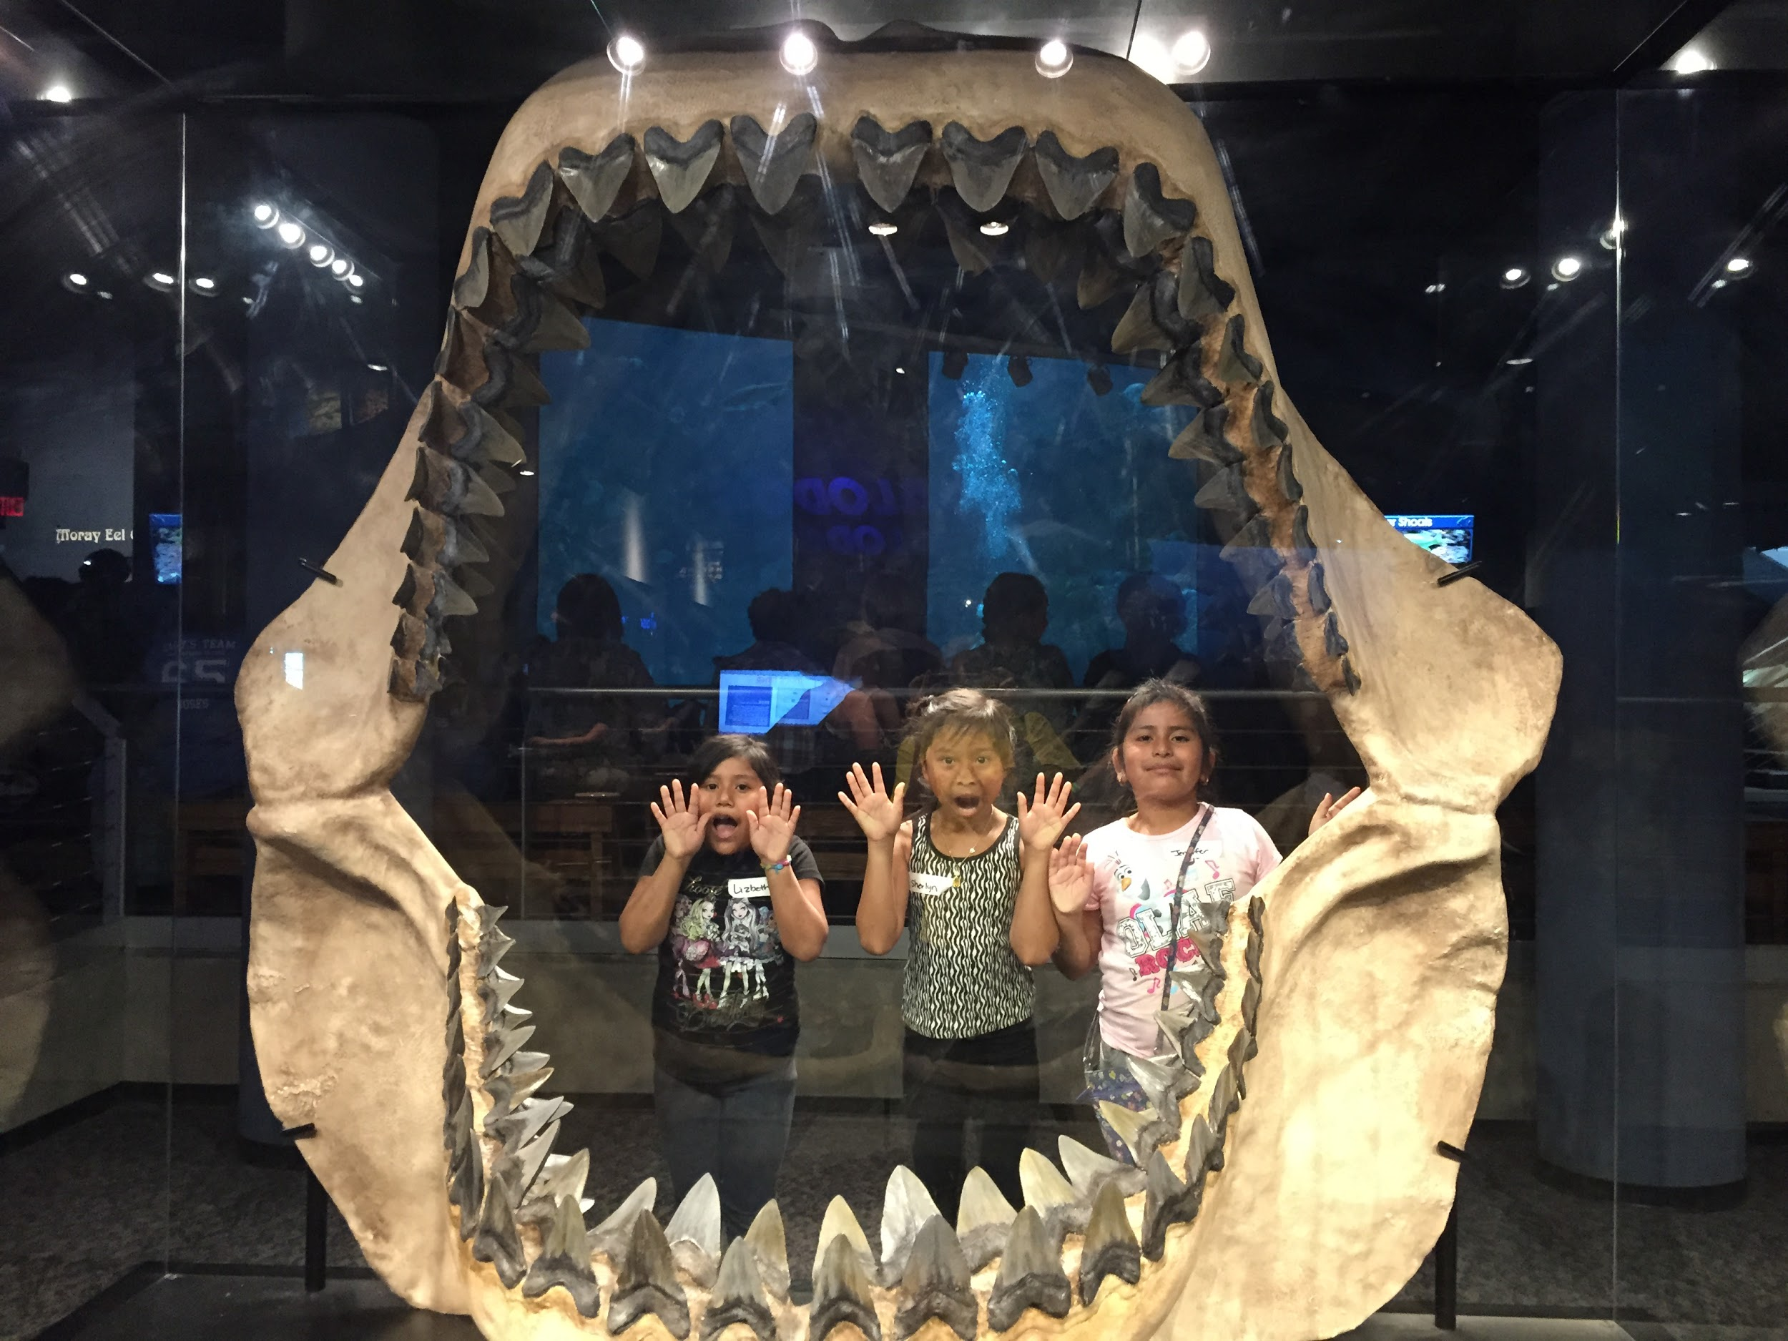
Funding
2018 - we combined funds with ESL to invite EL students that needed additional support.
Usually solely use MEP funds for our summer program.

Slide 5
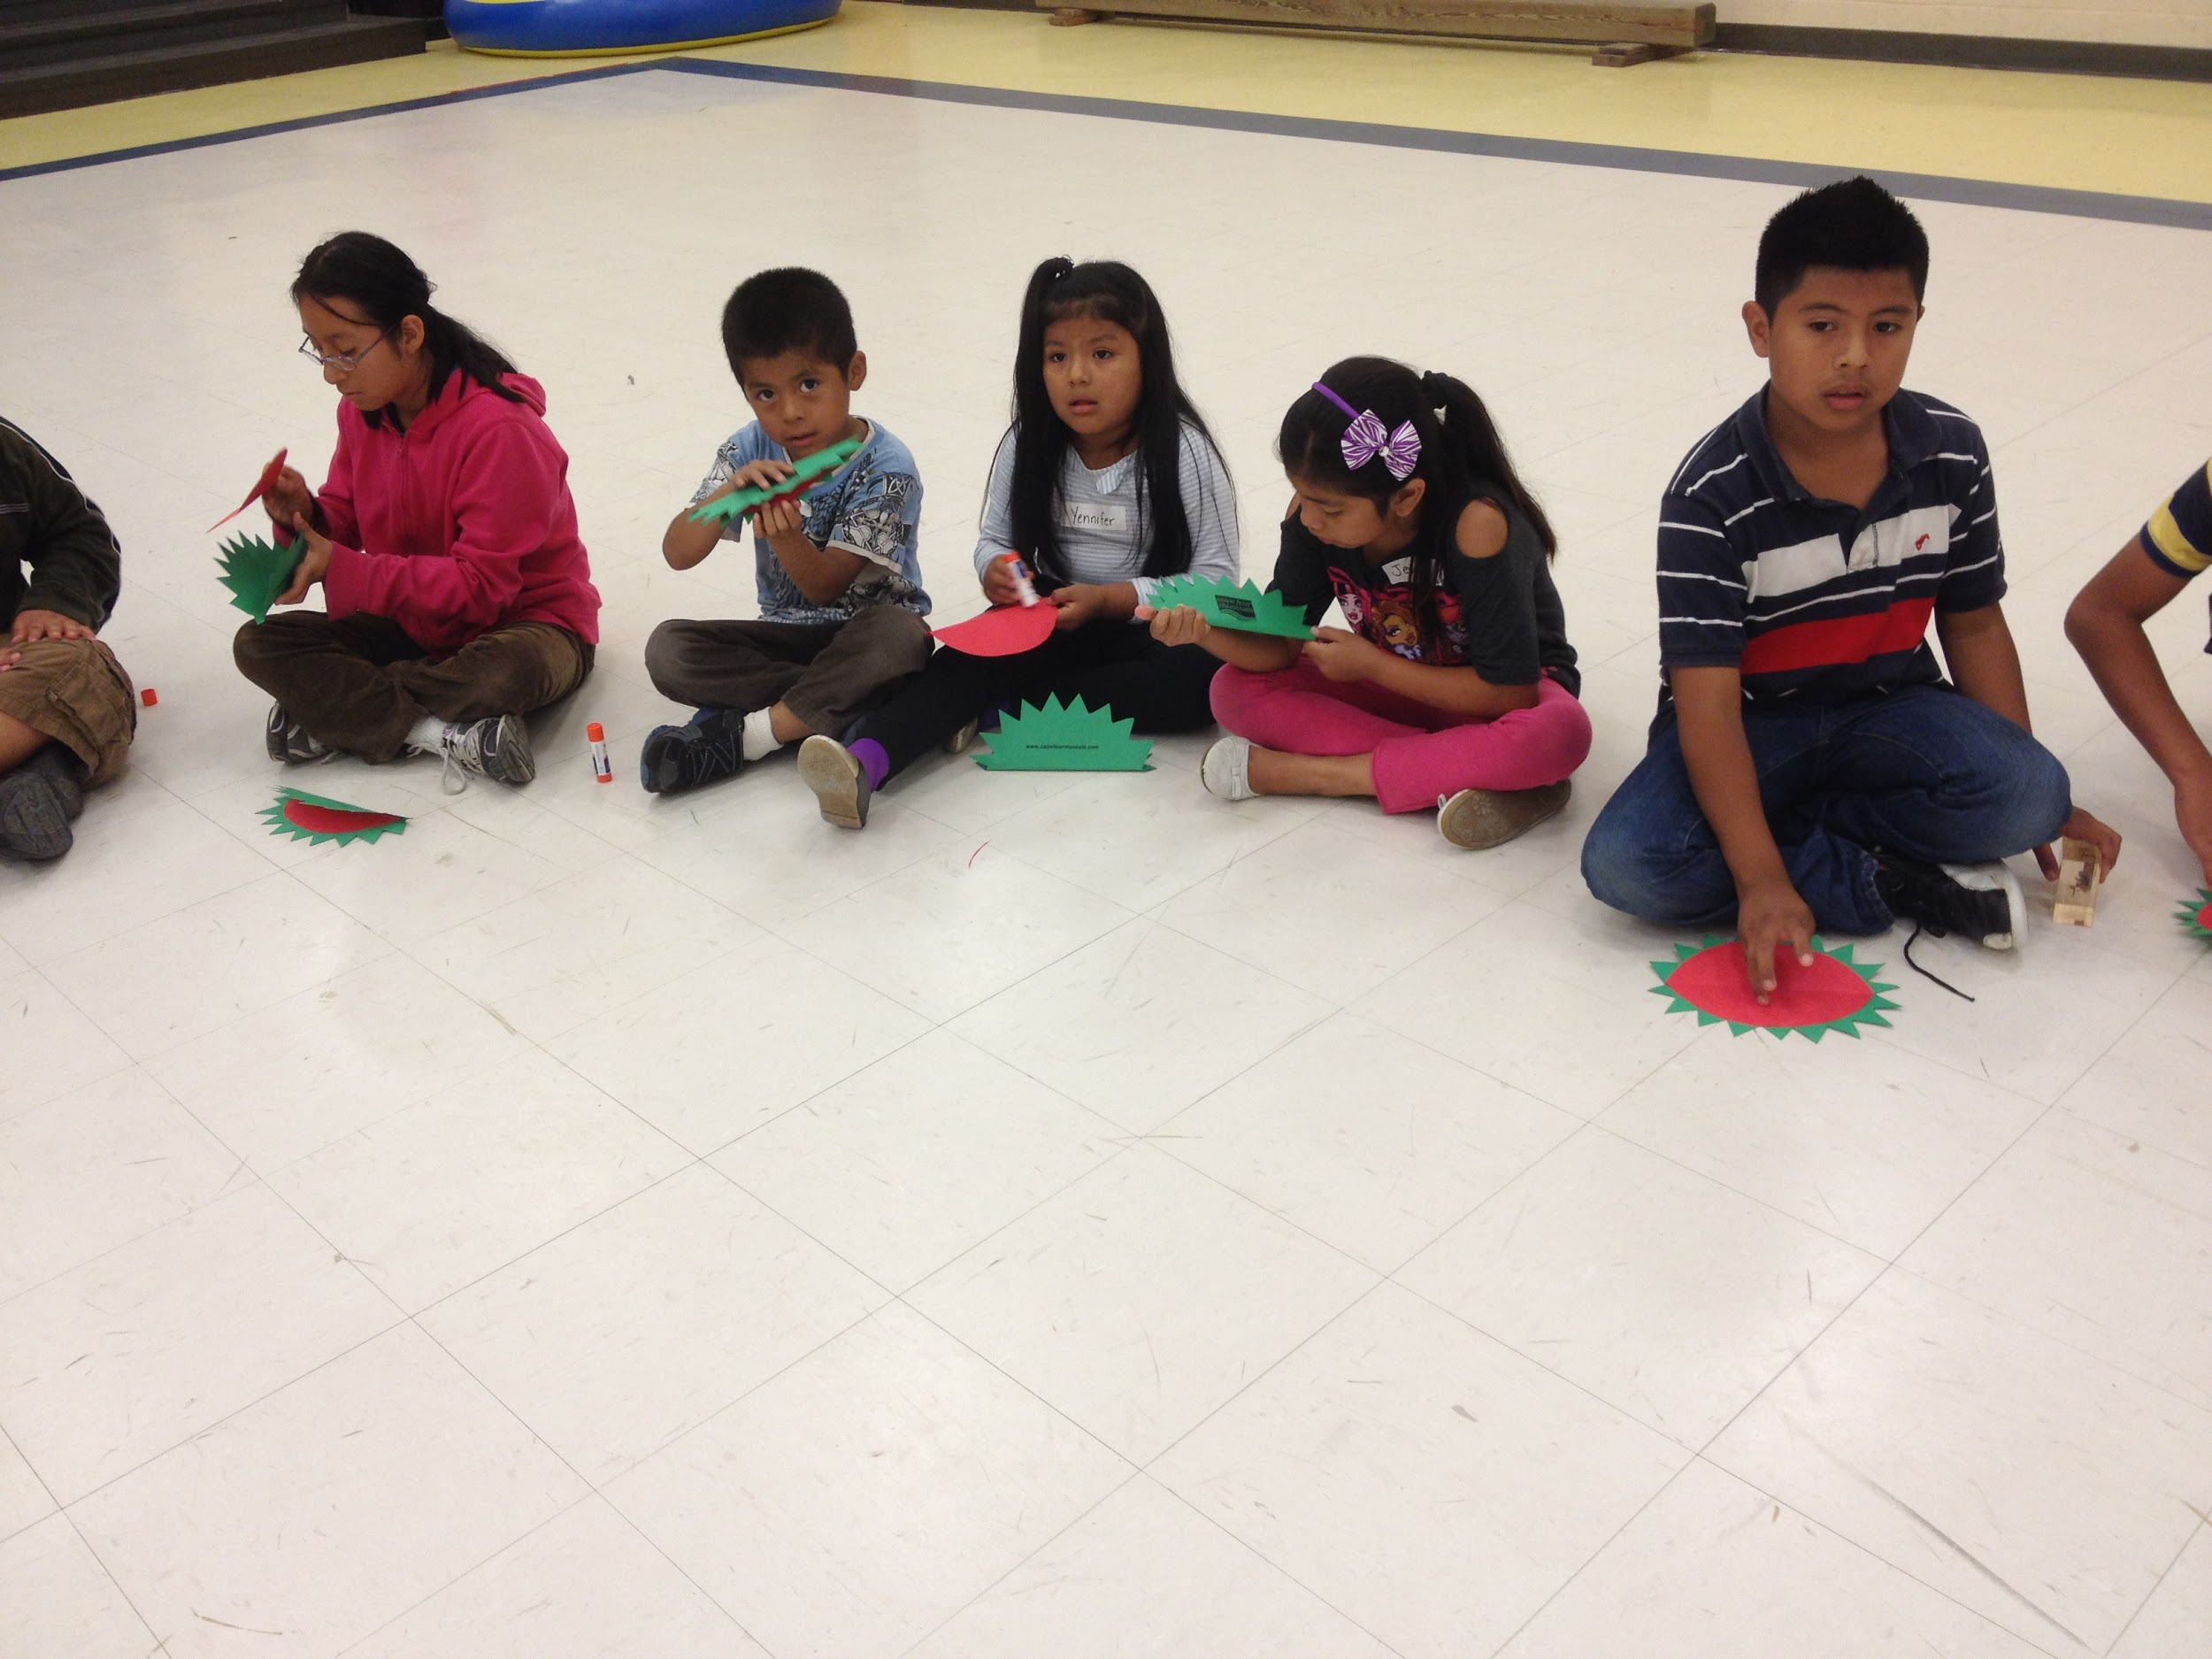
Ways to help cut costs
Partner with our Child Nutrition Department
Apply for the Summer Feeding Program - There is no cost to MEP for food
Receive breakfast, lunch, and snack
Partner with other programs for transportation
2019 - partnering with RtA to split the costs of transportation. We are paying a percentage of MEP students riding the buses.
Our program is at one central location in our county
Field Trips
Try to see if a program will come to you
Some museums offer a program at their location and cost includes admission to see exhibits at their museum
2014 - Ecosystems

Slide 6
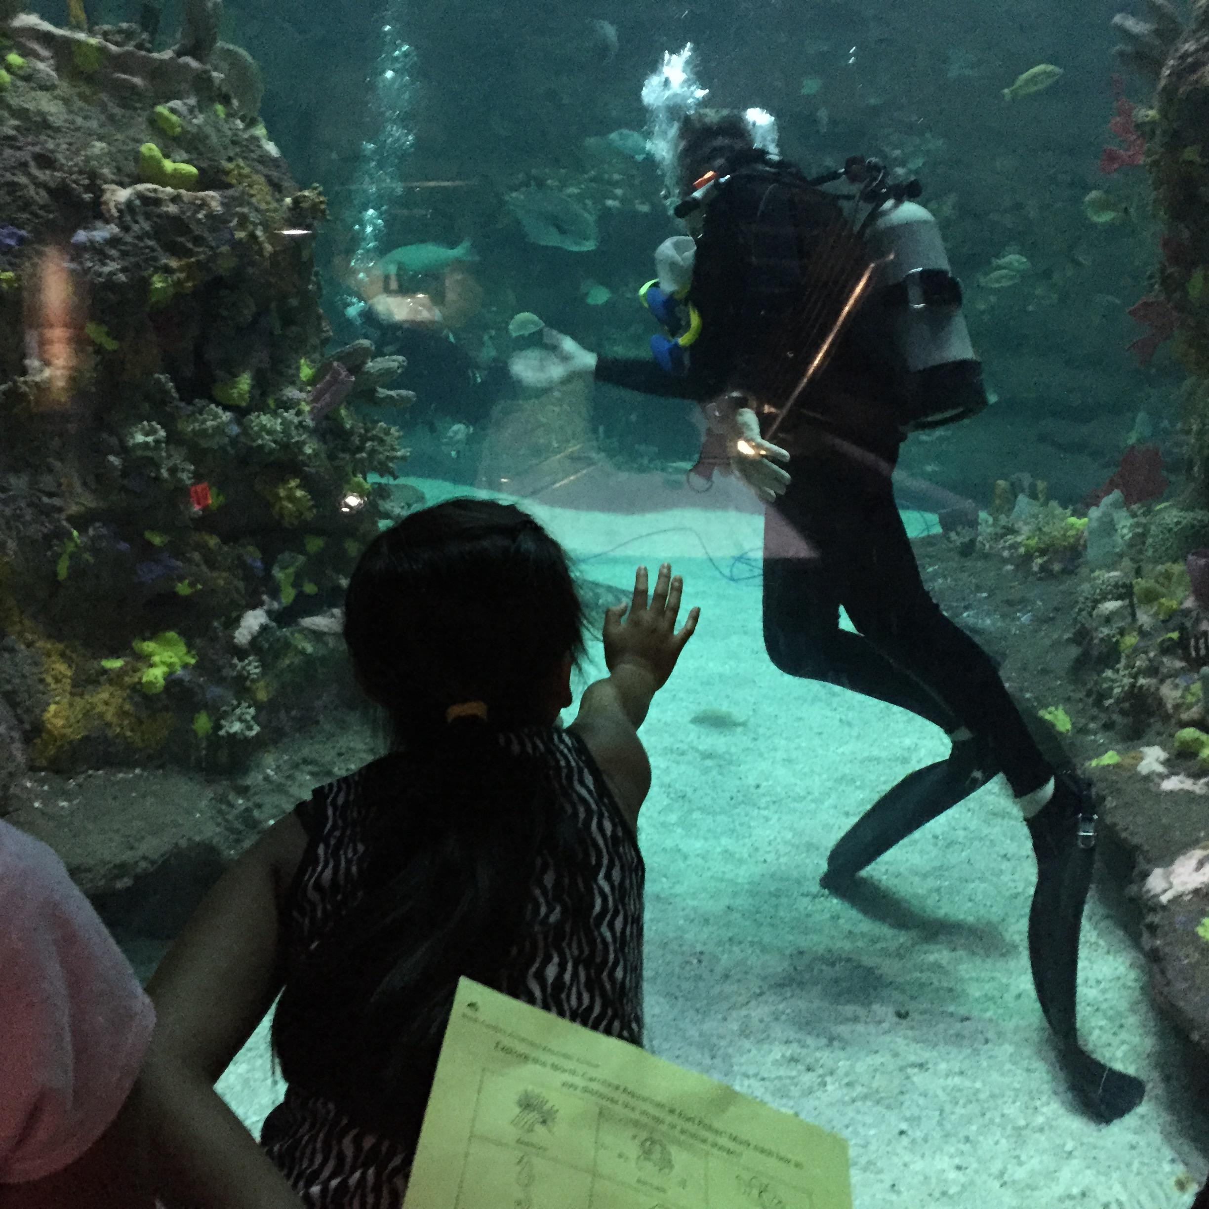
Focus/Themes
STEM or STEAM related
We have a theme every year
Fairy Tale STEAM - 2018
Superhero STEM - 2017
Fairy Tale STEAM - 2016
Forces and Motion - 2015
Ecosystems - 2014
Ocean/Sea - 2013
Forces and Motion - 2012

Slide 7
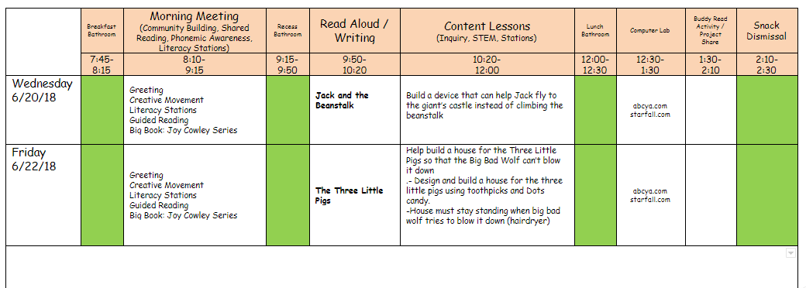
Glimpse of Daily Schedule

Slide 8
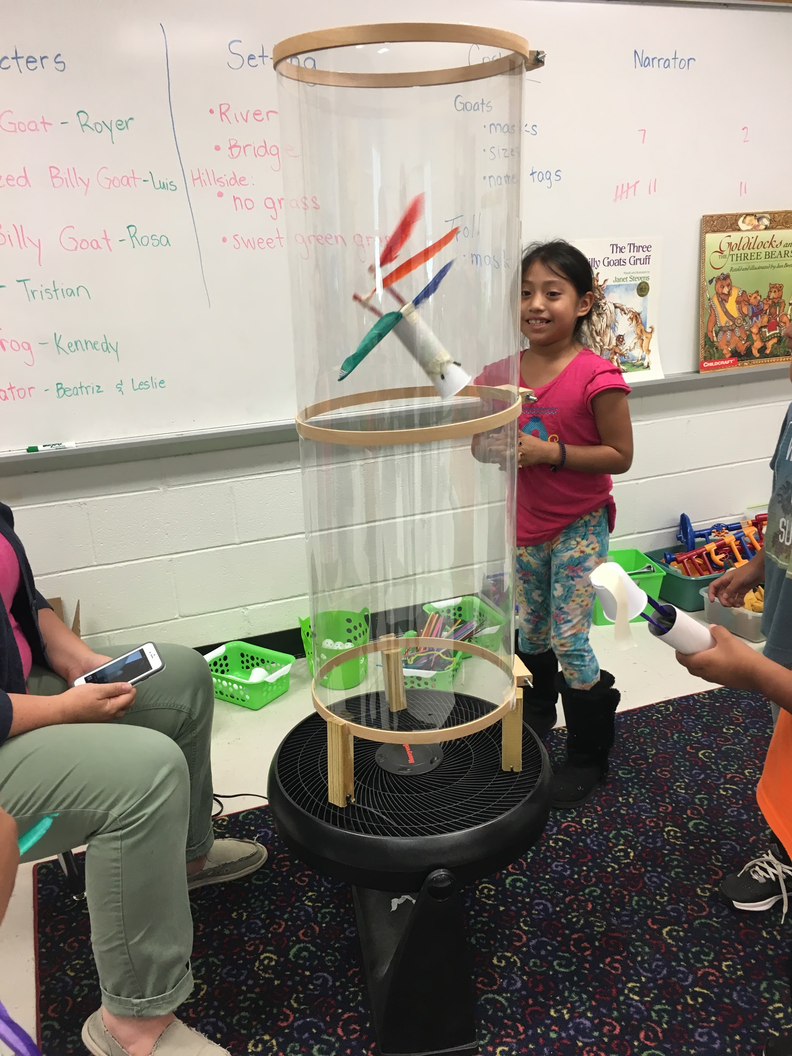
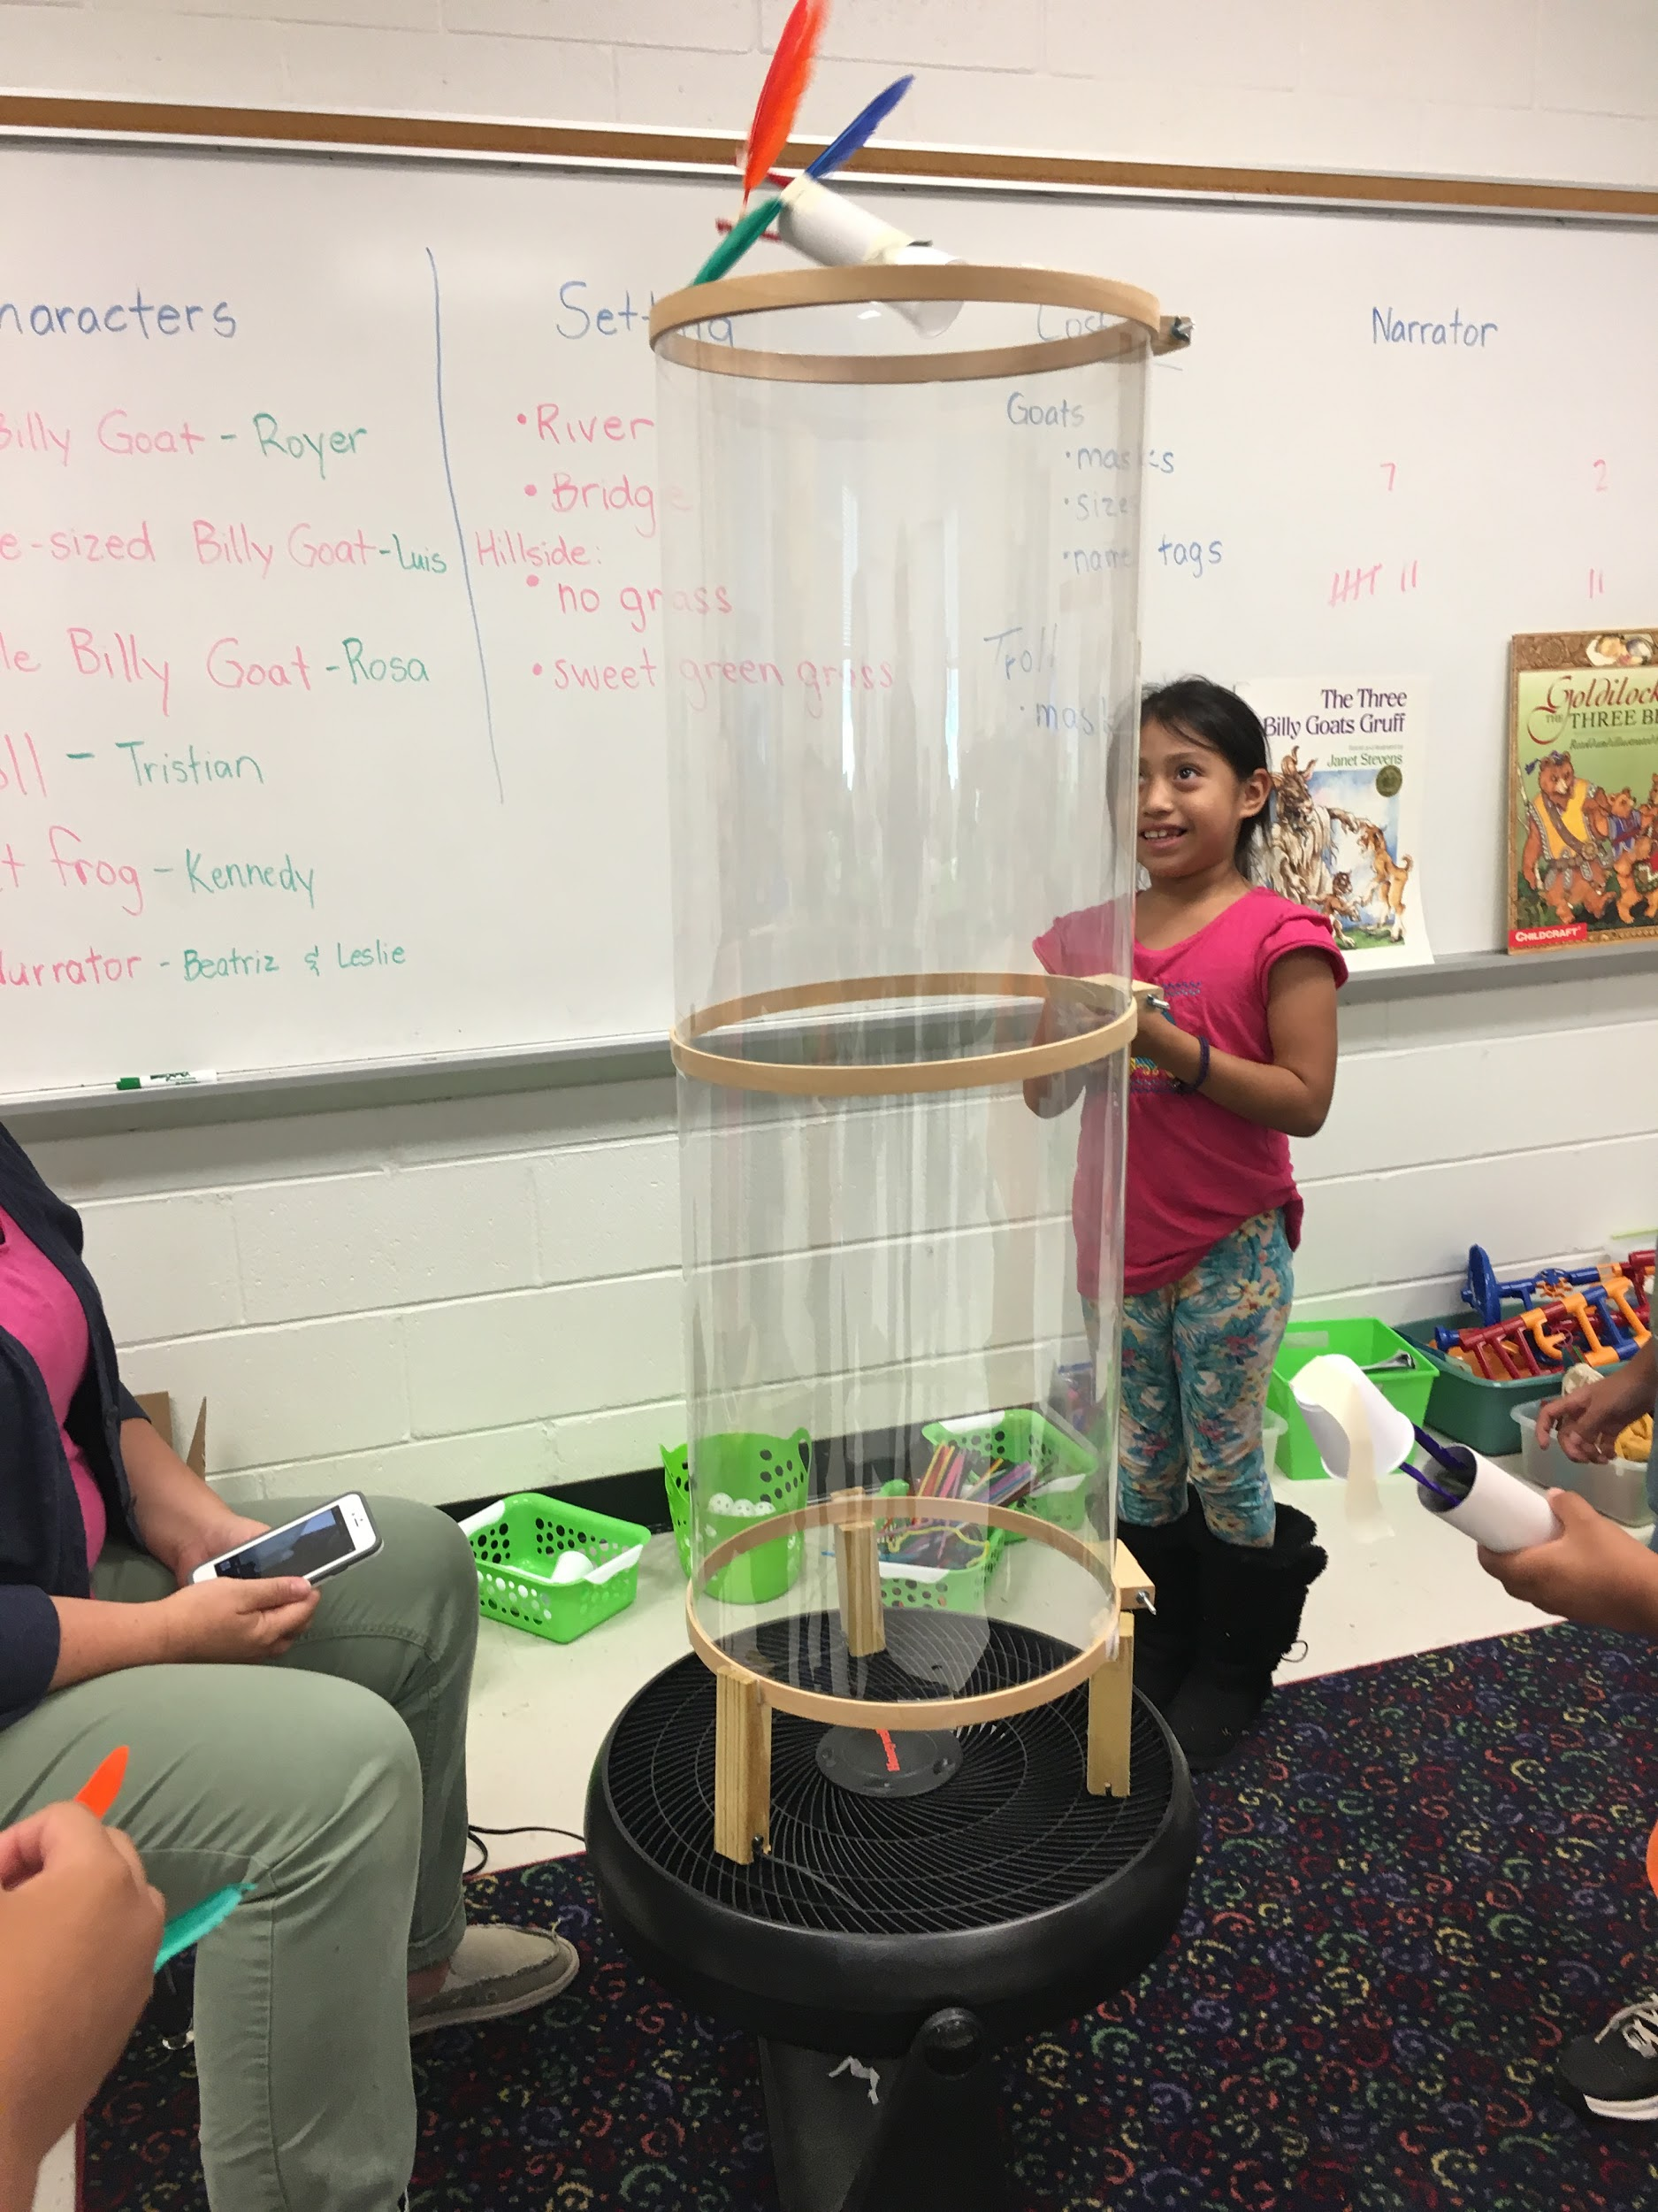
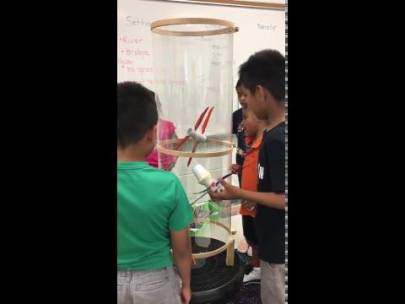
Jack and the Beanstalk

Slide 9
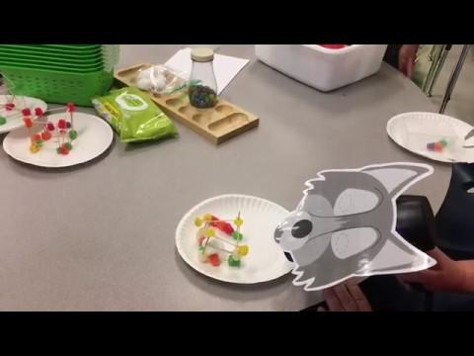
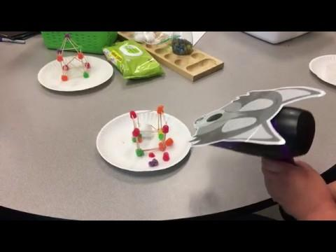
The Three Little Pigs

Slide 10
Making a program successful and engaging
The program strives to have students learning and engaged, but since we don’t have the constraints of the regular school year the learning occurs in a more relaxed environment (with structure). The students are able to do activities more than once and are encouraged to do so, especially if they are working to improve the item they were testing. The students engage in a different hand-on activity each day which helps the material seem new and exciting to the students. Without realizing it the students guide their own learning.

