Slide 1
Exito en el Trabajo Families, Osys wherefore art thou?
BY: Maria Alcala .
&
Ivan A. Padron Mirant .

Slide 2
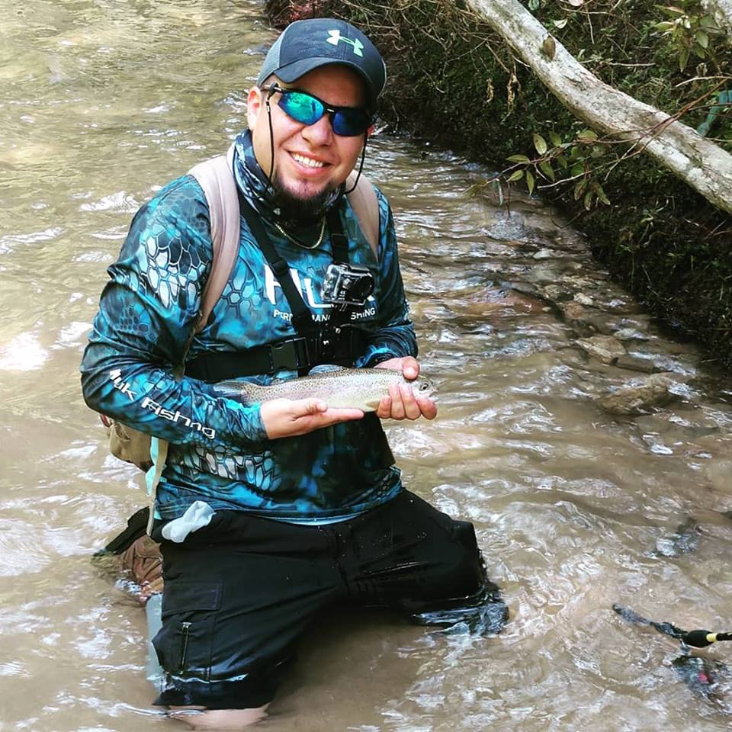
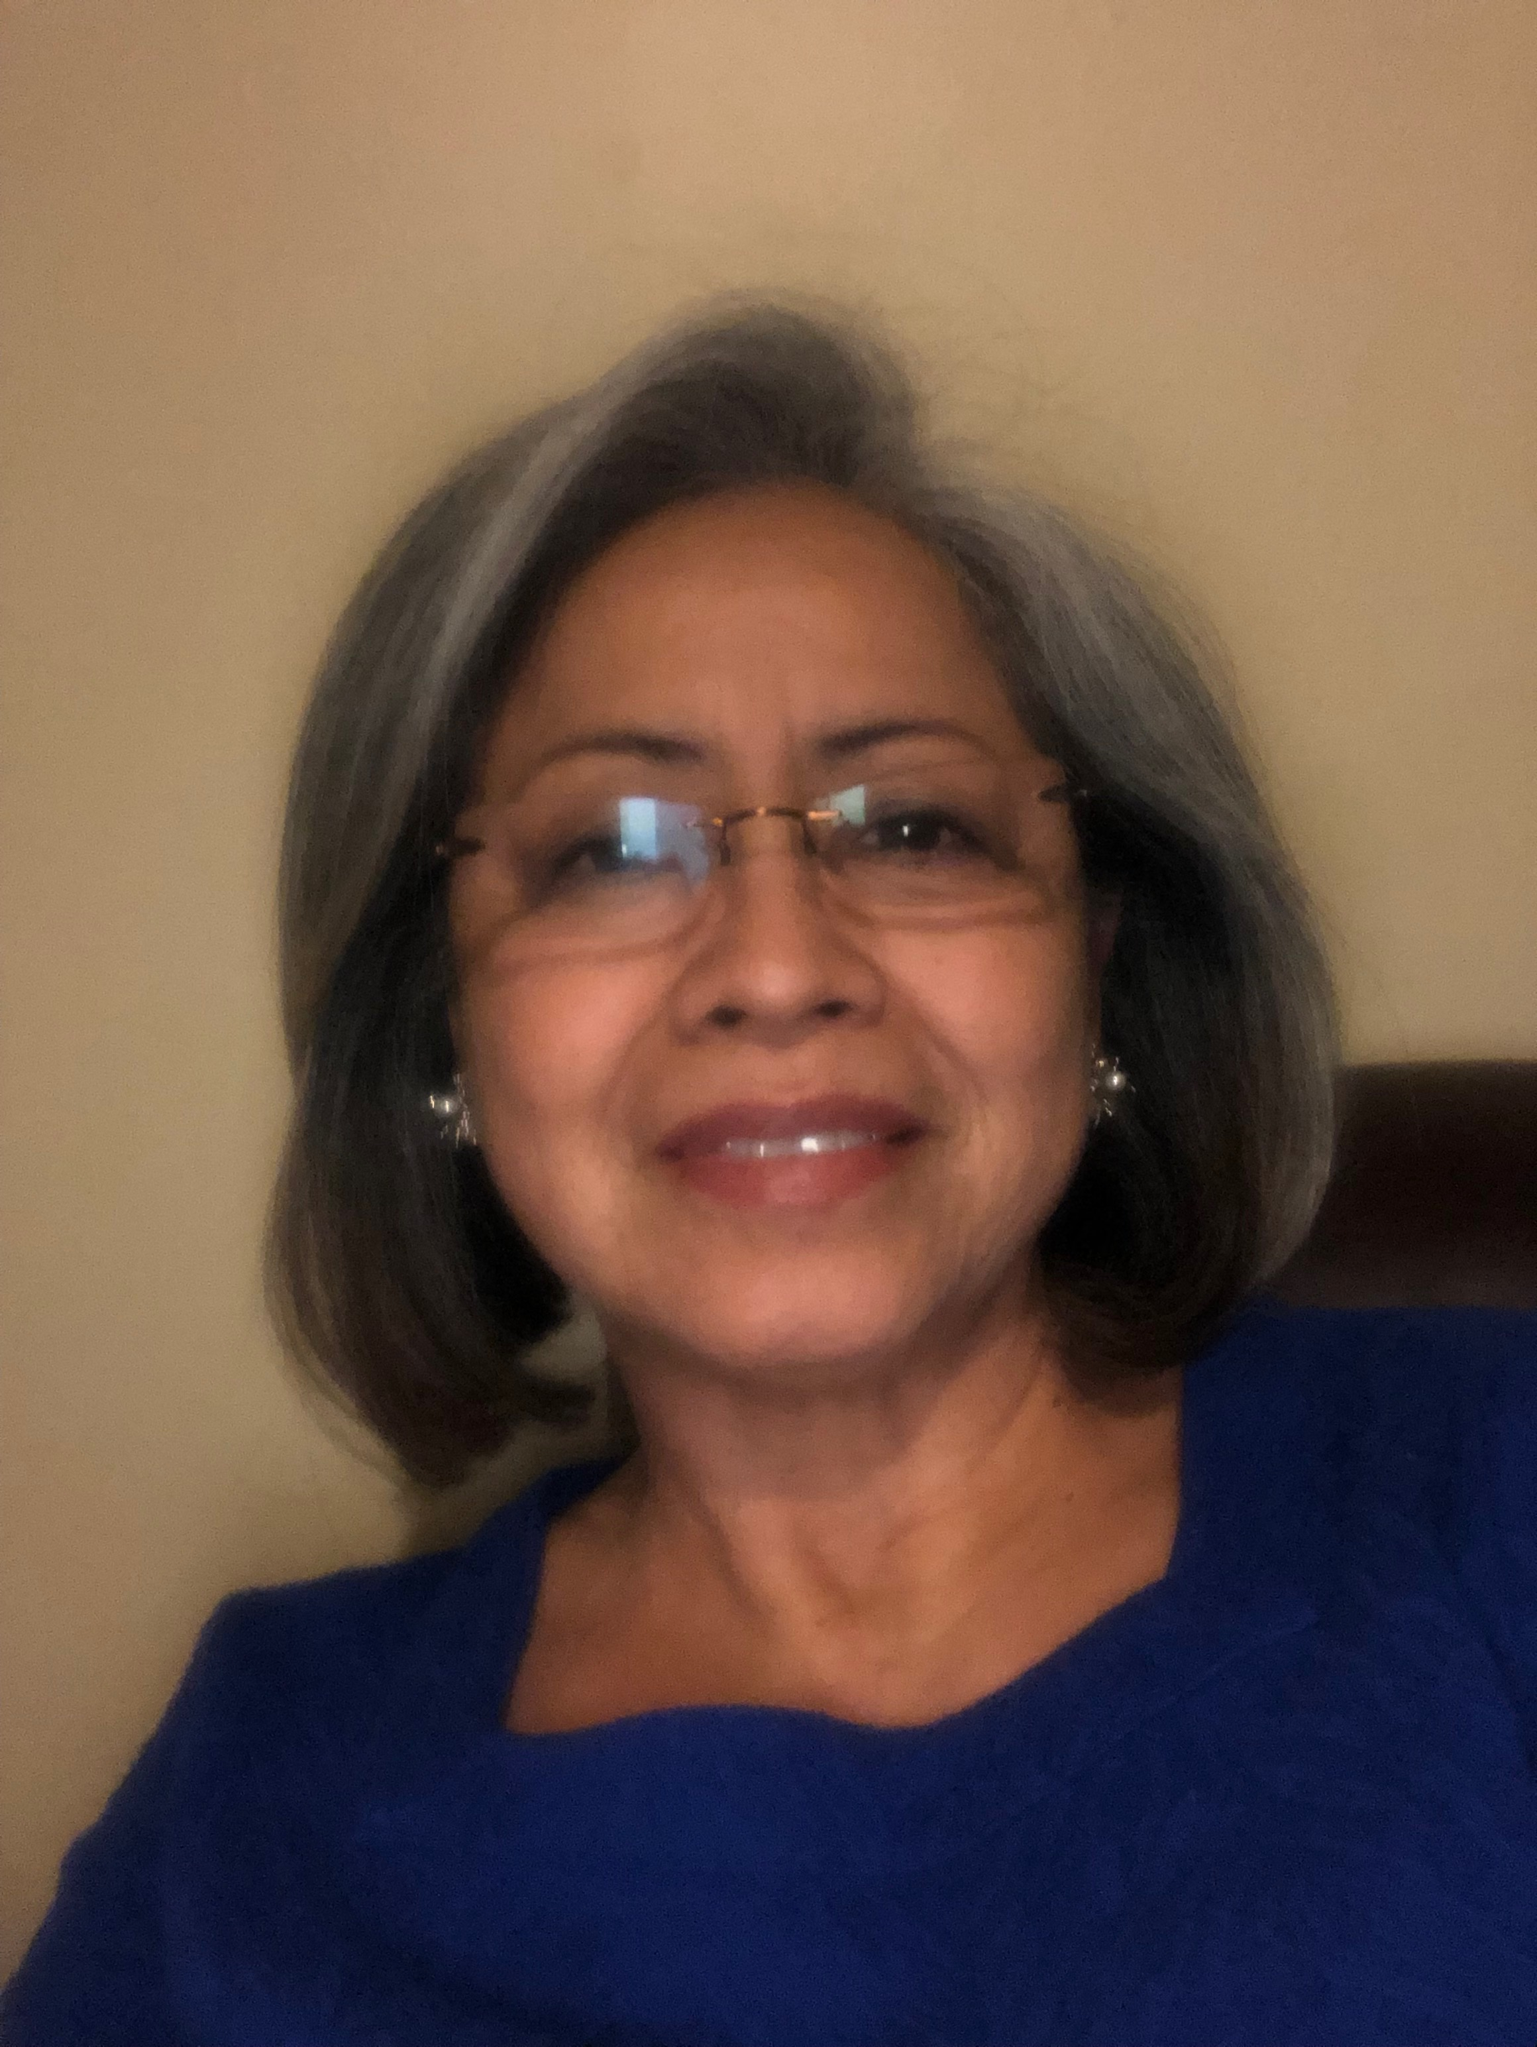
Who are these people?
Maria Alcala
Ivan Alejandro Padron Bueno

Slide 3
Presentation Objectives
How do I find QMW?
How do I approach them?
How do I serve them?
This Photo by Unknown author is licensed under CC BY-SA.

Slide 4
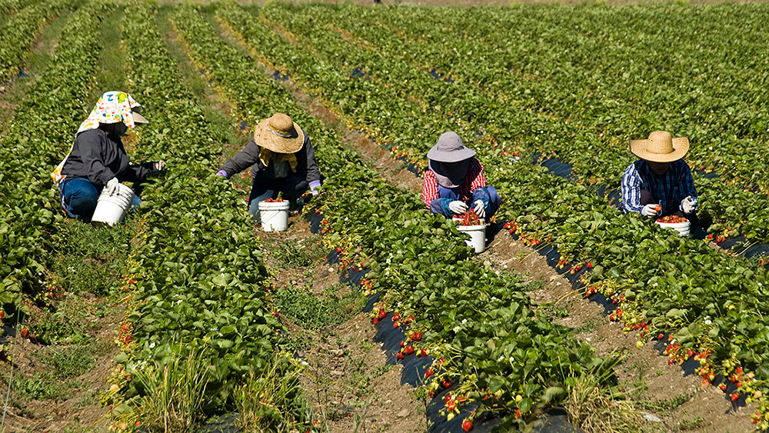
How Do I Find QMW?
What is a QMW?
Qualifying Migratory Worker
This Photo by Unknown author is licensed under CC BY-NC-ND.
This Photo by Unknown author is licensed under CC BY-NC.

Slide 5
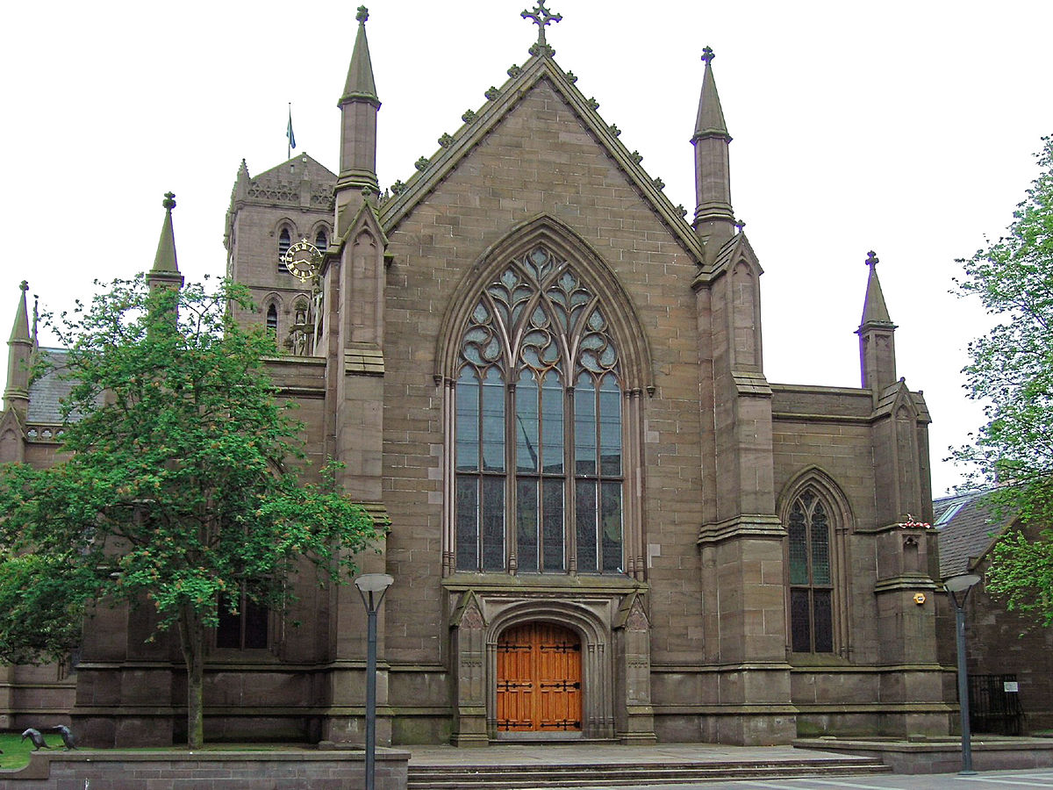
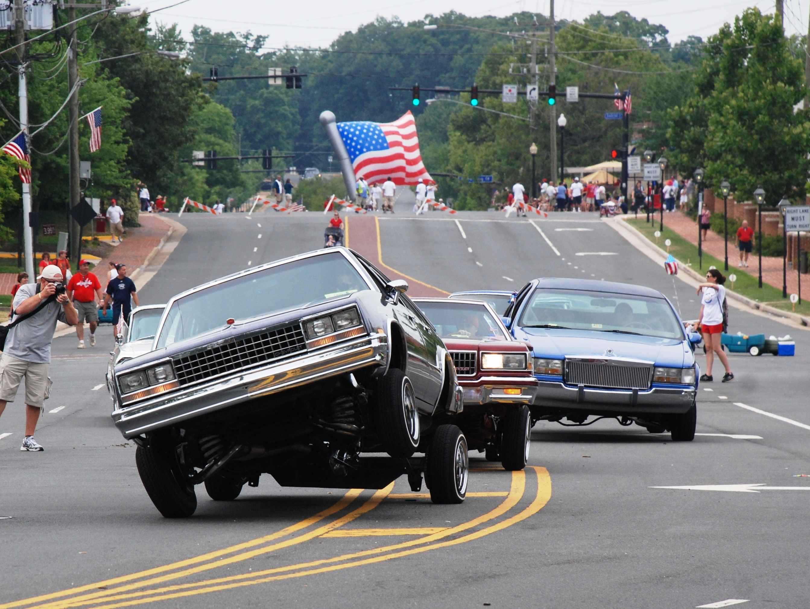
How Do I Find QWM?
Out on the town
Churches
Driving around
Laundry mats
Mexican Stores
This Photo by Unknown author is licensed under CC BY-SA.
This Photo by Unknown author is licensed under CC BY-SA.

Slide 6
How Do I find QMW
Networking
Schools
Clinics/Hospitals
Business
Local organizations

Slide 7
How Do I find QMW
WALMART
This Photo by Unknown author is licensed under CC BY-SA-NC.

Slide 8
How Do I find QMW
MSIX
MSIX
MSIX
MSIX

Slide 9
How Do I approach them?
School bus stops
Their homes
Other immigrant families
School reunions
Agriculture farms

Slide 10
How Do I Serve Them?
HEP
Clases de ESL para adultos
Juntas de Pre-k
Información ( tarjetas de referencia) Servicios alimentación y salud
Colegios/Iglesias
ESL”youth”

