Slide 1
Data on your MEP
English Learners (ELs)- where to find it and how to use it!
April 30, 2019
Marshall Foster
Notes:
In this presentation, you will learn where data on ELs can be found within the PowerSchool environment, how to access these data and how to utilize it when contemplating service delivery options, including instructional strategies for your MEPs who are EL.

Slide 2
Opening Activity
Notes:
Danise: Where do you currently find information on your MEP students?
TURN AND TALK:

Slide 3
Resources
New English Language Development Website
  https://sites.google.com/dpi.nc.gov/ncels/el-data/ps-el-user-guides
PowerSchool login
  https://idp.ncedcloud.org/idp/AuthnEngine#/authn
Notes:
Our Immigrant Headcount

Slide 4
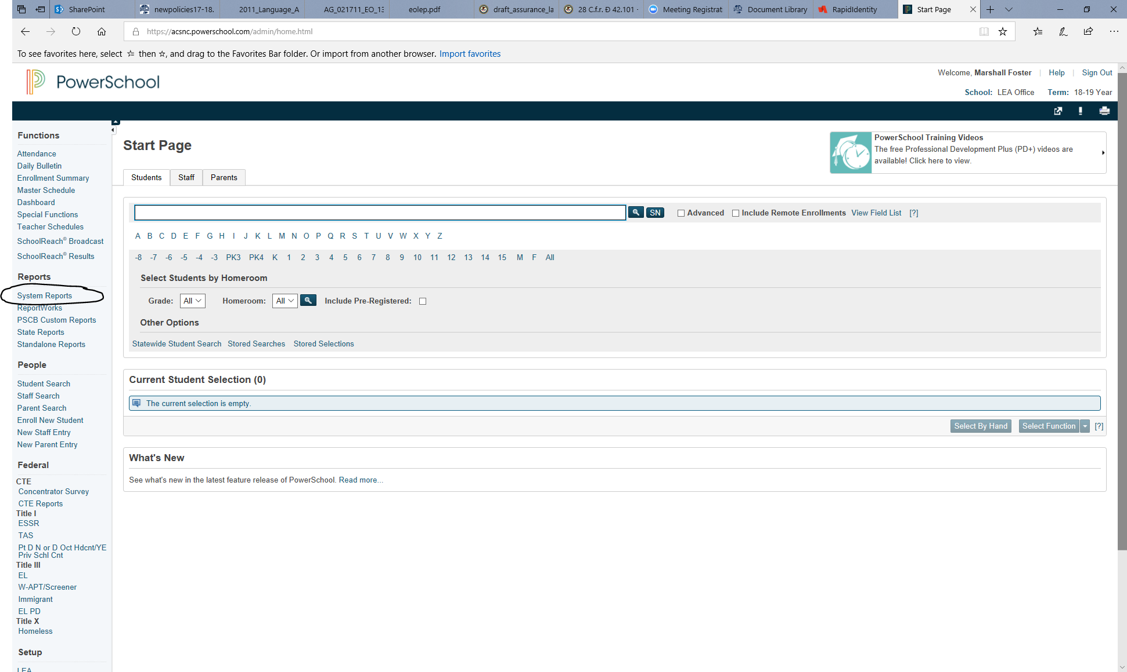
Notes:
Let’s look at what’s available in PowerSchool

Slide 5
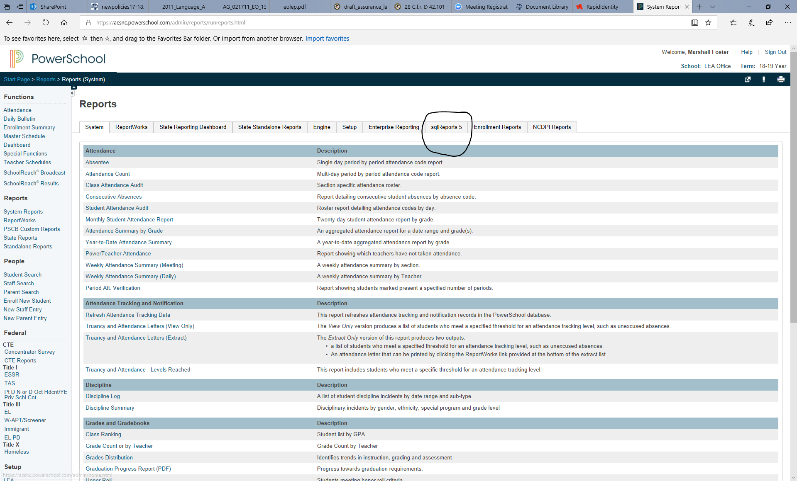

Slide 6
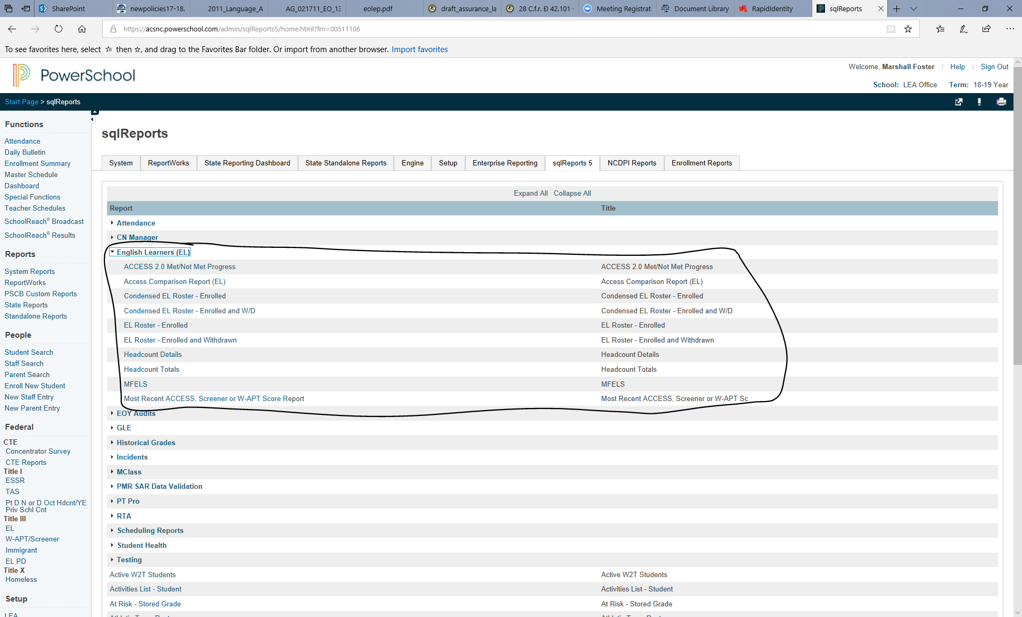

Slide 7
ACCESS 2.0 Met/Not Met Progress
Access Comparison Report (EL)
Condensed EL Roster - Enrolled
Condensed EL Roster - Enrolled and W/D
EL Roster - Enrolled
EL Roster - Enrolled and Withdrawn
Headcount Details
Headcount Totals
MFELS
Most Recent ACCESS, Screener or W-APT Score Report

Slide 8
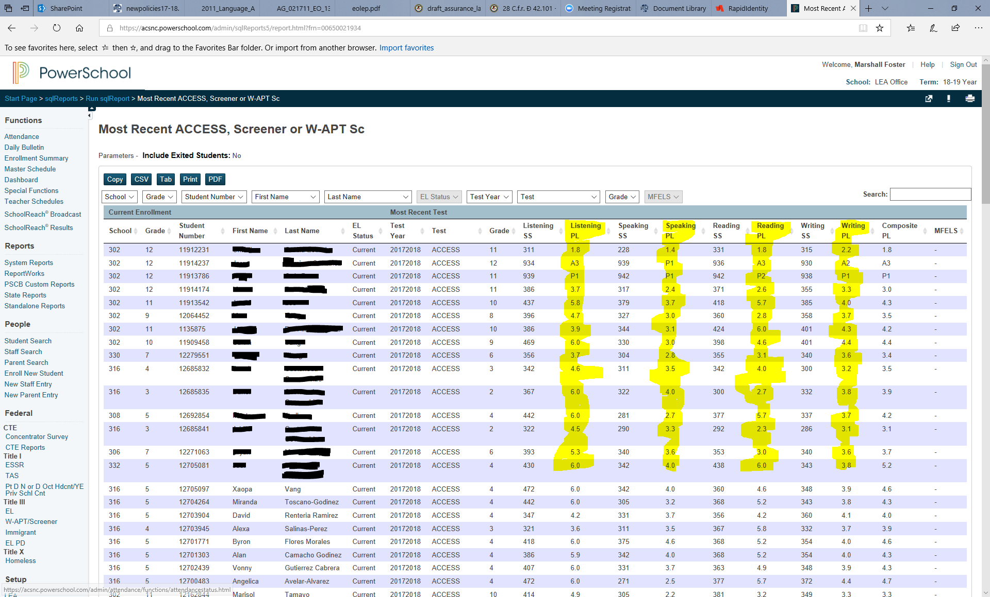

Slide 9


Social Language (BICS)
Notes:
Danise Melecio AND JENNY GRINDSTAFF OF YANCEY COUNTY SCHOOLS:
Discuss Social Language (BICS - Basic Interpersonal Communicative Skills) along the following 6 points:
Language: informal, everyday vocabulary, shorter sentences, simple vocabulary and grammar
Setting: social, small number, often with friends, usually face-to-face
Degree of understanding: exact understanding not needed
Topic: familiar topics (friends, daily routine, TV shows, sports)
Clues: many nonlinguistic clues (nonverbal, visual, gestures, expressions, context)
Clarification: easy to get clarification (look puzzled, ask a question)

Slide 10


Academic Language (CALP)
Notes:
Discuss Academic Language (CALP - Cognitive Academic Language Proficiency) along the following 6 points and compare with BICS:
Language: formal, academic/school vocabulary; longer sentences, complex grammar
Setting: school, lecture format, reading a textbook, little situational/experiential context
Degree of understanding: exact understanding demanded; higher order thinking
Topic: new, cognitively complex; less background knowledge to build on, can be abstract
Clues: few if any nonlinguistic ( nonverbal, visual) clues; most clues language based
Clarification: difficult to ask for clarification

Slide 11
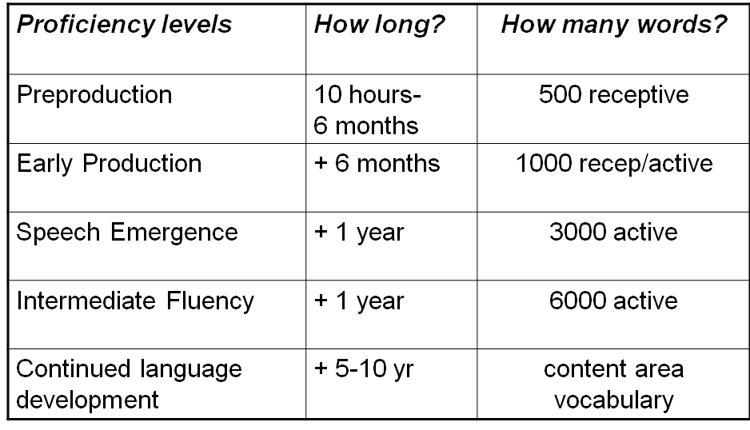
Stages of Language Development
Notes:
TURN AND TALK: Take a look at the chart showing Stages of Language Development. What do you notice when looking at this chart especially thinking about ELs in your classroom?
Second language acquisition theory recognizes a continuum of learning – that is, predictable and sequential stages of language development. The learner progresses from no knowledge of the new language to a level of competency closely resembling that of a native speaker.
1.Explain meaning of receptive vocabulary and productive or active vocabulary.
Receptive vocabulary = the word we understand when we hear or read them
Productive or active vocabulary = the word we use when speaking or writing

Slide 12
Why doesn’t my new EL student talk to me? How can I assess?
The “Silent Period”
Just as native speakers as young children understand more than they can say, second language learners may understand but not speak
Silent period can last for many months
Ask the student to demonstrate understanding by pointing/gesturing/matching/acting out/drawing a picture

Slide 13
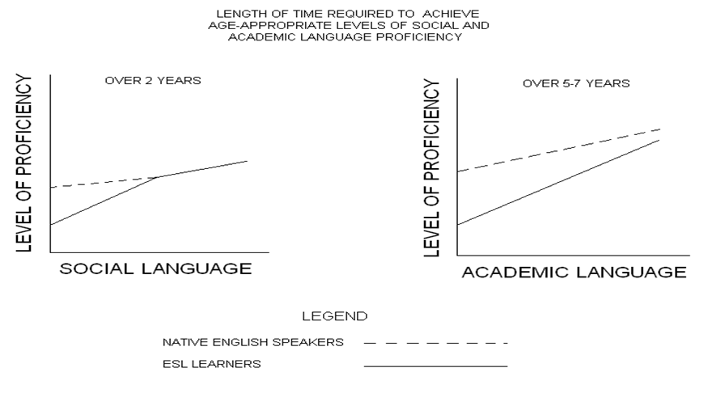
Length of Time Required to Achieve Age-Appropriate Levels of Social and Academic Language Proficiency
Notes:
30 SEC TURN AND TALK - What do the two charts show in comparison? How do you see this in your students?

Slide 14
Once students learn to speak reasonably fluently, aren’t their problems over?
Speaking English is not the same as using English to learn academic content.
Thomas & Collier research states:
ELs must typically gain MORE THAN ONE YEAR’S ACHIEVEMENT (15 months gain) in each of SEVERAL CONSECUTIVE YEARS to ever close the initial achievement gap with native English speakers WHEN TESTED IN ENGLISH (L2).
Notes:
English Speakers make one year of achievement gain during each school year (10 months gain in a 10 month school year) for each year of school. To close the achievement gap ELLs must gain more than one year’s achievement (15 months gain in 10 months) in each of several consecutive school years. To illustrate further, if a group of English language learners experiences an initial three-year gap in achievement assessed in English (math, science, social studies, language arts, reading), they must make an average of about one-and –a-half years’ progress in the next six consecutive years (for a total of nine years’ progress in six years) to reach the same long-term performance level that a typical native-English speaker reaches by making one year’s progress in one year’s time for each of six years. (Thomas & Collier, 1997)

Slide 15
Facts to Know about your ELs...
Based upon a study by Thomas & Collier, 1997.
Students 8-11 with some native language education took 5-7 years to test at grade level in English.
Students with little or no formal education who arrive before the age of eight, took 7-10 years to reach grade-level norms in English language literacy.
**Consider the students who were older than 8 when they came to your school system. Have you had any students in your classes that fall into this category?

Slide 16
I teach high school. Isn’t it harder to learn a second language the older you are?
Pronunciation may be more native-like with younger learners
Older and younger learners are both equally capable of acquiring a second language

Slide 17
Why do some students learn English easier than others?
Concept already learned in the native language
  Acquiring new concepts, skills, sounds, meaning, structure and developing specialized content and vocabulary is double the work
Formal schooling in their first language
More challenges if not on grade level in the first language
**Be aware of students’ prior knowledge and plan lessons to address their needs

Slide 18
English Learners need to learn English asap!
Shouldn’t we insist on English ONLY?
Native language should be valued
Learning English is an additive process – L1 should not be lost in the process
Very young students are still developing L1 abilities at the same time they are acquiring L2
Meaningful interaction in both languages strengthens language acquisition
Discussing concepts in L1 can help students gain content knowledge and affirm understanding.
Notes:
TURN AND TALK?

Slide 19
Long Term English Learners
The majority of English Learners in some middle and high school programs are classified as Long Term English Learners meaning they have been in an EL program for six years or more.

Slide 20
CHARACTERISTICS
Low Self-Esteem is one of the highest contributors
to Long Term English Learners
Usually grouped with “low” students
Teacher doesn’t modify assignments which leads to constant feeling of failure for the students.
Long Term English Learners tend to speak fluent social English and it is even their preferred language of communication and therefore teachers assume they can learn academic content with no modifications or language support.
Because of their sense of failure (many times beginning in Elementary school) LTELs become passive and disengaged in all classroom activities.

Slide 21
As a secondary classroom teacher, what can I do to help meet their needs?
Consistency is IMPERATIVE to EL classroom success: daily schedule & teacher expectations.
Always speak in academic language during your instructions: Don’t say “OK, you guys...get into groups” after a lesson taught in academic register.
ELs NEED to have quality language modeled at all times in the classroom setting.
Oral Language is KEY to literacy, therefore, you cannot let an EL sit silently and disengaged during your classroom instruction.
Modify their assignments according to their EL Plan.

Slide 22
WIDA
World-class Instructional Design and Assessment
English Language Development Standards K-12 (adopted by 39 states including NC)
Connects to our NC State Standards
Higher-order thinking at all levels of language proficiency

Slide 23
North Carolina English Language
Proficiency Levels
•Proficiency levels assessed by the state-designated English Language Proficiency Test (ACCESS 2.0)
•6 Different Levels
•Students may have a different proficiency level in each of the four language domains: reading, writing, listening, speaking.

Slide 24
WIDA English Language Development Standards
Download for free on the WIDA website:
https://wida.wisc.edu/
Click Teach
Under Teaching with Standards, Click English Language Development Standards
Scroll down page: Under Yellow 2012 Resources, Click 2012 Amplification of the English Language Development Standards
This will download the 2012-ELD-Standards.pdf

Slide 25
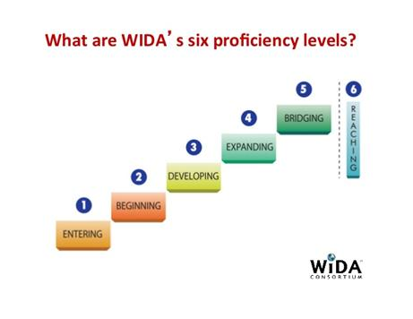
Six English Language Profiency Levels

Slide 27
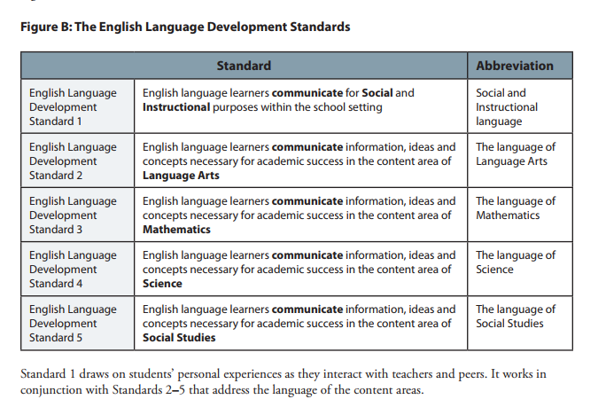
*Page 4 of 2012-ELD-Standards.pdf

Slide 28
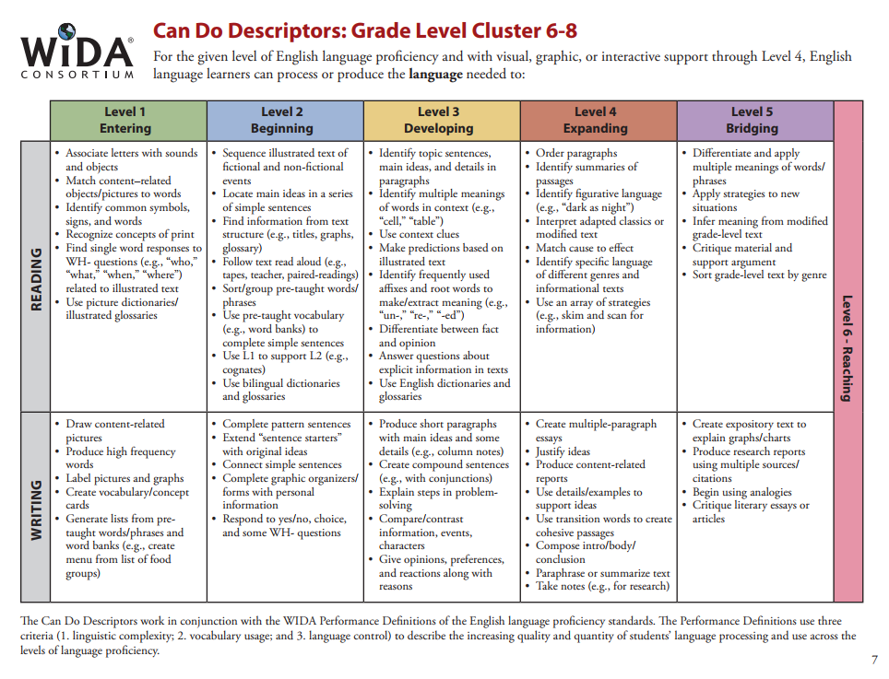
Can Do Descriptors
**Page 7 of 6-8 Can Do Booklet

Slide 29
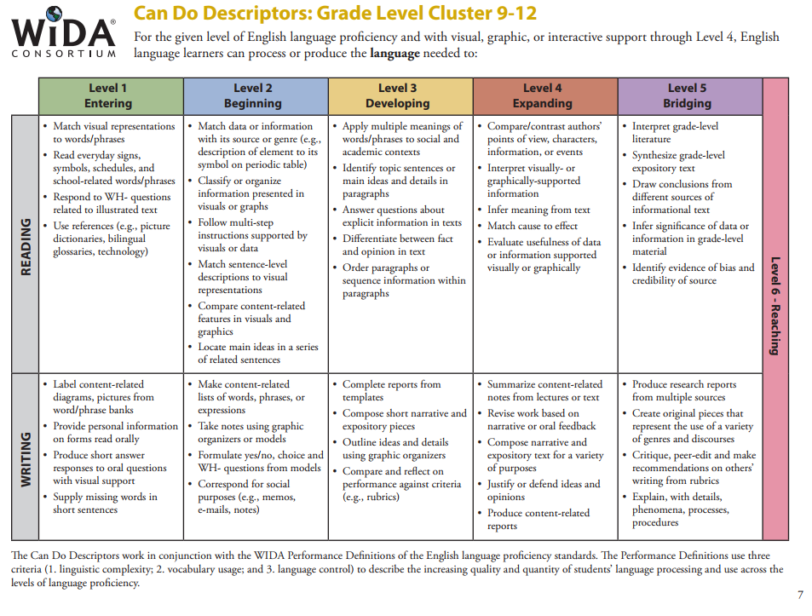
Can Do Descriptors
Page 7 of 9-12 Can Do Booklet

Slide 30
A Closer Look at WIDA Standards Manual
Let’s pay closer attention to:
Cognitive Function
And
Instructional Support

Slide 31
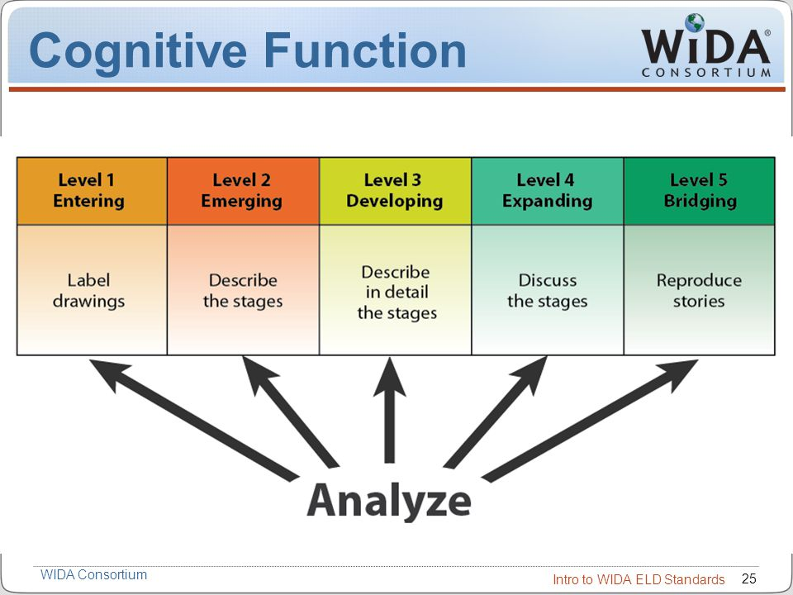
Paragraph at the bottom of
page 5: Figure D
Understand
Analyze
Evaluate
Notes:
WIDA has adopted language used by Bloom’s revised taxonomy to represent a cognitive demand across all levels of language proficiency.
When I think of cognitive functions… I think of what the brain does in order to demonstrate knowledge in the content area or lesson.
The WIDA manual is helpful because it gives examples of cognitive functions for students with differing language levels and within different language domains. (Levels 1-6) Language Domains (L, S, R, and W).
When you are planning a lesson for a classroom with EL students, you can call on these cognitive functions to differentiate the language use students at different levels would use in order to demonstrate or learn content knowledge in your classroom.
A student performing at a level 4 in writing should be able to respond in writing to compare or contrast content learned in the classroom. They could be expected to write a paragraph, or even an essay, with text evidence in order to analyze the comparison in the question you have posed.
We could not expect a Level 2 (Emerging) student to be able to produce the language needed in order to respond to a task where they would analyze by comparing and contrasting at a paragraph level. A Level 1 or 2 student can still cognitively be expected to analyze, but with a different cognitive function instead of writing a paragraph or essay to compare and contrast.
For instance a Level 2 student may be able to classify visually-supported words or phrases related to the content you are teaching using a graphic organizer with a partner.

Slide 32
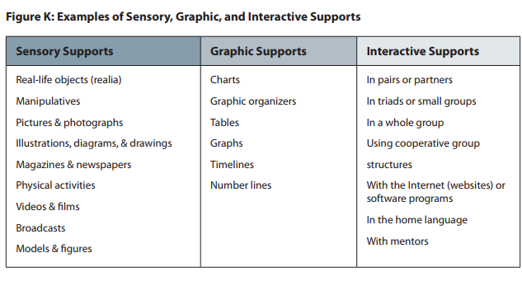
Instructional Support
Notes:
Instructional supports help to scaffold language development for ELs. It is important to provide these supports to students at least up until Level 4. More than one support may be given to students during a lesson. For example, providing the interactive support of having a student work with a partner may not be enough to scaffold language development. They could also use a graphic organizer along with a partner in helping them formulate the language needed to complete a certain task.

Slide 33
Questions?

