Slide 1

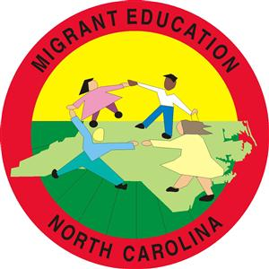

Implementing Successful Summer Programs Using Community Collaborations
Hunter Ogletree, Coordinator – Henderson County Public Schools’ Migrant Education Program
Lisa Delany, Summer/Afterschool Program Lead Teacher – Henderson County Public Schools’ Migrant Education Program
Diana Torres-Edwards, Coordinator – Boys and Girls Club of Henderson County
Notes:
1 minute
The purpose of this workshop is to demonstrate how local migrant education programs can replicate best practices to cultivate unique and impactful community collaborations to address the needs of migrant students and families as they transition to a new environment during the summer.
Participants will learn about a collaboration between the Boys and Girls Club and Migrant Education Program in Henderson County, NC, including best practices that other programs can replicate to build similar collaborations with organizations in their local environment. Positive results include improvement in reading levels at the end of the program, promoting self-confidence, and registering students for school in a timely manner. In addition, educational strategies implemented will be addressed including STEM, ESL, and more. Information and ideas for teachers and schools regarding interventions used to minimize the loss of instruction due to lack of data and adjustment period will be discussed. Finally, guidelines and recommendations will be given in a "how to" portion of the presentation followed by a Q&A time with participants, as well as brainstorming ideas to successfully implement similar collaborations in districts across the nation.

Slide 2
Objectives:
At the end of this sessions, participants will
Understand the importance of building community collaborations in implementing summer programs for migratory children and youth.
Understand the steps to take to build a community collaboration.
Understand the specific details of how a local program in NC initiated a community collaboration.
Notes:
1 minute

Slide 3
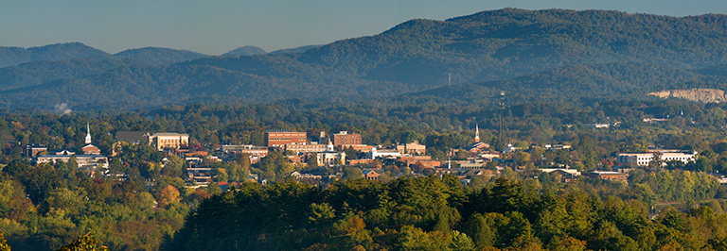
Community Context
Hendersonville, NC
East Coast Migrant Stream
borders South Carolina
rural mountainous region of Western NC
Notes:
1 minute
Henderson County has a strong history of migrant farm work. Henderson County is the seventh largest apple county in the U.S. and 60% of tomatoes produced in NC come from Henderson County. According to NC Employment Security Commission, 2500 migrant farmworkers and their families migrate to our county on a yearly basis during the summer and early fall months.
School stats??? Low ratings, absences, etc…
# elementary, middle, high students, OSY,
uses / importance of the apple business in local economy
impact of migration on economy and schools
average attendance dates and significance

Slide 4
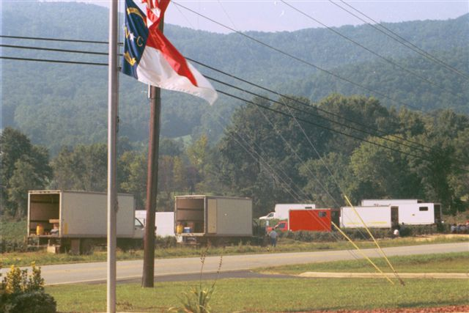
Community Context
7th largest apple county in the US
60 percent of tomatoes produced in NC come from Henderson County
2500 migrant farmworkers and their families annual
Notes:
1 minutes
Henderson County has a strong history of migrant farm work. Henderson County is the seventh largest apple county in the U.S. and 60% of tomatoes produced in NC come from Henderson County. According to NC Employment Security Commission, 2500 migrant farmworkers and their families migrate to our county on a yearly basis during the summer and early fall months.
School stats??? Low ratings, absences, etc…
# elementary, middle, high students, OSY,
uses / importance of the apple business in local economy
impact of migration on economy and schools
average attendance dates and significance

Slide 5
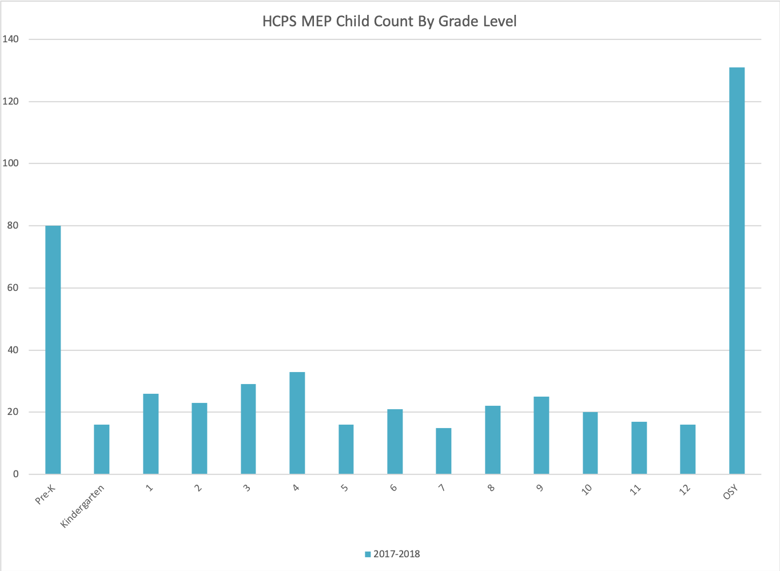
Program Context
Notes:
1 minute
Henderson County has a strong history of migrant farm work. Henderson County is the seventh largest apple county in the U.S. and 60% of tomatoes produced in NC come from Henderson County. According to NC Employment Security Commission, 2500 migrant farmworkers and their families migrate to our county on a yearly basis during the summer and early fall months.
School stats??? Low ratings, absences, etc…
# elementary, middle, high students, OSY,
uses / importance of the apple business in local economy
impact of migration on economy and schools
average attendance dates and significance

Slide 6
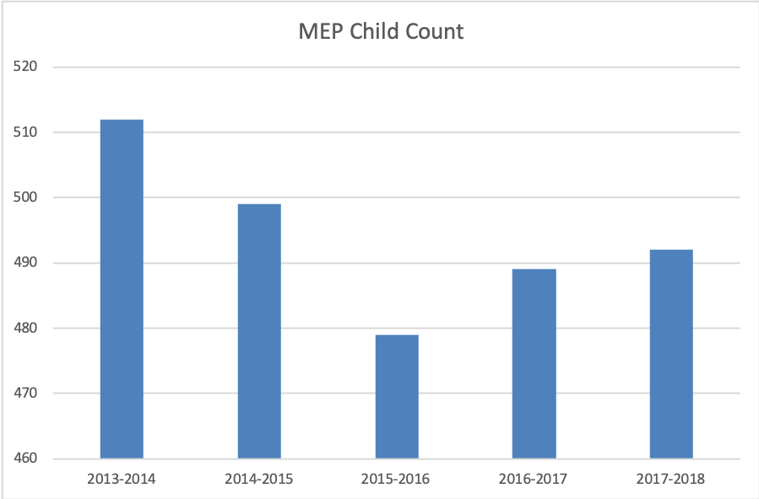
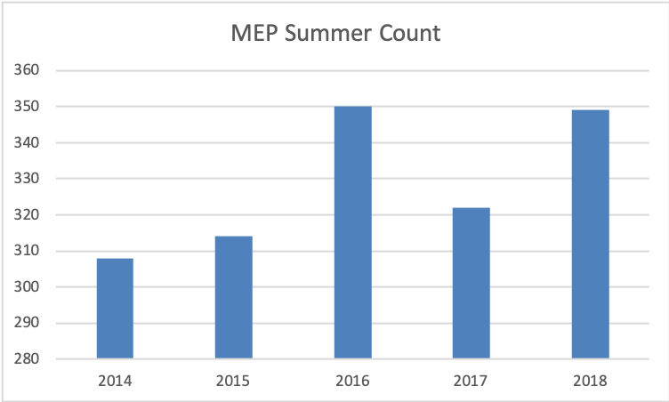
Program Context
Notes:
1 minute
Henderson County has a strong history of migrant farm work. Henderson County is the seventh largest apple county in the U.S. and 60% of tomatoes produced in NC come from Henderson County. According to NC Employment Security Commission, 2500 migrant farmworkers and their families migrate to our county on a yearly basis during the summer and early fall months.
School stats??? Low ratings, absences, etc…
# elementary, middle, high students, OSY,
uses / importance of the apple business in local economy
impact of migration on economy and schools
average attendance dates and significance

Slide 7
Activity
Find a partner. Through conversation, discover something that they know how to do that you could benefit from. It can be something small or big, work related or personal.
For example, a small thing would be: you have children and at birthday parties you might need someone that can face paint or make a cake.
A bigger thing could be that you need someone to look at your car and they have some mechanical background.
Notes:
15 minutes
Are we going to have a report back after the activity, where people introduce their partner, what state they are from and their role in the program

Slide 8

Why are community collaborations important?
Partnerships could help you have access to new services, reach more families, or increase the quality of services.
Community partners should help strengthen a weakness in your program.
Sharing thought processes, goals and resources allows for a greater and more profound impact on the children we serve.
Notes:
3 minutes
Ask the audience….”Why do you think community collaborations are important?

Slide 9
Identify Your Needs
Assess your program and write down what are one or two areas of weakness.
Examples could be:
Family Outreach
Summer daytime programs for students
Language Barriers
Transportation
Building Rapport
Housing
Health care
Staffing
Notes:
5 minutes

Slide 10

Considerations for Identifying Agencies In Your Community
Do you have a common vision or goal?
Do they have accommodations that you could benefit from?
Do they have resources you could utilize?
Are there strategies that are effective that you could replicate?
What are ways that you can build on what they have in place?
Is there something you could assist them with?
Do you have any contacts with them already?
Notes:
5 minues
Now that we have identified needs within our program…What are some considerations that we should consider when identifying community agencies that could potential help fulfill our program needs?

Slide 11
Initiating A Community Collaboration
Visit their agency.
Introduce yourself. Tell them who you are,what your goals and ideas are and your purpose for pursuing a collaboration with them.
Ask questions and learn all about them
Share interests
LISTEN! Allow them to express their thoughts and ideas.
Be direct and clear on what you want your partnership to look like, but incorporate areas of collaboration and compromise.
Write things down
Be prepared to feel uncomfortable; this is a new venture.
Invite them to visit your program space.
Don’t rush the process.
Notes:
4 minues

Slide 12

Win-Win Collaborations
Seek commonality and a shared vision
Be clear as to why you want the collaboration
See beyond what’s on the table
Understand the “why”of your potential collaboration relationship
This Photo by Unknown Author is licensed underCC BY\
Notes:
3 minutes

Slide 13
Activity
With your partner from the first activity, build a partnership where you both can interchange their skills, service, or a product from them. And vice versa.
Write down a simple contract and benefits of your partnership
Notes:
10 minutes

Slide 14
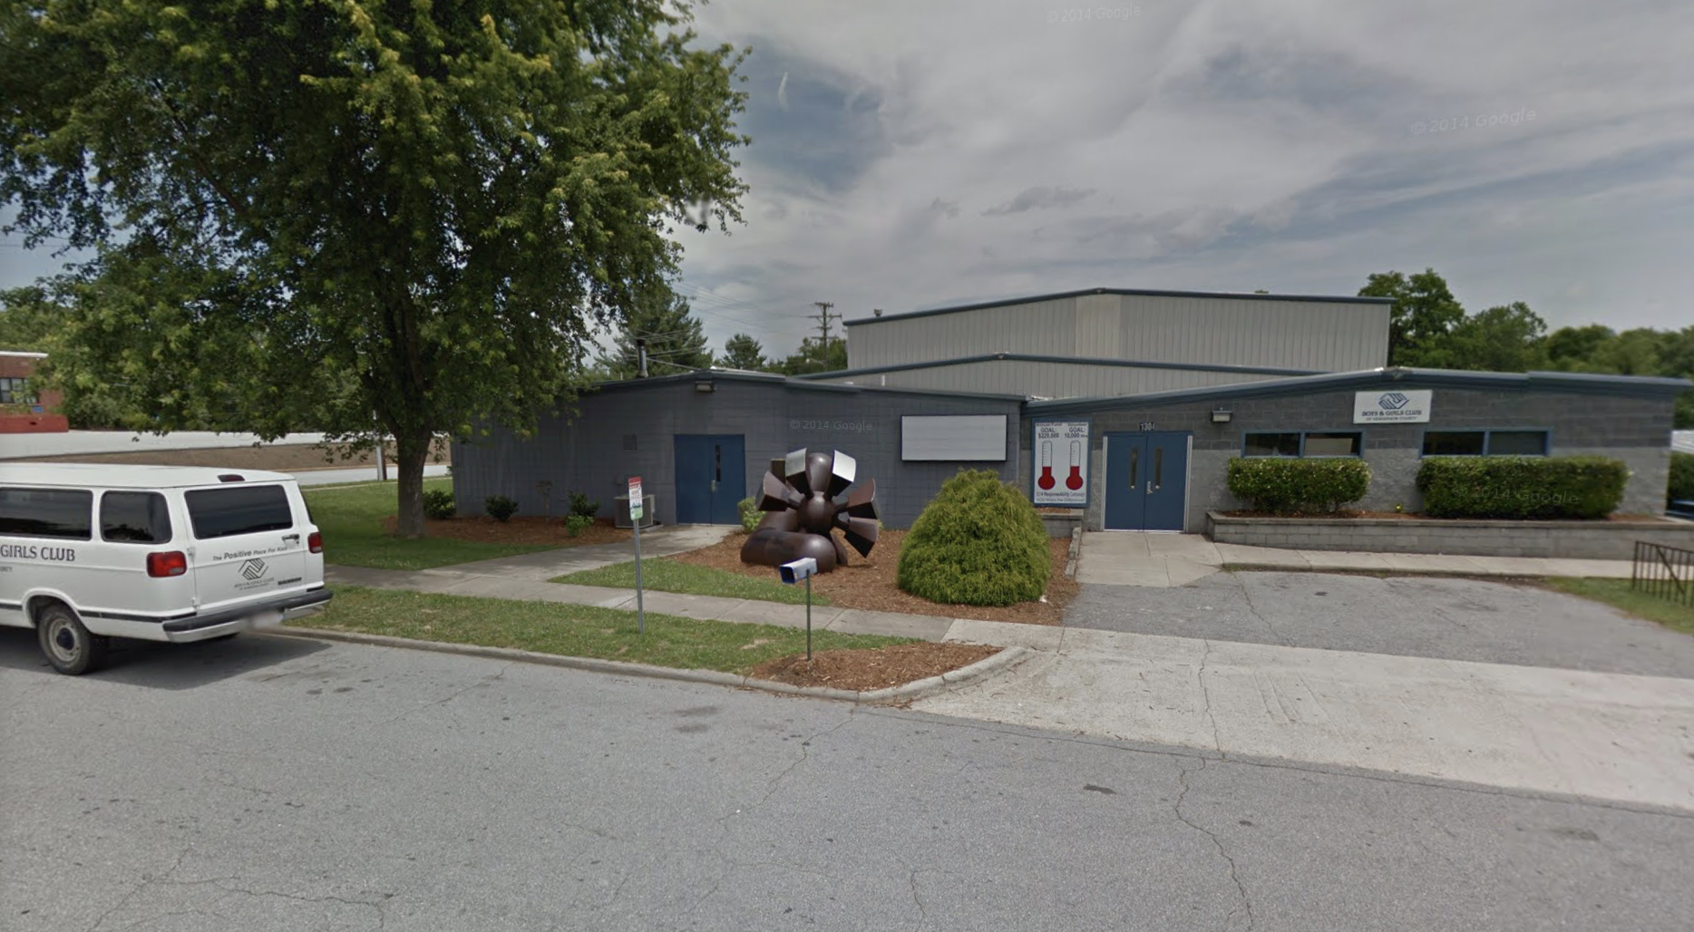
Boys & Girls Club Community Collaboration with Henderson County MEP Program
Since 2008 Henderson County Public Schools’ MEP has partnered with Boys & Girls Club of Henderson County.
What has each party contributed to the collaboration over the years?

Slide 15
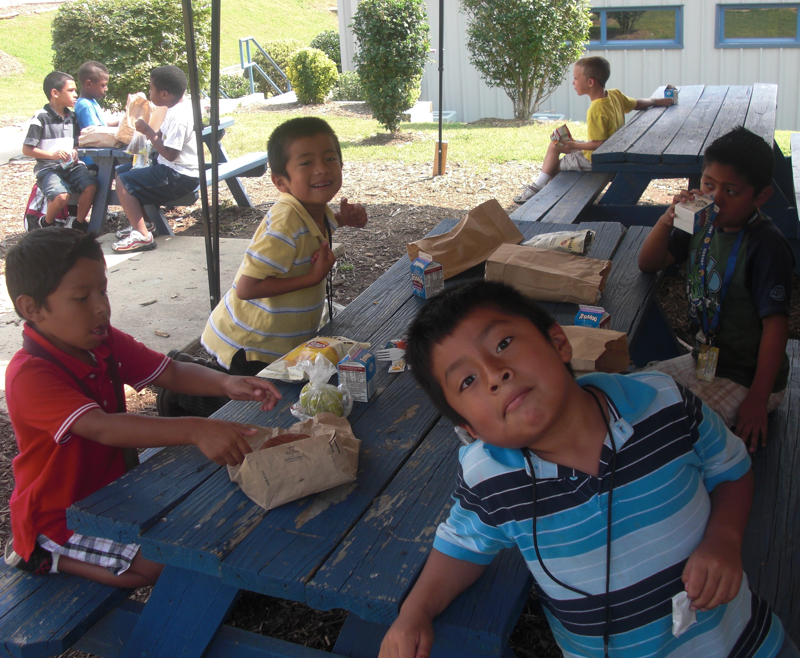
Boys & Girls Club Community Partnership with Henderson County MEP Program
The Boys and Girls Club:
Secures a certain amount of slots for migrant student membership at free cost for entire summer.
Provides space for MEP students to engage in the total Boys & Girls Club experience, including a state of the art facility space with 2 full size gyms, 3 gamerooms, and 50,000 square feet of classroom space.
Provides hot lunches M-F, and a hot dinner on Friday evenings.
Provides weekly field trips and swimming trips.
Access to 15 passenger vans for transportation of migrant students.

Slide 16
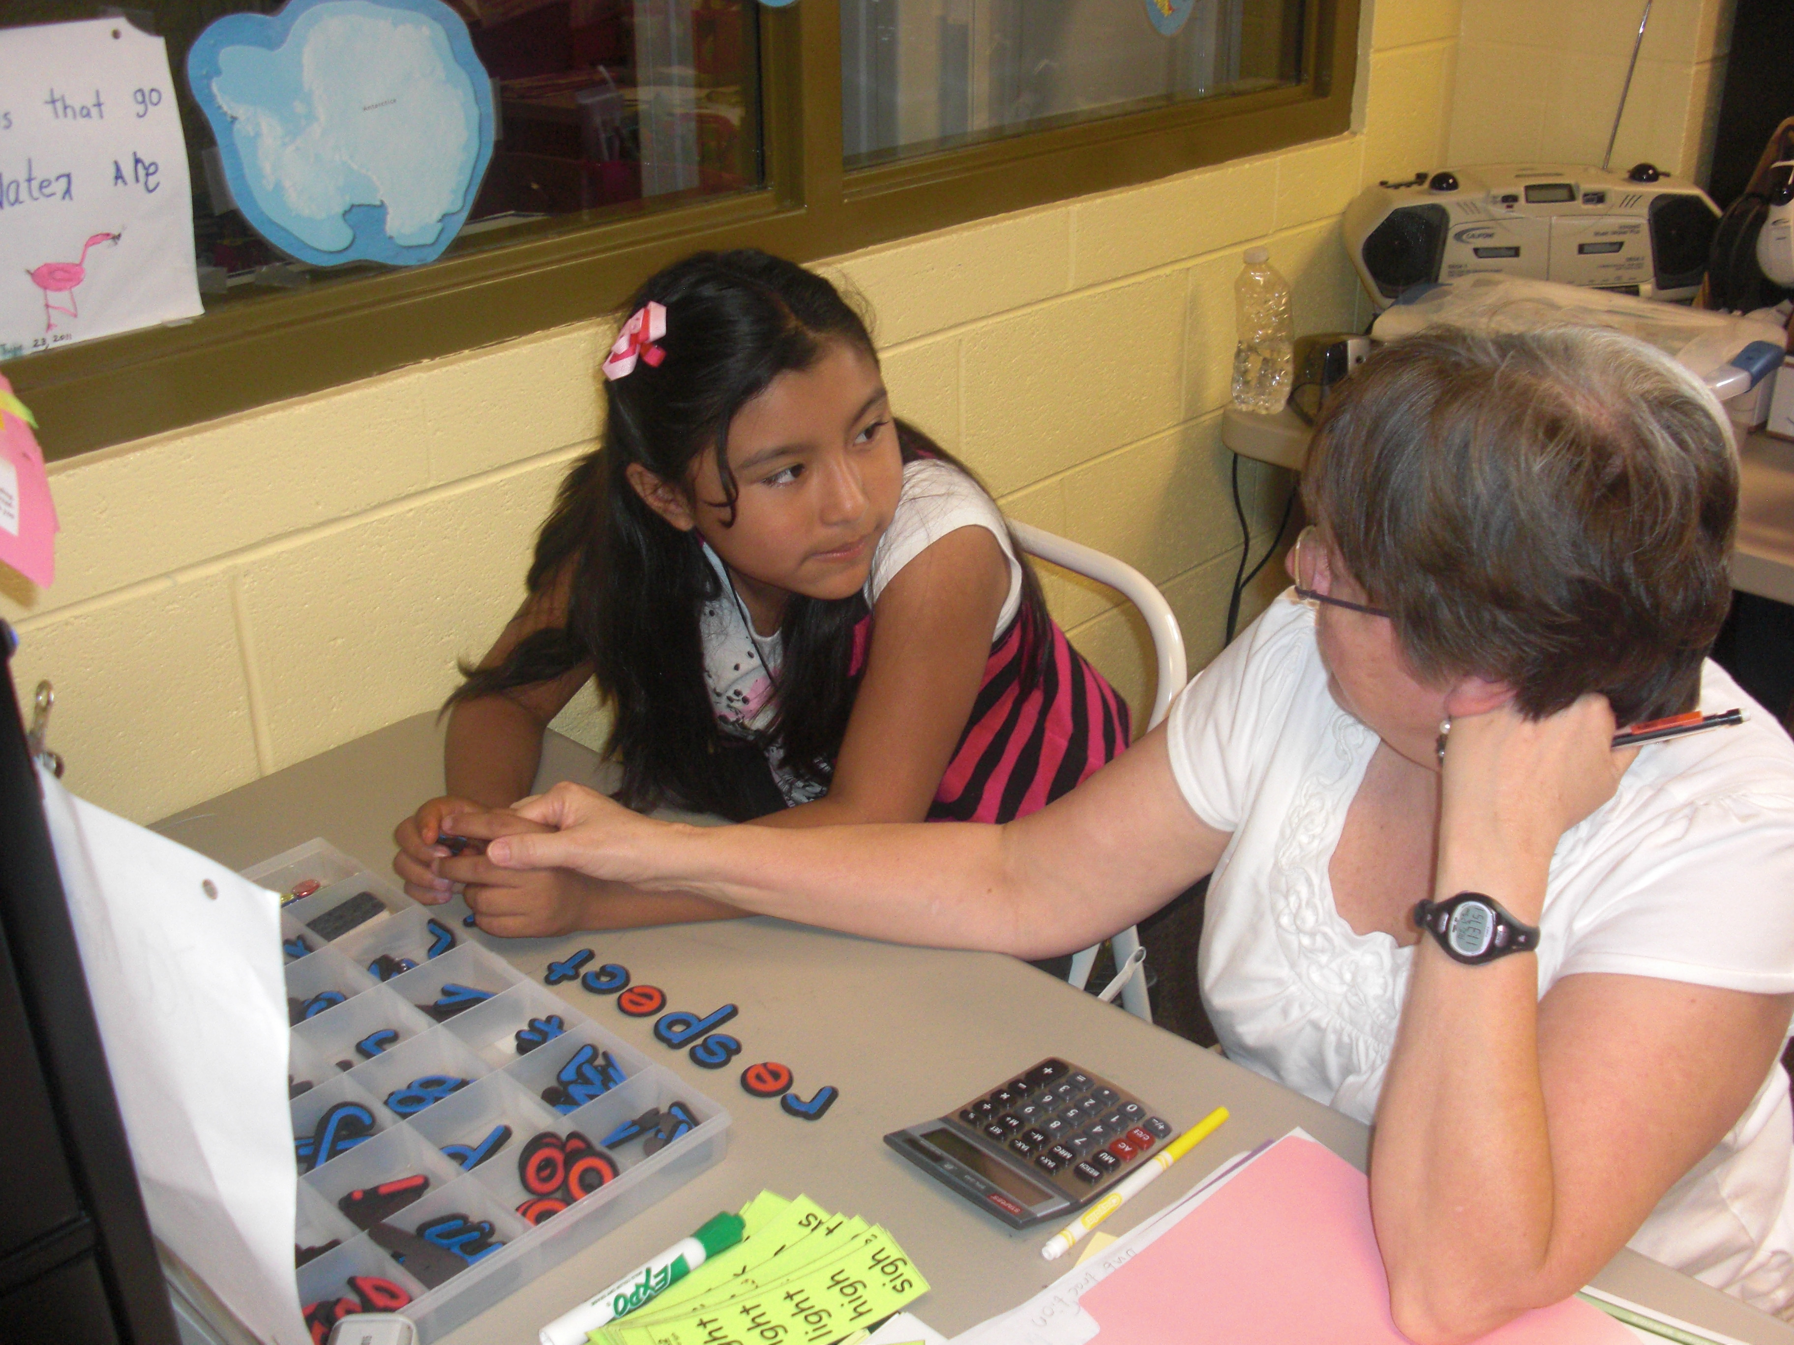
Boys & Girls Club Community Collaboration with Henderson County MEP Program
The MEP:
Provides three reading specialists for instructional support to MEP students.
Provides five MEP staff members who are mainstreamed into Boys and Girls Club schedule. Provides hot lunches M-F, and a hot dinner on Friday evenings.
Provides educational supplies and materials.
Provides assessments, school reports, and language level testing.
Notes:
HCPS MEP provides reading specialists to assess and provide small group and individual lesson with students struggling in school.
Five MEP staff members are mainstreamed into the BGC daily schedule for a portion of the day to help MEP members build a relationship in an unknown setting. (as a support for migrant students as they adapt to new environment, adjust to new social settings and develop interpersonal skills with new people) Then MEP staff work one-on-one with members needing additional skills. The MEP staff then provide instruction through STEM activities and independent tutoring for migrant students in a group or pull out setting.
HCPS provides educational material and supplies for their services
HCPS provides school assessments, school reports, and language level testing

Slide 17
Major Objectives For The MEP at Boys & Girls Club
Raise below-level students to grade level in language skills.
Prevent learning loss from the previous school year.
Boost all academic basic skills.
Mainstream youth into all club programs to improve socialization.
Develop cultural diversity in youth.
Educate migrant families about schools and services.

Slide 18
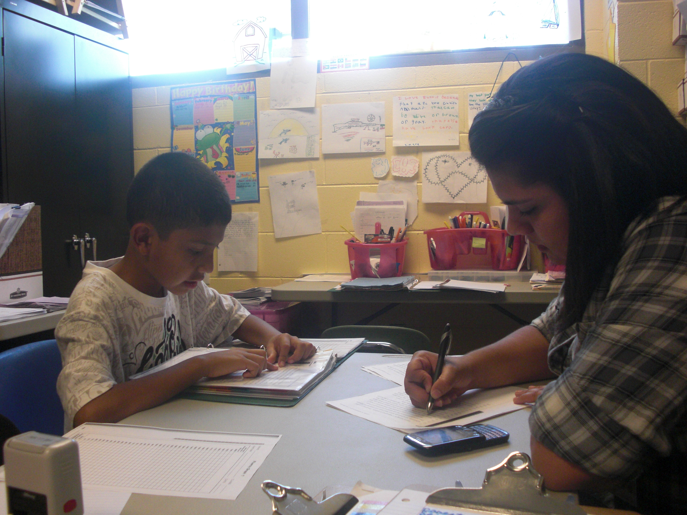
In 2018…
More than 50% began the program below grade level in language competencies – reading, writing, speaking.
63% of participants improved language skills from beginning to end of the summer program.
37% of participants maintained language skills from beginning to end of the summer program.
Zero participants regressed in language skills.
All participants attended weekly field trips.
More than 50 migrant parents and children attended a MEP Family Night at the Boys and Girls Club
100% of the parents attending the Family Nite gave the club their gratitude for the club and its programs.
Notes:
More than 50% began the program below grade level in language competencies – reading, writing, speaking.
63% of participants improved language skills from beginning to end of the summer program.
37% of participants maintained language skills from beginning to end of the summer program.
Zero participants regressed in language skills.
All participants attended weekly field trips throughout the region, including zoos, water parks, national forest trails, museums, swimming pools, and more. Most participants would not have these “real world” experiences otherwise.
More than 50 migrant parents and children attended a Family Nite at the club, sharing dinner and good cheer, and learning about the program and the critical family requirements to provide their children appropriate education. Parents received basic educational materials on grade-level math, language arts and ESL.
100% of the parents attending the Family Nite gave the club their gratitude for the club and its programs.

Slide 19
Wrap-Up
With your partner, talk about two things that you will take back to your local area to implement around building community collaborations around summer programs
Questions?
Contact Information
Hunter Ogletree – hgogletree@hcpsnc.org
Lisa Delany – ladelaney@hcpsnc.org
Diana Torres-Edward – dianat@bgchendersonco.org
Notes:
Hunter - 5 minutes

