Slide 1
OSY and the HSE Credential:
HEP/MEP Collaboration through HEP Online
Presented by Wake Tech HEP
April 2019

Slide 2
Presentation Objectives
Learn about HEP and its mission
Learn about the High School Equivalency (HSE) in North Carolina
Discuss the HEP/MEP collaboration model
Learn about HEP Online
Notes:
The purpose of the HEP program is to assist migratory and seasonal farm workers (or their children) who are at least 16 years old and not currently enrolled in school to obtain the equivalent of a high school diploma and then to either gain employment or begin post-secondary education or training.

Slide 3
Two Organizations, One Goal
MEP MISSION
HEP MISSION
Ensure that all migrant students
reach challenging academic standards and graduate with a high school diploma or complete an HSE
Serve
OSY
Assist migrant and seasonal farmworker students in obtaining the equivalent of a high school diploma or HSE
Let’s collaborate!
Notes:
The purpose of the HEP program is to assist migratory and seasonal farm workers (or their children) who are at least 16 years old and not currently enrolled in school to obtain the equivalent of a high school diploma and then to either gain employment or begin post-secondary education or training.

Slide 4
What is HEP?
High School Equivalency Program
Office of Migrant Education, U.S. Department of Education five-year grant
Awarded to Wake Tech in 2001, 2006, 2011, and 2016
Designed to help farmworkers and their families prepare to obtain the HSE diploma
At the end of the course, HEP helps graduates continue studying
There are 51 HEP programs HEP in the United States, including Puerto Rico
Wake Tech HEP program is the only program of its kind in North Carolina
Notes:
The purpose of the HEP program is to assist migratory and seasonal farm workers (or their children) who are at least 16 years old and not currently enrolled in school to obtain the equivalent of a high school diploma and then to either gain employment or begin post-secondary education or training.

Slide 5
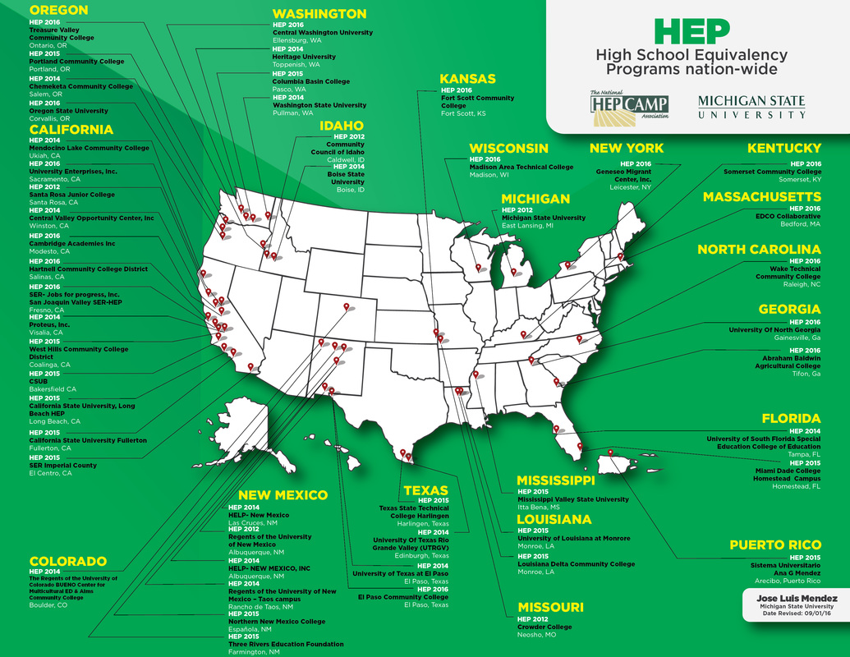

Slide 6
Eligibility Requirements
Have attended a public school in the United States and received Migrant Educational Services (Title 1 C) while enrolled.
Have participated in a WIA section 633 program. Or,
Have been an agricultural worker (or a family member of the worker) who worked on a farm in the United States:
For at least 75 days in the last 24 months
On a seasonal/temporary basis (not year round)
On production (not processing)
As a primary form of income
Work includes agriculture, ranching, orchards, forestry, Christmas trees, dairy, poultry, or fish farms
Provide proof of farm work:
COE
With a QAD of 5 years or less
Only the children listed in the COE qualify – no parents
HEP Application forms

Slide 7
Program Background

Slide 8
2,219
HEP students served since 2001
Notes:
Insert success rate?
With our new grant award, we’re on track to serve more than 2,500 students with our program. We’ve learned a lot about how to serve this population to the best of our abilities and we’ve also been able to see our students be successful as a result of the HEP program.
These are some of our success stories…

Slide 9
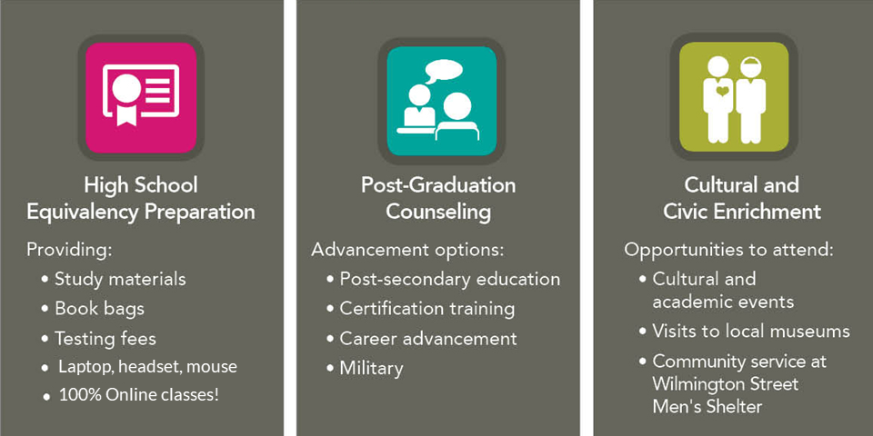
Support Services
Notes:
Our staff not only recruits students and teaches courses, but we also use grant funds to…

Slide 10
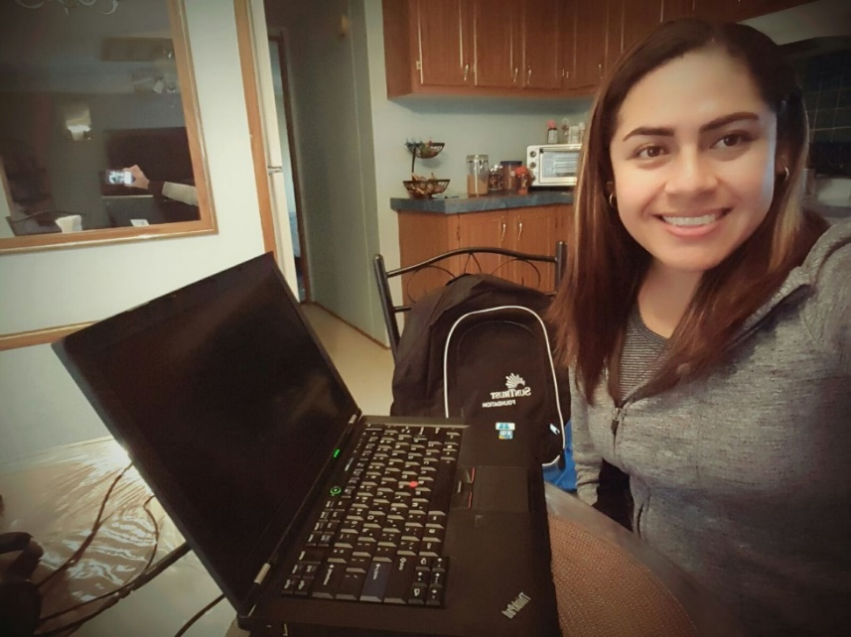
Program Structure
5-Month Program
January-May
July-November
3 classes/week
Online
Evenings (7:30-10pm)
Online homework
Daily communication and Support through WhatsApp

Slide 11
High School Equivalency in NC
In January of 2014, the GED® became a proprietary computer-based test delivered by Pearson VUE
In 2015, North Carolina approved two more test alternatives to the GED®:
HiSET®
TASC®
Because of the characteristics of the test, the company’s reputation, and the availability of Spanish materials, HEP decided to prepare students for the HiSET® test

Slide 12
HEP Online
Curriculum delivered via Moodle
In English and in Spanish!
Students study 3 subjects at a time
Coursework based on:
Textbook Assignments
Videos
Short Quizzes
Official Practice Tests
Virtual Classes 3x week via Adobe Connect

Slide 13
HEP/MEP Collaboration Process
_{MEP}
_{Identifies Student}
_{MEP} Coordinates Entrance Test with HEP
_{HEP}
_{Processes Student Application}
_{HEP}
Administers Entrance Test in Raleigh
_{MEP}
Administers Entrance Test locally
_{MEP}
Attends Orientation with student
HEP
Conducts class
_{MEP}
Provides support with weekly contact and/or tutoring

Slide 14
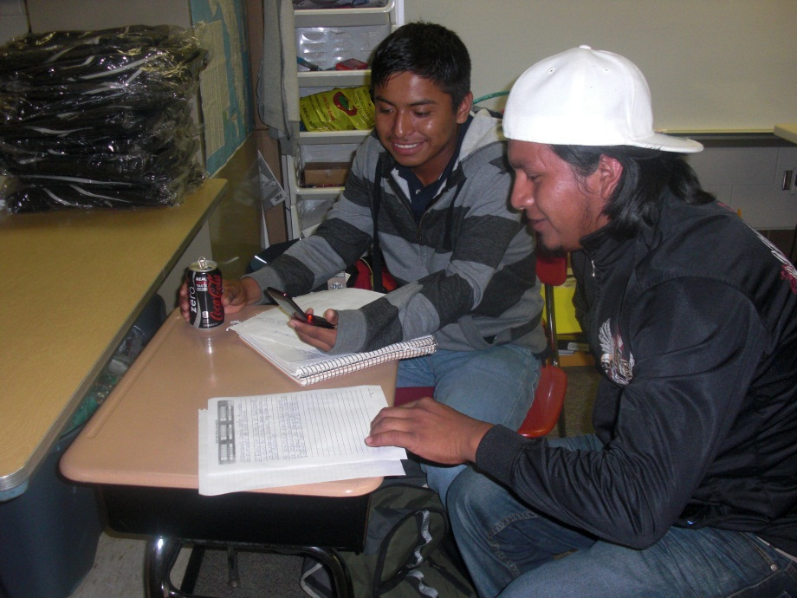
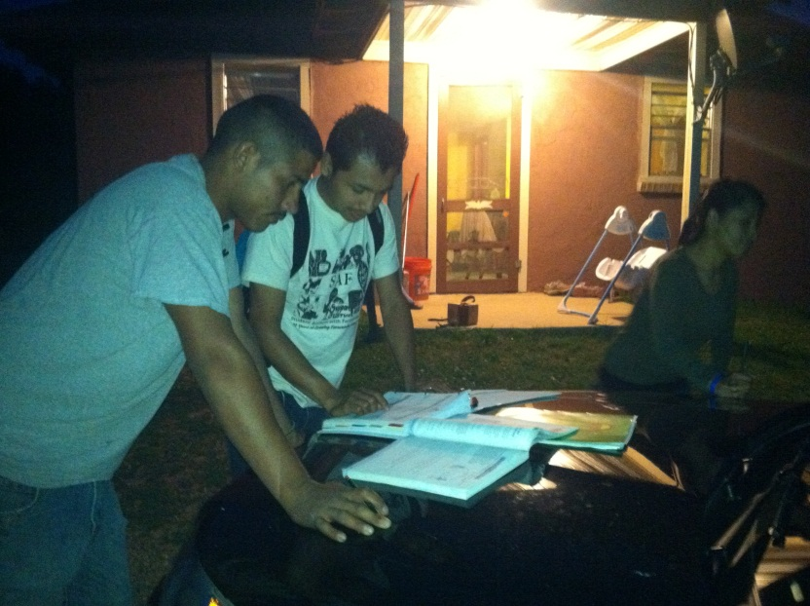
HEP/MEP Collaboration at Its Best

Slide 15
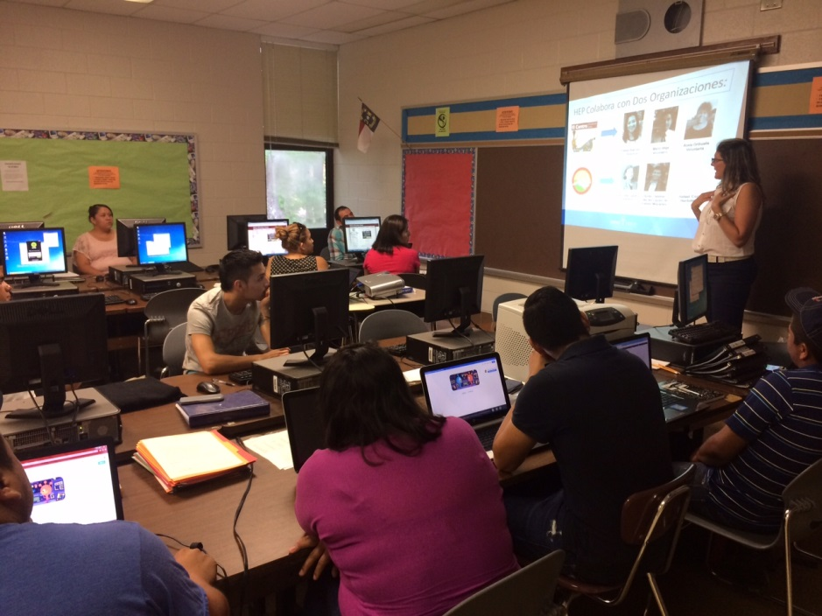
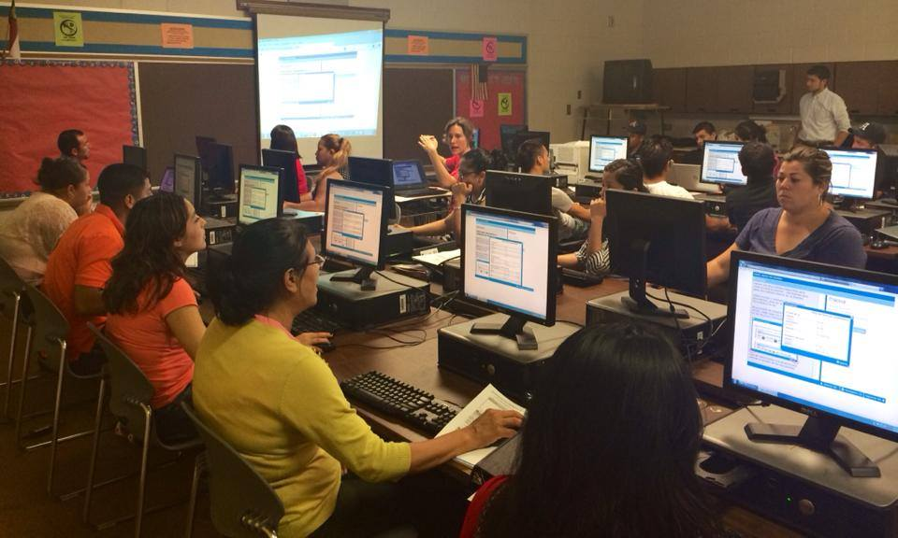
HEP Orientation, Henderson County

Slide 16
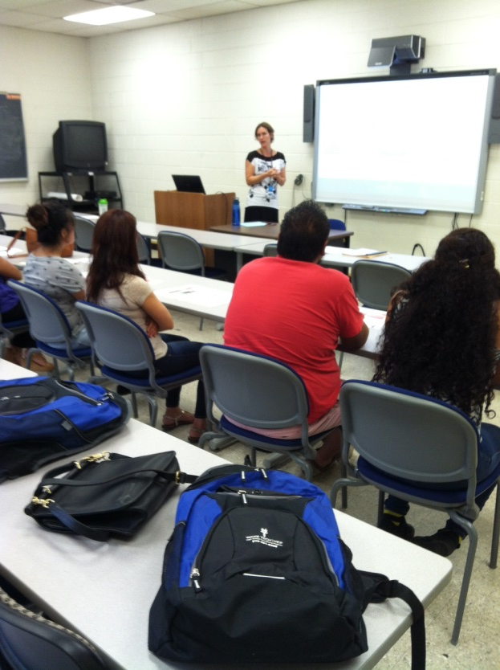
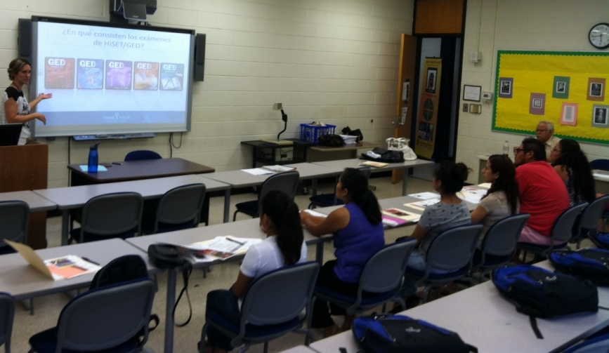
HEP Orientation, Bladen County

Slide 17
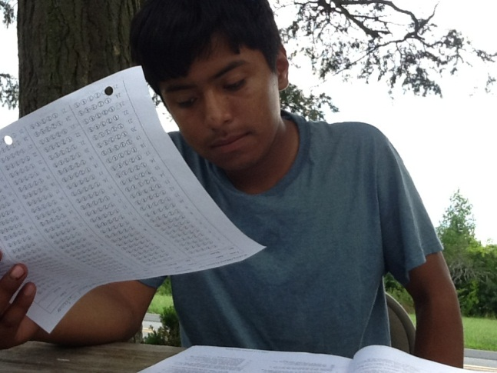
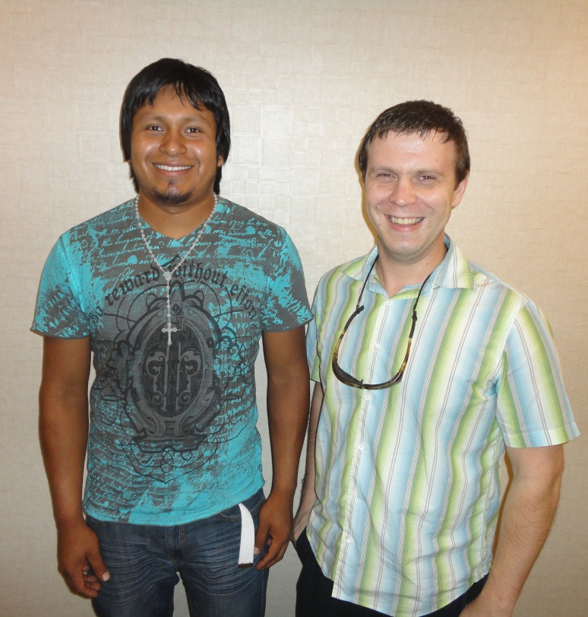
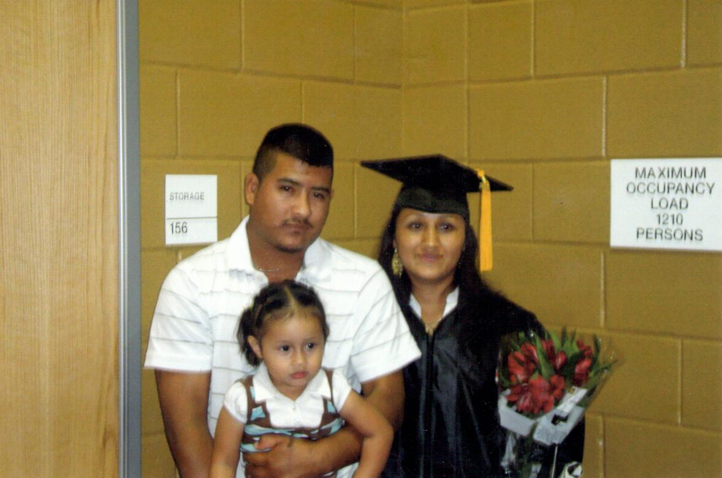
OSY Graduates
Daniel, MEP/HEP student,
taking an Official Practice Test

Slide 18
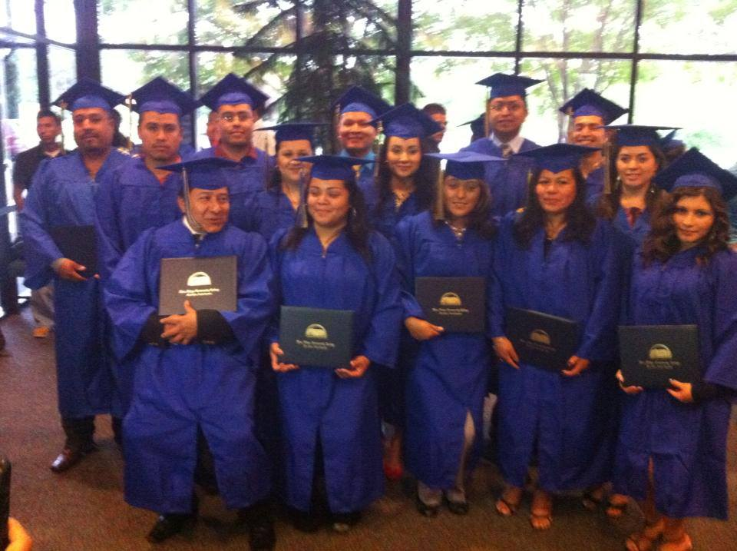
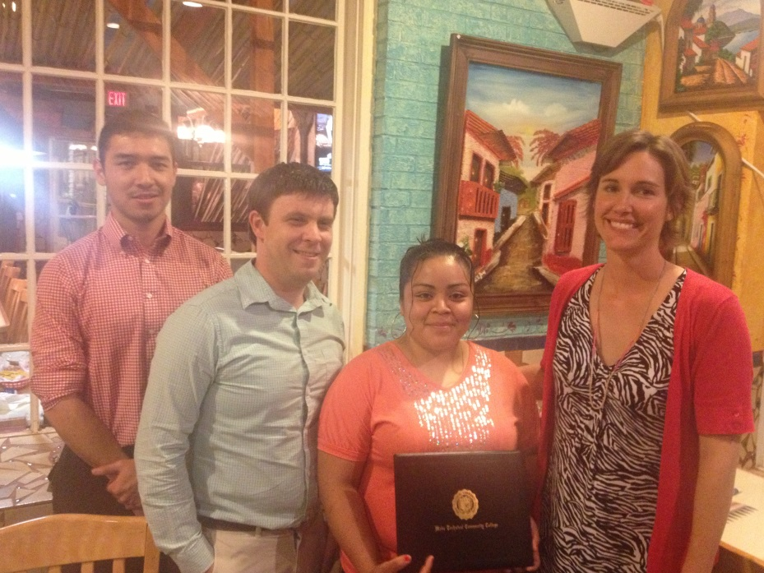
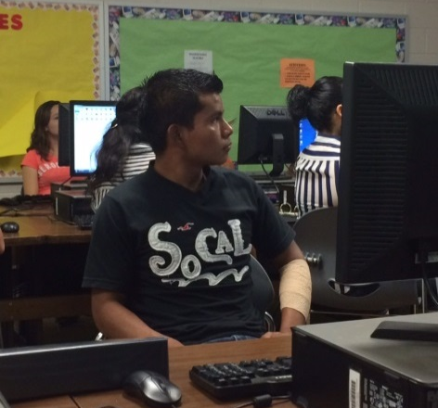
More OSY Graduates

Slide 19
HEP Team
Notes:
Many of our staff have been with this program since the beginning.
Thank you for supporting our program and the US Department of Education over the past 15 years. Here is to another successful funding cycle!

Slide 20
Connect with Us
919-980-1892

Slide 21
Contact Us
Maria Lafuente Fister
HEP Director
melafuente@waketech.edu
Katie Covington
HEP Instructor/Coordinator
kmcovington@waketech.edu
Wake Tech HEP Blog:
http://blogs.waketech.edu/hep/
Wake Tech HEP Facebook Page:
https://www.facebook.com/Wake.Tech.HEP/

