Slide 1

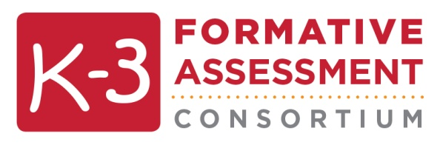
K-3 Formative Assessment Administrator Training
Notes:
Script:
Welcome to the K-3 Formative Assessment presentation for administrators. I want to start by thanking you for supporting your teachers as they begin learning about and implementing this assessment.

Slide 2

Principal leadership is second only
to classroom instruction
among all school-related factors
that contribute to what
students learn at school.
NASSP, NAESP 2013 Leadership Matters
Notes:
Script:
Research shows that in order for any change or new initiative to succeed, a supportive and knowledgeable school leader is critical. You play a very important role in ensuring that your teachers have a successful experience with the K-3 Formative Assessment Process. We truly appreciate your participation here today and the support that you’ll be providing your teachers.

Slide 3

Agenda
This session:
  Formative Assessment Process
Other sessions:
  Data Security
  Supporting Your Teachers
Notes:
Script:
In this session, we are going to cover a number of different topics to help administrators better understand this assessment and what is being asked of teachers. This session includes an overview of the assessment process. In separate sessions we will discuss data security issues, and strategies for how you can support your teachers in using this assessment.

Slide 4

Let’s Reflect
What 3-5 goals & aspirations do you have for the K-3 children served in your school?
How does assessment help your school reach those goals & aspirations?
Notes:
Script:
Let’s reflect for a moment about the early grades, Kindergarten through third grade. Take a moment to think about your goals and aspirations for the K-3 children in your school. Then, think about how assessment helps your school reach those goals and aspirations. Discuss with a colleague(s).

Slide 5
What Research Tells Us
  The PK-3rd grade years are the most promising window of opportunity during which to influence children’s lifelong trajectories.
Kauerz, 2013
Educational researchers
Economists
Neuroscientists
Developmentalists
Molecular biologists
Genomic scientists
Notes:
Script:
Developmental science has long identified the years from birth through age 8 (the age at which most children are in third grade) as a critical period during which children’s educational pathways are set.
Kauerz, K. (2013). The path to lifelong success begins with P-3. Principal, 92 (4), 12-16. [National Association of Elementary School Principals]
http://www.awelearning.com/files/4813/9387/9373/Kauerz_MA13.pdf

Slide 6
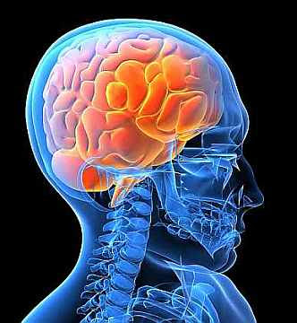
What Research Tells Us
Brain science tells us that it becomes more difficult—not to mention more expensive—to close achievement gaps in populations of older children…
…In short, development during the PK-3rd grade years sets the tone for children’s later educational and lifelong success.
  Kauerz, 2013, p. 13
Notes:
Script:
Brain science tells us that it becomes more difficult—not to mention more expensive—to close achievement gaps in populations of older children. Based on this science, as well as economic cost-benefit arguments, P-3 approaches provide a compelling argument: If children are given a stronger start earlier in life, they will be more successful in grades 4-12 and beyond. In short, development during the preschool through third-grade years sets the tone for children’s later educational and lifelong success. (p. 13). The P-3 years are critical!
Kauerz, K. (2013). The path to lifelong success begins with P-3. Principal, 92 (4), 12-16. [National Association of Elementary School Principals]
http://www.awelearning.com/files/4813/9387/9373/Kauerz_MA13.pdf

Slide 7
What Research Tells US
  ...Children achieve at higher levels.
  Teachers regularly assess what children know and can do
  Use that information to guide instruction
  AND
Notes:
Script:
The research on formative assessment clearly shows that when teachers regularly assess what children know and can do and use that information to guide instruction, children achieve at higher levels-- which is why it is important that teachers know how to implement a formative assessment process successfully.

Slide 8
Why Should Teachers Want to Assess?
It’s All About…
  Meeting children where they are
  Helping each child reach challenging and achievable goals
DAP
Developmentally Appropriate Practice
Notes:
Script:
Why should teachers want to assess? It’s all about 1) Meeting children where they are and 2) helping children reach challenging and achievable goals that contribute to their ongoing development and learning. This is the definition of Developmentally Appropriate Practice. Good assessment is developmentally appropriate practice and good instructional practice.
Source: Phillips & Scrinzi (2013). Basics of Developmentally Appropriate Practice: An Introduction for Teachers of Kindergartners. Washington, DC. NAEYC.

Slide 9
Why Should Teachers Want to Assess?
In order to do so…
Formative
Assessment
Know where they are
Teachers: supportive, engaging, reliable relationships
Children: Actively Involved
exploring, discovering, playing, experiencing, questioning, discussing, interacting, & constructing understanding
Notes:
Script:
In order for teachers to meet children where they are and help them reach challenging and achievable goals, research clearly states that 1) teachers need to know where children are now 2) teachers need to provide supportive, engaging, reliable relationships, and 3) children need to be actively involved to construct understanding. Today, we’ll focus on “Knowing where children are” and Formative Assessment is at the heart of how teachers know where students are in their learning and development.
Source: Phillips & Scrinzi (2013). Basics of Developmentally Appropriate Practice: An Introduction for Teachers of Kindergartners. Washington, DC. NAEYC.

Slide 10


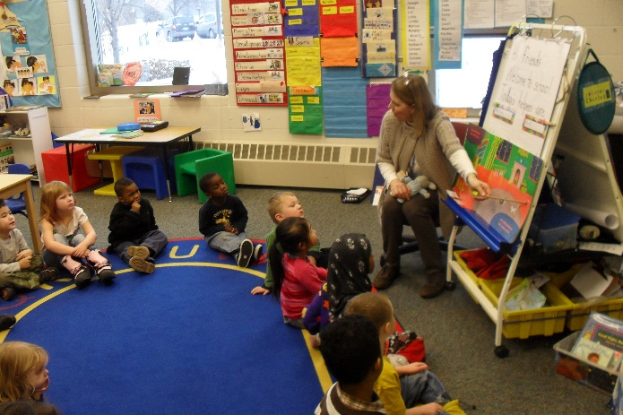

Different Types of Assessment
Summative Assessment
Developmental Screener
Formative Assessment
Notes:
Script:
Let’s begin by thinking about different types of assessments. When you think of assessment, you could be thinking about a lot of different things. Sometimes we think of a developmental screener. That is a brief, simple procedure used to determine if developmental skills are progressing as expected, or if there is cause for concern and further evaluation. Examples include the Ages & Stages Questionnaire (ASQ) and the Battelle Developmental Inventory Screening Test.
Other times, we think of summative assessments which are used to evaluate student learning, skill acquisition, and academic achievement at the conclusion of a defined instructional period. These assessments evaluate student learning at the end of an instructional unit by comparing it against some standard or benchmark. Examples include state assessments and district benchmark or interim assessments.
Then there is formative assessment…

Slide 11
Formative Assessment
Formative Assessment
  A process used by teachers and students during instruction that provides feedback to adjust ongoing teaching and learning to help students improve their achievement of intended instructional outcomes.
  American Educational Research Association,
  The American Psychological Association (APA), and
  The National Council on Measurement in Education (NCME), 2014 &
  Council of Chief State School Officers (CCSSO), 2006
Notes:
Script:
Formative Assessment is a process. As highlighted in the definition on the screen, there are several key features of a formative assessment. It is a process that occurs during instruction and what teachers learn from the process is to be used to guide instruction with students.

Slide 12
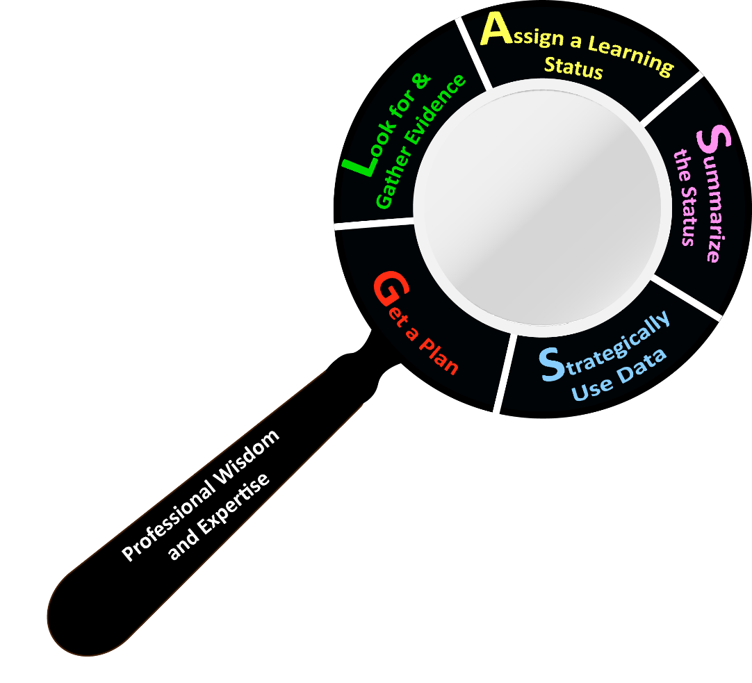
Formative Assessment Process
Get a plan
Look for and gather evidence
Assign a learning status
Summarize the status
Strategically use data
Notes:
Script:
A way to think about this process is to think about a magnifying glass. As we look through this “formative assessment ‘lens” we see…
The first step in the process is to get a plan. Getting a plan for how you will assess in your classroom is essential.
The second step in the process is to look for and gather evidence. You must use good observation strategies and collect evidence that provides you with information about the child.
The third step in the process is to assign a learning status. After you observe a child and document what you see, you need to determine the learning status for that piece of evidence—what skill was the child demonstrating?
The fourth step is to summarize the status. After collecting multiple pieces of evidence, you look across the evidence to determine what the status summary is for the child.
The fifth step is to strategically use data. This is an essential step—how to you take the information you have learned about the whole child and use it to inform your planning and instruction?
It is also important to note that this process occurs over and over again as you engage in assessment and instruction. It is not a one and done!

Slide 13
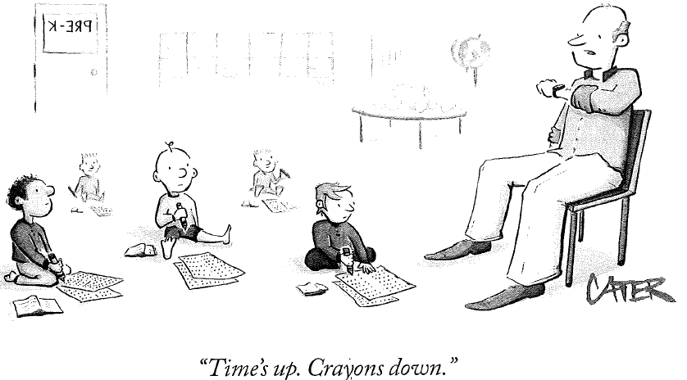
What the K-3 Formative Assessment Process is NOT
Notes:
Script:
The goal of the K-3 Formative Assessment is to provide a systematic way for teachers to assess children and use that information to plan and implement instruction. The goal is not to create more stress for teachers OR for children.

Slide 14

What the K-3 Formative Assessment Process is NOT
K‒3 Formative Assessment Process is NOT:
  A developmental screener
  A structured direct child assessment
  A high-stakes test
  Linked to teacher evaluations
Notes:
Script:
The K-3 Formative Assessment Process is NOT a high-stakes, summative, direct assessment.

Slide 15

K-3 Formative Assessment Process
An assessment process that…
  Informs teaching and learning in Kindergarten through Grade 3
  Occurs within instructional routines
  Is manageable in a typical classroom setting
Notes:
Script:
Basically, the K-3 Formative Assessment Process informs teaching and learning in kindergarten through Grade 3. Teachers collect information about what each child knows and can do through everyday instructional routines and interactions and uses that information to move learning forward. We want to emphasize that this assessment is not designed to be used for accountability purposes or other high-stakes decisions. The primary purpose of this assessment process is to help teachers support their students’ learning and development.

Slide 16
Key Points
Notes:
Script:
Let’s look at some key points of this assessment process.

Slide 17
Key Point #1: K-3 Formative Assessment Process focuses on the whole child.
Approaches to Learning
Cognitive Development
Language Development
& Communication
Physical/Motor Development
Social-Emotional Development
Notes:
Script:
This assessment process focuses on the whole child. This means that it addresses five domains of learning and development and it goes beyond the typically assessed literacy and math areas to include domains such as social- emotional development and approaches to learning. Research clearly indicates the importance of attending to and supporting children’s growth and development in all of these areas because children’s development in one area impacts their development in other areas.

Slide 18
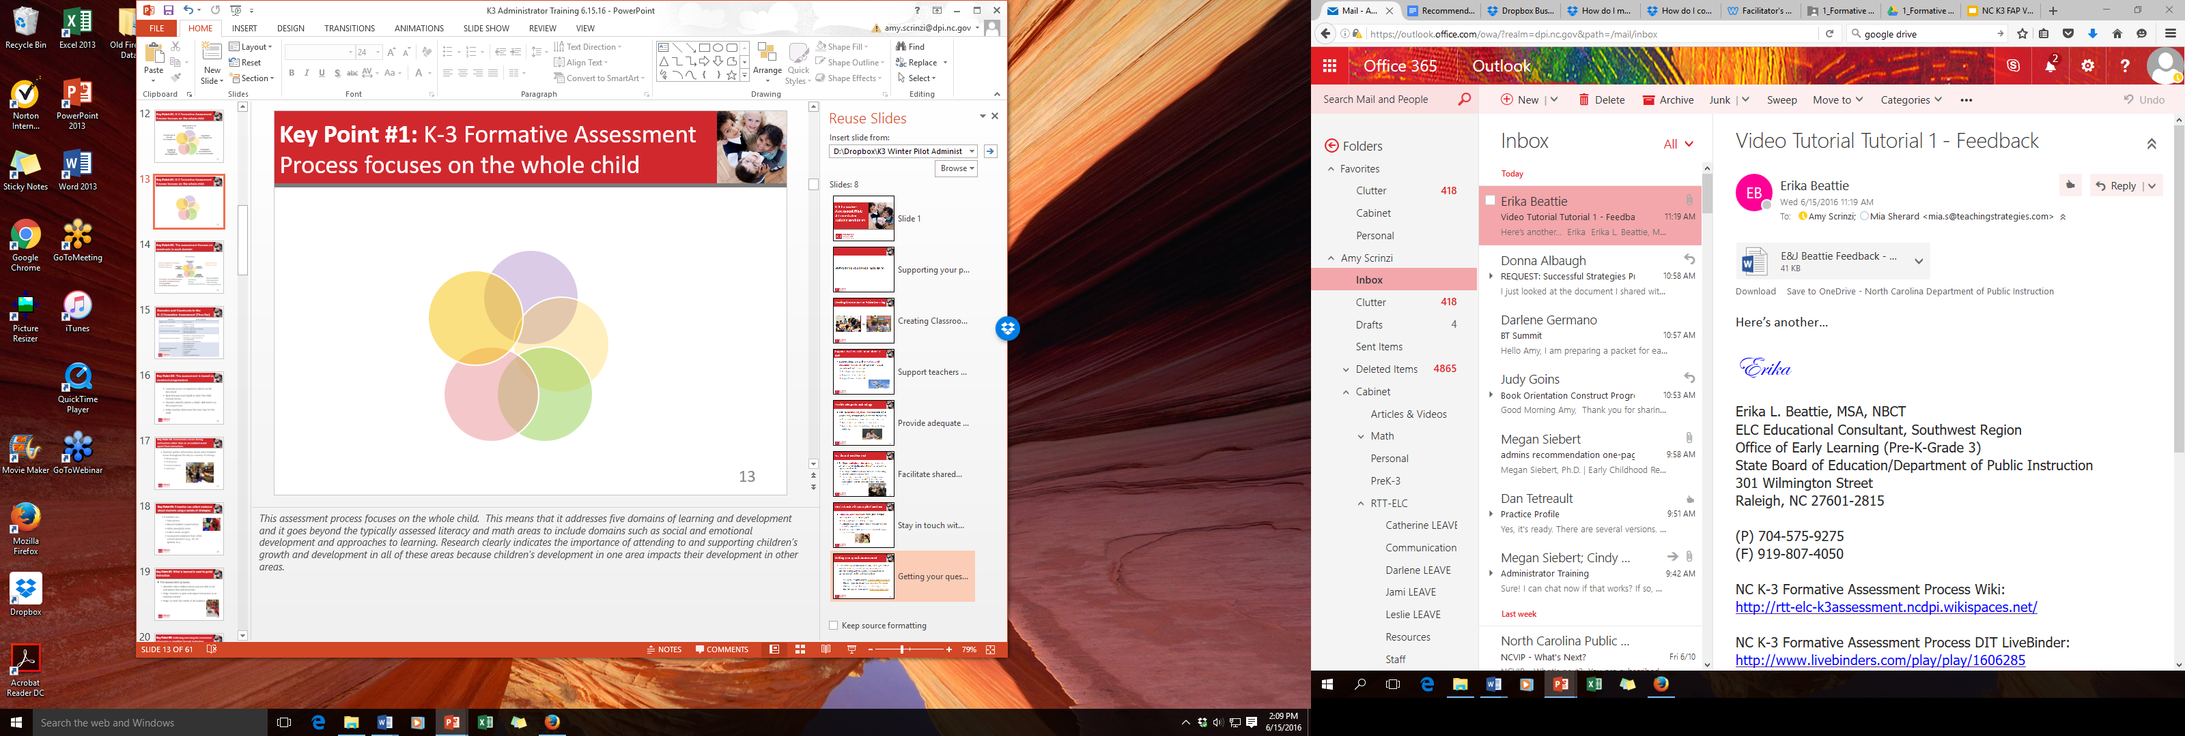
Key Point #1: K-3 Formative Assessment Process focuses on the whole child.
Approaches to Learning
Perseverance
Social-Emotional Development
Emotion Regulation Strategies
Emotion Expression
Emotional Literacy
Cognitive Development
Object Counting
Problem Solving
Mathematical Patterns
Language & Communication
Book Orientation
Print Awareness
Letter Naming
Following Directions
Vocabulary Concepts
Writing
Reading Comprehension Strategies
Physical/Motor Development
Fine Motor: Grip & Manipulation
Fine Motor: Hand Dominance
Crossing Midline
Gross Motor
Notes:
Script:
As this assessment process focuses on the whole child, it zooms in on particular areas in each of those 5 domains of learning and development that researchers & educators have identified as most important for future success. Currently, this process looks at these particular areas, called “constructs”.

Slide 19

Key Point #2: The assessment process is based on construct progressions.
  Learning occurs in sequences which can be described
  New learning must build on what the child already knows
  Teachers identify where a child’s skill level is on the progression
  Helps teacher determine the next step for the child
Notes:
Script:
For each of those constructs we just looked at, a construct progression has been developed. Construct progressions are sequences of learning in a content area. These sequences support instruction because, in addition to helping a teacher understand where a child is, they also show where a child needs to go next. A critical feature of this assessment is that it is based on a series of construct progressions. We will be talking more about construct progressions later in the presentation.

Slide 20
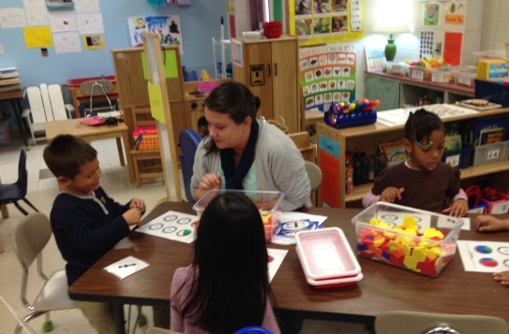
Key Point #3: This assessment process occurs during instruction.
  Teachers gather and use information about what students know throughout the day in a variety of settings:
    Whole group
    Small group
    Learning Areas/Centers
    Stations
    Pairs
    Individual
Notes:
Script:
This assessment process occurs during instruction rather than as an isolated event apart from instruction. One of the most important things to understand about this assessment is that it is designed to be a part of instruction and not something that takes time away from instruction. Teachers can learn about students in a variety of settings and this forms the basis for how teachers determine what children know and can do. This doesn’t mean that a teacher doesn’t talk with, work with, or observe a single student. It simply means that it’s done during instruction, rather than separate from what is currently happening at that given moment.

Slide 21
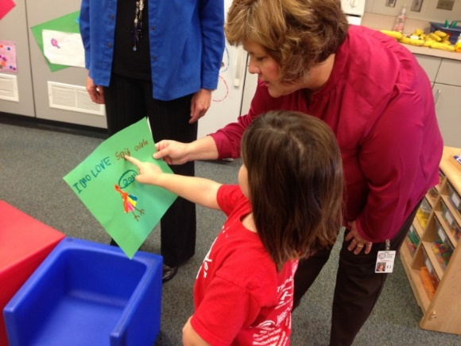
Key Point #4: A teacher can use a variety of strategies to collect evidence.
  Talk with families
  Write or record anecdotal notes
  Take photos & videos
  Record student conversations
  Collect work samples
  Incorporate evidence from other school educators (e.g., PE, OT, Speech, ELL)
Notes:
Script:
Another feature of this assessment is that teachers will be collecting and documenting evidence of what children know and can do. Teachers can use multiple strategies to capture what a child knows. These can include, for example, observing the child and taking notes, collecting work samples, or taking pictures.

Slide 22

Key Point #5: What is learned is used to guide instruction & learning.
Identifies what children know and are able to do and where they will head next
Helps teachers to plan and adjust instruction in an ongoing manner
Helps to meet the needs of all students
Notes:
Script:
As noted earlier, formative assessment is meant to guide instruction. What teachers learn through this assessment process helps them better understand what their children know and are able to do. This information helps teachers plan and adjust instruction to better meet the needs of all their students.

Slide 23

Key Point #6: This process is simplified through technology.
Evidence and skill level are recorded in a secure, web-based application (“tech platform”)
  Reports can be generated to support interpretation & planning
Notes:
Note to Trainer:
Use or adapt this slide to reflect the technology platform and any other technology (e.g. evidence application) used as part of your assessment process.
Script:
Technology is used to support this assessment in various ways. The platform provides a secure space for teachers store evidence, record the child’s learning status, and generate reports. Your teachers will be learning how to use the tech platform as part of their K-3 Assessment training.

Slide 24

Key Point #6: This process is simplified through technology.
Resources & Support Website
  Updates for participants
  Access electronic copies of all materials
  Access construct-specific online modules
  Ask questions and communicate with fellow teachers
Notes:
Note to Trainer:
Use or adapt this slide if your state, district, or school is providing a resource site.
Script:
A website with resources has also been created for teachers. If you would like to also access this site, please look for contact information further in the presentation.

Slide 25

In Summary
Notes:
Let’s summarize…

Slide 26
In Summary
The K-3 Formative Assessment
  is a process
  focuses on the whole child
  is based on construct progressions
  occurs during instruction, using a variety of strategies to collect evidence
  guides instruction & learning
  is simplified through technology
Notes:
Note to Trainer:
Use this slide as-is if you are using a technology platform as part of your assessment process. Otherwise, remove the final bullet.
Script:
In summary, The K-3 Formative Assessment is a process that occurs during instruction to guide teaching and learning.

Slide 27
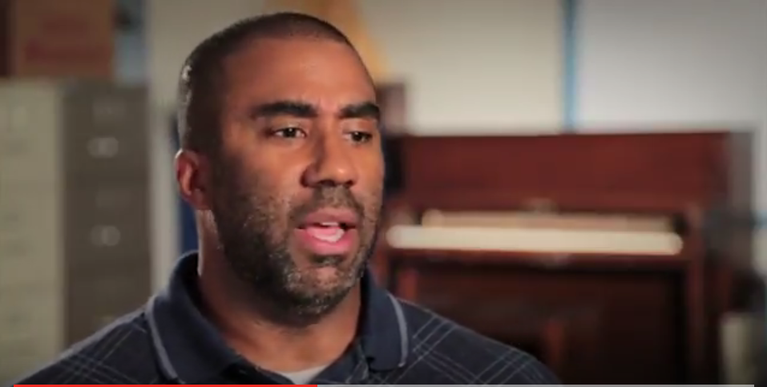
Norris Parker, Principal
Notes:
Script:
You’ve heard from us about this process. Let’s hear an Elementary Principal’s perspective on formative assessment.
Play Video:
Click on image in Slide Show mode, right click image and select “Open Hyperlink,” or copy and paste https://youtu.be/fPbxIQzUrMw into your browser.

Slide 28
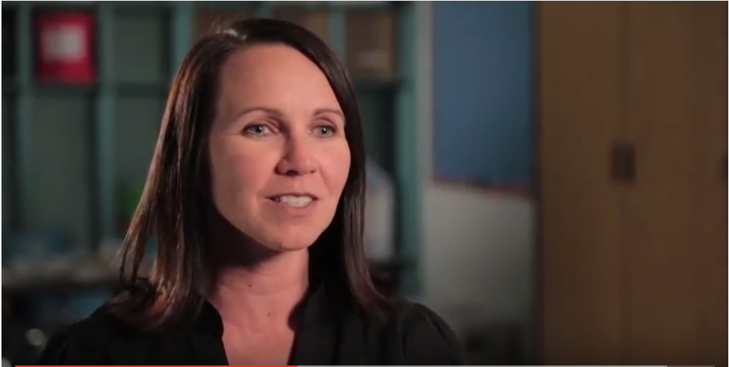
Jamie Gray, First Grade Teacher
Notes:
Script:
Jamie, a first grade teacher, summarizes formative assessment in this way.
Play Video:
Click on image in Slide Show mode, right click image and select “Open Hyperlink,” or copy and paste https://youtu.be/elT0Y02PLXU into your browser.

Slide 29
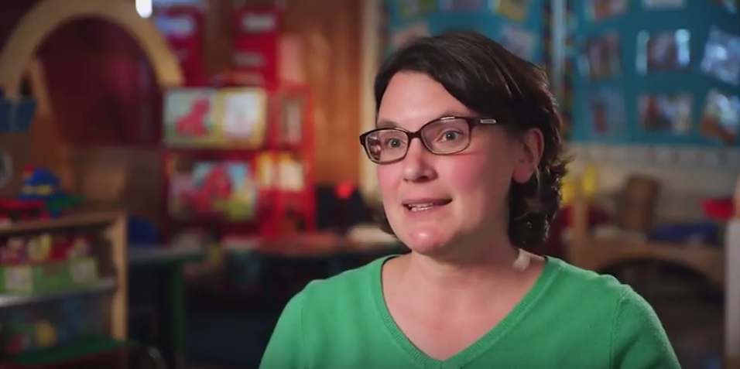
Susan Choplin, Kindergarten Teacher
Notes:
Script:
Here’s another teacher, Susan, summarizing formative assessment in her way.
Play Video:
Click on image in Slide Show mode, right click image and select “Open Hyperlink,” or copy and paste https://youtu.be/ekwJs7Goeso into your browser.

Slide 30

Jordan Krause, Principal
Notes:
Script:
This principal addresses the importance of formative assessment.
Play Video:
Click on image in Slide Show mode, right click image and select “Open Hyperlink,” or copy and paste https://youtu.be/1ZBrSM3oFXk into your browser.

Slide 31
Let’s Reflect
What are some similarities & differences between what your teachers are already doing and the K-3 Formative Assessment Process?
Notes:
Script:
Now that you know a bit more about the K-3 Formative Assessment Process, you may recognize particular aspects that are similar to what your teachers are already doing. You may also see aspects that are different. Take a moment to reflect and then let’s discuss your thoughts together.

Slide 32
A Closer Look
Notes:
Script:
Now that we’ve looked at this process from a mile high view, let’s take a closer look at what the teachers will be using as they implement this process in their classrooms.

Slide 33
Assessment Components
Construct Progressions
Assessment Means
Notes:
Script:
There are two assessment components that support this formative assessment process: Constructs progressions and assessment means. Let’s look at each of these in more depth, beginning with construct progressions.

Slide 34
Assessment Components
Construct Progressions
Assessment Means
Sequences of learning
Ways of gathering evidence
to identify a child’s skill level
Notes:
Script:
A construct progression is a carefully sequenced set of understandings and skills for a particular concept.

Slide 35
What is a Construct Progression?
Multi-step description of how students’learning develops over time
Steps range from less to increasingly more sophisticated forms of learning
Based on research and professional wisdom
Notes:
Script:
Each construct progression moves from less sophisticated skills to more sophisticated and refined skills. Progressions help a teacher figure out where the child needs to move next along the continuum of learning and development in that construct.

Slide 36
Domains and Constructs
Domain | K‒3 Constructs
Approaches to Learning | Perseverance
Cognitive Development | Object Counting Problem Solving Mathematical Patterns
Social-Emotional Development | Emotion Regulation Strategies Emotion Expression Emotional Literacy
Physical/Motor Development | Fine Motor: Grip & Manipulation Fine Motor: Hand Dominance Crossing Midline Gross Motor
Language Development & Communication | Book Orientation Print Awareness Letter Naming Following Directions Vocabulary Concepts Writing Reading Comprehension Strategies
Notes:
Note to Trainer:
You may need to adapt this slide based on the constructs being implemented by your state, district, or school.
Script:
As noted earlier, the assessment covers five domains of learning. One or more constructs are assessed within each domain. Some of these constructs have skills that may be acquired in kindergarten and other constructs span across grade levels up to Grade 3. For each of these constructs, there is a construct progression.

Slide 37
Construct Progression Example
Understanding | Skill | Performance Descriptor | Example
Children understand that books are objects with pages. | Holds or otherwise demonstrates awareness that a book is an object with pages | When observed interacting with a book, child orients the book upside down or right side up, opens the front or back cover, and turns pages one or more at a time, either front to back or back to front. | After selecting a book from one of the classroom book baskets, Ella opens the front or back cover and randomly turns one or more pages at a time. When handed a closed book in a non-upright orientation, James holds the book right side up or upside down, opens the front or back cover, and randomly turns pages one or more at a time.
Identifies the major concepts
Identifies the competencies with each understanding
Paints a picture of what a child may say, do, make or write for a given skill level
Notes:
Script:
The construct progression is comprised of 4 parts: Understandings, Skills, Performance Descriptors, & Examples:
Understanding: Identifies the major concepts within a particular construct.
Skill: Identify the competencies with each understanding, ranging from simple to more complex levels.
Performance Descriptors: Unpacks the skill a bit more, providing additional information about the skill itself.
Examples: Provides a context in the classroom; paint a picture of what a child may say, do, make or write to demonstrate his/her understanding or skill at each stage of the progression. Each skill in the sequence also has a corresponding performance descriptor and examples to help teachers better understand what children do when they are at a given skill level

Slide 38
Examples of Skill Levels on a Progression
Reading Comprehension Strategies has 8 skill levels (A to H)
  SKILL A: Listens to a story or informational text (with or without pictures) and demonstrates an understanding of the text.
  SKILL D: Reads without noticing when the reading does not make sense.
  SKILL G: Monitors reading and attempts to repair meaning by asking for and using comprehension strategies.
There are some differences across the progressions in terms of scope, breadth, and level of granularity.
Notes:
Note to Trainer:
Any construct and example skills may be used on this slide, if Reading Comprehension Strategies is not implemented as part of the assessment in your state. It is recommended that you select a progression with more steps, such as Writing, Problem Solving, or Emotional Literacy.
Script:
One of the construct progressions is Reading Comprehension Strategies which has 8 skill levels. Three of the skill levels are presented on the slide. Take a minute to read Level A, Level D, and Level G to see how the progression describes increasingly sophisticated skills with regard to Reading Comprehension Strategies.
As you explore all of the constructs, you’ll notice that there are some differences across the progressions in terms of scope, breadth, and level of granularity. The construct progressions differ in the number of steps as well as the distance between the steps because of the differences across the constructs.

Slide 39
Let’s Examine
Peruse the various construct progressions located on the Construct Progression Overview document.
Which constructs will be of particular interest to your teachers? Which will be new?
Notes:
Handout for This Slide:
Construct Progression Overview Document
Script:
Let’s take a moment to explore some of the other constructs on Construct Progression Overview document.
Now that you’ve had time to peruse some of the additional construct progressions, which constructs do you think will be of particular interest to your teachers? Which will be new? Discuss with a colleague.

Slide 40
Assessment Components
Construct Progressions
Assessment Means
Sequences of learning
Notes:
Script:
Now let’s talk about the second component of the assessment: the assessment means.

Slide 41
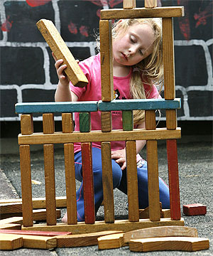
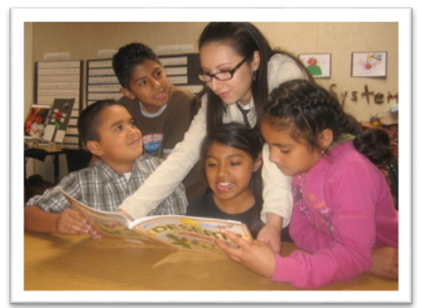
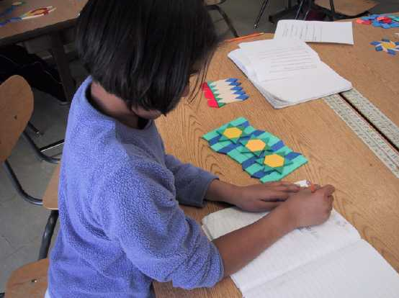
What is an Assessment Means?
Ways teachers gather evidence
to identify a child’s skill level
Observations
Situations
Tasks
Notes:
Script:
The assessment means are the ways in which a teacher gathers information about what a child knows or can do to determine where he or she is on the progression.
The assessment process uses three kinds of assessment means.
The primary assessment mean is observation. Since this assessment is meant to be embedded in instruction, teachers are encouraged to observe and document children in everyday classroom activities that are already occurring throughout the day.
The second type of assessment mean, situations, are meant to be used within an instructional routine when a teacher is not able to see a child display a particular skill/behavior in what s/he has already planned and needs support to elicit that behavior.
Finally, the third type, tasks, refer to a more formal activity that is meant to be done one-on-one or in very small groups. Tasks are to be used when neither observation nor the situation provided the teacher enough information to make a decision about a child’s learning status.
All of the constructs can be assessed through observations, some also have situations, and a few have tasks.

Slide 42
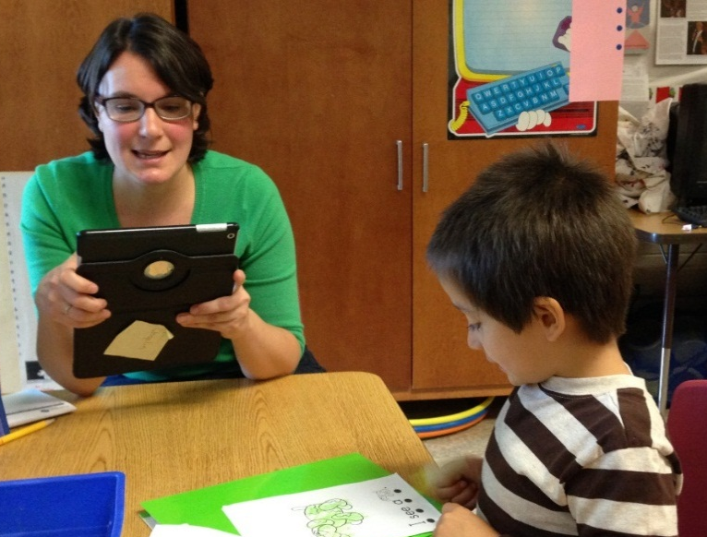
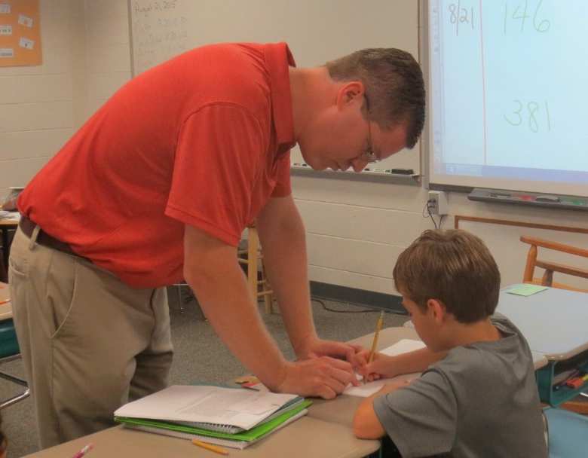
What is an Assessment Means?
Teachers document the evidence as part of the assessment process.
Teachers use evidence to determine where a child is on a construct progression.
Notes:
Script:
Teachers use these assessment means to uncover what a child knows and is able to do. Because children’s learning and development does not occur in a straight linear fashion, it’s important to collect evidence in a variety of ways in order to make an informed decision about what a child knows and understands.

Slide 43
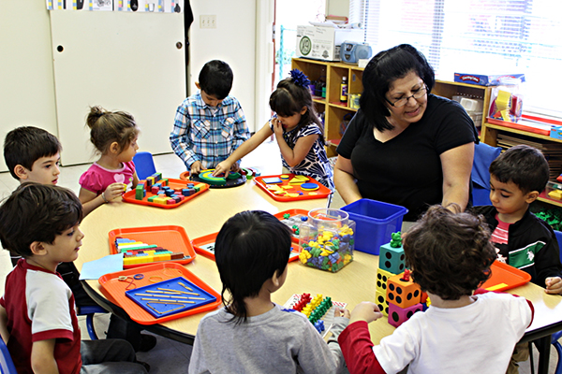

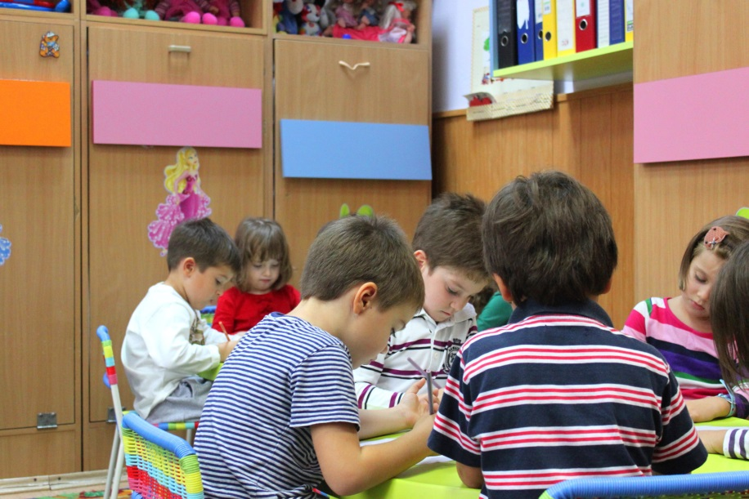
The Classroom Environment
vs.
© Lenutaidi | Dreamstime.com - Preschoolers To Kindergarten Photo
Notes:
Script:
One essential condition for implementing the assessment is that teaching and learning in the classroom be developmentally appropriate, with children actively engaged in a variety of learning activities. That means classrooms should look like the picture on the left where children are interacting with each other and with the materials in the classroom and not like the picture on the right where children are spending much of the day doing worksheets or listening in large groups.
Unfortunately, many classrooms are not developmentally appropriate. This is a challenge for teachers implementing an observation-based assessment to learn about what children know and can do because there is not much to observe in the classroom on the right. It also is an issue for the children in these classrooms because, as we know, this is not the way young children learn best. Active participation in engaging learning opportunities is not just something that should occur in kindergarten. It should be happening in all grades. We ask that you help your teachers create environments in their classrooms that support good learning – and good observation.

Slide 44
Let’s Reflect
How do your teachers already gather evidences of learning?
How does their current learning environment support the use of observations, situations and tasks?
Notes:
Script:
Let’s Reflect. What are you teachers already doing to learn about their students?
How does their current classroom environment support the use of observations, situations and tasks?

Slide 45
In Summary
Notes:
To Summarize…

Slide 46
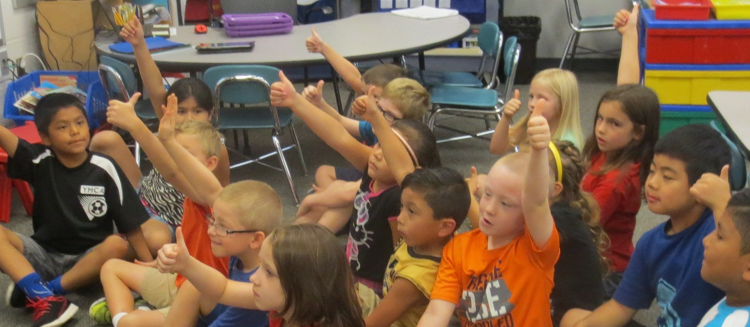
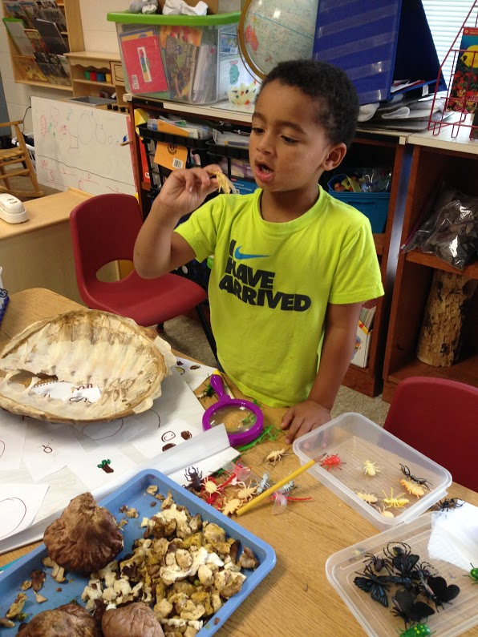
It’s All About…
Meeting children where they are
Helping each child reach challenging and achievable goals
Notes:
Script:
The K-3 Formative Assessment Process is all about meeting children where they are and helping each child reach challenging and achievable goals.

Slide 47
In Summary
Construct progressions are central to this formative assessment.
Teachers use assessment means to collect evidence of what a student knows during regular classroom routines.
Teachers uses that evidence to decide where a student is on a progression.
Teachers use what they have learned about the students to plan instruction and support students in moving to the next step of the progression.
Notes:
Script:
In summary, this is a formative assessment based on construct progressions. Teachers will primarily observe students to collect evidence about what a student can do, but might use other assessment means such as situations or tasks. Based on the evidence collected, teachers will determine where a child is on the progression and then use this information to guide their instruction.

