Slide 1
Transition and VR for Individuals with Deaf-Blindness

Slide 2
What is Transition?
a) NC 1500-2.37 Transition Services
Transition services means a coordinated set of activities for a child with a disability that
(1) Is designed to be within a results-oriented process, that is focused on improving the academic and functional achievement of the child with a disability to facilitate the child’s movement from school to post-school activities, including postsecondary education, vocational education, integrated employment (including supported employment), continuing and adult education, adult services, independent living, or community participation;
(2) Is based on the individual child’s needs, taking into account the child’s strengths, preferences
and interests; and includes

Slide 3
(i) Instruction;
(ii) Related services;
(iii) Community experiences;
(iv) The development of employment and other post-school adult living objectives; and
(v) If appropriate, acquisition of daily living skills and functional vocational evaluation.

Slide 4
(b) Transition services for children with disabilities may be special education, if provided as specially
designed instruction; or a related service, if required to assist a child with a disability to benefit
from special education.
(Authority: 20 U.S.C. 1401(34); 34 CFR 300.43
From Policies Governing Services for Children with Disabilities – July 2014

Slide 5
In short, transition is:
Coordinated set of activities
Results oriented process
Academic and functional opportunities
Post secondary education, vocational education, and employment
Independent living
Community participation
Based on strengths, preference, interests, and needs

Slide 6
Workforce Innovation Opportunity Act
WHAT IT IS:
It is the law and cannot be ignored

Slide 7
Who does WIOA serve?
Students with Disabilities: In NC, individuals at least 14 years old who are eligible for and (a) receiving educational or related services under an IEP according to IDEA or (b) receiving educational services under a 504 plan according to Section 504 of the Rehab Act. Students with disabilities remain in this category until they exit school or reach the maximum age of eligibility under IDEA (age 21 in NC) – whichever is sooner. These students may or may not meet the VR eligibility criteria.
Youth with Disabilities: Individuals with disabilities (as defined by the ADA) between the ages of 14 and 24

Slide 8
And now, a brief word about deaf-blindness

Slide 9
Deaf-Blind Definition
When we hear the term deaf-blind, we often imagine a person who is unable to hear or see anything; however, this is typically not the case.
“Deaf-blind” describes any combined hearing and vision loss that significantly limits children’s ability to get information from people and objects around them.
These losses can cause developmental delays in areas such as language, social skills, and mobility, but they do not always limit the individual’s learning potential

Slide 10
Wide range in the combination of hearing and vision loss
Effects vary based on the person – some with severe hearing and vision loss perform well with no to minor adaptations. Some with very minor losses require extensive accommodations.
Many students with hearing and vision loss are lost among students with multiple disabilities – the sensory impairment is unnoticed or is discounted

Slide 11
Although VR doesn’t start with these young adults until they turn 14, it is important that they understand the journey that got them to the transition point
You need to know where they have been in order to know where they are going
Remember, WIOA says work with the most significantly disabled. Collaboration is the key!

Slide 12
Major causes of Deaf-Blindness
Hereditary Syndrome Disorders (Usher syndrome, CHARGE syndrome, etc.)
Prematurity complications
Birth complications
Infections (Cytomegalovirus, Meningitis, etc.)
Severe Head Injury
Stroke

Slide 13
Complications of Prematurity – 16%
CHARGE Syndrome – 10%
Hydrocephaly – 4%
Microcephaly – 4%
Usher Syndrome – 4%
Asphaxia – 2.5%
Severe Head Injury – 2.5%
Unknown – 15%
86 % of the students on the census are “MU”

Slide 14
Approximately 90% of children with deaf-blindness have one or more additional disabilities or health problems; 75 % have two or more; 50% have three or more.
For children with complex needs, hearing and vision loss may not yet be recognized or addressed.
Classifications other than deaf-blindness are often listed as a child’s primary diagnosis on the Individualized Family Service Plan (IFSP) or Individualized Education Plan (IEP).

Slide 15
Many students with Deaf-Blindness and additional disabilities are served in school-aged program that is not on Occupational Course of Study track (OCS). Many are on the Extend 1 track.
Remember, one requirement of WIOA - most significantly disabled

Slide 16
Deaf-Blind Census
Referrals are received from LEA’s, TVI’s, TOD, EC Directors, etc.
The census is required - all school systems must complete annually and post using the DPI website
Teachers of the Hearing-Impaired, Family specialist, Family members, O&M, PT’s, OT’s, SLP’s, School Psychologist
http://ec.ncpublicschools.gov/disability-resources/deaf-blind/census

Slide 17
Deaf-blindness is an extremely low incidence disability!
There are approximately 10,000 children and youth with deaf-blindness in the United States.
There were 280 children and youth with deaf-blindness reported in 2016 in North Carolina.

Slide 18
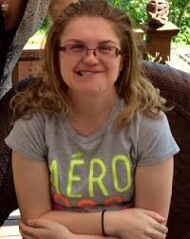
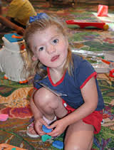
Children with
deaf-blindness are often the ONLY one in their school or community with this diagnosis.
http://www.chargesyndrome.org/about-charge.asp
https://www.gemssforschools.org/conditions/charge/default

Slide 19
Challenges of Deaf-Blindness
Anticipation – what is going to happen to me, where am I going, who is with me
Motivation- isolation and withdrawal, lack of exploration, interest in environment and people
Communication - language development, turn taking, interaction, socialization
Confirmation – this is how things work, when I do this, this thing happens, this thing does this action, this facial expression or tone of voice means this

Slide 20
Traditional Learners
Learn most information incidentally - just by seeing and listening to what goes on around them
Concepts that are developed through observing and hearing

Slide 21
Deaf-Blind
Incidental learning is difficult or does not occur
What is seen and heard may be distorted or pieces are missed
Hands-on experience and systematic instruction is essential to learning
These children learn differently

Slide 22
Learning Needs of Children Who are Deaf-Blind
Hands-on experiences
Active movement and exploration of their environment
Predictable, accessible schedules, consistency
Use of residual hearing and sight
High expectations
Trusting relationships
Communication! Communication! Communication!

Slide 23
Communication is
exchanging our ideas, thoughts, and feelings
the way we connect with people
often challenging for people with deaf-blindness

Slide 24
Communication and Connections
Individuals with deaf-blindness may use a variety of body movements, gestures, vocalizations, pictures, objects, sign language (visual or tactile), speech, augmentative/alternative systems, and other means to communicate.

Slide 25
Assessment and Planning
Accurately assessing a child’s communication skills, concept development, and optimal learning modalities is often challenging.
Standardized instruments are not typically appropriate.
A team approach, including parents, friends, and educational professionals, works best!
COLLABORATION!!

Slide 26
Assessments
Most formal assessments are not standardized for students with visual and hearing loss
Results of standardized assessment need to be interpreted with careful consideration
The team should look at results and consider factors that influence the outcome (accommodations, time of day, fatigue. Etc.)
More to assessment than just the results
Vocational assessments for DB - Do they exist?

Slide 27
Considerations
Need to consider what the child/young adult can do, likes to do, wants to do
They may not do it the way we would but they get the job done
Remember, the “Communication Bubble” see, hear, smell

Slide 28
Helen Keller National Center
DEAF-BLIND IMMERSION SEMINAR
5 days at HKNC in Sands Point, NY
Vocational
Lifestyle Assessment
Communication systems
Low vision and audiology
Environment Assessment
JJ’s Journey https://nationaldb.org/pages/show/jacobs-journey?cms=true

Slide 29
Assessment Resources
Assessing Communication and Learning in Young Children Who are Deafblind or Who Have Multiple Disabilities (free, online) http://www.designtolearn.com/uploaded/pdf/DeafBlindAssessmentGuide.pdf
The Communication Matrix (free, online) https://www.communicationmatrix.org/
HomeTalk- a Family Assessment of Children who are Deafblind (free, online) https://www.designtolearn.com/uploaded/pdf/HomeTalk.pdf
Reach for the Stars…Planning for the Future (purchase) https://shop.aph.org/webapp/wcs/stores/servlet/Product_Reach%20for%20the%20Stars,%20Planning%20for%20the%20Future,%20Braille_28938353P_10001_11051

Slide 30
More Assessments
Classroom Observation Instrument for Educational Environments Serving Students with Deaf-Blindness http://documents.nationaldb.org/products/coi-2006.pdf
School Inventory of Problem Solving Skills http://www.designtolearn.com/products/problem_solving
Career Planning Begins with Assessment: A Guide for Professionals Serving Youth with Educational and Career Challenges (2005) www.ncwd-youth.info/career-planning-begins-with-assessment
***Follow The Child (Jan van Dijk and David Brown)

Slide 31
Interveners
An Intervener is a person who consistently works one-to-one with a person with deaf-blindness to:
Provide support for social-emotional well-being
Provide support for development and use of communication
Provide access to sensory information
Connection to the world
http://theutscmessenger.com/wp/wp-content/uploads/2011/04/deafblind.jpg

Slide 32
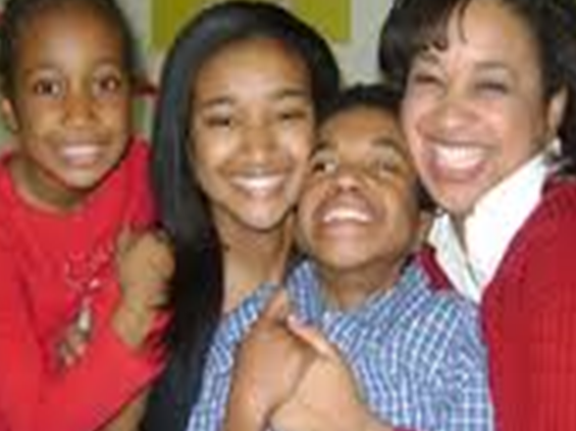
Families
Family-Professional Partnerships are essential for promoting optimal outcomes for children with deaf-blindness.
Parents should be supported in their role as advocates
Siblings often experience unique joys and frustrations in their role and may benefit from sibling support programs

Slide 33
Post-Secondary Transition
For all children who are DB, post-secondary transition planning should start early, at least by age 14
“He’s 11? That’s too late.” Quote in response to age of a child with DB during a transition session.

Slide 34
Pre-employment Transition Services (PETS)
Student Job Exploration Counseling- student career counseling activities
Student Work Based Learning Experience - student work experience
Student Counseling on Transition/Higher Ed Training Opportunities- student career prep counseling/education regarding higher education and career training opportunities
Student Workplace Readiness Training- training to develop social and independent living skills as a part of pre-employment training
Student Self-Advocacy Training- peer mentoring and other forms of self-advocacy training
15% of funding set aside for PETS

Slide 35
PETS
Pre-Employment and Transition Services (PETS)
The starting point for VR transition services (age 14)
Emphasizes key activities for preparing young people for vocational outcomes
Requires that VR Set Aside 15% of federal grant for PETS
Introduces the concept of serving those who are “potentially eligible” for VR services
Defines the ability to provide VR transition services to groups

Slide 36
Transition - Required component of the IEP when the student reaches 14 years of age or earlier if deemed necessary
Form DEC 4a to be completed at age 14 and annually thereafter
student’s strengths
preferences
interests
needs

Slide 37
Gathering Information

Slide 38
Transition Plans
Individualized
Input from the individual and assessments (gathering information)
Build on current interest
Offer various types of employment opportunities and various experiences
All the information is for the purpose of preparing students for adult life
Person Centered Planning – to get the students preferences, what a good day looks like for them

Slide 39
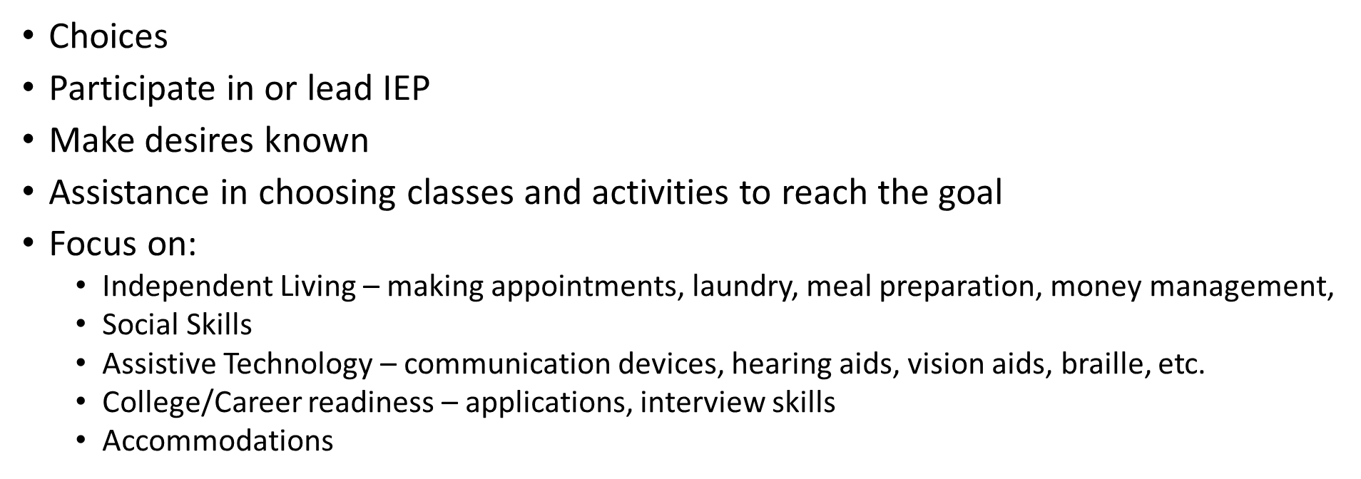
Self-Advocacy
Notes:
Never too young for choices

Slide 40
Adult Skills
Communication – request assistance, express wants and needs, conversations, meaningful relationships
Self-Care – participate in or make needs known in dressing, hygiene, grooming, toileting
Home management – pay bills, cleaning, laundry
Nutrition and meal preparation
Deal with change/unexpected events appropriately
Responsibility for medical issues
Respond appropriately to emergency situations
Community involvement

Slide 41
Exposure to work
Career exploration
Job shadowing
Work sampling
Service Learning/Volunteer
Apprenticeships
Paid work experience
Internship

Slide 42
On the job supports
Job coach
Interpreter
Intervener or SSP
Peers (with and without disabilities)

Slide 43
Customized Employment
Customized employment. Put it in your WIOA vocabulary!
Recognized and defined by the Department of Labor- Office of Disabilities Employment Policy 2001

Slide 44
Customized Employment
Individualized employment for a job seeker and the employer, including self-employment
Based on the strengths, needs, and interest of the job seeker
Task reassignment – duties of existing job assigned to a new job
Job carving –modification of an existing job
Job sharing – Two or more people share tasks based on each other’s strengths

Slide 45
Supported or Customized?
Supported Employment
Third Party Contract
Job coach fades after 90 days
Ultimate goal competitive employment
Customized Employment
May mean self-employment
Fit the job to the person
Ultimate goal competitive employment

Slide 46
Self-employment
There are advantages:
Set your own hours
Vary the routine a little or a lot
Frequent breaks
After overhead, all $$$ is yours
No work place politics
Around your family all the time

Slide 47
Self-employment
There are disadvantages:
Isolation, no opportunity for work friendships
Set up your own 401k
Taxes – responsible for them
No “paid” vacation time
Must pay for all your own office supplies
Around your family all the time
Because no community employment was offered

Slide 48
Educational and social advantages
Shop for materials
Lists and inventories
Where to get materials – stores, online
Transportation
Money – pay for supplies
Community inclusion
Craft fair or similar to sell item or self if a service
Notes:
Order business cards,

Slide 49
Self-employment ideas
Decorate mugs
Make greeting cards
Paper shredding
Recycling
Operate a snack shop
Package soup or dip mix
Artist
Clean offices

Slide 50
Bumps in the road
VR – Customized employment (we’re all still learning)
Open case file at age 14
Need for multiple jobs for one client
Communication
VR Vendors – lack of, unable to work with DB population
Double dipping – intervener and job coach money from same “pot”
VR – Contact, open a case

Slide 51
Collaboration - Everybody
How can we work together to provide Transition Services ?
School personnel, consumer, consumers' parents, and various VR professionals work together
Supported Employment – if a job coach is appropriate
Customized Employment - in a local community setting if appropriate
Self-employment- pros and cons
Future collaboration is still being worked out. Let’s work together to provide transition services for our students

Slide 52
People who can help
Dottie Snyder 919. 807.3987 Dorothy.Snyder@dpi.nc.govNC
DPI Deaf-Blind Consultant, Deaf-Blind Project
Andrea Blackwood
blackwooda@ecu.edu
ECU Teacher Support Program
Kim Harrell
Kimberly.Harrell@dhhs.nc.gov
Deaf-Blind Services, Division of Services for the Blind
NC DEAF-BLIND Project website: http://ec.ncpublicschools.gov/disability-resources/deaf-blind

Slide 53
Acknowledgements
Funded through the US Department of Education, Office of Special Education Programs
Housed at NC Department of Public Instruction
Provides technical assistance to families, teachers, and service providers of children and youth with deaf-blindness (birth-21 years)
Part of a network of state deaf-blind projects connected by the National Center on Deaf-Blindness.

Slide 54
Resources
CHARGE Syndrome Association - www.chargesyndrome.org
National Center on Deaf-Blindness-nationaldb.org
Office of Disability Employment Policy – Department of Labor http://www.dol.gov/odep/topics/CustomizedEmployment.htm
* Interpreterphoto https://www.google.com/search?site=&tbm=isch&source=hp&biw=1280&bih=689&q=interpreter&oq=interpreter&gs_l=img.12..0l10.2071.5765.0.8645.11.10.0.1.1.0.210.1214.5j4j1.10.0....0...1ac.1.64.img..0.11.1215.Ryq1wY67duQ#imgrc=wXW0AVJtSj5sJM%3A
Transition Presentation April, 2017 https://ec.ncpublicschools.gov/disability-resources/deaf-blind/post-secondary-transition-resources

Slide 55
Richard Luecking The Way to Work: How to Facilitate Work Experiences for Youth in Transition, 2009
David Wiley – 13 Important Skills for a Successful and Fulfilling Adult Life As Students Get Older: Every Lesson Matters. See/Hear, Winter, 1997
Alex’s Journey - https://nationaldb.org/pages/show/alexs-journey

Slide 56
Thanks Andrea and Kim!
The presenter offers very deep and sincere gratitude to Andrea Blackwood and Kim Harrell for their many considerable contributions to this presentation.

Slide 57
Questions - Transition
What are 5 important skills for a successful and fulfilling adult life?
What are the differences between Supported Employment and Customized Employment?
What are 3 reasons that Customized Employment is a valuable option for students with significant disabilities?
If you are/were working with a middle school student with significant disabilities, how would approach and build a relationship with VR services?

