Slide 1
ETIOLOGIES and DEAF-BLINDNESS
Dottie Snyder
April 11, 2018

Slide 2
Vision and hearing
80% or more of learning occurs through vision
All learning takes place through movement
Dual sensory loss limits access to people, places, and things
Impact on learning is HUGE
Incidental learning is limited
Distorted input visually and auditorially
If no direct interaction, no engagement

Slide 3
Common Causes
Over 50 etiologies that include vision and hearing loss
  Most common
  Usher syndrome and other genetic condition
  Rubella Syndrome
  Meningitis and similar illnesses
  Injury – auto accident, falls
  Aging
Congenital blindness with acquired hearing loss
  Kidney failure
  Prescription or illegal drugs
  Loud noise
Congenital hearing loss with acquired vision loss
  Macular degeneration
  Cataracts
  Diabetic neuropathy
  Glaucoma
  Tumors
http://www.deaf-blind.org/about-us
http://www.deaf-blind.org/about-us

Slide 4
NC Annual Child Count
Unknown/Undetermined – most common entry
Complications due to Prematurity (45)
CHARGE Syndrome (28)
Head/Traumatic Brain Injury (8)
Usher Syndrome (8)
Cytomegalovirus (CMV) (8)
Hydrocephalus or Microcephalus
  http://nationaldb.org/reports/national-child-count-2016/etiologies
Notes:
2016 NCDB Count

Slide 5
Hereditary Syndromes and Disorders
CHARGE Syndrome | 924
Down syndrome (Trisomy 21 syndrome) | 305
Usher I syndrome | 215
Stickler syndrome | 133
Dandy Walker syndrome | 111
Goldenhar syndrome | 107
Cornelia de Lange | 99
Usher II syndrome | 72
Wolf-Hirschhorn syndrome (Trisomy 4p) | 71
Trisomy 13 (Trisomy 13-15, Patau syndrome) | 55
Notes:
https://nationaldb.org/library/page/1944

Slide 6
Pre Natal Congenital Complications
Cytomegalovirus (CMV) | 292
Hydrocephaly | 213
Microcephaly | 208
Maternal Drug Use | 77
Congenital Rubella | 38
Fetal Alcohol syndrome | 20
Congenital Toxoplasmosis | 11
Neonatal Herpes Simplex (HSV) | 10
OTHER: Pre-Natal/ Congenital Complications | 510
Notes:
https://nationaldb.org/library/page/1944

Slide 7
Post Natal Non-Congenital Complications
Asphyxia | 199
Severe Head Injury | 161
Meningitis | 135
Tumors | 83
Stroke | 56
Encephalitis | 49
Infections | 32
Chemically Induced | 13
Direct Trauma to the eye and/or ear | 10
OTHER: Post-Natal/ Non-Congenital | 399
Complication of Prematurity | 1028
No Determination of Etiology | 1814
Notes:
https://nationaldb.org/library/page/1944

Slide 8
What is an etiology?
Study of etiology is ancient – China, Greece, and Rome
Etiology – the study of causes
Used in anthropology and physics
Most commonly used in the medical world
http://www.wisegeek.com/what-is-etiology.htm

Slide 9
Why is important to know the etiology?
Important in treating the person
Easier to treat when you know the cause
Unknown/Undetermined
  Not sure of changes in health status
  Try a variety of instruction techniques to find what works
  Lack of informational literature
  http://www.wisegeek.com/what-is-etiology.htm
Notes:
You treat the flu differently than a skinned knee
But it’s a label. For MU kids may limit the way the child is viewed by parents, by others – lower expectations, individuality lost in the label(s)

Slide 10
Complications of Prematurity

Slide 11
General Information
Born between 34 to 36 weeks
The earlier the baby is born, the higher the risk of complications
Birth weight can be a factor as well
Complications determine length of stay in the neonatal intensive care unit (NICU)
Risk of short term and/or long term complications
Development of sensory system may be impacted
Notes:
Late preterm, born between 34 and 36 completed weeks of pregnancy
Moderately preterm, born between 32 and 34 weeks of pregnancy
Very preterm, born at less than 32 weeks of pregnancy
Extremely preterm, born at or before 25 weeks of pregnancy https://www.mayoclinic.org/diseases-conditions/premature-birth/symptoms-causes/syc-20376730

Slide 12
Short Term Complications
Breathing –lungs don’t expand
Heart – low blood pressure, failure, murmur
Brain – bleeding (short term effect vs permanent damage)
Temperature – low core body temperature
Blood – anemia, jaundice
Immune system - infections
Notes:
Heart murmur may be long term
Burn energy just to stay warm

Slide 13
Long Term Complications
Cerebral Palsy – movement and muscle tone
Learning – developmentally delayed, learning disabilities
Chronic health issues – infections, feeding, and asthma
Behavior and Psychological problems –
Vision – Retinopathy of Prematurity
Hearing – at risk for some hearing loss

Slide 14
Prematurity and vision and hearing loss
Impact of combined vision and hearing loss
Loss of access to people, things, places, activities,
Limited incidental learning
Concept development delayed, distorted, or doesn’t happen

Slide 15
Notes:
Being Born Early – Developed by Barbara Purvis, NTAC (NCDB) https://nationaldb.org/materials/page/146/8

Slide 16
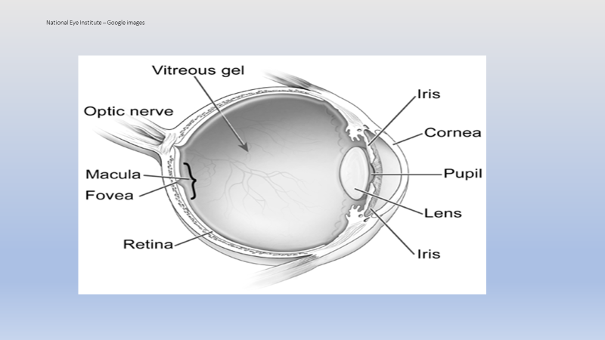
Notes:
Cornea – transparent, covers iris, pupil, and anterior chamber. Provides most of the optical power
Pupil – regulates light
Iris – Controls light by varying the pupil opening. Eye color
Lens – focusing
Macula – Central part of retina
Fovea – Located in the macula, produces sharpest vision and color discrimination
Retina – light sensitive area that converts images from the eye into electrical impulses that are sent to the brain via the
Optic nerve – carries impulses from retina to the brain

Slide 17
Retinopathy of Prematurity (ROP)
Underdeveloped blood vessels
  bleeding – blood vessels leak
  scarring – tissue build-up
  retinal detachment – retina detaches from underlying membrane
Possible effect on vision
  decreased visual acuity
  severe myopia (near sighted)
  field loss
  Strabismus
  glaucoma
Notes:
Can cause mild to severe visual impairment

Slide 18
Vision
Visual acuity – ability to distinguish object details and shape at specified distances (20 feet for distance, 16 inches near vision)
Severe myopia – inability to see at distances
          Corrective lenses or contact lenses
          High lighting
          Minimal glare
Field loss – ability to use indirect vision to see to the side, upper, and lower fields

Slide 19
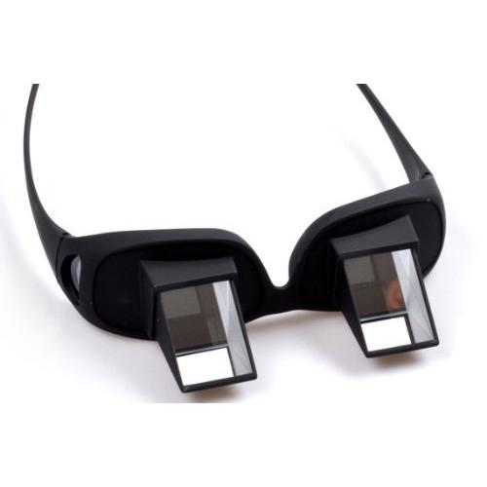
Strabismus – eyes do not focus on an object at the same time
  Esophoria – one or both eyes turn inward
  Esotropia – “crossed eyes”
  Exophoria – one or both eyes turn outward
  Hypertropia – one or both eyes turn upward
  Hypophoria – one or both eyes turn downward
          Prisim glasses
          Eccecntric viewing
          Use one eye for distance, one eye for near tasks
          Eye strain, blurring of print, loss of place when reading
          Preferential seating
          Source: Horizontal Refraction Glasses Bed Prism - Eyewear Traders

Slide 20
Glaucoma – increased eye pressure
  flucuating vision
  peripheral loss
  poor night vision
  light sensitivity
  near vision problems
  decreased contrast sensitivity
  headache
  red eyes
  dizziness
  cloudy cornea
  degeneration of optic disc

Slide 21
Adaptations/Considerations
        Sunglasses
        Adjustable lighting
        No glare
        Good contrast
        Magnifiers
        Closed-circuit television (CCTV)
        Be aware of fluctuation in vision performance
        Be aware of pain
        Travel assistance in unfamiliar areas

Slide 22
Communication
Receptive language - understand language before they speak (comprehension)
Expressive language – ability to speak
May talk late
Notes:
Delay depends on amount, if any, brain injury. Also degree of hearing loss

Slide 23
The Premature child goes to school
Initially, may be all about health care depending on gestation
Early Intervention and sensory stimulation critical
OT, Speech/Language therapists, stimulating environments at home and EI settings
May lag behind through elementary school
On-going therapy and intervention
Work with child on strengths and weaknesses, build confidence
Tutoring and teacher/parent contact
May catch up in middle school, especially if focused on a goal
Notes:
Breathing, brain injury may have early influence on infant and toddler development
Exposure to books, games, and age-appropriate activities as much as possible

Slide 24
RESOURCES ROP
Premature Birth - https://www.mayoclinic.org/diseases-conditions/premature-birth/symptoms-causes/syc-20376730
Levack, N. (2001) Low Vision A Resource Guide with Adaptations for Students with Visual Impairments, 2nd Edition, Texas School for the Blind and Visually Impaired
Being Born Early Means More than You Think https://nationaldb.org/materials/page/146/8
Hear See Hope http://www.hearseehope.com/about-usher-syndrome/

Slide 25
Resources - ROP
http://www.aboutkidshealth.ca/En/ResourceCentres/PrematureBabies/LookingAhead/OverviewofLearningandEducationinthePrematureBaby/Pages/Back-in-the-Classroom.aspx

Slide 26
USHER SYNDROME

Slide 27
Usher Syndrome
Is genetic with a hearing and vision loss
Vision loss – Retinitis pigmentosa
  Retina deteriorates
  Diagnosed by an ophthalmologist or an optometrist
Hearing loss – Sensorineural
  Newborn screening identifies infants with hearing loss
Estimated that 1-6,000 to 1 -25,000 have US https://www.usher-syndrome.org/our-story/blog/all-you-need-to-know-about-usher5.html
Usually normal intelligence
Notes:
Screening of children who were deaf was discontinued since RP can only be diagnosed by eyecare professional. Inaccurate screening.
In 2006 a microchip saliva screening tool was developed
With better testing available, there may be a higher incidence of US than currently believed

Slide 28
Usher Syndrome Type I
Born with severe to profound hearing loss
Poor balance – walk around 15 months
Night blindness – as early as age 5
Visual field loss – age 10, usually less than 20° by mid 20’s
Central vision – progressive loss, cataracts
Prognosis – varies, may have light perception

Slide 29
Type I Implications
RP may not be diagnosed until early teens
Many children attend schools for the deaf
ASL is usually the primary communication mode
Cochlear Implants may help
Many consider themselves members of the deaf community
Acceptance is individual

Slide 30
Usher Syndrome Type 2
Hearing loss – at birth, may be mild
Language delay or speech irregularity may be first sign
Balance – normal
Night blindness – teens to 20’s
Visual field loss – late teens, slow progression
Central vision – late teens through early adulthood
Prognosis – varies, fair vision in daylight through 20’s to middle age or later, possible only light perception around age 60+

Slide 31
Type II Implications
US may not be apparent or suspected at birth
Hearing loss at birth through early childhood may be very mild
Hearing aids may be beneficial, especially from diagnosis to late middle age
RP may not be diagnosed until mid-teens or later
Acceptance may be more difficult – life changes
Finding support and information may be challenging for the family and individual
Notes:
Life changes – braille, ASL, give up driving, loss of independence, coping skills, career,

Slide 32
Usher Syndrome Type III
Normal or near normal hearing at birth
Hearing loss noticeable in the teens
Significant hearing loss to deafness by late adulthood
Vision may be normal
Blind spots in the late teens to early adulthood
Legally blind in mid-adulthood
Onset varies from person to person

Slide 33
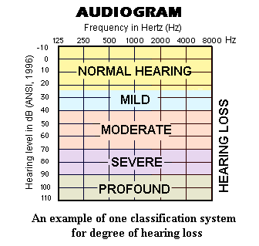
Audiograms
Notes:
Pitch – low to high Sound – soft to loud
Source: https://www.google.com/search?tbm=isch&source=hp&biw=2133&bih=1038&ei=gbvEWr7gOaqk_QaNwL9I&q=audiogram&oq=audiogram&gs_l=img.12..0l10.2688.6612.0.8635.9.8.0.1.1.0.118.697.6j2.8.0....0...1ac.1.64.img..0.9.705....0.-ywdQxLX4o8#imgrc=iwNnXk_PWv34bM:&spf=1522842507300

Slide 34
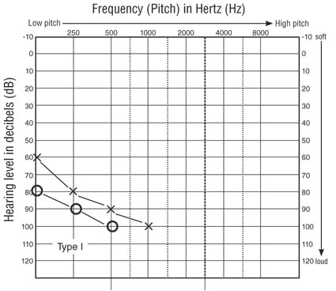
Audiogram – Type I – Check copyright
Notes:
Understanding Usher SyndromeASHA

Slide 35
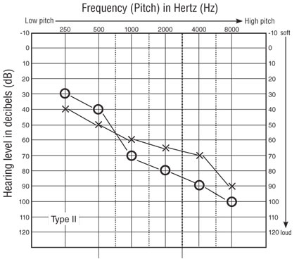
Type II
Notes:
Understanding Usher SyndromeASHA

Slide 36
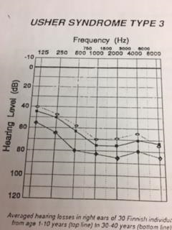
Audiogram Type III
Notes:
Source unknown
Sorry about the perspective

Slide 37
Retinitis Pigmentosa (RP)
Retina is affected
Degeneration of photoreceptor cells in the retina
  Rods – light sensitive receptor cell that works in low light
  Cones – light sensitive receptor providing sharp visual acuity and color discrimination
As receptors die, vision is lost

Slide 38
RP Symptoms
Difficulty seeing at night
Difficulty seeing in low light
Loss of peripheral vision
May take many years to progress to blindness

Slide 39
When it is not Usher’s Syndrome
Possible to have RP and bilateral hearing loss and NOT US
Alstrom Syndrome Bardet-Biedel Syndrome
Cockayne Syndrome Refsum Syndrome
Flynn-Aird Syndrome
Sometimes US is incorrectly diagnosed
Retinal specialist can verify

Slide 40
Usher Screening- Back in the day . . . .
Student questionnaire
Low contrast
Cone adaptation
Balance
Field – Hand Disc Perimeter
Notes:
Discontinued around 2010 – determined that it is a medical diagnosis because next slide please . . . . .

Slide 41
Students who passed
Legitimate – Vision was fine, no Usher Syndrome
Knew how to answer questions, perform tasks
Laid-back evaluator
Unqualified evaluator
Young adults (aged 11 - 21) with Usher’s Syndrome
Notes:
3 young adults with US at NCDB passed one year.

Slide 42
Students who failed US screening
Vision problems (acuity)
Didn’t understand the directions
Evaluator didn’t understand the directions
Wanted to go with staff for eye appointment

Slide 43
Classroom implications
Lighting – good lighting with minimal glare
Seating
  Non-cluttered background
  Avoid excessive movement
  Windows behind student
  Easy access to areas in the classroom
  Keep drawers and doors closed
Environment
  Boards – clean, high contrast marker
  Neutral colors

Slide 44

Travel - Inside
Travel – obstacles, hazards, familiar, and unfamiliar
Arrangement of furniture
Trailing rails
Keep drawers and cupboard doors closed
Contrast – wall, floors, furniture
Textures/Cues – stairs, classrooms
Steps – Color contrast, textures
Glare
Notes:
Cut curbs, speaking traffic signals, textures at top of steps,

Slide 45
Travel - Outside
Night travel
Lighted pathways
Tactual guide strips
Adequate lighting on buildings – name, doors, numbers
Placement of planters and other potential hazards
Placement of informational signs (speed, do not enter)
Use of human or dog guide

Slide 46
Label the rooms
Print – 2 inches high
Color
Contrast
Placement – on the wall by the door. Consistent
Braille
Consider raised numbers and letters

Slide 47
Materials
Learning Media Assessment (LMA)
Print or braille?
  Print – contrast contrast
  Size size size font font
  Tactile skill development
Individual Materials vs Universal Design
  Graphs or charts
  Tests
Assistive Technology
  Low vision aids
  FM system
Notes:
Organization – materials in the same order and same place
Bigger is not usually better for these students

Slide 48
TESTS to identify RP
Elctroretinogram (ERG)
The definitive test for RP, however, is the the electroretinogram (ERG), which has been found to be 95 percent accurate. The test must be administered by an ophthalmologist. An ERG measures the elecricity given off by nerve impulses in the retina of the eye. The patient sits in a dark room until the eyes adjust to the darkness. One eye is then patched and the other fitted with a special contact lens. The test, which is painless, measures the electrical response of the uncovered eye as it is exposed to flashing lights.
https://www.unr.edu/ndsip/secpagesEnglish/usher/usher.html

Slide 49
Electronystagmography (ENG)
This test is considered the “gold standard” for diagnosing ear disorders affecting one ear at a time. This test is used to determine whether or not an individual’s dizziness or vertigo is caused by inner ear disease. This test involves carefully measuring the eye’s involuntary movements while the individual’s balance is stimulated in a variety of ways. The test is composed of four separate parts: (1) the calibration test, which will assess rapid eye movements, (2) the tracking test, which will assess the eye’s movements as it tracks a visual target, (3) the positional test, which will measure dizziness depending on the posture of the head, and (4) the caloric test, which will measure the ear’s response to varying temperatures of water run through the ear in small tubes.

Slide 50
Visual Field Test
Measures side vision using a machine called a Goldman Perimeter. It will indicate the field of vision (normal field=180 degrees).
Psycho-Physical Test
Indicates which colors, if any, an individual can distinguish and the amount of contrast needed to see.
Dark Adaptation Test
Determines an individual's ability to see in the dark and how long it takes to adjust to the dark.

Slide 51
Your Teacher of the Visually Impaired can help provide all the accommodations and moderations needed to make the classroom and all educational activities accessible.

Slide 52
Communication
Speech
  Use of FM or other devices
  Be aware of potential to miss words
Sign Language
  Within visual field
  Tactile
  Interpreter
  Use of touch cues throughout the day (Haptics)

Slide 53
The Teacher of the Deaf and Hard of Hearing can help you determine and create the most useful communication mode.

Slide 54
Adjustment - Family
Has the family made the child aware of the diagnosis?
Acceptance by the parents, by the child
Grieving process – both child and parents
  Denial/Isolation
  Anger
  Bargaining
  Depression
  Acceptance
Counseling – family and child
Notes:
Protect the child, not tell him/her
Acceptance – ignore it, go away. Need to accept, treatment may help extend useful vision
https://psychcentral.com/lib/the-5-stages-of-loss-and-grief/

Slide 55
Adjustment - student
Different from peers
Acceptance of support services – O&M, braille, career goals
Depression
Isolation
Major life changes – hobbies, friendships, spontaneity, independence, freedom, driving
Change in communication mode
Deaf culture – accepted or no?

Slide 56
Time
Deaf-Blind Standard Time
  Adequately explain the material in preferred language mode
  Use of touch cues by one to one staff
  Examine materials
  Ask questions regarding instruction
  Time to process all the information
  Time to produce the answers
  Assignment adjustment – half of the questions
Notes:
Need time and a half
Depends on vision and hearing loss and difficulty of material
May need to customize tasks – assigned half the questions or problems to equalize length of time spent on homework or in class assignments

Slide 57
Resources – Usher’s Syndrome
https://www.usher-syndrome.org/our-story/blog/all-you-need-to-know-about-usher5.html
Ashley Benton, NC Deaf/ Deaf-Blind Coordinator – Ashley.Benton@dhhs.nc.gov
https://www.unr.edu/ndsip/secpagesEnglish/usher/usher.html
Tip Sheet https://www.unr.edu/ndsip/tipsheets/23-Tips%20for%20Students%20with%20Usher%20Syndrome.pdf

Slide 58
Cytomegalovirus (CMV)

Slide 59
General Information
Affects people of all ages
By age 40, over half of the adults have been affected
It stays in the body forever and can reactivate
Most people show no symptoms

Slide 60
CMV transmission
Blood transfusions
Organ transplants
Respiratory droplets
Saliva
Sexual contact
Urine
Tears
Most people come into contact with CMV in their lifetime
https://medlineplus.gov/ency/article/000568.htm
Notes:
Usually only people with weak immune systems are affected

Slide 61
Babies
One of 200 babies are born with congenital CMV infection
Only one of five will be sick or have long term health problems
The virus passes from the mother to the infant

Slide 62
Signs and Symptoms – At birth
Premature
Small
Small head
Seizures
Organ problems – liver, lungs, and spleen

Slide 63
Signs and Symptoms – Long term
Hearing loss
Vision loss
Intellectual disability
Small head size
Muscle weakness
Seizures

Slide 64
Treatment
Antiviral medications for infant showing signs and symptoms at birth
Regular hearing checks
Regular Pediatrician follow-up

Slide 65
Educational Consideration
Hearing
Vision
Intellectual disability
Seizures
Support services – Physical Therapy, TVI, Occupational Therapy, Teacher of the deaf/HH

Slide 66
CMV in North Carolina
7 of 8 have Intellectual Disability
Five have orthopedic complications
8 of 8 have communication limitations
4 of 8 have complex medical needs

Slide 67
CMV Resources
https://www.cdc.gov/cmv/overview.html
https://www.mayoclinic.org/diseases-conditions/cmv/symptoms-causes/syc-20355358
https://medlineplus.gov/ency/article/000568.htm

Slide 68
CEUs
To be eligible for the 1.0 CEU you must
Attend all 5 webinars
Respond to questions
If you have questions please contact me

Slide 69
QUESTIONS
In your opinion, what are some advantages and disadvantages in having a child labelled with an etiology or etiologies?
Do you believe that the NC census accurately represents the number of children with a) ROP, b) Usher Syndrome and c)CMV?
Choose one of the three etiologies above and briefly explain why you believe that the census is accurate/inaccurate.
Choose a child that you currently work with. Do you what his/her etiology is? How does knowledge of the etiology drive your services or what other factors do you use to determine how to best serve the child?

Slide 70
EVALUATION
Please take a minute to respond to the evaluation:
4- High Quality/Relevance 3-Good 2- Fair 1-Poor
The presenter was knowledgeable on the topic
The webinar content will be useful to me in working with students
I have reconsidered the abilities of students who are DB based on the webinar
The webinar was an effective method of providing the information
One hour was the right amount of time for this topic
Comments:

Slide 71
Submit answers and evaluation to:
Dorothy.Snyder@dpi.nc.gov
Thank you for participating in this webinar series.

