Slide 1
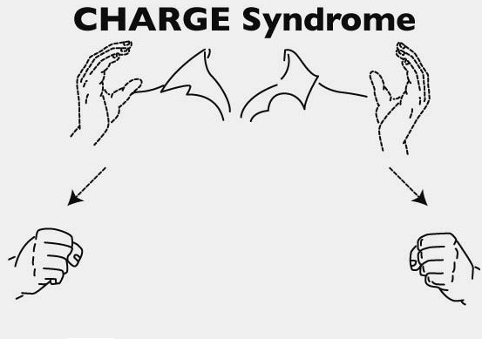
CHARGE SYNDROME
CHARGE Syndrome Foundation

Slide 2
General Supervision
SPP/APR
Data Collection
Dispute Resolution System
Improvement, Correction, Incentives, & Sanctions
Policies, Practices and Procedures
Monitoring Activities
Targeted Technical Assistance
Fiscal Management
Notes:
Graduation - SWD

Slide 3
Academics
Transition
Behavior

Slide 4
Academics
Technical and adaptive leadership
Behavior
Active implementation of evidence-based behavioral programming
Transition
Systemic and coordinated supports (including wraparound)
Consistent attendance
Extracurricular and/or employment opportunities
Comprehensive and efficient assessment system
Culturally responsive instruction
Positive school/class climate
Comprehensive and efficient assessment system
Active implementation of evidence-based instruction
Active implementation of evidence-based transition practices
Local capacity building
Local capacity building
Local capacity building

Slide 5
If you have met one person who is deaf-blind, you have met one person who is deaf-blind
If you have met one person with CHARGE Syndrome, you have met one person with CHARGE Syndrome
Notes:
Everybody is unique.

Slide 6
CHARGE - General Information
Genetic mutation CHD7
Clinical diagnosis
1 in 10,000
Diverse – mild to more involved characteristics (medical)
Determined – “I want/need”
Unique
CHARGE Conferences
Notes:
Mild to more severe traits
Determined – sometimes called perseverance
Center of the universe and we exist to serve them

Slide 7
Some Statistics- 2016 Annual DB Census
National
NC
Annual count – 9635
CHARGE Syndrome - 924
Intervener – 668
Additional Disabilities – 8424
DB (Part B) – 1486
MU - 3387
Annual count – 289
CHARGE Syndrome – 28*
Intervener – 35
Additional Disabilities – 278
DB (Part B) – 33
MU - 175
Notes:
From the 2016 Annual Child Count NCDB http://nationaldb.org/reports/national-child-count-2016

Slide 8
Eligibility Category – NC Census
MU = 11
Deaf-Blind = 8
Intellectual Disability = 3
OHI = 2
DD = 3
23 identified as having Intellectual Disability
21 have Communication/Speech Disability

Slide 9
CHARGE
C = Coloboma (eye) 80 – 90%
H = Heart 75%
A = Choanal atresia 50 -60 %
R = Retardation of growth and development 90%
G = Genitourinary anomalies
E = Ear anomalies and/or deafness (middle and inner ear) 90 – 95%
These features are no longer used to make the diagnosis
Notes:
CHARGEr’s are diverse. (met one person . . . ). Features, vision, hearing, medical issues, all vary greatly person to person.
Many don’t go through puberty without hormone therapy
G-tubes are common, early on
Many secondary characteristics – stuff mouth, switch night-day, OCD, late walk and talk

Slide 10
Coloboma
May effect the iris, retina, macula, optic disk, or eyelid
Iris - No to minimal affect on visual field or acuity (usually)
Retina – Loss in the visual field, usually in the upper field
Macula or optic disk – Significant affect on visual acuity
May be sensitive to bright lights
Usually visually perform much better than testing would indicate
Magnifiers may be helpful
80-90% of individuals with CHARGE have colobomas
Notes:
Like a cleft palate of the eye
Often keyhole shaped
Retinal coloboma – retinal detachment risk
A LVE would give recommendations for print size and low vision aids

Slide 11
National Eye Institute – Google images
Notes:
Area of vision affected depends on location of the coloboma
Some are very significant, not usually blind but really limited vision
May use vision in new and unusual ways – spot green jelly bean on a green chair 30’ away but walk straight into pole or BIG piece of furniture on the way

Slide 12
Coloboma - Iris

Slide 13
“Look at the camera”
Notes:
https://www.chargesyndrome.org/wp-content/uploads/2016/11/Friday-July-28-2017-Handouts.pdf Meg Hefner, M.S. CHARGE 101

Slide 14
Elements of Vision
Lighting –amount of light, changes in lighting (bright to dark), problems (glare, icky light)
Contrast – high/low, color, figure/ground (clutter)
Size – big print, small print, font types, distance, optics
Notes:
Mention this because . . . . It will relate to classroom strategies

Slide 15
Vision Myths
The child must be able to communicate for the eye care professional to obtain a reliable visual acuity
Distance and near vision are closely related
Functional vision is closely related to visual acuity
Eyeglasses always correct vision to 20/20

Slide 16
The other “C’s” of CHARGE Syndrome
Cranial Nerve Abnormalities
Possible facial palsy
Breathing and swallowing may be affected
Choanal Atresia
Breathing impacted
Notes:
May appear to be uninterested or not happy. Flat affect

Slide 17
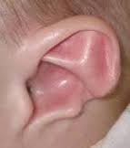
CHARGE Ear/Hearing
Unusual shape
Mixed hearing loss, often severe to profound
Fluctuating with infections/fluid
May respond to cochlear implant
May be progressive
Possible balance problems
Notes:
Hearing loss – tolerate hearing aids, cochlear implants
Probable balance problems
CHARGE ear

Slide 18
Hearing Testing
Audiogram
Auditory Brainstem Response
Functional Hearing Assessment
Notes:
Processing

Slide 19
Heart/Medical
Usually multiple and/or complex medical conditions
Surgery early and often
Trach
Feeding tube
Cleft palate
Allergies
Reversed sleep pattern
Swallowing problems
Notes:
Between 1-5 child does walk, possibly aided, Between 3-5 health may improve. Trachs come out. Oral meal consumption may begin or increase (MM)
Don’t feel well or have energy

Slide 20
The Bubble
World only exists as far as they can see and hear
Incidental learning is limited
Distorted or missing visual and auditory information
Experiences
Expectations
Health problems

Slide 21
CHARGE “Behavior”
All behavior is communication
Can tell you what is wrong/missing from their environment – Tim Hartshorne, 2017 CHARGE Conference
May be sensory cause – pain, temperature, insecure, can’t see/hear
Thought to be perseverative (OCD), may be just persistent
Anxious about completing a task, having enough work
Change the perspective (it’s not this, it’s that)
Routines but flexibility when needed
Notes:
Because of illness at birth, lack exposure to people, places, activities, etc. Often presumed to have ID. Might but probably not as severe as thought. These kids really need opportunity to catch up. Competence – need to assume it is there.
Behavior is communication – request, refuse, exchange ideas
What they want, how they communicate, what the other person understood
Building flexibility is a topic itself
Change the perspective – it’s not a blue pencil, it’s an NCDB pencil)
OCD – when you really were trying to make a point (Politics discussions for example, late for something)
Sensory impact on behavior– pain, texture, temperature

Slide 22
Is it Autism?
Autism
Deaf-Blind
Uninterested
Self-Stim
Over stimulated
Uninterested/immature
Reluctance
Unable
Regulation
Under stimulated
Functional
Unique physical needs
Notes:
Behavior functions
AU – stop looking for the function of behavior
Irrational fear vs painful experience
ABA – not always a bad thing for CHARGE but need to look at function of behaviors

Slide 23
Obsessive Compulsive Disorder and CHARGE
Recurrent and persistent thoughts
Repetitive behaviors
True OCD – irrational thoughts leading to irrational behavior
CHARGERs have circumstances that lead to anxiety (exposure happens all the time and is unavoidable. Defensive response to deal with the anxiety

Slide 24
“A lot of what looks like OCD in CHARGE is really just a reaction to having multi-sensory impairments” David Brown
Creative responses to abnormal , anxiety-provoking circumstances
CHARGE Syndrome and Behavior: Diagnosis and Intervention
T. Hartshorne, D. Brown, M. Schmittel, S. Madhaven-Brown, S. Muhn July 29, 2017 CHARGE Syndrome Conference

Slide 25
Multi-impaired Sense of
Vision
Hearing
Touch
Proprioception
Temperature
David Brown and Julie Maier – CHARGE Conference 2015
Pain
Vestibular
Smell
Taste
Notes:
“CHARGE kids are truly multi-sensory impaired” David Brown

Slide 26
Senses
Distance senses
Vision
Hearing
Smell
Impact senses
Taste
Touch
Kinesthetic
Notes:
10’ or further
Impact senses help compensate for loss of distance senses

Slide 27
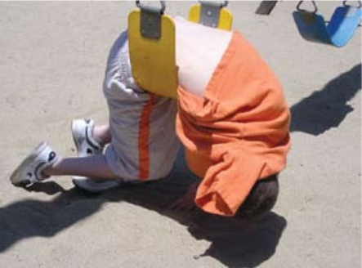
Senses - Proprioceptive
Proprioceptive – deep pressure
Walking
Flapping
Finger posturing
Hit self
Toe walking
Mouthing
Positions – on back, floor, couch
Notes:
Impact on movement and learning
Pressure - too much, not enough – hold/drop, shake hands
Push-pull, lift,

Slide 28
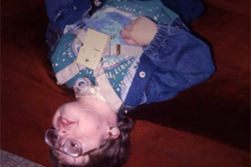
Senses - Vestibular
Vestibular – Head movements
Controlled by the inner ear
Spinning (self)
Spinning objects
Upside down
Repetitive movements
Notes:
Constant sensation of spinning

Slide 29
More on those weird positions
Vestibular sense – have none or overactive
Visual field loss – upper, lower, sides
Low muscle tone – positioning, tire easily
Poor proprioceptive sense – no idea where you are in space
Tactile – too much or not enough, defensive
Comfort – Reflux, feeding tubes,
Notes:
Only weird to us Make perfect sense to the child

Slide 30
Sensory Integration
Process of organizing sensory input so that the brain produces useful body responses, perceptions, emotions, and thoughts.
Smells
Touch
Picky eater
Meltdowns
Fearful and anxious
Loud noises
Notes:
Sensitive to smells, noise, lights, touch
Response meltdown to escape
Sensation of floating – need to be anchored
Fast spinning may help

Slide 31
Sensory Integration
Movement
Space mountain
Swinging
Deep pressure
Unusual Positions
Stabilization
Enhance vision
Oral Motor
Occupational Therapist, Physical Therapist
Speech-Language Therapist
Notes:
Some of these kids have low muscle tone, bone malformations = get tired, pain, stress
Team input is an absolute – favored positions, pressure, response to movement

Slide 32
Routine Transitions made manageable
What they see, what they hear
Extra time to process directions
People – they know, help them, consistently, not too many
Environmental cues – know where they are, barrier free routes, consistent landmarks or cues
Time – repetitions
Notes:
Early or later transition – hallways, going into auditorium, classrooms, PE
Time – Always need to consider time for a child who is DB, especially when there are sensory issues, intellectual, health, etc
The skill level, confidence level –age, health, experiences, O&M,

Slide 33
Concepts
A concept is a mental representation, image or idea of tangible and concrete objects (e.g., a chair, a dog) and intangible ideas and feelings (e.g., colors, emotions).
A skill is the ability to do something (e.g., tying a shoe, using vision to find an object).
Concrete concepts: relate to objects or things that are tangible (e.g., a car, a chair).
Semi-concrete concepts: relate to an action, color, position, or something that can be demonstrated but not held in one’s hand (e.g., jumping, behind, red).
Abstract concepts: include feelings (e.g., love, nervousness).
Sighted and hearing children receive a constant flow of visual and auditory information which facilitates the development of concepts. For children with combined vision and hearing loss, the flow of information is incomplete. Concepts don’t develop naturally or easily. Alternate strategies must be used to teach these children concept development.
Notes:
Concept slides from ©2006 SKI-HI Institute at Utah State University.
http://www.sparkle.usu.edu/Topics/concept_development/index.asp

Slide 34
Areas of concept development affected by deaf-blindness:
Objects exist: children with deaf-blindness have difficulty learning about the existence of objects because they can not see or hear objects clearly.
Objects have permanence: children with combined vision and hearing loss can’t observe objects and people at a distance and know that things exist beyond their fingertips.
Objects differ: children with deaf-blindness won’t know that one object is different form another unless they can touch and explore them.
Objects have names or labels: children with both a hearing and vision loss need to use touch to support language learning.
Objects have characteristics: children with deaf-blindness will have difficulty identifying the different characteristics of objects because of the lack of access to information about those objects.
Objects have functions or use: children with combined vision and hearing loss can’t observe how objects are used, or hear the sounds associated with the functions of objects.
Notes:
Concept slides from ©2006 SKI-HI Institute at Utah State University.
http://www.sparkle.usu.edu/Topics/concept_development/index.asp

Slide 35
To Build Concepts
Use activities that are meaningful to the child
Use activities that the child enjoys
Attach language to all experiences
Build on language that is already known to the child
Use a total communication approach that is appropriate for the child
Remove variables that may cause confusion for the child
Generalize the concepts to a variety of situations.
Concept slides from ©2006 SKI-HI Institute at Utah State University.
http://www.sparkle.usu.edu/Topics/concept_development/index.asp

Slide 36
More on Concepts
Need to be taught through more than one sensory mode (vision, hearing, touch, smell, taste, movement)
Need to be taught trough more than one communication mode
Multiple opportunities to learn and interact in an enhanced context to understand what is going on around him/her
Adaptations and accommodations for EVERY activity
Hands on participation
Notes:
Best of hearing, vision, and touch. Movement is essential.

Slide 37
Strategies

Slide 38
In the classroom
Seating – to best use residual vision and hearing
If they are sitting alone, they may not (probably aren’t) getting much, if any information
The advantages of having a one-on-one
Break down the information
Hands on
Time – to process information, form response, plan and perform response

Slide 39
Seating for all activities
How does the child use their vision?
Have you seen a FVA?
Does have /Did have TVI services?
Fluctuating vision
Glasses not always “fix” vision to 20/20
Hearing
Hearing aids, cochlear implants, BAHA
FM system, captioning
Background noise
Can the child hear the 1:1?
How does s/he feel today? Sensory breaks.
Notes:
Can’t see the board –maybe they could yesterday, not today
Impact of that during class and information that is up there, copying assignments

Slide 40
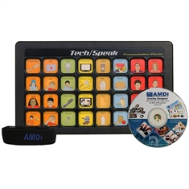
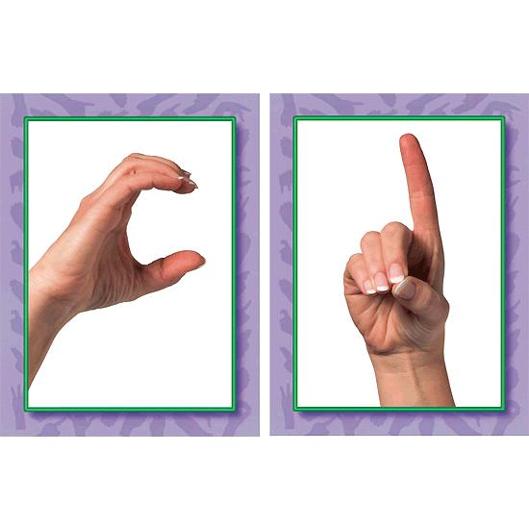
Communication
Pre-symbolic
Objects
Pictures
Speech
ASL
Tactile Sign
Print in palm
Communication devices (GoTalk, computer, Quick Talker, Talk ‘n Tote)
Notes:
Signs need to be in the visual field – upper, lower, peripheral
Understanding that communication is give-take, 2 or more people

Slide 41
Sign Language
Needs to be at an understandable level – vocabulary, speed, size
In the visual field
Expressive
Receptive
Notes:
Usually demonstrate receptive language more than expressive

Slide 42
Respect Communication
If the child’s behavior is saying “I need to move” – they need to move
Communication may not be traditional
“Bad” behavior has gotten quick responses in the past
Concept of “wait or later”
Introduce the elements of conversation - topic, turn taking
Notes:
Conversation may consist of passing an object back and forth.

Slide 43
Infant and Toddler Development
Inconsistent responses to sounds and visual images
Lack distance perception of the environment – no curiosity
Balance problems
Delays in motor development
Tactile sensitivity
Overactive startle response
Difficulty in interacting with things in the environment
Difficulty in generalizing experiences

Slide 44
Communication is non-typical or delayed
Gaze at lights
Fixate on a spinning toy or other object
Fear and confusion
Don’t anticipate change
If alone for very long, not seek or interact with toys or materials
Limited incidental learning (reproduce sounds, identify objects)

Slide 45
Assistive Technology
In the classroom
In the home
In the community
Communication
Mobility
Independence
Daily Living
Social

Slide 46
Assistive Technology
Everyday Tools
Smart phones
Ipads and tablets
Closed captioning
Descriptive video
Notes:
Cameras, magnifiers, Zoom text,

Slide 47
Evaluation and Training
Look at the strengths not deficits
What does he want to do? Preferences
Natural settings to evaluate and teach
Support to enhance skills
Viewpoint that allows the student to have a fulfilling life (can do vs cannot do)
Notes:
Natural settings i.e., functional
Really look at the positive, even if the activity seems like a minor one.

Slide 48
Always presume competence

Slide 49
Resources
CHARGE Syndrome Organization - chargesyndrome.org
CHARGE Syndrome Conference information - https://www.chargesyndrome.org/for-families/conferences/
Perkins - http://www.perkinselearning.org/scout
Texas School for the Blind and Visually Impaired – tsbvi.edu
National Center on Deaf-Blindness - nationaldb.org
NC CHARGERs – Kim Lane, kimandmike@gmail.com
Notes:
CHARGE Conference – Dallas Texas August 2019

Slide 50
Notes:
2017 CHARGE Conference Orlando FL
The NC Attendees - CHARGERs, parents, grandparents, nurses, Interveners, Teachers, Speech Therapist

Slide 51
NC Deaf-Blind Project
Dottie Snyder – NCDPI Statewide Consultant for Deaf-Blind Dorothy.Snyder@dpi.nc.gov
Andrea Blackwood – East Carolina Teacher Support Program Technical Assistance Coordinator blackwooda@ecu.edu
Debra Pickens – ECAC Family Engagement Specialist dpickens@ecacmail.org
Notes:
Key contacts

Slide 52
CEU Questions
Do you work with or have a student with CHARGE in your LEA?
What do the letters in CHARGE stand for?
What are some resources you would use to find information on CHARGE Syndrome
What are some accommodations that you may need to consider for a child with CHARGE Syndrome in a classroom setting?
E-mail response to Dottie at Dorothy.Snyder@dpi.nc.gov by April 13, 2018

