Slide 1
Office Of Civil Rights Data Collection (OCR / CRDC)
Exploring the Federal Submission Tool
Terra Dominguez
State OCR Coordinator
terra.dominguez@dpi.nc.gov

Slide 2
About this Presentation
This presentation is a collection of each status update.
Download the full presentation here.
Slides from previous updates/webinars have been hidden to allow attendees to focus on current information.
Originally Presented: 01/28/2022

Slide 3
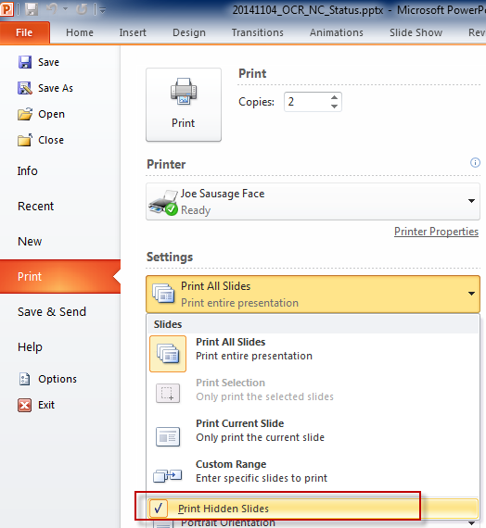
About this Presentation…
Hidden slides will print if your print settings are not updated.
If you are using this presentation to follow along with the Status Update, the following is recommended:
Click File
Click Print
From Settings, click the Print All Slides drop-down
Uncheck Print Hidden Slides
Originally Presented: 01/28/2022

Slide 4
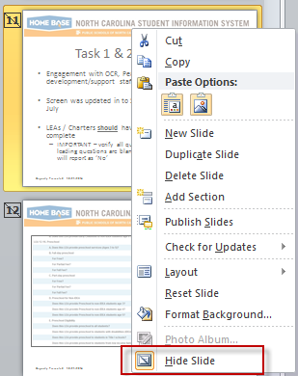
About this Presentation…
To display hidden slides:
Download and open the original PowerPoint file
From the left pane, right click slide
Click ‘Hide Slide’
Originally Presented: 01/28/2022

Slide 5
More About this Presentation
Page numbers
Page numbers do not update if a slide is hidden
‘Originally Presented’ and ‘Updated’ date are located on the footer
Slides may be re-used with each webinar
Latest ‘Known Issues’ stamped with
‘Known Issues’ which are resolved stamped with
Originally Presented: 01/28/2022

Slide 6
Agenda
Where we are Today
CRDC Communities Website
Federal Submission Tool
Messages on the Home Screen
Navigation
Reports
Questions, Discussion, Closing
Originally Presented: 01/28/2022

Slide 7
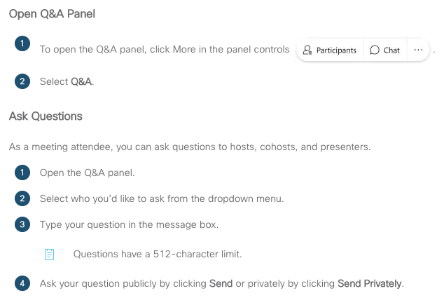
Questions in WebEx
Preface each question with the topic
Originally Presented: 01/28/2022

Slide 8
Where we are Today
Originally Presented: 01/28/2022

Slide 9
As of Today – Data Loaded
LEA Level - Complete
SSPR: Students, Schools, & Programs
CRCO: Civil Rights Coordinator/Desegregation Plan
HIBD: Harassment or Bullying
DSED: Distance Education
HSEE: High School Equivalency Exam
Originally Presented: 01/28/2022

Slide 10
As of Today – Data Loaded
School Level
DIND: COVID-relational Directional Indicators
SCHR: School Characteristics
PSCH: Preschool
ENRL: Enrollment
PENR: Program Enrollment
COUR: Courses & Classes
Class Counts by Certified Teacher
APIB: Advanced Placement
STAF: Staff & School Support Staff
SECR: School and Security Staff
INET: Internet Access and Devices
EXAM: SAT/ACT
RETN: Retention
ATHL: Single-Sex Interscholastic Athletics
JUST: Justice Facilities
(this section applies to a single LEA only)
Originally Presented: 01/28/2022

Slide 11
As of Today – Data Pending
School Level
DISC: Student Discipline
ARRS: Student Discipline OFFN: Offenses
HIBS: Harassment or Bullying
RSTR: Restraint & Seclusion
Do not add data to modules NCDPI has not uploaded.
Originally Presented: 01/28/2022

Slide 12
As of Today – Data Pending
A solution for the remaining modules is being worked on in-house.
CRDC discipline related data which NCDPI will load are extracted from the state incident dataset which was submitted to the state at EOY. Data will be transformed for CRDC requirements.
Any data recorded or updated in PS after EOY which was not reported to the State Discipline Data Coordinator will not be included.
NCDPI will continue to notify the PSUs on progress.
Originally Presented: 01/28/2022

Slide 13
As of Today – NCDPI Uploads Complete
NCDPI has completed all data uploads. PSUs must resolve errors, update or add remaining data, and certify the collection by February 28, 2022.
Originally Presented: 02/04/2022

Slide 14
Grade Levels in PS - Nulls
Per PSU request, NCDPI began the process of updating PS data to conform to the CRDC business rules regarding Nulls and Zeros.
Grade levels which were missed or recorded incorrectly in PS will result in no data (null) submitted to the federal submission.
If this has occurred, review the CRDC PowerSchool Preview report and record the data within the Federal Submission Tool.
NCDPI will continue to improve the Null/Zero logic for future collections.
Originally Presented: 01/28/2022

Slide 15
NC will not…
Submit data for any optional survey questions except for Number of Incidents Committed by Student
Submit data for Allegations of Harassment or Bullying by Religion Type (HIBS-1c)
Will not be collected for the CRDC per General Statue, Chapter 115C (ncleg.net) section 402.5.
Remaining optional Survey questions will be developed for the SY21-22 CRDC Collection
Originally Presented: 01/28/2022

Slide 16
Completing the Collection
PSUs must complete the collection by validating and Certifying the data after upload to the Federal Submission Portal
Originally Presented: 01/28/2022

Slide 17
Due Date and Extensions
Federal Submission Due Date February 28, 2022
CRDC Partner Support indicated the OCR administration will NOT consider an exention for this collection.
- PSUs can contact the Helpdesk but the request will most likely be denied at this point.
Originally Presented: 01/28/2022
Updated: 02/04/2022

Slide 18
OCR ‘First Reminder’ Messaging
On February 3, 2022, the OCR administration began sending reminder messages to complete the collection.
Please inform any who are concerned that the letter is a reminder.
The OCR administration will likely continue reminders until certification is completed.
NCDPI has no control over these messages.
Originally Presented: 02/04/2022

Slide 19
CRDC Communities Website
Originally Presented: 01/28/2022

Slide 20
CRDC Communities Website
Hosted by the Federal Government
Launching point for the Tool
Documents
Videos
Link to Partner Support Helpdesk
Civil Rights Data Collection Resource Center.
Google or use the link provided on the NCDPI CRDC pages and recent notifications
Originally Presented: 01/28/2022

Slide 21
CRDC Federal Survey Forms
You still need these to complete the process.
All PSUs are required to submit data for both forms.
LEA Form
School Form
Located on the CRDC Communities, within the tool and on NCDPI Website
Originally Presented: 01/28/2022

Slide 22
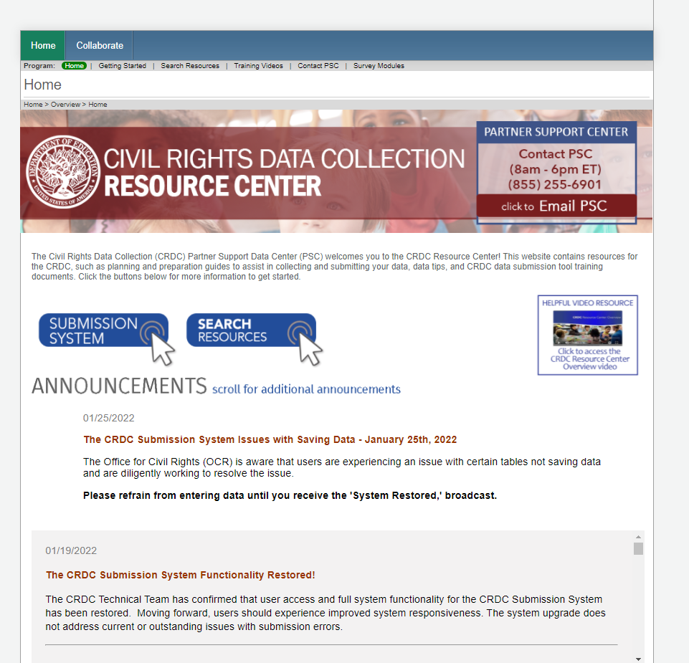
Home Page - Top
More Resources
Help Desk
Submission Tool Link
New User Video
Important Messages
Originally Presented: 01/28/2022

Slide 23
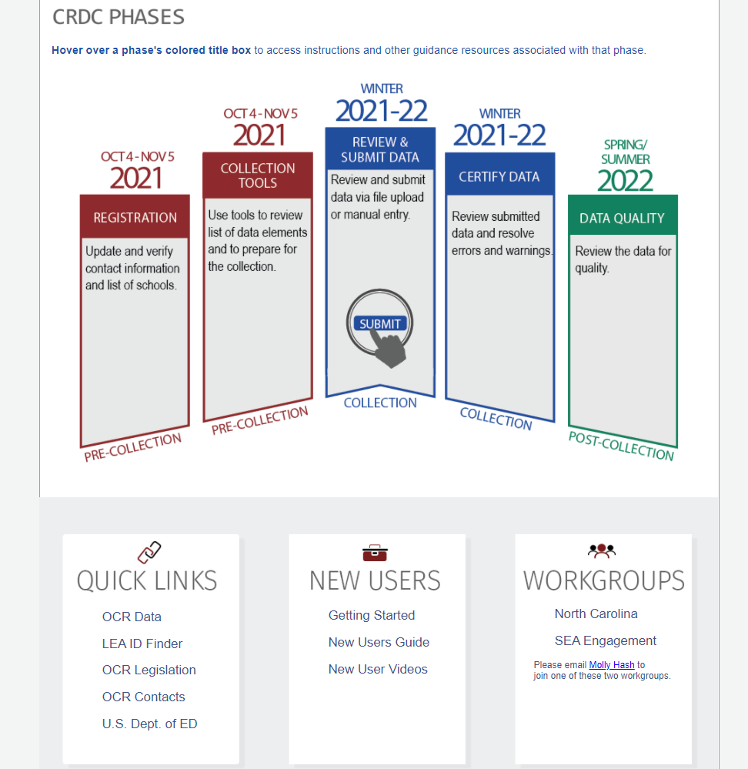
Home Page - Bottom
Hover for More Resources
Workgroup to start new message threads
NOTE: uses a separate login
Published CRDCs,
OCR Administration Links
More New User Resources
Originally Presented: 01/28/2022

Slide 24
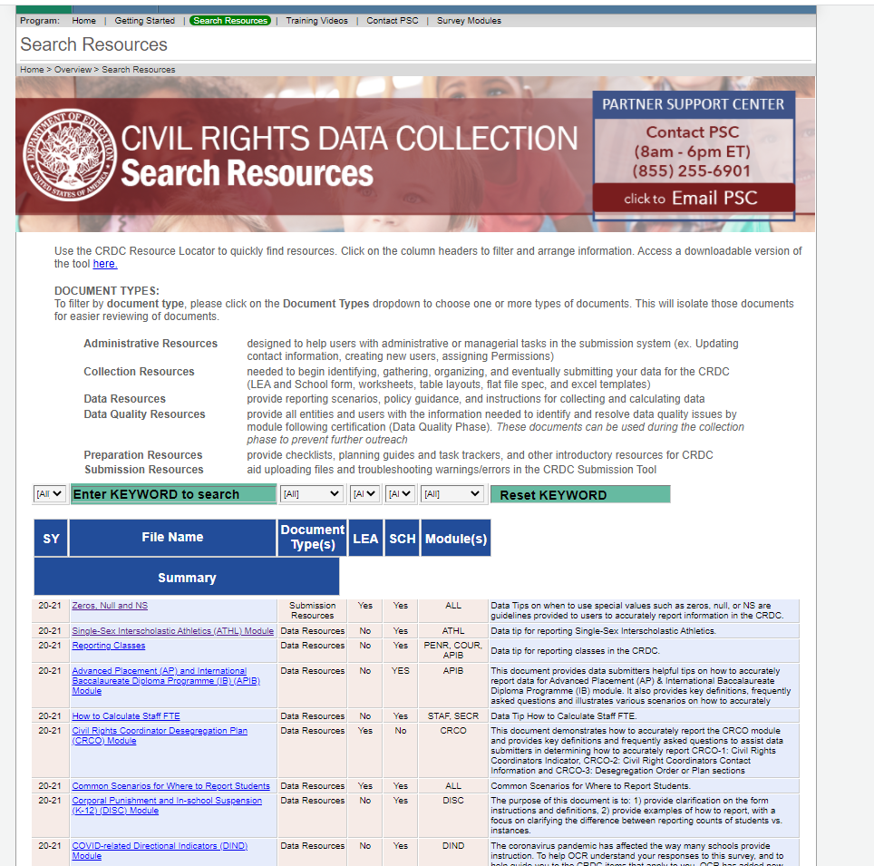
Document Library
Click Resources at the top of the page
Use KEYWORD SEARCH
‘User Guide’ ‘Navigation’
‘Permissions’
‘ARRS’
Originally Presented: 01/28/2022

Slide 25
Recommended Documents
Submission System User Guide
Submission Errors and Warnings
CRDC Business Rules Single Inventory (BRSI) 2020-21
Add New Users and Set Permissions
How to Create and Submit an Action Plan
Flat File Specifications
LEA Level Table Layouts
School Level Table Layouts
For PSUs that want to create files to upload
Originally Presented: 01/28/2022

Slide 26
Federal Submission Tool
Originally Presented: 01/28/2022

Slide 27
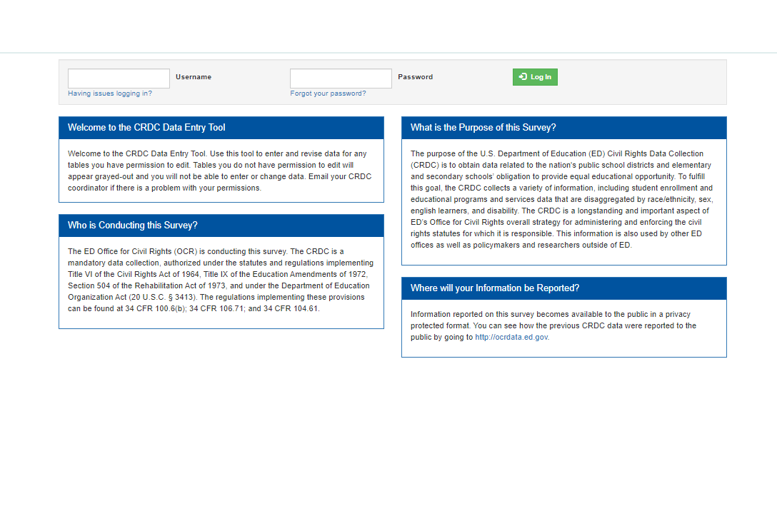
Submission Login
Most Recent email address
Password Reset Link
If you did not receive an email from Partner Support, reset your password.
If your PSU changed emails, use your most recent email address, reset your password.
Even if you remember your password from a previous collection, reset your password.
If you still don’t have permissions, contact me.
Originally Presented: 01/28/2022

Slide 28
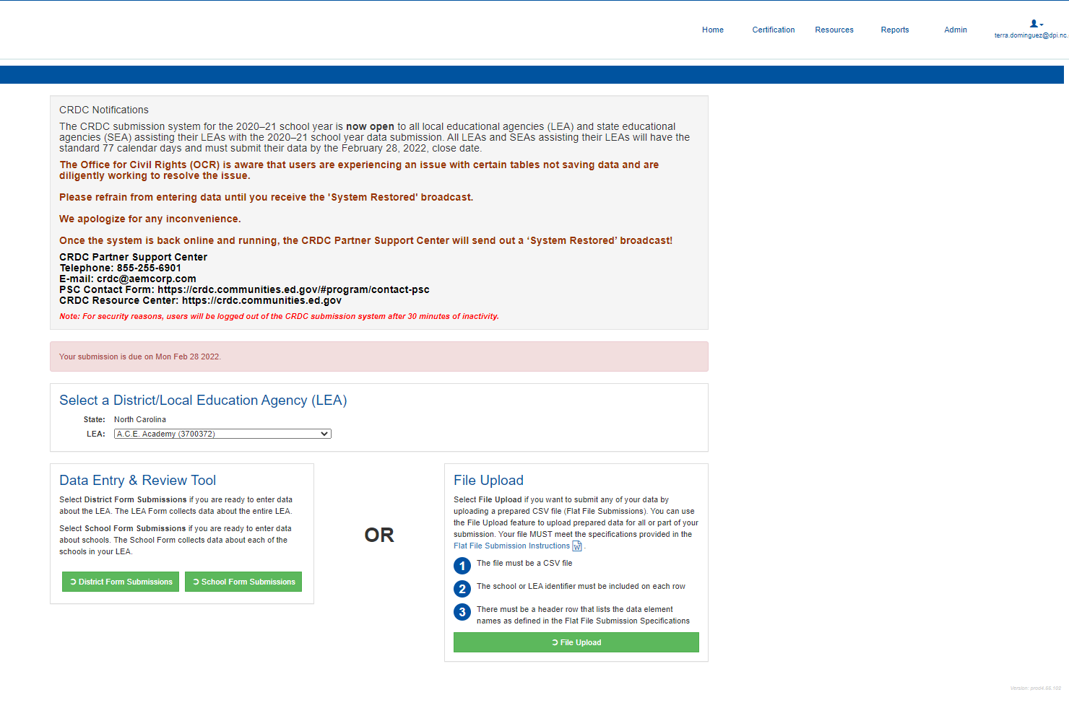
Submission Home Page
Links on all pages
Always Read the Messages
Full PSU or Select School
File Uploads
Navigate by screen, manual entry
Originally Presented: 01/28/2022

Slide 29
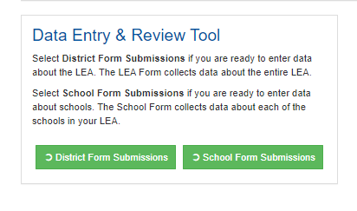
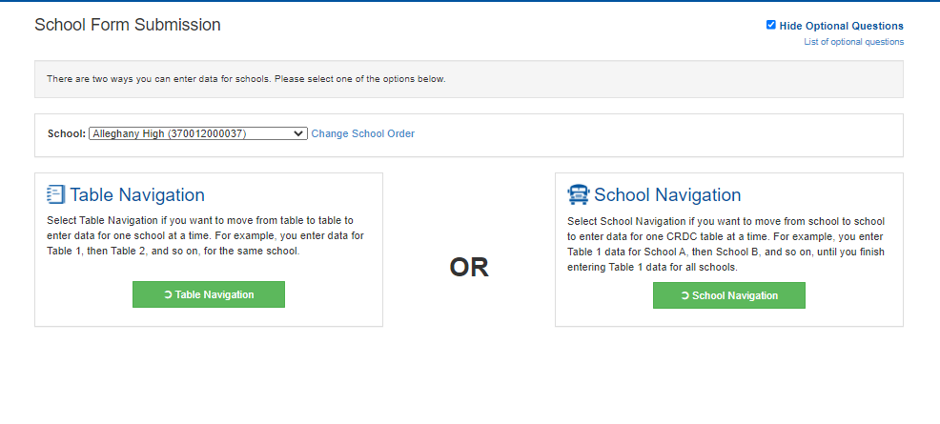
Home
Remember two things in case you get lost:
The links above are always on the screen.
Also, most screens have breadcrumbs.
Screen navigation
Navigate single school module by module
Navigate through modules, from school to school
Originally Presented: 01/28/2022

Slide 30
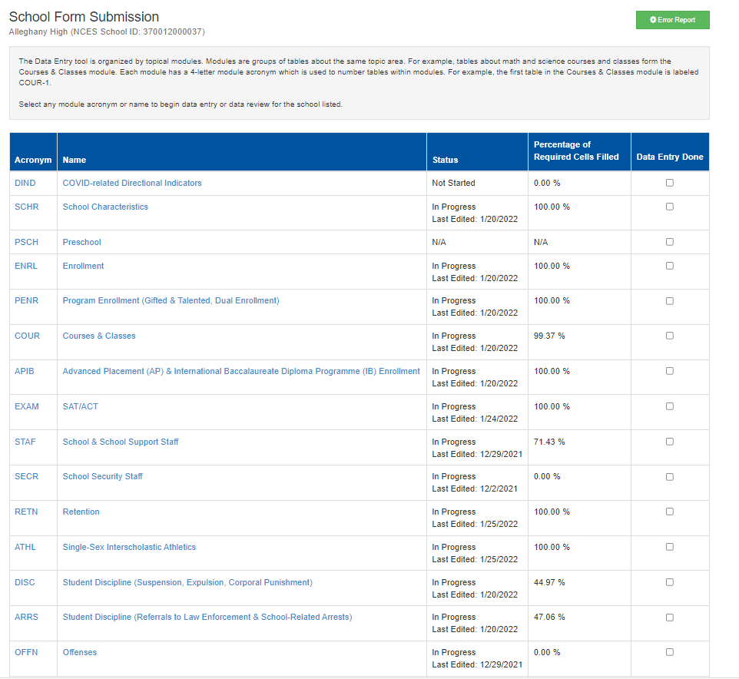
First Screen by Table or School
Links to Errors and Warnings tables by module
Displays percentage complete by module. Clicking a module link takes you to the list of questions.
Originally Presented: 01/28/2022

Slide 31
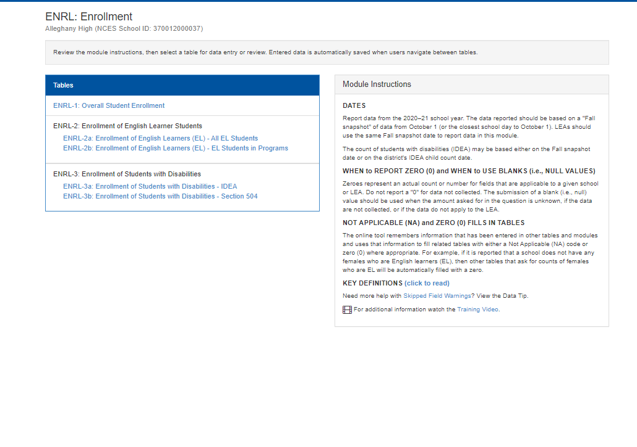
List of Questions Example
Click to a link to navigate to the module question screen
Help is embedded in the screen
Originally Presented: 01/28/2022

Slide 32
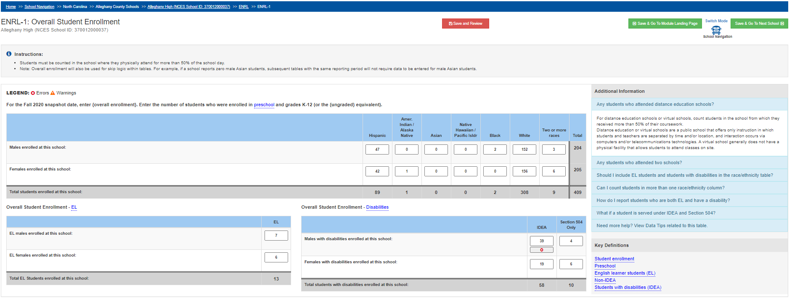
Module Question Screen by School Example
Breadcrumbs
Save and Review
Save & Next School
Click to review and resolve error.
Help is embedded in the screen
Originally Presented: 01/28/2022

Slide 33
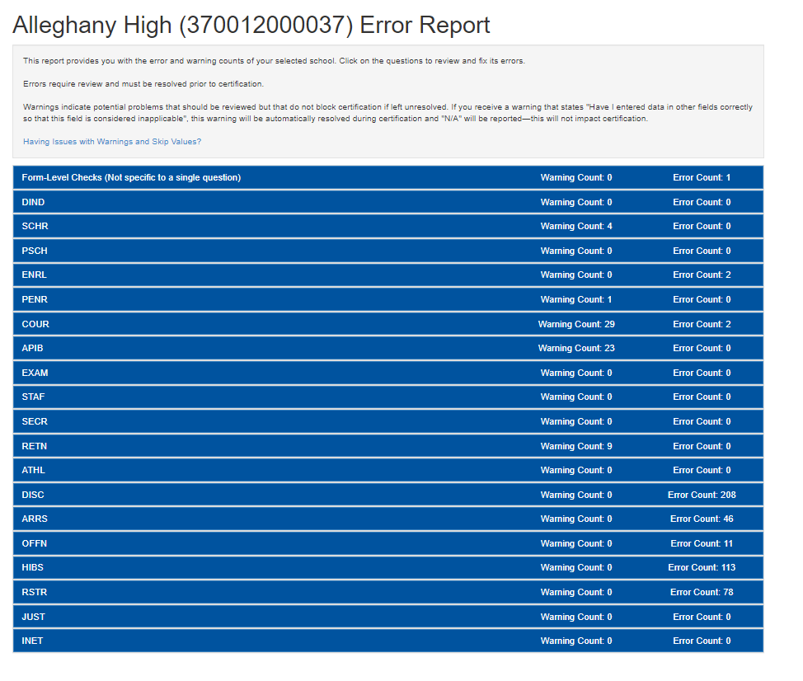
Errors and Warnings – Report Icon
This is what appears when you click the green Error Report button
Originally Presented: 01/28/2022

Slide 34
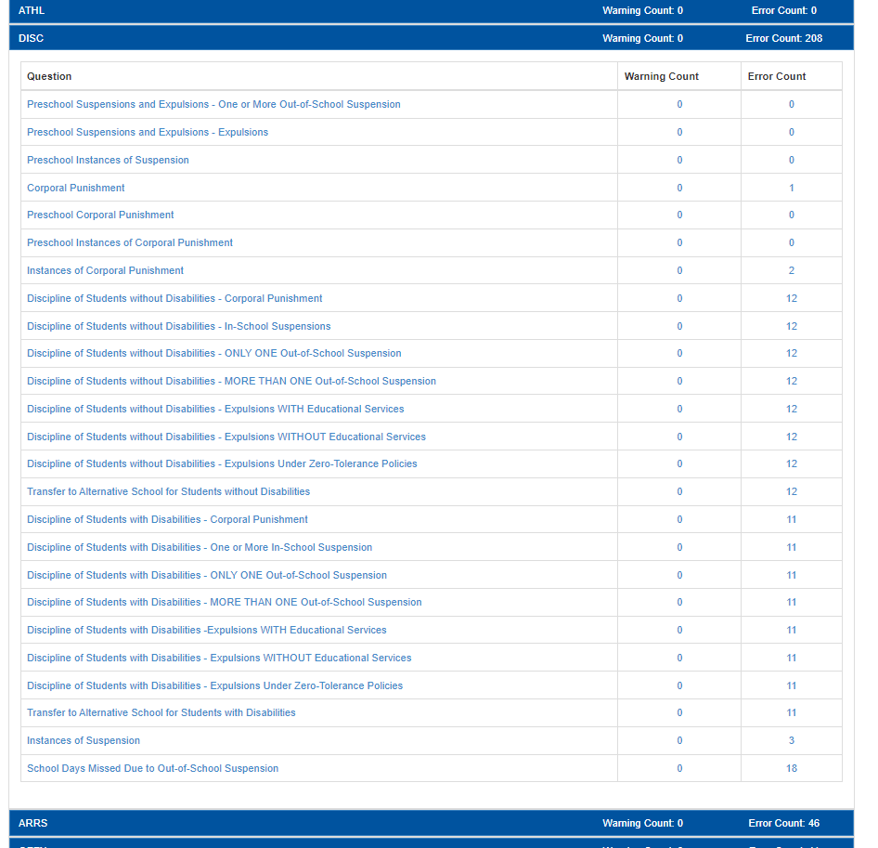
Errors and Warning by Module
Click the row to expand and see all Errors and Warnings for the module.
Click the Error or Warning link to go to the module question screen
Originally Presented: 01/28/2022

Slide 35
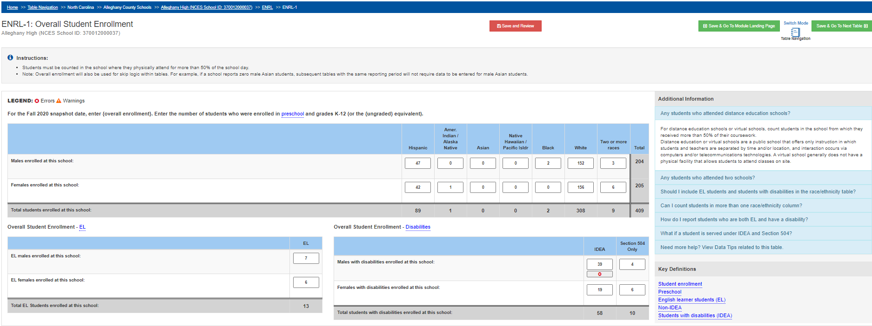
Module Question Screen Example
Breadcrumbs
Save and Review
Save & Next Table
Click to review and resolve error.
Help is embedded in the screen
Originally Presented: 01/28/2022

Slide 36
Errors and Warnings
Errors impact ability to Certify collection
Work on Errors first when pressed for time
Warnings should be reviewed
Less Warnings this year with null logic added to NCDPI process
Warnings do not need to be cleared from system
Originally Presented: 01/28/2022

Slide 37
Errors and Warnings
Some NC common Errors:
IDEA or LEP male/female does not match overall male/female for subgroup (ENRL-1, ENRL-2a, ENRL-3a)
Reported to the vendor – will be resolved in next collection
Female IDEA Geometry count is null (COUR-9d)
Will be fixed as we continue to improve null logic
Distance Learning Aggregate counts exceed previous year collection (DSED-2)
New from CRDC system
Originally Presented: 01/28/2022

Slide 38
Errors Resolution
In the example provided in the next two slides, a user must either update the overall enrollment for the IDEA element (ENRL-1), or IDEA enrollment (ENRL-3a).
This error example generates two errors on the CRDC.
Originally Presented: 01/28/2022

Slide 39
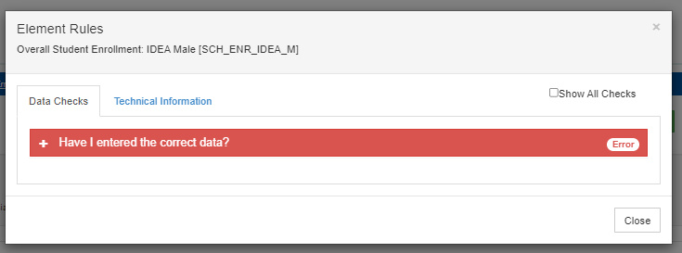
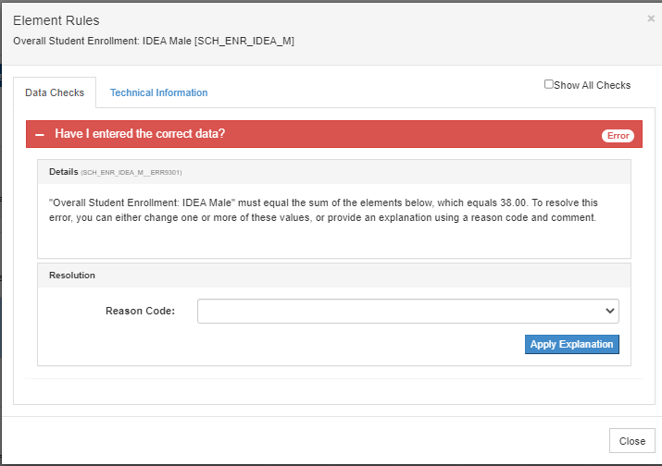
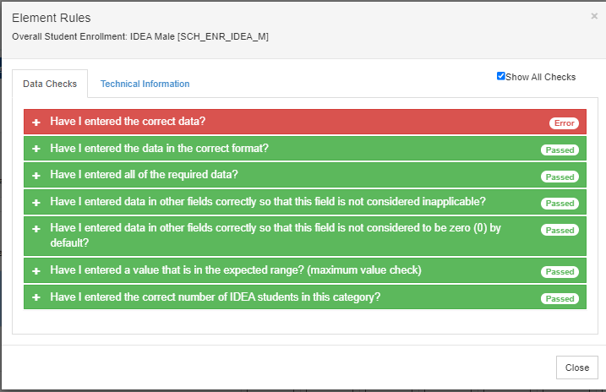
Error Resolution – ENRL-1
Click the red X on the errored element in the module question screen. Expand Data Checks.
CRDC Logic Checks
Error Message
Originally Presented: 01/28/2022

Slide 40
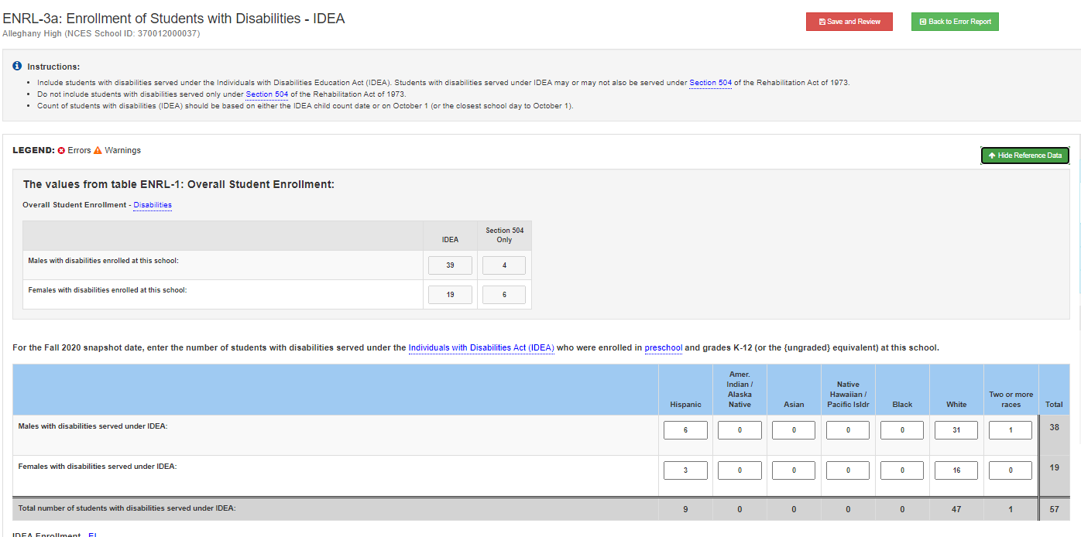
Error Resolution – ENRL-3a
Reference Data button in ENRL-3a displays info from ENRL-1
Originally Presented: 01/28/2022

Slide 41
Errors Resolution
In the example provided in the next slide, a user must provide a value for the element. (COUR-9d)
This error was mistakenly generated by the null logic. In this case, it is safe to update the element with the value of ‘0’.
Originally Presented: 01/28/2022

Slide 42
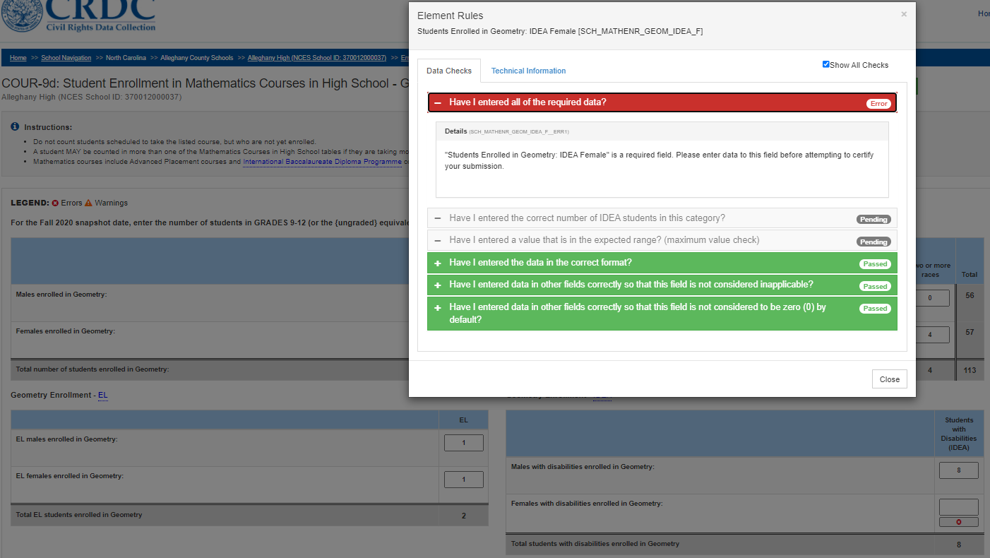
Error Resolution – COUR-9d
Update the element. In this example, record ‘0’.
Originally Presented: 01/28/2022

Slide 43
Errors Resolution
In the example provided in the next slide, if appropriate, a Reason Code can be recorded to resolve the error. (DSED-2)
Reason Codes are perfectly acceptable ways to resolve an error.
Originally Presented: 01/28/2022

Slide 44
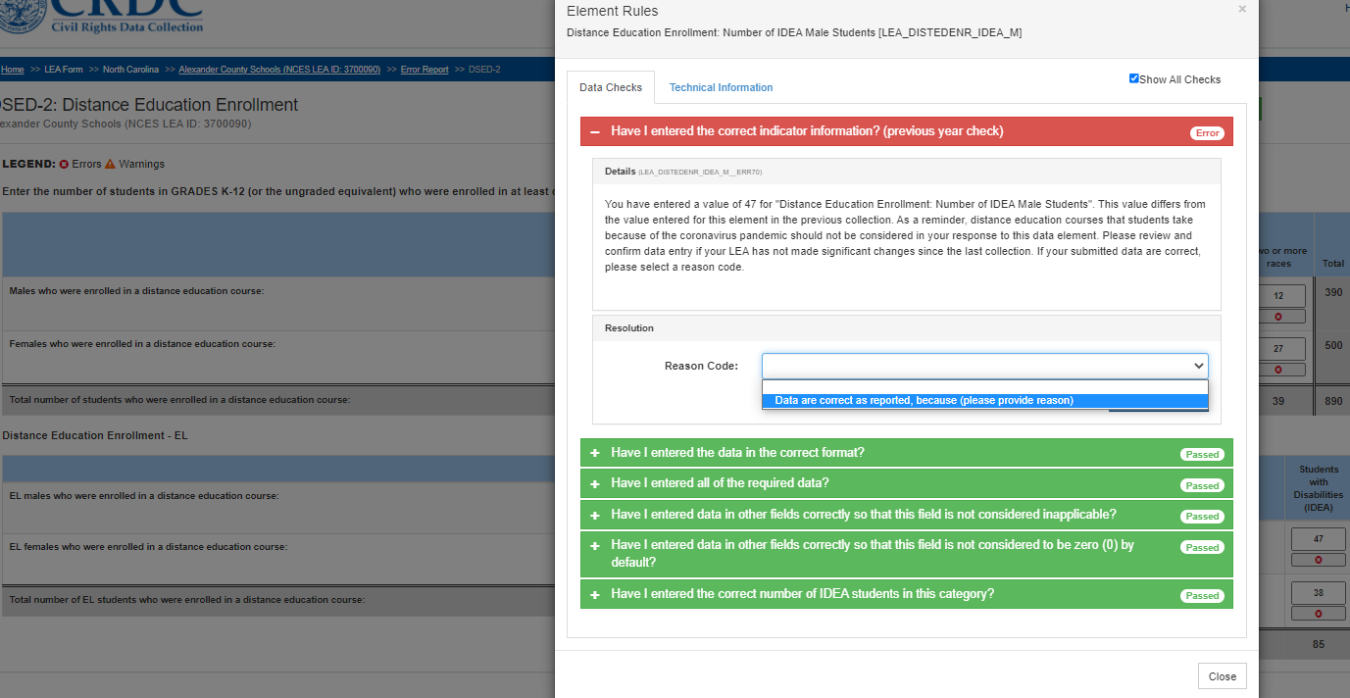
Error Resolution – DSED-2
Use Reason Codes when data are correct as supplied.
Originally Presented: 01/28/2022

Slide 45
Error Examples & Reason Codes
"Students with disabilities who received an expulsion with educational services: IDEA Two or More Races Male" must be less than the value of 0 reported for "Students with disabilities served under IDEA: Two or More Races Male", but you have entered a greater value. To resolve this error, you can either change one of these values, or provide an explanation using a reason code and comment.”
Enrollment Element (Snapshot)
Full Year element
Originally Presented: 02/04/2022

Slide 46
In More Human Terms -
The system is trying to validate full year data against enrollment data which is based on the snapshot date of 10/1/2020.
This may occur in the following modules:
EXAM
RETN
ATHL
DISC
ARRS
OFFN
HIBS
RSTR
Reason Code text suggestion:
‘Enrollment is Snapshot, xModule is Full Year. Business Rules conflict with System Rules.’
Originally Presented: 02/04/2022

Slide 47
Error Examples & Reason Codes
“You have entered a value of 1 for Female 504 students in this category, but this exceeds the total number of Female students in this category (0). In order to resolve this error, you must change one or more of these values.”
IDEA Elements
Section 504 Only Element
Originally Presented: 02/04/2022

Slide 48
In More Human Terms -
The system is trying to validate Section 504 Only against IDEA race/ethnicity data.
This may occur in the following modules:
DISC
ARRS
HIBS
RSTR
Reason Code text suggestion:
‘Students are either IDEA or Section 504 Only. The data are mutually exclusive’
Originally Presented: 02/04/2022

Slide 49
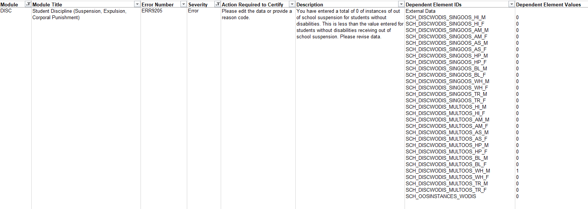
Error Examples & Reason Codes
“You have entered a total of 0 of instances of out of school suspension for students without disabilities. This is less than the value entered for students without disabilities receiving out of school suspension. Please revise data.”
This male student is not IDEA and is Section 504 Only
Originally Presented: 02/04/2022

Slide 50
DISC-11 Instances of Suspension
Federal Business Rule:
“For a student who receives multiple out-of-school suspensions, each out-of-school suspension occurrence should be counted as an instance of out-of-school suspension. For example, for a student who receives a one-day out-of-school suspension in the fall, and a three-day out-of-school suspension in the spring, the out-of-school suspensions would be considered two instances.
The male student who is not IDEA and is Section 504 Only is counted here. The question is broken out into three categories. In the federal tables, The Section 504 Only data are being counted with IDEA students. Both the definition and the system logic need clarification.
Originally Presented: 02/04/2022

Slide 51
DISC-11 Instances of Suspension
Reason Code text suggestion:
‘Data are accurate as reported. Business rules imply that categories are mutually exclusive.’
Originally Presented: 02/04/2022

Slide 52
In More Human Terms -
The system treating Section 504 Only students differently across the system.
NCDPI is in discussions with the feds about this issue.
The issue will likely not be resolved in this collection.
Feel free to submit helpdesk tickets about these errors to garner more awareness.
Originally Presented: 02/04/2022

Slide 53
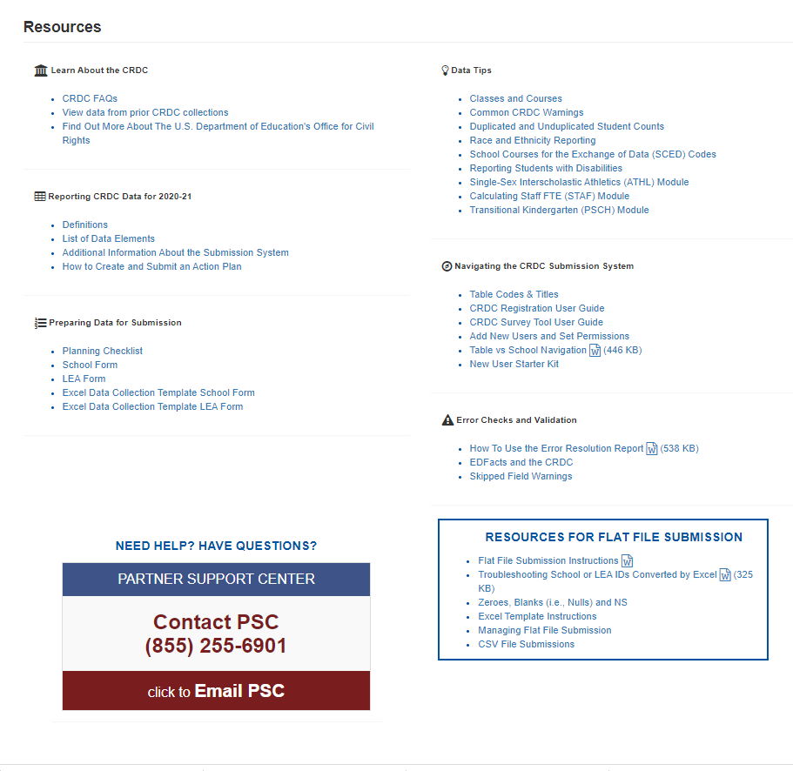
Resources
Links within the tool to popular documents.
Help Desk Link
Originally Presented: 01/28/2022

Slide 54
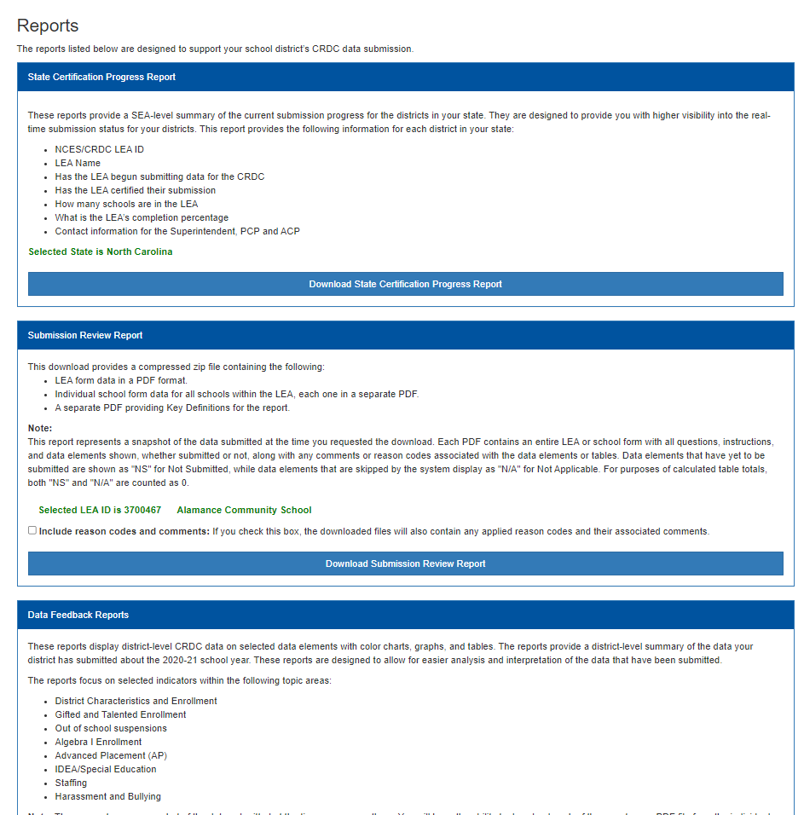
Reports
LEA overview of progress to completion
PDF Copy like federal forms with data populated. ‘Human’ and readable, can be used for review and for and for copies after Certification
Charts and Graphs by Modue
Originally Presented: 01/28/2022

Slide 55
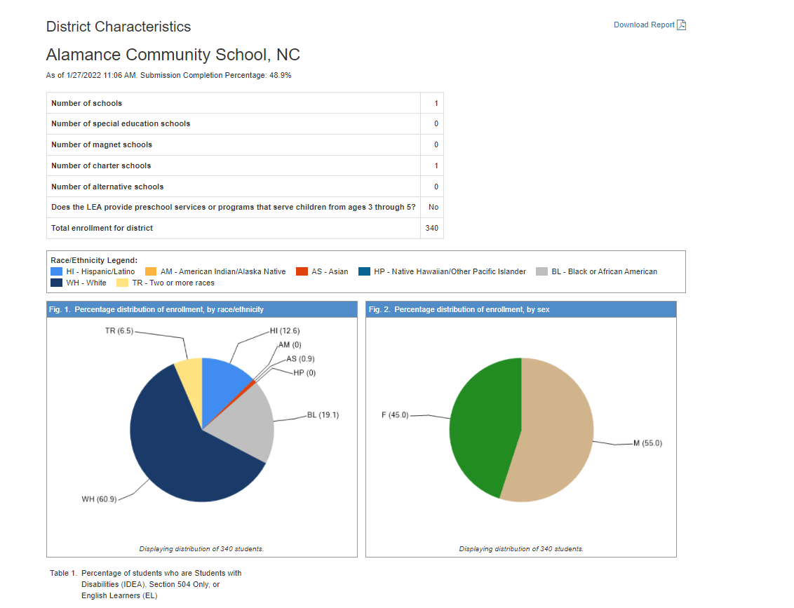
Data Feedback
Download
Originally Presented: 01/28/2022

Slide 56
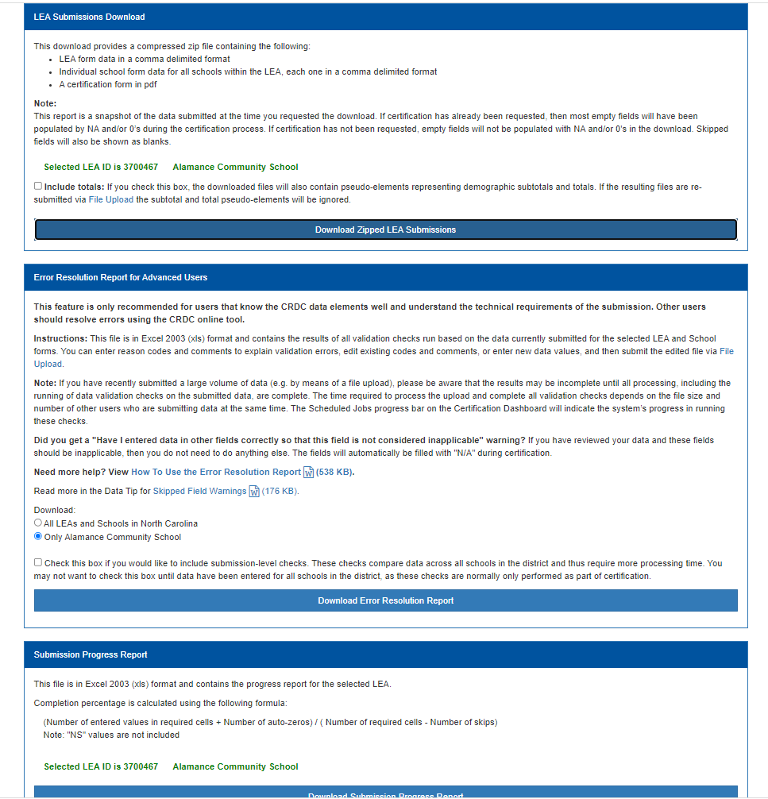
Reports
Zip file containing data files in upload format.
Spreadsheet of all errors and warning by module and error code. Must unprotect each worksheet to use filters.
May seem overwhelming. Very useful for an overall picture without having to navigate the system. Always start with errors. Drawback: identifies schools by NCES code
Spreadsheet containing % completion by module
Originally Presented: 01/28/2022

Slide 57
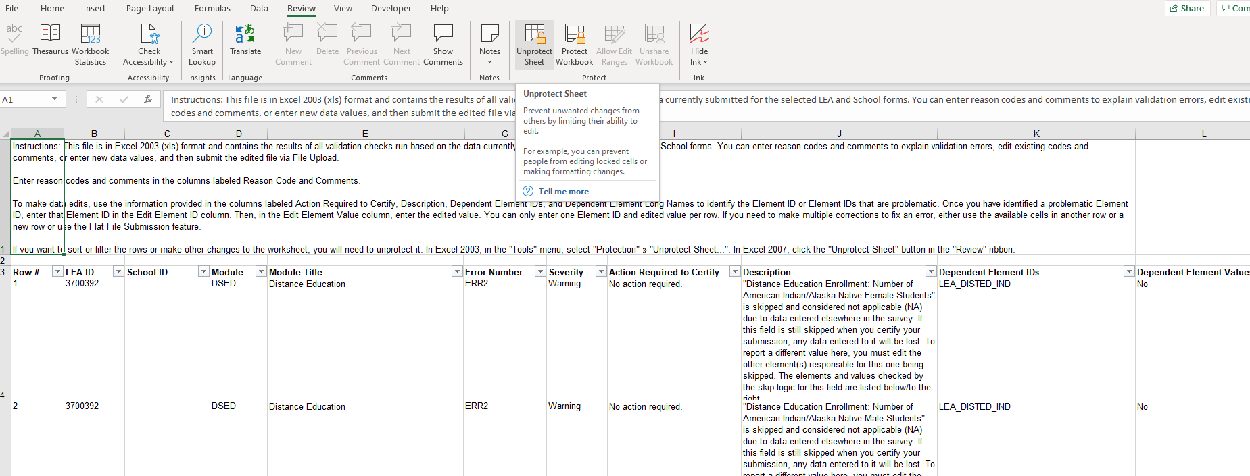
Error Resolution
Click Review, Click Unprotect
Elements and more data to the right
Filter Module
Filter Severity to view Errors or Warnings
Originally Presented: 01/28/2022

Slide 58
Reports
User Access Report – not super useful
Spreadsheet identifying elements the
CRDC system considers skipped based on leading questions.
Example: No PK – all PK remaining elements will be skipped
Some of these reports may seem to be overwhelming but may be an efficient way to review data if the system is experiencing latency issues.
Originally Presented: 01/28/2022

Slide 59
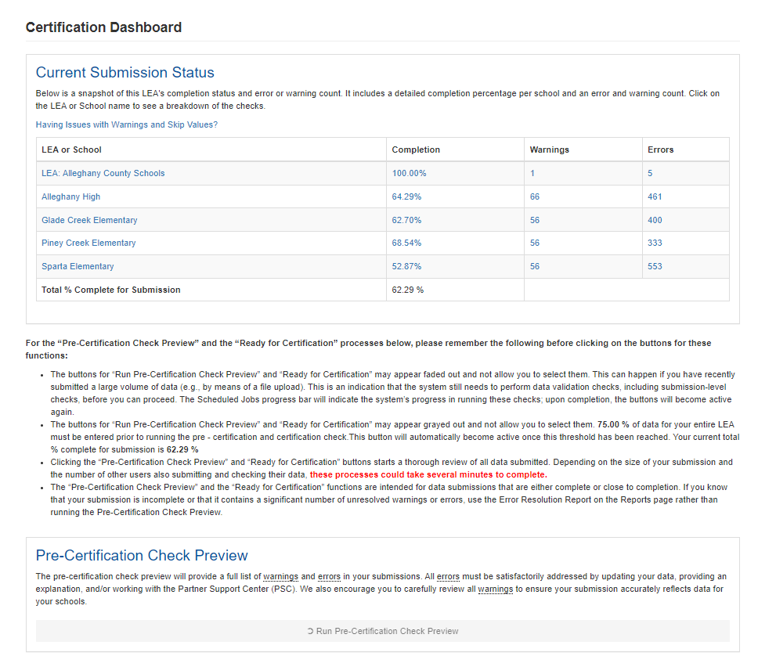
Certification
Drill by school lists modules, % complete
Links to Errors and Warnings tables by module
LEA Admin – Birdseye view of completion % Warnings and Errors
Originally Presented: 01/28/2022

Slide 60
Certification - %
Links to Errors and Warnings tables by module
School Link and % link navigate to this screen
Originally Presented: 01/28/2022

Slide 61
Certification - Errors
Errors and Warning columns on Certification Home Page link to this screen.
The Error Report button on the percentage complete also link to this screen.
Originally Presented: 01/28/2022

Slide 62
Certification - Errors
Click the row to expand and see all Errors and Warnings for the module.
Click the Error or Warning link to go to the module question screen
Originally Presented: 01/28/2022

Slide 63
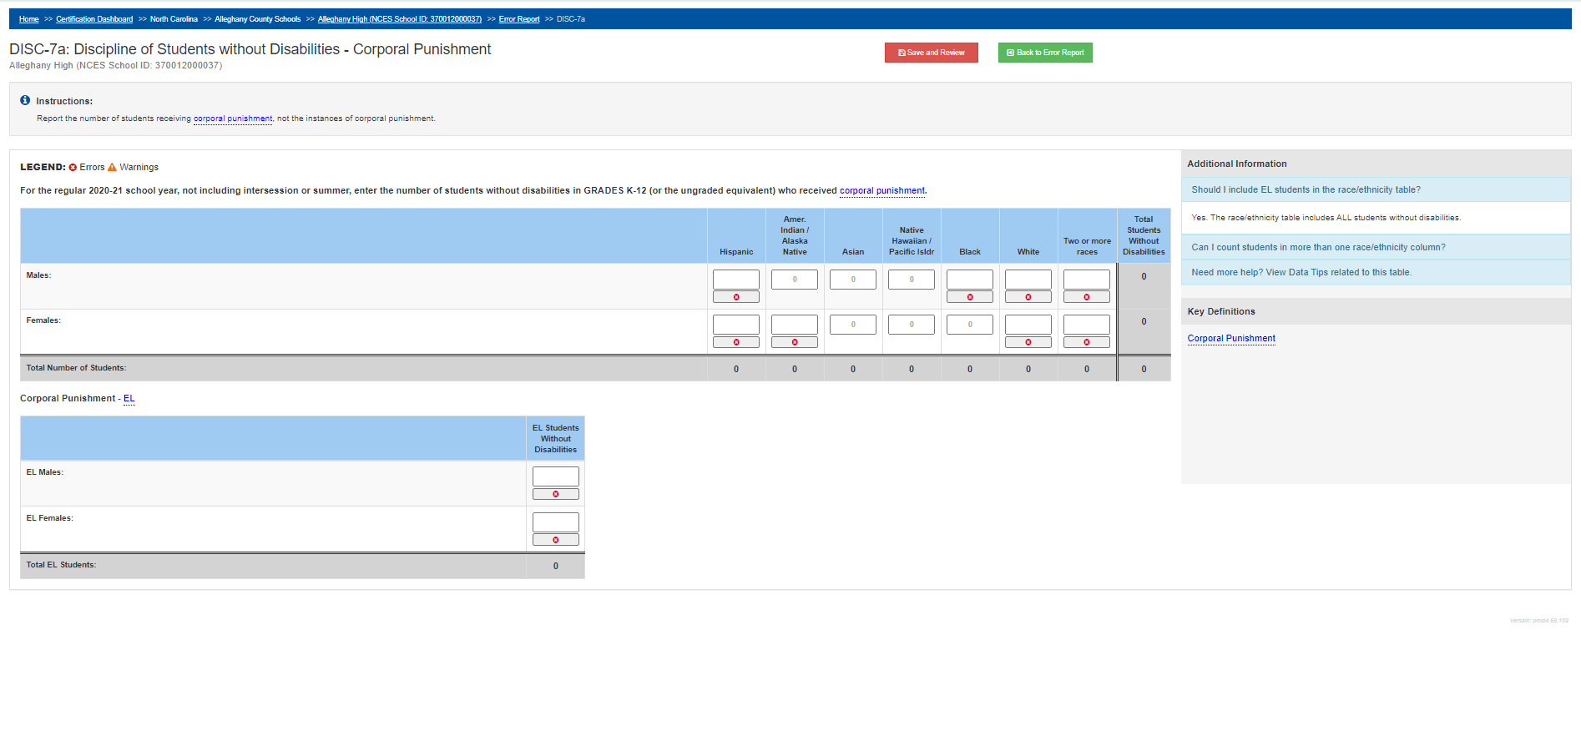
Module Question Screen Example
Breadcrumbs
Save and Review
Help is embedded in the screen
Click to review and resolve error.
Originally Presented: 01/28/2022

Slide 64
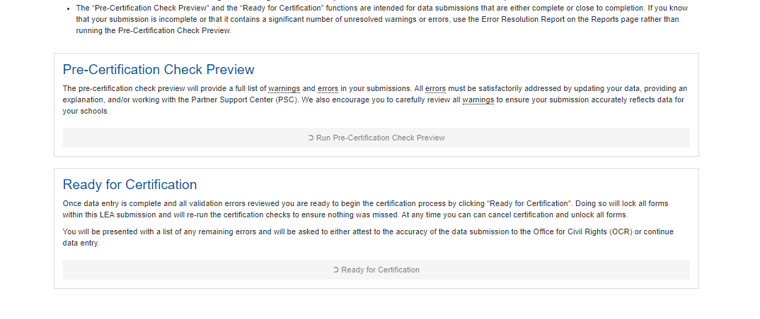
Certification
Certification button
To complete the collection the PSU must Certify. The Certification button turns Green when all Errors are resolved.
Resolve Errors first then review Warnings
Originally Presented: 01/28/2022

Slide 65
All PSUs must Certify the collection by February 28, 2022
Originally Presented: 01/28/2022

Slide 66
Any Questions?
Originally Presented: 01/28/2022

Slide 67
Support
Issue / Concern | Contact | Contact Info
Data not loaded for school Questions about data | HBSC Support Center | (919) 716-1840 or https://ncgov.servicenowservices.com/sp_dpi
No access to Federal Portal Incorrect permissions for account School does not exist in the Federal Portal | CRDC Partner Support | (855) 255-6901 or crdc@aemcorp.com
Originally Presented: 01/28/2022

Slide 68
Thank You!
Originally Presented: 01/28/2022

