Slide 1
FY24 BSCA 21st CCLC Competitive Summer Enhancement Grant Program September 13, 2023 RFP TA Day 1 10am-12pm NC Department of Public Instruction Office of Federal Programs
Notes:
Susan

Slide 2
North Carolina Department of Public Instruction Office of Federal Programs ~ 21st CCLC Team
21st Century Community Learning Centers (CCLC)
Leadership
Alex Charles ~ Interim Senior Director
Susan Brigman, Section Chief ~ Specialty Programs
NCDPI 21st CCLC Program Administrators
Dr. Darren Hamilton
Gina White
Hawhana Locklear
Wendy Buck
Areli Perez Nava
NCDPI Fiscal Monitors
Katrina Blount
Ashton Moss
Monica Pask
NCDPI Data Management
Anita Harris
Administrative Support
Melba Strickland
Shana Fryar
Notes:
Susan: Introduce the Team

Slide 3
Housekeeping
WebEx Etiquette
First Name, Last Name, Organization Name in Chat
How to Ask Questions
Presentation Slides will be Posted
Notes:
Susan
WebEx Etiquette:
- Stay Muted unless asking a question
- Turn camera off to support better bandwidth and audio call quality
- Ask questions in the chat; moderators/presenters will answer via chat or out loud for the group; we will collect questions asked in the chat during the webinar to include in the FAQ
Slides will be posted on 21st CCLC webpage along with a recording of the webinar

Slide 4
Agenda
Funding Source
Purpose of the Grant
Eligibility
Good Standing
Focus
Grant Award and Duration
Funding Ranges
How to Apply
Priority Points
Grant Timeline
Notes:
Susan

Slide 5
Funding Source
On June 25, 2022, President Biden signed into law the Bipartisan Safer Communities Act (BSCA), which included additional 21st CCLC funding.
NCDPI was awarded approximately $1.4 million ($1,400,000) in supplemental BSCA 21st CCLC funds and proposes using the BSCA award to fund the FY24 BSCA 21st CCLC Competitive Summer Enhancement Grant Program.
Notes:
Susan Reference ESSA submitted documentation referencing 21st CCLC
Moving forward this will be referenced as the Summer Enhancement Grant

Slide 6
BSCA 21st CCLC SEG Purpose
To foster safer, more inclusive school environments as well as support evidence-based practices intended to increase attendance and engagement of students, especially those in middle grades and high school.
Notes:
Susan

Slide 7
Eligibility
Only open to organizations who are currently receiving 21st CCLC funds (Cohort 15 and Cohort 16 subgrantees)
New (Draft) Non-Regulatory Guidance issued by USED
Notes:
Susan-
Flag why cohort 14 can’t apply for this grant- enhancement focus Do we keep the non-regulatory guidance comment since it isn’t completely approved? Small amount probably not recurring
Only applicants who are currently receiving 21st CCLC funds for the 2023-2024 academic year (i.e., subgrantees in Cohort 15 and/or Cohort 16) are eligible to apply for the FY24 BSCA 21st CCLC Competitive Summer Enhancement Grant Program.

Slide 8
Good Standing Definition
To be in Good Standing, applicants must have:
submitted all 21st CCLC final evaluation reports and data as required, and
finalized all comprehensive program and/or fiscal monitoring review findings or questioned costs, and
no unresolved fiscal findings from a previous fiscal year (FY23 or earlier) by the Office of the State Auditor (OSA) at the time the application is due (October 31, 2023).
If the applicant organization is deemed Not in Good Standing by NCDPI Office of Federal Programs (OFP) at any point during the review process, the application may be identified as “Not Recommended” for funding to the SBE.
Notes:
Susan

Slide 9
FY24 BSCA 21st CCLC SEG Program Focus
In alignment with the United States Department of Education guidance for BSCA funds, the FY24 BSCA 21st CCLC Competitive Summer Enhancement Grant Program seeks to fund summer intensive programs designed to improve students’ access to innovative learning strategies that focus on reducing chronic absenteeism and increasing student engagement in learning.
Notes:
Susan-

Slide 10
Focus Areas
For the purposes of the FY24 BSCA 21st CCLC Competitive Summer Enhancement Grant Program, all proposed summer intensive programs must be designed to support students in one or more of the following focus areas:
Kindergarten transition for rising kindergarteners (PreK students)(only for PSUs)
5th grade to 6th grade transition for rising 6th grade students
8th to 9th grade transition for rising 9th grade students
Intensive tutoring previewing upcoming school year learning standards and/or credit recovery programs
Comprehensive mental health supports (e.g., hiring certified, professional mental health staff to support students in developing social and emotional skills)
Notes:
Areli

Slide 11
Summer Intensive Programs
NCDPI defines summer intensive programs as comprehensive, consecutive 2–3-week targeted interventions designed to eliminate skills gaps, accelerate learning, ease the social transition, and/or prepare participating students for success in the upcoming school year.
Baker-Wright, T., Maldonado, C. (2019). A career-oriented summer: Planning your summer bridge program. Jobs for the Future. https://archive.jff.org/resources/planning-summer-bridge/
Notes:
Areli-
Research has shown that students who participate in intentional summer intensive programs have fewer discipline problems, increased self esteem, improved motivation to learn and reduced drop out rates.

Slide 12
Innovative Learning
For the purposes of this grant, innovative learning strategies can be defined as strategies that leverage high-quality academic instructional materials designed to:
focus on grade-level content,
access students’ prior knowledge,
provide rich, hands-on learning experiences, and
explicitly integrate social, emotional, and academic skill building.
Notes:
Areli-
Research has shown that targeted, high-quality summer learning programs focused on both social-emotional supports and skill-building in the areas of math and reading can support students to make and sustain academic progress, as well as reduce unexcused absences and chronic absenteeism, in the upcoming school year.

Slide 13
High Quality Interactive Enrichment
For the purposes of the 21st CCLC FY24 BSCA 21st CCLC Competitive Summer Enhancement Grant Program, proposed enrichment and/or academic activities should be designed to deeply engage all participants by:
being multi-disciplinary in approach (i.e., students must use academic skills from multiple subject areas),
being broad in offering (e.g., arts, recreation, health and wellness, STEM, cultural activities, etc.), and,
providing relevant and engaging learning experiences by connecting students’ academic skills and knowledge with their cultural (e.g., leveraging student-interests in the design and implementation of the program, working with students to build classroom norms and site culture, etc.) and community (e.g., student apprenticeships with community businesses, exploration opportunities, project-based learning, community field trips, service-learning opportunities, etc.) contexts.
Cantor, P., Osher, et al. (2019). Malleability, plasticity, and individuality: How children learn and develop in context. Applied Developmental Science, 23(4), 307–337.
Notes:
Areli

Slide 14
Serving Current 21st CCLC Students
Eligible applicants may only propose to serve the same feeder schools and target student populations as their standard 21st CCLC grant if:
the applicant does not currently receive summer funding as part of their standard 21st CCLC grant, and/or
if the applicant’s proposed summer intensive program is occurring on different dates before and/or after the completion of the standard 21st CCLC summer program, and/or
if the applicant’s proposed summer intensive program is occurring on the same dates as the standard 21st CCLC summer program but is not being implemented at the same time (i.e., the summer enhancement program must occur before and/or after standard 21st CCLC summer program hours on a given day).
Notes:
Areli

Slide 15
Family Engagement
All proposed programs must include a family engagement component, as family engagement is a key factor for effectively reducing chronic absences among students.
For the purposes of the FY24 BSCA 21st CCLC Competitive Summer Enhancement Grant Program, all applicants must propose to host at least two (2) educational workshops for families of participating students.
One workshop must focus on deepening participating families’ understanding of the connection between consistent school-day attendance and future student success.
The other workshop(s) must focus on offering families training on age-appropriate home-based strategies for supporting students’ social-emotional well-being, and/or providing access to community resources supporting student and family mental health.
The implementation of all family educational workshops must be concurrent with the proposed summer intensive program’s implementation timeline.
Attendance Works (2015). Bringing attendance home: Engaging parents in preventing chronic absence. Attendance Works Parent Tool Kit, https://www.attendanceworks.org/wp-content/uploads/2017/09/062215_AW_ParentToolkit-1.pdf
Notes:
Areli

Slide 16
Supplement vs. Supplant
The purpose of a supplement, not supplant provision is to help ensure that federal grant funds are expended to benefit the intended population defined in the authorizing statute, rather than being diverted to cover expenses the grantee would have paid out of other funds in the event the federal funds were not available.
Notes:
Katrina –
As a part of this statute these funds are intended To foster safer, more inclusive school environments as well as support evidence-based practices intended to increase attendance and engagement of students, especially those in middle grades and high school.

Slide 17
Examples of Supplement/Supplant
Funds awarded for the Summer Enhancement Grant must not be used to supplement any aspect of your Cohort 15 or Cohort 16 Summer Programming in your FY 24 award.
Ex: Using SEG funds to pay for a teacher to provide intensive tutoring for your Cohort 15 summer program
Funds awarded in FY 24 for Cohorts 15 and 16 must not be used to supplement/supplant funds with your Summer Enhancement Grant.
Ex. Using FY24 cohort 15 or 16 funds for contracted services to pay for a pottery artist to work with students during SEG programming.
Not operating a Cohort 15 summer program and only operating a SEG summer program in its place
Notes:
Katrina-
In either scenario this would include; salaries and fringes, supplies & materials, contracted services, transportation, snacks, field trips, etc.

Slide 18
Grant Award and Duration
For the FY24 BSCA 21st CCLC Competitive Summer Enhancement Grant Program, applicants may request funds ranging from $25,000, not to exceed $150,000 based on:
1) needs identified in the community and schools;
2) scope of the program;
3) proposed number of students served;
4) program design;
5) organizational capacity; and
6) evaluation capacity
Organizations may request reimbursement for expenses back to March 1, 2024, and through September 2, 2024.
Notes:
Katrina – The FY 24 Bipartisan Safer Communities Act 21st CCLC Competitive Summer Enhancement Grant Program, applicants may request funds in the amount from $25,000 up to $150000 based on the following:
Needs identified in the community and schools
Scope of your program
Proposed number of students served
Program Design
Organizational capacity, and
Evaluation capacity
Once programs are awarded they may request reimbursement for expenses back to March 1, 2024 and up through September 2, 2024.

Slide 19
Funding Ranges for FY24
Range 1
25-49 students; 2-3 weeks; 16+ hours per week: $25,000 - $50,000
Range 2
50-75 students; 2-3 weeks; 16+ hours per week: up to $75,000
Range 3
76-100 students; 2-3 weeks; 16+ hours per week: up to $120,000
Range 4
101+ students; 2-3 weeks; 16+ hours per week: up to $150,000
To determine the level of funding eligibility, NCDPI utilized the Wallace Foundation Out-of-School Time Cost Calculator to develop the funding ranges below based on the number of students served, the duration of the summer intensive program, and its physical location.
Notes:
Katrina – Here in this slide are the funding ranges for the Bipartisan Safer Communities Act – Summer Enhancement Grant
To determine the level of funding eligibility, NCDPI utilized the Wallace Foundation Out-of-School Time Cost Calculator to develop the suggested ranges below based on the number of students served, the duration of the program, and it’s physical location. Used most expensive program possible for grade level and county

Slide 20
Submit the application in CCIP
Once you have drafted your proposal, all information (including Document uploads,) must be entered into the web-based grant management system
Only proposals submitted through CCIP as at least “Draft Completed” by 12:00 p.m. NOON EDT, October 31, 2023 will be reviewed/evaluated
Once an application is submitted, no changes can be made to the proposal
Notes:
Katrina – Once you have drafted your proposal, all information (including Document uploads) must be entered into the web-based grant management system (CCIP).
Only proposals submitted through CCIP up to “Draft Completed” by 12:00 noon EDT, October 31, 2023 will be reviewed/evaluated.
Once the application is submitted in CCIP, there cannot be any changes made to the proposal
If there aren’t any questions, I will turn things over to Wendy Buck.

Slide 21
How to Apply
Notes:
wendy
We will now transition to discussing how applicants can access all application information for the FY23 Competitive Summer Mini-Grant.

Slide 22
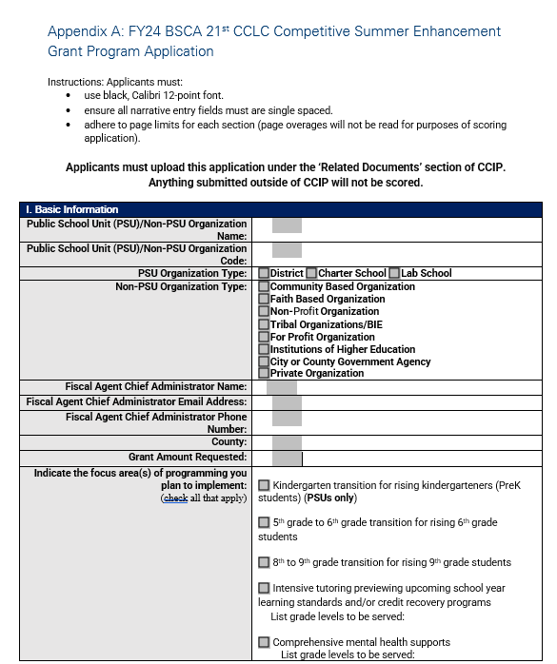
Paper Application
Complete the paper application following all the directions.
Upload it in the related documents section in CCIP under required documents.
Notes:
Wendy
Needs to be in black, calibri 12 point font, ensure all narrative fields are signles paced, adhere to page limits for each section.

Slide 23
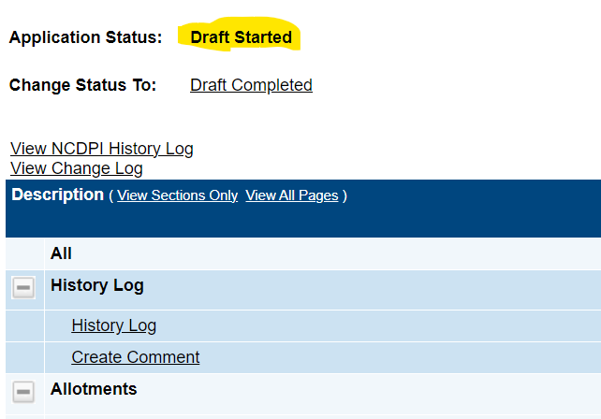
Funding Application Guidance
Before any applicant can begin uploading any related Documents they will need to click on the “Draft Started” link on the Section Page of CCIP. ​
Notes:
Wendy- This will be a paper application. However, it will be uploaded in CCIP as a required related document.

Slide 24
FY24 Priority Points
Absolute Priority – Serve Students in Title I Eligible Schools
Competitive Priorities:
CSI/TSI Schools (2 points if 100% of identified schools are designated as CSI, 1 point if 100% of identified schools are a combination of CSI and TSI).
Joint Applications ( 1 point if LEA receiving funds under Title I, Part A and at least one public or private community organization)
School Environment (1-3 points)*
Mental Health (1 point)*
Notes:
Wendy

Slide 25
CSI/TSI CSI/TSI Schools Link
Priority consideration shall be given to applications demonstrating models that propose all (100%) schools to be served are identified as Comprehensive Support and Improvement (CSI) Schools and/or Targeted Support and Improvement (TSI) Schools.
2 points if 100% of identified schools are designated as CSI
1 point if 100% of identified schools are a combination of CSI and TSI
Notes:
Wendy
Refer to the State CSI/TSI 2022-23 list and on this slide. (This link is found on the Proposed Feeder School Form)

Slide 26
Joint Application
Notes:
Wendy
This document should outline the specific roles and responsibilities of each partnering agency, entity, or organization participating in a joint submittal. The MOU must be signed and dated by each agency, entity, or organization participating in the joint submission where required.

Slide 27
School Environment Priority Points
Propose to serve students from proposed feeder schools with greater rates of (a) chronic absenteeism, (b) suspensions (short and long term), (c) expulsions, (d) criminal acts, and/or (e) instances of bullying/harassment in their school environment when compared to the State of North Carolina.
Priority points for School Environment will be assigned as follows:
At least (2) of the above school environment characteristics occurring at a greater rate for most proposed feeder schools (i.e., at least 51%) when compared to State of North Carolina (1 point)
At least (3) of the above school environment characteristics occurring at a greater rate for most proposed feeder schools (i.e., at least 51%) when compared to State of North Carolina (2 points)
(4) or more of the above school environment characteristics occurring at a greater rate for most proposed feeder schools (i.e., at least 51%) when compared to State of North Carolina (3 points)
Notes:
Wendy
Read the slide- This information will be confirmed utilizing the NC Report Card information for the feeder schools to be served and placed on the FY24 BSCA Feeder Schools and Performance Status Form for upload as part of the application.

Slide 28
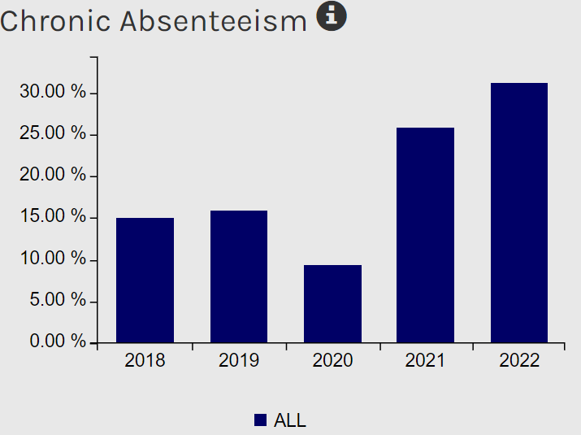
School Environment Information NC Report Card Link
Notes:
Wendy

Slide 29
Mental Health Priority Point
Priority consideration shall be given to applications that propose to hire certified and qualified mental health professionals and/or partner with qualified mental health service providers employing certified mental health professionals to intentionally support students’ social and emotional well-being.
If funded, documentation to confirm mental health certification/qualification will be required to be uploaded in CCIP.
Notes:
Wendy
Read the slide.

Slide 30
Priority Consideration Note
No priority consideration will be given based on the region served by the FY 24 BSCA 21st CCLC Competitive Summer Enhancement Grant Program.
Notes:
Wendy
Already considered when receiving Cohort 15 and 16
Turn over to Katrina

Slide 31
CCIP Budget Section
Katrina Blount, Fiscal Monitor
Notes:
Katrina In this section we will look at the budget requirements of the application for the Summer Enhancement Grant.

Slide 32
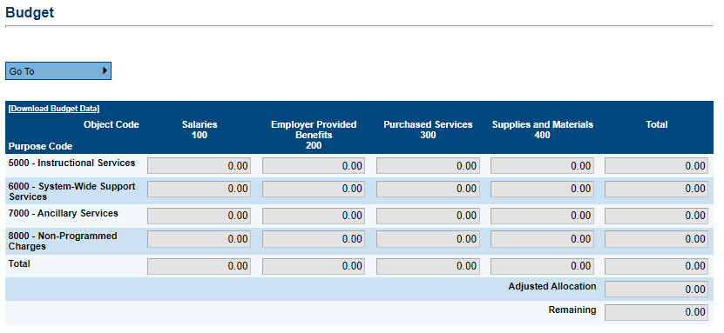
Funding Application: Budget Section
Students Enrolled | Number of Weeks, Hours per Week | Potential Range of Funding
25-49 Students | 2-3 Weeks; 16+ hours/week | $25,000-$50,000
50-75 Students | 2-3 Weeks; 16+ hours/week | up to $75,000
76-100 Students | 2-3 Weeks; 16+ hours/week | up to $120,000
100+ Students | 2-3 Weeks; 16+ hours/week | up to $150,000
Notes:
Katrina
Here is a screen shot of the Budget Section taken directly from CCIP. Applicants will need to enter amounts across the fields in this table to populate the program’s proposed grant award amount. Keep in mind program grant awards are based on the Funding Level ranges listed in the bottom right table.

Slide 33
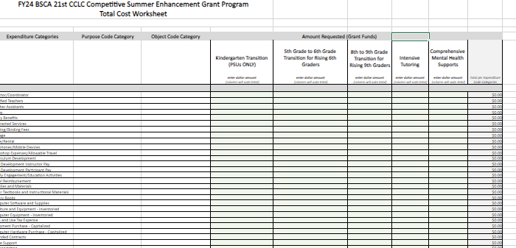
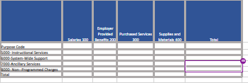
Total Cost Worksheet
Notes:
Katrina
As a reminder, Applicants will complete a total cost worksheet to provide reviewers with a highlevel snapshot of how they plan to spend potential FY24 Summer Enhancement Grant funds. Please note, if an applicant is awarded grant funds, the tentative budget submitted in the form of the Total Cost Worksheet is not considered an approved budget for the project. If funded, awarded applicants will complete a budget 208 form for review and approval.

Slide 34
CCIP Budget – Purpose & Object Codes
Purpose Codes | Definition
5000 Instructional Services | Instructional services include the costs of activities dealing directly with the interaction between teachers and students.
6000 System-Wide Support Services | Support services include the costs of activities providing support for the 21st CCLC program regardless of where these services are housed. These services provide administrative, technical, personal, and logistical support to facilitate, sustain, and enhance instruction
7000 Ancillary Services | Support services for PSUs only. This would include the cost of cafeteria (support) staff working to prepare and provide snacks to students during 21st CCLC programming.
8000 Non-Programmed Charges | Non-programmed charges for the 21st CCLC grant include amounts expended for indirect costs charged to a grant.
Object Code | 100 Salaries | 200 Employer Provided Benefits | 300 Purchased Services | 400 Supplies and Materials
Chart of Accounts-PRC 110; Purpose Codes and Object Codes Descriptions
Notes:
Katrina - For budgeting and accounting purposes, expenditures for 21st Century Community Learning Centers are classified into specific purpose and objects code. For some background:
Purpose codes help us understand the reasoning behind expenditures and how expenses are used. Purpose includes the activities or actions that are performed to accomplish the objectives of your 21st Century Program.
5000s for Instructional Services
6000s for System-Wide Support Services
7000s for Ancillary Services – these codes will apply to PSUs only for Nutrition Services
8000s for Non-Programmed Charges
Object codes help organize budgets further as they are the service or commodity obtained as a result of a specific expenditure. There are 4 major object categories used in 21st Century Chart of Accounts.
100s Salaries
200s Employer Provided Benefits
300s Purchased Services
400s Supplies and Materials
There are links on this slide for a full list of 21st CCLC account codes, and then descriptions for specific purpose and object codes.
Before we move on to the next section, we will check the chat to see if there are any questions.
I will now turn things over to Areli Perez Nava.

Slide 35
CCIP Related Documents
Wendy Buck, Program Administrator
Areli Perez Nava, Program Administrator
Notes:
Areli

Slide 36
Related Document section in CCIP
Required Documents
Application (template provided)
Basic Organization Information (template provided)
Statement of Assurances (template provided)
Program Schedule (no template provided)
Proposed Feeder School(s) with School Poverty & Performance Status (template provided)
Private Schools Consultation (template provided)
Total Cost Worksheet (template provided)
Debarment (template provided)
Criminal Background (template provided)
Conflict of Interest (template provided)
Notes:
Areli
As you are looking to upload the required documents into CCIP for your application please make sure you are using the latest appropriate template if one is provided. If there is no template provided you will need to create and upload your own document into CCIP. For example the organization chart does not have a template.
If you are completing a joint application please note that some documents require multiple uploads for the starred documents. Basic Organization Information, Statement of Assurances, Debarment Certification, Criminal Background
Proposed Feeder Schools Template- Applicants must complete the Excel template provided with appropriate information completed for all schools the 21st CCLC program proposes to serve and the related poverty percentages and low performing status of each.

Slide 37
Documents Already Completed and approved include:
Financial Audit Statement
Fiscal Questionnaire
Notes:
Areli

Slide 38
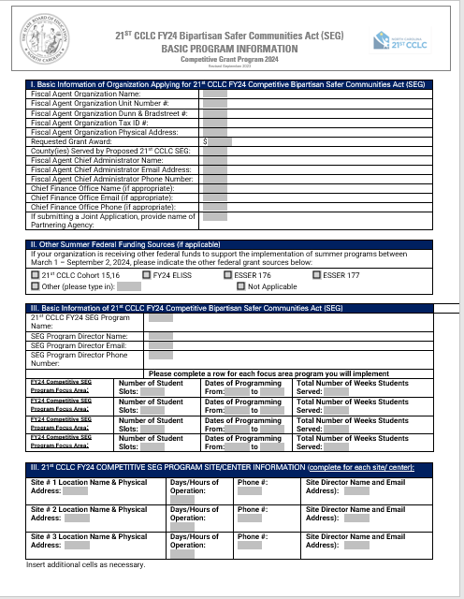
Basic Organization Information
Notes:
Areli
Similar to other 21st CCLC grants, the FY24 Competitive Summer Enhancement Grant will require an updated Basic Info form. Please note this form has been updated from the current school year forms, so current 21st CCLC programs, including those who are NOT applying to serve additional feeder schools, must complete and upload a new Basic Information sheet as part of their FY23 Competitive Summer Enhancement Grant Application.
NCDPI 21st CCLC program staff utilize this important file to create email listservs and to address important grantee Program and Fiscal Monitoring Notification Letters so it is important to keep this document as up to date as possible.
We encourage all applicants to make sure the following items are in alignment:
# of weeks and # of students served listed on the Basic Information sheet are aligned with provided funding levels in the RFP
All site locations for your summer program are included on the basic information form and ensure the same sites listed in application are also listed on basic information sheet.
You will also want to Make sure all contact information is accurate and up to date

Slide 39
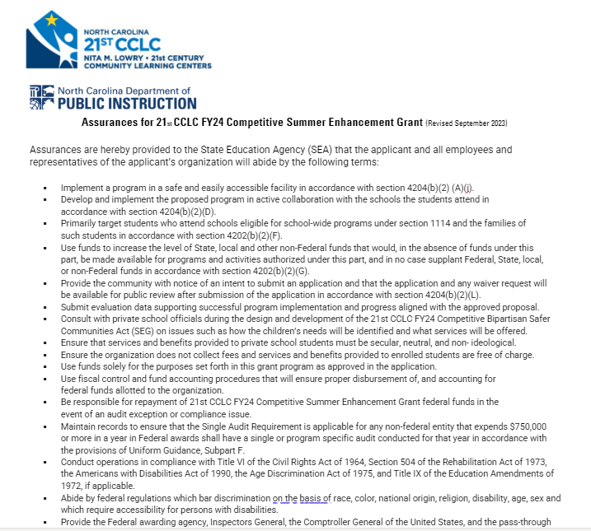
Statement of Assurances
The additions to the Statement of Assurances include an attestation that all federal funds including 21st CCLC funds will be used for supplemental purposes and not supplanting.
Also, PSUs are the only 21st CCLC programs that can apply to provide a transition program for Pre-K to Kindergarten students.
Attest to serve a different population of students or serve the same students as the standard 21st CCLC program at a different time. Any programming proposed to serve the same feeder schools and target student populations as their standard 21st CCLC grant must fall under the following:
The program does not currently receive summer funding as part of their standard 21st CCLC grant and/or
The proposed summer intensive program is occurring on different dates before and/or after the completion of the standard 21st CCLC summer program, and/or
The proposed summer intensive program is occurring on the same dates as the standard 21st CCLC summer program but is not being implemented at the same time (i.e., the summer enhancement program must occur before and/or after standard 21st CCLC summer program hours on a given day).
Notes:
Areli

Slide 40
Program Schedule
Applicants must provide a sample schedule for one week of programming to include:
planned activities
hours/days of operation for each of the program types (focus areas)
grade ranges served.
If a program schedule varies by sites, provide a sample schedule for each site.
Applicants will upload the program schedule under ‘Related Documents’ section of CCIP and must also respond to the Program Schedule narrative section on the paper application. Both the uploaded program schedule and the corresponding narrative section will be utilized to score applications.
Notes:
Areli

Slide 41
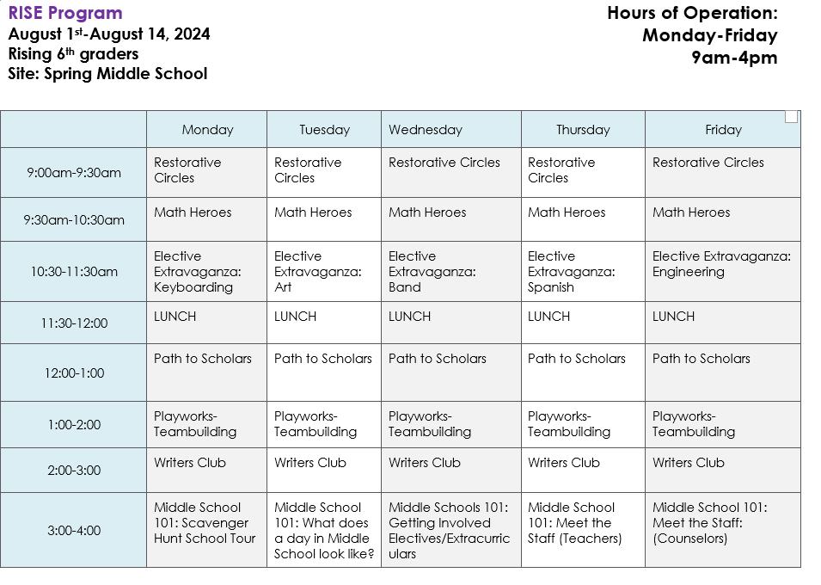
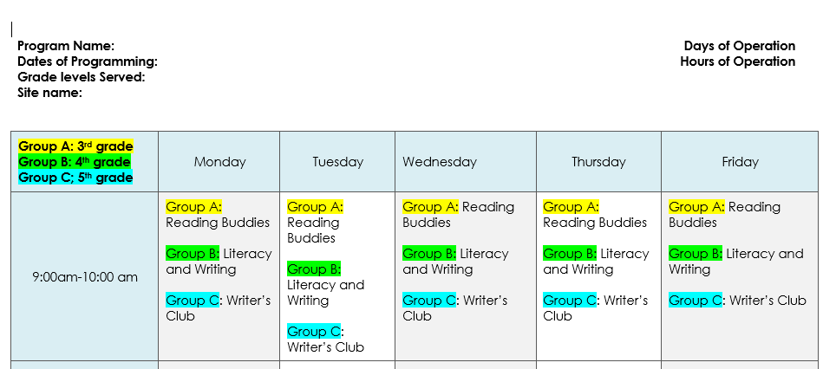
Example A
Sample
Program
Schedules
Example B
Notes:
Areli

Slide 42
Proposed Feeder School(s) with School Poverty and Performance Status
NC Report Card Link
Notes:
Wendy- NC report card link- only the environmental factors if applying for the priority point(s)

Slide 43
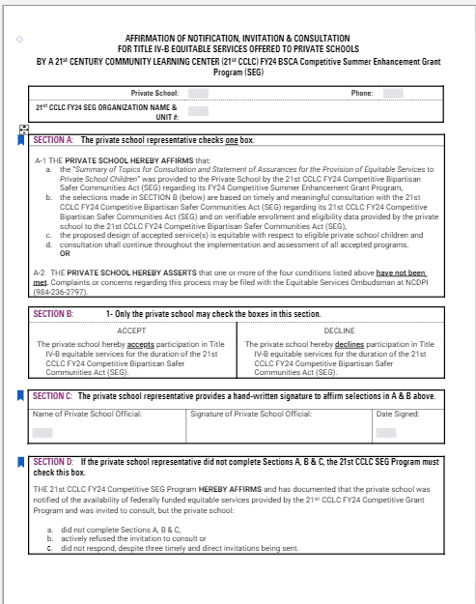
Private Schools Consultation
Section 8501 of the Every Student Succeeds Act (ESSA) requires timely and meaningful consultation occur between any entity receiving FY 24 BSCA 21st CCLC Competitive Summer Enhancement Grant Program funds and private school officials prior to any decision that affects the opportunities of eligible private school children, teachers, and other educational personnel to participate in programs under this Act
NC List of Private Schools
Notes:
Wendy- Section D- SMG
Section 8501 of the Every Student Succeeds Act (ESSA) requires timely and meaningful consultation occur between any entity receiving 21st CCLC FY23 Competitive Summer Mini-Grant
Program funds and private school officials prior to any decision that affects the opportunities of eligible private school children, teachers, and other educational personnel to participate in programs under this Act, and shall continue throughout the implementation and assessment of activities under this section.
The organization must annually notify private schools operating within the 21st CCLC FY23 Competitive Summer Mini-Grant Program area of availability, of the opportunity for private school student participation at no cost. The private schools included must be listed to include any private schools operating in the attendance area of the 21st CCLC FY23 Competitive Summer Mini- Grant Program and the Consultation and Statement of Assurances for the Provision of Equitable Services to Private School Children for Title IV-A form must be uploaded to CCIP where indicated. If no private schools are operating, the applicant must upload a statement indicating there are no schools are operating. Additionally, all applicants must upload new consultation forms and cannot upload consultation forms from previous competitions.
NOTE: The current list of North Carolina conventional non-public schools (i.e., private schools) is available at the link on your screen.
WILL STILL NEED SIGNATURE***

Slide 44
21st CCLC Private Schools Process for Pending Grant Approvals
Intent forms need to be sent with date for consultation pending grant award approval.
If awarded, then all private school documents would need to be uploaded by time of budget approval and release of funds.
You can upload a
1. list of private schools; and
2. one private school form filled out at the top for your organization and sign; and
3. identify the date of your tentative consultation meeting.
The private schools to consider for consultation for this grant would be the schools within the attendance zone of the feeder schools served with the 21st CCLC FY23 Summer Mini-grant.
Notes:
Wendy
Due to short application window, if there are private schools in your service area, applicants should submit the intent forms with date for consultation pending grant award approval. You can upload a list of private schools and one private school form filled out at the top for your organization and sign. On the list of private schools, identify the date of your tentative consultation meeting. If awarded, then all private school documents would need to be uploaded by time of budget approval for release of grant funds.
DPI; list of private schools and identify the date of tentative

Slide 45
Optional Document Summary
Memorandum of Understanding (MOU) (This document is required if application is jointly submitted by at least one local education agency (LEA) and one other eligible entity.)
Partnership Agreement (optional template provided)
Letters of Commitment
Notes:
Wendy-
Memorandum of Understanding (MOU) – (optional template provided)
This document should outline the specific roles and responsibilities of each partnering agency, entity, or organization participating in a joint submittal. IF The MOU is utilized must be signed and dated by each agency, entity, or organization participating in the joint submission where required.
Partnership Agreement – (optional template provided)You can download the MOU and tweak to fit your individual situation
This document should outline the specific roles and responsibilities of each partnering agency, entity, or organization participating in a joint submittal. A collaborative partner provides routine, regular, and ongoing services to the program as outlined in a partnership agreement (e.g., the regular use of facilities and equipment, mentors/tutors, etc.). The Partnership Agreement should be signed and dated by each agency, entity, or organization.
Letters of Commitment
The establishment of collaborative partners is critical to both the implementation and sustainability of the 21st CCLC FY24 Competitive Summer Enhancement Grant Program. Although Letters of Commitment are in the Optional Document section, applicants can demonstrate efforts to establish and maintain partnerships for implementing the grant by including signed Letters of Commitment in the application.
Letters of Commitment have a slot to be uploaded in CCIP .

Slide 46
MOU required for joint application
Notes:
Wendy
Here is a look at what the MOU template looks like. If it is utilized as the MOU please upload in the appropriate slot under optional documents. If you utilize it as a template for a partnership agreement you may tweak as needed and upload in that slot under optional documents.

Slide 47
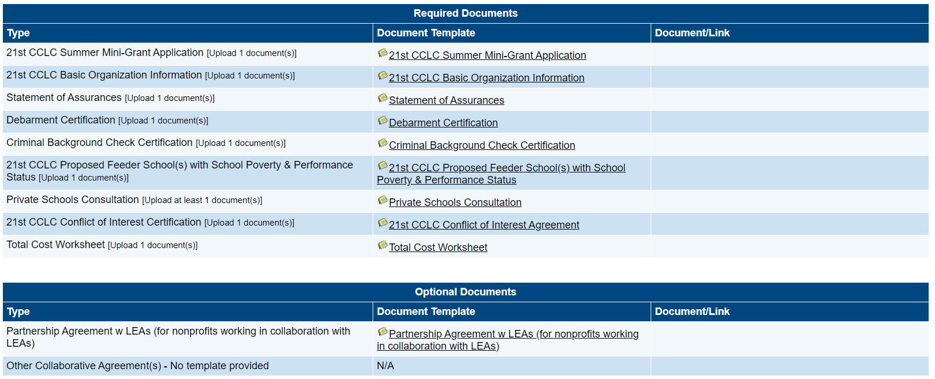
Submission in CCIP; 12:00PM NOON EDT October 31 2023“Draft Completed”
Notes:
Wendy
Here is a screen shot of WHERE to upload the required files. Before uploading any of the required documents, please ensure that your authorized representative signs and dates each file before uploading. After all Required Documents are uploaded, you will need to change the funding application statue to “DRAFT COMPLETED” you do NOT need to move the funding application through “Chief Administrator Approved” and if you do so before all application components are completed and verified, you will be UNABLE to have the funding application sent BACK for additional edits since this is a competitive grant; a score will have to be inserted priors for your organization to make later revisions/upload an official budget for review

Slide 48
Important Considerations
If Grant Funds are awarded the additional documents are important to consider now:
Building Maintenance and Fire Inspection Reports
Occupancy Report
Documentation of collaboration with Feeder Schools
Transit Inspection Report
Organization Chart
Mental health certifications/qualifications (if applying for mental health priority point)
Notes:
Wendy
Consulting with Feeder School is very important to begin now. Emphasize looking for space, making with relationship with feeder schools

Slide 49
Submit the application in CCIP
Once you have drafted your proposal, all information (including Document uploads,) must be entered into the web-based grant management system
Only proposals submitted through CCIP as at least “Draft Completed” by 12:00 p.m. NOON EDT, October 31, 2023 will be reviewed/evaluated
Once an application is submitted, no changes can be made to the proposal
Notes:
Wendy
In order to have your application officially reviewed for the competition, all applicants must submit their application via CCIP. READ THE SCREEN.

Slide 50
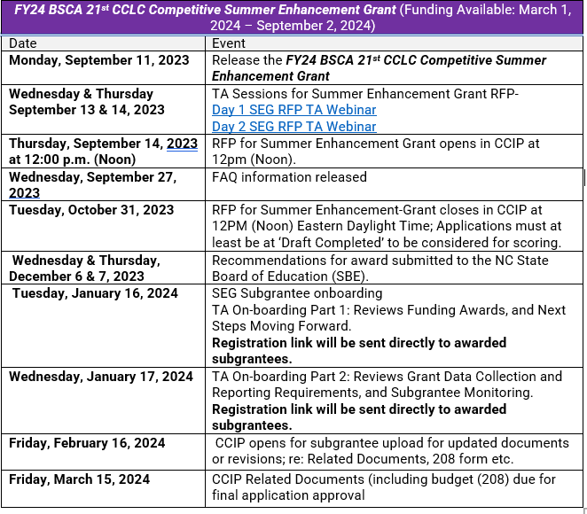
Grant Competition Timeline
Notes:
Wendy

Slide 51
Day 2 Reminder
Tomorrow September 14th from 10:00am-12 noon part 2 of the RFP TA.
Click the link below
FY24 SEG Day 2 RFP TA.
Notes:
Wendy

Slide 52
Questions
Susan Brigman, Section Chief ~ Specialty Programs
Office of Federal Programs
Susan.Brigman@dpi.nc.gov

