Slide 1
Supporting Success in CSI and TSI Identified Schools
Office of Federal Programs (OFP)
Comprehensive and Targeted Support (CTS)
Notes:
Thank you for having us. Today’s presentation focuses on the Framework for NCDPI Support to PSUs with CSI and TSI Identified Schools. We’ll walk through key areas of identification, funding, and support. At the conclusion, a QR code will be available for you to scan and share your feedback. Your input is greatly appreciated as we refine our support efforts.

Slide 2
Our Shared Commitment
  ✔ Supporting identified CSI & ATSI schools
  ✔ Aligning funding with strategic impact
  ✔ Sustaining improvement beyond the grant period

Slide 3
  What is the Comprehensive Support and Improvement (CSI) Identification?
CSI- Low Performing (CSI-LP) - ESEA section 1111(c)(4)(D)(i)(I)
  Schools whose School Performance Grades are in the bottom five percent of all Title I served schools; or
  Schools that did not exit CSI-LP status
CSI- Low Graduation Rate (CSI-LG) - ESEA section 1111(c)(4)(D)(i)(II)
  Schools with a four-year cohort graduation rate lower than 66.7% regardless of Title I status
CSI- Not Exiting Additional Targeted and Support (CSI-AT) - ESEA section 1111(c)(4)(D)(i)(III)
  Schools with a subgroup that did not exit ATSI after six years and are Title I served

Slide 4
  What is the Targeted Support and Improvement (TSI) Identification?
Additional Targeted Support and Improvement (ATSI) – ESEA section 1111(d)(2)(C)
  Schools have student subgroup(s) that are underperforming. For the fall 2025-26 identifications, any school with one or more subgroups identified as TSI-CU and receiving a subgroup letter grade score at or below the highest performing CSI-LP school’s School Performance Grade score based on the 2024-25 data, was identified as ATSI. Schools identified as CSI-LP are not eligible to be identified as ATSI.
Targeted Support and Improvement – Consistently Underperforming (TSI-CU) – ESEA section 1111(c)(4)(C)(iii)
  Schools are identified TSI-CU when schools have subgroup(s) that are consistently underperforming. Schools with one or more subgroups receiving an “F” letter grade in the accountability system for the most recent and previous two years are identified as TSI-CU. This is an annual identification list.

Slide 5
Funding with Purpose – 80/20
80% - Direct Support to Identified Schools
  Activities directly impacting CSI / TSI Schools
  (Ex.: interventions, coaching, tutoring)
  Use 50000 instructional Services purpose codes
  May be coded at 00000 or individual school sites
Notes:
PSUs must ensure all identified CSI and ATSI schools receive support and may distribute funds, including any remaining FY25/GY35 PRC 0105 funds based on current data, needs assessment, resource allocation review, etc. (funds may also be used to support TSI-CU identified schools). Allocations are calculated in the first year of the three-yar allotment cycle and will remain consistent through the three-years, unless modified by a special provision listed in the allotment policy.

Slide 6
Funding with Purpose – 80/20
Up to 20% - Administrative Allowance
  System-wide activities supporting implementation
  (Ex.: coordination, oversight, data analysis)
  Must use 60000 System-Wide Support Services purpose codes
  Must be coded at site 00000

Slide 7
Alignment to Approved Plans
All PRC 0105 funded activities must:
  ✔ Align directly with approved CSI / TSI plans
  ✔ Support school and PSU-level strategies
  ✔ Be clearly connected to identified needs

Slide 8
Building Sustainable Capacity
PRC 0105 funded activities should:
  ✔ Build leadership and instructional capacity
  ✔ Strengthen data and monitoring systems
  ✔ Continue beyond the availability of funds

Slide 9
Temporary Funds. Lasting Systems.
PRC 0105 funds are temporary and supplemental.
They are designed to:
  ✔ Accelerate improvement
  ✔ Strengthen systems
  ✔ Sustain progress beyond the funding cycle

Slide 10
Temporary Funds. Lasting Systems.
Incentives & Bonuses
  Codes 01800, 01810, and 01830 currently appear in the PRC 0105 Chart of Accounts due to prior year approvals.
    The codes are NOT allowable for FY-26 PRC 0105.
    Incentives / Bonuses may not be charged.
    The codes are planned to be removed from PRC 0105 July 1, 2026.

Slide 11
Temporary Funds. Lasting Systems.
Salaries
  PRC 0105 funds are not intended to serve as a long-term funding source for ongoing positions.
  PRC 0105 funds are designed to be a temporary support to establish a baseline for sustainable outcomes.
  Several salary codes that currently appear in the Chart of Accounts for PRC 0105 are planned to be removed from PRC 0105 July 1, 2026 (ex.: 5420-105-116 Assistant Principal)
Notes:
Discuss the lessons learned with ESSER funding (funding cliff)

Slide 12
Necessary & Reasonable Expenditures
All expenditures must be:
  ✔ Necessary to implement the approved plan
  ✔ Directly tied to improved outcomes
  ✔ Reasonable and cost-effective

Slide 13
Supplement, Not Supplant
PRC 0105 funds must:
  ✔ Supplement existing funding sources
  ✔ Enhance or expand services
  ✔ Not replace required or previously funded services

Slide 14
Coordinated PSU Leadership Support
The PSU commits to:
  ✔ Coordinated leadership and monitoring
  ✔ Data analysis and progress review
  ✔ Resource Allocation Review (RAR)
  ✔ Ongoing technical assistance

Slide 15
PSU Role in Reviewing the School Level RAR (self-assessment)
The PSU is not required to agree with every school RAR self-assessment response.
The RAR should be used as a data point to understand the school’s perception of resource alignment.
If gaps or misunderstanding exist, the PSU should use this as an opportunity for clarification and education.
Example: A school reporting “insufficient staff” may benefit from review of funding formulas or staffing allocations.
Notes:
The RAR is a conversational tool, not a compliance checkbox.

Slide 16
Facilitation Script for PSU Conversations with Principals
“When reviewing your RAR responses, we want to clarify that the goal is not agreement on every item, it’s understanding. The RAR reflects how the school perceives the current resource alignment and capacity.
The school indicated that staffing is insufficient. Let’s look at the data together. We can review:
* Position allotments
* Current funding sources
* Opportunities for strategic reallocation
Sometimes the issue is truly a resource gap. Other times, it may be a matter of understanding how staffing formulas or funding streams operate.”
Notes:
This conversation allows us to align perception with data and ensure we are maximizing available resources in support of the schools CSI / TSI plan.

Slide 17
NCStar Implementation with Fidelity
All identified CSI / ATSI schools will:
  ✔ Utilize NCStar for improvement planning
  ✔ Complete all required indicators
  ✔ Implement strategies with fidelity
School Improvement Planning and NCStar Website
​Sample PSU NCStar Feedback form in CTS Website: Resources
Notes:
Walk-through NCStar (Comprehensive Plan Submission, Annual Feedback Folder, Monthly Coaching Comments, Team (parent), Indicators – notes toward full implementation)

Slide 18
NCStar – Required Indicators
Identification | Required Indicators for NCStar 1.0 | Required Indicators for NCStar 2.0
ATSI CSI-AT CSI-LG CSI-LP | D.1.02 – Resource Allocation Review | CSI-ATSI .02 – Resource Allocation Review
ATSI CSI-AT CSI-LP | A4.01 – Evidence Based Intervention | G1.02 – Evidence Based Intervention
CSI-LG | A.4.10 – Evidence Based Intervention | CSI-LG .01 – Evidence Based Intervention

Slide 19
Parent Notification Requirements
Parent Notification Letters will be:
  ✔ Developed and distributed annually
  ✔ Direct distribution on or before November 30
  (ex.: bookbags, folders)
  ✔ Aligned with federal and state requirements
Link: Sample Parent Notification Letters (CTS Website)
Notes:
Go to CTS Website – share sample letters

Slide 20
Collaboration with NCDPI
PSUs agree to:
  ✔ Collaborate with NCDPI staff
  ✔ Participate in required support visits
  ✔ Comply with reporting requirements
  ✔ Engage in required supports for CSI / TSI schools
  (ex.: Needs Assessment – Resource Link – CTS Website)
Notes:
Navigate to the CNA / ANA tab on the CTS website

Slide 21
Students & Sustainable Success
PRC 0105 exists to:
  ✔ Accelerate meaningful improvement
  ✔ Strengthen PSUs and school systems
  ✔ Close opportunity gaps
  ✔ Ensure lasting impact for students

Slide 22


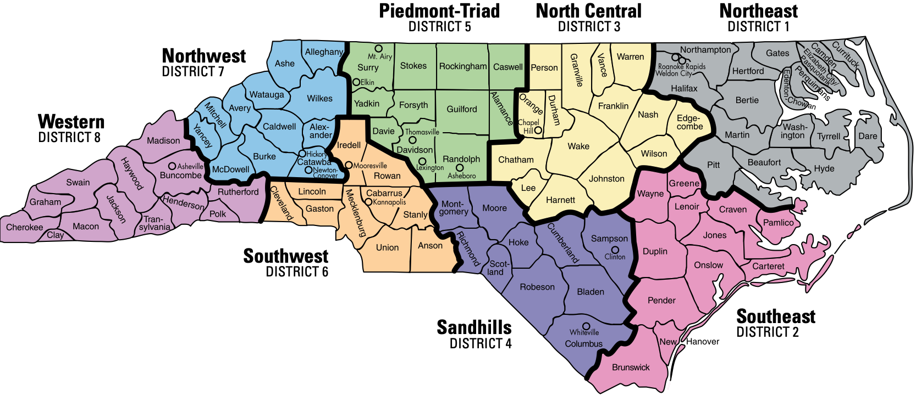


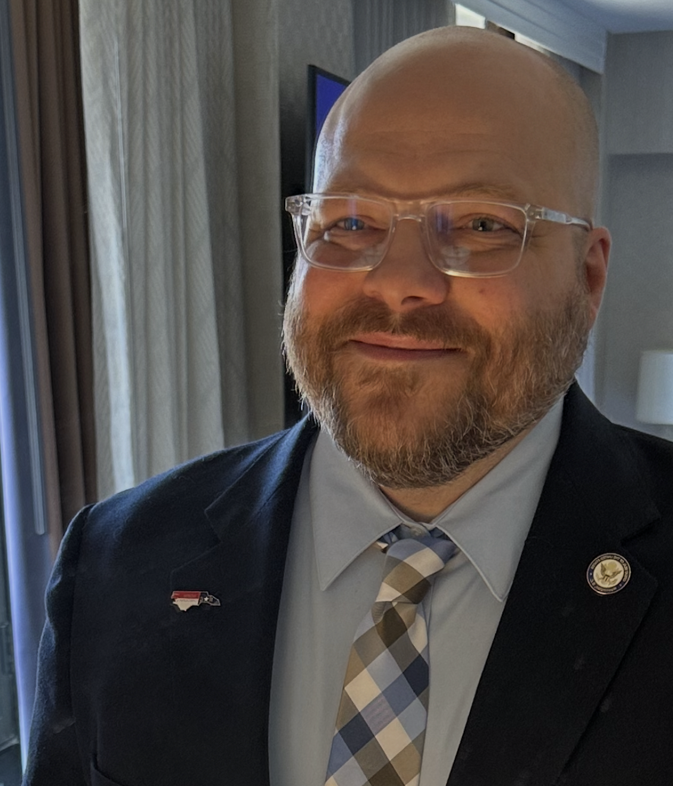
NCDPI Office of Federal Programs
Link: Comprehensive and Targeted Support (CTS) Contacts
Dr. James Popp, Section Chief
Dr. Penny Crooks
(5 & 7)
Dr. Richard Lewis
(3 & 4)
Julie Higdon
(6 & 8)
Tenisea Madry
(1 & 2)
Notes:
A CTS Program Administrator will support two regions, ensuring comprehensive coverage. The Section Chief will work closely with the team to provide oversight, strategy alignment, and coordination across all efforts.

Slide 23
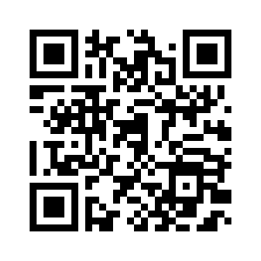
Feedback
https://forms.gle/ivuT1Fbqq9RTFa8L7
Notes:
Thank you for reviewing this important information with me. Please scan the QR code to provide feedback. Your partnership is critical as we work together to support Comprehensive and Targeted Support across North Carolina.

