Slide 1
Office Of Civil Rights Data Collection (OCR / CRDC)
State Level Submission Project Status Update
Terra Dominguez
State OCR Coordinator
terra.dominguez@dpi.nc.gov

Slide 2
About this Presentation
This presentation is a collection of each status update.
Download the full presentation here.
Slides from previous updates/webinars have been hidden to allow attendees to focus on current information.
Originally Presented: 10/29/2021

Slide 3
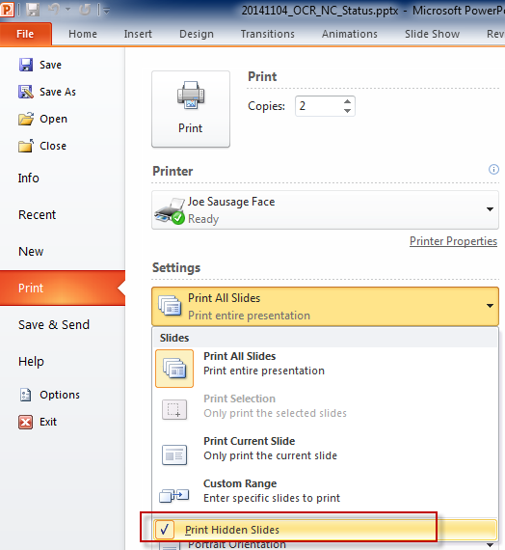
About this Presentation…
Slides that are hidden will print if your print settings are not updated.
If you are using this presentation to follow along with the Status Update, the following is recommended:
Click File
Click Print
From Settings, click the Print All Slides drop-down
Uncheck Print Hidden Slides
Originally Presented: 10/29/2021

Slide 4
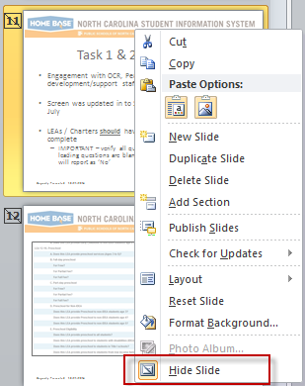
About this Presentation…
To display hidden slides:
Download and open the original PowerPoint file
From the left pane, right click slide
Click ‘Hide Slide’
Originally Presented: 10/29/2021

Slide 5
More About this Presentation
Page numbers
Page numbers do not update if a slide is hidden
‘Originally Presented’ and ‘Updated’ date are located on the footer
Slides may be re-used with each webinar
Latest ‘Known Issues’ stamped with
‘Known Issues’ that are resolved stamped with
Originally Presented: 10/29/2021

Slide 6
Agenda
Overview
Resources
Non-PowerSchool Data
CRDC and PowerSchool
Federal Submission Tool
Closing
Originally Presented: 10/29/2021

Slide 7
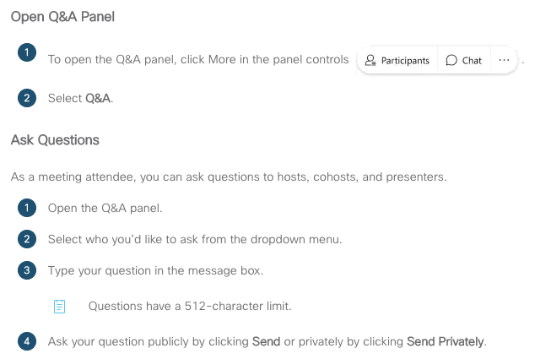
Questions in WebEx
Preface each question with the topic

Slide 8
Overview
Overview, Timeline, Collection Changes
Originally Presented: 10/29/2021

Slide 9
Overview
The CRDC is a bi-annual, national collection submitted to the Office of Civil Rights
All public schools and charters are required to submit
Results published nationally at: https://ocrdata.ed.gov/
Analyzed by lawmakers, communities, reporters, researchers
Federal support and Submission Tool located at the
Civil Rights Data Collection Resource Center
Originally Presented: 10/29/2021

Slide 10
Data Contained in CRDC
LEA /School/Justice Facility Characteristics
Enrollment
PK
Student
Program
Course
Retention
Certified Class Counts
College and Career Ready
FTE/Staff
Athletics
Discipline
Arrests
Offenses
Harassment/Bullying
Suspension/Expulsion
Restraint/Seclusion
Internet Devices
Originally Presented: 10/29/2021

Slide 11
CRDC Federal Survey Forms
The first step to understanding the CRDC is to download the LEA and School Forms from the Civil Rights Data Collection Resource Center.
All PSUs are required to submit data for both forms.
LEA Form
School Form
Originally Presented: 10/29/2021

Slide 12
NCDPI Transfers Data
NCDPI gathers and submits data on behalf of the PSUs
Registration (Contacts) and PSU universe (Directory)
SIS data
Non-SIS data
All PSUs MUST log into the Federal Submission Portal to validate, and certify the data to complete the collection
Originally Presented: 10/29/2021

Slide 13
PSUs Perform the Following:
We are here!
Update CRDC screens in PowerSchool
Generate and review CRDC PowerSchool reports
Update data in Federal Submission Tool
Certify data is correct within the Tool
Originally Presented: 10/29/2021

Slide 14
Data is recorded during the school year
OCR publishes new requirements for the CRDC
NCDPI updates reporting process based on OCR requirements
NCDPI provides a preview of data prior to Federal Submission opening
NCDPI transfers data to Federal Submission Tool
PSUs log into Federal Submission Tool, validate and Certify
Originally Presented: 10/29/2021

Slide 15
Timeline*
December 3, 2021 PowerSchool CRDC Preview report closes
December 6 - 14, 2021 NC DPI will load data to the Federal Submission Portal
December 15, 2021 PSUs may now update the Federal system, correct errors and Certify
Collection Closes
February 28, 2022 * Dates may be subject to change
Originally Presented: 10/29/2021

Slide 16
Timeline - Extended
December 17, 2021 PowerSchool CRDC Preview report closes
December 20 - 31, 2021 NC DPI will load data to the Federal Submission Portal
January 03, 2022 PSUs may now update the Federal system, correct errors and Certify
Collection Closes
February 28, 2022 * Dates may be subject to change
Originally Presented: 10/29/2021
Updated: 11/19/2021

Slide 17
Key Dates*
September 20, 2021 PowerSchool CRDC setup screens opened in PowerSchool
Screen setup is critical to report functionality
September 24, 2021 Contact and PSU universe (directory) information sent to Partner Support
Contacts will receive first logins to the Federal Submission Tool
Universe file establishes which PSUs must report
October 25 – December 3, 2021 Run and review the PowerSchool CRDC Preview report
SIS data will be extracted after the submission close date. If the LEA level report is not run, the PSU must submit data to the Federal Submission Portal on their own
* Dates may be subject to change
Originally Presented: 10/29/2021

Slide 18
Key Dates*
September 20, 2021 PowerSchool CRDC setup screens opened in PowerSchool
Screen setup is critical to report functionality
September 24, 2021 Contact and PSU universe (directory) information sent to Partner Support
Contacts will receive first logins to the Federal Submission Tool
Universe file establishes which PSUs must report
October 25 – December 17, 2021 Run and review the PowerSchool CRDC Preview report
SIS data will be extracted after the submission close date. If the LEA level report is not run, the PSU must submit data to the Federal Submission Portal on their own
* Dates may be subject to change
Originally Presented: 10/29/2021
Updated: 11/19/2021

Slide 19
More Key Dates*
December 6 – December 14, 2021 SIS Data is extracted, NCDPI uploads data, PSUs should receive accounts to Federal Submission Portal from Partner Support
December 15 - February 28, 2022 PSUs may now update the Federal system, correct errors and Certify
All PSUs MUST log into the Federal Submission Portal to validate, and certify the data to complete the collection by February 28, 2022
* Dates may be subject to change
Originally Presented: 10/29/2021

Slide 20
More Key Dates*
December 20 – December 31, 2021 SIS Data is extracted, NCDPI uploads data, PSUs should receive accounts to Federal Submission Portal from Partner Support
January 03, 2022- February 28, 2022 PSUs may now update the Federal system, correct errors and Certify
All PSUs MUST log into the Federal Submission Portal to validate, and certify the data to complete the collection by February 28, 2022
* Dates may be subject to change
Originally Presented: 10/29/2021
Updated: 11/19/2021

Slide 21
NCDPI Data Uploads
PSU Contacts – published
School Directory File (Universe) – published
LEA – PowerSchool data
School – PowerSchool data
Certified Teacher Class Counts – re-published
Internet Devices – published
FTE – published
Click here to view Non-PowerSchool Data Files
Originally Presented: 10/29/2021
Updated: 12/03/2021

Slide 22
Removed from CRDC
Several early learning indicators that can be derived from aggregate data provided
Cost and length of PK and Kindergarten
Credit Recovery
AP Exam scores
Teacher years of experience
Current & Previous year count of teachers
Teacher Absenteeism
School Expenditures
Originally Presented: 10/29/2021

Slide 23
Added to CRDC
COVID Related Directional Indicators
EL Enrollment by subgroup
Additional 504 counts
IB Student Enrollment
AP Student Enrollment
Number of Incidents committed by student
Originally Presented: 10/29/2021

Slide 24
Optional for SY2021
Number of Incidents committed by School staff
Allegations against school staff
Resignation or Retirement
Determined Responsible
Determined Not Responsible
Determination Pending
Duty Reassignment
Allegations of Harassment or Bullying by Religion Type
Originally Presented: 10/29/2021

Slide 25
NC will not…
Submit data for any optional survey questions except for Number of Incidents Committed by Student
Submit data for Allegations of Harassment or Bullying by Religion Type (HIBS-1c)
Will not be collected for the CRDC per General Statue, Chapter 115C (ncleg.net) section 402.5.
Remaining optional Survey questions will be developed for the SY21-22 CRDC Collection
Originally Presented: 10/29/2021
Updated: 11/05/2021

Slide 26
PowerSchool Improvements
Consolidated ‘CRDC Part 1’ and ‘CRDC Part 2’
Added LEA Office level validation views
Enhanced School level validation views
Students cross enrolled for courses collected for the CRDC will count at the Homeschool
Updated Discipline/School Safety logic
Originally Presented: 10/29/2021

Slide 27
Completing the Collection
PSUs must complete the collection by validating and Certifying the data after upload to the Federal Submission Portal
Originally Presented: 10/29/2021

Slide 28
Resources
Documentation, Resources, Support, Communication
Originally Presented: 10/29/2021

Slide 29
Documentation
Federal OCR LEA and School Forms
Must be used to understand collection dates, business rules, key definitions and to validate PowerSchool CRDC Preview Reports
NC Specific Documentation
CRDC Task List
Preparing for the CRDC
Setting up PowerSchool for the CRDC
Reviewing the PowerSchool CRDC Preview Report
CRDC NC Data Dictionary and Course Code List
Originally Presented: 10/29/2021
Updated: 11/05/2021
29

Slide 30
CRDC – NCDPI Resources
NC Public Schools Civil Rights Data Collection Website
CRDC Timeline
NC Specific CRDC Documentation
Archived Communications
Non-PS data files
LEA and School Forms
Link to Partner Support Resource Center
Originally Presented: 10/29/2021

Slide 31
CRDC – Federal Level Resources
All PSUs are required to access, validate and Certify the data in the Federal Submission Tool.
Civil Rights Data Collection Resource Center
Submission System access
Partner Support Contact Information
Videos and Guides
Originally Presented: 10/29/2021

Slide 32
Support
Contact the SEA OCR Coordinator with questions or concerns about
PowerSchool
Timeline
Data
Contact CRDC Partner Support for questions regarding
Federal Submission Tool functionality
User Accounts (After December 15)
Originally Presented: 10/29/2021

Slide 33
Communication Opportunities
Coordinator Contacts are housed in EDDIE
Managed by LEA/Charter – update anytime
Communications directly from SEA OCR Coordinator
NC Workgroup
Peer group for coordinators throughout the state
EDDIE OCR Contacts automatically added
Access/Removal Requests: molly.hash@aemcorp.com
Originally Presented: 10/29/2021

Slide 34
NC Workgroup Access and Usage
Optional
Site is password protected
Accounts have been created and will be sent to individuals Friday, November 05, 2021
Adhere to all FERPA and HIPAA guidelines when participating in this workgroup
Posts will be distributed to ALL NC Workgroup members
Originally Presented: 10/29/2021
Updated: 11/05/2021

Slide 35
Non-PowerSchool Data
Originally Presented: 10/29/2021

Slide 36
Data not Accessible to NCDPI
PSUs which do not collect data required for the CRDC in PowerSchool are responsible for adding data to the Federal Submission Portal after the NCDPI upload *
Examples include
Section 504
Interscholastic sports
Discipline and Safety data
*Data updated prior to the NCDPI upload will be overwritten
Originally Presented: 10/29/2021

Slide 37
Non-PowerSchool Data Files
Non-PowerSchool Data files are published on the NCDPI website to provide a review period like the PowerSchool process.
PSUs are encouraged to review these files to prepare for any updates needed in the Federal Submission Portal.
If your PSU did not contribute data as specified by state requirements, or there is more information at the local level, update the Federal Submission Tool after upload.
Click here to view Non-PowerSchool Data Files
Originally Presented: 10/29/2021

Slide 38
Non-PowerSchool Data Files
All Non-PowerSchool data files are school level
Staff
Data provided by NCDPI Financial Business Services. The data comes from Payroll. Work with the Finance Officer, or if applicable, the Charter Management Company.
Excerpt from the School Form: Include staff regardless of how staff were funded (i.e., federal, state, and/or local funds or funds from another entity).
The file provided by NCDPI will only contain what was reported to the state.
Originally Presented: 10/29/2021
Updated: 11/05/2021

Slide 39
Non-PowerSchool Data Files
Internet Access
Data provided by NCDPI DLMI. The most recent collection period was December 2020-Jan 2021.
Class count by Teacher Certification
Data in this file is a cross walked from Licensure codes, Staff UID, and CRDC specific course codes.
Originally Presented: 10/29/2021
Updated: 11/05/2021

Slide 40
Non-PowerSchool Data Files
Internet Access
Data provided by NCDPI DLMI. The most recent collection period was December 2020-Jan 2021.
Class count by Teacher Certification
Data in this file is a cross walked from Licensure codes, Staff UID, and CRDC specific course codes.
File is still in review – pending update week of November 22, 2021
Originally Presented: 10/29/2021
Updated: 11/19/2021

Slide 41
Non-PowerSchool Data Files
Internet Access
Data provided by NCDPI DLMI. The most recent collection period was December 2020-Jan 2021.
Class count by Teacher Certification
Data in this file is a cross walked from Licensure codes, Staff UID, and CRDC specific course codes.
Originally Presented: 10/29/2021
Updated: 12/03/2021

Slide 42
About Non-PS Data Files
Download the files from the NCDPI website
Each file can be filtered by Federal ID, LEA Number, School Number and School Name
Additional column headers are based on CRDC survey number
Originally Presented: 10/29/2021

Slide 43
CRDC and PowerSchool
Screen Setup, Report Generation, Submission and Validation Views
Originally Presented: 10/29/2021

Slide 44
PowerSchool Steps
Complete set up for the CRDC
Download ‘Setting up PowerSchool for the CRDC’
Run and review the report
This report must be run at the LEA level. School level reports are optional
Download ‘Reviewing the PowerSchool CRDC Preview Report’
Do not Approve report until notified by NCDPI
Data will be extracted after December 3.
PowerSchool Setup and Report Generation are performed in the Current Year in PowerSchool
Originally Presented: 10/29/2021
Updated: 11/05/2021

Slide 45
PowerSchool Steps
Complete set up for the CRDC
Download ‘Setting up PowerSchool for the CRDC’
Run and review the report
This report must be run at the LEA level. School level reports are optional
Download ‘Reviewing the PowerSchool CRDC Preview Report’
Do not Approve report until notified by NCDPI
Data will be extracted after December 17.
PowerSchool Setup and Report Generation are performed in the Current Year in PowerSchool
Originally Presented: 10/29/2021
Updated: 11/19/2021

Slide 46
PowerSchool Setup
CRDC setup screens are critical to the PS CRDC Preview report
Some tasks may be delegated to school level personnel
LEA Office Level users performing setup tasks should have access to all schools created in the PS instance
Lottery schools
Program schools
Schools created for local level needs
Originally Presented: 10/29/2021

Slide 47
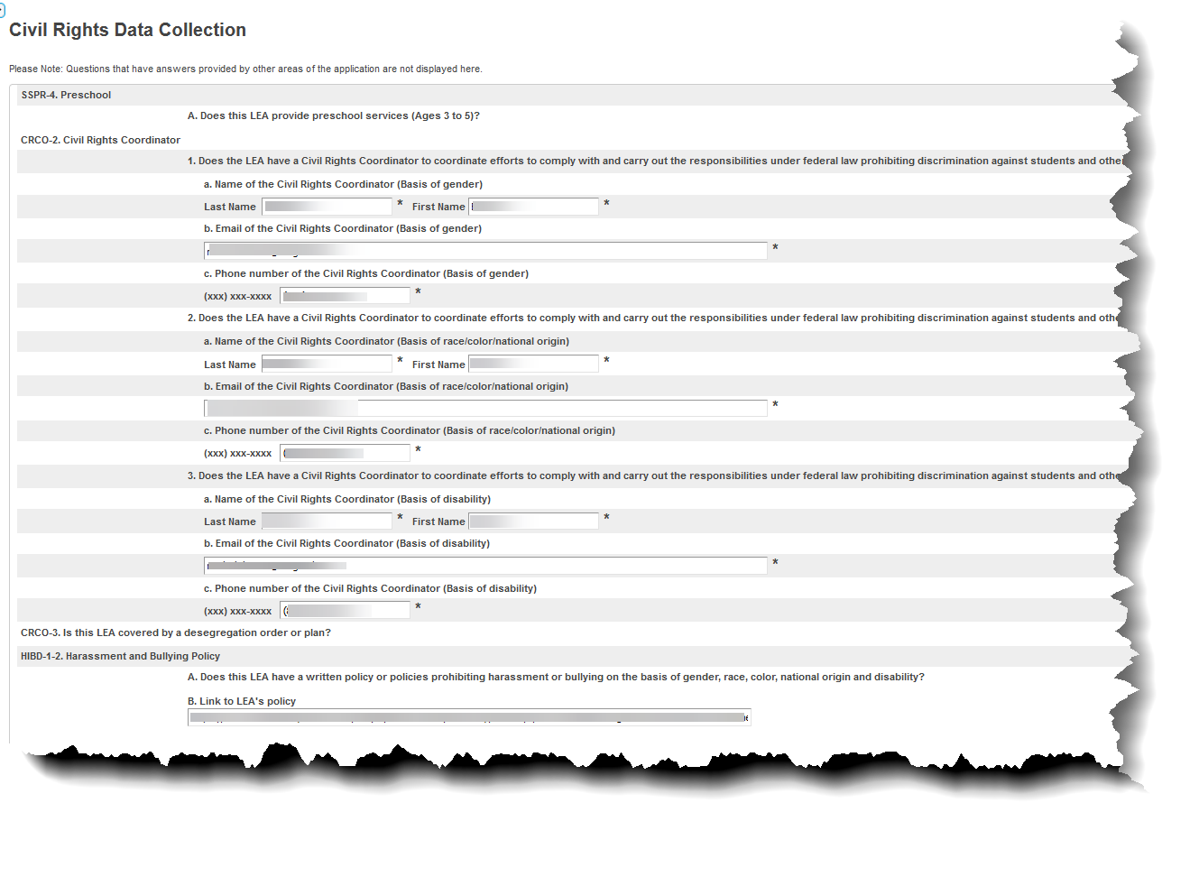
Start Screen > Select LEA Office > Setup > LEA > Civil Rights Data Collection (CRDC)
Originally Presented: 10/29/2021

Slide 48
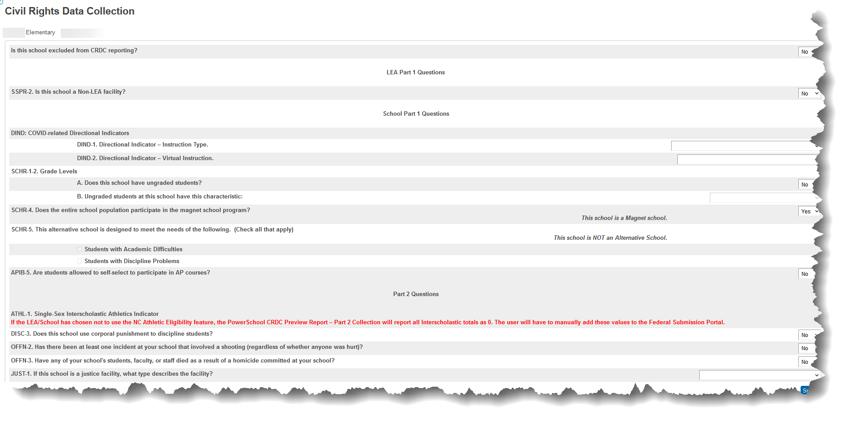
Start Screen > Select school > Setup > School > Civil Rights Data Collection (CRDC)
Originally Presented: 10/29/2021

Slide 49
School Level CRDC Screen Tips
‘Is this school excluded from CRDC reporting?’
Select ‘No’ if the entity is
A public school with student enrollment during the collection year
A program school with student enrollment during the collection year
‘Is this school a Non-LEA facility?’
Select ‘Yes’ if the entity is
A program school with student enrollment during the collection year
CECAS
Homeless
Migrant
Immigrant
More at four and PK centers, if applicable
For Program Schools, only answer the above two questions
Originally Presented: 10/29/2021

Slide 50
School CRDC Screens Tips …
Some data on page is auto-populated
Magnet Program
Alternative Program
Special Education
If these data are incorrect, make the correction in the Federal Submission Tool
Athletic Eligibility data will generate on the CRDC report, if populated in PowerSchool
*Magnet, Alternative and Special Education indicators are in the EDDIE application
Originally Presented: 10/29/2021

Slide 51
Start Screen > Select school > Setup > School > CRDC EDDIE Grade Levels
Add Grade levels on the left as seen in EDDIE
Add all grade levels to Program Schools
Low and High Grade – no impact on reporting
As seen in EDDIE
Originally Presented: 10/29/2021

Slide 52
CRDC EDDIE Grade Levels Screen Tips
Year ID 30 is required SY20-21 collection
Can be edited as needed
Public schools should be auto populated
Must add a record for each program school
Program Schools should have all grade levels
Grade levels do not need to be consecutive
Grade levels must be separated by a colon
LOW_GRADE and HIGH_GRADE columns are not used by the CRDC reports
Originally Presented: 10/29/2021

Slide 53
PowerSchool Update
The November 05, 2021 Maintenance weekend corrected two known issues in the PS CRDC Preview Report:
Cross Enrollment Passing Algebra counts
Cross Enrollment AP/IB student aggregate counts
Coordinators can Approve the LEA Level PowerSchool CRDC Preview report after November 15, 2021 – unless notified by NCDPI
Added: 11/05/2021

Slide 54
PowerSchool Update
The November 05, 2021 Maintenance weekend corrected the only two known issues in the PS CRDC Preview Report:
Cross Enrollment Passing Algebra counts
Cross Enrollment AP/IB student aggregate counts
Added: 11/05/2021
Updated: 11/19/2021

Slide 55
Reported Issues
Out of School Suspension (DISC)
Reported November 10, 2021
Official communication sent to state
School detail – DISC-2, DISC -11
School Aggregate – DISC-1A DISC-7c, DISC-7d, DISC-9c, DISC-9d, DISC-12
Added: 11/19/2021

Slide 56
Reported Issues
Out of School Suspension (DISC)
Reported November 10, 2021
Official communication sent November 19, 2021
School detail – DISC-2, DISC -11
School Aggregate – DISC-1A DISC-7c, DISC-7d, DISC-9c, DISC-9d, DISC-12
_____________________________________________________________________
Fix will be implanted into production close of business Friday December 03, 2021
No downtime required for state
Official communication sent to state Thursday December 02, 2021
Added: 11/019/2021
Updated: 12/03/2021

Slide 57
Reported Issues …
Course Data (COUR)
Reported November 16, 2021
Communication to NC WorkGroup
Official communication sent November 19, 2021
__________________________________________
Fix to be implanted into production close of business Friday December 03, 2021
No downtime required for state
Official communication sent to state Thursday December 02, 2021
Added: 11/019/2021
Updated: 12/03/2021

Slide 58
CRDC Preview Report
The PowerSchool CRDC Preview report DOES NOT flag errors or warnings
Originally Presented: 10/29/2021

Slide 59
CRDC Submission Views
LEA Level Submission reports are critical to NCDPI extracting data and must be run
Submission Reports exist at the LEA and School level
School level Submission reports allow the ability to drill to the student ID level if needed and do not impact the data collection if they are not run
There are four Submission report views*
CRDC LEA Detail
CRDC LEA Aggregate
CRDC School Detail
CRDC School Aggregate
*When at the School level, only data applicable to the school will be display
Originally Presented: 10/29/2021

Slide 60
CRDC Submission Views …
Detail views contain counts, Yes/No indicators or strings of text
Aggregate views are student counts by Sex, Race/Ethnicity and Subgroup*
*EL, IDEA, Section504
Originally Presented: 10/29/2021

Slide 61
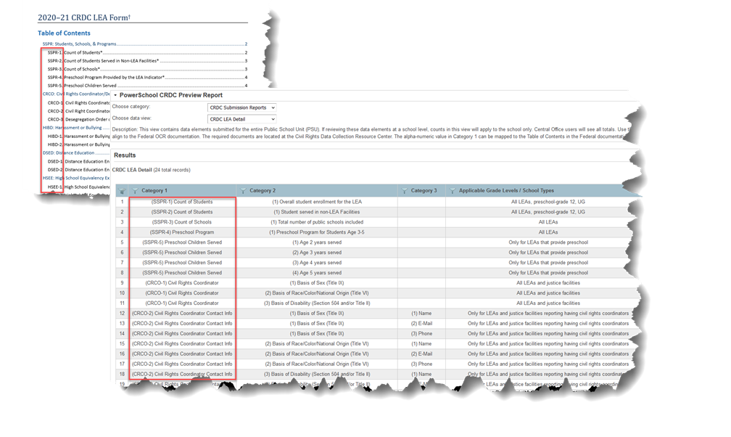
CRDC Submission Views …
Use the Federal CRDC forms to understand definitions and instructions for the data required for reporting.
Category 1 reflects the Table of Contents of the Federal forms
Originally Presented: 10/29/2021

Slide 62
CRDC Validation Views
LEA Level
CRDC School Setup Validation
CRDC School Last Run Date
School Level
CRDC Student Detail – Admission and Withdraw
CRDC Student Detail – School Enrollment, Program Enrollment, Retention
CRDC Student Detail – Course Enrollment, Exams, Athletics
CRDC Student Detail – Discipline
CRDC Student Detail – Preschool Discipline
CRDC Class Detail by School
Originally Presented: 10/29/2021

Slide 63
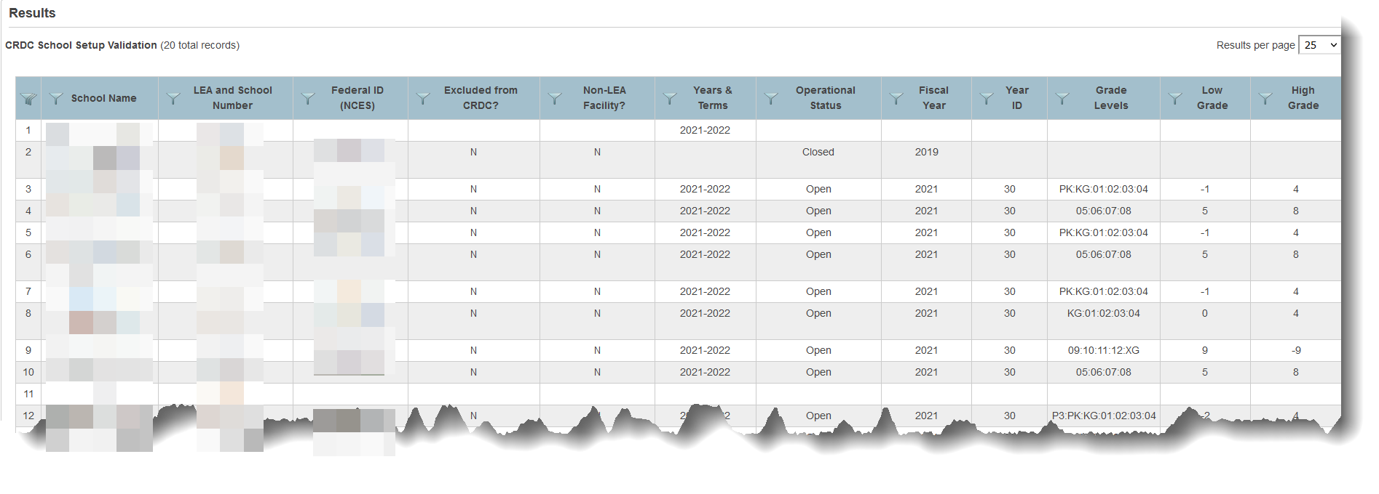
CRDC School Setup Validation
Setup information about each school for the CRDC in one report
Elements from the Civil Rights Data Collection (CRDC), CRDC EDDIE Grade Levels and School Info screens
Use this view to help determine if selections are correct for each school
Originally Presented: 10/29/2021

Slide 64
CRDC School Last Date Run
See when a School level report was last run and by whom
This may be important if updates are made to the report before submission ends
The LEA Office level report and School level reports are asynchronous
Users at the School level will not see updates if the School level report is not re-run
Originally Presented: 10/29/2021

Slide 65
School CRDC Validation Views
Most views are grouped by CRDC modules
Each Student Detail view displays records by Student Name, Student UID, Sex, Age, Ethnicity, IDEA, Section 504, and EL Program.
Additional indicators or counts for the student display based on the category of the validation report.
Originally Presented: 10/29/2021

Slide 66
School CRDC Validation …
CRDC Student Detail – Admission and Withdraw
Enrollment records (Entry and Exit dates) for all students who attended during collection year
CRDC Student Detail – School Enrollment, Program Enrollment, Retention
Single record for each student who is being calculated in overall enrollment
Indicators for program enrollment and retention information
CRDC Modules: SSPR, DSED PSCH, ENRL, PENR, RETN
Originally Presented: 10/29/2021

Slide 67
School CRDC Validation …
CRDC Student Detail – Course Enrollment, Exams, Athletics
Single record for each student being calculated in overall enrollment
Indicators for CRDC specific courses, SAT/ACT exams and Athletic information
Cross Enrolled and Cross Enrolled School columns indicate if a student is being counted in CRDC course enrollment for the given school.
Columns are specific to the CRDC and cannot be used to identify all cross enrolled students
If students appear cross enrolled and should not, check to verify there are not overlapping dates in All Enrollments.
CRDC Modules: COUR, APIB, EXAM, ATHL
Originally Presented: 10/29/2021

Slide 68
Student Detail Validation View Example
Originally Presented: 10/29/2021

Slide 69
School CRDC Validation …
CRDC Student Detail – Discipline
Single record for each student being calculated in the overall enrollment
Indicators and counts for school safety data
CRDC Modules: DISC, ARRS, OFFN, HIBS, RSTR,
CRDC Student Detail – Preschool Discipline
Single record for each Preschool student being calculated in the overall enrollment
Suspensions, expulsions, corporal punishment indicators
CRDC Modules: DISC
Originally Presented: 10/29/2021

Slide 70
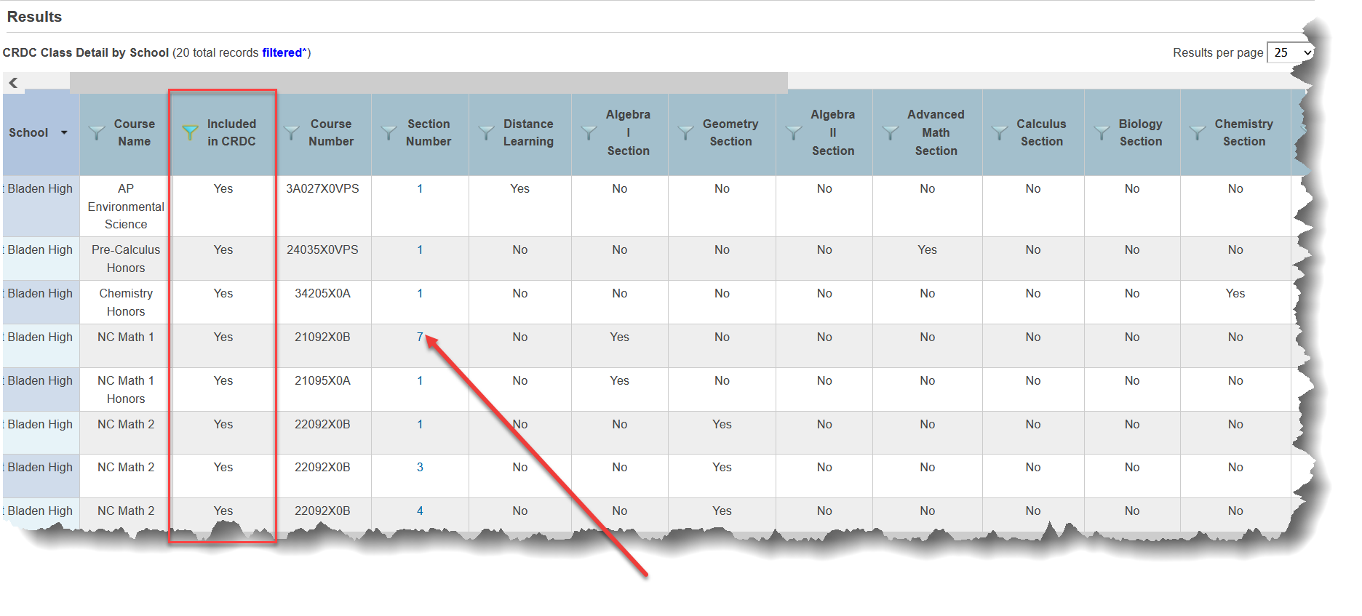
School CRDC Validation …
CRDC Class Detail by School
All course sections scheduled for the collection year
Included in CRDC indicator
Click Section Number link to view a previous year student roster
Originally Presented: 10/29/2021

Slide 71
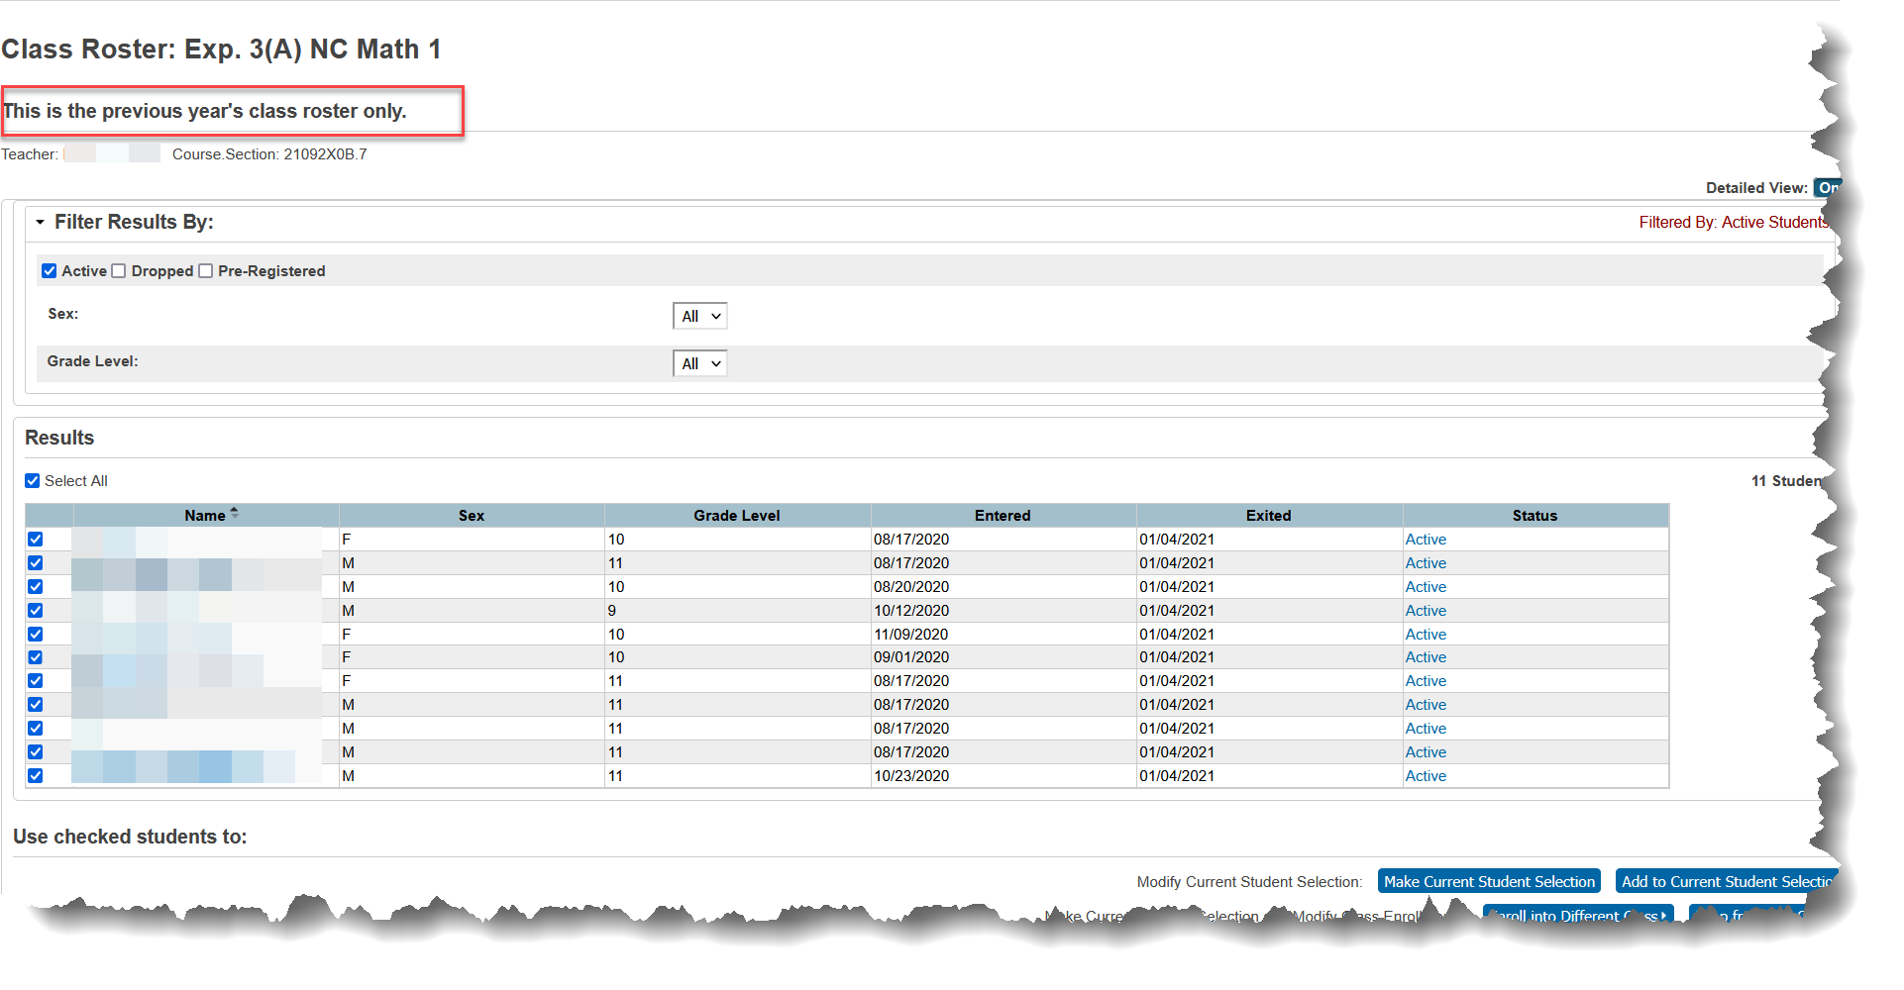
Previous Year Class Roster
Originally Presented: 10/29/2021

Slide 72
CRDC School Level Report
Can be toggled on and off in the State Reporting Dashboard at the LEA Office level
School level reports do not impact the collection if they are not run
Originally Presented: 10/29/2021
Originally Presented: 10/29/2021

Slide 73
Federal Submission Tool
Originally Presented: 10/29/2021

Slide 74
Accounts
Accounts will be provided to those listed on the PSU Demographics and Contacts File - submitted October 10, 2021
Logins will be sent by CRDC Partner Support
Expect accounts in early December
PSUs may create additional accounts as needed
Originally Presented: 10/29/2021

Slide 75
Federal Submission Tool
Do not update data until after NCDPI has completed uploads
Users may make manual updates or load data files
Review warnings
Must resolve all errors
Certify data before February close date
Functional documents are located the Civil Rights Data Collection Resource Center
Originally Presented: 10/29/2021

Slide 76
Closing
Reminders, Questions, Discussion
Originally Presented: 10/29/2021

Slide 77
Reminder - Documentation
Federal OCR LEA and School Forms
Must be used to understand collection dates, business rules, key definitions and to validate PowerSchool CRDC Preview Reports
NC Specific Documentation
CRDC Task List
Preparing for the CRDC
Setting up PowerSchool for the CRDC
Reviewing the PowerSchool CRDC Preview Report
CRDC NC Data Dictionary and Course Code List
Originally Presented: 10/29/2021
Updated: 11/05/2021
77

Slide 78
Reminder – All PSUs Must Run the LEA Level Report
LEA Level Submission reports are critical to NCDPI extracting data and must be run
PSUs which do not collect data required for the CRDC in PowerSchool are responsible for adding data to the Federal Submission Portal after the NCDPI upload
Added: 11/05/2021

Slide 79
Reminder – Do Not Approve
Do not approve the PowerSchool CRDC Preview report until notified by NCDPI
There are two known issues pending update
Cross Enrollment Passing Algebra counts
Cross Enrollment AP/IB student aggregate counts
Originally Presented: 10/29/2021

Slide 80
Reminder – Approve After November 15, 2021
Approve the LEA Level PowerSchool CRDC Preview report after November 15, 2021 – unless notified by NCDPI
Added: 11/05/2021

Slide 81
Reminder – Do Not Approve
Do not approve the PowerSchool CRDC Preview report until notified by NCDPI
Issues have been reported from the state and are pending update
Out of School Suspensions (DISC)
Course data module (COUR)
Originally Presented: 10/29/2021
Updated: 11/19/2021

Slide 82
Reminder – Do Not Approve
Do not approve the LEA Office Level PowerSchool CRDC Preview report until notified by NCDPI
Originally Presented: 10/29/2021
Updated: 12/03/2021

Slide 83
Reminder – Non-PS Data Files
Download the files and review
Prepare to make updates to the Federal Submission Tool as needed
Originally Presented: 10/29/2021

Slide 84
Any Questions?
You can book a 30-minute appointment with me in the afternoons from November 1 through December 3
I will respond with a Teams Meeting invite
https://calendly.com/terralynne/30min
Originally Presented: 10/29/2021

Slide 85
Any Questions?
You can book a 30-minute appointment with me in the afternoons from November 1 through December 17
I will respond with a Teams Meeting invite
https://calendly.com/terralynne/30min
Originally Presented: 10/29/2021
Updated: 11/19/2021

Slide 86
Support
Issue / Concern | Contact | Contact Info
Data not loaded for school Questions about data | HBSC Support Center | (919) 716-1840 or https://ncgov.servicenowservices.com/sp_dpi
No access to Federal Portal Incorrect permissions for account School does not exist in the Federal Portal | CRDC Partner Support | (855) 255-6901 or crdc@aemcorp.com
Originally Presented: 10/29/2021

Slide 87
Thank You!
Originally Presented: 10/29/2021

