Slide 1
Determining Comparability
Office of Federal Programs
Updated August 2026

Slide 2
Title I, Part A: Key Objectives
Understanding Comparability Basics
  Discover the principles of comparability and importance in fair resource allocation among schools.
Demonstrating Comparability
  Learn effective methods for showing that schools meet comparability requirements in practice.
Identifying Helpful Resources
  Explore tools and materials that support compliance with Title I, Part A regulations and guidelines.
Notes:
Our key focus for today’s session covers three main objectives.
First, we will explore comparability basics.
Next, we will review and discuss methods for demonstrating comparability effectively.
Finally, we will explore resources available for comparability reporting.

Slide 3
Comparability Basics
Comparability is a comparison of the use of funds in Title I and non-Title I Schools or all Title I schools.
Comparability ensures the use of Title I funds as supplemental to state and local funds.
Notes:
Comparability is a federal requirement. It provides a profile of compliance. Likewise, it provides a benefit for individual public-school units to level the educational opportunities.
Comparison isn’t limited to Title l and non-Title l schools. The profile report also requires public school units serving all Title l schools to compare higher poverty Title l schools to lower Title l poverty schools.
What is the goal? To assure that all students receive quality teaching, impactful learning experiences, additional support and resources regardless of the school attended.

Slide 4
Comparability Exemptions
PSUs are exempt when there is one school per grade spans.
PSUs that are single-site units are exempt.
Schools with fewer than 100 students are excluded from calculations.
Notes:
There are criteria exemptions for reporting. These include:
a PSU that has only one school serving one grouping of grade spans. For example: one K-2, one 3-5, one 6-8, one 9-12 or elementary, middle, and high.
a PSU identified as a single site providing services to one elementary, one middle, and/or one high school. To clarify, a single site can have more than one campus location, however, the school serves defined grade spans at different locations. For example, an elementary campus, a middle campus, and a high school campus. Three campuses but the PSU only serve one grade span grouping at each campus.
A PSU with a school that has 100 or less students will be exempt from profile reporting.

Slide 5
Supplement – Supplant
Federal Funds Must Enhance Education
  Federal funds under Title I are meant to supplement, not replace, state and local education funding for schools.
Schools Must Demonstrate Additional Services
  Schools must show that Title I funds provide additional resources and educational services.
Compliance Shall Maintain Funding
  Adhering to the requirements is vital in keeping federal support and sustaining programs.
Notes:
Supplement-Supplant is complex in that it provides for on-going research, interpretation, and reading. Here are 3 easy rules to remember.
1) Ensure federal funds are value added by providing additional resources for the most disadvantaged. Some questions to ask, reflect, and answer: 1) How are federal funds providing additional services and resources? What opportunities are or will be provided? What does the data indicate? How are the services funded with Title l positively impacting student outcomes.
2) Demonstrate the use of funds through documented actions, services, and resources provided for the purpose of Title l funds in the current year. “This Year’s Students – This Year’s Funds”. Eddy
Maintain compliance. Have a consistent process and timeline for all things comparability including funds expended and remaining, activities, resources (both human and material) impacting comparable services. Simple actions such as a comparability review (dated/signed), schedules demonstrating use of funds including personnel, purchased services, resources, materials and how these are used are a few of the most basic actions to demonstrate the use of Title l funds.

Slide 6
Comparability Comparison Profiles
Student-to-Staff Ratio
Salary-to-Student Ratio
Students to classroom teachers or instructional staff
FTE counts by “like” positions as determined by PSU
Excludes all federal positions
Most common due to ease and tracking
Salary by classroom teachers or instructional staff
Base salaries by “like” positions
Excludes all federal paid salaries
An alternative method for reporting
Notes:
The student to staff ratio compares the student enrollment to staff based on data collection on one specific date. The base salaries to enrollment ratio compares salaries to enrollment.
The profile for the enrollment reported will not change as a PSU works through the reporting process.
Only like (consistent) instructional staff positions or like instructional salaries across all schools will be compared and included in the profile report.
The like positions or base salaries to include will be determined by the PSU.
All positions and salaries paid with federal funds will be excluded in the staff count.
The positions included will provide direct instructional services and/or direct support services that lead to students’ academic success. All staff counts must be certified, licensed, or credentialed.
A note to remember, a PSU cannot select a minimal number of instructional staff or salaries to include. For example, selecting one or two specific departments or support services only to report. (Check with Melissa or Alex on this.)

Slide 7
State and Local Exclusions
State/local allowable exclusions from calculations include:
Language instruction for emergent bilingual students
Excess costs of providing services to students experiencing disability
Staff salary differentials for years of employment
Staff bonus pay
Supplemental programs that meet the intent and purpose of Title I
Notes:
There are a few state and local exclusions that are allowable for comparability reporting.
Excessive costs for unique student needs may be excluded.
Additional payments beyond base pay may be excluded.
Specific programs that support the purpose of Title l may be excluded.
Contact your program administrator prior to the consideration for exemption of these exclusions.
It is important to note that documentation to support these exclusions is necessary.
Keep all documentation on file for monitoring or auditing purposes.

Slide 8
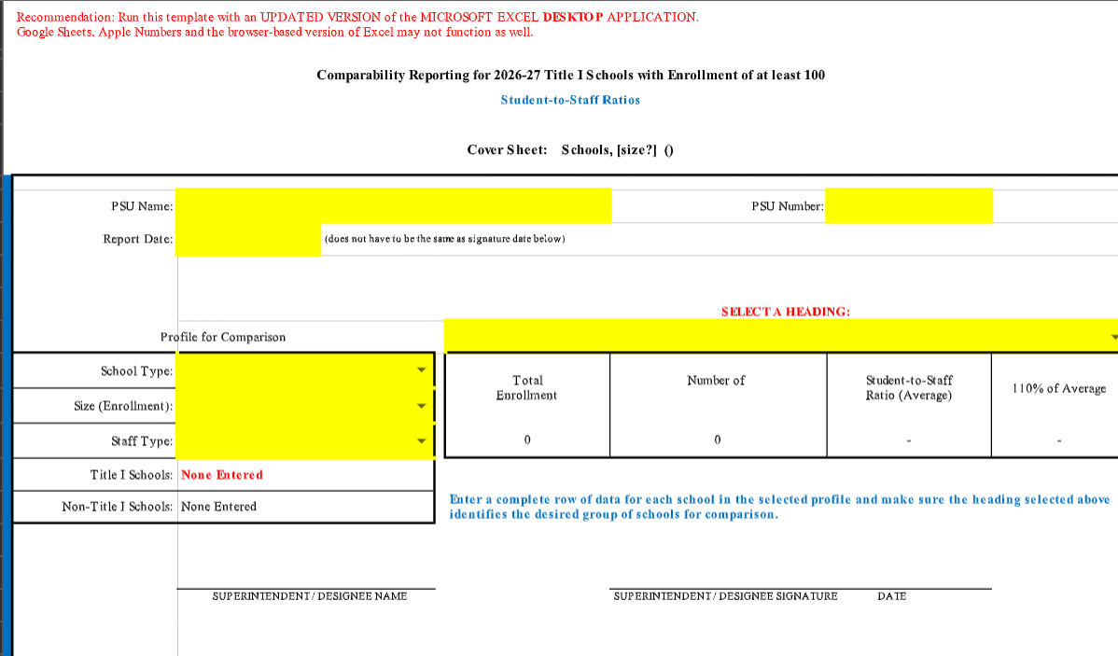
Cover Sheet – Tab 1
Complete Highlighted Profile
PSU Name and Number Must Be Entered
Dropdowns
School Type
Size/Enrollment
Staff Type

Slide 9
Student-to-Staff Ratio Title I Schools – Tab 1continued
Page 1 is a continuation of the Cover Sheet.
Enter Title I School Name, Grade Span, Enrollment, Number of Staff
Entries will tabulate and provide comparability results of Yes/No
Scroll for additional page access
Information entered will provide on-going results.

Slide 10
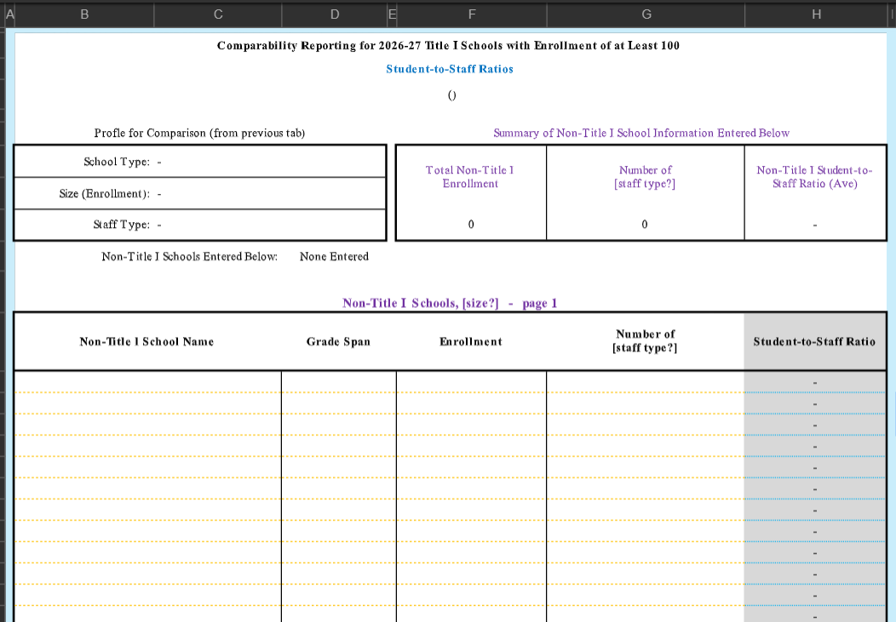
Student-to-Staff Ratio Non-Title I Schools – Tab 2
Page 1 is a continuation of the Cover Sheet.
Enter Title l School Name, Grade Span, Enrollment, Number of Staff
Entries will tabulate and provide comparability results of Yes/No
Information entered will provide on-going results
Scroll for additional pages

Slide 11
Cover Sheet – Tab 1
Complete Highlighted Profile
PSU Name and Number Must Be Entered
Dropdowns
School Type
Size/Enrollment
Staff Type

Slide 12
Salary-to-Student Ratio Title I Schools – Tab 1 continued
Page 1 is a continuation of the Cover Sheet.
Enter Title I School Name, Grade Span, Enrollment, Base Salary Total
Entries will calculate and provide comparability results of Yes/No
Information entered will provide on-going results
Scroll for additional pages

Slide 13
Salary-to-Student Ratio Non-Title I Schools – Tab 2
Information will pre-populate
Enter Non-Title School Name, Grade Span, Enrollment and Base Salary Total
The Salary-to-Student Ratio will calculate
The Salary-to- Student Ratio will populate to Tab 1 – Title I Schools.

Slide 14
How Do I Submit?
Download the completed Profile Reports
Print and Scan all completed reports as one document
Sign into CCIP, Title I, Sections, History Log, Create Comment
Click Attachment and Upload Profile Report as one document
Check “Send Email to North Carolina CCIP Contact”
Click Judi Godfrey and Dr. Sue Hatley
Save and Go
Do not change the status on the Sections Page
Notes:
Please consider a brief email making us aware that the comparability report is ready for review.

Slide 15
Contacts
Judi Godfrey
judi.godfrey@dpi.nc.gov
Sue Hatley
sue.hatley@dpi.nc.gov
Notes:
We are here to assist and support through the comparability process.

