Slide 1
EC Director and Coordinator
April Webinar
April 20, 2021

Slide 2
Agenda
Additional information HB 82 (Summer Learning)
Homebound/Modified Day Placements
Reminder: EC Processes and ECATS - User Guide
HB 317
Extraordinarily Exceptional Educator Recognition
ECATS Translation
Staff Update

Slide 3
HB 82
Initial Guidance (4.14.21)

Slide 4
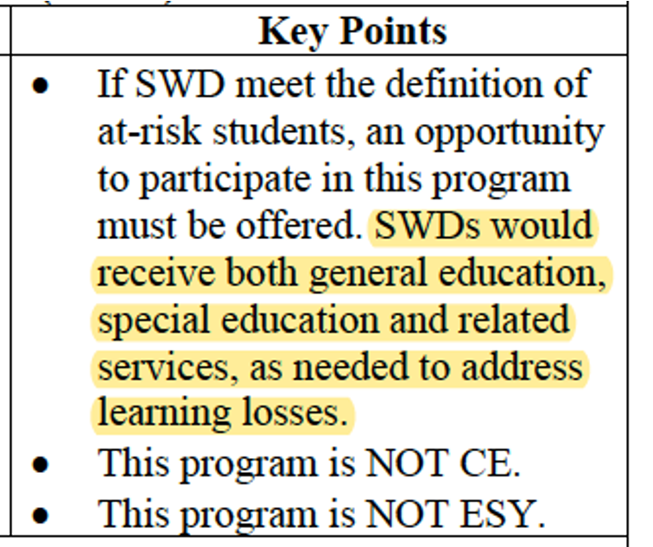
HB 82
EC Office Hours (4.16.21)

Slide 5
HB 82
Who are “At-Risk Students?”

Slide 6
HB 82: Essential Questions
Of the At-Risk EC Students Identified…
•Are the learning losses because of missed general education instruction?
•Are the learning losses because of missed special education instruction?
•Does the learning loss meet the criteria of Extended School Year?
•Is the learning loss because of a failure to provide FAPE?
•Is the student in need of future (recovery services) that include specially designed instruction?

Slide 7
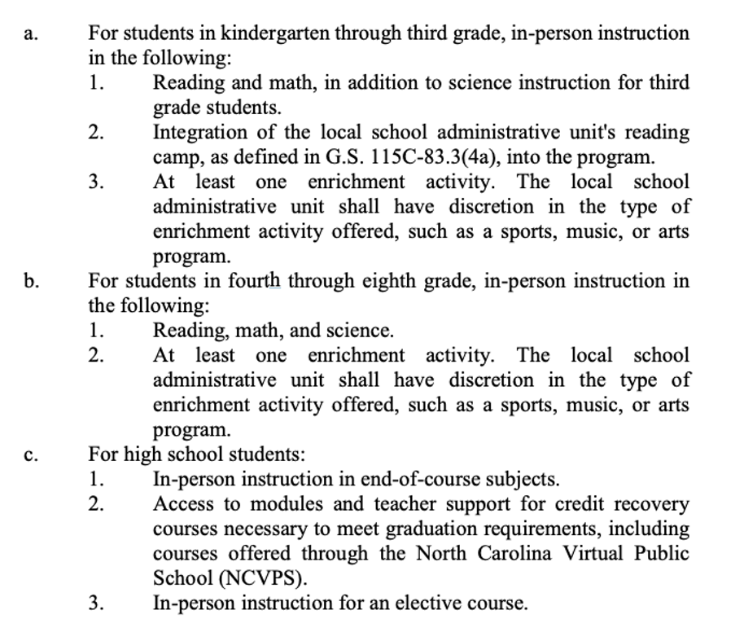
HB 82
•Is not intended to be a one size fits all
•Remember the criteria for the program

Slide 8
HB 82: Next Steps/Updates
SBE Meeting (4.19.21)
NCDPI Guidance Document
Template for Summer Learning Choice Program
NCDPI Internal Meeting (4.21.21)
Operationalizing HB 82 (?)
TA for PSUs (?)
Any new information, as a result of these meetings, will be pushed out to PSUs with an opportunity for EC Office Hours if substantively different from initial EC Guidance (4.16.21).

Slide 9
Homebound and
Modified Day Placements
Priority Monitoring Area in 2021-2022
Technical Assistance will be front loaded prior to monitoring activity
Important Resources
Documenting in ECATS
Guidance Document

Slide 10
EC Process and ECATS - User Guide
CANVAS
All essential EC processes - Initial Referral to Disciplinary Change in Placement
Awarding CEUs
Local Management
Found HERE
Breadcrumbs: ECD>Conferences,PD & Webinars>Training Materials

Slide 11
HB 317 Data Collection
Should have received individual student surveys
Tom Page - thomas.page@dpi.nc.gov
Information sent in EC Director Weekly Updates
Due date: July 16, 2021
Video tutorial
Primary/Secondary contacts survey

Slide 12
HB 317 Data Collection
Questions
Tom Page - thomas.page@dpi.nc.gov
Regional Consultants for DHH
Nancy Woytowich nancy.woytowich@dpi.nc.gov
Antwan Campbell antwan.campbell@dpi.nc.gov
Virginia Madorin virginia.madorin@dpi.nc.gov

Slide 13
Extraordinarily Exceptional Educator Recognition
The EEE spring recognition survey is open through April 30, 2021
https://bit.ly/EEE2021
EEE spring virtual recognition board available May 15, 2021

Slide 14
ECATS Translation
Updates

Slide 15
Staff Update
Dottie Snyder is retiring May 1, 2021!
Consultant for Deaf-blind
NC Deaf-blind Project Director
New contact:
Sherri Vernelson, Section Chief, SSAT
sherri.vernelson@dpi.nc.gov

